Slide 1
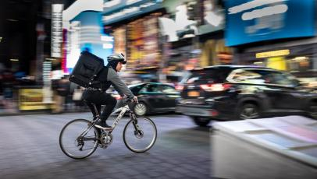
NPD UK Foodservice Perspectives: The Delivery market during Covid
November 2020

Slide 2
Key points
Delivery visits are up +15% so far in 2020, and are expected to continue to grow during lockdown 2.0
The first lockdown brought in new delivery users, and this can be expected to happen again in lockdown 2.0
Most top delivery food & beverage items have further increased in popularity during Covid, with pizza, chips and Chinese rounding out the top three
Vegan/vegetarian, more partnerships and new platforms are among delivery trends to watch in 2021
Notes:
Key drivers

Slide 3
Agenda
1 – Where we are now
2 – The Delivery market
3 – What next?

Slide 4
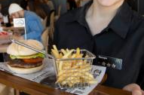
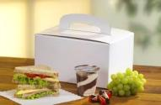
With a second lockdown upon us, we are currently moving backwards in the recovery. Delivery will benefit from this
Second wave
Old Normal
Restrictions
Baseline
Recovery
New Normal
The foodservice world as we know it
Stores are closed and we are starting to approach the peak
We are operating on the baseline and the market is contracted
Restrictions begin to be released and consumers return
Most restrictions are released and most businesses are back
Source: NPD CREST

Slide 5
So far this year, foodservice spend is down -38% vs. 2019
£15.8bn
Less spend vs. last year
(Jan to Sep)
3.6bn
Fewer visits vs. last year
(Jan to Sep)
Monthly Consumer Spend Trend PCYA
Source: NPD CREST

Slide 6
Some market segments have fared better than others
Workplace remains very weak, while QSR has proven to be the most resilient, thanks to its ability to offer delivery, drive thru and takeaway services effectively
Monthly Consumer Spend Trend PCYA
Source: NPD CREST

Slide 7
Covid 2nd wave – escalation of restrictions across EU
With restrictions back in place, how can operators and manufacturers best tap into the growth of delivery?
October 2020
November 2020
Wk 41
(5-11 Oct)
Wk 42
(12-18 Oct)
Wk 45
(2-8 Nov)
Wk 46
(9-15 Nov)
Wk 47
(16-22 Nov)
Wk 43 (19-25 Oct)
Wk 44 (26Oct-1Nov)
Confinement for Madrid city and Navarra region
Curfew from 9pm to 6am on the biggest cities
Curfew (11pm-5am) for several regions + shopping mall closure
Regional differences: Curfew on crowded places, like High Streets, Pubs, Schools, small events
Bar and restaurant closed after 6pm
2° lockdown (until Dec 1°) with non essential stores closed
Light lockdown non essential shops will remain open (1 customer/ 10SM)
Curfew extended to 54 depts
Wales in ‘firebreak’ shutdown
National Curfew from 11pm-6am and confinement for nearly all regions
Northern Ireland restrictions:
takeaway /delivery only
Republic of Ireland restrictions: takeaway /delivery only
England in shutdown
Scotland 5 tier system introduced
Source: NPD CREST
Notes:
WALES – 17 day shutdown from 23 Oct with non-essential stores, restaurants, bars and pubs closed. This is coming to an end, from Monday 9th of November new rules apply
N. IRELAND – restrictions from 16 Oct to 13 Nov stores remain open but restaurants, bars coffee shops open for takeaway or delivery only.
SCOTLAND – 5 Tier system introduced on 2 Nov. Tier 4 will include non-essential stores to close but no city at this point yet. Tier 3 involves bars & restaurants to close.
ENGLAND – lockdown from 5 Nov to 2 Dec and all non-essential stores to close (click & collect option open) but restaurants, bars and pubs closed (takeaway, drive thru and delivery still possible).
Premises may sell food and soft drinks but not alcohol between the hours of 05:00 and 22:00 for take-away. The purchaser may enter the premises.
• Delivery can continue outside of those hours and buyers may not enter the premises from which they are buying the product.
• Alcohol may be sold – but it must be pre-ordered and the purchaser must not enter the premises.

Slide 8
The Delivery market
2

Slide 9
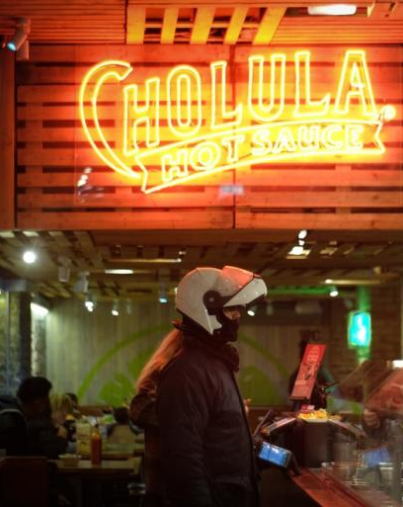
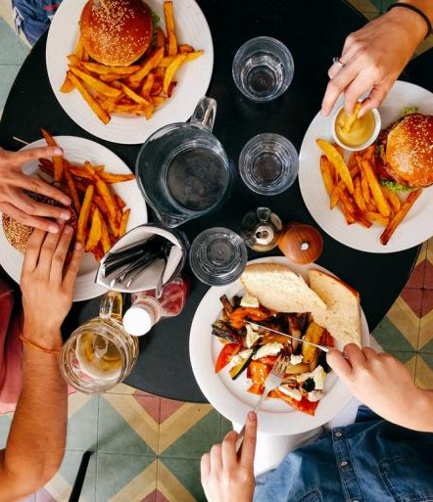
Year to date (Jan to Aug)
Total Delivery
Digital Delivery
Total Out of Home
+15% | +17% | -43%
+41% | +45% | -38%
Visits
Spend
Source: NPD CREST YTD September 2020

Slide 10
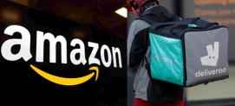
Dark Kitchens & Virtual Brands
Groceries, DIY kits, boxes
Aggregators diversifying
Delivery trends & developments in 2020
Blurred Boundaries
New investment in aggregators
Contactless
Total Delivery
Top 3 Aggregators
Visits
Spend
Source: NPD CREST

Slide 11
September’s performance highlights the two-tier nature of the market
Year on year change in spend
Grab & Go / Other
Eat In
+38%
+27%
-29%
-33%
Delivery
Drive Thru
Source: NPD CREST September 2020

Slide 12
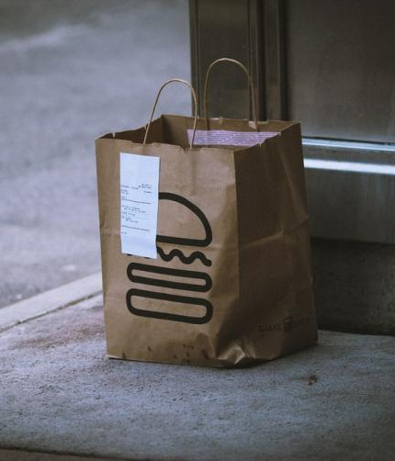
The number of delivery buyers grew during the first lockdown, and can be expected to do so again during the second lockdown
Delivery buyer metrics and % change May/June 2020 vs. February/March 2020
Buyers
Frequency:
Visits Per Buyer
25.8mn
7.0
+25%
+2%
Source: NPD SnapMyEats

Slide 13
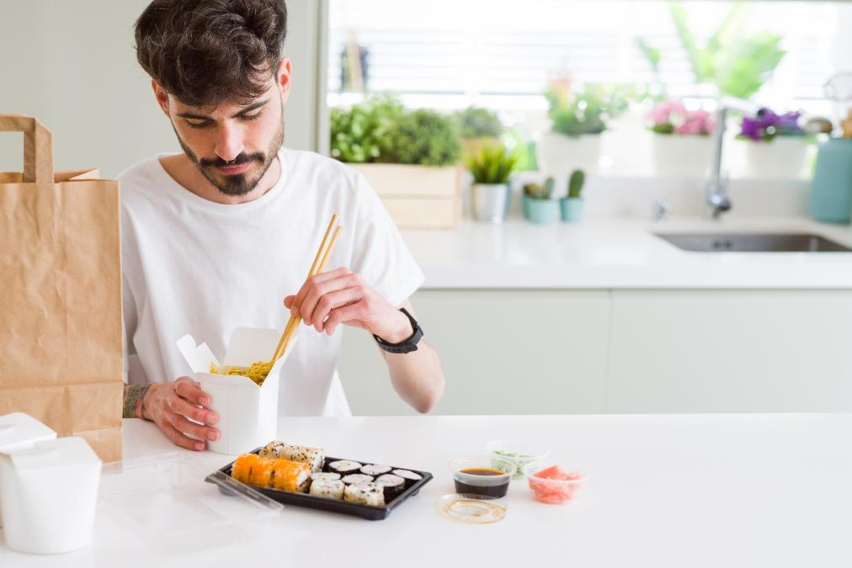
Delivery Usage
Many consumers that used delivery services for the first time during lockdown plan to continue to do so
% of Population using Restaurant Delivery Services
Source: The NPD Group/COVID-19 Foodservice Sentiment Study, Europe March/May 2020

Slide 14
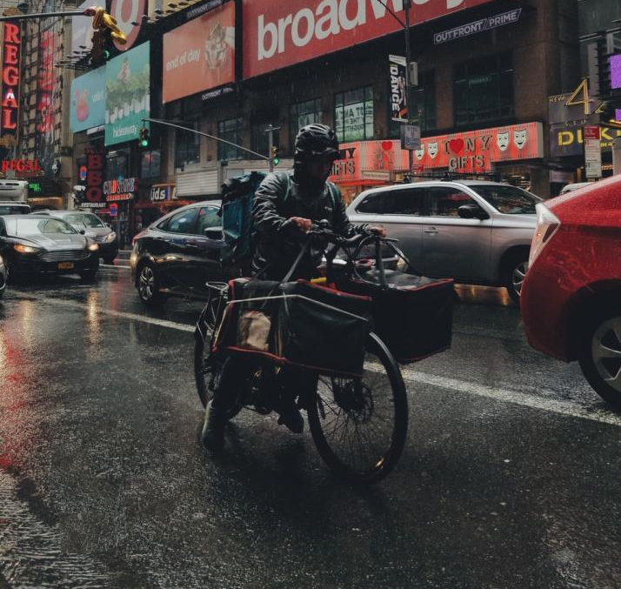
Impact of Covid on delivery choices
For 27% of consumers, a key reason for ordering delivery is to support their local restaurant
% of delivery visits
What other reasons, if any, influenced your decision to choose this restaurant/outlet? Delivery visits
Source: NPD CREST September 2020

Slide 15
In 2020 Delivery has grown significantly in key channels, up to 20% of QSR visits, and is not expected to return fully to pre-Covid levels
% of total visits by ordering channel
100
QSR
Full Service
Pubs
Source: NPD CREST YTD September 2020

Slide 16
Lunch has increased in importance during Covid, but dinner continues to be the main daypart for deliveries
Index vs. Pre
95
114
103
79
Pre-Covid
Post-Covid
Source: NPD CREST YTD September 2020

Slide 17
Family delivery occasions have grown significantly, and now account for half of all deliveries
Index vs. Pre
131
67
83
66
118
Pre-Covid
Post-Covid
Source: NPD CREST YTD September 2020

Slide 18
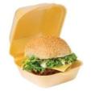
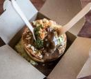
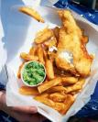
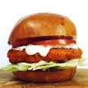
During Covid, most top delivery food items have increased in popularity, with pizza further cementing its No.1 position
Top 10 Food items ordered for Delivery, Incidence (Visit %),
YTD Sep 20 vs YTD Sep 19
1. Pizza
26.2%, +0.9ppt
2. Chips/Fries
17.9%, +2.6ppt
3. Chinese dish
13.8%, +2.0ppt
4. Beef burger
8.8%, +2.3ppt
5. Sandwich
8.4%, -2.3ppt
6. Savoury bakery
7.2%, -0.3ppt
7. Indian dish
6.6%, +0.2ppt
8. Fish
5.0%, -1.5ppt
9. Chicken burger
4.7%, +1.1ppt
10. Wedges/Skins
3.2%, +0.6ppt
Source: NPD CREST YTD September 2020

Slide 19
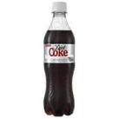
Soft drinks have become even more popular for deliveries in 2020
Top 10 Drink items ordered for Delivery, Incidence (Visit %),
YTD Sep 20 vs YTD Sep 19
1. Regular Cola
14.3%, +2.0ppt
2. Diet/Low Cal Cola
10.9%, +1.2ppt
3. Juice Drinks
6.2%, +1.0ppt
4. Bottled Water
5.9%, -4.7ppt
5. Flavoured CSD
5.1%, -1.2ppt
6. Coffee
3.3%, -0.5ppt
7. Wine
2.4%, +0.7ppt
8. Beer
2.2%, +0.8ppt
9. Dairy Drinks
1.4%, +0.3ppt
10. Tea
1.4%, +0.2ppt
Source: NPD CREST YTD September 2020

Slide 20
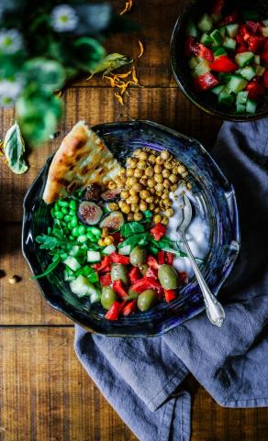
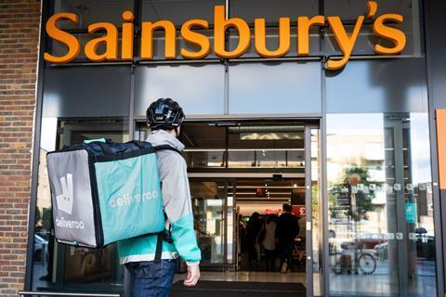
What’s next for delivery?
Further partnerships: Sainsbury’s has teamed up with Deliveroo and Uber Eats to offer rapid delivery
New platforms entering the delivery market
Overall growth of +15% in delivery visits expected in 2020
Vegan & vegetarian delivery orders are seeing significant growth year-on-year
Slerp
Source: NPD CREST

Slide 21
Key points
Delivery visits are up +15% so far in 2020, and are expected to continue to grow during lockdown 2.0
The first lockdown brought in new delivery users, and this can be expected to happen again in lockdown 2.0
Most top delivery food & beverage items have further increased in popularity during Covid, with pizza, chips and Chinese rounding out the top three
Vegan/vegetarian, more partnerships and new platforms are among delivery trends to watch in 2021
Notes:
Key drivers

Slide 22
What next?
3

Slide 23
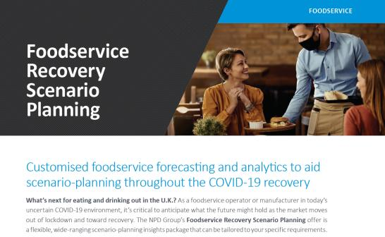
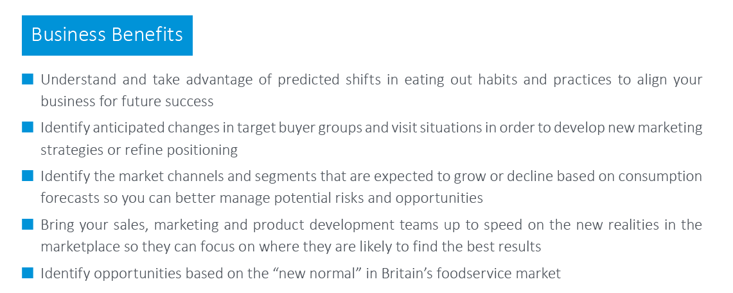
What’s next for eating and drinking out in the UK? – NPD’s Foodservice experts can help you navigate the recovery, plan ahead, and anticipate opportunities
The NPD Foodservice team is able to help you and your business in several ways. As well as market tracking and opportunity sizing, NPD has created a forward-looking package of foodservice insights that anticipates the impact of COVID-19 on consumer behaviour in the U.K. and beyond.
It provides the strategic support you need to inform critical business decisions, adapt your strategy, and be prepared for the opportunities and challenges that will arise as the market recovers.

