Slide 1
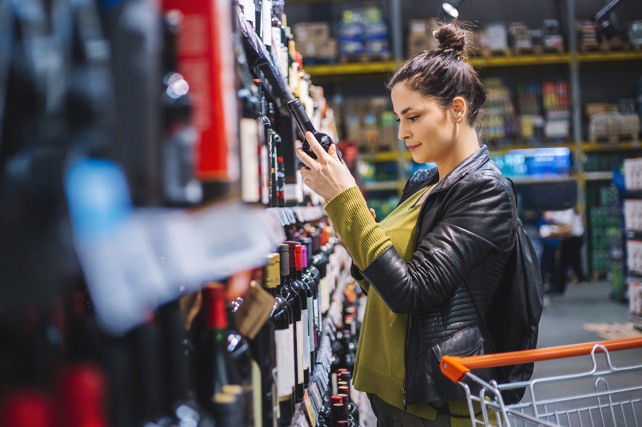
FMCG Essential Retail – What you need to know!
Share of Trade
52 we data to 17.06.23
Share of Total Grocers
Value Change %
Penetration
£ Spend per Visit
2022
2023
2022
2023
% Change
2022
2023
% Change
27.1% | 26.9% | 7.9% | 86.2 | 86.6 | 1.3% | 26.8 | 27.4 | 2.1%
13.6% | 13.6% | 8.5% | 67.6 | 69.4 | 3.5% | 25.0 | 25.2 | 2.2%
12.0% | 12.0% | 8.9% | 69.2 | 70.5 | 2.7% | 27.7 | 28.2 | 1.1%
11.0% | 12.0% | 18.7% | 67.0 | 70.0 | 5.4% | 24.4 | 26.0 | 2.1%
8.0% | 8.6% | 16.4% | 60.7 | 64.3 | 6.9% | 21.5 | 22.2 | -6.6%
9.1% | 8.3% | -0.6% | 62.5 | 62.4 | 0.7% | 25.4 | 23.8 | 6.5%
4.5% | 4.4% | 7.5% | 50.3 | 50.3 | 0.9% | 9.1 | 9.3 | 3.4%
4.2% | 3.9% | 0.3% | 26.2 | 26.9 | 3.6% | 23.4 | 21.3 | 2.1%
3.5% | 3.6% | 10.2% | 50.1 | 50.7 | 2.0% | 15.0 | 15.6 | -9.2%
2.6% | 2.6% | 7.7% | 50.6 | 52.0 | 3.5% | 19.8 | 20.1 | 3.8%
1.6% | 1.6% | 4.9% | 5.6 | 6.9 | 24.6% | 69.6 | 72.4 | 1.7%
Store Portfolio
Store Numbers as of 17.06.23
Store Numbers
Total
Convenience
Small
Large
Super
Mega
2752 | 1896 | 25 | 283 | 195 | 353
1400 | 813 | 43 | 172 | 142 | 230
589 | 2 | 134 | 86 | 113 | 254
499 | 4 | 10 | 185 | 245 | 55
3658 | 2664 | 820 | 174 | 0 | 0
331 | 22 | 50 | 207 | 44 | 7
1004 | 538 | 294 | 150 | 14 | 8
954 | 77 | 830 | 47 | 0 | 0
26 | 0 | 0 | 0 | 0 | 26
Value Index
52 we 17.06.23
Pre Family
New Family
Maturing Family
Life stage
Post Family
Older Couple
Older Singles
Established Family
114 | 96 | 102 | 101 | 93 | 104 | 93
78 | 93 | 82 | 94 | 99 | 109 | 110
89 | 146 | 137 | 134 | 104 | 84 | 70
85 | 103 | 75 | 90 | 95 | 115 | 106
85 | 139 | 153 | 127 | 85 | 90 | 73
102 | 94 | 78 | 87 | 86 | 88 | 163
115 | 86 | 33 | 70 | 87 | 129 | 125
125 | 115 | 117 | 107 | 88 | 104 | 75
112 | 66 | 47 | 59 | 90 | 118 | 144
74 | 54 | 114 | 117 | 96 | 101 | 101
147 | 86 | 104 | 67 | 129 | 102 | 73
Source: Nielsen Homescan SOT based on FMCG [New Base], Benchmark Total Grocers% Change Penetration = % Change in actual buyers
Penetration = Change in shoppers

Slide 2
FMCG Essential Retail
Tesco Clubcard has been named the UK’s favourite digital retail loyalty scheme as it “gets the basics right” for shoppers amid the ongoing cost-of-living crisis. New research has revealed that over a third of respondents (35%) named Tesco’s Clubcard loyalty programme as their top pick, putting it streets ahead of its closest rival, Sainsbury’s Nectar programme (17%).
Sainsbury’s is expanding its Nectar Prices initiative by introducing offers on dairy and bakery products for the first time. The expansion of Nectar Prices comes following the launch of the initiative in April, with Sainsbury’s now offering discounts on over 900 products across categories such as health and beauty, confectionery and snacking, beers, wines and spirits, household, baby and pet, food cupboard items, as well as its latest addition of dairy and bakery. The supermarket giant has said it will continue to add products to Nectar Prices as it looks to offer shoppers better value year-round.
ASDA is freezing prices on over 500 branded and own-branded products to help customers save during the cost-of-living crisis. The price lock, which will run until the end of August, includes cupboard essentials such as cereals, pasta and tea, as well as salads, burgers and ice cream. Running from 13 June to 10 July, the trial can be accessed by customers who sign up to one of Asda’s delivery pass services. “We’re always looking at ways we can support our customers and communities throughout the year, which is why we’re locking the prices of hundreds of products until the end of August,” Asda chief commercial officer, Kris Comerford, said. “We know that household budgets are tight at the moment, so we want to be able to offer the best value and give customers the confidence they can shop the products they love throughout summer.”
Morrisons has unveiled its sixth round of price cuts this year across summer favourites, cupboard fillers and fresh essentials. The new prices, which are being held for a minimum of eight weeks, will roll out across items such as mince, tomatoes and butter, as well as squash, cereal, pitta bread and scotch eggs. This comes as Morrisons reduced or held the price of 1,000 products last month that will remain locked low until mid-July. It also forms part of the retailers “deflation dividends”, as Morrisons chief executive, David Potts termed it, as it promises shoppers will see many more price drops over the coming months.
Source: NielsenIQ Homescan, Grocer & Nam News

Slide 3
FMCG Essential Retail
Waitrose has cut the prices of more than 200 everyday products as part of a £100m investment in price. The upmarket grocer said it had lowered prices in “every aisle”, including un British butter, tomato ketchup, Fairtrade golden caster sugar, British cocktail sausages, salad and ice creams. Half of these products are now at least 10% cheaper, as the grocer said that “price cuts have been made without compromising on exceptional quality or Waitrose values, which include sourcing higher welfare meat and commitments to British farmers.” Waitrose commercial director Charlotte Di Cello said: “We’re investing millions in lowering the prices of everyday food across our aisles so customers benefit every time they shop with us.”
Aldi has teamed up with Team GB to offer every child in the UK a chance to try an Olympic or Paralympic sport for free. In partnership with both Team GB and ParalympicsGB, the German discounter has launched its ‘Get a Taste for Sport’ initiative, a new campaign aiming to help an estimated 20 million children stay active this summer. From 19 June to 31 July, shoppers who spend more than £30 in store at Aldi will receive a voucher which entitles a child to a free taster session of an Olympic or Paralympic sport of their choosing.
Lidl’s GB has revealed that it is has become the first UK supermarket to start incorporating Prevented Ocean Plastic into its new water bottles. Appearing in the German discounter’s stores throughout July, Lidl’s San Celestino Italian sparkling mineral water bottles will contain a minimum of 30% Prevented Ocean Plastic, which would have otherwise ended up in the ocean. With 12 million bottles sold annually, the initiative is expected to save almost 100 tonnes of plastic from entering oceans per year, equivalent to almost four million plastic water bottles. The move builds on the discounter’s previous strides in this space. Lidl became the first UK supermarket to introduce food packaging using Prevented Ocean Plastic in 2020.
Source: NielsenIQ Homescan, Grocer & Nam News

Slide 4
FMCG Essential Retail
Iceland has unveiled a ‘world-first’ supermarket aisle dedicated to food designed to be cooked in air fryers, as sales for the modern kitchen gadget have surged in recent months. The air fryer aisle is part of a trial at one Food Warehouse store in London, according to The Daily Mail. The specialist aisle will have approximately 287 items, consisting mainly of frozen foods, alongside instructions on how to cook it in the air fryer. Iceland executive chairman Richard Walker said. ”As the popularity of air fryer cooking grows, this aisle will give customers easy access to products that work perfectly in this time and energy saving cooking appliance.” In April, Iceland launched a new selection of savings across its frozen meal ranges, such as a 3 for £10 offer on frozen fish, making it easier for customers who are feeling the squeeze on their household budgets.
Coop is campaigning to break the ‘class ceiling’ as nearly a fifth of UK adults believe they have missed out on a job due to their background, accent or social status. The convenience retailer has launched a nine-point plan on social mobility and is calling on other businesses to adopt similar measures. It also includes making changes to internal job adverts to ensure colleagues see how their skills could suit a sideways move or promotion. The retailer looks to help employees become more financially resilient and will establish a new mentoring scheme for colleagues from lower socio-economic backgrounds. “It cannot be right that those from less advantaged backgrounds are almost twice as likely to end up in working class jobs than others from more privileged backgrounds,” Co-op Group CEO, Shirine Khoury-Haq, said.
Ocado appoint Ted Baker's former chief executive to join the board of Ocado Group amid speculation that the online grocer faces a takeover. Rachel Osborne departed Ted Baker earlier this month after three and a half transformative years in charge of the high street fashion brand. She will join Ocado as a non-executive director from the beginning of September, and will also serve as a member of its audit and people committees. Ocado shares skyrocketed by nearly a third last week when the Times reported that 'technology heavyweights' like Amazon were potentially interested in acquiring the Hertfordshire-based company.
Source: NielsenIQ Homescan, Grocer & Nam News

