Slide 1
Retail Observations: On-line New and Re-launched Products
12th June | Suzi Pegg-Darlison

Slide 2
New products summary
 | Ambient | Chilled | Frozen | Grand Total
Asda |  |  | 1 | 1
Iceland |  |  | 1 | 1
Morrisons | 13 | 1 | 1 | 15
Ocado | 3 | 6 | 3 | 12
Sainsburys | 1 | 7 | 1 | 9
Waitrose | 3 | 2 |  | 5
Grand Total | 20 | 16 | 7 | 43
Source: Retailer website (12/07/2021)

Slide 3
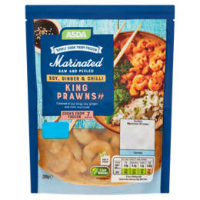
Asda
Frozen (1)
Source: Retailer website (12/07/2021)

Slide 4
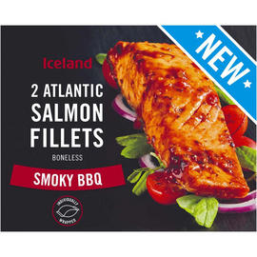
Iceland
Frozen (1)
Source: Retailer website (12/07/2021)

Slide 5
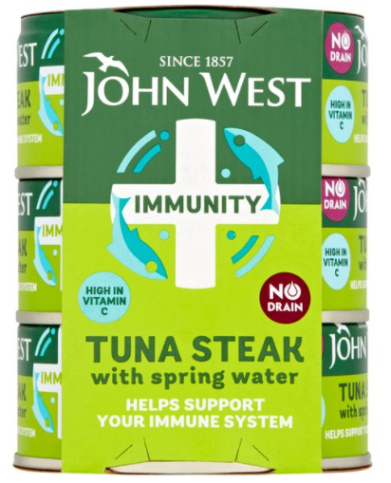
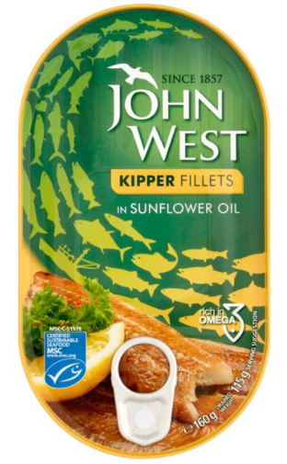
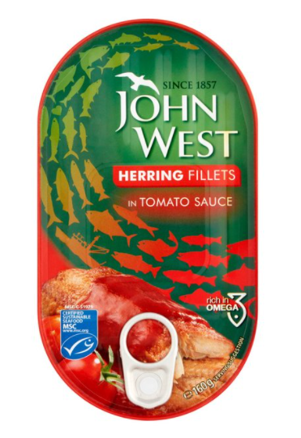
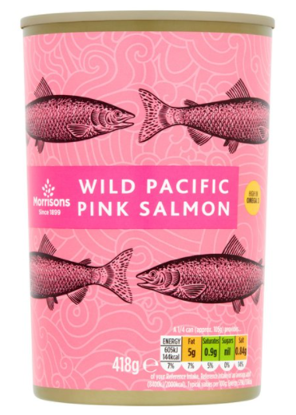
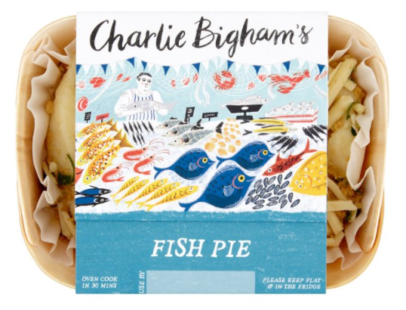
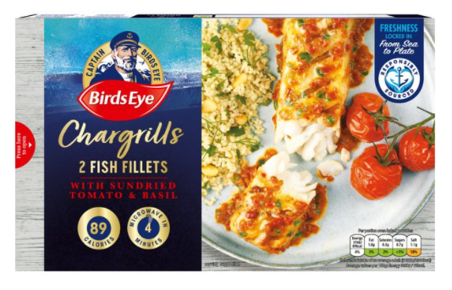
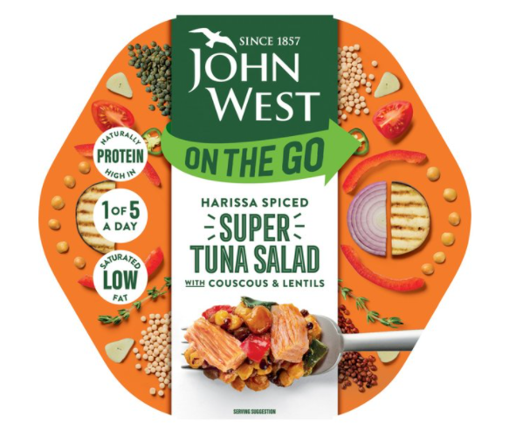
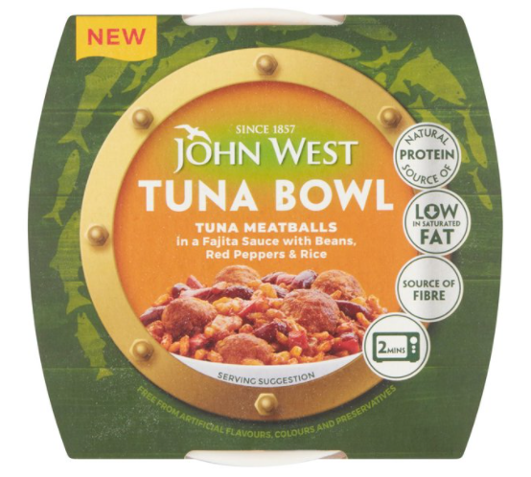
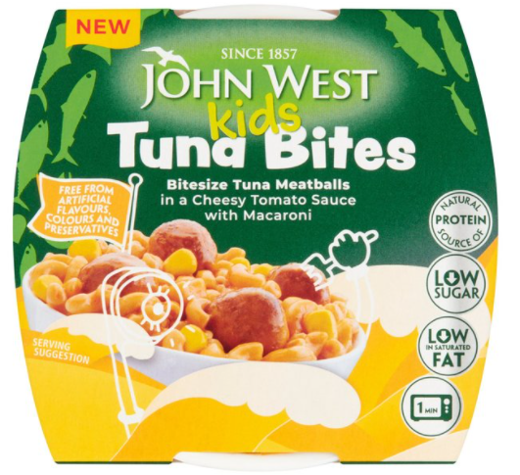
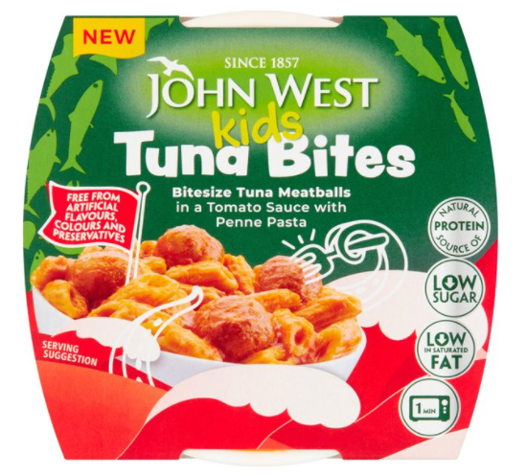
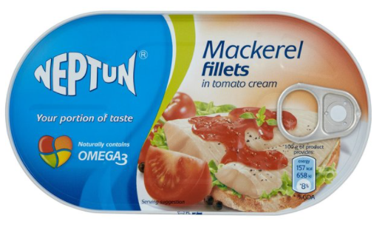
Morrisons
Ambient (13)
Chilled (1)
Frozen (1)
Source: Retailer website (12/07/2021)

Slide 6
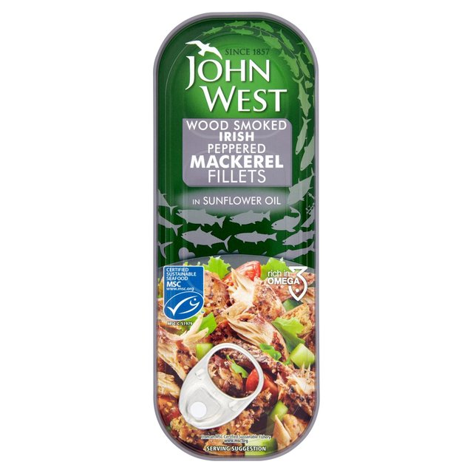
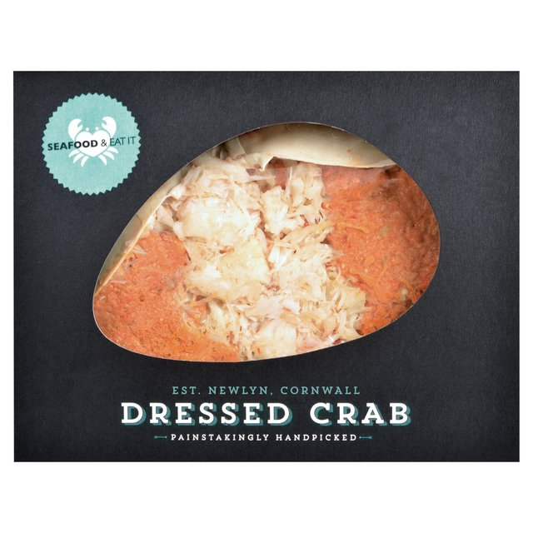
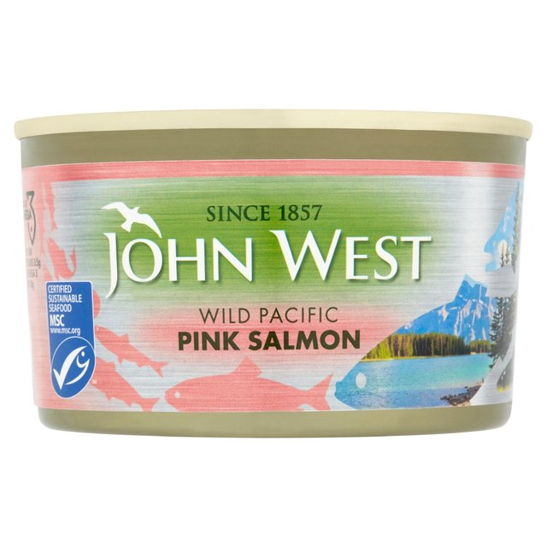
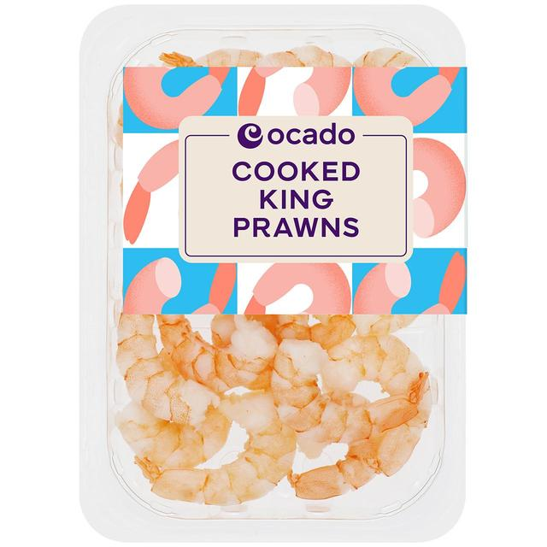
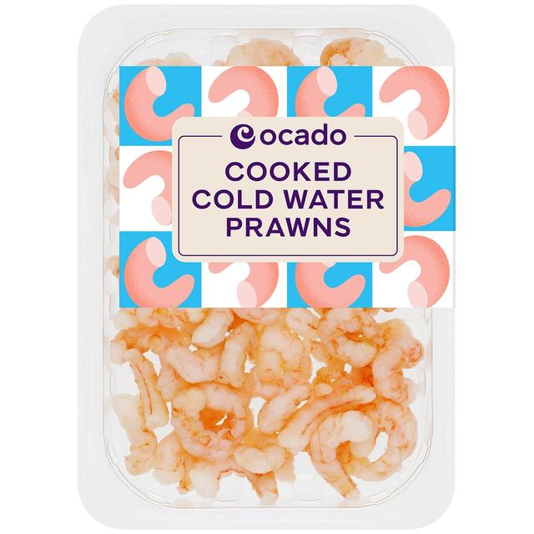
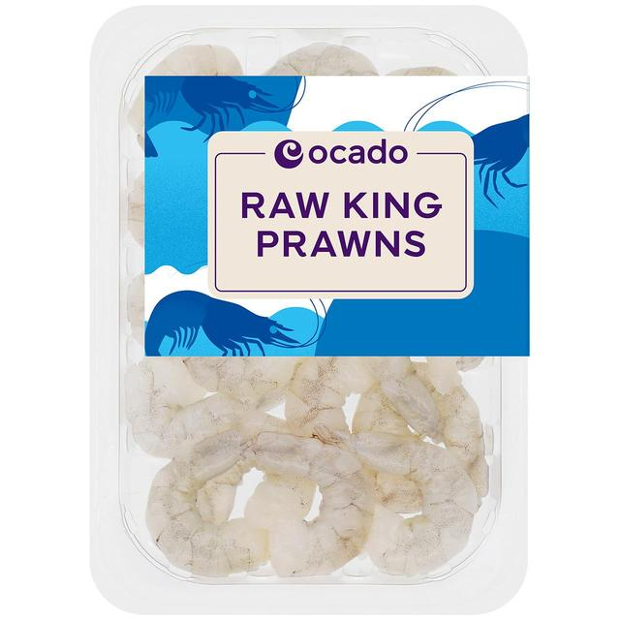
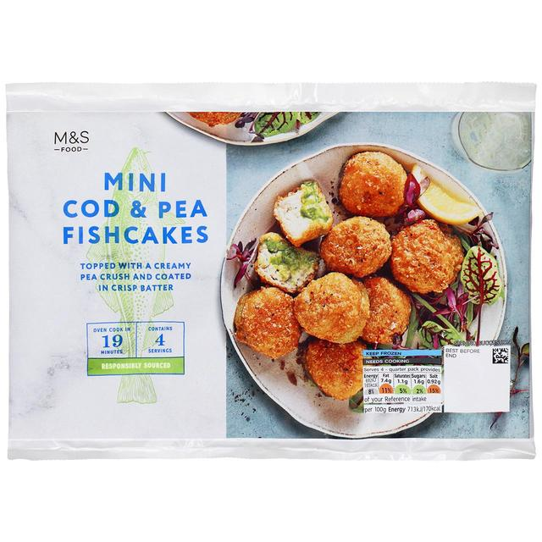
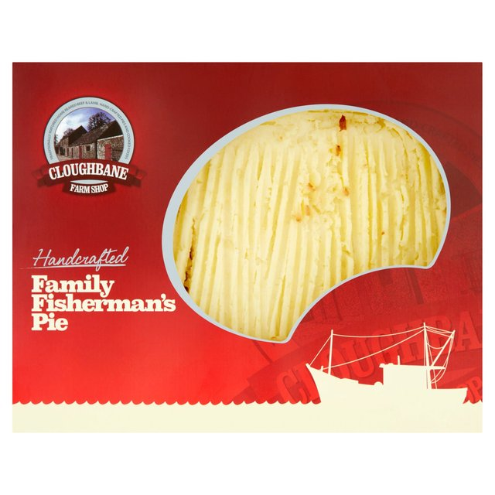
Ocado
Ambient (3)
Chilled (6)
Frozen (3)
Source: Retailer website (12/07/2021)

Slide 7
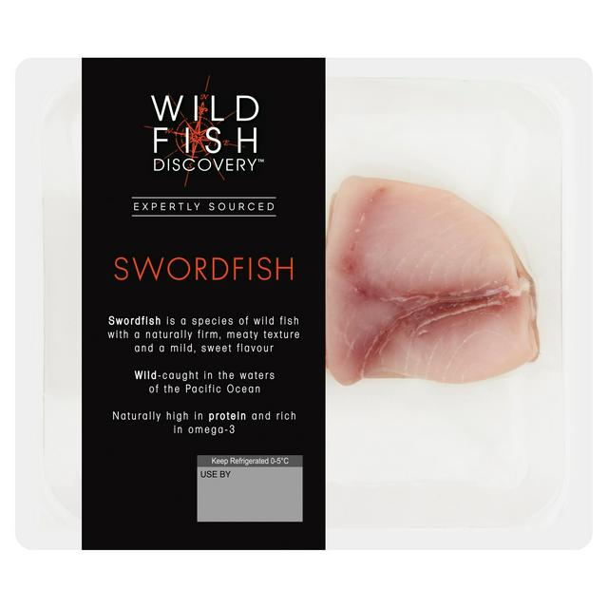
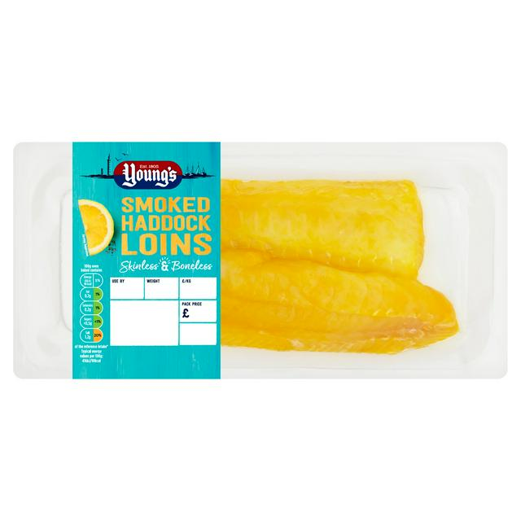
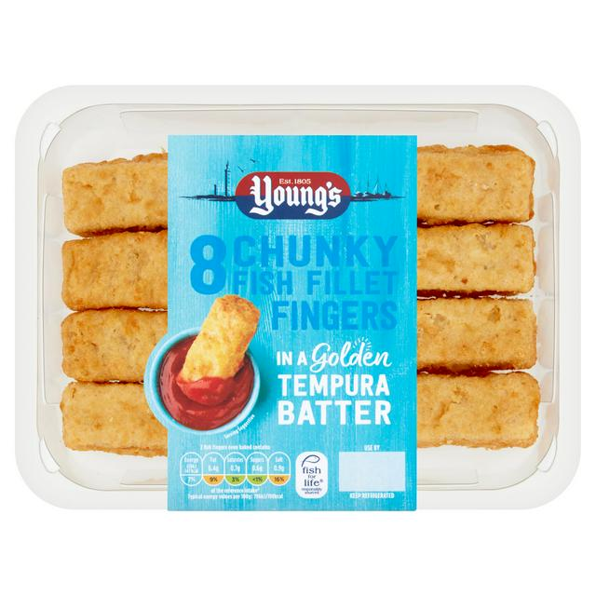
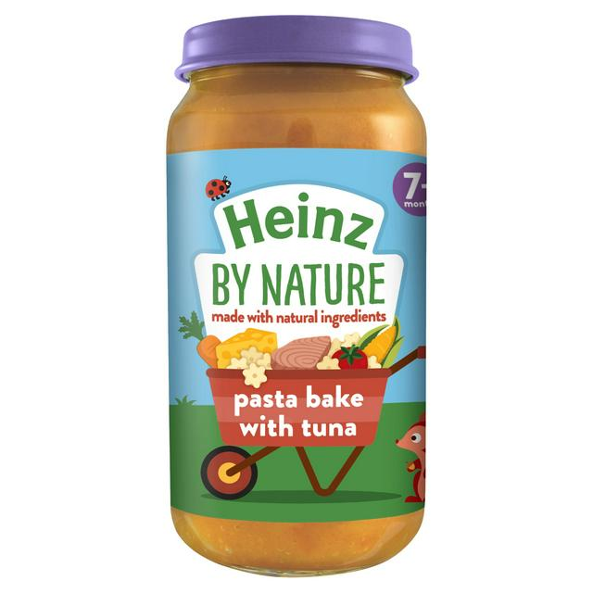
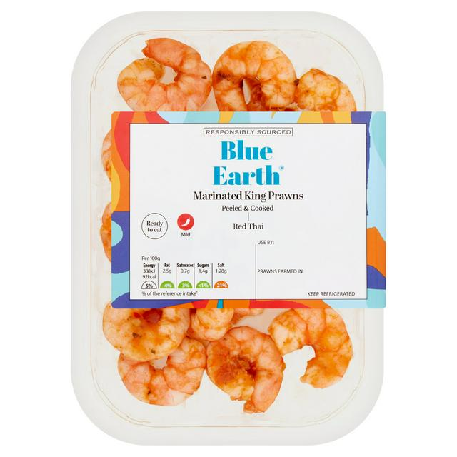
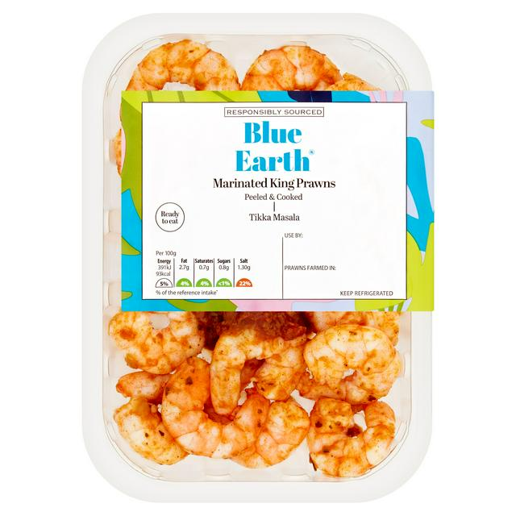
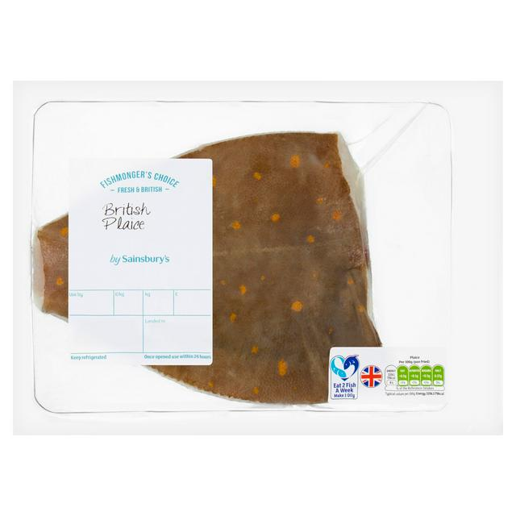
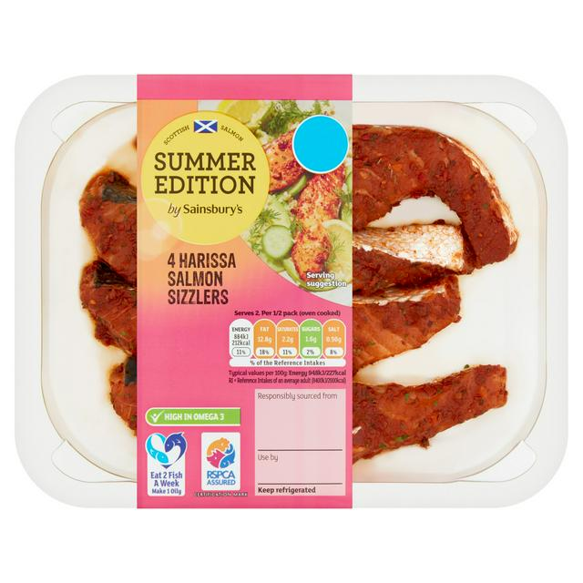
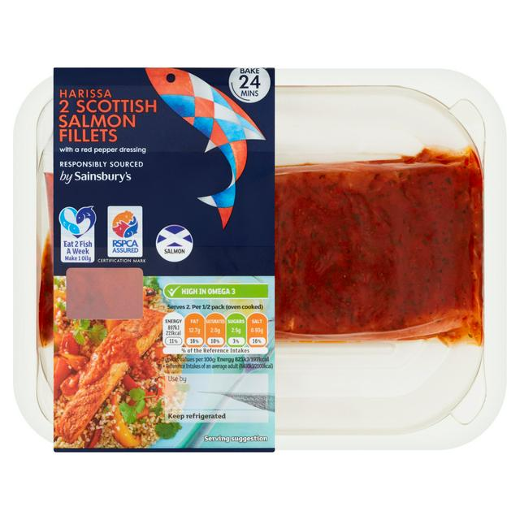
Sainsburys
Ambient (1)
Chilled (7)
Frozen (1)
Source: Retailer website (12/07/2021)

Slide 8
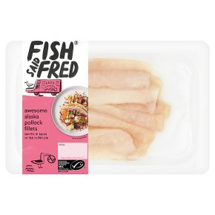
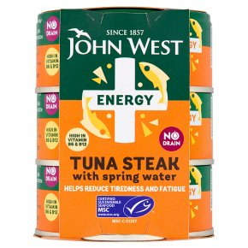
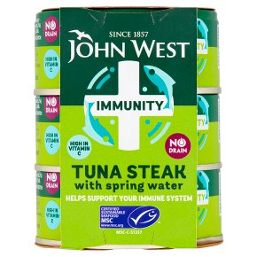
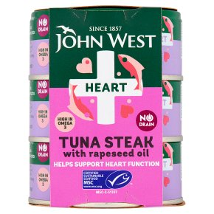
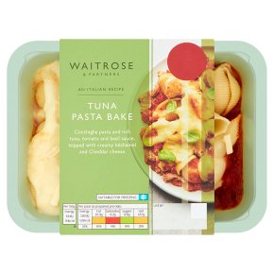
Waitrose
Ambient (3)
Chilled (2)
Source: Retailer website (12/07/2021)

Slide 9
Thank you
For further details please contact:
Julia Brooks
Market Insight Analyst
Julia.brooks@seafish.co.uk
+44 (0) 1472252358 / 07944 682751
Suzi Pegg-Darlison
Market Insight Analyst
Suzi.pegg-darlison@seafish.co.uk
+44 (0) 1472 252358 / 07944 682697

