Slide 1
NielsenIQ Total Till Executive Summary
4 weeks ending 17th July 2021
Retailer & Business Insights Team
29th July 2021

Slide 2
Five take outs from Total Till for the 4 weeks to 17th July 2021
1
July sales were upbeat helped by the goodwill factor of the Euro championship and another heatwave
2
As shoppers adjust to post pandemic living, shopping behaviours are starting to normalise
3
Growth in BWS has started to slow and will disproportionately impact total sales at the retailers.
4
Discounters remain the only retailers to report stronger shopping KPI’s than pre-pandemic.
5
Headwinds are fast approaching, fmcg need an extended summer heatwave to help boost sales.

Slide 3
What happened? Overview

Slide 4
More travel, better weather and different family meal occasions have all helped to ease the decline in sales in July
Three column numbered list
1
2
3
Against softer comparatives (Lockdown 1.0 ended 3rd July) sales declines slowed to just 1.3%.
Convenient foods and Bakery out performed this month with more meals on the go and the 2nd heatwave at the end of the month as well as the Euro’s which would have changed meal time for supporters (Delicatessen +9.4%, Soft Drinks and Crisps & Snacks both +6.1%).
Promotional spend has stabilised at 21% of sales, this level of promotional activity is becoming the ‘new’ normal.
Food prices are still lower than a year ago, reflecting nervousness in the industry with the furlough scheme ending in Q4 a concern for many. Retailers continue to promote everyday low prices whilst the Discounter channel invest in new store openings and making their offer increasingly attractive to promiscuous shoppers.
Source: NielsenIQ Homescan FMCG, NielsenIQ Scantrack

Slide 5
Despite the softer comparatives only the Discounters reported positive growth
Tailwinds
*Discounters +7.6%
Grocery Multiples -0.9%
Supermarkets -1.1%
Headwinds
*Value Retailers -8.7%
*Online -3.6%
Convenience -2.5%
-1.3%
Total Till
Source: NielsenIQ Scantrack Total Store Read, *Homescan FMCG 4w/e 17th July 2021

Slide 6
In total, British shoppers made 45m MORE shopping trips than last July but spent £2.39 LESS per trip, buying 1.4 FEWER fmcg items
Three column numbered list
-11%
-11%
+9%
Spend per visit fell to £18.85 from
£21.20
Items in basket fell to 11.8 from 13.2
Frequency of visit increased to 16 trips from 15
.
Source: NielsenIQ Homescan GB FMCG 4w/e 17th July 2021 vs 4we 18th July 2020

Slide 7
Against weaker comparatives, July sales were an improvement
Wk 1:
Covid Distortions
Wk 2:
Different meal occasions
Wk 3:
Euro’s Boost
Wk 4:
Another heatwave
Against the final week of Lockdown 1.0, sales for the first week of the reporting period slumped by more than 5%, as this year shoppers were allowed more freedom to travel, to do more leisure activities and eat outside of the home.
The higher value BWS category will be disproportionately impacting Total Store sales, meaning lower value categories will have to work harder to make up the shortfall as sales migrate back to the ontrade.
With more leisure and recreational activities fewer meals will be consumed in the home, increasing demand for Delicatessen, Bakery and Food to Go.
Many of these categories are now enjoying double digit growth such as Sushi, Rotisserie, Sandwiches and Freshly Prepared Fruit and Salad.
With England making it to the Euro’s final, there was an appetite for larger social gatherings.
Retailers sold out of England merchandise including T’Shirts and Flags.
Shoppers celebrated with Convenience Food, Beer & Cider and participation increased with an uplift in football equipment.
Against slightly weaker comparatives (easing of rules Lockdown 1.0) there was a slight increase in sales vs year ago.
With temperatures soaring in the final week of the trading period shoppers bought more discretionary items.
Demand for Soft Drinks, Convenience and prepared foods increased, as well as Sun Preps, Ice-creams, Ice Cubes, Inflatables and Paddling Pools.
NielsenIQ Scantrack, NielsenIQ Homescan

Slide 8
Spend increased in the final 2 weeks as England united to watch the Euros and better weather encouraged alfresco dining
Grocery Multiples Weekly year on year value growth
Late May Bank Holiday, Half Term
And 2 week mini heatwave
End of July mini heatwave
14June UK Vaccine programme
Accelerated to respond to the rapid spread of the Delta Variant
From 17th May upto 6 people can meet indoors allowing the majority of Hospitaility to re-open
Euro 2020
Final
Covid Distortions
Source: NielsenIQ Scantrack Total Store Read Grocery Multiples

Slide 9
Average weekly fmcg spend has continued to slow but remains comfortably ahead of 2 years ago
Macro view based on 12 week trends
Source: NielsenIQ Homescan GB FMCG, based on rolling 12w/e

Slide 10
As shoppers adjust to post pandemic living, we are seeing the return of more and smaller shopper trips
Source: NielsenIQ Homescan GB FMCG, based on rolling 12w/e

Slide 11
Another heatwave, more travel, staycations and an impassioned Euro Championship all helped to build confidence and boost sales in July ..

Slide 12
Post Covid behaviours have started to normalize, with online penetration and spend on offer stabilizing
£12.2b
was spent in GB food & drink retailers (-1.5% vs last year)
Basket spend
Trips
Online
Convenience Stores*
Offer Spend
-11%
+10%
-3.6%
-2.5%
21%
Continues to shrink and is the lowest average basket spend since Mar20
45m more GB trips than last year
6m FEWER trips than last month (June)
28% shoppers bought groceries online
13.4% share of GB
Against tough year ago comparatives (+9.6%)
V 2 years ago 4w/e 20Jul19 +6.8%
No change for 5 months, indicating a new level of spend may have normalised.
Sales in Bricks & Mortar stores declined -1.7%.
Source: *NielsenIQ Scantrack GB Total Store Read/Homescan FMCG 4w/e 17th July 2021

Slide 13
July saw a decline in visits vs June, as better weather and leisure activities encourage different eating occasions and more travel
 | Timely injection of sunshine 4w/e 19th June | Changing meal occasions 4w/e 17th July
Stores visited | +2.4% increase in visits vs last month and +26% vs the all time low of last year. | -1.2% decline in visits vs last month and +25% vs the all time low of last year.
Online penetration | 28% of GB shoppers +1%/+106k more shoppers vs last year | 28% of GB shoppers +1%/+141k more shoppers vs last year
Bricks & mortar shopping trips | 464m shopping occasions +15%/61m more than last year and +2.6% vs last month. | 459m shopping occasions +11%/44m more than last year and -1.3% decline vs last month.
Basket Size | £18.98 -£4.34/-18% vs last year and -1.5% vs last month | £18.85 -£2.39/-11% vs last year and -0.7% vs last month
Source: NielsenIQ Homescan GB FMCG

Slide 14
Whilst growths vs pre-Covid have begun to slow, most are still enjoying uplifts vs 2 years ago, indicating spend has yet to shift back into hospitality
Category overview 4w/e 17th July 2021 Value Growth
Super-category performance 4w/e 17th July 2021 Value Growth
~Health, Beauty, Toiletries & Baby
*Confectionery, Crisps & Snacks, Nuts & Seeds
#Clothing, Entertainment, Electrical, Home, Sports & Leisure, Seasonal, Stationery, Toys
Source: NielsenIQ Scantrack Grocery Multiples

Slide 15
As shoppers focus more on ‘wellbeing’, leisure activities are on the rise bringing a welcome boost to discretionary & healthcare categories
Leisure & Personal
Heatwave
Health
Convenience
Football Equipment +98%
Umbrellas +98%
Rucksack/Suitcase/Holdalls +59%
Party Accessories +29%
Protein Bars +23%
Champagne +22%
Sports & Energy Drinks +18%
Clothing +18%
Personal Electrical +17%
Petcare +16%
Cut Flowers +15%
Bird Food +15%
Books +14%
Suncare +31%
Pools & Inflatables +30%
Mineral Water +18%
Flavoured Non Carbs +18%
Children’s Medicine +127%
Cough/Cold & Flu +125%
Throatcare +54%
Glasses & Lenses +35%
Anti Smoking +31%
Hayfever +25%
Women’s Health +18%
Stomach +15%
Incontinence +15%
Adult Oral Analgesics +14%
Family Planning +13%
Sushi +74%
Rotisserie +43%
Sandwiches +31%
Fresh Prep Fruit +27%
Frozen Desserts & Cakes +25%
Fresh Meat Subs +21%
Prep Salad +20%
Re-usable shopping bags +19%
Cake Chilled +15%
Morning Goods & Speciality Breads +13%
Better weather, more travel and staycations also encouraged more spend on ‘food to go’ and convenience foods
Source: NielsenIQ Scantrack Grocery Multiples 4w/e 17th July 2021 vs year ago

Slide 16
What happened by channel?

Slide 17
The Euros and mid July heatwave were not enough to lift supermarket sales
Health and more travel continue to boost sales at Chemists and Forecourts … other channels will need to work harder to maintain sales as consumer demand for recreation and leisure increases and spend shifts out of fmcg
Total Store Channel growth 4w/e 17th July 2021
Source: NielsenIQ Scantrack Total Store Read
Nb. Supermarkets include Dark Stores and Pick stores

Slide 18
YTD Larger Formats, Online & Discounters continue to outperform most smaller stores, with travel re-opening, Forecourts are the exception
Total Store Channel growth YTD 28w/e 17th July 2021 vs Last Year
Vs last year
Source: NielsenIQ Scantrack Total Store Read, *Homescan FMCG
Nb. Supermarkets include Dark Stores and Pick stores

Slide 19
Against 2 years ago, growths are robust for most channels, the next 24 weeks are expected to be more challenging as sales shift back to hospitality
Total Store Channel growth YTD 28w/e 17th July 2021 vs 2 years ago
Vs 2 years ago
Source: NielsenIQ Scantrack Total Store Read, *Homescan FMCG
Nb. Supermarkets include Dark Stores and Pick stores

Slide 20
After a strong start to 2021, spend is expected to drift back into hospitality & leisure when restrictions ease on 19th July
With economic activity expected to return to pre-Covid levels by the end of the summer, we should expect a further normalisation food & drink spend and shopper activity.
Source: *Nielsen Scantrack Total GB and Grocery Multiples 12w/e growth vs 2019

Slide 21
13% share is expected to be the new normal for Online
As retailers continue to innovate with faster delivery slots, online shopping will become more convenient, adding a further boost to sales as shoppers shop more missions
4w/e
Source: NielsenIQ Homescan Online FMCG

Slide 22
The trading environment is getting tougher for food & drink retailers and 2 years ago growth has started to slow
GB Total Coverage FMCG Sales
-£189m Shoppers spent less on groceries than last year
+£674m more than 4w/e 20th July 2019
*Supermarkets include Online Dark Stores, Depots and Picking stores
Source: NielsenIQ Scantrack (FMCG = Total Store Read excluding General Merchandise, Tobacco and Medicines
Supermarkets > 3,000sqft
Convenience < 3,000sqft

Slide 23
Headwinds are approaching food & drink retailers need sustained sunny weather to boost sales and encourage spend on added value categories during staycations …

Slide 24
Retailer News

Slide 25
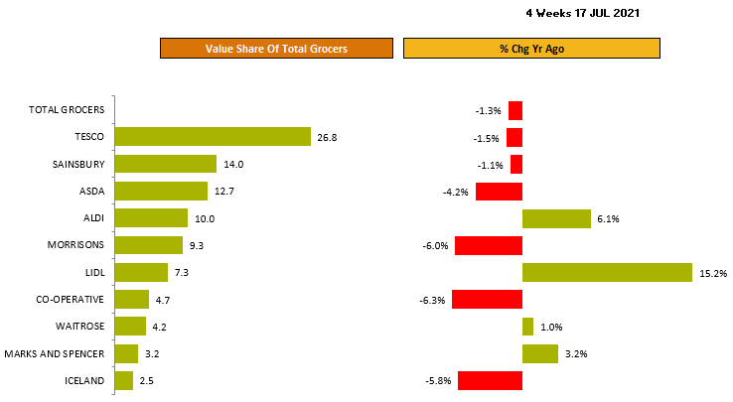
Discounters, M&S & Waitrose continue to attract more sales
Source: NielsenIQ Homescan Total Till 4 weeks ending 17th Jul 2021
Ocado FMCG 12w/e growth -2%

Slide 26
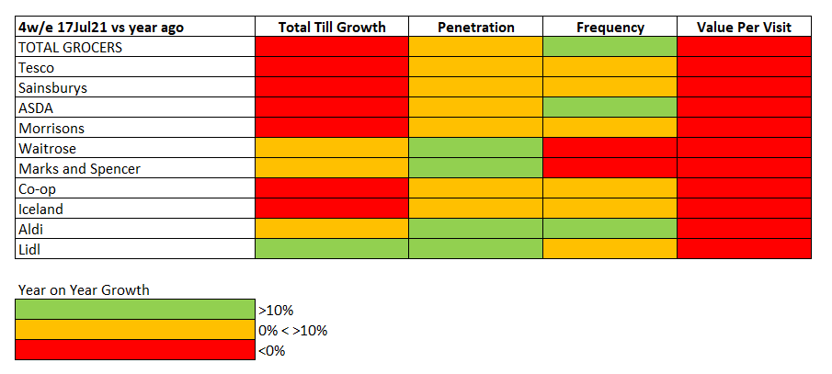
As shoppers start to travel more, all retailers are attracting more shoppers and most an increase in visits
Source: NielsenIQ Total Till and Homescan FMCG 4 weeks ending 17th July 2021
*Discounters 12w/e

Slide 27
Discounters are reporting stronger shopper KPI’s than pre-pandemic with more shoppers, visits and bigger basket spends
4w/e 17th July 2021 vs 4w/e 18th July 2019
FMCG Growth +16% +15% +15% +8% +8% +7% +6% +5% +2% +2%
Source: NielsenIQ Homescan FMCG

Slide 28
Sainsbury’s and Tesco hold market share
Two column numbered list
Tesco (-1.5%) and Sainsbury (-1.1%) continue to have the best performance within the top4, with ASDA sales down 4.2% and Morrisons -6.0% (where the year ago comparatives are still the toughest within peer group).
1
3
The decline in sales, against the surge of last year, at Co-operatives (-6.3%) and Iceland (-5.8%), have now slowed and Lidl sales growth (+15.2%) remains comfortably ahead of Aldi (+6.1%).
Only the Discounters are emerging post pandemic in a stronger position than the same period 2 years ago, attracting more shoppers, visits and higher basket spends.
2
Over the full 12 weeks, Discounters, Waitrose, M&S and also Sainsbury have all gained in market share.
In contrast, sales at M&S food stores (+3.2%) continue to rally strongly now all shops are open and there is more travel. Waitrose (+1.0%) are also re gaining some of the market share lost during the lockdown a year ago.
Both these retailers are seeing the biggest uplifts in new shoppers +25% for M&S and +20% for Waitrose, though penetration has not yet reached pre-pandemic levels
4
Source: NielsenIQ Total Till, Nielsen Homescan FMCG

Slide 29
Promotional spend may have reached a new normal at 21% with little fluctuation over the last 12 months
% Exp On Offer: FMCG
26%
21%
20%
2019
2020
2021
Source: Nielsen Homescan Grocery Multiples 4w/e

Slide 30
At retailer level promotional offer remains a differentiator with Iceland and ASDA seeing the biggest uplift this month
 | %Value sales bought on offer | +/- % pts vs last year
Waitrose | 34% | +0%
Ocado | 32% | -2%
Co-op | 31% | +0%
Morrisons | 30% | -1%
Tesco | 24% | +2%
Iceland | 23% | +5%
M&S | 21% | -3%
Sainsbury’s | 20% | +2%
ASDA | 19% | +3%
Lidl | 9% | +0%
Aldi | 4% | -0%
% Value sales bought on offer
Grocery Multiples 21% (+1% points)
Source: NielsenIQ Homescan % Value fmcg sales bought on offer, 4w/e 19th June 2021

Slide 31
July is the fourth month of cheaper food driven by fresh, the decline has accelerated slightly indicating the focus by retailers to keep prices low
Source: BRC-NielsenIQ Shop Price Index

Slide 32
FMCG will need an extended summer heatwave to help mitigate incoming winds
Three column numbered list
1
2
3
The year to date growth, at the Grocery Multiples +3% and good summer weather over the next 6 weeks will help retailers gain incremental sales, as will staycations, with fresh, chilled and drinks categories expected to benefit the most.
Sales at Convenience stores are currently -2.5% but should benefit from the better weather helping sales to stabilise.
There are 2 headwinds on the horizon:
As consumer demand increases in recreation and leisure this will dampen fmcg spend and whilst we are not yet seeing the return of inflation in food retailing (BRC NielsenIQ Jul-21 SPI for food is currently -0.4%), the recent increase in CPI is likely to lead to different shopping behaviours later in the year.
With 4 in 10 households watching their spend more than they did before the pandemic (NielsenIQ Homescan Survey) this is a watch out, especially with furlough ending later in Q3 and many roles in hospitality channels still uncertain.
In summary, as economic activity edges closer to pre Covid levels, we can expect further normalisation of Total Till spend.
Nielsen are now projecting full year growths in the range of -1.5% to +1.5%.
With GB Total Store YTD growths currently +2.1%, the final 24 weeks to 1st January 2022 will be challenging and with the above projections could average between +0.9% and -5.5%, which is significantly lower than the first half of 2021.

Slide 33
Appendix

Slide 34
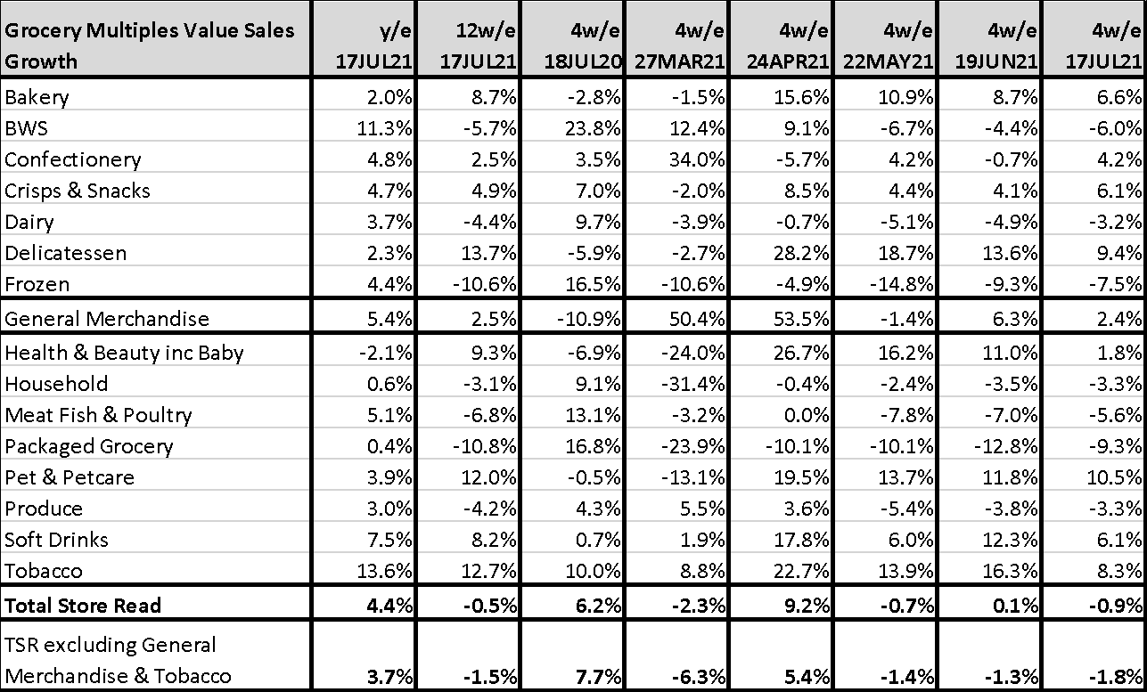
Bakery and Delicatessen were the fastest growing categories in July helped by warmer weather, the Euro’s and more food on the go
Source: NielsenIQ Scantrack Total Store Read Grocery Multiples

Slide 35
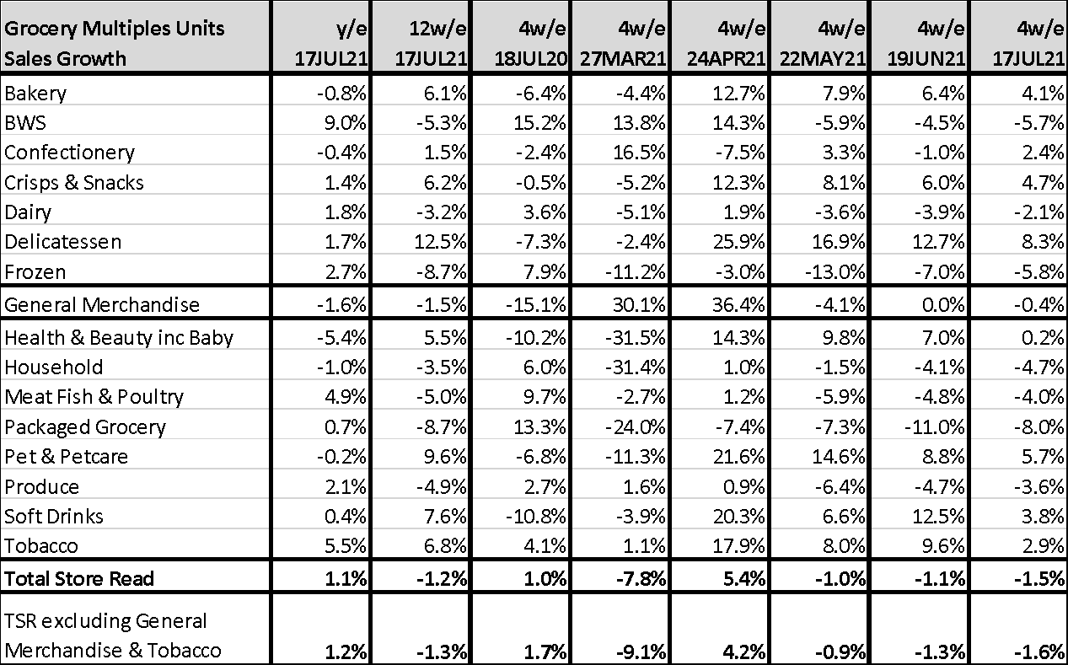
With more meals consumed out of the home, Packaged Grocery, Frozen and BWS will continue to normalise and be a drag on store sales.
Source: NielsenIQ Scantrack Total Store Read Grocery Multiples
Notes:
Numbers in this slide may change due to NDH00TSR data later

