Slide 1
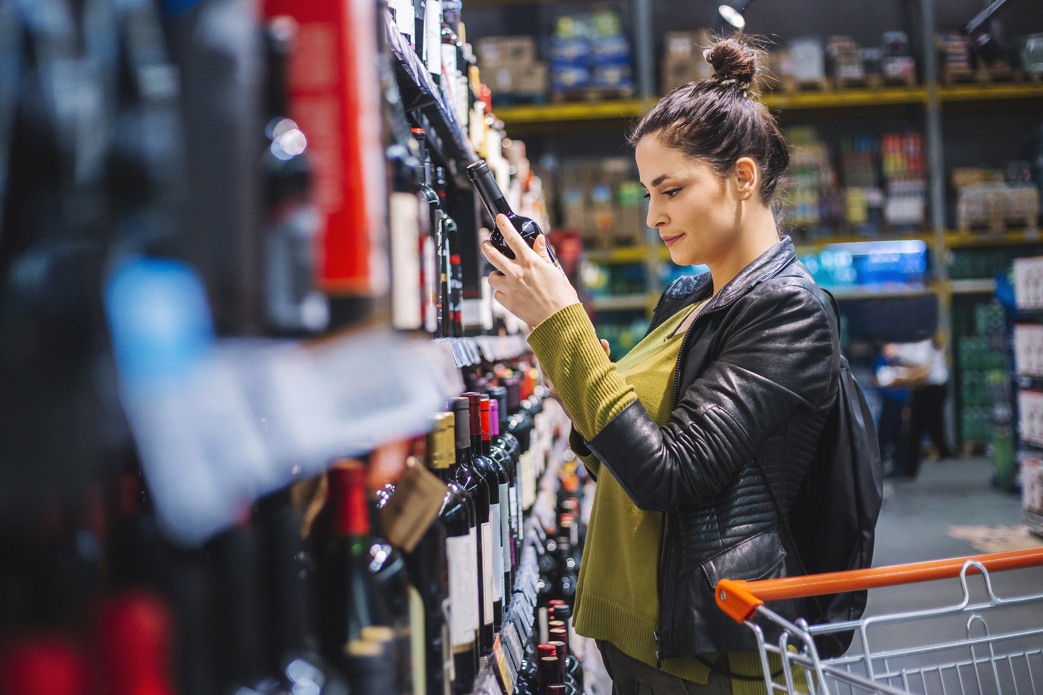
FMCG Essential Retail – What you need to know!
Share of Trade
52 we data to 18.06.22
Share of Total Grocers
Value Change %
Penetration
£ Spend per Visit
2021
2022
2021
2022
% Change
2021
2022
% Change
27.0% | 27.2% | -0.2% | 84.0 | 86.2 | 3.5% | 28.98 | 26.79 | -7.6%
14.0% | 13.7% | -2.9% | 65.2 | 67.6 | 4.7% | 27.67 | 24.94 | -9.9%
12.3% | 12.0% | -3.5% | 67.9 | 69.2 | 2.9% | 30.27 | 27.66 | -8.6%
10.3% | 11.0% | 5.4% | 63.8 | 66.9 | 5.8% | 26.07 | 24.21 | -7.1%
9.7% | 9.2% | -6.3% | 60.5 | 62.5 | 4.1% | 28.60 | 25.43 | -11.1%
7.2% | 7.8% | 8.6% | 56.6 | 60.7 | 8.1% | 22.57 | 20.96 | -7.1%
4.6% | 4.5% | -3.5% | 49.1 | 50.4 | 3.4% | 10.19 | 9.09 | -10.8%
4.3% | 4.2% | -3.2% | 23.6 | 26.1 | 11.6% | 26.89 | 23.41 | -12.9%
3.3% | 3.6% | 7.8% | 44.8 | 50.0 | 12.6% | 18.05 | 14.99 | -17.0%
2.7% | 2.6% | -3.0% | 49.3 | 50.6 | 3.6% | 21.50 | 19.76 | -8.1%
1.8% | 1.6% | -7.1% | 4.3 | 5.6 | 31.5% | 74.32 | 69.73 | -6.2%
Store Portfolio
Store Numbers as of 18.06.22
Store Numbers
Total
Convenience
Small
Large
Super
Mega
2712 | 1855 | 26 | 285 | 194 | 352
1396 | 809 | 43 | 173 | 143 | 228
587 | 0 | 133 | 86 | 113 | 255
497 | 2 | 10 | 185 | 245 | 55
3733 | 2726 | 828 | 179 | 0 | 0
334 | 23 | 50 | 209 | 44 | 7
1013 | 540 | 298 | 155 | 13 | 7
957 | 79 | 834 | 44 | 0 | 0
23 | 0 | 0 | 0 | 0 | 23
Value Index (52 we 18.06.22)
Life stage
Pre Family
New Family
Maturing Family
Post Family
Older Couple
Older Singles
Established Family
107 | 102 | 100 | 106 | 100 | 102 | 89
84 | 92 | 72 | 99 | 103 | 108 | 110
99 | 129 | 142 | 126 | 100 | 85 | 72
96 | 99 | 82 | 88 | 89 | 117 | 101
97 | 141 | 148 | 119 | 85 | 89 | 76
119 | 82 | 73 | 88 | 105 | 84 | 158
82 | 58 | 42 | 68 | 94 | 129 | 132
119 | 113 | 122 | 108 | 84 | 104 | 76
93 | 68 | 48 | 58 | 88 | 126 | 142
95 | 64 | 128 | 122 | 98 | 88 | 102
110 | 163 | 117 | 52 | 140 | 90 | 75
Source: Nielsen Homescan SOT based on FMCG [New Base], Benchmark Total Grocers% Change Penetration = % Change in actual buyers
Penetration = Change in shoppers

Slide 2
FMCG Essential Retail
Tesco As a thank you for their service, on Sunday, June 26 (Armed Forces Day), all serving Armed Forces personnel, around 159,000 regulars and 32,000 reservists, can present their MOD90 identification card at any Tesco café and get a free full cooked breakfast, vegan cooked breakfast, sausage bap or a bacon bap. All 295 Tesco cafes across Great Britain will be offering the promotion – limited to one free breakfast per cardholder. Rhys Little, Chair of the Armed Forces Network at Tesco, said: “We've got a long history of getting behind those who have been in the forces. We've received the Gold award from the Defence Employer Recognition Scheme twice now (in 2016 and 2020), and we were also the first retailer to sign the Armed Forces Covenant in 2014. We also do our best to give anyone leaving the army, navy, or RAF a chance to forge a new career.” Tesco will be sponsoring the spectacular event being promised in Scarborough which is at the heart of the celebrations with displays by the Red Arrows and the RAF Falcons Parachute Display Team and a series of thrilling flybys.
Sainsbury’s has expanded its trial with the charity Newlife to all of its supermarkets, allowing customers to return clothing nationwide. Newlife has built its foundation on recycling, reprocessing, and reusing clothing to support 1.1 million disabled and terminally ill children in the UK. Sainsburys has donated 65.5 tonnes unsellable and faulty clothing to Newlife since the partnership launched in 2019. Any of Sainsbury’s Tu clothing range that is not fit for resale in store will be recycled or resold by Newlife to help fund its work and support Sainsbury’s commitments within its sustainability strategy, Plan for Better. Sainsbury’s Director of Technical & Ethical Stephen Johnson said: “Sainsbury’s is committed to taking action to protect the environment and to supporting our local communities. We’re pleased to be rolling out our partnership with Newlife across all of our supermarkets and are incredibly proud of what we have achieved together so far.
ASDA new 'Just Essentials' range are set to begin rolling out in time to help families with the ongoing cost of living crisis. Featuring a total of 293 low cost products, the supermarket chain has said it will be the "largest ever budget-friendly range" to help shoppers combat rising costs. The new range will replace Asda's current Smart Price range and will span across fresh meat, fish and poultry, bakery, frozen and cupboard staples. Household items such as washing up liquid, toilet roll, shampoo and conditioner will also be included. A further 130 items will be rolled out by the end of June, increasing to 276 by August 13, with the final 26 products landing in stores by the end of the year. Asda will stock the full range in all 581 of its food stores, as well as online. Sam Dickson, Vice President Asda brand and propositions, said: “Nine out of ten of our customers have told us they are concerned about the cost-of-living crisis, with 44% of them saying they’re actively looking for ways to make their grocery budget go further. “We’ve developed Just Essentials by Asda to offer our customers the same value they know and love from our Smart Price range, but across a much larger and more diverse range of products, and with a bold brand that is hard to miss. Our mission is to meet all household needs through Just Essentials by Asda, and ensure that families can enjoy nutritious food, no matter their budget.”
Morrisons has announced it is selling ice pops for dogs to help keep them cool this summer. Costing £5 for a pack of six, the Woof & Brew Ice Pops are made with natural, herbal ingredients and developed in partnership with vets. Usually retailing at £6 on Amazon and specialist pet retailers, customers can save 20 per cent by heading to Morrisons to pick up a pack. Pet charity Blue Cross recommends keeping pets cool by using tasty ice cube treats and the ice pops are a perfect option. Dogs can’t sweat through their skin like humans and rely on panting and releasing heat through their paws and noses to regulate their body temperature. Jaymie Broughton, Morrisons pet care & treats buyer, said: “With the summer predicted to be a hot one, we want to help customers look after their pets and ensure that no-one misses out on having fun in the sun. These Woof & Brew Paw Pops are perfect for cooling down dogs in the heat and are the cheapest price on the high street.” To help customers stock up for the summer, Morrisons has cut prices on more than 75 products from household brands and will be offering many more ‘when it’s gone, it’s gone’ offers across toys, accessories, and pet bedding as part of its Pet Event, running until Sunday July 10.
Source: NielsenIQ Homescan, Grocer & Nam News

Slide 3
FMCG Essential Retail
Waitrose has diverted the equivalent of ten million meals of surplus food through its partnership with charity FareShare. Through its stores, customer fulfilment and distribution centres throughout the UK, Waitrose has committed to reducing its food waste by redistributing perfectly good to eat surplus to FareShare. More than 300 Waitrose stores redistribute surplus food daily via FareShare Go. Sarah Dayanada, Sustainability & Ethics Manager at Waitrose, said: “Everyone deserves access to fresh, quality food, and our partnership with FareShare helps make this happen. “We’re thrilled to be marking this milestone and are grateful to our fantastic Partners, customers and volunteers who’ve made it possible. We look forward to building on this success, preventing food waste and getting items to those who need it most.”
Aldi has announced a huge change to the way it sells toilet roll - and other supermarkets have been urged to follow suit. The discount supermarket is to add signs and symptoms of bowel cancer to all packs of own brand paper in response to Bowel Cancer UK’s #GetOnARoll campaign. It is the UK’s fourth most common cancer, and the second biggest cancer killer. The retailer has followed in the footsteps of M&S and is making the crucial change that could potentially save hundreds, if not thousands of lives. Almost half of adults around the UK could not name a single symptom of bowel cancer in a recent survey. Aldi has teamed up with Bowel Cancer UK to include the potentially life-saving information, together with a QR code for customers to find out more, on over 70m packs of toilet rolls every year. Julie Ashfield, Managing Director of Buying, at Aldi, said: “It’s shocking to learn that almost half of all adults in the UK cannot name a single symptom of bowel cancer. "When we heard how powerful it could be to simply print the signs and symptoms on loo roll packaging – so they are there when people most need to see them - we were really keen to get involved.
Lidl Shoppers can take the products off the shelves, pay for them, and leave them at a collection point near the tills. As the cost-of-living crisis worsens Lidl has launched a “Good to Give” label directing customers to the products which foodbanks need desperately to give people a varied, healthy diet. The initiative – thought to be an industry first – aims to increase donations to foodbanks. The shelf labels will highlight long-life items that offer a greater variety of nutritional benefits and which can be dropped at the donation points beyond the checkouts in all Lidl stores. The items will be collected regularly by local foodbanks and community projects..
Source: NielsenIQ Homescan, Grocer & Nam News

Slide 4
FMCG Essential Retail
Iceland announced the 3p' sale scheme to help customers tackle the cost of living crisis with the sale on essential items. With food prices rising at a record rate, the discount supermarket has already sought to help vulnerable consumers through its age-based discount for elderly people. Adding up to three of these products to your virtual basket and applying the code ‘ICEPENNY’ at checkout will reduce their price to just 3p. As well as lowering the prices of these items, Iceland is also offering free delivery to customers who spend more than £40. Richard Walker, Managing Director at Iceland, said: “We’re continuing to work hard to ensure our customers are being supported as much as possible as the cost of living continues to rise and we hope our 3p everyday essentials sale will help a little. “Our previous sales at Christmas and Easter were very popular and this time we’ve taken the decision to branch out and offer this deal on everyday essentials, as well as vegetables, to help our customers as we navigate through the cost-of-living crisis.”
Coop has partnered with a rain harvesting project in the Galapagos and five new net-zero farms to support them with grants for the first round of their Carbon Innovation Fund. A total of 14 projects have been awarded a combined £1.3 million from the Co-op Foundation, which aims to reduce carbon emissions in the food, farming, and aquaculture sectors through innovative methods. The carbon innovation fund is a total £3 million partnership, part-funded through the sale of compostable carrier bags in Co-op stores. It is the largest partnership of its kind between the retailer and a charity. Nick Crofts, CEO of the Co-op Foundation, said: “We created the Carbon Innovation Fund to encourage innovation and help tackle emissions in the food and farming industries – and what an incredible first 14 projects we’re funding. “From Cornwall to Malawi, we’re working with our new partners to create sustainable change and develop inventive solutions to complex issues. We cannot wait to see what our partners achieve as they co-operate to make our world a better place to live.” The Carbon Innovation Fund follows Co-op’s own commitment to become a net zero business by 2040. Verity Warnecke, head of climate change at the Co-op, added: “We are facing into a climate and environment crisis, and we have to recognise that we all need to do more, and quicker. “The Carbon Innovation Fund forms part of the action we are taking, it supports doing something different and encourages innovation that can be shared to benefit society in general – and the first round of funding does exactly that.
Ocado is set to open a new customer fulfilment centre in Leeds following the approval of a change of use application by Leeds Council. The new grocery delivery facility which is located at Unit B Fox Way in Hunslet, totals 17,500ft2 and will provide 140 jobs. It would operate 24 hours a day, seven days a week. Consultant Gerald Eve which is advising the online retailer said: “Ocado is seeking to occupy the property as part of their growing network of distribution hubs across England. “Since the Covid-19 Pandemic, distribution has become a crucial part of the UK’s infrastructure. Whilst the sector was already on the rise, due to increased demand for online shopping, the pandemic has accelerated the demand for online shopping and highlighted the importance of being able to access groceries and essential items via the internet. It is expected that this trend will continue long after the effects of the pandemic ease. Ocado have identified Leeds as a key area where the demand for goods is high yet the existing availability of distribution hubs is low, which ultimately affects the service Ocado are able to provide to the customer and results in long wait times for groceries. The objective of Ocado is to occupy this unit, and serve the central and wider Leeds area, providing an essential service that will be much needed long after the effects of the pandemic ease off.”
Source: NielsenIQ Homescan, Grocer & Nam News

