Slide 1
Quarterly CREST Report
Data to September 2021

Slide 2
Executive Summary – GB – Q3 2021
UK GDP has grown by 1.3% in Q3 2021 and 2.1% below where it was before the coronavirus pandemic at Quarter 4 (Oct to Dec) 2019. 19th July, dubbed ‘Freedom Day’, saw the lifting of virtually all restrictions affecting the restaurant industry. This, coupled with the UEFA European Football Championship running in July, meant Q3 2021 was off to a good start for the foodservice industry. August was another strong month, benefitting from a high number of staycations during the school holidays. However, in September consumer confidence dipped again, down to -13 from -8 in August, driven by concerns around fuel and food shortages, surging inflation squeezing household budgets, and climbing Covid rates.
CREST data showed traffic was up +35% in the foodservice industry in Q3 2021 vs Q3 2020, when the industry was still affected by restrictions. However, comparing Q3 2021 to Q3 2019 shows that traffic is still down -21% compared to pre-pandemic level. Onsite has been making the slowest recovery, with traffic down -38% compared to Q3 2019, while QSR is faring best, with traffic down -13% compared to Q3 2019.
All dayparts have seen a strong recovery when compared to Q3 2020 but are still behind 2019 levels. Dinner is the best performing daypart, driven by the continuing popularity of deliveries, with traffic down -5% compared to Q3 2019. PM Snacking and Lunch are currently seeing the slowest recovery, down -26% and -25% on 2019 levels, respectively. These dayparts are still heavily affected by a large share of the population working from home more than in 2019.
QSR was the best performing segment, with an -13% decline in visits compared to Q3 2019, but individual QS segments saw different performances. Out of major categories, QS Pizza is performing best, with traffic up +11% on Q3 2019. QS Chicken and Traditional Domestic Cuisines are also seeing positive traffic growth. In contrast, Coffee Bars continue to see decline, with traffic down -22% vs Q3 2019.
Traffic is still below pre-pandemic levels for all demographics. Families with young children are performing best, with traffic down -2% compared to Q3 2019. Older consumers are taking longer to return to their pre-pandemic dining habits, with traffic from 35-49s down -35%, and the 50+ down -27% compared to Q3 2019. Social occasions are making the biggest recovery, fueled by families and younger consumers dining out together, while more functional visits are still far below 2019 levels.
2

Slide 3
Executive Summary - Seafood Q3 2021
Q3 2021 Seafood visits have bounced back further to reach 95% of pre-pandemic level
QSR and Fish and Shops showed the best recovery rates;
Workplace and Education started to recover after a nearly zero activity a year ago;
Quick value on-the go occasions will be instrumental in growing the market post pandemic.
SERVINGS AFFECTED BY LOCKDOWN
TTM seafood servings are recovering but still lower than previous 12-months period, affected by slower recovery at Pubs and FSR
In TTM, QSR and Workplace/Education show growth vs last year while Pubs, FSR and Travel locations are still negative
ALL CHANNELS IN DECLINE
ENGAGING WITH YOUGER CONSUMERS
Better engagement with younger customers will be beneficial as they are bouncing back to pre-pandemic behaviour faster than older generations.
Seafood deal rates are similar to protein on average. Average seafood price is slightly below protein average, and below beef and poultry products.
DEAL RATES & PRICE
Source: The NPD Group/CREST®, YE Sept 21

Slide 4
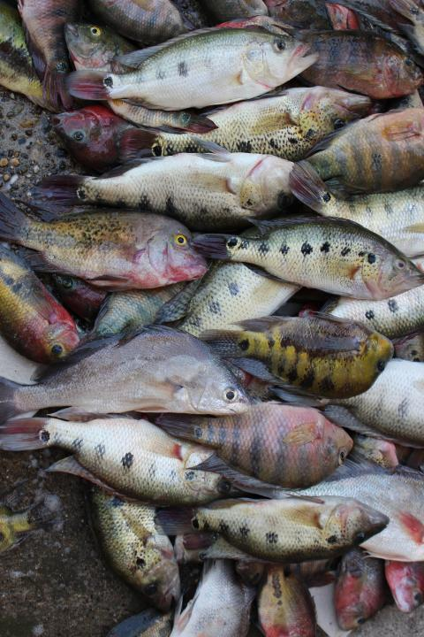
Topline Industry
& Protein Performance
Visits bounced back in Q3 2021 but still below 2019 levels
Annual Spend is above the pre-pandemic level thanks to increases in average check
All spend increase is coming from QSR, including Fish and Chip Shops

Slide 5
Markets continued to recover in Q3 2021
Total Out of Home
Components of Spending vs. Year Ago
Total Spend, Visits and Avg. Eater Check
Source: The NPD Group/CREST®, YE Sept 21
28
n.a.: Low sample / Numbers flagged grey and italic: Please read as tendencies / ++/--: pcya >+/-15%

Slide 6
The market continued to recover in Q3 with 12-month spend growing above previous year; visits are still down
Spend(£bn)
Visits(bn)
Av. Ind. Spend
Total Food & Drink Servings (m)
Total OOH | £42.0 | 0.6% | 6.8 | -12.8% | £6.2 | 15.4% | 17,184 | -12.7%
Pubs | £5.5 | -20.4% | 0.5 | -35.9% | £10.8 | 24.2% | 1,537 | -39.2%
FSR* | £8.8 | -1.9% | 0.7 | -14.0% | £12.5 | 14.2% | 2,045 | -20.6%
QSR** | £23.8 | 18.2% | 4.6 | 2.1% | £5.2 | 15.8% | 11,073 | 5.0%
Travel & Leisure | £3.5 | -24.6% | 0.5 | -32.6% | £7.6 | 11.8% | 1,189 | -34.8%
Work/Education | £0.4 | -62.8% | 0.5 | -47.0% | £0.7 | -29.5% | 1,236 | -39.8%
Fish & Chips | £1.0 | 12.4% | 0.3 | 5.2% | £3.8 | 7.0% | 612 | 5.4%
QSR excl. Fish & Chips | £22.8 | 18.5% | 4.3 | 1.9% | £5.3 | 16.3% | 10,461 | 5.0%
*FSR includes Café/Bistro
**QSR includes Fish & Chips
Source: The NPD Group/CREST®, YE Sept 21

Slide 7
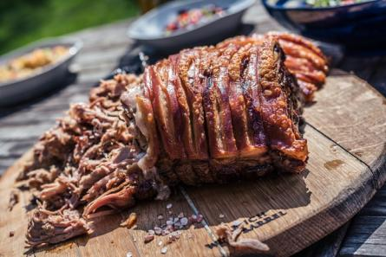
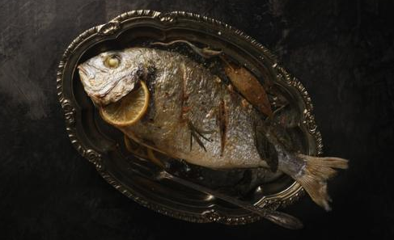
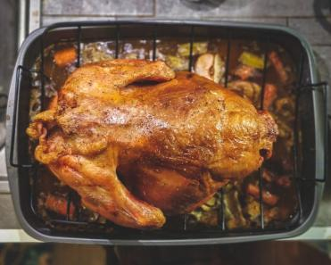
Topline Protein Performance
Protein servings recover faster than non-protein
Pork is the protein with the largest losses
Seafood’s incidence improved in the last 12 months

Slide 8
Protein servings recover faster than non-protein
Total Out of Home
Protein/Non-Protein Servings
% Servings Share
YOY Servings (%)
YOY Servings (000s)
-15.2%
-7.5%
Source: The NPD Group/CREST®, YE Sept '21

Slide 9
Each protein group saw servings decline in the last 12 months to September 2021
Total Out of Home
Servings Share & YOY, and Incidence by Protein
% Incidence Change
Servings Change (000s)
1.06
-0.53
0.10
1.29
1.47
Source: The NPD Group/CREST®, YE Sept '21

Slide 10
All proteins but lamb have increased average spend over the last 12 months
Total Out of Home
Average Individual Spend
YE Sept'21
Spend Change
YE Sept'21 vs. '20
Source: The NPD Group/CREST®, YE Sept '21

Slide 11
Alost 40% of Seafood visits were on deal; all proteins showed deal share growth
Total Out of Home
Deal Rate %pts Change
YE Sept '21 vs. '20
Deal Rates %
YE Sept '21
Source: The NPD Group/CREST®, YE Sept '21

Slide 12
Topline Seafood Performance
Q3 2021 Seafood visits have bounced back further to reach 95% of pre-pandemic level
Workplace and Travel segments are still heavily in decline

Slide 13
Q3 2021 Seafood visits have bounced back further to reach 95% of pre-pandemic level
Seafood Only
Components of Spending vs. Year Ago
Total Spend, Visits and Avg. Eater Check
 | Q3 19 | Q4 19 | Q1 20 | Q2 20 | Q3 20 | Q4 20 | Q1 21 | Q2 21 | Q3 21 |  | YE Sep 19 | YE Sep 20 | YE Sep 21
Visits, m | 276 | 262 | 214 | 51 | 181 | 156 | 117 | 155 | 262 |  | 1,035 | 708 | 690
Total Spend, £m | 1,055 | 1,169 | 822 | 270 | 808 | 656 | 710 | 692 | 968 |  | 4,109 | 3,074 | 3,156
Avg. Eater Check, £ | 3.83 | 4.46 | 3.84 | 5.29 | 4.47 | 4.20 | 6.08 | 4.47 | 3.69 |  | 3.97 | 4.34 | 4.58
Source: The NPD Group/CREST®, YE Sep 21
28
n.a.: Low sample / Numbers flagged grey and italic: Please read as tendencies / ++/--: pcya >+/-15%

Slide 14
QSR shows marked recovery in seafood; the rest of the market is still lower than year ago
Seafood Visits (bn)
Seafood Servings (bn)
Total OOH | 0.69 | -2.6% | 0.79 | -4.8%
Total QSR | 0.42 | 13.8% | 0.47 | 13.4%
QSR excl. Fish & Chip Shops | 0.26 | 14.1% | 0.30 | 13.1%
QSR Fish & Chip Shops | 0.16 | 13.1% | 0.17 | 14.0%
Pubs | 0.07 | -28.4% | 0.08 | -27.6%
Full Service(incl. Cafe/Bistro) | 0.09 | -18.2% | 0.11 | -25.9%
Workplace/Education | 0.05 | 23.5% | 0.06 | 38.1%
Travel & Leisure | 0.05 | -38.6% | 0.07 | -40.2%
Source: The NPD Group/CREST®, YE Sept '21

Slide 15
38% of all Seafood is served in QSR (excluding F&C Shops), but it only accounts for 3% of the segment
Total Out of Home
Channel Shares & Incidence
Source: The NPD Group/CREST®, YE Sept '21

Slide 16
Fish & Chips Shops are more reliant on dinner than any other day part; lunch is under-represented
Total Out of Home
Servings % by Daypart
Source: The NPD Group/CREST®, YE Sept '21

Slide 17
Fish and Chip Shops are heavily reliant on Friday and Saturday visitors
Total Out of Home
Servings % by Day of the Week
Source: The NPD Group/CREST®, YE Sept '21

Slide 18
Quick Service
QSR visits in Q3’21 are at 87% of 2019 level
12-month Sales at QSR are higher than pre-pandemic
Seafood increased servings vs year ago along with other proteins but pork

Slide 19
QSR visit recovery is ahead of the rest of the market
QSR
Total Quick Service
Components of Spending vs. Year Ago
Total Spend, Visits and Avg. Eater Check
Source: The NPD Group/CREST®, YE Sept '21
140
slide 4

Slide 20
Servings of all proteins but pork increased in QSR
QSR
Servings Share & YOY, and Incidence by Protein
% Incidence Change
1.30
-1.90
0.30
1.60
0.30
Source: The NPD Group/CREST®, YE Sept '21

Slide 21
Fried Fish is more important than year ago with 45% of all seafood servings
QSR
Servings % Share
% Contribution to Growth
Source: The NPD Group/CREST®, YE Sept '21

Slide 22
Poultry has the largest increase in individual spend; Seafood spend increased but lower than average
QSR
Average Individual Spend
YE Sept'21
Spend Change
YE Sept'21 vs. '20
Source: The NPD Group/CREST®, YE Sept '21

Slide 23
Seafood Sandwiches are the largest sub-type in QSR, but lost some share due to closures and less commute
QSR
Incidence by Seafood Type/Species
YE Sept '21
YE Sept 21 vs. 20 Positive
YE Sept 21 vs. 20 Negative
Source: The NPD Group/CREST®, YE Sept '21

Slide 24
Deal rates have increased in QSR, including for seafood
QSR
Deal Rates %
YE Sept '21
Deal Rate Ppt Change
YE Sept '21 vs. '20
Source: The NPD Group/CREST®, YE Sept '21

Slide 25
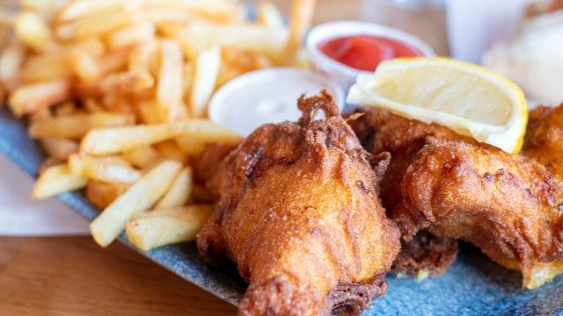
Fish & Chip Shops
Visit recovery to Fish & Chip shops has slowed down in Q3, thus visits were above last year’s but still below 2019 levels
Total spend is in Q3 is 14% below Q3 2019

Slide 26
Visit to Fish & Chip shops have bounced back in Q3 and were above last year’s but still below 2019 levels
F&C
Components of Spending vs. Year Ago
Total Spend, Visits and Avg. Eater Check
Source: The NPD Group/CREST®, YE Sept '21

Slide 27
Seafood is the largest protein for Fish & Chip shops, servings showed growth over the last 12 months
F&C
Servings Share & YOY, and Incidence by Protein
% Incidence Change
2.60
-1.80
0.50
-1.80
-0.50
Source: The NPD Group/CREST®, YE Sept '21

Slide 28
Fried Fish is the largest product group for Fish & Chip Shops and the biggest growth contributor
F&C
Servings % Share
% Contribution to Growth
Source: The NPD Group/CREST®, YE Sept '21

Slide 29
Cod is the most popular of at Fish and Chip Shops; haddock losing its share
F&C
Incidence by Seafood Type/Species
YE Sept '21
YE Sept 21 vs. 20 Positive
YE Sept 21 vs. 20 Negative
Source: The NPD Group/CREST®, YE Sept '21

Slide 30
Seafood’s average spend has been growing in the past year to September 2021
F&C
Average Individual Spend
YE Sept'21
Spend Change
YE Sept'21 vs. '20
Source: The NPD Group/CREST®, YE Sept '21

Slide 31
Seafood deal rate within the Fish & Chip Shops has not changed much over the last 12 months
F&C
Deal Rates %
YE Sept '21
Deal Rate Ppt Change
YE Sept '21 vs. '20
Source: The NPD Group/CREST®, YE Sept '21

Slide 32
Quick Service excl. Fish & Chip Shops
QSR is the leader of the recovery – growing in spend above 2019 levels
Visits in Q3’21 are still below pre-pandemic at 87%

Slide 33
Visits to QSR excl. Fish and Chip Shops increased by 28.8% in Q3 2021, still lower than in Q3 2019
QSR
(excl. F&C)
Components of Spending vs. Year Ago
Total Spend, Visits and Avg. Eater Check
Source: The NPD Group/CREST®, YE Sept '21

Slide 34
Poultry has the largest servings share in QSR excl. Fish & Chips shops; seafood’s share improved
QSR
(excl. F&C)
Servings Share & YOY, and Incidence by Protein
% Incidence Change
0.90
-1.80
0.20
2.00
0.50
Source: The NPD Group/CREST®, YE Sept '21

Slide 35
Non-fried Fish is the largest category in QSR excl. Fish & Chip Shops, but it lost share to Fried Fish
QSR
(excl. F&C)
Servings % Share
% Contribution to Growth
Source: The NPD Group/CREST®, YE Sept '21

Slide 36
Seafood Sandwiches is the most important sub-category in QSR, but its share declined
QSR
(excl. F&C)
Incidence by Seafood Type/Species
YE Sept '21
YE Sep 21 vs. 20 Positive
YE Sep 21 vs. 20 Negative
Source: The NPD Group/CREST®, YE Sept '21

Slide 37
Seafood products are cheaper than other proteins in QSR, except pork
QSR
(excl. F&C)
Average Individual Spend
YE Sept'21
Spend Change
YE Sept'21 vs. '20
Source: The NPD Group/CREST®, YE Sept '21

Slide 38
All proteins with the exception of lamb and pork are seeing deal rates increasing in the last 12 months
QSR
(excl. F&C)
Deal Rates %
YE Sept '21
Deal Rate PPT Change
YE Sept '21 vs. '20
Source: The NPD Group/CREST®, YE Sept '21

Slide 39
Pubs
Pubs continue to recover post lockdown with Q3’21 sales above 2019 level
Visits however are still down at 84% of pre-pandemic

Slide 40
Pub visits partially recovered since they were allowed to reopened in early July
Pubs
Components of Spending vs. Year Ago
Total Spend, Visits and Avg. Eater Check
Source: The NPD Group/CREST®, YE Sept '21
228
slide 4
n.a.: Low sample / Numbers flagged grey and italic: Please read as tendencies / ++/--: pcya >+/-15%

Slide 41
Because of the prolonged period of almost full closure Pubs servings are still down vs year ago
Pubs
Servings Share & YOY, and Incidence by Protein
% Incidence Change
2.10
-3.80
0.50
2.00
0.50
Source: The NPD Group/CREST®, YE Sept '21

Slide 42
Shellfish and products with fish fillings have stolen share from fish
Pubs
Servings % Share
% Contribution to Growth
Source: The NPD Group/CREST®, YE Sept '21

Slide 43
Salmon and Cod are the most popular fish species in Pubs
Pubs
Incidence by Seafood Type/Species
YE Sept '21
YE Sep 21 vs. 20 Positive
YE Sep 21 vs. 20 Negative
Source: The NPD Group/CREST®, YE Sept '21

Slide 44
Average cheque in Pubs has increased across all proteins
Pubs
Average Individual Spend
YE Sept'21
Spend Change
YE Sept'21 vs. '20
Source: The NPD Group/CREST®, YE Sept '21

Slide 45
Seafood has seen the largest increase in the percentage of deal/promotions
Pubs
Deal Rates %
YE Sept '21
Deal Rate Ppt Change
YE Sept '21 vs. '20
Source: The NPD Group/CREST®, YE Sept '21

Slide 46
Full Service (Including Café/Bistro)
Recovery continues with visits in Q3’21 at 84% of 2019
Sales are well above pre-pandemic levels thanks to increases in average check

Slide 47
In Q3 visits to Full Service Restaurants recovered to 84% of pre-pandemic levels
FSR
Components of Spending vs. Year Ago
Total Spend, Visits and Avg. Eater Check
Source: The NPD Group/CREST®, YE Sept '21
185

Slide 48
Similarly to Pubs, 12-month visits to Full-Service Restaurants were still lower than a year ago
FSR
Servings Share & YOY, and Incidence by Protein
% Incidence Change
-1.40
1.30
-0.60
-1.80
1.50
Source: The NPD Group/CREST®, YE Sept '21

Slide 49
Fried fish and products with fish fillings gained share in the last 12 months.
FSR
Servings % Share
% Contribution to Growth
Source: The NPD Group/CREST®, YE Sept '21

Slide 50
Salmon is the most important species in full service restaurants, followed by shellfish
FSR
Incidence by Seafood Type/Species
YE Sept '21
YE Sep 21 vs. 20 Positive
YE Sep 21 vs. 20 Negative
Source: The NPD Group/CREST®, YE Sept '21

Slide 51
Seafood individual spend showed the largest £ increase over the last 12 months
FSR
FSR
Average Individual Spend
YE Sept'21
Spend Change
YE Sept'21 vs. '20
Source: The NPD Group/CREST®, YE Sept '21

Slide 52
Seafood deal rates are ahead of all other proteins and growing faster than average
FSR
Deal Rates %
YE Sept '21
Full Service Restaurants
Deal Rate Ppt Change
YE Sept '21 vs. '20
Source: The NPD Group/CREST®, YE Sept '21

Slide 53
Travel & Leisure
Travel and Leisure recovery is the slowest as the industry still suffers from lower international traffic levels
Consumption of all proteins is down within the segment, only pork showed positive incidence change

Slide 54
Travel & Leisure visits are the slowest to recover with tourism still at historically low level
T&L
Components of Spending vs. Year Ago
Total Spend, Visits and Avg. Eater Check
Source: The NPD Group/CREST®, YE Sept '21
77
slide 4

Slide 55
Seafood servings in Travel and Leisure are still heavily depressed
T&L
Servings Share & YOY, and Incidence by Protein
% Incidence Change
-2.20
6.50
-0.20
-0.50
-2.60
Source: The NPD Group/CREST®, YE Sept '21

Slide 56
Shellfish and other fish-filled products grew share
T&L
Servings % Share
% Contribution to Growth
Source: The NPD Group/CREST®, YE Sept '21

Slide 57
Seafood individual spend has increased only slightly in Travel and Leisure over last 12 months
T&L
Average Individual Spend
YE Sept'21
Spend Change
YE Sept'21 vs. '20
Source: The NPD Group/CREST®, YE Sept '21

Slide 58
Deal rates for Seafood are above average and were growing in importance
T&L
Deal Rates %
YE Sept '21
Deal Rate Ppt Change
YE Sept '21 vs. '20
Source: The NPD Group/CREST®, YE Sept '21

Slide 59
Workplace & Education
Work and Education showed the largest year on year increase in visits once workers started to return to offices in September
Still only at 56% of pre-pandemic level

Slide 60
Traffic has been recovering over the last two quarters but still less than half of 2019 level
W&E
Workplace & Education
Components of Spending vs. Year Ago
Total Spend, Visits and Avg. Eater Check
Source: The NPD Group/CREST®, YE Sept '21

Slide 61
Seafood re-gained incidence and gained servings
W&E
Servings Share & YOY, and Incidence by Protein
% Incidence Change
12.40
-4.00
-0.60
6.00
-1.90
Source: The NPD Group/CREST®, YE Sept '21

Slide 62
Seafood Performance
& Demographics by Type
Socialising is by far the most important motivation when choosing Seafood while eating out;
QSR is by far the major opportunity to improve the appeal of seafood;
Non-Fried Fish has increased its share so far this year due to growths in Haddock and Cod; Fried variety of the same species also grew
Seafood doesn’t attract its fare share of younger consumers and lower social classes outside of Fish and Chip Shops

Slide 63
Socialising is by far the most important motivation when choosing Seafood while eating out
Index – Seafood vs. Total Food/Drink
Motivation for Eating/Drinking Visit OOH
 | Total OOH | Pubs | FSR | QSR | Fish & Chips | QSR excl. Fish & Chips
Convenience | 94 | 112 | 94 | 85 | 98 | 111
Functional | 98 | 81 | 91 | 99 | 94 | 95
Socialising | 128 | 110 | 121 | 125 | 108 | 110
Treating | 100 | 82 | 100 | 105 | 98 | 88
Source: The NPD Group/CREST®, YE Sept '21

Slide 64
QSR is still the major opportunity to improve the appeal of seafood
Total Seafood
Visits SWOT Analysis
O
S
Over/Under-Perform vs Total Channel Growth
W
T
Over/Under-Trade vs Channel Share of OOH
Bubble Size Represents Channel % Share of Seafood
Source: The NPD Group/CREST®, YE Sept '21

Slide 65
Fish has increased its share with Haddock growing in importance; Tuna increased share in non-fried category
Total Out of Home
Servings % Share
Source: The NPD Group/CREST®, YE Sept '21

Slide 66
The youngest seafood customers are at Travel & Leisure, Work/Education and QSR segments of the market
Demographic Map – Servings by Channels & Types
% Servings Aged Over 35
% Servings Social Class ABC1
Source: The NPD Group/CREST®, YE Sept '21

Slide 67
Travel & Leisure, and Fish & Chip Shops are performing very well with kids
% Servings Involving Kids
Note: Low Sample sizes - use data cautiously: Work/Edu; Shellfish Fish & Chips.
Source: The NPD Group/CREST®, YE Sept '21

Slide 68
Scampi are growing importance as does shellfish overall, while Fish Burgers are getting less important, however still important overall
Total Seafood
Incidence and %pt Change by Type
Growing Importance but less Important overall
Growing Importance and more Important overall
% pt Incidence Change
Lessening Importance and less Important overall
Lessening Importance but more Important overall
% Incidence
Source: The NPD Group/CREST®, YE Sept '21

Slide 70
CREST Measures
Measure | Question answered
Sales | How much did the guests spend overall in the foodservice Market?
Visits | How many guests went to the restaurants?
Average Eater Check | What did the guests spend on average during a restaurant visit?
Average number of items | How many items did the guests order on average?
Average price per item | What was the average price of each product?
Servings | How many portions of a product were sold?
Incidence | What is the importance of a product in the Market?

Slide 71
CREST Calculations
Measure | Question answered
Average Price Per Item | Average Individual Spend divided by Items per Eater
Incidence | Simply stated, the %of orders (or visits) that include a specific food or beverage item, group of items, or category of items. A pure measure of item importance (e.g. on a scale from 1-100 how important is this item)
Index | Reflects the relative importance of a specific variable (e.g. demo, occasion segment, etc.)
Contribution to Growth/Marline | CTG and/or CTD = % of visit or servings growth/Marline sourced to a specific variable (e.g. demo, occasion segment, etc.)
% Change vs. Same Period Year Ago | YOY or PCYA the % change vs. same time period year ago (e.g. annual, quarter, month, etc.).

Slide 72
Q3 2021 Seafood visits have bounced back further to reach 95% of pre-pandemic level
Seafood Servings vs. Year Ago
Total Spend, Visits, Servings and Avg. Eater Check
 | Q3 19 | Q4 19 | Q1 20 | Q2 20 | Q3 20 | Q4 20 | Q1 21 | Q2 21 | Q3 21 |  | 0.0% | 0.0% | 0.0%
Visits, m | 276 | 262 | 214 | 51 | 181 | 156 | 117 | 155 | 262 |  | 1,035 | 708 | 690
Servings, m | 324 | 318 | 245 | 60 | 208 | 173 | 130 | 179 | 309 |  | 1,178 | 1,191 | 831
Total Spend, £m | 1,055 | 1,169 | 822 | 270 | 808 | 656 | 710 | 692 | 968 |  | 4,109 | 3,074 | 3,156
Avg. Eater Check, £ | 3.83 | 4.46 | 3.84 | 5.29 | 4.47 | 4.20 | 6.08 | 4.47 | 3.69 |  | 3.97 | 4.34 | 4.58
Source: The NPD Group/CREST®, YE Sep 21
28
n.a.: Low sample / Numbers flagged grey and italic: Please read as tendencies / ++/--: pcya >+/-15%

