Slide 1
Retail Observations: On-line New and Re-launched Products
6th September | Suzi Pegg-Darlison

Slide 2
New products summary
 | Ambient | Chilled | Frozen | Grand Total
Iceland |  |  | 12 | 12
Morrisons | 2 | 2 |  | 4
Ocado | 5 | 1 | 3 | 9
Sainsburys |  | 2 |  | 2
Waitrose |  | 1 |  | 1
Grand Total | 7 | 6 | 15 | 28
Source: Retailer website (06/09/2021)

Slide 3
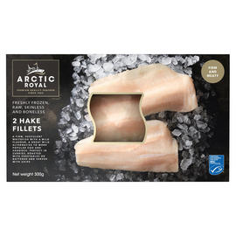
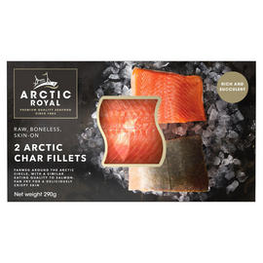
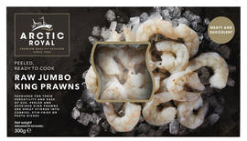
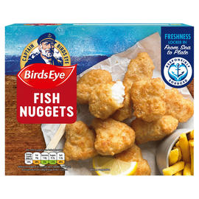
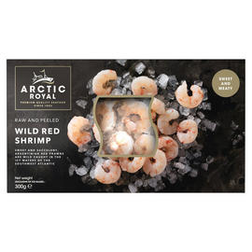
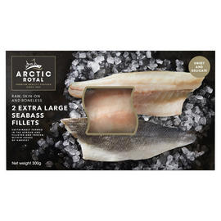
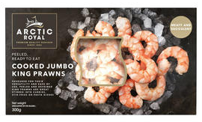
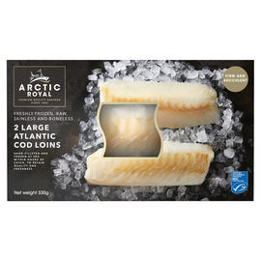
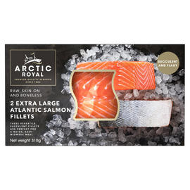
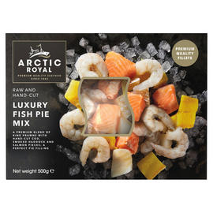
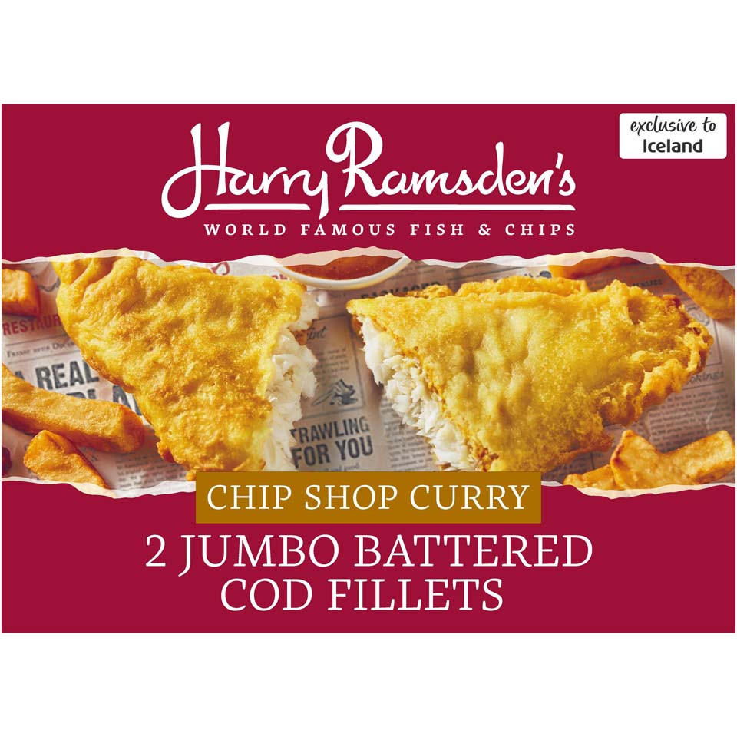
Iceland
Frozen (12)
Source: Retailer website (06/09/2021)

Slide 4
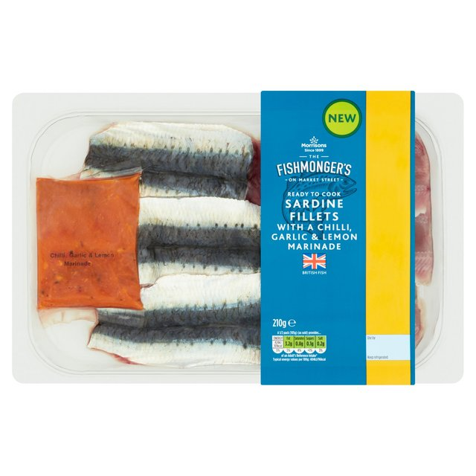
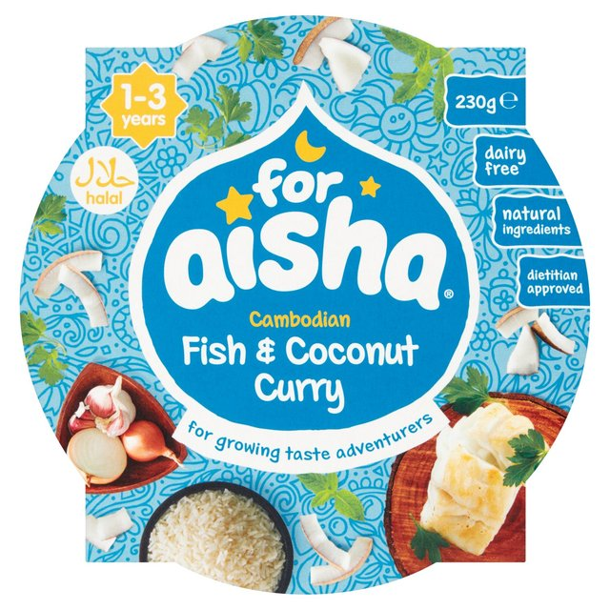
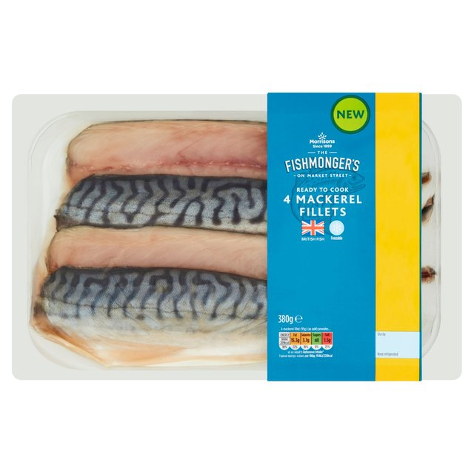
Morrisons
Ambient (2)
Chilled (2)
Source: Retailer website (06/09/2021)

Slide 5
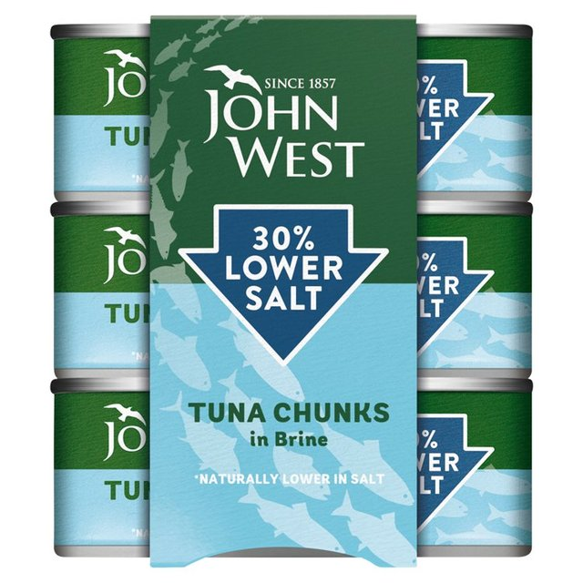
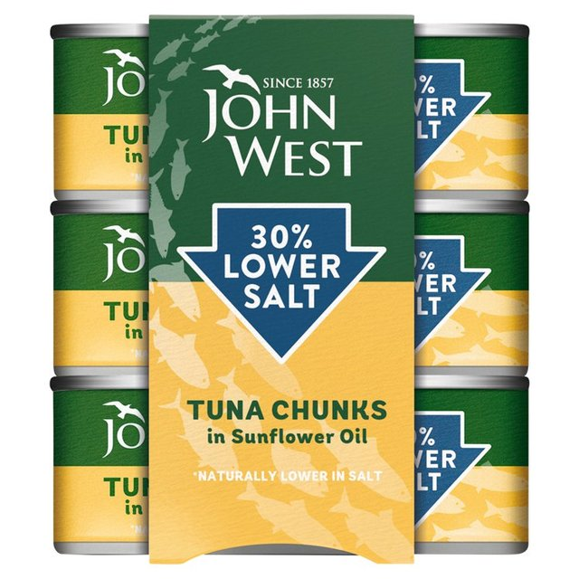
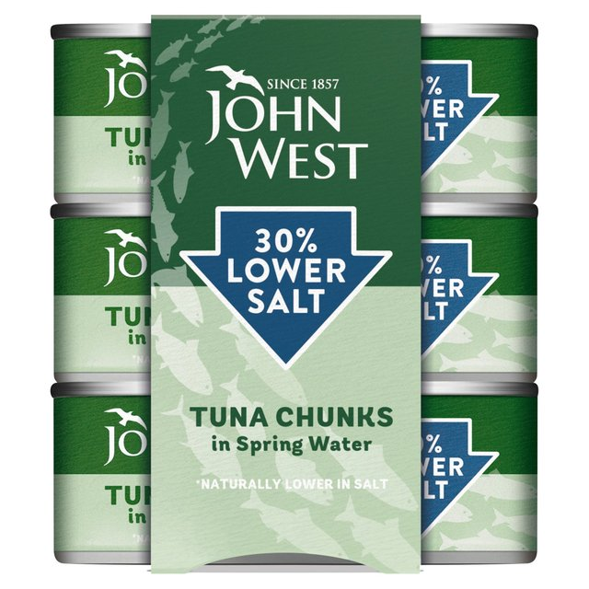
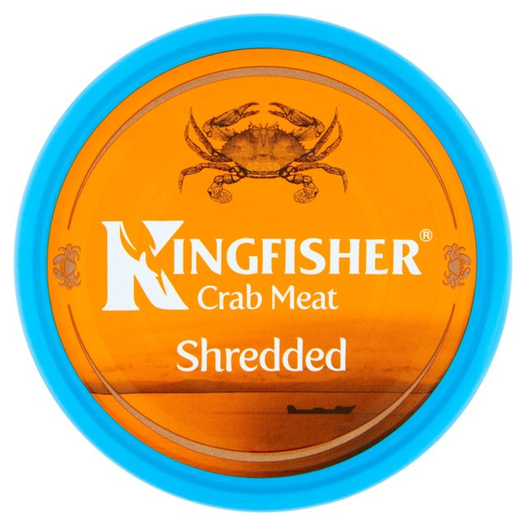
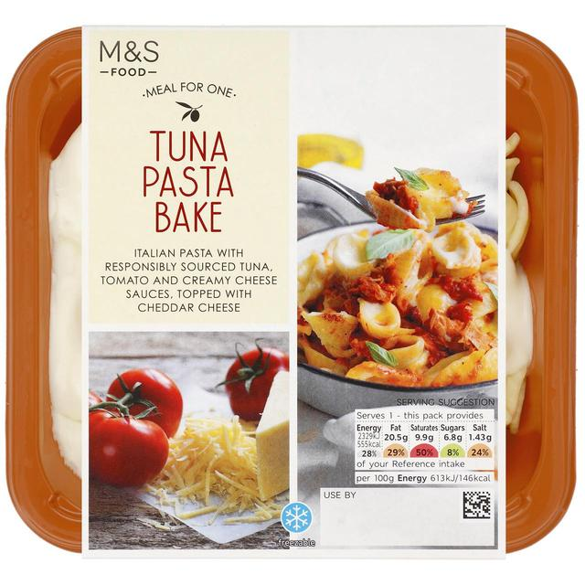
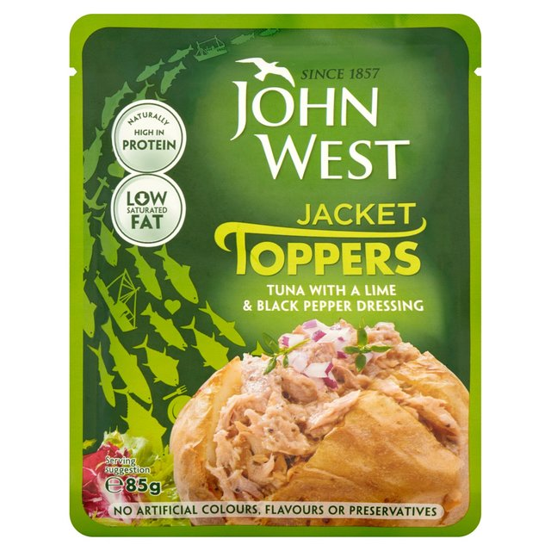
Ocado
Ambient (6)
Chilled (3)
Source: Retailer website (06/09/2021)

Slide 6
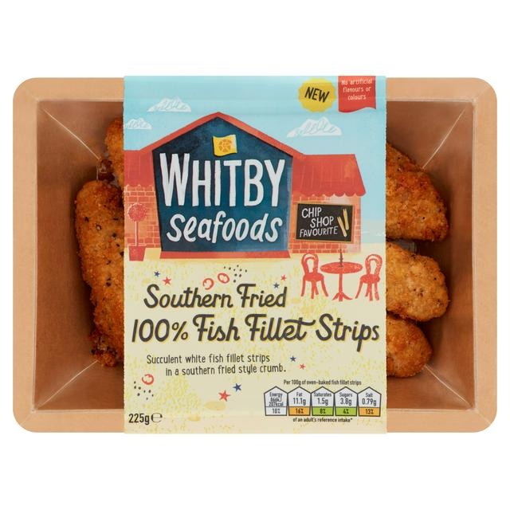
Sainsbury’s
Chilled (2)
Source: Retailer website (06/09/2021)

Slide 7
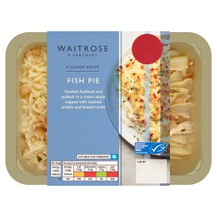
Waitrose
Chilled (1)
Source: Retailer website (06/09/2021)

Slide 8
Thank you
For further details please contact:
Julia Brooks
Market Insight Analyst
Julia.brooks@seafish.co.uk
+44 (0) 1472252358 / 07944 682751
Suzi Pegg-Darlison
Market Insight Analyst
Suzi.pegg-darlison@seafish.co.uk
+44 (0) 1472 252358 / 07944 682697

