Slide 1
NIQ Total Till Executive Summary
4 weeks ending 24th February 2024
Sally Cowen
Retailer & Business Insights Team
7th March 2024

Slide 2
5 key takeouts
1
Events fuel growth
2
Online outperformed helped by the weather
3
Macro trends of Cheaper, Convenient and Healthy continue
4w/e 24th February 2024
4
Discounter growth slows
5
Early Easter boost to sales expected

Slide 3
Market Overview

Slide 4
Retailers chased growth and promotions remain high
Event boost | More visits | Discounter growth slows
Total Till sales slowed to +5.3% in the 4 weeks to 24th February, from +6.6% in January. | The increased focus on events led to an increase in shopper visits. | Having gained a 20% uplift in sales in 2023, the discounters now have tough comparatives.
February proved to be anomaly breaking both the ‘wettest’ and ‘warmest’ meteorological records. Sales rallied in the 2 weeks leading upto Valentine’s Day. This year we had back to back events with Pancake Day pre-ceding. Both fell during half-term, allowing families more time to celebrate the events. All retailers took advantage of the events and Spend on offer, remained high at 24%. Food inflation has now slowed to 5%* and we have started to see some ‘deflation’ in dairy, this may spread to other sectors of the assortment as retailers pass on price cuts coming through the supply chain. | Whilst the continued wet weather was less conducive for shopping on the high street, shoppers did spend more online. Online fmcg once again outperformed stores. With Valentine’s day providing an additional boost. With an array of ‘romantic’ products grouped for simple purchase, buying online proved an easy option for some. Half term will have encouraged more uptake of pancake making and w/e 17th February saw a rise in sales of baking ingredients. The macro trends of buying cheaper, more convenient and healthier continued with a number of categories benefiting. | After 2 years of declining volumes the industry is ready to fight back looking to steal sales from hospitality as well as the Discounters. Morrisons was the last of the 4 big supermarkets to announce a price matching initiative vs the Discounters. It was another strong month for Ocado and M&S. Ocado will have benefited from the weather and both retailers will have seen uplifts from M&S’ Valentine’s inspired range. Sainsbury’s outperformed the Discounters, by attracting more shopper and visits emphasising the importance of a multi-format strategy.
Source: NIQ Scantrack, Homescan FMCG
*BRC-NIQ SPI February 2024

Slide 5
Sales growth held at
 | Online* +7.9% Grocery Multiples +4.2% Supermarkets +4.0% Instore* +3.8% Discounters* +3.4% Convenience +2.1% Value Retailers* +1.9%
+5.3%
Total Till
Source: NIQ Scantrack Total Store Read, *Homescan FMCG 4w/e 24th February 2024

Slide 6
Sales did improve on January but are below last year’s trend
4 weekly value growth vs prior period
Source: NIQ Scantrack Total Store Read, Total Coverage and Grocery Multiples 4w/e value growth vs prior period

Slide 7
Price matching, inclement weather and events brought a mix of fortunes in February
Wk1: More price cuts
Wk2: Volumes improve
Wk3: Half term boost
Wk4: More wet weather
Everyday lines cheaper
With slowing food inflation, super category growth has slowed to single digit.
Cost price food inflation remains an outlier in Chocolate, as dark chocolate is linked to health benefits and the ingredient popularity continues to grow. Chocolate Confectionery +15%.
Demand for Healthier choices, comfort foods continues with strong growth for Dried Veg & Pulses, Rice & Grains, Produce Nuts and Herbs & Spices.
As well as discretionary items, shoppers are now spending less on some KVI items including Milk -7%, Butter & Spreads -7% and Dry Pasta -5%.
Unit growths remain positive
Unit growths, against weak comparatives improved +1.5%, making 8 consecutive weeks of positive growth.
Growth remain higher for Ambient categories reflecting the higher food inflation in these categories +7.2% Ambient vs +3.4% Fresh (BRC-NIQ SPI February 2024).
A week of events
This year Valentine’s and Pancake Day coincided with half-term.
Value sales topped £2.8Bn and units remained positive at +1.3%.
Valentine’s day brought a welcome boost to confectionery which saw sales improve to +17.5%, units were however negative -0.1%, a stark reminder of the cost price inflation in this category.
Choc Box Gifting saw value sales +27% and units +17%. We are also starting to see an early build for Easter Eggs, with Easter 2 weeks earlier this year.
Unit growths slow
The inclement weather was less conducive for shopping and unit growths slowed to just +0.1%, maintaining the 10 week streak of positive growth.
Momentum continues to build for Easter. With concerns around availability, shoppers are buying eggs early with value growth +46% equating to £7.6m incremental sales and units +30% or 3m additional eggs sold.
Continued downpours saw a spike in umbrella’s with shoppers spending £1m more on this category over the full 4 week trading period.
Source: NIQ Scantrack Grocery Multiples

Slide 8
Value is holding and unit growth has maintained a 10 week streak
Grocery Multiples Weekly year on year value growth
2w/e 30Dec23
Value +5.8%
Units +1.0%
Source: NIQ Scantrack Total Store Read Grocery Multiples

Slide 9
Food Shop Price Inflation slowed again in February and remains at its lowest level since June 2022
The BRC cited that ‘easing supply chain pressures’ have begun to ‘feed through to food prices’ but ‘significant uncertainties’ remain as geopolitical tensions rise
BRC-NielsenIQ Shop Price Index Year on year % changes in shop prices
Source: BRC-NIQ Shop Price Index

Slide 10
Shoppers made 5m more shopping trips, spent £0.61 MORE per occasion but bought, on average 0.2 FEWER FMCG items per trip
+3.2%
-1.1%
+0.2%
Spend per visit increased to £19.59from £19.00
Items in basket are 10.4 down from 10.6 last year
Frequency of visit improved to 18.1 trips from 18.0 last year
Source: NIQ Homescan FMCG Total GB 4w/e 4th February2024 vs 4w/e 25th February 2023

Slide 11
Shoppers spent 6% more than January, an uplift in visits was the key driver
 | Careful start to New Year 4w/e 27th January 2024 | Events helped fuel more visits in Feb 4w/e 24th February 2024
Basket Size | £19.72 +£0.90/+4.8% vs last year and -10.6% vs last month 10.5 items (-1.1% vs last year and -5.4% vs last month) | £19.59 +£0.61/+3.2% vs last year and -0.9% vs last month 10.4 items (-1.9% vs last year and -0.2% vs last month)
Bricks & Mortar shopping trips | 474m shopping occasions +0.7%/+3m MORE than last year and -5.7% FEWER trips v last month | 509m shopping occasions +0.9%/+4.6m MORE than last year and +7.1% MORE trips v last month
Online penetration | 25% of GB shoppers -1.5%/-109k FEWER shoppers vs last year -6.2%/-487k FEWER shoppers than last month +0.4%/+84k MORE orders than last year and -5.7%/-1.1m FEWER than last month | 26% of GB shoppers +0.5%/+157k MORE shoppers vs last year +2.7%/+106k MORE shoppers than last month +3.7%/+703k MORE orders than last year and +4.2%/+791m MORE than last month
Growth of the Discounters | 63% of GB shoppers, +1.9%/+342k MORE v last year +6.7%/+5.1m MORE shopping occasions v last year and -0.7%/-569k FEWER trips vs last month. | 64% of GB shoppers, -0.2%/+46k MORE v last year +6.2%/+5.2m MORE shopping occasions v last year and +8.6%/+7m MORE trips vs last month.
Source: NIQ Homescan GB FMCG

Slide 12
Most retailers took advantage of the ‘dine-in’ meal deals, which will have helped to drive incremental visits and basket spend.
Pancake day falling in half term will also have given more time for shoppers to enjoy the event.

Slide 13
Category

Slide 14
As highlighted by the BRC, easing supply chain prices have begun feeding through to retail prices and most categories are seeing growth slow, confectionery remains an outlier
Derived Inflation/Deflation
+5.0%~
* TSR (Total Store Read) excludes General Merchandise & Tobacco
Source: NiQ Scantrack Grocery Multiples, 4w/e 24th February 2024
Derived Inflation: Difference between Value Sales growth and Unit Sales growth
~BRC-NIQ Food Shop Price Inflation Jan24

Slide 15
Sales were more robust than last month, lifted by Confectionery, BWS and Produce as shoppers toasted the end of Dry January, celebrated loved ones, bought early for Events and adopted healthier eating habits
Category overview
4w/e 24th February 2024 Value Growth
Supercategory performance
4w/e 24th February 2024 Value Growth
Source: NIQ Scantrack Grocery Multiples
~Health, Beauty, Toiletries & Baby
*Confectionery, Crisps & Snacks, Nuts & Seeds
#Clothing, Entertainment, Electrical, Home, Sports & Leisure, Seasonal, Stationery, Toys

Slide 16
In February shoppers celebrated ‘events’, sought ‘convenient’ and ‘cheaper’ meal options and ‘healthier’ choices
Household, Health & Beauty | Core Grocery | Convenience | Discretionary/ Treats
Children’s Medicines +25% Anti Smoking +25% Glasses & Lenses +19% Disinfectants +17% Garment Care +16% Deodorants & Body +15% VMS & Dietary Health +15% Cough, Cold & Flu +13% Fabric Conditioner +12% Dish Wash +12% Baby Toiletries +11% Beauty Skincare +9% Stomach Remedies +8% Aircare +8% Detergents +7% | Seeds +25% Dried Veg & Pulses +23% Tea +21% Produce Nuts +19% Homebaking Nuts +16% Herbs & Spices +16% Oil +15% Cooking Vinegar & Alc +15% Eggs +15% Rice & Grains +13% Sugar & Sweeteners +12% Fresh Fruit +10% Fresh Veg +10% Baking Sundries +10% Canned Veg +10% Fresh Poultry +9% Canned Fish +9% Fresh Meat +9% Frozen Poultry +8% Canned Meat +7% | Fresh Gravy +19% Salad +15% Pickles & Pickled Veg +14% Sushi +13% Trtd/Prep Fresh Meat Prd +13% Frozen Chips +13% Fresh Meal Accom +13% Fresh Fruit Drinks +12% Olives & Antipasti +12% Ice Cubes +11% Frozen Potato +11% Yoghurts +11% Fresh Noodles +10% Rice Cakes +9% Frozen Fruit +8% Ambient Mexican Accom +7% Cooking Sauces +7% Fresh Prepared Fruit +7% Ambient Ready Meals +7% Fresh Savoury Snacks +7% | Stout +27% Leisure (inc Umbrella)+25% Audio Visual +21% Frozen Bakery Products +20% Chocolate Confectionery +18% Gift Wrap +16% Miniatures (Wine) +15% Flavoured Non Carbs +13% Re-usable Shop Bags +13% Mineral Water +11% Olives +10% Sugar Confectionery +10% Fresh Dips +9% Books +8% Ice-cream +8% Sweet Biscuits +7% Stamps +7% Fresh Desserts +7% Cider +7%
With Pancake day falling in half term, shoppers will have had more time to prepare w/e 17Feb Lemon/Lime Juice +46%, Golden Syrup +29%, Chocolate Spread +27%, Baking Mixes +23%, Flour +18% and Eggs +16%
w/e 17th Feb
Food & Drink
Frzn Bakery Products +18%
Miniatures (Wine) +15%
Olives +9%
Fresh Desserts +8%
Fresh Dips +8%
Fresh Ready Meals £57m +3%
Gifting
Gift Wrap +30%
Choc Boxes £20m +27%
Beauty Skincare +14%
Fragrances +14%
Greeting Cards £20m +13%
Stamps +13%
Cut Mixed Flowers +12%
Books +9%
Cosmetics +7%
Cut Roses £19m +4%
Source: NIQ Scantrack Grocery Multiples 4w/e 24th February 2024 vs year ago (value growth)

Slide 17
To save money shoppers are more willing to ‘dine-in’, if this means they are able to afford the ‘treats that they enjoy’. For some it may mean a glass of stout, for others it may mean elevating breakfast with bakery products. More may be turning to flexitarian diets, a win:win if their quest is to save money and eat more healthily. Pancake day brought a boost for eggs, whilst a supply chain scare sparked a run on Tea. Valentine’s Day may have encouraged the sale of books, (a tradition in Barcelona). Some shoppers may also have bought early, ahead of international book day (7th March).
Top Growing Sub Categories in the Grocery Multiples
Ranked by % unit growth
Discretionary
Health
Convenience
Core Grocery
Household
Source: NIQ Scantrack Grocery Multiples 4w/e 24th February 2024 vs year ago

Slide 18
At overall fmcg level OL unit growth is effectively flat, there are some differences by category.
‘Events’ are resilient even when shoppers are looking to reign in spend. Shoppers are willing to make compromises to celebrate loved ones.
February saw OL BWS and Health & Beauty categories overperform, whilst switching to OL Dairy and Dry Grocery will help shoppers to feed their families for less.
Own Label contribution to volume sales and difference in growth vs category performance
8w/e 24th February 2024
OL y/e Contribution
Volume Sales
OL y/e Volume
Growth Differential
+0.1%
OL FMCG YTD volume growth
64%
OL FMCG volume share
Source: NIQ Homescan FMCG Units YTD vs year ago

Slide 19
Performance by category (volume per buyer)
12w/e 24th February 2024 vs year ago
Shoppers are continuing to manage spend by buying fewer groceries overall.
Meat, Fish & Poultry and Dairy are the exceptions. The former benefiting fewer calories being consumed in the hospitality sector, whilst slowing food inflation and aggressive retailer pricing is helping to reduce the cost of key lines in Dairy.
To help manage costs shoppers will be prioritising spend, trimming items out of their baskets and buying ‘more cheaply’ and in ‘other’ channels to manage overall spend.
Total Category
Brands
OL
Source: NIQ Homescan

Slide 20
Shoppers remain ‘considered’ in their spending, buying ‘more cheaply’ including in ‘emerging’ channels such as TikTok, to help manage overall spend.
With February labelled the ‘warmest’ and ‘wettest’ on record, this did impact behaviour with more demand for salad and brollies. The focus was however on ‘Valentine’s’ and ‘Pancake Day’ which did stimulate additional spend and a reminder that shoppers will spend more on ‘events that matter’, even if this means saving elsewhere.

Slide 21
What happened by channel?

Slide 22
Slowing food inflation continues to be reflected in channel growth. The continued ‘wet’ weather benefited larger store formats and online.
Total Store Channel value growth 4w/e 24th February 2024
Value Growth
Nb. Supermarkets include Dark Stores and Pick stores
Source: NIQ Scantrack Total Store Read , *Homescan FMCG

Slide 23
Following on from the softest month of the year, all channels saw sales improve in February
Total Store Channel value growth 4w/e 24th February 2024 vs Prior period
Nb. Supermarkets include Dark Stores and Pick stores
Source: NIQ Scantrack Total Store Read, *Homescan FMCG

Slide 24
Sales have started to slow in line with inflation. Larger formats are outperforming the High Street and Online is outperforming stores, helped by the weather.
Total Store Channel YTD value growth 8w/e 24th February 2024 vs 8w/e 25th February 2023
Nb. Supermarkets include Dark Stores and Pick stores
Source: NIQ Scantrack Total Store Read, *Homescan FMCG

Slide 25
Continued wet weather will have benefited online, which has now performed ahead of stores for the 4th consecutive month and share has improved vs last year.
Online 4 weekly Performance vs YA
Source: NIQ Homescan Online FMCG

Slide 26
With most online retailers offering dedicated Valentine’s ranges, it would have been easy for shoppers to order from a wide range of consumable and gifting options. Tesco promoted their ‘Whoosh’ rapid delivery service, capitalising on last minute requests for Valentine’s. February saw an increase in new shoppers and an uplift in orders.
Online KPI Performance
% Difference year on year
Source: NIQ Homescan Online FMCG

Slide 27
FMCG growth was more even this month, with Supermarkets just edging Convenience stores. Half term emergencies and ‘event’ top-ups, may however have brought a boost to smaller formats
4 week ending (FMCG) 24th February 2024 vs LY and Prior Month
+£474m spent more on groceries v LY
+£647m spent more on groceries than prior period
(4w/e 27th January 24)
Weekly YOY value growth (FMCG)
*Supermarkets include Online Dark Stores, Depots and Picking stores | Supermarkets > 3,000sqft Convenience < 3,000sqft
Source: NIQ Scantrack (FMCG = Total Store Read excluding General Merchandise, Tobacco and Healthcare)

Slide 28
Alcohol was higher up shoppers agendas as they celebrated the end of Dry January. As well as Valentine’s Day (boxed chocolates), shoppers will have brought forward spend for Easter Eggs, keen not to disappoint with availability being an issue in recent years. Supermarkets will have enjoyed a bigger uplift from Valentine’s with their wider ranges, whilst Convenience stores saw incremental sales from ‘emergency’ purchases and ‘food on the go’.
Incremental Sales
4w/e 24th February 2024 vs PRIOR period
Supermarkets | Convenience
Chocolate Confectionery +£93m Still Wine +£59m Cut Flowers +£43m Spirits +£35m Fresh Fruit +£22m Lager +£21m Sweet Biscuits +£19m Greetings Cards +£18m Tobacco & Smoking +£16m Crisps & Snacks +£15m Morning Goods & Speciality Breads +£13m Cake Ambient +£12m | Tobacco & Smoking £38m Chocolate Confectionery £33m Still Wine £20m Lager +£15m Sports & Energy Drinks +£11m Sugar Confectionery +£11m Cut Flowers +£10m Crisps & Snacks +£10m Sandwiches +£9m Sweet Biscuits+£8m Cola +£6m Mineral Water +£5m
Relative to January, there was more incremental spend for discretionary items and treats.
Source: NIQ Scantrack

Slide 29
FMCG growth*
Big 4 Supermarket share vs Discounters
12 w/e Total Till share of Grocers
+7%
+6%
Big 4
Supermarkets
Discounter
Discounters
Big 4 Supermarkets
Discounter share is ahead of last year, the next 3 months mark the peak of food inflation* in the comparatives.
Discounter’s are now lapping 20%+ growth in their comparatives. Overall growth remains ahead of the big 4 Supermarkets but has slowed considerably with toughest comparatives yet to come.
Source: NIQ Total Till 12w/e value Share of Trade Top 4 vs Discounters; *NIQ Homescan FMCG 12w/e value sales vs year ago
Source: BRC-NIQ SPI 15% Mar23, +15.7% Apr23, +15.4% May23)

Slide 30
Incremental Sales
4w/e 24th February 2024 vs year ago
Discounters | Value Retailers
Fresh Fruit +£13m Fresh Meat +£7m Salad +£6m Eggs +£6m Fresh Vegetables +£6m Still Wine +£4m Chocolate Confectionery +£4m | Sweet Biscuits +£2.5m Spirits +£1.6m Cola +£1.5m Oral Hygiene +£1.5m Sugar Confectionery +£1.5m Still Wine £1.2m
With inflation slowing and each of the big 4 supermarkets now price matching against the Discounters, incremental sales have also slowed.
Shoppers continue to spend more on fresh foods at the Discounters and sweet treats at the Value Retailers.
Source: NIQ Homescan FMCG

Slide 31
Slowing food inflation is being reflected in slowing growth across the industry.
Whilst promotions may switch spend, it is events that drive industry growth. Valentine’s Day allowed retailers the forum to ‘delight’ shoppers and from an Online perspective this would have meant ease of purchase and flexible delivery choices.

Slide 32
Retailer News

Slide 33
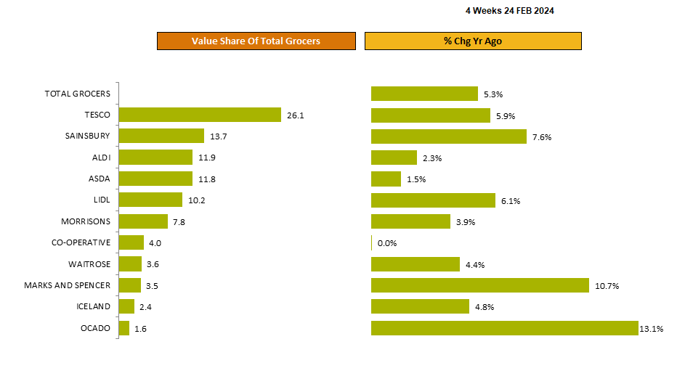
Sainsbury’s grew ahead of Aldi and Lidl.
Retailer Share of Trade and Growth
4w/e 24th February 2024 vs last year
Source: NIQ Total Till (Value Share of Trade)

Slide 34
1
Sales momentum continues to slow at the Discounters with Lidl (+6.1%) ahead of Aldi (+2.3%). Since the start the year there has been a stall in the growth of new shoppers and falling spend per visit in recent weeks, at these 2 retailers but this is against double digit sales growth in Q1 2023.
5
Fuelled by a boost from new shoppers, Ocado (+13.1%) is the fastest growing retailer at the moment closely followed by M&S (+ 10.7%).
6
Waitrose growth is now stable at +4.4% although frequency of visit is still falling
2
2024, continues to see slowing food inflation and more price matching.
After a 20% boost to sales last year Discounters are now lapping tough comparatives and the retailer performance rankings are changing.
After a challenging end to 2023, Iceland (+4.8%) is now benefiting from a growth in visits but overall, spend per visit is unchanged at just over £20 with their core demographics likely to be more impacted by the continued increases in the overall cost of living.
Sainsbury’s (+7.6%) grew ahead of the Discounters in the last 4 weeks and Tesco (5.9%) is also growing market share. Sainsbury’s continues to attract new shoppers and more visits which underlines the importance of an established multi format strategy (i.e Supermarkets, Convenience, Online), the benefit of Argos at Sainsbury’s and the continued success of the all-encompassing `food first` retail strategy.
With the extension of price cuts and some new ‘More from Morrisons’ offers, Morrisons sales have improved (+3.9%) and there was a jump in spend per visit by almost 10% in the last 4 weeks. The recent launch of an Aldi and Lidl price match (copying Asda and the last of the big 4 supermarket to adopt the strategy) now has the potential to attract new shoppers to Morrisons this Spring.
7
3
4
ASDA (+1.5%) now has the weakest growth across the industry (other than Co-op +0%) and whilst penetration dipped again at ASDA in the last 4 weeks, spend per visit is now stabilising at £28.90 (+4%) and having more large stores, this compares favourably to Morrisons (£24.4). With the rapid roll out of ASDA Express to c. 470 new shops underway, this may dilute spend per visit a little in the medium term but will be compensated for by more visits and potentially more shoppers over the longer term.
Source: NIQ Total Till 4w/e 27Jan24

Slide 35
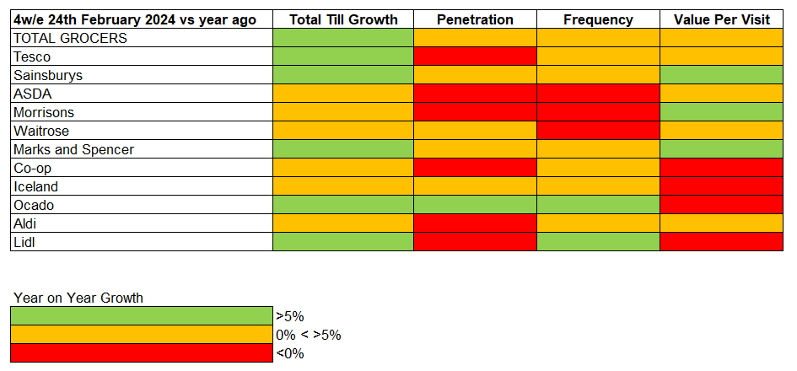
Overall spend is slowing across the industry. With shoppers mindful of how much they are spending ‘occasions’ are proving a catalyst for growth. Retailers with the strongest growth Ocado, M&S and Sainsbury’s each attracted more shoppers and an increasing frequency. Those with the weakest growth Co-op, ASDA and Aldi all lost shoppers.
Year on Year growth in KPI’s (FMCG)
Source: NIQ Homescan FMCG

Slide 36
Against the softest month of the year all retailers saw an uplift in fmcg spend fueled by more visits. On average shoppers spent 5% more on fmcg compared to January. M&S raised the ‘Dine-in’ bar for Valentine’s Day, offering a meal for two for £25, at the other end ASDA’s ‘Dine-in’ experience was on offer at £12.
KPI % Difference vs PRIOR period
4w/e 24th February 2024 vs 27th January 2024
FMCG Growth | +11% | +9% | +7% | +6% | +6% | +6% | +6% | +5% | +4% | +3% | +2%
Source: NIQ Homescan FMCG

Slide 37
With events this February landing in half term, shoppers will have had more time to celebrate and more opportunities to shop. Online was a star performer, helped by the weather but also as technology improves so should the agility of this channel, to capitalise on events. With lingering single digit inflation shoppers continue to spend more to buy less.
FMCG shopper metrics by channel
Latest 4 weeks growth vs LY
Shoppers
Spend (£ per buyer)
Volume (units per buyer)
Trips (transactions per buyer)
Source: NIQ Homescan FMCG 4w/e 24th February 2024

Slide 38
Advertising and Promotions

Slide 39
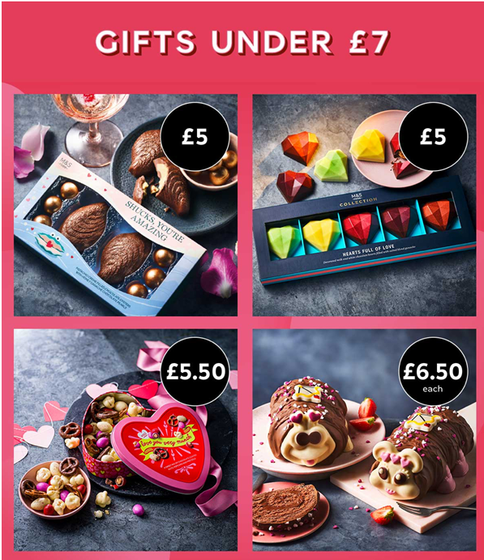
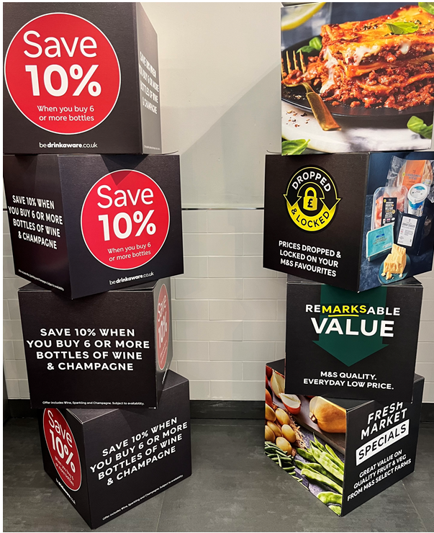
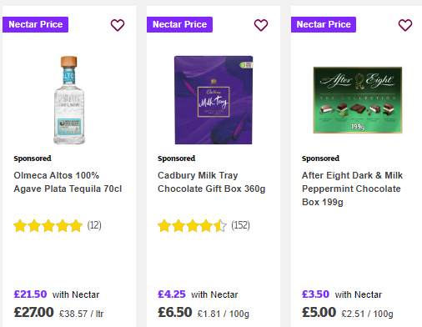
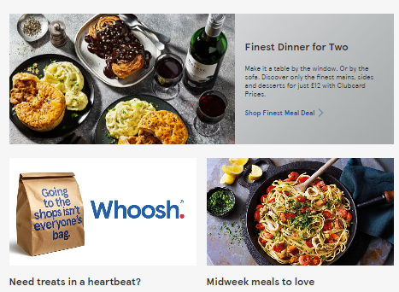
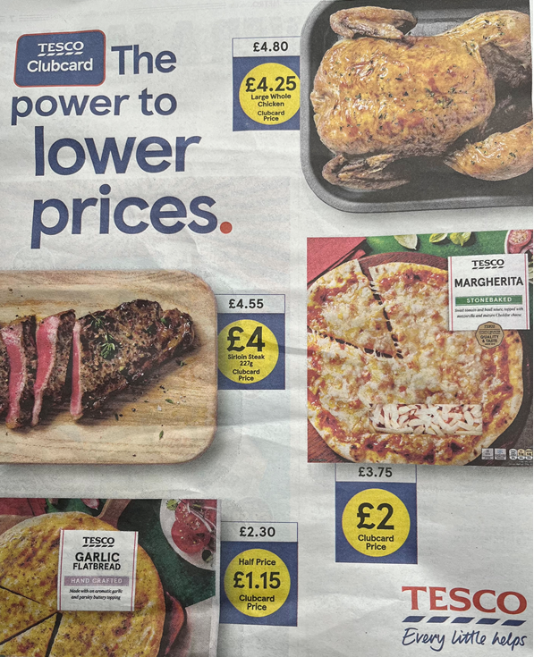
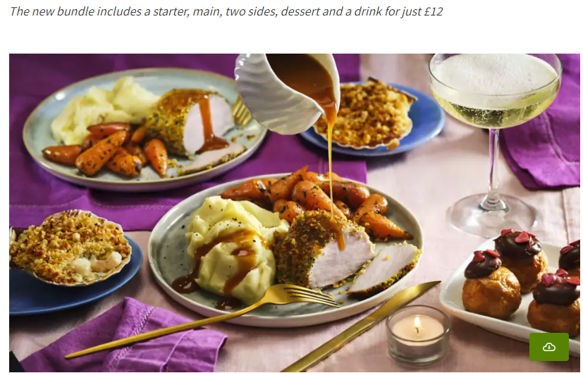
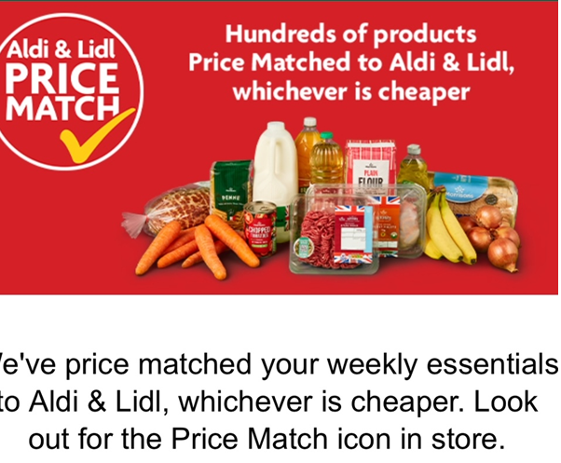
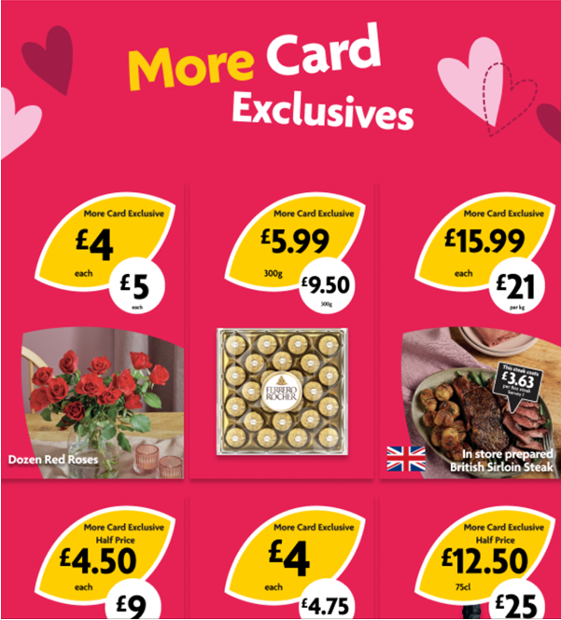
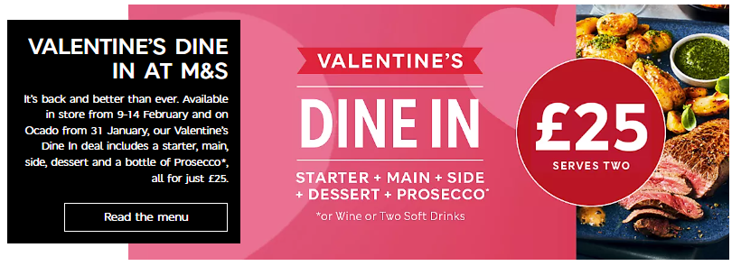
In February Morrisons were the last of the big 4 supermarkets to price match against Aldi (& Lidl). Sainsbury’s and Tesco continue to offer discounts to loyalty card users. Whilst most retailers pushed an array of offers associated with Valentine’s day including ‘dining-in’, gifting, cards & wrap and jewellery, fragrances & cosmetics.
Retailer Messages
Price
Loyalty Drivers
Dining
Source: Retailer Marketing including Digital and Press, Retailer Websites 4w/e 24th February 2024

Slide 40
With all retailers pushing events, promotional spend edged up and is well ahead of last year’s comparatives. This trend is reflected in both Branded and OL spend on offer. BWS had the highest branded promotional participation in February at 44%, whilst 27% of OL Delicatessen sales, which includes Ready Meals, were bought on offer.
% of FMCG value sales bought on offer
4 weekly trend
2023
2024
2022
Source: NIQ Homescan FMCG Multiples (including Discounters)

Slide 41
Spend on offer is high, for this time of year
Promotions are up significantly on last year. The increase in investment does however vary, with the biggest uplifts from Iceland, Sainsbury’s, Co-op, Tesco, ASDA and Lidl.
 | % Value sales bought on offer | +/- pts vs last year
Iceland | 36% | +8%
Ocado | 35% | -6%
Waitrose | 34% | +1%
Co-op | 30% | +4%
Sainsbury’s | 30% | +6%
Morrisons | 30% | +3%
Tesco | 29% | +4%
M&S | 24% | -4%
ASDA | 20% | +4%
Lidl | 11% | +4%
Aldi | 5% | +2%
24%
Multiples* value sales bought on offer (+4% points change v LY)
Source: NIQ Homescan % Value FMCG value sales bought on offer, 4w/e 24th February 2024 vs year ago, Multiples includes the Discounters
*Source: NIQ Scantrack Total Coverage FMCG Average Price per unit 12w/e 30th Dec23 vs 12w/e 1st Jan21

Slide 42
Grocery shopping is becoming fragmented and understanding the ‘full view’ will become increasingly important.
FMCG recovery | Price cutting will continue | Early Easter to boost sales
Against a period of larder ‘de-stocking’ last year, sales are recovering as food inflation slows. | With each of the nation’s big supermarkets now price matching against the Discounters lower prices and price cutting is set to continue. | Promotions will remain high, as suppliers look to re-engage with shoppers and the early Easter will be the next catalyst for spend.
The ‘core’ grocery supercategories are leading the recovery which are now back in positive value and unit growth. Over the course of 2023, Discounter sales increased by 20%, the battle ground in 2024, will be for the big 4 supermarkets to ‘win’ these sales back whilst the Discounters will be raising their game to retain this spend. | Inflation is expected to dip below 5% in the coming months, so prices will remain high and significantly higher than 2 years ago. Retailers will want to pass on cost price savings and improve the competitiveness of their offer. More investment in OL may be the best route to achieve this. | After the ‘wettest’ February on record shoppers will be looking forward to more consistent drier weather in March. A sustained sunnier spell, will bring a boost to shopper confidence* and help to encourage more visits to the High Street. Online, has performed well and will need to sustain this momentum with a strong offer for Mothering Sunday, whilst encouraging shoppers to trade up and forward buy for Easter.
Source: NIQ Scantrack, NIQ Homescan
*GfK

Slide 43
Valentine’s Day 2024

Slide 44
Sales before Valentine’s Day often sees an uptick as consumers look for special treats for their loved ones
14% of HHs were likely to celebrate Valentine’s Day
This year, Valentine’s food and drink saw unit growth of +0.9%, while Valentine's gifting saw unit growth of +1.2% - a positive year for both categories.
Gifts such as flowers, cards and chocolates are often associated with the Valentine's Day occasion.
However, there are opportunities in dining options with consumers typically opting for more luxurious food and drink.
Consumers often celebrate in the On-Trade, where sales on Valentine’s Day this year were 9% higher than on 14 February 2023.*
Or the occasion offers an opportunity for the supermarkets to encourage consumers to premiumise and celebrate at home.
Brands attract shoppers in with event themed products and enticing promotions to celebrate.
Across Valentine’s food and gifting in the 2 weeks of Valentine's
£871m was spent last year
Valentine’s Food/Drink sales:
£726m
Valentine’s Gifting sales:
£174m
£900m spent this year
Source: NIQ Scantrack | Total Coverage inc Discounter Shop Receipt Data | Total Valentine's Food and Gifting (See last slide for definitions) | 2we 17.02.24 vs YA and 2YA, *CGA Daily Drinks Tracker

Slide 45
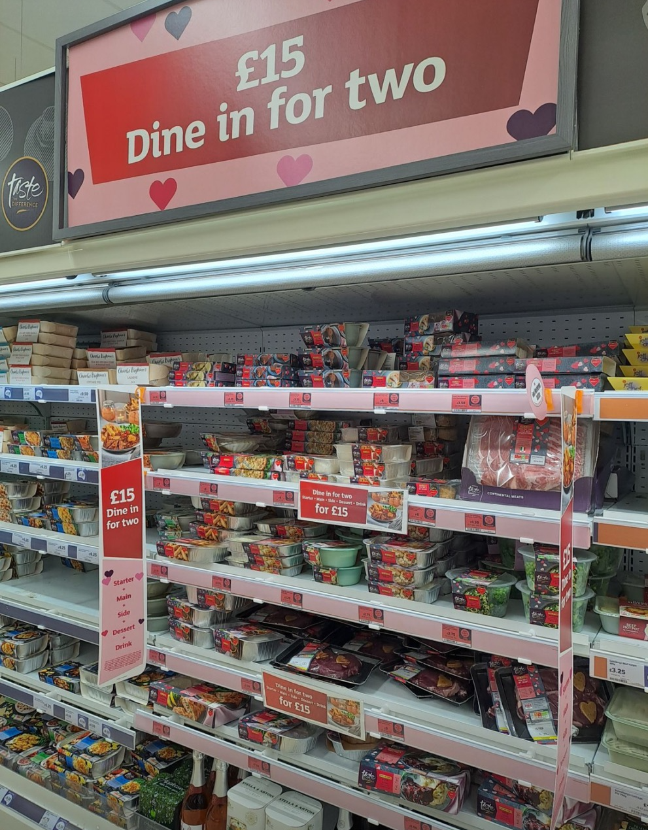
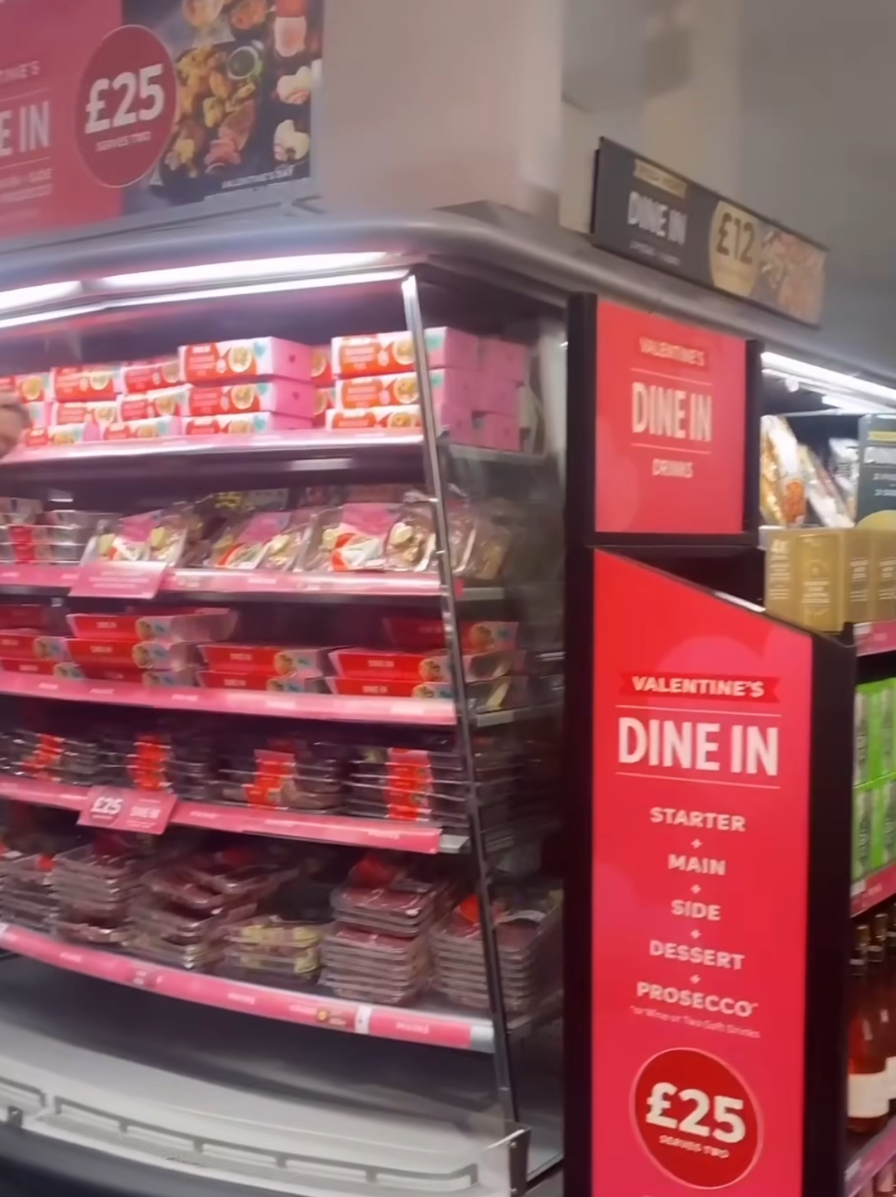
Retailers can capitalise on the event as consumers look to create a special occasion at home
75%
of consumers say they are eating out less due to the COL
Mike Watkins Head of Retailer & Business Insight
Sainsbury’s
Waitrose
M&S
Valentine’s Day is one of the big events of the year.
For retailers, it’s not just about incremental spend and more items in the basket, it’s also a reason for shoppers to choose (a different) retailer for premium food. Which in turn, helps retailer equity and secures repeat visits for the regular, weekly grocery shop.
Source: NIQ Homescan Survey | Q: In the last year, as a result of the cost-of-living crisis, has your household reduced the amount spent on food and drink from cafes, pubs, restaurants, canteens, takeaway shops, etc? | Images from LinkedIn

Slide 46
Higher prices has ensured value growth for this year
BWS
IMPULSE
HEALTH & BEAUTY
£747m sales value
+2.0% % chg YA
+6.3% % price chg
£997m sales value
+7.4% % chg YA
+9.6% % price chg
£541m sales value
+4.8% % chg YA
+5.9% % price chg
Source: NIQ Scantrack | Total Coverage inc Discounter Shop Receipt Data | BWS, Impulse & HBPC Supercategories | 2we 17.02.24 vs YA | value sales, value change, price per unit change

Slide 47
Spend on overall Valentine’s Gifting grew this Valentine’s, primarily due to inflation
Value Share of Valentine’s Gifting | 2we 17.02.24 vs YA
 | Sales Value YA | Sales Value TY | % chg
VALENTINE’S GIFTING | £165,251,411 | £173,724,911 | +5.1%
CUT FLOWERS | £81,625,858 | £85,368,347 | + 4.6%
FRAGRANCES | £14,454,765 | £14,145,911 | - 2.1%
TOILETRIES GIFT PACKS | £3,107,756 | £3,508,496 | +12.9%
BOXED CHOCOLATES | £31,691,993 | £35,132,933 | + 10.9%
GREETING CARDS | £34,371,040 | £35,569,224 | + 3.5%
Inside ring = value share YA Outside ring = value share TY
Despite price increases, consumers did buy more units of flowers (+2.0%), greeting cards (+2.2%) and toiletries gift packs (+20.6%) this year – this shows that some people are still eager to celebrate special occasions!
Not all categories grew in units however, as Fragrances declined significantly (-33.2%) compared to last year.
The categories declining in units, have experienced the highest price rises. Indicating that shoppers are spending mindfully whilst still commemorating the occasion.
Source: NIQ Scantrack | Total Coverage inc Discounter Shop Receipt Data | Valentine’s Gifting | 2we 17.02.24

Slide 48
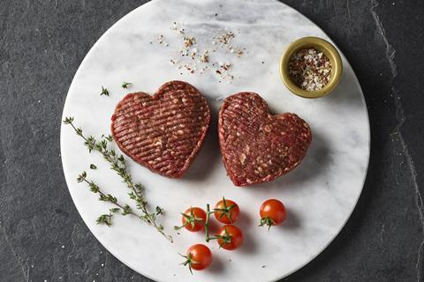
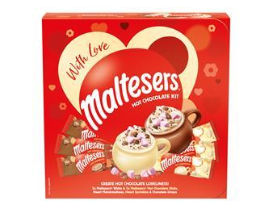
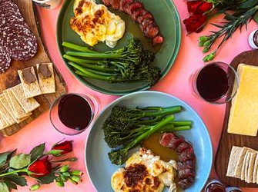
After a weak year in terms of volume last year, shoppers who chose to celebrate at home bought more this year
 | Sales Value YA | Sales Value TY | Value % chg | Unit % chg
SPARKLING WINE | £38,525,058 | £37,854,799 | -1.7% | -0.1%
CHAMPAGNE | £10,400,611 | £9,297,700 | -10.6% | -15.3%
STILL WINE | £251,250,718 | £253,508,403 | +0.9% | -6.0%
MORNING GOODS & SPECIALITY BREADS | £97,795,559 | £104,679,862 | +7.0% | +4.6%
CAKE CHILLED | £20,304,900 | £21,194,035 | +4.4% | +2.9%
CAKE AMBIENT | £78,037,276 | £80,131,228 | +2.7% | -3.0%
FRESH READY MEALS | £126,450,908 | £132,798,190 | +5.0% | +3.4%
FRESH DESSERTS | £47,521,564 | £48,905,966 | +2.9% | +0.8%
TREATED & PREPARED FRESH MEAT PRODUCTS | £18,751,767 | £21,693,915 | +15.7% | +8.4%
FRESH VEG ACCOMPANIMENTS | £16,239,124 | £16,691,327 | +2.8% | +3.2%
Source: NIQ Scantrack | Total Coverage inc Discounter Shop Receipt Data | Valentine’s food and drink | 2we 17.02.24

Slide 49
The fall in fragrances may be as a result of their improved online performance
In personal care, Fragrances have gained 1.2%pts of volume share compared to 2 years ago during the Valentine’s period
Volume Share | Personal Care | 2we 17.02.24
Fragrance’s share during Valentine’s Day has continuously grown in the last two years
During the Valentine’s shopping period…
Pure players, Beauty specialists and Second-hand platforms are over indexing their share of Fragrance sales against their annual average
Source: FoxIntelligence | 2we 17.02.24 vs 2we 17.02.23 vs 2we 17.02.22

Slide 50
Implications for Valentine’s Day 2025
Valentine’s products will continue to broaden their appeal with the popularity of ‘Galentines’ and ‘Palentines’ twists on the event, creating more celebration occasions.
Valentine’s Day next year falls on a Friday. This could encourage shoppers to spend more in the On-Trade; however, retailers should still stock a plentiful range of Valentine’s categories to encourage footfall.
Further opportunities will come from the spread of Valentine’s themed goods into other categories such as pet treats and wider food categories.
Next year, Pancake Day will be a couple of weeks after Valentine’s Day (4 March 2025), which will open up more display space for Valentine’s promotions.
Online will continue to play a role in shopping behaviour, particularly in gifting with more specialists and DTC options targeting shoppers.
Unprecedented climate or geopolitical events could continue to impact the market, affecting cost and supply of items.

Slide 51
Definitions
Valentine’s Gifting Categories
Toiletries gift packs
Fragrances
Cut flowers
Boxed & gift chocolates
Greeting cards
Valentine’s Food and Drink Categories
Fresh ready meals
Morning goods & celebratory breads
Fresh desserts
Chilled cake
Ambient cake
Fresh veg accompaniments
Treated & prepared fresh meat
Still wine
Sparkling wine
Champagne
HBPC Valentine's Gifting = Fragrances + Toiletries Gift packs
Valentine’s Day periods used:
VD 2024: 2we 17.02.24
VD 2023: 2we 18.02.23
VD 2022: 2we 19.02.22

Slide 52
Appendix

Slide 53
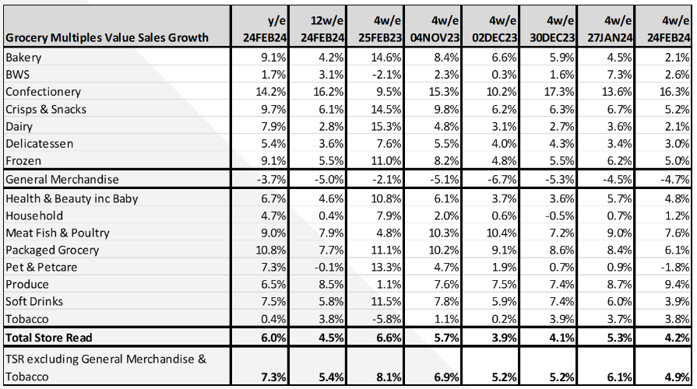
Across the Grocery Multiples, where the outlier is Confectionery due to cost price inflation in commodities, Produce, Meat, Fish & Poultry and Packaged Groceries are the fastest growing super categories and are all core staples.
Value sales growth by supercategory
Source: NIQ Scantrack Grocery Multiples

Slide 54
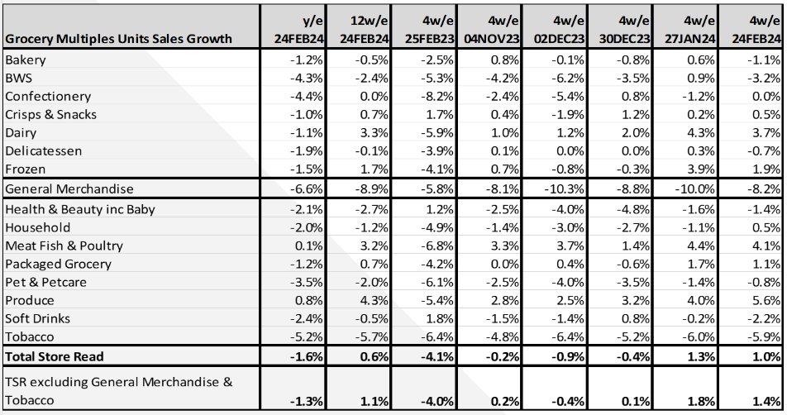
Units remain in positive growth, helped by lower inflation, retailer price cutting and weak comparatives. Last year with inflation at 14.5%*, shoppers destocked their pantries. Against these soft comparatives, recovery is being led by core groceries including Produce, Meat, Fish & Poultry, Dairy, Frozen, and Packaged Grocery.
Unit sales growth by supercategory
Source: NIQ Scantrack Grocery Multiples
*BRC-NIQ SPI

