Slide 1
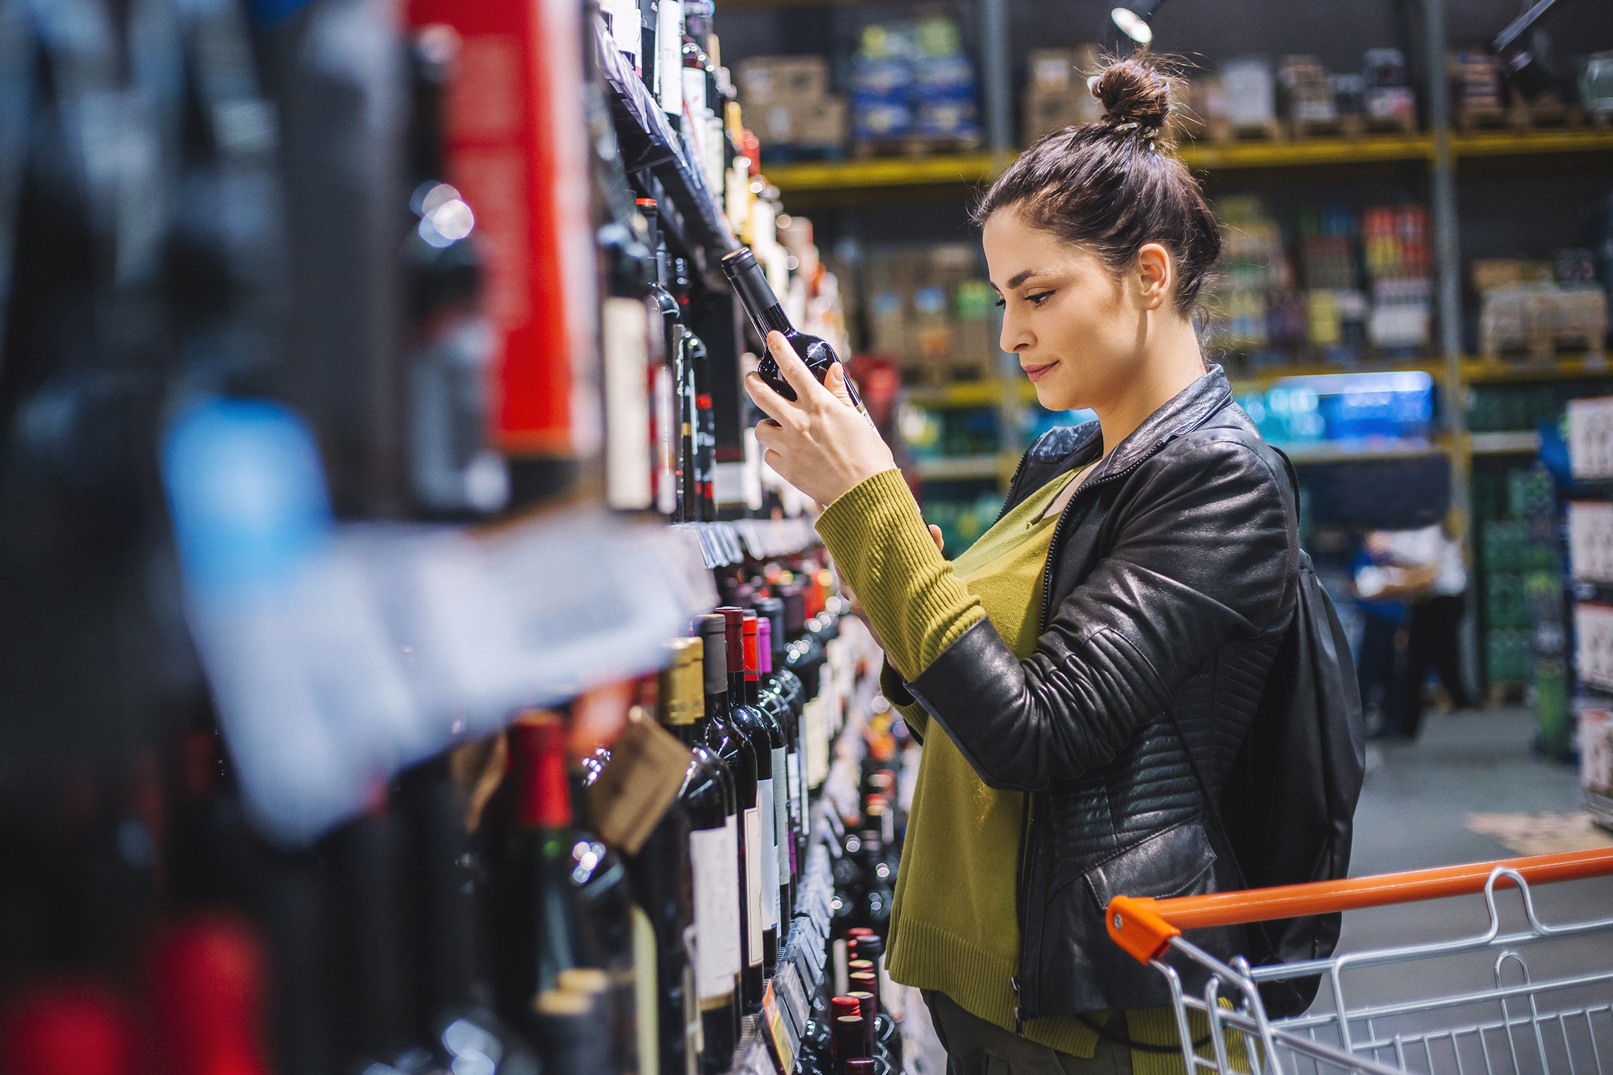
FMCG Essential Retail – What you need to know!
Share of Trade
52 we data to 26.03.22
Share of Total Grocers
Value Change %
Penetration
£ Spend per Visit
2021
2022
2021
2022
% Change
2021
2022
% Change
27.1% | 27.2% | -0.7% | 84.6 | 85.9 | 2.5% | 30.55 | 27.03 | -11.5%
13.9% | 13.8% | -2.5% | 65.5 | 66.8 | 3.0% | 29.19 | 25.31 | -13.3%
12.4% | 12.1% | -4.0% | 67.9 | 69.1 | 2.7% | 32.35 | 27.87 | -13.8%
10.1% | 10.9% | 5.9% | 63.0 | 66.4 | 6.3% | 27.35 | 24.27 | -11.3%
9.8% | 9.3% | -5.8% | 60.2 | 62.3 | 4.4% | 30.27 | 26.03 | -14.0%
6.9% | 7.7% | 9.7% | 56.1 | 59.3 | 6.6% | 23.07 | 21.21 | -8.1%
4.7% | 4.5% | -6.0% | 51.1 | 49.7 | -2.0% | 10.79 | 9.23 | -14.5%
4.3% | 4.3% | -1.3% | 23.4 | 25.8 | 10.8% | 28.54 | 24.22 | -15.1%
3.2% | 3.5% | 9.4% | 43.4 | 49.2 | 14.4% | 18.97 | 15.53 | -18.1%
2.7% | 2.6% | -4.9% | 49.7 | 50.0 | 1.5% | 21.96 | 20.02 | -8.8%
1.7% | 1.7% | -5.4% | 4.1 | 5.1 | 24.1% | 78.10 | 70.37 | -9.9%
Store Portfolio
Store Numbers as of 26.03.22
Store Numbers
Total
Convenience
Small
Large
Super
Mega
2682 | 1830 | 25 | 281 | 194 | 352
1402 | 814 | 46 | 174 | 143 | 225
588 | 0 | 134 | 86 | 113 | 255
497 | 2 | 10 | 189 | 243 | 53
3719 | 2716 | 823 | 180 | 0 | 0
334 | 23 | 50 | 209 | 44 | 7
1000 | 524 | 300 | 156 | 13 | 7
957 | 77 | 836 | 44 | 0 | 0
23 | 0 | 0 | 0 | 0 | 23
Value Index (52 we 26.03.22)
Life stage
Pre Family
New Family
Maturing Family
Post Family
Older Couple
Older Singles
Established Family
108 | 102 | 101 | 106 | 101 | 101 | 88
87 | 93 | 74 | 95 | 104 | 109 | 109
102 | 133 | 139 | 123 | 101 | 84 | 73
92 | 100 | 81 | 90 | 91 | 117 | 98
104 | 139 | 149 | 118 | 81 | 88 | 77
123 | 81 | 76 | 86 | 102 | 88 | 153
83 | 60 | 38 | 67 | 100 | 127 | 135
118 | 113 | 121 | 107 | 85 | 104 | 74
89 | 58 | 49 | 64 | 89 | 125 | 144
112 | 62 | 123 | 123 | 95 | 88 | 103
104 | 148 | 129 | 59 | 140 | 89 | 66
Source: Nielsen Homescan SOT based on FMCG [New Base], Benchmark Total Grocers% Change Penetration = % Change in actual buyers
Penetration = Change in shoppers

Slide 2
FMCG Essential Retail
Tesco have expanded their free charging points for electric vehicles to 500 locations as usage surge 300% in the past year. Jason Tarry, CEO at Tesco UK and ROI, said: “We’re thrilled to see the rollout of free EV charging at our retail stores gather pace. “The network is helping customers visiting Tesco who need to save time and charge while they shop. “This latest milestone highlights the commitment across the business to our goal of carbon neutrality in the UK by 2035.”
Sainsbury’s has announced it is adding over 350 brand-new World Food products across UK stores which is the biggest investment into its World Food category to date. 50 of the new ranges have been chosen by its colleagues, as the supermarket diversifies its food offering further and builds on the supermarkets work to ensure inclusivity for all customers “no matter their ethnic or religious backgrounds”. “It’s important our customers can buy products that meet their everyday needs and tie in with cultural and religious celebrations, and so we’re pleased to announce this expansion of and investment in our World Food range,” Sainsbury’s food commercial director Rhian Bartlett said.
ASDA has confirmed the extension of its new loyalty app trail to 48 stores across the UK- with three in Central Scotland. The expansion means that shoppers based in parts of Edinburgh will now be able to take advantage of the supermarket’s first ever loyalty scheme. It is the first ever time the supermarket has launched a loyalty scheme for its customers, and it follows in the footsteps of Tesco and their popular Clubcard membership. Since its launch, the supermarket has said that more than 90,000 customers have downloaded the app and 50,000 are using it on a regular basis.
Morrisons has announced a new incentive to shoppers facing soaring petrol prices. Until Sunday 27 February, customers will get a coupon entitling them to 7p off a litre of fuel when they spend £40 in one of its stores. The coupon can be redeemed until Sunday 6 March at any Morrisons petrol station, although it excludes some items including fuel, tobacco, and lottery products. It comes as petrol prices surged to a record high this week with predictions of further rises in coming weeks.
Source: NielsenIQ Homescan, Grocer & Nam News

Slide 3
FMCG Essential Retail
Waitrose is partnering with Dairy company Muller in the UK on a trail to scrap clue, green and ref caps used on milk bottles, replacing them with clear caps. The move could boost the availability of recycled high- density polyethylene (rHDPE) on the market by 1560 tonnes a year. Unlike fully recyclable plastic milk- bottles, coloured milk caps cannot be recycled back into food- grade packaging. Introducing clear caps enables retention of the material for reuse within the food sector. The trial is set to place over the course of April.
Aldi is launching a hot cross bun gin liqueur to get you in the mood for Easter. The discount supermarket is set to release the limited-edition Infusionist Hot Cross Bun Gin Liqueur that is flavoured with notes of caramel, raisins, and spice. The sweet tipple will be available to buy in stores and online just in time for Easter celebrations from March 31. With an ABV (alcohol by volume) of 20%, the hot cross bun booze will be priced at £8.99 for a 75cl bottle when it goes on sale. It can be enjoyed neat, over ice or mixed with ginger ale and a slice of fresh orange for a zesty twist.
Lidl has contacted the UK government to offer jobs to newly arrived Ukrainians, as it prepares to open a regional distribution centre in Luton, creating 1,200 jobs. Great Britain CEO Ryan McDonnell said: “We have thousands of live job vacancies and so we are in contact with Government to understand how we can help individuals coming from Ukraine with employment opportunities”. The company has donated €10 million (£8.6 million) in food and hygiene products to countries bordering Ukraine to support refugees displaced by the Russian invasion.
Source: NielsenIQ Homescan, Grocer & Nam News

Slide 4
FMCG Essential Retail
Iceland has announced that it will soon a release Bake Your Own Cookies kits from Greggs, and shoppers have been quick to share their excitement. Iceland will be selling Triple Chocolate and Milk Chocolate 'bake from frozen' dough, meaning customers can enjoy Greggs cookies straight from their own oven. According to the product descriptions, consumers can enjoy "soft, crumbly cookies full of delicious milk chocolate chunks" for the milk chocolate cookies and "soft and delicious chocolate cookies with tempting dark and white chocolate chunks" with the triple chocolate variety. News which has been met with a great response from fans online.
Coop has announced they have improved food waste while optimising sell-through and margins, through the implementation of WasteInsight, a dynamic markdown solution from Retail Insight. With sustainability continuing to rise up the retail agenda, the symbol group retailer implemented WasteInsight, to enable its stores to calculate a product’s optimal discount price and timing of the markdown to reduce waste while maximising sell-through and minimising loss. By standardising and automating markdown processes, Co-op was provided with more visibility into the effects of their decisions, allowing them to analyse and understand the projected impact of those markdowns. “The new markdown process is far more transparent and proactive than it was before. Retail Insight’s solution enables us to steer our markdown strategy toward a more optimised way of working, with clear goals and improved visibility into outcomes,” Southern Co-op head of commercial operations Charles Duthie said.
Ocado has launched a new range of healthy and easy recipes inspired by Disney. The range features food inspired by much-loved characters including Moana, 101 Dalmatians, Lion King and Cars. The recipes range from £7 to £8 per meal, which serves four people working out at less than £2 per serving. Giovanna Fletcher, who is working with Ocado to launch the meals, said: “As a Mum of three I know how challenging it can be to cook with the kids, and especially encouraging them to try new, healthy foods – whether it’s fighting fussy eating habits, or simply finding the time.
Source: NielsenIQ Homescan, Grocer & Nam News

