Slide 1
Easter Review 2021
May 2021

Slide 2
Agenda
1
FMCG & Retailer performance
2
Category performance
3
Spotlight on Chocolate
4
Spotlight on Hot Cross Buns
Dates analysed: 2021 4w/e 03.04.21, 2020 4w/e 11.04.20, 2019 4w/e 20.04.19 unless otherwise stated

Slide 3
Summary
Growth vs 2020
Retailer Trends
Total store was up +3.7% this Easter vs last, driven by non food as shoppers prepared for soially distanced gatherings with friends and family
The discounters won from a retailer perspective, with Online nearly doubling share vs 2019
Easter products drive bigger baskets
Easter Chocolate
Hot Cross Buns
Grew at +41% in the 4 weeks to Easter, driven by higher average spend per trip. Easter Eggs availability issues in the final week have halted the growth for most manufacturers.
Hot Cross Buns are a traditional product with traditional shoppers. Look to accelerate 2022 by targeting younger shoppers with more innovation.
Dates analysed: 2021 4w/e 03.04.21, 2020 4w/e 11.04.20, 2019 4w/e 20.04.19 unless otherwise stated

Slide 4
A bumper Easter in the home despite lapping March 2020 stockpiling
31%
of GB HHs bought extra or special items for Easter 2020
£14.5b
+3.7% vs Easter 2020
+11.8% vs Easter 2019
Source: NielsenIQ Scantrack, Total Store Read, Total Coverage including Discounters, data 4w/e 3rd April 2021

Slide 5
However, without Non Food performance is flat at +0.6%
Super Category Performance (£m) Total Store – Total Coverage inc Discounters – Value Chg – Easter 2021 vs 2020
Source: NielsenIQ Scantrack, Total Store Read, Total Coverage including Discounters, data 4w/e 3rd April 2021

Slide 6
Trend of fewer, bigger baskets continues at a topline level
Trips per buyer
Spend per trip
Units per trip
2021
16.7
£20.37
12.7
2020
17.0
£20.24
12.7
-7.9%
+21.5%
+17.4%
2019
18.1
£16.76
10.8
Source: NielsenIQ Homescan, FMCG, Total GB, data 4w/e 3rd April 2021

Slide 7
Branded underperforms after strong 2020, share remains higher than 2019
Branded vs PL Performance FMCG – Value % Chg and Share – Total GB
Branded Value % Purchased On Promotion FMCG – Total GB
Branded share:
2019
2020
2021
46.8%
48.8%
48.0%
Source: NielsenIQ Homescan, FMCG, Total GB, data 4w/e 3rd April 2021

Slide 8
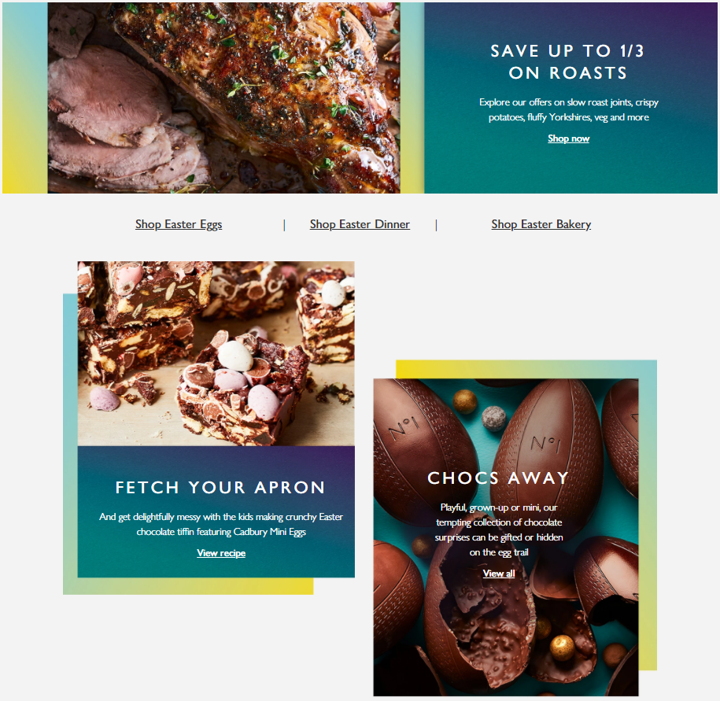
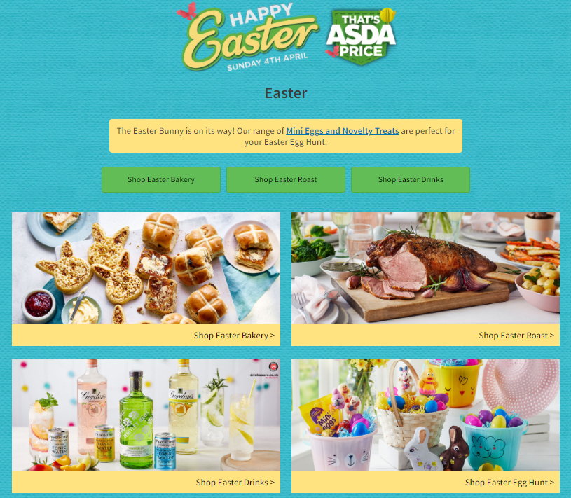
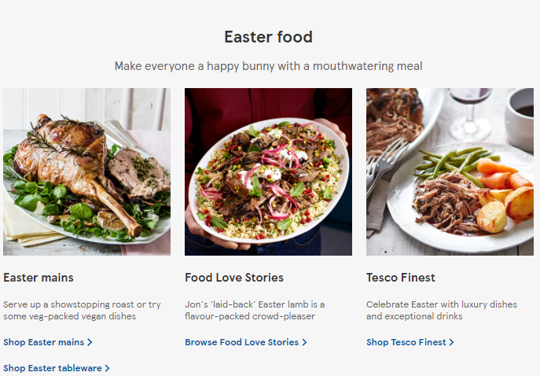
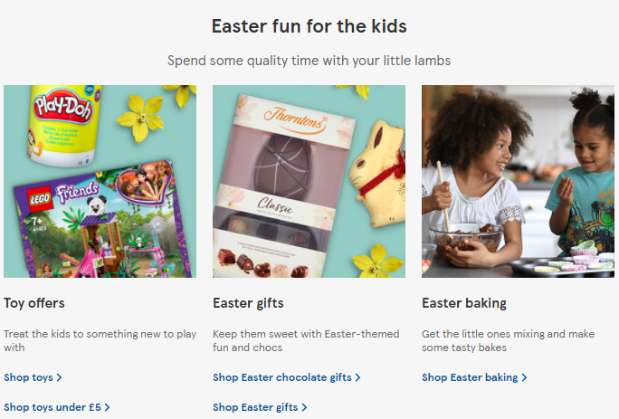
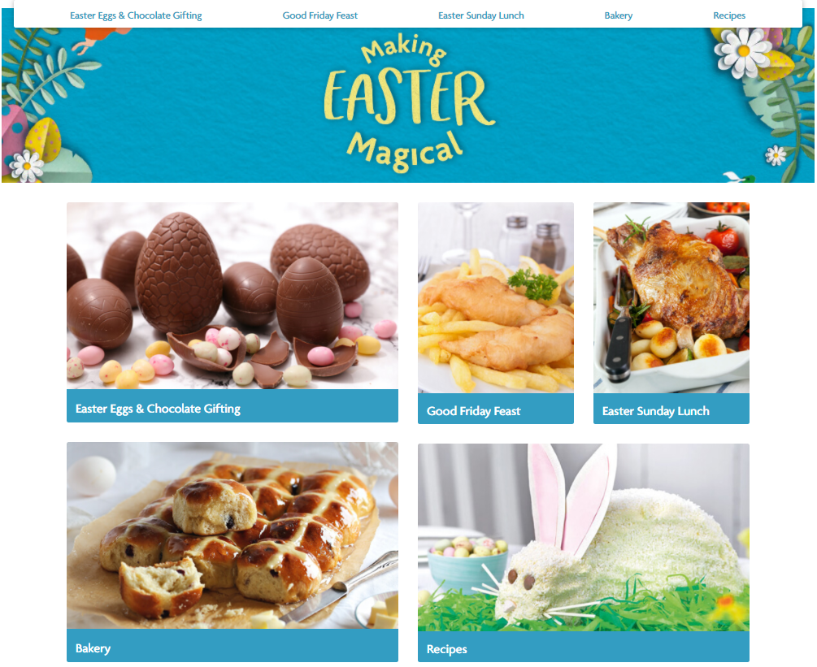
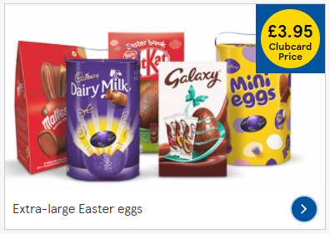
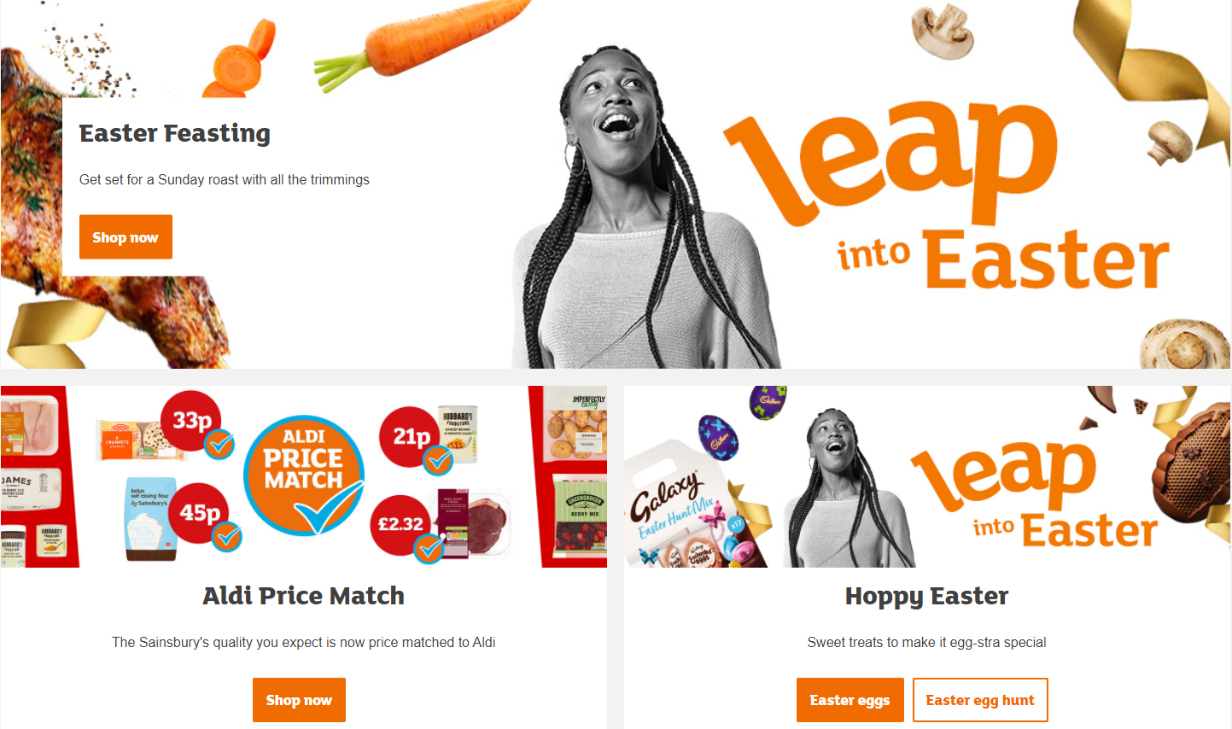
Retailers focused on traditional Easter products and comms on price

Slide 9
Discounters regained momentum after a disappointing 2020, whilst Co-op share back to ‘normal’
Retailer Share of Trade (£) FMCG – Total GB – Easter 2021 vs 2020 & 2019
Source: NielsenIQ Homescan, FMCG, Total GB, data 4w/e 3rd April 2021

Slide 10
Households shopping in fewer retailers (shown by HHs decline for Tesco, Sainsbury’s, Waitrose, Iceland) cause overall trips to decrease
Retailer Drivers of Value Change FMCG – Total GB – Easter 2021 vs 2020
Households shopping within each retailer visit more often
Source: NielsenIQ Homescan, FMCG, Total GB, data 4w/e 3rd April 2021
For data looking at Easter 21 vs 19, see appendix

Slide 11
Online share of trade almost double that of 2019
Online Share of Trade (£) FMCG – Total GB – Easter 2021 vs 2020 & 2019
Penetration
Trips per buyer
Spend per trip
30.8%
+32%
2.7
+27%
£60
-5%
2021
23.3%
+35%
2.1
-4%
£63
+6%
2020
2019
17.3%
2.2
£60
Source: NielsenIQ Homescan, FMCG, Total GB, data 4w/e 3rd April 2021

Slide 12
Online reaches new shoppers with most retailers capitalising
Older demographics see highest share and penetration increases
All retailers but Asda and Ocado gain share of online
Retailer Share (£) of Online – Total Online – FMCG – Easter 2021 vs Easter 2020
30.4% shoppers aged 65+ bought online Easter 2021 (+18.7pts vs 2019) accounting for 29% value (+13pts vs 2019)
But New and Maturing Families still over-index spending online
New: 18% SOT 124 idx
Maturing: 17% SOT 118 idx
Source: NielsenIQ Homescan, FMCG, Total GB, data 4w/e 3rd April 2021

Slide 13
Category performance

Slide 14
General Merchandise categories are winners
Top 20 growing categories Sales >£2m – Total Coverage inc Discounters – Value % Chg – Easter 2021 vs Easter 2020
As shoppers prepared for socially distant gatherings with friends and family, this translated into strong growth for Clothing, Party Accessories and Homeware
Driven by
Party Accessories
Source: NielsenIQ Scantrack, Total Coverage including Discounters, data 4w/e 3rd April 2021

Slide 15
At super category level, BWS had another strong Easter driven by units per trip, as did Fresh & Chilled
Category Drivers of Value Change FMCG – Total GB – Easter 2021 vs 2020
-0.3%
3.5%
-2.7%
6.5%
-4.9%
-13.6%
-9.9%
-5.8%
5.1%
Source: NielsenIQ Homescan, FMCG, Total GB, data 4w/e 3rd April 2021
For data looking at Easter 21 vs 19, see appendix

Slide 16
Strongest growth and early purchasing seen for Easter Chocolates
Easter Choc Confectionery Total Coverage inc Discounters – Value Sales – Weekly build up to Easter
Hot Cross Buns Total Coverage inc Discounters – Value Sales – Weekly build up to Easter
Fresh Lamb Total Coverage inc Discounters – Value Sales – Weekly build up to Easter
+41% vs Easter 2020
+13% vs Easter 2019
+27% vs Easter 2020
+8% vs Easter 2019
+16% vs Easter 2020
+13% vs Easter 2019
Source: NielsenIQ Scantrack, Total Coverage including Discounters, data 4w/e 3rd April 2021

Slide 17
Baskets containing Easter products are bigger than average
Shopper spend per trip on total FMCG when these items are in the basket, and index vs average FMCG basket:
Easter Chocolate
Sweet Buns (Hot Cross Buns make up majority of this)
Fresh Lamb
£38.69
190
£38.57
189
£56.17
276
Source: NielsenIQ Homescan, FMCG, Total GB, data 4w/e 3rd April 2021

Slide 18
Spotlight on Chocolate

Slide 19
Easter Chocolate Growth is driven by higher spend per trip, yet most sales and gains come through the final 4 weeks of Easter
Total GB | Easter Chocolate – Easter ‘21 vs ‘20
Total Coverage inc. Discounters – Value Sales – Weekly Easter period breakdown
72.2%
+2.5%
Penetration
Spend per trip
£4.14
+10.5%
Units per trip
2.6
+8.1%
Frequency
4.1
+2.4%
Early season = 1st 5 wks of yr, Easter Season = last 4 wks of Easter,
Mid Weeks= Mothers day and Valentines day
Source: NielsenIQ Homescan, Total GB, data 14w/e 3rd April 2021; Total Coverage incl Discounters 14w.e. 3rd April 2021 vs 15 w.e. 11th April 2020

Slide 20
Despite Online growing its importance, Discounters continue to see share gains in Easter Chocolate
Slightly less shoppers bought In-store vs Easter ‘20
as Online surpasses 10% of value share
All retailers saw growth except Bargains Stores;
Lidl saw the largest Household increase
Easter Chocolate – Easter ‘21 vs ‘20
Online
In-store
Value % Share
89.6%
-3.5%
10.4%
+3.5%
% Contribution to growth
68.8%
31.2%
HH Change
-0.4%
+55.6%
Source: NielsenIQ Homescan, 14w.e. 3rd April 2021 vs 15 w.e. 11th April 2020

Slide 21
After Easter ‘20 lockdown, Older Shoppers regain their share; Families are ahead of Easter ‘19 and over-index on spend
Total GB - Easter Choc – Family Stage
Avg £ per HH
Vs YA Vs 2YA
£16
+21%
+4%
£15
+9%
+1%
£20
+11%
+12%
£13
+21%
+4%
Source: NielsenIQ Homescan, 14w.e. 3rd April 2021 vs 15 w.e. 11th April 2020

Slide 22
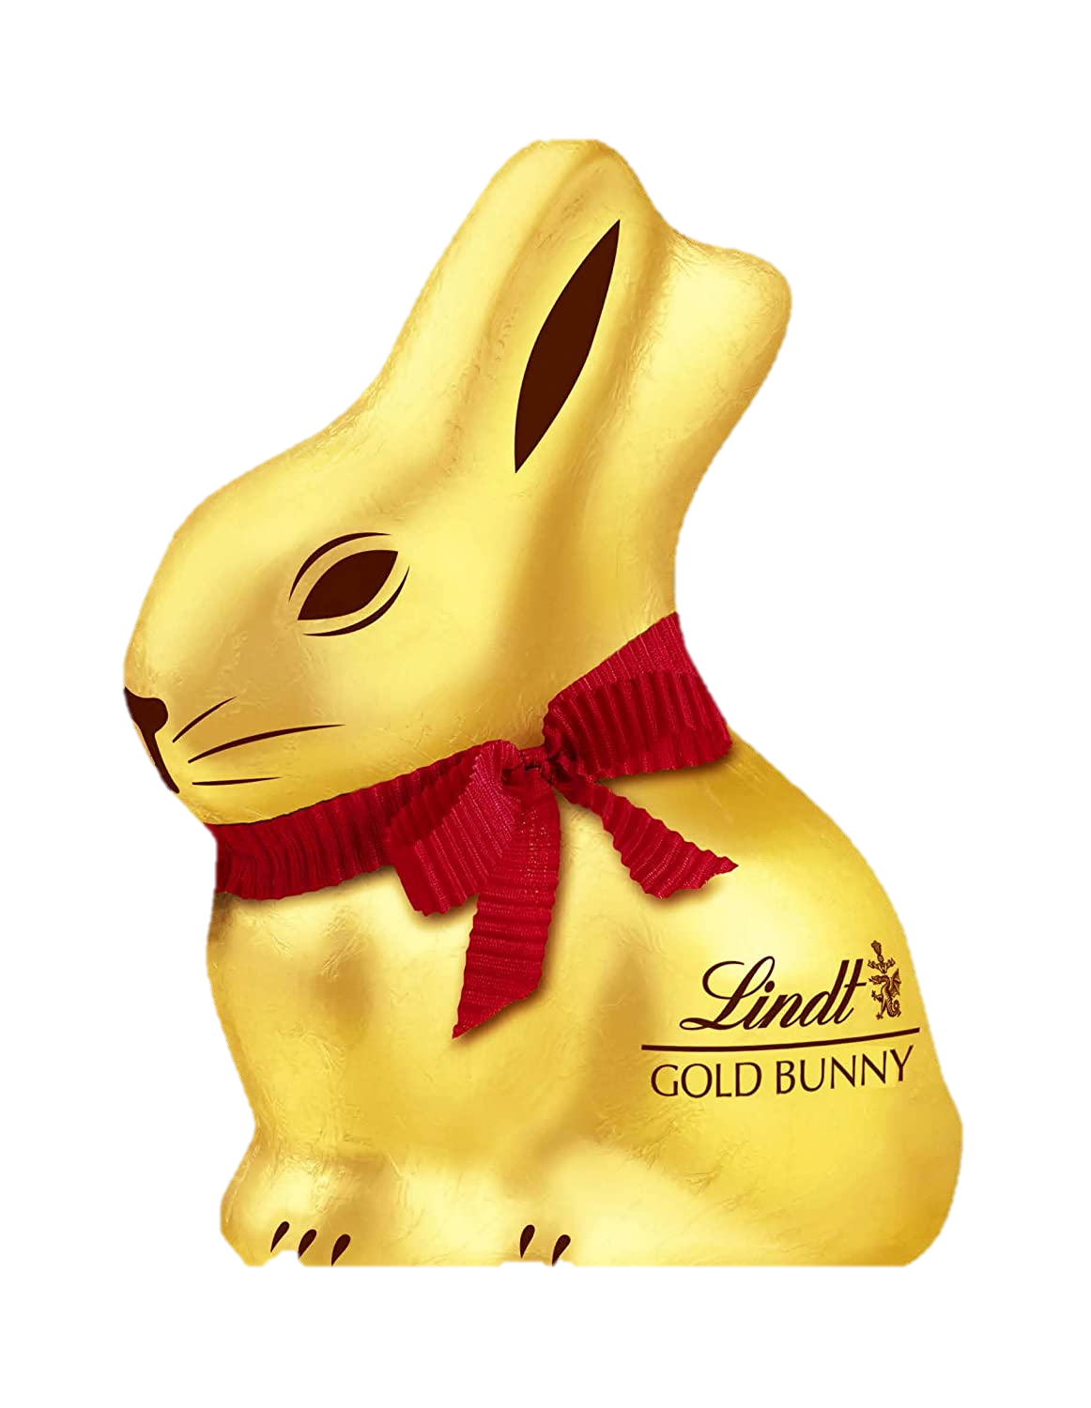
Lindt were the clear winners of Easter ‘21
Mondelez saw the steepest share losses;
Lindt & Nestle grew ahead and gained share
ROS is the main driver behind Easter growth;
Lindt outperformed in promotional gains
Manufacturers – Total Coverage – Value Share Pts Chg – Easter ‘21 vs Easter ‘20
Manufacturers – Grocery Multiples – KPI drivers– Easter ‘21 vs Easter ‘20
-3.9
-0.3
+2.6
+0.5
+0.5
-0.1
Source: NielsenIQ Scantrack, Total Coverage & Grocery Multiples | 14w.e. 3rd April 2021 vs 15 w.e. 11th April 2020

Slide 23
Traditional Eggs command the category and drive the growth; Self-Eat Singles was the only segment to decline
Easter Choc by Format – Grocery Multiples – Value % Share
Easter Choc by Format – Total Coverage
Source: NielsenIQ Scantrack, Grocery Multiples, data 4w/e 3rd April 2021; Total Coverage 14w.e. 3rd April 2021 vs 15 w.e. 11th April 2020

Slide 24
Availability issues this year on the last week of Easter across all manufacturers
Last week of Easter is the most critical of the season concentrating 1/3rd of the sales Easter Choc Grocery Multiples– %Concentration value sales – Weekly build up to Easter
Without this year availability issues, growth could have been higher
Easter Choc – Grocery Multiples – AC Wtd Dist. Pts. & % Chg vs YA – Easter 2021 vs Easter 2020
-4.0%
+1.0%
-7.1%
-17.2%
Source: NielsenIQ Scantrack Grocery Multiples

Slide 25
Biggest challenge for Confectionery in 2022 is HFSS, but with mitigating action it can be a growth Season
+4.2% available
Easter 2022 vs YA % value change
Headwinds
No multi-buys and no GE/FOS
Tailwinds
Rehome promos/ availability and signpost Seasonal aisle +£15m
Close 2021 availability issue +£12m
Implement HFSS in line with timing of rules: last 2 weeks only +£10m
Plan for a longer, stronger Season: category growth +£6m, 2 week longer Season +£2m, post Covid recovery +£11m
Maximum risk
-£38m
(loss of F&D/Display incremental sales for Easter Season)
NielsenIQ IQ Scantrack
Easter Season defined as January- Easter
Total GB Coverage

Slide 26
Spotlight on Hot Cross Buns

Slide 27
HXB regained value and more on 2019 vs 2020 poor performance with Aldi gaining 5ppts of share, while Tesco lost
Total HXB Value Sales (In Store Bakery & Plant)
Total Coverage – 8 Wks to Easter
Retailer Share of Trade (£)
Total GB – Total HXB (In Store Bakery (ISB) & Plant) – Latest 12 Weeks inc. Easter vs YA
+2.7%
Inside ring = Easter 2020
Outside ring = Easter 2021
Source: Nielsen Homescan WE 24.04.21 latest 12 weeks
Source: Nielsen Scantrack WE 03.04.21

Slide 28
Trips back up to levels seen in 2019 and we spent more per trip, bringing more value to HXB
Trips per buyer
Spend per trip
Units per trip
2021
2.63
£1.48
1.38
2020
2.51
£1.40
1.35
2019
2.64
£1.45
1.36
Source: Nielsen Homescan 12 Weeks to 24th April 2021 vs Prior Years Total Hot Cross Buns

Slide 29
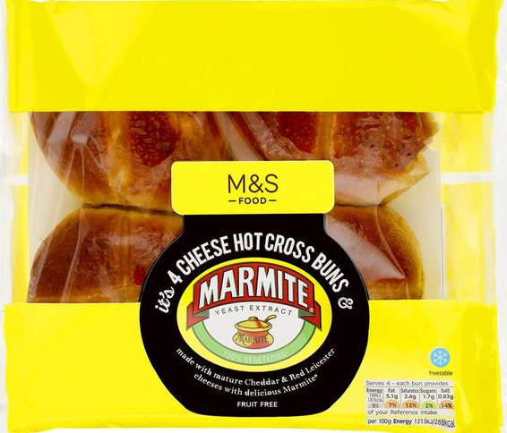
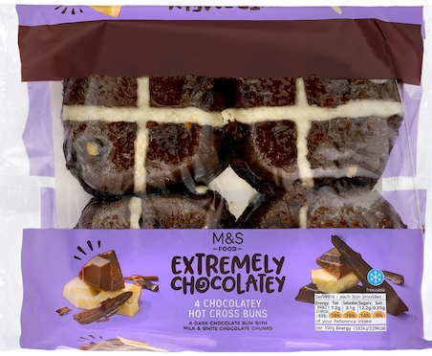
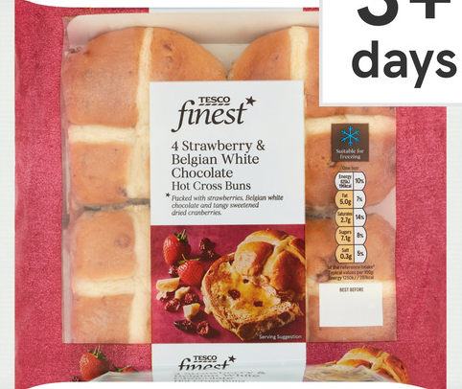
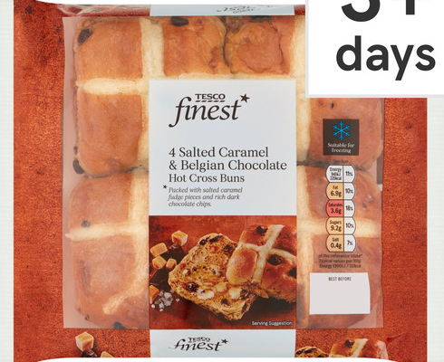
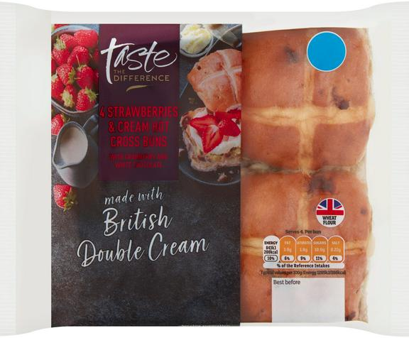
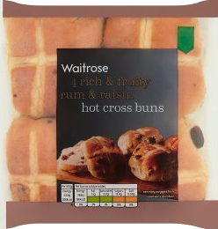
Plant HXB +32% YOY in Grocery Mults, driven by indulgent and different flavours (+£2.7m) vs Traditional (+£2.2m)
Indulgent/savoury flavours gain share
New and interesting flavours are the focus for NPD
Google searches for HXB recipes peaks in 2020
Plant HXB by Flavour – Grocery Multiples – Value Share – Easter 2021 vs Easter 2020
“Hot Cross Bun Recipe” – United Kingdom – Google Searches
Inside ring = Easter 2020
Outside ring = Easter 2021
100 = peak search volume
Source: Nielsen Scantrack, Grocery Multiples, data 4w/e 3rd April 2021, and Google Trends

Slide 30
Recruiting Northern families could be key to growth in future years
HXB more of a Southern delicacy though growth came from the North
Older Couples and Singles biggest groups for HXB
Total HXB by Region – Value Share – Total GB
Total HXB by Lifestage – Value Share – Total GB
South +12% vs YA
North +17% vs YA
Source: Nielsen Homescan WE 24.04.21 latest 12 weeks

Slide 31
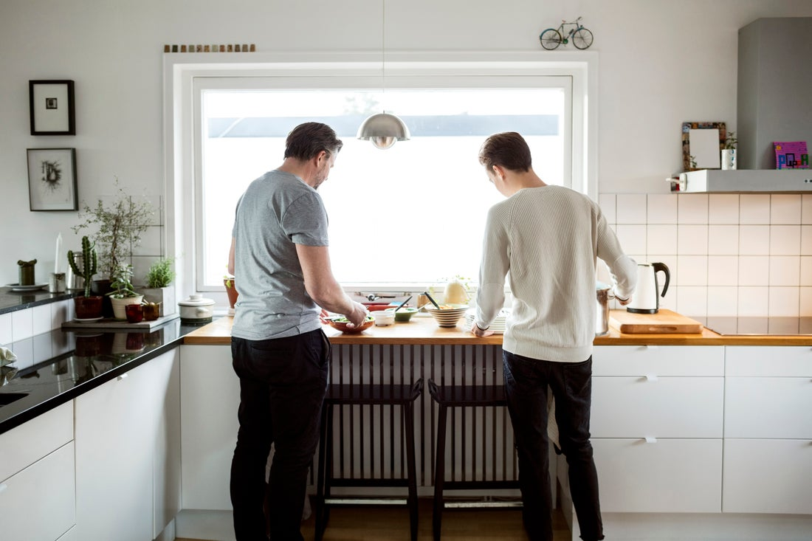
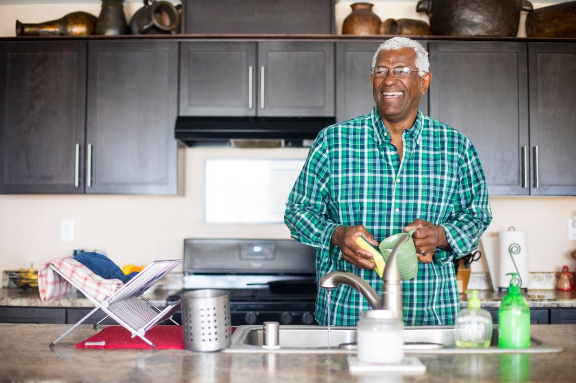
Online doubling importance vs YA as important HXB shopper groups migrate online
Online Grew Share by nearly 100%
Post Families and Older Singles driving online growth
Total HXB by Channel – Total GB – Purchase Value Share – Easter 2021 vs Easter 2020
Total HXB by Channel – Total GB – Purchase Value Chg – Easter 2021 vs Easter 2020
Post Families
161idx
Online Growth
Older Singles
133idx
Online Growth
Inside ring = Easter 2020
Outside ring = Easter 2021
Source: Nielsen Homescan 12 WE 24th April 2021

Slide 32
Hot Cross Buns: opportunities to reach new shoppers and ensure planned purchasing
Growth vs 2019
Excitement Drives Sales
Hot Cross Buns saw good growth this year taking the category ahead of 2019 levels (+2.7%).
New diverse flavours helped to grow the category outside of it’s traditional heart land. This could help excite and recruit new shoppers in the future.
Online
Families to the North
With online sales becoming more important, it is key to understand impulse purchases and how they will be hit. HXB’s will need to become more planned purchase and top of mind during the season.
New shoppers could come from Families & Younger households as the North showed faster growth(+17%), despite HXB’s under indexing there.

Slide 33
Summary
Growth vs 2020
Retailer Trends
Total store was up +3.7% this Easter vs last, driven by non food as shoppers prepared for soially distanced gatherings with friends and family
The discounters won from a retailer perspective, with Online nearly doubling share vs 2019
Easter products drive bigger baskets
Easter Chocolate
Hot Cross Buns
Grew at +41% in the 4 weeks to Easter, driven by higher average spend per trip. Easter Eggs availability issues in the final week have halted the growth for most manufacturers.
Hot Cross Buns are a traditional product with traditional shoppers. Look to accelerate 2022 by targeting younger shoppers with more innovation.
Dates analysed: 2021 4w/e 03.04.21, 2020 4w/e 11.04.20, 2019 4w/e 20.04.19 unless otherwise stated

Slide 34
Please contact your NielsenIQ representative if you have any questions

Slide 35
Appendix

Slide 36
Southern regions see highest growth – potentially driven by differing covid restrictions in Scotland and nice weather
-3.7%
Central & North Scotland
+1.5%
North East
-0.7%
Lancashire & Borders
-1.3%
Yorkshire
+3.0%
Central
-0.4%
East of England
+0.1%
Wales & West
-3.1%
London
+5.3%
South West
+2.4%
South & South East
Source: NielsenIQ Homescan, FMCG, Value % Chg, Total GB, Easter 2021 vs Easter 2020, data 4w/e 3rd April 2021

Slide 37
Compared with Easter 2019, most retailers see growth in units per trip
Retailer Drivers of Value Change FMCG – Total GB – Easter 2021 vs 2019

Slide 38
All super categories but Toiletries in growth vs 2019, driven by units per trip
Category Drivers of Value Change FMCG – Total GB – Easter 2021 vs 2019
13.9%
12.2%
13.5%
31.6%
18.0%
8.7%
-4.7%
5.6%
6.3%

