Slide 1
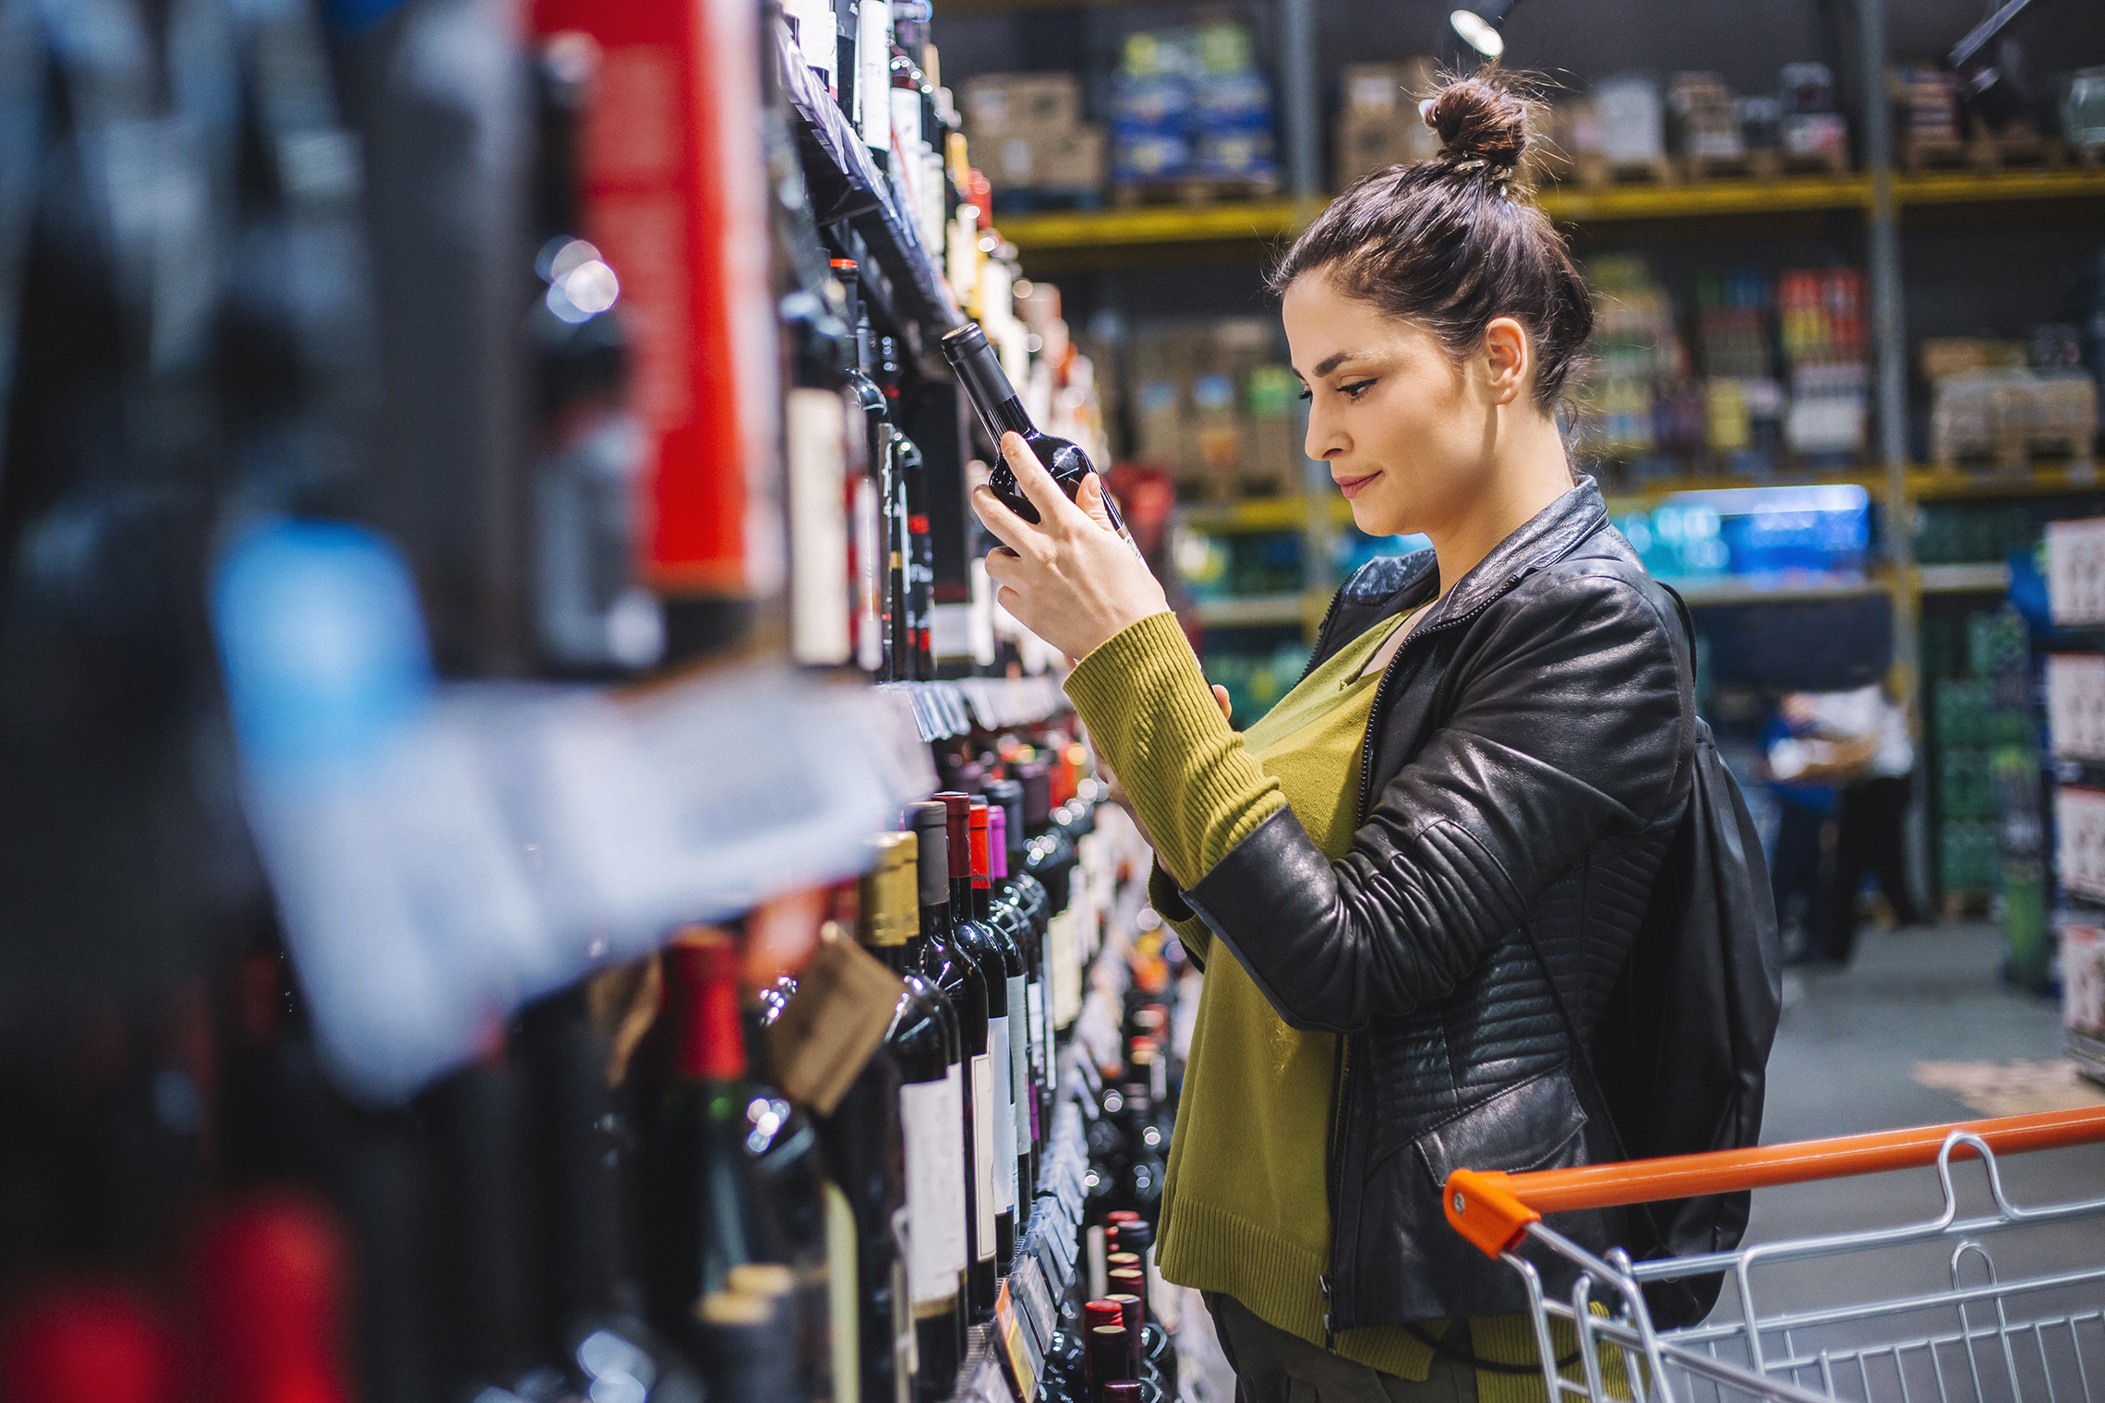
FMCG Essential Retail – What you need to know!
Share of Trade
52 we data to 15.07.23
Share of Total Grocers
Value Change %
Penetration
£ Spend per Visit
2022
2023
2022
2023
% Change
2022
2023
% Change
27.1% | 26.9% | 8.4% | 86.3 | 86.7 | 1.3% | 26.7 | 27.5 | 3.0%
13.6% | 13.6% | 9.0% | 67.7 | 69.7 | 3.7% | 24.9 | 25.3 | 3.1%
11.9% | 12.0% | 9.3% | 69.3 | 70.6 | 2.7% | 27.6 | 28.4 | 1.6%
11.1% | 12.1% | 19.1% | 67.3 | 70.2 | 5.3% | 24.5 | 26.2 | 2.8%
9.1% | 8.3% | -0.2% | 63.0 | 62.4 | -0.1% | 25.2 | 23.8 | 6.9%
8.1% | 8.6% | 16.0% | 61.2 | 64.5 | 6.3% | 21.5 | 22.2 | -5.5%
4.5% | 4.4% | 6.9% | 50.6 | 50.2 | 0.0% | 9.1 | 9.3 | 3.5%
4.2% | 3.9% | 0.9% | 26.3 | 27.2 | 4.3% | 23.2 | 21.2 | 3.0%
3.6% | 3.6% | 10.5% | 50.3 | 51.2 | 2.7% | 15.0 | 15.6 | -8.3%
2.6% | 2.6% | 7.8% | 50.9 | 51.9 | 2.9% | 19.7 | 20.2 | 4.1%
1.6% | 1.6% | 5.0% | 5.8 | 6.8 | 19.5% | 69.7 | 72.5 | 2.1%
Store Portfolio
Store Numbers as of 15.07.23
Store Numbers
Total
Convenience
Small
Large
Super
Mega
2753 | 1898 | 24 | 283 | 195 | 353
1401 | 814 | 43 | 172 | 142 | 230
589 | 2 | 134 | 86 | 113 | 254
499 | 4 | 10 | 185 | 245 | 55
3656 | 2663 | 819 | 174 | 0 | 0
331 | 22 | 50 | 207 | 44 | 7
1005 | 539 | 293 | 151 | 14 | 8
951 | 77 | 826 | 48 | 0 | 0
26 | 0 | 0 | 0 | 0 | 26
Value Index
52 we 15.07.23
Pre Family
New Family
Maturing Family
Life stage
Post Family
Older Couple
Older Singles
Established Family
114 | 96 | 102 | 100 | 93 | 104 | 94
76 | 94 | 82 | 93 | 99 | 109 | 111
89 | 145 | 137 | 134 | 105 | 83 | 71
80 | 104 | 74 | 93 | 95 | 115 | 105
86 | 137 | 153 | 126 | 85 | 90 | 73
100 | 99 | 76 | 87 | 86 | 88 | 164
122 | 85 | 32 | 69 | 87 | 131 | 120
129 | 116 | 115 | 107 | 88 | 104 | 75
114 | 62 | 48 | 59 | 90 | 119 | 144
72 | 53 | 113 | 115 | 98 | 101 | 102
152 | 90 | 104 | 65 | 127 | 102 | 75
Source: Nielsen Homescan SOT based on FMCG [New Base], Benchmark Total Grocers% Change Penetration = % Change in actual buyers
Penetration = Change in shoppers

Slide 2
FMCG Essential Retail
Tesco is to offer all of its 310,000 UK staff virtual appointments with a private doctor, as the NHS gets put under further pressure. The new scheme aims to give staff and their families access to unlimited GP appointments seven days a week, according to Reuters. It comes at a time where ongoing pressure on the NHS has left people unable to get appointments with their local GPs, due to ever-growing waiting lists.
Sainsbury’s is removing plastic trays from its ‘By Sainsbury’s’ own-brand steak range to save 249 tonnes of plastic per year. The trays will be replaced with a cardboard alternative which uses 70% less plastic. The new packaging, which has previously rolled out across the supermarket’s Taste the Difference and So Organic streaks, will now launch across 10 products in the By Sainsbury’s range and will be available in all stores and online from today. They can be recycled at home by rinsing the cardboard before placing it in a kerbside recycling bin.
ASDA is cutting the price of 226 own-label products to futher support families during the cost-of-living crisis. This comes as the latest Asda Income Tracker shows that 40% of UK households had negative disposable income last month. The price reductions, which are effective from 21 July in stores and online, run alongside the Big 4 grocers summer price lock campaign to freeze prices of 500 branded and own-label products until the end of August.
Morrisons has unveiled its seventh round of price cuts for the year as it looks to support customers through the cost-of-living crisis. From today, shoppers will be able to save up to 15% on over 170 branded and own-branded food essentials and summer favourites. The cuts are locked in price for at least eight weeks and include products such as Warburtons plain bagels, Morrisons’ Cumberland sausages, as well as Peroni Nastro Azzurro and Aperol. Morrisons chief customer and marketing officer Rachel Eyre said: “We’re committed to providing our customers with great quality products at affordable prices and this week we have announced our seventh wave of price cuts during 2023.
Source: NielsenIQ Homescan, Grocer & Nam News

Slide 3
FMCG Essential Retail
Waitrose has teamed up with Uber Eats for a multi-year partnership aiming to deliver groceries in as little as 20 minutes. The partnership has initially launched on the delivery service’s platform in five London stores, including Finchley Road, West Hampstead, Clerkenwell, St Katharine Docks, and Greenwich. It will then roll out to more than 200 shops across the UK by the end of August.
Aldi is set to launch its biggest ever meal donation over the school holidays, which is expected to provide around 1.5 million meals to those in need this summer. All of the German discounter’s 990 UK stores will support local charities and foodbanks during a period of increased demand, by redistributing surplus food via community giving platform Neighbourly. The supermarket has already donated over seven million meals so far this year, and has contributed over 30 million meals in total to local communities since the initiative was introduced in 2019. Aldi shoppers also have the option to donate food to local charities, food banks and community groups via the community donation points in its stores nationwide. Corporate responsibility director at Aldi UK, Liz Fox said: “The school holidays are always an incredibly hard time for households across the country, made even worse by the ongoing cost-of-living crisis.”
Lidl’s has revealed that it will donate 1.8m meals to low-income families across the school summer holidays, to support the fight against holiday hunger in the UK. The food will be distributed through Lidl’s charity network partner Neighbourly and other local organisations and comes against the backdrop of 31% of UK children living in poverty. It will include donations from its stores, as well as customer donations through its ‘Good to Give’ scheme – the supermarket’s ongoing campaign to increase the nutritional variety of meals provided for families in need.
Source: NielsenIQ Homescan, Grocer & Nam News

Slide 4
FMCG Essential Retail
Iceland has revealed that it is cutting the price of 500 grocery essentials in the latest competitive move to support shoppers during the cost-of-living crisis. The price cuts from the frozen food retailer include a 15 pack of Youngs Fish Fingers dropping from £3.50 to £2, Nescafe Coffee 200g from £6.50 to £4.50 and four cans of Heinz spaghetti in tomato sauce from £4 to £3.50, among many other items. It follows a number of supermarkets that have announced wide-ranging price cuts as they pass on falling commodity costs to customers, such as a £26m investment from Morrisons.
Coop and Starship Technologies autonomous grocery delivery service is expanding across more neighbourhoods in Leeds, in collaboration with Leeds City Council. The rollout will see 12,000 households in the Kippax and Swarcliffe areas able to access the convenience retailers groceries, delivered by robots. This follows a successful pilot launched last November, which saw 20,000 residents within the Adel and Tinshill area of Leeds accessing the service. Orders are placed through the Starship food delivery app and can arrive in under an hour, with customers able to watch the robot travel in real-time via an interactive map. Co-op ecommerce director, Chris Conway said: “Co-op stores are well placed in the heart of local communities to provide quick, easy and convenient grocery home deliveries for time-pressed shoppers – whether that is a full shop or, for last-minute top-ups and forgotten items. “We are committed to exploring new and innovative ways to increase access to our products and services, and delighted to be able to roll-out robot deliveries to provide further online flexibility and choice for consumers across Leeds.”
Ocado has launched a world-first trial of a nationwide digital deposit return scheme using financial rewards. Rolling out in partnership with technology company, Polytag, and recycling app Bower today, the system looks to improve the recycling rate of single-use plastic packaging in the UK. The online-grocer has applied QR codes to its own-brand two and four-pint milk bottles with consumers receiving a 20p reward for the first 20,000 that are scanned. The incentive will appear in the Bower app digital wallet, with the app’s GPS technology able to confirm if a consumer claiming the reward is standing within close range of a registered home recycling bin. The printed QR codes also allow brands to see real-time data on the packaging lifecycle of products, including if, when and where packaging is recycled.
Source: NielsenIQ Homescan, Grocer & Nam News

