Slide 1
In Store & On-line Observations New and Re-launched Products February 2019 Suzi Pegg, Market Insight Analyst

Slide 2
New Products
 | Asda | Iceland | M&S | Morrisons | Ocado | Sainsburys | Tesco | Waitrose | Grand Total
Ambient |  |  |  | 6 | 2 |  |  |  | 8
Prepared |  |  |  | 6 | 1 |  |  |  | 7
Sauce |  |  |  |  | 1 |  |  |  | 1
Chilled | 1 |  | 6 | 1 | 4 | 1 |  | 1 | 14
Breaded |  |  |  |  | 2 |  |  |  | 2
Meals | 1 |  | 4 |  |  |  |  | 1 | 6
Natural |  |  |  |  |  | 1 |  |  | 1
Prepared |  |  | 2 | 1 |  |  |  |  | 3
Sauce |  |  |  |  | 2 |  |  |  | 2
Frozen |  | 6 |  | 7 |  |  | 1 |  | 14
Battered |  |  |  | 1 |  |  |  |  | 1
Breaded |  |  |  | 1 |  |  |  |  | 1
Fingers |  | 5 |  | 4 |  |  | 1 |  | 10
Prepared |  | 1 |  | 1 |  |  |  |  | 2
Grand Total | 1 | 6 | 6 | 14 | 6 | 1 | 1 | 1 | 36
Source: Store Visits (21/02/2019)/Retailer Website (20/02/2019)

Slide 3
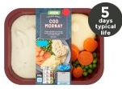
Asda
 | Standard | Grand Total
Chilled | 1 | 1
Meals | 1 | 1
Grand Total | 1 | 1
Chilled (1)
Source: Retailer website (20/02/2019)

Slide 4
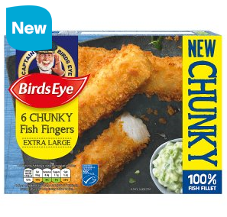
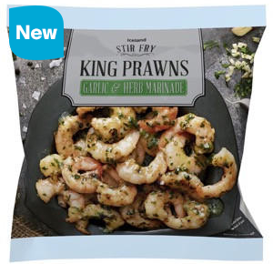
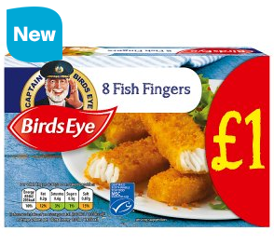
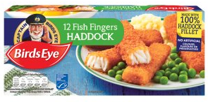
Iceland
 | Birds Eye | Grand Total
Frozen | 6 | 6
Fingers | 5 | 5
Prepared | 1 | 1
Grand Total | 6 | 6
Frozen (6)
Source: Retailer Website (20/02/2019)

Slide 5
M&S
 | Standard | Grand Total
Chilled | 6 | 6
Meals | 4 | 4
Prepared | 2 | 2
Grand Total | 6 | 6
Chilled (6)
Source: In-Store (21/02/2019)

Slide 6
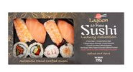
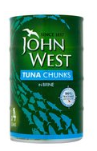
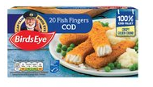
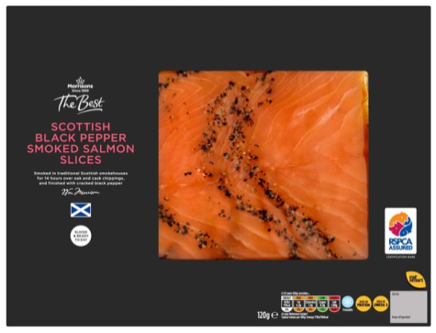
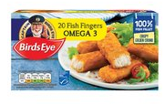
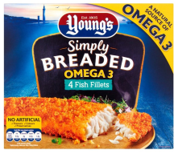
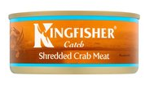
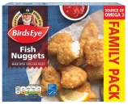
Morrisons
 | Birds Eye | John West | Kingfisher Catch | Lagoon | Standard | The Best | Youngs | Grand Total
Ambient |  | 3 | 2 |  | 1 |  |  | 6
Prepared |  | 3 | 2 |  | 1 |  |  | 6
Chilled |  |  |  |  |  | 1 |  | 1
Prepared |  |  |  |  |  | 1 |  | 1
Frozen | 5 |  |  | 1 |  |  | 1 | 7
Battered | 1 |  |  |  |  |  |  | 1
Breaded |  |  |  |  |  |  | 1 | 1
Fingers | 4 |  |  |  |  |  |  | 4
Prepared |  |  |  | 1 |  |  |  | 1
Grand Total | 5 | 3 | 2 | 1 | 1 | 1 | 1 | 14
Frozen (7)
Chilled (1)
Ambient (6)
Source: Retailer Website (20/02/2019)

Slide 7
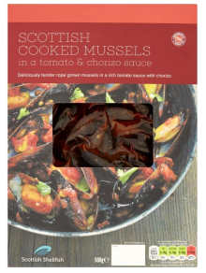
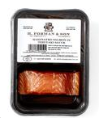
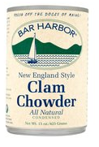
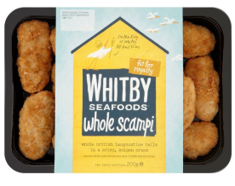
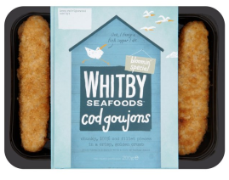
Ocado
 | Bar Harbor | H. Forman & Sons | Standard | Whitby Seafoods | Grand Total
Ambient | 1 |  | 1 |  | 2
Prepared |  |  | 1 |  | 1
Sauce | 1 |  |  |  | 1
Chilled |  | 1 | 1 | 2 | 4
Breaded |  |  |  | 2 | 2
Sauce |  | 1 | 1 |  | 2
Grand Total | 1 | 1 | 2 | 2 | 6
Chilled (4)
Ambient (2)
Source: Retailer Website (20/02/2019)

Slide 8
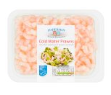
Sainsburys
 | Fishermans | Grand Total
Chilled | 1 | 1
Natural | 1 | 1
Grand Total | 1 | 1
Chilled (1)
Source: Retailer Website (20/02/2019)

Slide 9
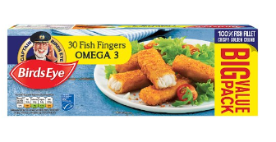
Tesco
 | Birds Eye | Grand Total
Frozen | 1 | 1
Fingers | 1 | 1
Grand Total | 1 | 1
Frozen (1)
Source: Retailer Website (20/02/2019)

Slide 10
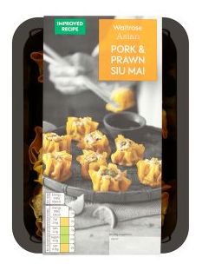
Waitrose
 | Standard | Grand Total
Chilled | 1 | 1
Meals | 1 | 1
Grand Total | 1 | 1
Chilled (1)
Source: Retailer Website (20/02/2019)

