Slide 1
NielsenIQ Total Till Executive Summary
4 weeks ending 10th September 2022
Sally Cowen
Retailer & Business Insights Team
22nd September 2022

Slide 2
Five take outs from Total Till for the 4 weeks to 10th September 2022
1
Growths slow to 2.5% as shoppers return from holidays
ASDA was the fastest growing Grocery Multiple
2
3
Online share looks to be stablising at around 11%
4
Volume growths are down in all supercategories except Soft Drinks
5
Shoppers remain cautious about their own personal finances

Slide 3
Market Overview

Slide 4
Total Till growths have slowed in September
Three column numbered list
1
2
3
With food inflation still accelerating (BRC NielsenIQ Food SPI Aug22 +9.3%), Total Till sales growth slowed in the last 4 weeks as shoppers returned from holidays and reset their spending patterns after the recent hot summer weather.
This time last year we had food price deflation (-0.2%).
In terms of channel performance, visits to store were up +4.8% and continue to normalise with online visits down 5.3%.
Online share of fmcg sales has now fallen to 11.1% from 12.3% a year ago but remains similar to last month and may indicate that we have reached the next sustainable level for online share.
Convenience stores are still trading well with sales +2.2% albeit a little off the peak we saw during the 3 Heatwaves.
Volume sales remain weak across the assortment with Soft Drinks the only category to see growth in September, helped by the final days of the 3rd heatwave.
Pet & Petcare saw robust value growth at +12.7%, indicating some shoppers are less willing to economise where their pets are concerned.
Food inflation continues to lift sales in Dairy +9.3% and Bakery +6.9%.
After last month’s heatwave, value growth slowed for Frozen to +6.8% and Delicatessen to +5.1%.
Source: NielsenIQ Homescan FMCG, NielsenIQ Scantrack

Slide 5
Growths in September were more subdued as shoppers took stock after Britain’s hot summer
Tailwinds
*Instore +4.9%
*Discounters +4.5%
Convenience +2.2%
Grocery Multiples +2.2%
Headwinds
**Value Retailers +0.2%
Supermarkets +1.6%
*Online -7.2%
+2.5%
Total Till
Source: NielsenIQ Scantrack Total Store Read, *Homescan FMCG 4w/e 10th September 22, **Homescan Total FMCG

Slide 6
Without the summer sun to help boost basket spends, shoppers spent less in September
Whilst 4 weekly sales remained robust throughout the long summer, shoppers are reigning in spend at the start of Autumn.
Inflation continues to lift value growths but there is an undercurrent of shoppers managing basket spend by reducing wastage and buying cheaper staples.
Source: *Nielsen Scantrack Total Store Read Total Coverage and Grocery Multiples 4w/e value growth vs prior period

Slide 7
September was a transient month after the Summer holidays
Wk 1:
Last days of 3rd heatwave
Wk 2:
August Bank Holiday
Wk 3:
Getting ready for school
Wk 4:
The end of an era …
After soaring temperatures at the start of the week, mixed weather followed and value sales slowed to £2.5Bn at the Grocery Multiples.
Against soft year ago comparatives value growth was upbeat at +3.2%.
More mixed weather followed as the nation’s youth received their exam results.
The Bank holiday weekend will have encouraged some last minute trips whilst others will have taken extended leave.
Value sales improved on the prior week, indicating some additional purchasing for the weekend.
The final week before school, some shoppers planned last minute breaks boosting sales of Suncare.
Impulse categories continue to report strong growth as demand for ‘food to go’ increased.
As shoppers look to make savings on their weekly groceries Dry Pasta has become a top performer with sales growth this week +27%.
With all kids now back at school, some shoppers booked late summer holidays Bags & Luggage saw growth +28%.
As news of our Queen spread across the nation, sales this week were subdued.
Value sales dipped to their lowest level since the lull after Easter.
The mixed weather also saw a run on umbrellas which saw sales increase 225%.
Source: NielsenIQ Scantrack

Slide 8
A turning point for many as shoppers enjoyed last minute breaks and prepare for the financial headwinds
Grocery Multiples Weekly year on year value growth
July heatwave
3rd heatwave
2021 Hot Spell
2w/e 23Jul21
Source: NielsenIQ Scantrack Total Store Read Grocery Multiples

Slide 9
Food inflation continues to accelerate and is now at a 14 year high
Source: BRC-NielsenIQ Shop Price Index

Slide 10
Fuel prices have continued to fall since the July peak but remain significantly higher than last year
Ultra Low Sulphur Unleaded Fuel
Shoppers are on average still paying £17 more, each time they fill up a 55 litre tank with unleaded fuel.
For shoppers filling up weekly, this will equate to an additional £875 per annum.
Whilst fuel prices are lower than July, they are significantly higher than last year and will be an unwelcome squeeze on household income.
Pence per Litre
% Growth
Source: Government UK

Slide 11
September has been a watershed month after a Summer of festivities and warm weather. More shoppers will start to face up to an Autumn of adjustment, having to make household budgets stretch further with uncertainty ahead.

Slide 12
Shoppers made 22m MORE shopping trips but spent £0.18 LESS per trip, buying 0.9 FEWER fmcg items
Three column numbered list
-1%
-8%
+4%
Spend per visit fell to £18.15 from
£18.30
Items in basket fell to 10.5 from 11.5
Frequency of visit increased to 17.6 trips from 17.0
.
Source: NielsenIQ Homescan GB FMCG 4w/e 10th September 2022 vs 4we 11th September 2021

Slide 13
As we edge into Autumn, shoppers bought more items than last month and shopped more often at the Discounters
 | More Summer Sun 4w/e 13th August 2022 | September watershed 4w/e 10th September 2022
Basket Size | £17.84 -£0.51/-2.8% vs last year and -1.2% vs last month 10.4 items (-9.3% vs last year and -2.9% vs last month) | £18.15 -£0.18/-1.0% vs last year and +1.6% vs last month 10.5 items (-8.0% vs last year and +1.6% vs last month)
Bricks & mortar shopping trips | 503m shopping occasions +7.9%/+37m more than last year and -0.6% less trips v last month | 487m shopping occasions +4.8%/+22m more than last year and -3.3% less trips v last month
Online Penetration | 26% of GB shoppers -4%/0.3m fewer shoppers vs last year -2.2%/-174k fewer shoppers than last month | 26% of GB shoppers -1%/-111k fewer shoppers vs last year -0.4%/-27k fewer shoppers than last month
Growth of the Discounters | 60% of GB shoppers, +7%/+1.2m more v last year +8%/+5m more shopping occasions v last year and -5% fewer trips vs last month. | 60% of GB shoppers, +6%/+1m more v last year +4%/+2.6m more shopping occasions v last year and +1% more trips vs last month.
Source: NielsenIQ Homescan GB FMCG

Slide 14
With holidays disrupting online shopping, share has drifted to a new post lockdown low, however, is expected to regain momentum as we enter the winter months.

Slide 15
Category

Slide 16
Absolute value sales have slowed since August, as shoppers have replaced seasonal food with core packaged grocery
Catgory overview 4w/e 10th September 2022 Value Growth
Supercategory performance 4w/e 10th September 2022 Value Growth
~Health, Beauty, Toiletries & Baby
*Confectionery, Crisps & Snacks, Nuts & Seeds
#Clothing, Entertainment, Electrical, Home, Sports & Leisure, Seasonal, Stationery, Toys
Source: NielsenIQ Scantrack Grocery Multiples

Slide 17
Shoppers reigned in spend in September, focussing instead on core groceries and items that met specific needs
Health & Personal Care
Household/Staples
Convenience
Autumn
Suncare +47%
Gift Packs +34%
Deodorants/Body Spray +22%
Glasses & Lenses +20%
Beauty/Skincare +13%
Anti Smoking +12%
Sports Equipment +11%
Baby Changing +10%
Dry Pasta +29%
Oil +20%
Milk +19%
Oil +16%
Frozen Potato +18%
Dog +15%
Cat +14%
Rice & Grains +13%
Frozen Ready Meals +12%
Eggs +12%
Frozen Poultry +10%
Fresh Poultry +10%
Ice Cubes +23%
Ambient Fruit Juice +22%
Sports & Energy Drinks +20%
Sandwiches +17%
Flavoured Carbonates +16%
Mineral Water +15%
Plasticware +14%
Pot Snacks +12%
Dry Noodles +12%
Chilled Bread +11%
Umbrellas +121%
Luggage +23%
Jewellery +15%
Insect Control +10%
Shoppers spent more on personal products, convenient and staple foods as they returned to work, sporting activities and regular routines.
Source: NielsenIQ Scantrack Grocery Multiples 4w/e 10th September 22 vs year ago

Slide 18
Looking ahead shoppers are expected to adjust their shopping behaviour to help manage overall household spend.

Slide 19
What happened by channel?
-1.8%

Slide 20
Growth slowed across most trade channels at the end of Summer
Total Store Channel growth 4w/e 10th September 2022 vs last year
Source: NielsenIQ Scantrack Total Store Read , *Homescan FMCG, **Homescan Total FMCG
Nb. Supermarkets include Dark Stores and Pick stores

Slide 21
Tougher comparatives continue to challenge YTD growth, whilst store openings help drive momentum at the Discounters
Total Store Channel growth YTD 36 w/e 10th September 2022 vs last year
Source: NielsenIQ Scantrack Total Store Read , *Homescan FMCG, **Homescan Total FMCG
Nb. Supermarkets include Dark Stores and Pick stores

Slide 22
Despite weaker sales in September vs August, shoppers still spent more in the Discounters and Value Retailers
Total Store Channel growth 4w/e 10th September vs Prior period
Vs prior month
Source: NielsenIQ Scantrack Total Store Read, *Homescan FMCG, **Homescan Total FMCG
Nb. Supermarkets include Dark Stores and Pick stores

Slide 23
Online share has stabilised over the last 4 months and is now at its lowest level since post pandemic, growth is anticipated in the colder months
4w/e
Source: NielsenIQ Homescan Online FMCG

Slide 24
End of the heatwave at the start of the period, lifted fmcg sales at Convenience stores
4 week ending (FMCG)
GB Total Coverage FMCG Sales, 4w/e 10th September 2022
+£306m Shoppers spent MORE on groceries than last year
Weekly yoy value growth (FMCG)
-£326m MORE than 4w/e 13th August 2022
*Supermarkets include Online Dark Stores, Depots and Picking stores
Source: NielsenIQ Scantrack (FMCG = Total Store Read excluding General Merchandise, Tobacco and Healthcare
Supermarkets > 3,000sqft
Convenience < 3,000sqft

Slide 25
With back to normality on most agendas, shoppers spent more on dairy, pet and lunchtime refreshments
Incremental Sales 4w/e 10th September 2022 vs prior period
Supermarkets
Convenience
With shoppers returning to work and schools re-opening, shoppers spent more on Food to Go compared to August.
Shoppers also spent more on Dairy and Pet at the Supermarkets, whilst the hotter weather at the start of the period would have stimulated demand for Soft Drinks.
Milk was also the biggest drivers of incremental sales at Convenience stores, compared to prior month. There was also more demand for convenience foods and treats including Sugar Confectionery, Morning Goods and Ice-Cream.
Milk +£32m
Cheese +£15m
Crisps & Snacks +£13m
Fresh Poultry +£12m
Dog +£9m
Cat +£9m
Fresh Ready Meals +£8m
Sandwiches +£8m
Butter & Spreads +£7m
Sports & Energy Drinks +£7m
Mineral Water +£7m
Flav Carbs +£7m
Milk +£16m
Sports & Energy Drinks +£14m
Crisps & Snacks +£12m
Sandwiches +£11m
Mineral Water +£11m
Cola +£7m
Sugar Confectionery +£6m
Flavoured Carbonates +£5m
Morning Goods/Spec Breads +£4m
Fresh Ready Meals +£4m
Cheese +£3m
Ice Cream +£3m
Source: NielsenIQ Scantrack

Slide 26
Double digit growth in Pet, Dairy, Frozen and Household is now all being driven by inflation
Source: NielsenIQ Scantrack Grocery Multiples, 4we 10th Sep 2022
Derived Inflation: Difference between Value Sales growth and Unit Sales growth
* TSR Excludes General Merchandise & Tobacco

Slide 27
Moving out of the holiday season, shoppers are demanding more ‘Food to Go’ and Convenience Foods, as they return to work and everyday living. Inflation will be squeezing shopper budgets as shoppers adjust to spending more on weekly grocery items such as Milk, Cheese & Butter and Spreads.

Slide 28
Retailer News

Slide 29
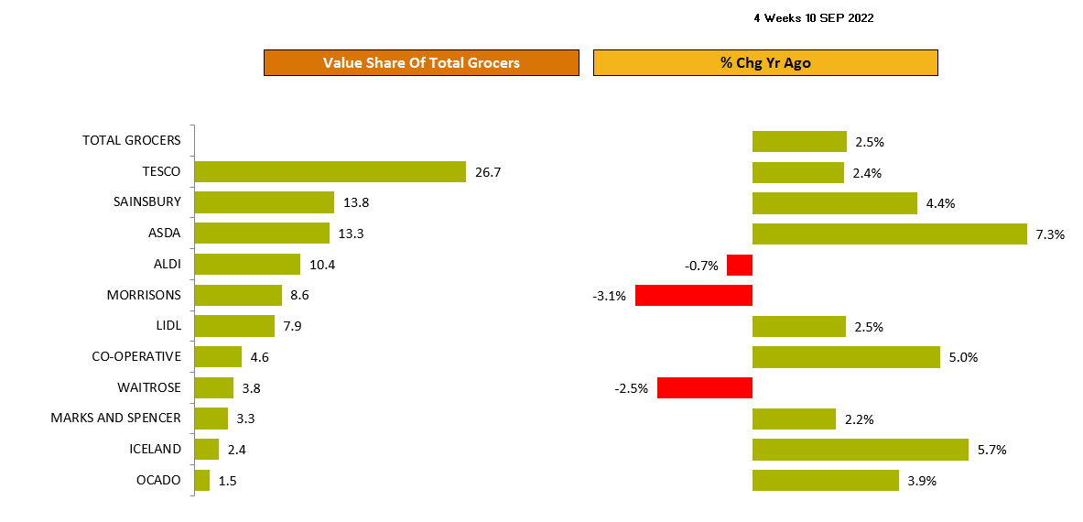
ASDA is the fastest growing retailer
Source: NielsenIQ Homescan Total Till 4 weeks ending 10th Sep 2022

Slide 30
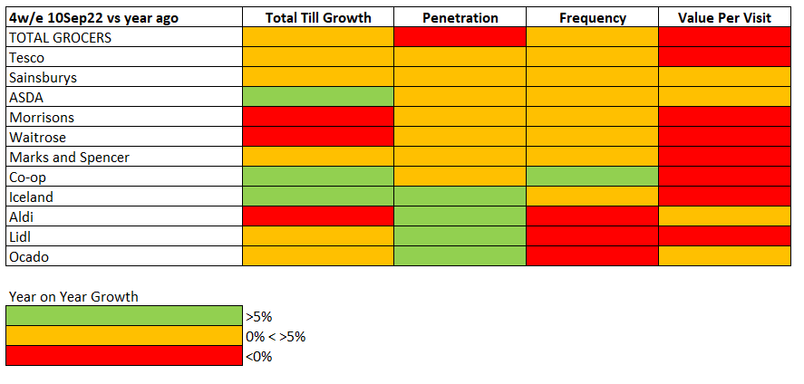
With shoppers buying less impulse and food for alfresco dining, many retailers are continuing to see a decline in spend per trip
Source: NielsenIQ Total Till and Homescan FMCG 4 weeks ending 10th September 2022

Slide 31
After the hot summer the Discounters and ASDA are showing signs of recovery
4w/e 10th September 2022 vs 4w/e 13th August 2022
FMCG Growth +3% +1% +0% -0.4% -1.2% -2.8% -3% -4% -5% -6% -6%
Source: NielsenIQ Homescan FMCG

Slide 32
Top 4 continue to have momentum with share holding at 62%
12w/e share of Total Till
Top 4
Discounters
Over the longer term Top 4 and the Discounter combined share of Total Till Spend, has held at 80%.
Top 4 share has held at 62% the highest since February. Discounter share has fallen to 18%, the lowest since February.
The latest period may yet prove a turning point as more shoppers look to manage household spend by looking to save on their weekly groceries.
Discounter momentum is expected to return in Q4.
Source: NielsenIQ Total Till 12w/e 10th September 22 vs year ago

Slide 33
OL has outperformed across the assortment with the exception of drinks
OL Contribution
Value Sales
Growth
Differential
As inflation continues to bite, shoppers are looking to make savings across their grocery basket.
The summer of heatwaves and events has helped drive demand in Soft Drinks which is one of the few categories where brands have outperformed.
Switching to Own Label is a compromise many shoppers are willing to make, we expect this momentum will continue in Q4.
Source: NielsenIQ Homescan Total GB, 36w/e 10Sep22 vs year ago

Slide 34
ASDA is the fastest growing retailer and growth has slowed at the Discounters
Two column numbered list
1
Whilst all of the retailers remain in growth (except Morrisons -3.1% and Waitrose -2.5%), the Top4 continue to lose market share to Aldi and Lidl due to their accelerated store opening programme and Discounter share in the last 4 weeks remains at 18.3%.
After a stellar 6 months, M&S is holding market share at 3.3% and growths (+2.2%) are now normalising.
4
5
2
Co-op (+5%) had a strong end to summer driven by +10% increase in visits and Iceland (+5.7%) had a significant increase in shopper penetration (+9%) as households looked to manage budgets by buying more frozen foods. As neighbourhood retailers, both are benefiting from the trend of shopping little and more often.
Discounter growth moderated after a strong summer and against high comparatives, Lidl growths slowed to +2.5% with Aldi sales were down -0.7%. The next 8 weeks sales will inform if this is a one off `trend break`.
3
6
ASDA (+7.3%) have rebounded strongly in the last 4 weeks, helped by weak year ago sales (this time last year sales were down almost 2%) but ASDA are also attracting 300K new shoppers, suggesting that new pricing and range initiatives for example ‘Just Essentials’ are starting to have an impact.
Ocado growth (+3.9%) is still just ahead of the overall market and continue to gain market share in online.
Sainsbury’s sales remain robust (+4.4%) and like Tesco (+2.4%), recent growth has been driven by more visits and new shoppers with spend per visit up slightly v last year at Sainsbury to £24.70 and down 1% at Tesco to £26.00.
4
Source: NielsenIQ Total Till, Nielsen Homescan FMCG

Slide 35
The next 8 weeks may see a change in shopping behaviour as the cost of living crisis impacts more shoppers. Price and the perception of value, will become ever more important as we edge into the final quarter.

Slide 36
Promotions

Slide 37
Promotional spend edged up slightly, with more branded offers in Drinks, Frozen and Dairy categories
% Exp On Offer: FMCG
22%
21%
20%
2020
2021
2022
Source: Nielsen Homescan Grocery Multiples 4w/e

Slide 38
Retailers are using multiple strategies to emphasise value and savings to customers
 | %Value sales bought on offer | +/- % pts vs last year
Ocado | 40% | +10%
Waitrose | 33% | -1%
Co-op | 29% | +1%
Iceland | 27% | +6%
Morrisons | 26% | -3%
Tesco | 25% | +3%
M&S | 25% | +2%
Sainsbury’s | 24% | +5%
ASDA | 17% | -2%
Lidl | 8% | -1%
Aldi | 3% | 0%
% Value sales bought on offer
Grocery Multiples 21% (+1% points)
Source: NielsenIQ Homescan % Value fmcg sales bought on offer, 4w/e 10th September 2022 vs year ago

Slide 39
What’s next?

Slide 40
Expect a slow October with sales momentum only improving at the end of November
Three column numbered list
1
2
3
With food prices continuing to rise and household energy costs about to jump in October shoppers will increasingly now focus on the cost of their weekly groceries and how to further reign in spend during Q4.
With CPI inflation expected to remain close to current (+10%) levels for the rest of the year and large increases in energy costs anticipated as we enter autumn, it is not a surprise that 57% of consumers are saying they have been severely or moderately affected by the cost of living crisis and in 3 months this is anticipated to rise to 76%.*
*NielsenIQ Homescan Survey August 2022 ( Basis: those asked to what extent do they see themselves affected in 3 months’ time)
This will inevitably encourage households to shop around for groceries, look for savings across different retailers and kerb basket spend to help manage personal finances.
With these headwinds, we are expecting FMCG growths for the rest of the year to sit close to +2/+3% driven by inflation but with negative volume growth continuing into Q4 and the potential for the industry to bring forward seasonal promotions during the Autumn half-term.

Slide 41
Appendix

Slide 42
Whilst the end of the 3rd heatwave will have helped to stimulate demand in Soft Drinks, inflation will be distorting growth in others
Source: NielsenIQ Scantrack Total Store Read Grocery Multiples

Slide 43
Unit growth remains weak across the assortment, with Soft Drinks the only category to see growth in September
Source: NielsenIQ Scantrack Total Store Read Grocery Multiples

