Slide 1
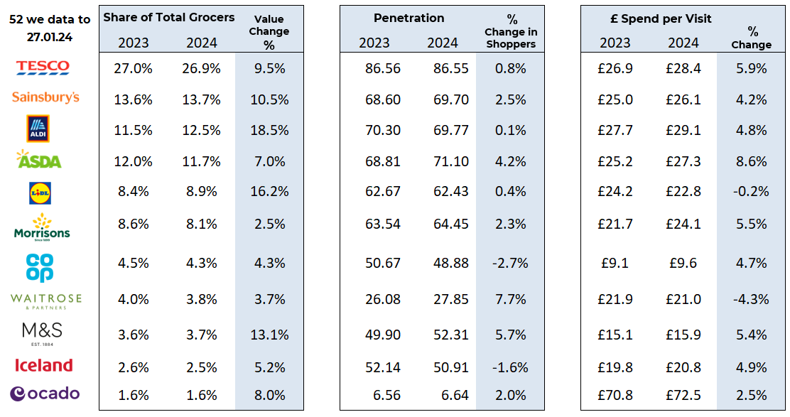
Essential
Retail
52 w/e, 04TH NOV 23
FMCG - Share of Trade and KPIs
Share of Trade
Source: NIQ Homescan SOT based on FMCG, Benchmark Total Grocers
% Change in Shoppers = % Change in Households buying

Slide 2
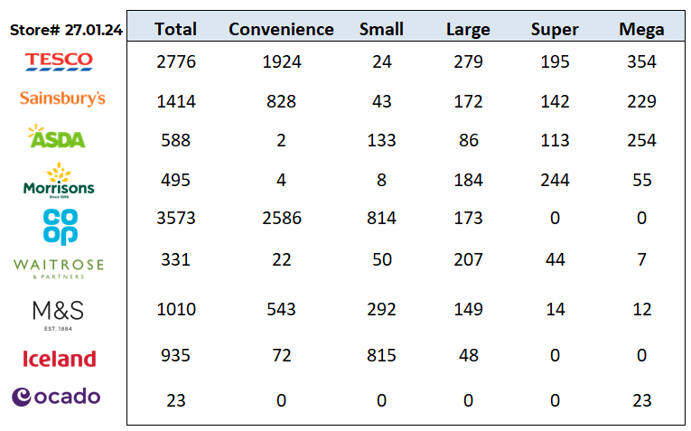
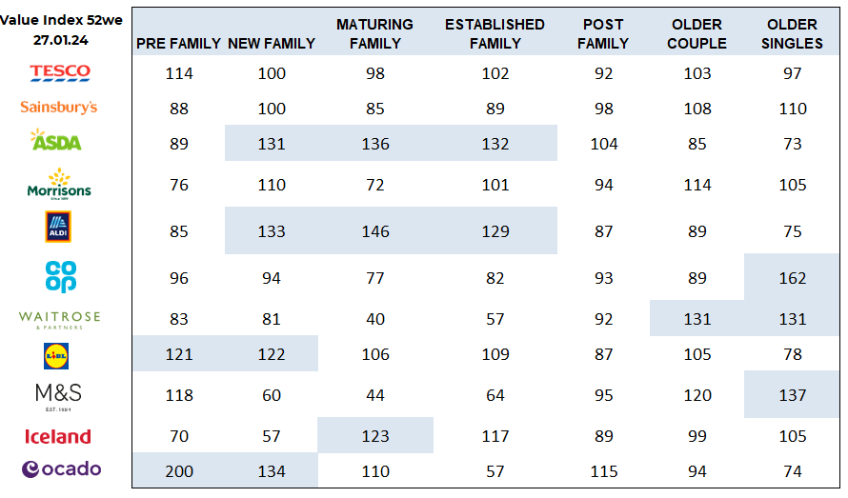
FMCG - Store Numbers and Demographics
Store Profile
Life Stage
Source: NIQ Store Numbers, Homescan Lifestage indices indexed on GB Households

Slide 3
Tesco is temporarily accepting slightly smaller vegetables to help UK growers struggling after recent storms and flooding. As a result of the rainfall and poor growing conditions this winter, vegetables such as sprouts, cauliflowers, cabbages and leeks may be smaller in size than usual. The move will also help the supermarket giant keep British produce on shelves for customers and reduce the risk of shortages.
Sainsbury’s is investing a total of £220m into lowering prices this financial year to “give more value back” to shoppers amid the cost-of-living crisis. This month, the supermarket giant increased its Aldi Price Match campaign to a total of 550 products, almost doubling the range year on year. It now also has the largest range of baby products price matched to the discount grocer, with over 60 Little Ones lines matched including nappies, baby food and wipes.
ASDA has partnered with Grocery Aid, to provide financial, emotional and practical support to employees impacted by breast cancer as part of its Tickled Pink campaign. The supermarket raised £1.4m in November through its AsdaTickled Pink Gala Ball. Working with GroceryAid, the retailer will make these funds available to provide financial support to employees that have either received a breast cancer diagnosis or treatment in the last 12 months themselves or have a partner who has via a grant scheme
Morrisons has rolled out new seated areas in its stores as it encourages weary shoppers to “stop and rest”.
A table with chairs has been introduced in store, along with a sign that reads: “Please feel free to take a break from your shopping”. The new feature was spotted by one customer in Kent who took to social media to praise the initiative.
Morrisons replied on X: “Need to take five? We’ve put seating areas in our stores for anyone needing a break mid-shop. Sit down, have a chat and take as long as you need.” Morrisons’ move follows other supermarkets’ attempts to improve the shopping experience.
Source: NielsenIQ Homescan, Grocer & Nam News
© 2024 Nielsen Consumer LLC. All Rights Reserved.

Slide 4
Waitrose has relaunched its food-to-go range with a renewed focus on animal welfare standards, British ingredients, and sustainable packaging.The refreshed range, which features a new brand design, boasts a new selection of recipes, offering shoppers more flavours including a spicy bean and sweet potato wrap, chicken and piri piri pasta, and a no chicken and pesto sandwich. Waitrose has also modified the packaging by reducing plastic and making it easier to recycle. It builds on the upmarket grocer’s move to introduce its first-ever £5 lunchtime meal deal in August last year.
The relaunched range comes as Waitrose has called on the government to strengthen animal welfare labelling “so people can be in the know about how their food’s been produced, regardless of where they choose to shop’.
Aldi has hit a climate milestone of saving almost 1,000 tonnes of C02 in one year through its partnership with Too Good To Go. Since launching in February last year, the discount supermarket has sold 400,000 ‘surprise bags‘ to customers, which it claimed saved shoppers £8m. The surprise bags include a range of grocery products that are close to their sell-by-date for a reduced price of £3.30 each for at least £10 worth of food. Aldi UK national sustainability director Liz Fox said: “Our partnership with Too Good To Go has been vital in helping Aldi hit its target for reducing food waste early – which has since seen us set a new goal to reduce food waste by 90% before 2030.
Lidl’s has made another investment into pay, which will see its 26,000 hourly-paid workers receive the highest rates of pay in the sector, it claimed. The grocer has invested £37m in pay, which also includes increases for salaried colleagues across the business. From 1 March, entry-level roles at the discount supermarket will be 17% higher than the new National Minimum Wage being introduced in April.
Source: NielsenIQ Homescan, Grocer & Nam News
© 2024 Nielsen Consumer LLC. All Rights Reserved.

Slide 5
Iceland Foods managing director Richard Walker is calling on lawmakers to give retailers more freedom to help reduce the cost of baby formula. Walker is urging for cross-party support for the amednment of the Digital Markets, Competition and Consumers Bill which is currently being passed through the House of Lords, to allow the secretary of state to make regulations over the promotion and sale of infant formula, Sky News reported.
He has said that this change could allow stores to sell baby formula in exchange for vouchers or loyalty points, or promote discounted products. Walker also said the amendment would give ministers the opportunity to “strip away regulations which are currently making it harder for families to access more affordable formula.”
Coop is aiming to grow its number of members from 5m to 8m by 2030. It comes as data shows that Co-op’s membership is growing ahead of its expectations, with its current members up almost 15% on the previous year, according to the retailer. The convenience giant also saw a 21% uptick in members shopping with Co-op in December. Co-op’s food business is now targeting a larger share of the convenience market via omnichannel growth, with plans to acquire new stores, more than double its number of new franchise stores, open 400 Nisa stores, and accelerate share in the quick commerce market to over 30%.
Ocado’s has launched a new price promise TV ad campaign as it promises to match rival retailers’ prices.
The 30-second spot introduces the online grocery retailer’s new strapline, ‘Get the price promise that really stacks up’, highlighting its offer compared to other retailers. Building upon its previous campaign when the initiative launched last year, the ad explains that the Ocado Price Promise checks the prices on over 10,000 products on Tesco.com – including Clubcard prices. Ocado head of brand advertising Sarah Emerson said: “Everything we do at Ocado starts with our customers and we know that getting great value groceries is more important than ever.
Source: NielsenIQ Homescan, Grocer & Nam News
© 2024 Nielsen Consumer LLC. All Rights Reserved.

