Slide 1
Retail Observations: On-line New and Re-launched Products
11th June 2020

Slide 2
New Products Summary
 | Iceland | Morrisons | Tesco | Waitrose | Grand Total
Ambient |  | 4 | 4 |  | 8
Prepared |  | 4 | 4 |  | 8
Chilled |  | 2 | 2 | 4 | 8
Natural |  | 1 |  |  | 1
Prepared |  |  | 2 | 4 | 6
Sauce |  | 1 |  |  | 1
Frozen | 1 | 2 |  | 6 | 9
Battered |  |  |  | 1 | 1
Breaded | 1 | 1 |  |  | 2
Fingers |  | 1 |  |  | 1
Natural |  |  |  | 5 | 5
Grand Total | 1 | 8 | 6 | 10 | 25
Source: Retailer Website (11/06/2020)

Slide 3
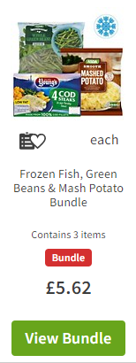
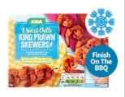
Asda
Source: Retailer Website (11/06/2020)

Slide 4
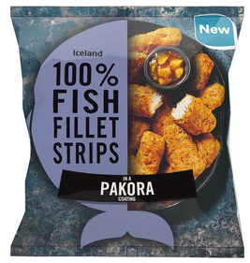
Iceland
Frozen (1)
Source: Retailer Website (11/06/2020)

Slide 5
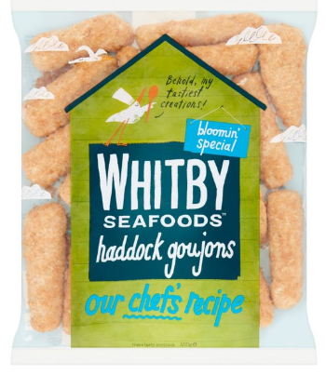
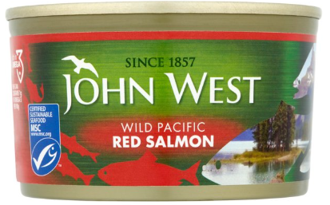
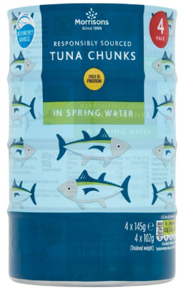
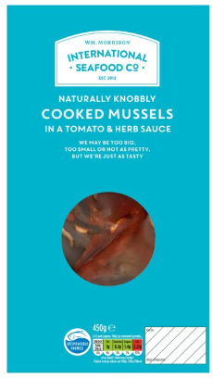
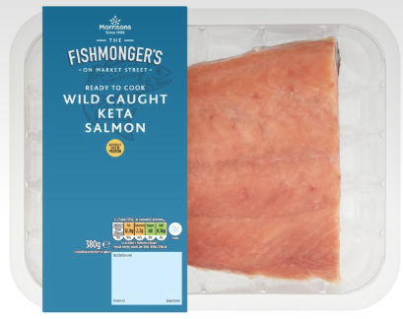
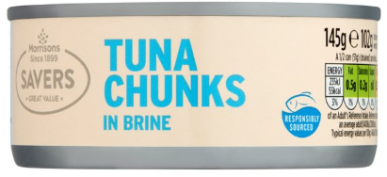
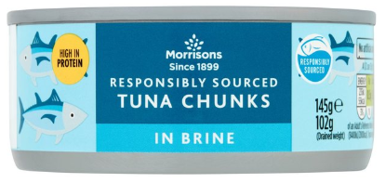
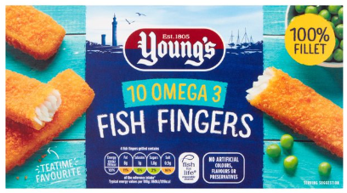
Morrisons
Chilled (2)
Ambient (4)
Frozen (2)
Source: Retailer Website (11/06/2020)

Slide 6
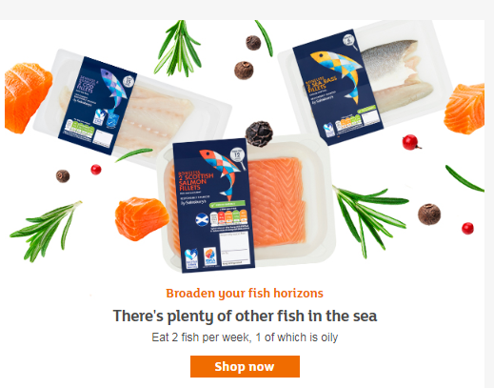
Sainsburys
Source: Retailer Website (11/06/2020)

Slide 7
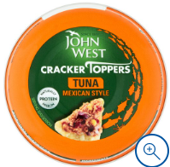
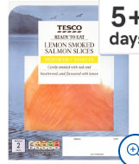
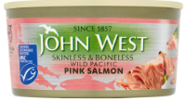
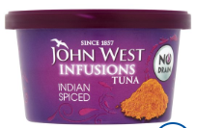
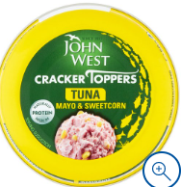
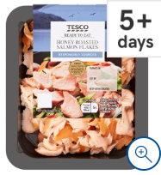
Tesco
Ambient (4)
Chilled (2)
Source: Retailer Website (11/06/2020)

Slide 8
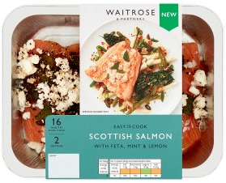
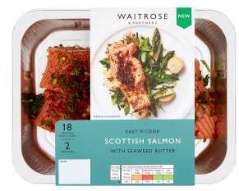
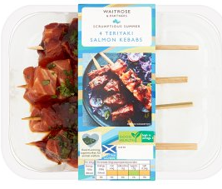
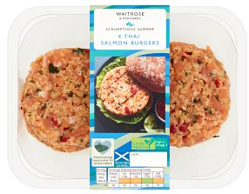
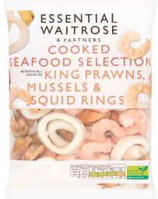
Waitrose
Chilled (2)
Frozen (2)

Slide 9
For further details please contact:
Julia Brooks
Market Insight Analyst
Julia.brooks@seafish.co.uk
+44 (0) 1472252358 / 07944 682751
Suzi Pegg-Darlison
Market Insight Analyst
Suzanne.pegg@seafish.co.uk
+44 (0) 1472 252358 / 07944 682697
seafish.org.uk
Thank you

