Slide 1
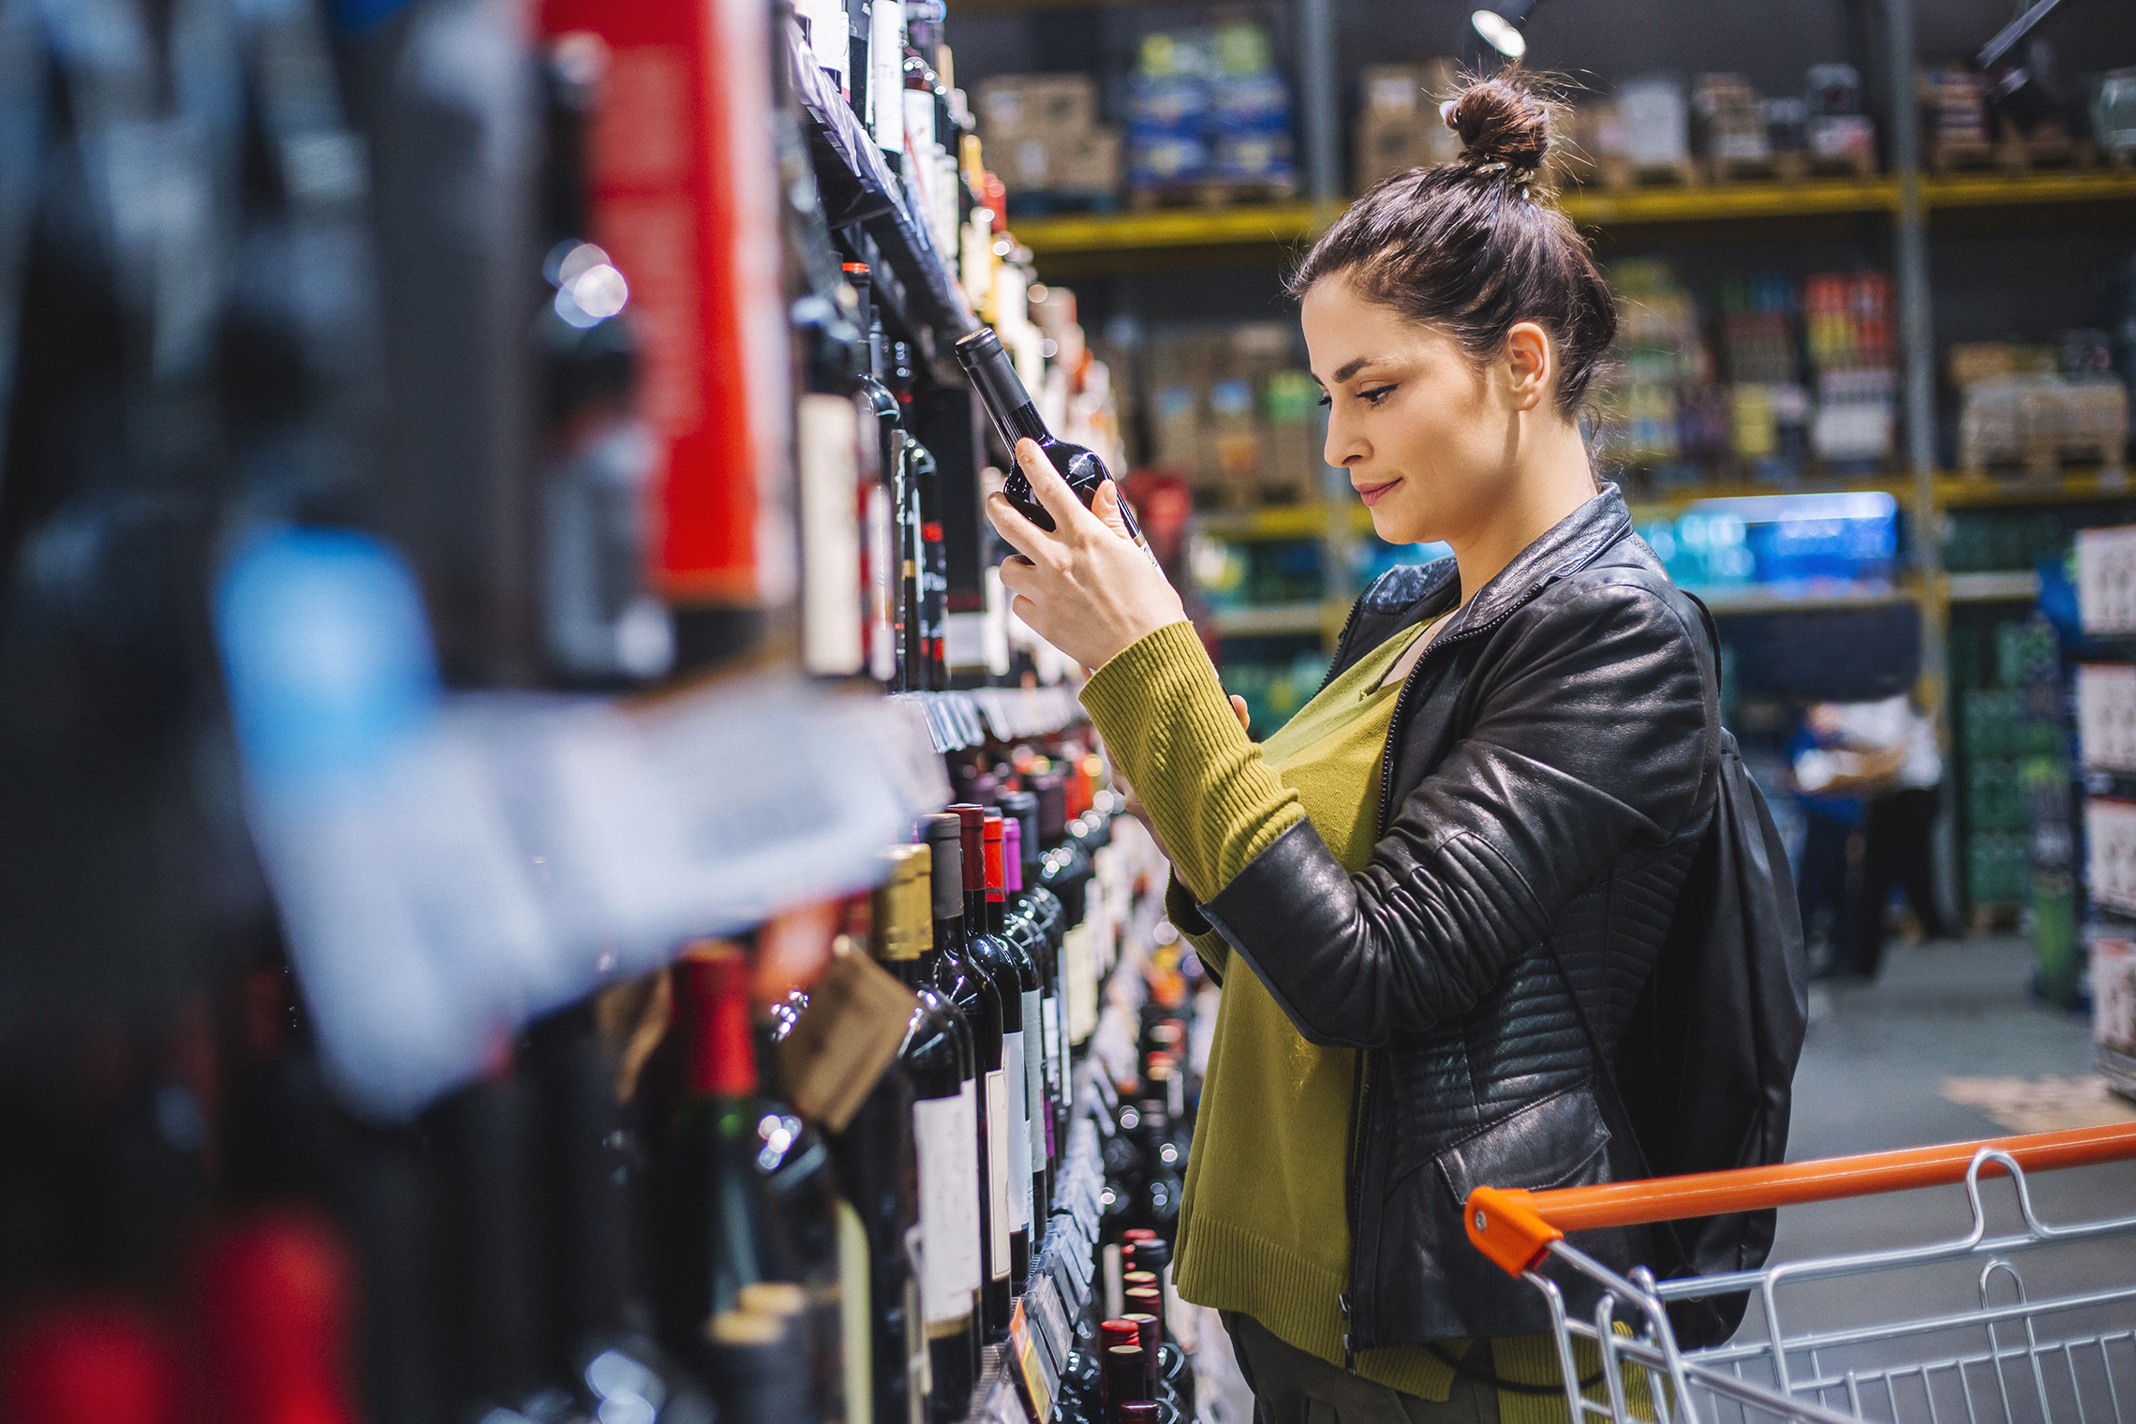
FMCG Essential Retail – What you need to know!
Share of Trade
52 we data to 22.04.23
Share of Total Grocers
Value Change %
Penetration
£ Spend per Visit
2022
2023
2022
2023
% Change
2022
2023
% Change
27.1% | 27.0% | 6.3% | 86.0 | 86.8 | 1.8% | 26.9 | 27.1 | 0.1%
13.7% | 13.6% | 6.3% | 67.1 | 69.2 | 4.1% | 25.1 | 25.1 | 0.7%
12.0% | 12.0% | 6.7% | 69.1 | 70.4 | 2.8% | 27.8 | 27.9 | -0.2%
10.9% | 11.8% | 15.5% | 66.6 | 69.5 | 5.1% | 24.3 | 25.4 | 0.4%
9.2% | 8.5% | -2.0% | 62.4 | 62.5 | 1.0% | 25.9 | 23.8 | 4.7%
7.9% | 8.5% | 15.9% | 59.7 | 64.5 | 8.9% | 21.5 | 21.9 | -8.0%
4.5% | 4.5% | 6.8% | 49.7 | 50.8 | 3.0% | 9.2 | 9.2 | 1.6%
4.3% | 3.9% | -0.9% | 26.0 | 26.5 | 2.9% | 24.0 | 21.4 | -0.2%
3.5% | 3.6% | 8.6% | 49.3 | 50.4 | 3.0% | 15.4 | 15.4 | -10.9%
2.6% | 2.6% | 7.0% | 50.2 | 52.3 | 4.9% | 19.9 | 19.9 | -0.4%
1.6% | 1.6% | 3.7% | 5.2 | 6.8 | 33.6% | 69.7 | 71.9 | 0.1%
Store Portfolio
Store Numbers as of 22.04.23
Store Numbers
Total
Convenience
Small
Large
Super
Mega
2756 | 1899 | 25 | 284 | 195 | 353
1399 | 813 | 43 | 171 | 142 | 230
588 | 1 | 134 | 86 | 113 | 254
499 | 4 | 10 | 185 | 245 | 55
3669 | 2673 | 821 | 175 | 0 | 0
331 | 22 | 50 | 207 | 44 | 7
1008 | 539 | 296 | 153 | 13 | 7
958 | 77 | 834 | 47 | 0 | 0
26 | 0 | 0 | 0 | 0 | 26
Value Index
52 we 22.04.23
Pre Family
New Family
Maturing Family
Life stage
Post Family
Older Couple
Older Singles
Established Family
114 | 93 | 103 | 101 | 93 | 104 | 93
77 | 96 | 80 | 97 | 100 | 109 | 108
90 | 143 | 137 | 131 | 102 | 85 | 71
84 | 103 | 79 | 88 | 97 | 114 | 105
86 | 145 | 150 | 128 | 85 | 89 | 74
105 | 89 | 78 | 88 | 91 | 86 | 161
115 | 74 | 35 | 73 | 89 | 130 | 120
122 | 113 | 119 | 108 | 89 | 103 | 75
103 | 68 | 47 | 62 | 90 | 120 | 143
71 | 56 | 115 | 119 | 96 | 100 | 103
131 | 80 | 104 | 72 | 137 | 102 | 71
Source: Nielsen Homescan SOT based on FMCG [New Base], Benchmark Total Grocers% Change Penetration = % Change in actual buyers
Penetration = Change in shoppers

Slide 2
FMCG Essential Retail
Tesco supported by chef and Tesco Good Food ambassador, Jamie Oliver, launch campaign looking to help consumers make the most of the ingredients they already have in their kitchen. By implementing a Use Up Day each week, households could save an average £260 per year. To help shoppers create a ‘Use Up Night In’, the leading retailer has unveiled a guide containing recipes, ways to use up leftovers and how to host a potluck party where each guest is encouraged to bring their own ingredients. Tesco head of campaigns, Tony McElroy said. “Since creating Use Up Day in 2021, Tesco has helped thousands of customers make the most of their food shop and reduce waste,”
Sainsbury’s to work with Blue Yonder. To make faster decisions, offer the right products to meet consumer expectations, tackle the impacts of inflation and manage frequent supply chain disruptions. Sainsbury’s, has digitally transformed its end-to-end supply chain strategy working with Blue Yonder. The retailer intends to implement Blue Yonder’s demand planning, store order planning, and fulfillment solutions across all its food categories – fresh, frozen and ambient – as part of its Supply Chain Transformation Programme. “Our Supply Chain Transformation Programme will enable us to get products to the right place at the right time for customers by improving our ability to efficiently transport products across our network. For the first time ever, we are now using machine learning to enable automatic forecast calculation and generation of store orders, so this is an exciting moment” said Meinir Childs, Director of Supply Chain, Sainsbury’s.
ASDA is opening its first Deliveroo HOP site in Tottenham Hale (North London) next month, as it extends its partnership with Deliveroo to a further 100 locations across the UK. The new rapid-delivery site – based at the supermarket’s new ‘Asda Express’ convenience store in Tottenham Hale, which opened last December – will mean shoppers can have their groceries delivered in as little as 15 minutes. Over 1,300 Asda products will be available through the new Deliveroo Hop service, which is initially being launched on a trial basis. Asda says the trial is part of a wider strategy to bring “value and quality to more communities across the UK” by giving customers the opportunity to shop whenever and however they like. “The trial will provide us with valuable insight into how we can look to leverage our new convenience stores to bolster our last-mile delivery options for customers,” said senior VP of ecommerce Simon Gregg
Morrisons are kicking off their new pricing initiative trial across more than 20 stores in the north east of England, with a full rollout marked for this summer. After scrapping the More loyalty card in May 2021 and replacing it with the My Morrisons app instead, the exclusive savings card now looks set to return. The grocer is the latest major supermarket to embrace loyalty member schemes pricing as businesses look to emulate the success of Tesco’s Clubcard Prices. Morrisons have invested in “significant price cutting” to help customers through the cost-of-living crisis. “We are continuing to invest in our loyalty scheme to make sure it offers our customers great value and builds on the popularity of My Morrisons Exclusives,” a Morrisons spokesman told The Grocer. “We are currently conducting a trial in order to listen to customer feedback before we roll out any changes nationally.”
Source: NielsenIQ Homescan, Grocer & Nam News

Slide 3
FMCG Essential Retail
Waitrose is set to become the first UK supermarket to trial selling wine bottles without plastic or foil sleeves that are typically found around the neck. The change, which is rolling out on the 24th April across the upmarket retailer’s range of ten Loved and Found wines, is estimated to save half a tonne of unnecessary packaging per year. Initially, four bottles will be sold without neck sleeves and by the end of the year, this will be removed from the entire range. Waitrose MW and beer, wine and spirit sourcing manager, Barry Dick said that these sleeves were first introduced to prevent pests from getting into the wine corks, “causing the wine to leak, or taste musty.”
Aldi is set to boost its sustainability ambitions across its entire UK fresh produce supply chain through the Leaf (Linking Environment and Farming) Marque certification. The discount grocer is aiming for all its UK fresh produce growers to be certified by the end of 2023. The system will support Aldi’s growers to advance their sustainable farming practices in key areas such as soil and water management, reducing waste, enhancing wildlife and biodiverity, energy efficiency, and carbon footprinting. “We are committed to reducing our environmental impact wherever possible – including lowering greenhouse gas emissions, reducing waste and increasing our sustainable sourcing – all while offering high quality products at unbeatable prices,” Aldi UK corportate responsbility director, Liz Fox said
Lidl’s has updated its list of priority locations for new stores as it looks to reach over 1,100 sites across the UK. Last year, the discount grocer opened over 50 new stores and welcomed an additional 15 new sites within the last three months. Lidl now has plans to expand further across Great Britain in the future, as it saw a record number of new shoppers to its stores in 2022. In a bid to roll out stores in priority locations, Lidl has unveiled an updated list of sites that span areas including Scotland, the north of England, Wales, the midlands, central England, as well as the east and south of England
Source: NielsenIQ Homescan, Grocer & Nam News

Slide 4
FMCG Essential Retail
Iceland Foods has launched a new selection of savings across its frozen meal range, making it easier for customers who are feeling the squeeze on their household budgets. The frozen food retailer has a 3 for £10 offer on frozen fish, and a 3 for £10 on frozen meat, ideal for filling the freezer and reducing waste. “There has never been a better moment to take another look at what is possible from the freezer aisle for your weekly shop,” group buying director for Iceland Foods, Andrew Staniland said. “Not only is frozen food fresher, and healthier with less preservatives – there are some great new innovations that will bring excitement and variety to family mealtimes.” He added: “It can also help reduce food waste, with a stocked freezer meaning there are always new options, while delivering on value.”
Coop Members are being encouraged to vote as part of Co-op’s 2023 AGM, where they are set to provide support towards raising £5 million for Barnardo’s – the UK’s biggest children’s charity. Members of the UK’s largest co-operative business – who are eligible to vote – will generate £1 for voting on representatives within Co-op’s National Members’ Council, directors on the Co-op Board or on AGM motions, including bringing more young people into Co-op. Group CEO Shirine Khoury-Haq commented: “Our members are strongest when we come together and drive the direction our Co-op takes on our vision. “We hope that by making this donation available to voting members, they can get even more value for their vote, including building on a brilliant start to our fundraising for Barnardo’s, with whom we are all so delighted to partner.”
Ocado has cut milk prices as production costs start to decline. The online-only supermarket has dropped the price of its own-brand skimmed, semi-skimmed and whole four pint varieties by 10p to £1.55, and its two pint offerings by 5p to £1.25. These match the updated prices at Big 4 grocer’s Tesco and Sainsbury’s, which were the first to slash the cost of milk last week. The retail price reductions come as large wholesalers have cut their prices by 5p a litre, as cows have produced more milk during the “spring flush”, which has led to oversupply. “We know that value is front of mind for our customers right now, particularly when it comes to the items they buy week in and week out,” an Ocado spokesperson said.
“We know every penny counts and – as milk is a staple on many family shopping lists – that these savings will help make food budgets stretch a little further. ”This follows Ocado’s latest investment in value to support shoppers amid the cost-of-living crisis, as last month the retailer launched its new Price Promise, which looks to compare prices against over 10,000 like for like products at Tesco.
Source: NielsenIQ Homescan, Grocer & Nam News

