Slide 1
Retail Observations: On-line New and Re-launched Products
15th March 2021 | Suzi Pegg-Darlison

Slide 2
New products summary
Retailer | Ambient | Chilled | Frozen | Grand Total
Sainsbury's | 3 | 1 |  | 4
Morrison's |  | 5 | 5 | 10
Tesco |  |  | 4 | 4
Iceland |  |  | 4 | 4
Waitrose |  | 1 |  | 1
Ocado |  | 3 |  | 3
M&S |  | 1 | 5 | 6
Grand Total | 3 | 11 | 18 | 32
Source: Retailer websites (15/03/2021)

Slide 3
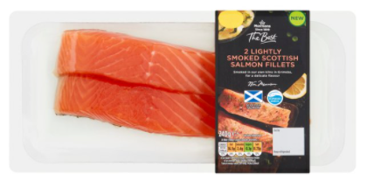
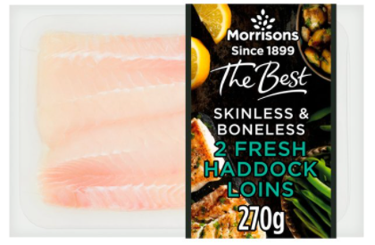
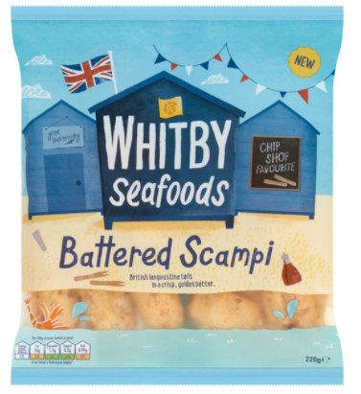
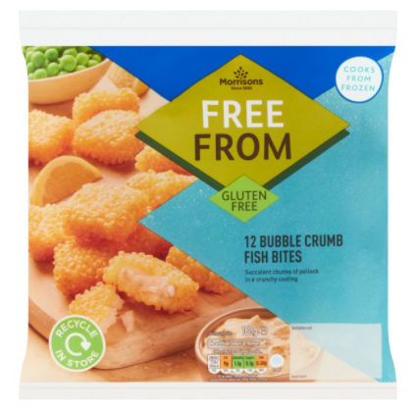
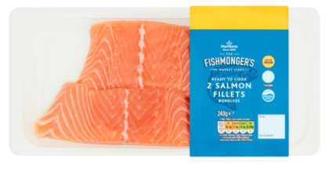
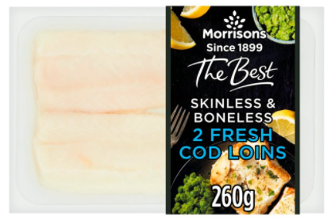
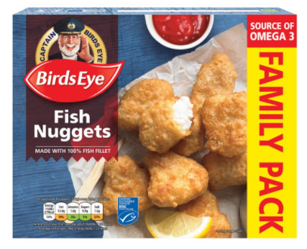
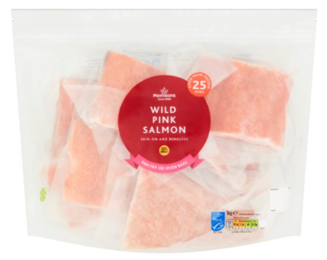
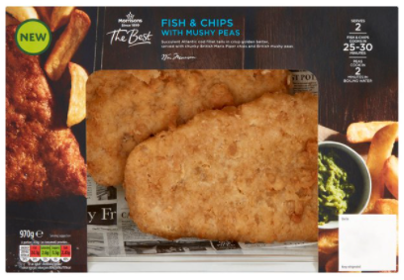
Morrisons
Chilled (5)
Frozen (5)
Source: Retailer website (15/03/2021)

Slide 4
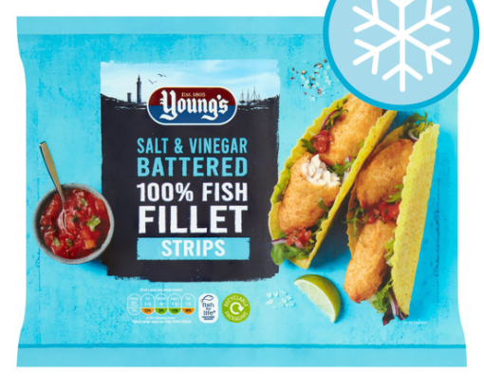
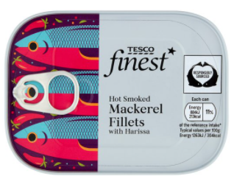
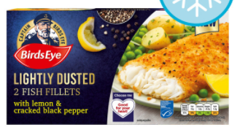
Tesco
Ambient (1)
Frozen (3)
Source: Retailer website (15/03/2021)

Slide 5
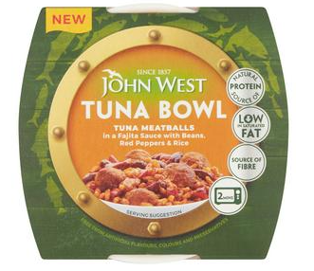
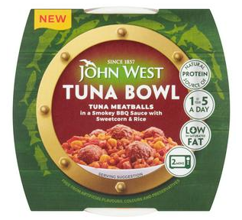
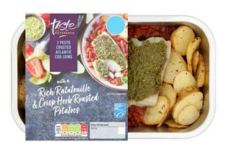
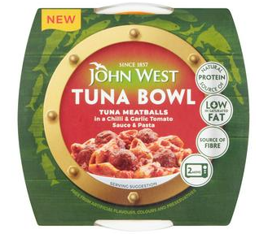
Sainsburys
Ambient (3)
Chilled (1)
Source: Retailer website (15/03/2021)

Slide 6
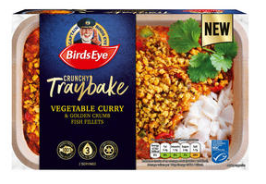
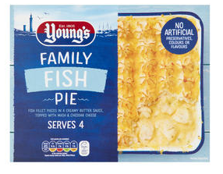
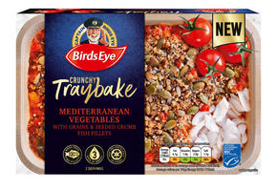
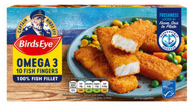
Iceland
Frozen (4)
Source: Retailer website (15/03/2021)

Slide 7
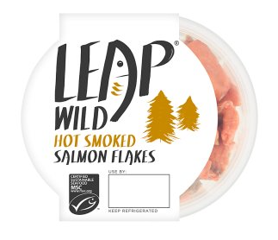
Waitrose
Chilled (1)
Source: Retailer website (15/03/2021)

Slide 8
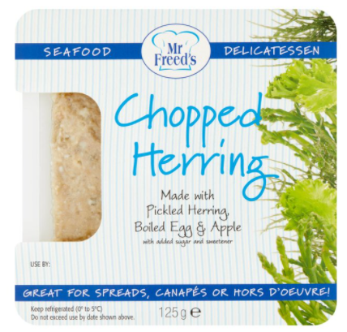
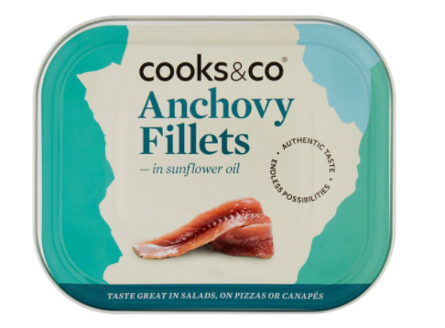
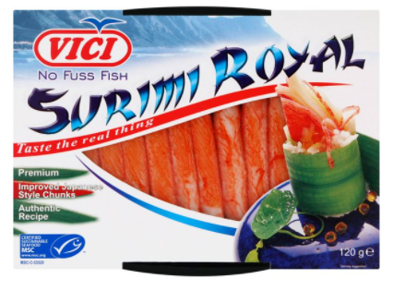
Ocado
Ambient (1)
Chilled (2)
Source: Retailer website (15/03/2021)

Slide 9
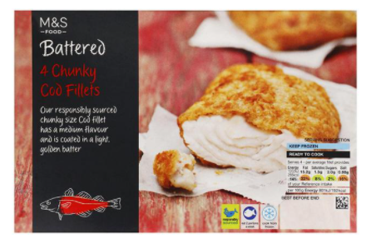
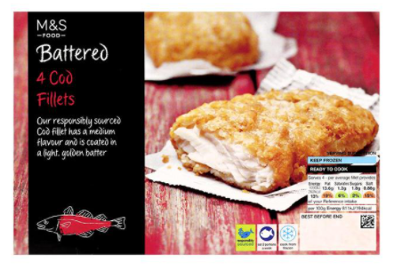
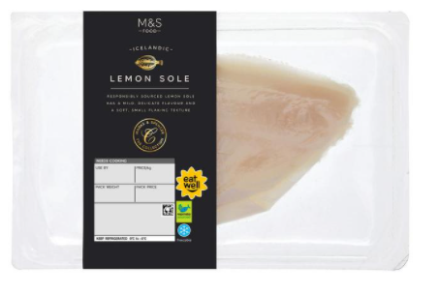
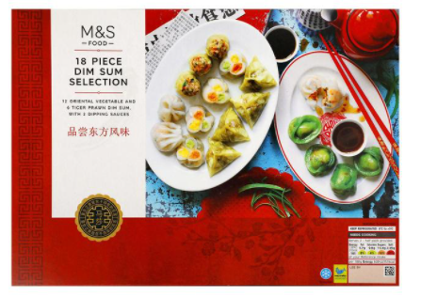
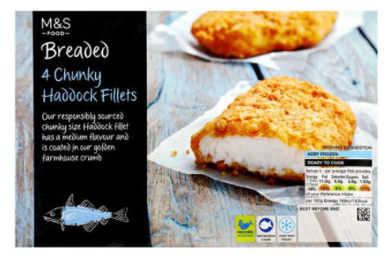
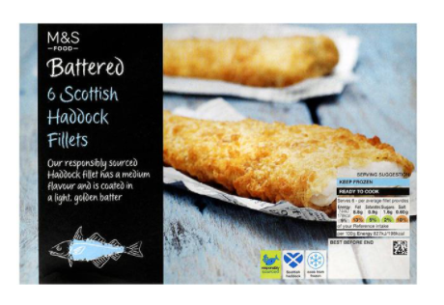
M&S via Ocado
Chilled (1)
Frozen (5)
Source: Retailer website (15/03/2021)

Slide 10
Thank you
For further details please contact:
Julia Brooks
Market Insight Analyst
Julia.brooks@seafish.co.uk
+44 (0) 1472252358 / 07944 682751
Suzi Pegg-Darlison
Market Insight Analyst
Suzanne.pegg@seafish.co.uk
+44 (0) 1472 252358 / 07944 682697

