Slide 1
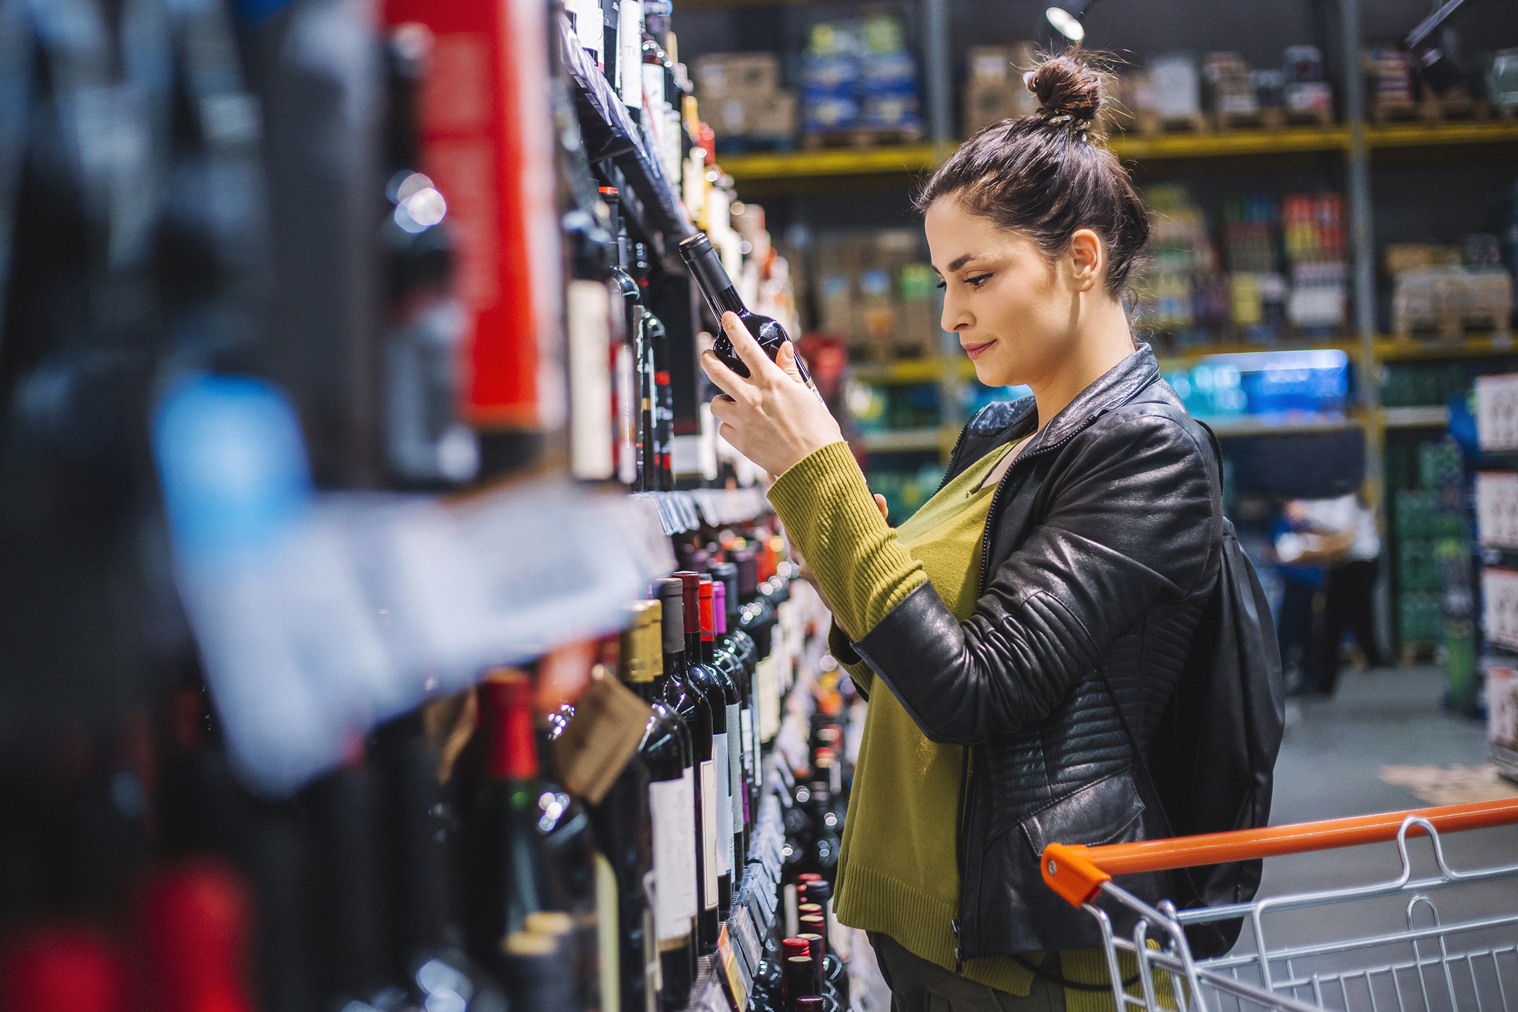
FMCG Essential Retail – What you need to know!
Share of Trade
52 we data to 04.12.21
Share of Total Grocers
Value Change %
Penetration
£ Spend per Visit
2020
2021
2020
2021
% Change
2020
2021
% Change
27.1% | 27.2% | 1.4% | 86.7 | 85.1 | -0.9% | 28.77 | 27.67 | -3.8%
12.5% | 12.2% | -1.2% | 70.4 | 68.9 | -1.3% | 30.46 | 28.64 | -6.0%
14.0% | 13.8% | 0.2% | 68.8 | 66.5 | -2.5% | 27.13 | 26.16 | -3.6%
9.7% | 9.5% | -1.2% | 62.6 | 61.3 | -1.3% | 28.51 | 27.08 | -5.0%
4.8% | 4.5% | -5.5% | 53.6 | 49.6 | -6.6% | 10.37 | 9.53 | -8.1%
4.3% | 4.3% | 1.8% | 25.4 | 25.2 | 0.2% | 25.98 | 25.50 | -1.8%
3.2% | 3.4% | 5.7% | 45.8 | 47.2 | 3.9% | 17.10 | 16.60 | -2.9%
2.7% | 2.6% | -0.6% | 52.2 | 50.1 | -3.3% | 19.82 | 20.83 | 5.1%
6.7% | 7.5% | 13.0% | 59.0 | 58.3 | -0.4% | 21.67 | 21.74 | 0.3%
10.1% | 10.6% | 6.4% | 66.4 | 65.4 | -0.7% | 26.23 | 24.76 | -5.6%
1.6% | 1.7% | 4.5% | 4.7 | 5.0 | 7.3% | 77.81 | 71.76 | -7.8%
Store Portfolio
Store Numbers as of 06.11.21
Store Numbers
Total
Convenience
Small
Large
Super
Mega
2675 | 1824 | 25 | 280 | 194 | 352
1397 | 811 | 46 | 173 | 144 | 223
593 | 0 | 134 | 86 | 113 | 255
497 | 2 | 10 | 189 | 243 | 53
3727 | 2719 | 828 | 180 | 0 | 0
333 | 22 | 50 | 209 | 44 | 7
998 | 522 | 300 | 156 | 13 | 7
956 | 77 | 836 | 43 | 0 | 0
25 | 0 | 0 | 0 | 0 | 25
Value Index (52 we 04.12.21)
Pre Family
New Family
Maturing Family
Life stage
Post Family
Older Couple
Older Singles
Established Family
110 | 100 | 102 | 108 | 99 | 100 | 89
90 | 98 | 74 | 92 | 103 | 110 | 108
101 | 132 | 134 | 123 | 102 | 85 | 74
92 | 100 | 81 | 89 | 93 | 117 | 99
107 | 143 | 150 | 115 | 81 | 89 | 76
114 | 74 | 84 | 80 | 104 | 91 | 147
87 | 62 | 37 | 64 | 99 | 128 | 139
121 | 111 | 122 | 110 | 83 | 103 | 76
80 | 53 | 49 | 64 | 90 | 127 | 146
111 | 61 | 124 | 125 | 94 | 90 | 100
100 | 154 | 132 | 59 | 144 | 86 | 65
Source: NielsenIQ Homescan SOT based on FMCG [New Base], Benchmark Total Grocers% Change Penetration = % Change in actual buyers
Penetration = Change in shoppers

Slide 2
FMCG Essential Retail
Tesco look to be paving the way to reducing packaging on everyday items. The new way of winding toilet paper means that the supermarket giant can reduce the size of its large multipacks without changing the number of sheets in each pack. Tesco claims that it will save 67 tonnes of plastic packaging each year because of the winding toilet paper more tightly.
Sainsbury’s have teamed up with Amazon to launch their first checkout free store based in central London. The supermarket is using Amazon’s Just Walk Out technology in the store as part of Amazon’s first partnership with a third-party international customer for the technology. Customers scan a QR code using the supermarket's SmartShop app when entering the store. The walkout technology automatically adds anything shoppers take off the shelf while also removing it from their virtual cart if they put it back. When leaving users then scan the QR code again and the supermarket then charges customers to the credit or debit card linked to the account.
ASDA will run a national scheme to give back to those on the front line throughout the pandemic until January 2, 2022. Blue Light Card holders will receive 10% discount by presenting their card at the checkout which includes food and drink, George at Asda clothing and homeware, toys, gifts and optical.
Morrisons are to continue their festive charity work by committing over 25,000 hours of support from its Community Champions over Christmas. Across 12 days, it said more than 500 staff will carry out thousands of “acts of kindness” including donating gifts to key workers, giving away flowers and mistletoe and making donations to local charities fighting hunger. Among projects lined up in the community, the staff will be donating decorations to local refuge centres and spending time helping prepare food at community kitchens. They will also be gifting hampers to local heroes who have played a big part in supporting their local community, as well as donating gifts to families in need of support.
Aldi opened a champagne bar in the west end on the 8th December until the 12th, curious customers were stunned as they were invited in to sample the Champagne, unaware of the price or the supermarket behind the idea.
Source: NielsenIQ Homescan, Grocer & Nam News

Slide 3
FMCG Essential Retail
Co-op is replacing its traditional multi-million-pound Christmas TV advertising with a move to promote the network of Community Fridges. The retail giant said its funding will double to 500 the network of Community Fridges, which was set up by environmental charity Hubbub in 2016. A Community Fridge is a social space that brings people together to eat, connect, learn new skills and reduce food waste.
Waitrose have pledged to increase the price they pay to farmers to help producers through the current crisis. It will be putting in a base price that aims to ensure its farmers won’t be disadvantaged by the falling pig price, rather than, it said, ‘cutting the price of the pork we sell and putting on promotions to take advantage’. Waitrose senior agriculture manager Jake Pickering said: “Our farmers are key partners in the success of our business and true pioneers of leading food and animal welfare standards in the UK.
Lidl has increased the rates of pay for new shop floor workers. The move means the supermarket giant has overtaken rivals Aldi, ASDA, Tesco, Morrison’s and Sainsbury's to become the highest-paying grocer in the country. The budget retailer has increased its wages to make them the highest paid by any supermarket. Lidl bosses said entry-level wages will rise from £9.50 to £10.10 an hour outside London and from £10.85 to £11.30 in the capital from March next year.
Iceland supermarket boss has said that staff will not be forcing shoppers to wear masks after England came into line with the rest of the UK and made them mandatory in shops.
Ocado 600,000+ Ocado.com customers will receive an early Christmas present this week in the form of a personalised video summarising their year in shopping with Ocado. Stink Studios is behind the creative and delivery of the MyOcado2021 campaign, using the online supermarket’s current brand platform, There’s an Ocado Just for You as the core concept to deliver customers a Christmas advert Just for Them. Each film, which varies in length of up to two minutes, summarises the customer’s year in shopping with Ocado, their top purchases and how they’ve helped contribute to Ocado’s sustainability mission.
Source: NielsenIQ Homescan, Grocer & Nam News

