Slide 1
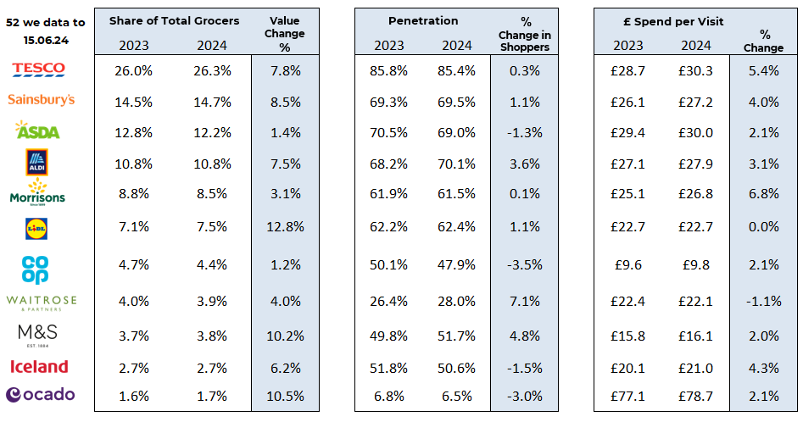
Essential
Retail
52 w/e, 15th June 24
FMCG - Share of Trade and KPIs
Share of Trade
Source: NIQ Panel On Demand (POD), Benchmark Total Outlets
% Change in Shoppers = % Change in Households buying

Slide 2
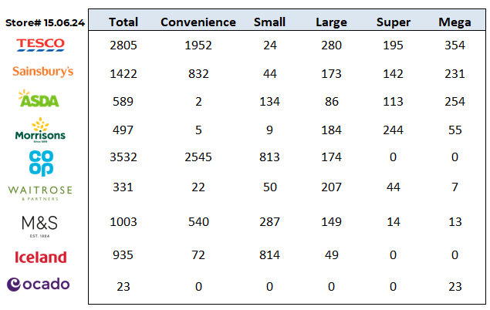
FMCG - Store Numbers and Demographics
Store Profile
Life Stage
Source: NIQ Store Numbers, Homescan Lifestage indices indexed on GB Households

Slide 3
TESCO ROLLS OUT PERSONALISED RECEIPT CLUBCARD COUPONS
Tesco is rolling out Clubcard Coupons in receipt form, containing personalised promotions and discounts for customers. The supermarket giant is now encouraging Clubcard holders to regularly check for any coupons they might receive with their receipt. The new printed coupon initiative will run alongside Clubcard coupons in the Tesco Grocery & Clubcard app and is based on customer’s shopping habits. The tailored discounts and free promotional products are selected based on customer’s tastes and include bonus points and instant discounts for them to use both in-store and online.
SAINSBURY’S ROLLS OUT ‘BUY NOW, PAY LATER’ OPTIONS ACROSS BRANDS
Sainsbury’s is rolling out ‘buy now, pay later’ options for its general merchandise and clothing brands, in a new partnership with payment processing service Klarna. Shoppers purchasing products online at Argos, Habitat and Tu clothing will be able to use a flexible payment option. The grocer‘s new partnership will allow customers to choose between paying for the product in full, within 30 days or across three interest-free payments.
ASDA RELAUNCHES EUROS-INSPIRED ‘HAPPY TO CHAT ABOUT THE GAME’ INITIATIVE
Asda delivery drivers will wear ‘Happy to Chat about the game’ badges, using the Euros as a means to tackle loneliness.
It follows on from Asda’s ‘Happy to Chat’ initiative, which encourages customers to have a quick chat with their delivery driver as their shopping is being delivered. Centred around the upcoming summer of sports, the updated initiative aims to unite customers and sports fans of all ages. A survey found that almost a quarter (23%) of shoppers admitted they were only interacting with people once a week – many of whom were delivery drivers – with the figures showing that the elderly are identified group most in need of support in tackling loneliness.
MORRISONS CUTS PRICES OF MATCH DAY ESSENTIALS AHEAD OF EUROS Morrisons is rolling out deals on a selection of food and drinks to help shoppers save ahead of the Euros. As part of the offers, the supermarket giant has launched a limited-edition Market Street pizza and nachos deal which includes two 14″ pizzas and large nachos for £10 – representing a saving of £3. This will be available alongside food items such as a limited-edition 14″ spicy ‘half n half’ pizza with tabasco, which is available in-store from 17 June for £3.50 and includes roasted chicken, sweetcorn, red and green jalapenos, nduja sausage and mini beef meatballs. Morrisons is also launching football themed treats to mark the occasion, including a giant football cookie, football cupcakes, and Euros football crumpets. Drinks offers include two for £21 on selected 10 to 20 pack World beers such as Birra Moretti, San Miguel and Madri, as well as ‘buy six save 25%’ on over 80 bottles until 18 June.
Source: NielsenIQ Homescan, Grocer & Nam News
© 2024 Nielsen Consumer LLC. All Rights Reserved.

Slide 4
WAITROSE RELAUNCHES PREMIUM NO.1 RANGE WITH 200 NEW ADDITIONS + FIRST INSTORE BAKERY WITH CAFÉ LAUNCHED
Waitrose has relaunched its premium No.1 range with nearly 200 new and improved products. The line, which now includes over 600 items, offers premium ready meals, dips, pasta & sauces, coffee, desserts, bakery treats, as well as fresh meat and fish. The upmarket grocer has launched 130 new products, which will be rolled out from June to October and include Best of British berry preserve, croissant cups, Heather honey smoked salmon, truffle houmous and tomato & vodka sauce. The relaunch of Waitrose’ premium range follows recent collaborations with premium brands over the last few months, including Ottolenghi, Wildfarmed bread, Tony’s Chocolonely, and Biscuiteers. Last month the supermarket launched its first in-store bakery with café chain Gails in a move aimed at “strengthening the partnership” between the two companies.
ALDI INVESTS £90M IN UPGRADING OVER 30 STORES THIS SUMMER
Aldi is set to refurbish over 30 UK stores this summer, marking an investment of £90m throughout 2024.
Over 100 stores across the UK will get an upgrade to various levels in the upcoming year, from Crewe to Cardiff and Didcot to Dumfries. Improvements include creating more space and ensuring stores have more sustainable features, through energy-efficient technology such as installing doors on fridges to cut energy usage and using natural refrigerants to reduce carbon impact. The work is due to take place between June and August, with some stores, such as Leek Newport and Brierly Hill, set to undergo the most significant changes
LIDL CALLS ON CONTRACTORS AS IT LOOKS TO OPEN HUNDREDS OF STORES
Lidl is calling upon contractors to sign up for a series of events as it looks to expand its network with hundreds of new store openings. Aimed at both creating new relationships and bolstering existing partners, the discounter will host events giving contractors the chance to learn about opportunities to work with Lidl. The events will be attended by the supermarket’s property and construction teams, and are set to take place from July in Newcastle, Glasgow, Birmingham and Southampton. It follows the grocery retailer earlier this year publishing a list of potential areas it wished to expand into, which also included Edinburgh, Leeds, Liverpool, and London.
Source: NielsenIQ Homescan, Grocer & Nam News
© 2024 Nielsen Consumer LLC. All Rights Reserved.

Slide 5
ICELAND TO INVEST £100K IN BRAND ACCELERATOR SCHEME
Iceland Foods is to invest £100k in a scheme aimed at supporting brands to develop exclusive products for the supermarket. Dubbed Brands on Ice, the frozen food retailer has called on both challenger and established brands to pitch new innovation ideas to its team as part of its brand acceleration programme. Successful brands will then receive an investment, capped at £100,000, to support the launch of the product and activation within its stores, online and internationally. Among other features, Iceland’s product launch investment rate care includes online product web design and package point, in-store shelf edge, point of sale and store level design as well as help with social media plans, activations, and customer performance data.
CO-OP RAMPS-UP PARCEL LOCKER PARTNERSHIP WITH INPOST
Co-op is accelerating its parcel locker partnership with InPost by introducing three times as many parcel lockers.
InPost Lockers will be available at over 150 of the convenience retailer’s stores by the end of 2024, providing a parcel collection and return services, and giving shoppers a convenient out-of-home (OOH) alternative to parcel deliveries being made to home. InPost UK CEO Neil Kuschel said: “We are delighted to announce the acceleration of our partnership with stalwart retailer, Co-op, enhancing our commitment to accessible parcel services.” It comes as, according to InPost, last year alone the number of parcels it handled doubled to 46.5 million while over half of UK shoppers have used parcel lockers and 62% of the population in London, Birmingham and Manchester live just a seven-minute walk from an InPost Locker.
OCADO: SALES OF RESTAURANT-BRANDED ‘FAKEAWAYS’ SOAR
Sales of restaurant-branded ‘fakeaways’ have rocketed at Ocado as shoppers look to treat themselves on a budget. According to the online grocer, products such as Franco Manca pizzas, Gourmet Burger Kitchen burgers and Itsu meals have soared 51% over the past year. Ocado’s delivery data found that the weekend is the most popular time for these items to be delivered, with products from brands including Leon, Pizza Express and Gymkhana delivered most often on Fridays, while shoppers are opting for Nando’s, Wagamama and YO!Sushi on Sunday. The retailer has also seen a positive response to the rise of ‘restaurant to retail’ options on shelf, as exclusive to Ocado, sales of jarred sauces from two Michelin star Indian restaurant Gymkhana have risen, while sales of Hawksmoor steaks are also up since last year. It comes as new research found that consumers are more conscious of their spending on takeaways and meals out than they were this time last year.
Source: NielsenIQ Homescan, Grocer & Nam News
© 2024 Nielsen Consumer LLC. All Rights Reserved.

