Slide 1
Seafood Trends Across U.K. Restaurants through Q1 2019
Prepared by::
S Pegg s_pegg@seafish.co.uk

Slide 2
Seafood Category Trends

Slide 3
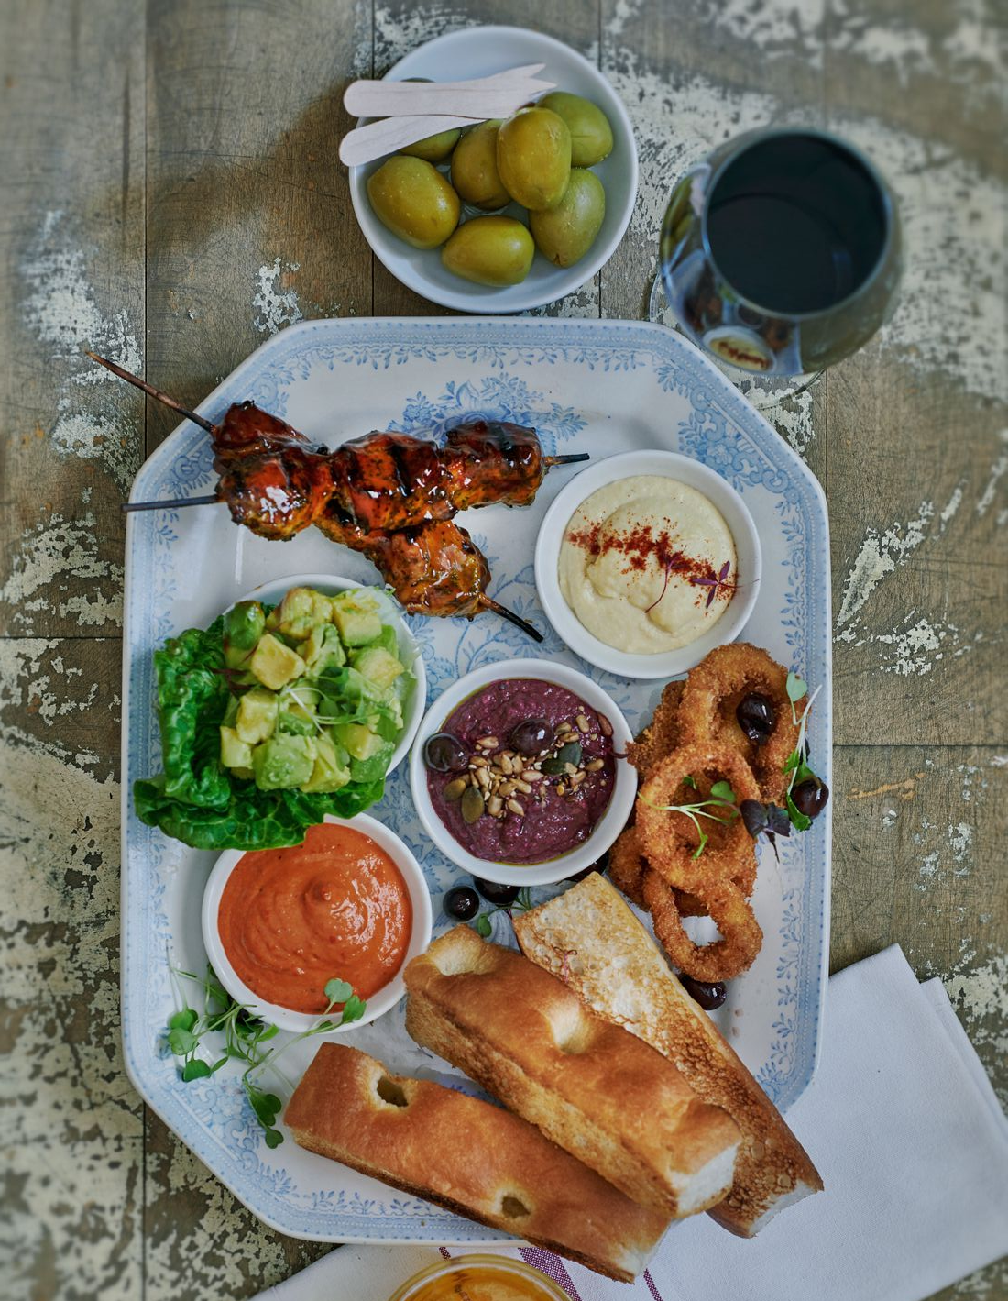
Spotlight on Small Plates
On The Menu
Bill's: Bill's Sharing Plate – Deviled chicken skewers, crispy calamari, garlic and lemon aioli, spiced tortillas, avocado, tzatziki and spicy red pepper dip and Gordal olives. £14.95
Brakspear: Mixed Sharing Platter For Two – 30-month aged Parma ham, ventricina, coppa, smoked salmon, chicken liver parfait, chalkidiki olives, plum and red onion chutney and mixed toat. Also available on Sunday menu with cornichons. Gluten free available. £18.00
Notes:
Base: Menu Items Across 277 Restaurant Operators in the UK
Source: Technomic Ignite Menu Data

Slide 4
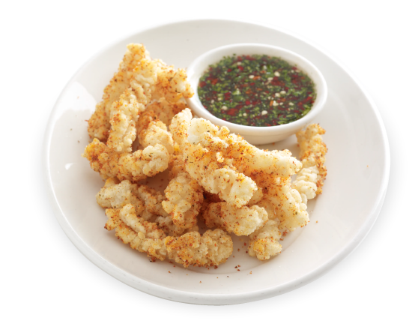
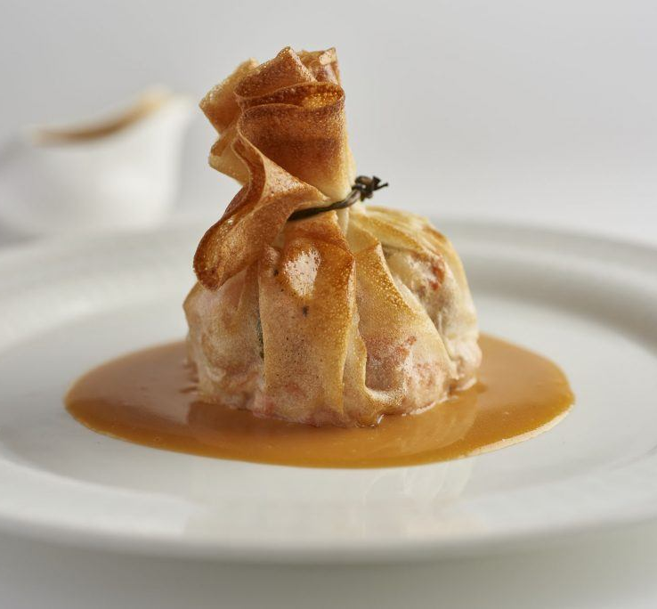
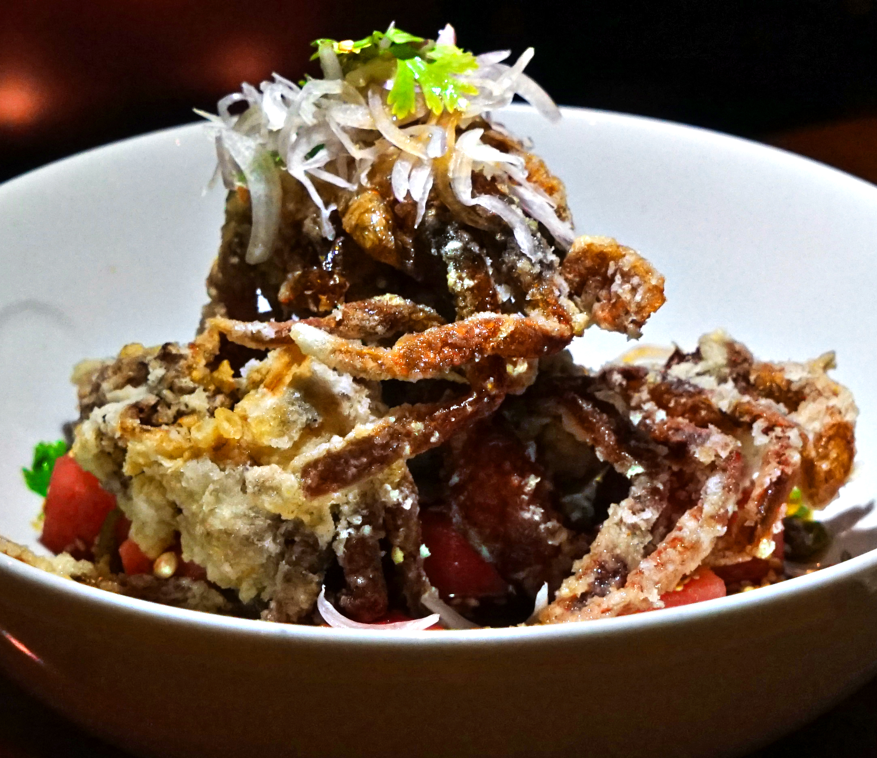
Indulgent Offerings: Breaded Seafood Trends
Wagamama: Chilli Squid
Crispy fried squid dusted with shichimi, served with a chilli coriander dipping sauce
Nobu: Soft Shell Crab Tempura
With amazu jalapeno. Hot dish.
Notes:
Base: Menu Items Across 277 Restaurant Operators in the UK
Menu incidence for fastest-growing is at least 9 (flavours) and 6 (seafood types) menu items
Source: Technomic Ignite Menu Data

Slide 5
Seafood Menu Insights

Slide 6
The number of U.K. operators menuing seafood declined slightly over the past year
Notes:
Base: Menu Items Across 277 Restaurant Operators in the UK
Source: Technomic Ignite Menu Data

Slide 7
Seafood lost menu share across main categories to ancillary mealparts such as add-ons and kids’ menus; seafood appetizers and ethnic dishes are trending
Notes:
*Protein Specialty Roll category refers sushi rolls formats
Base: Menu Items Across 277 Restaurant Operators in the UK
Menu incidence for fastest-growing is at least 9 menu items
Source: Technomic Ignite Menu Data

Slide 8
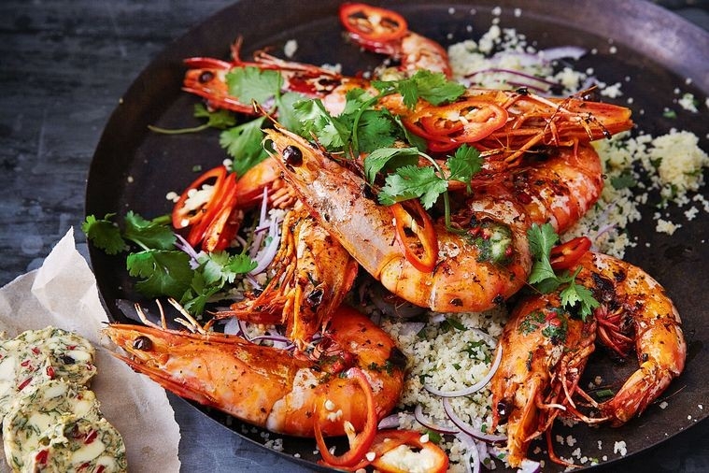
Prawns and salmon have the highest menu penetration across all seafood dishes and continue to gain menu share
Notes:
Base: Menu Items Across 277 Restaurant Operators in the UK
Source: Technomic Ignite Menu Data

Slide 9
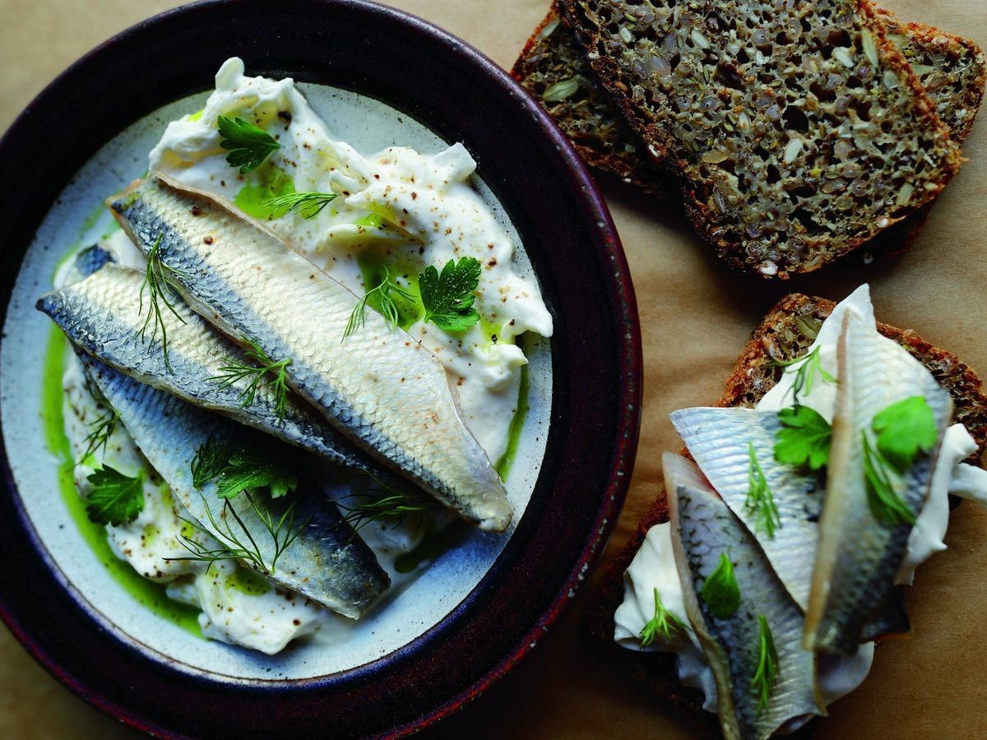
Herring, sardine and cockle are increasingly menued across U.K. menus in 2019
Notes:
Base: Menu Items Across 277 Restaurant Operators in the UK
Menu incidence for fastest-growing is at least 9 menu items
Source: Technomic Ignite Menu Data

Slide 10
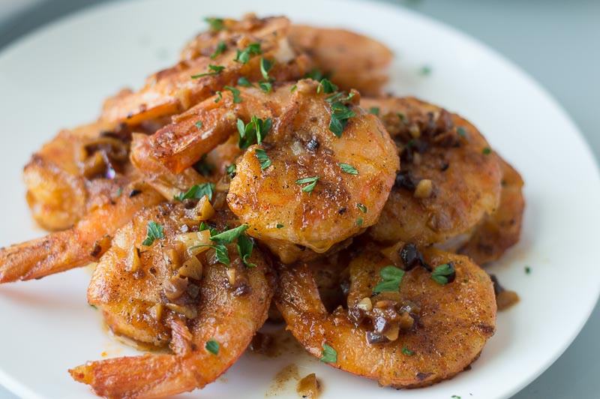
Garlic, followed by tomato and chili, are the most common flavours paired with seafood and continue to gain share across seafood menus
Notes:
Base: Menu Items Across 277 Restaurant Operators in the UK
Source: Technomic Ignite Menu Data

Slide 11
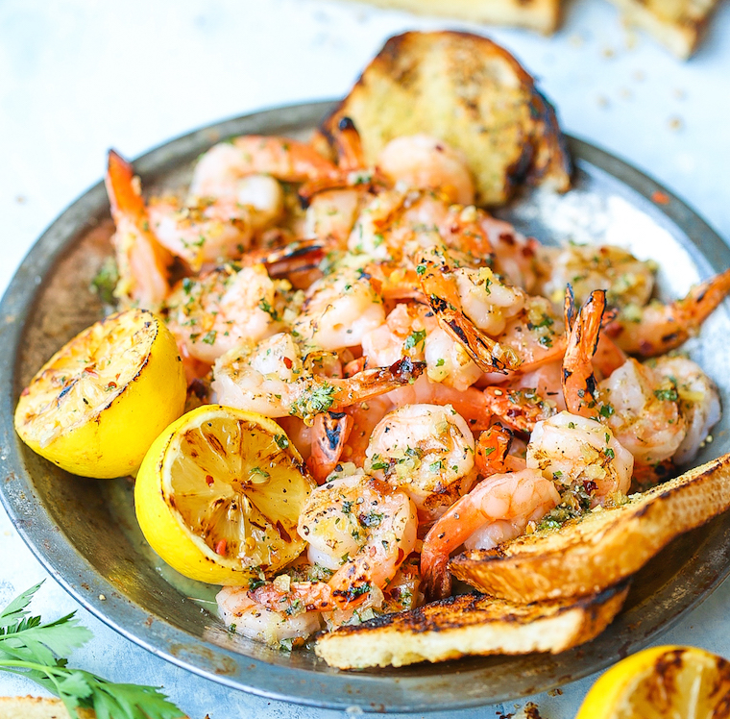
Bold and ethnic notes emerge across seafood formats
Notes:
Base: Menu Items Across 277 Restaurant Operators in the UK
Menu incidence for fastest-growing is at least 8 menu items
Source: Technomic Ignite Menu Data

Slide 12
Trending On The Menu
Restaurant Bar & Grill, The | Yellowfin Tuna Sashimi | Small plates. Wasabi, pickled ginger, soy. | £10.75
Adnams Pubs | Sweet Cured Herring | Served with herring mousse, pickled shallots, and sourdough crumb. | £7.50
Bank Restaurant & Bar | Sardines | Whole grilled Atlantic sardines, rosemary, parsley and lemon. | £8.75
Piccolino Ristorante e Bar | Calamari Fritti | Crispy fried calamari, roast garlic mayonnaise & lemon. On the lunch and early evening menu. | £8.50
Hambleton Hall | Roast Skrei Cod | Mussels, cauliflower, cumin and coriander sauce. Main option on Menu of the Day three or four courses. | £78.00
Revolution Bars | Cajun Popcorn Shrimp | Lightly battered shrimp bites with a pop of Cajun spice. Served with zesty lemon mayo. | £5.00

Slide 13
Macro Trends & Global Examples

Slide 14
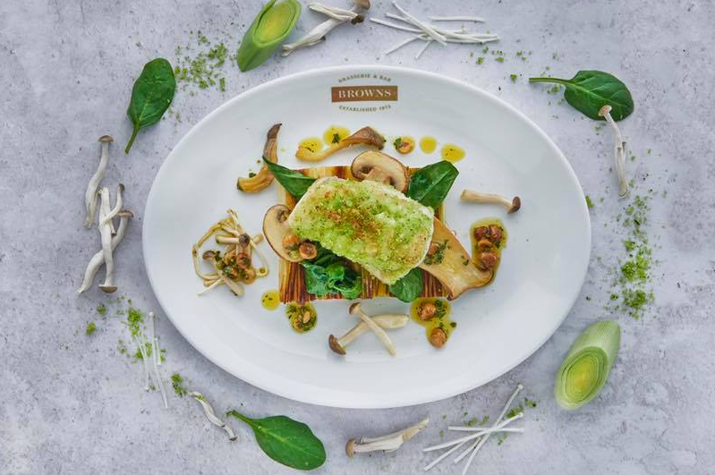
Monkfish
Roasted monkfish offered as a stand-alone dish
Often wrapped in bacon and prosciutto
Less expensive alternative to lobster
Roast Monkfish
Browns Bar & Brasserie
Notes:
Source: 2019 UK Spring Menu Innovations

Slide 15
Salmon
Showcased as a feature in Christmas menus
Also highlighted in pasta, risotto, ramen and seafood platters
Served with potatoes and seasonal vegetables
Salmone Lenticchie
Bella Italia
Notes:
Source: 2018 UK Fall Menu Innovations

Slide 16
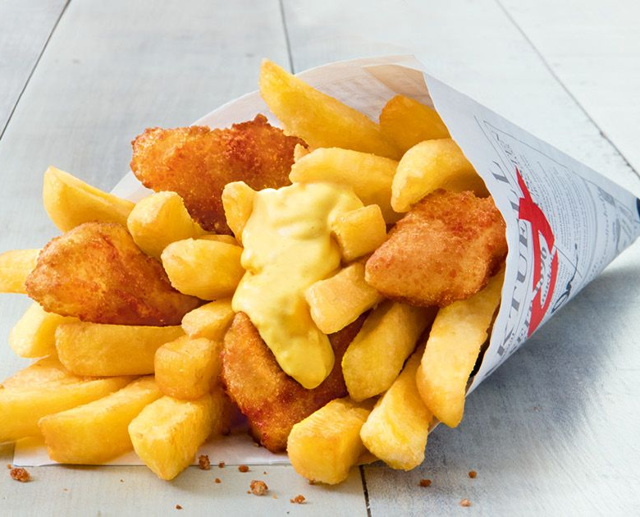
Fish and Chips with Sweet Curry Sauce
Nordsee (Germany)
Type of addition
Novelty LTO
What sets it apart
Classic fish and chips dressed up in a popular street flavor and served in an on-the-go cup
How it’s described
With a creamy spicy-sweet curry sauce that gives our crispy golden-brown baked premium Alaskan salmon fillets and our extra-thick french fries a very special taste
Notes:
Source: Technomic Global Menu Innovation (Q1 2019)

Slide 17
Rauchmatjes Chia-roll
Nordsee (Germany)
Type of addition
Seasonal LTO
What sets it apart
Chia seeds lend a functional boost to this seasonal fish sandwich
How it’s described
The offering has smoked MSC-certified, wild catch fish, fresh salad, creamy sylt sauce (lingonberry jam) and a crispy multigrain bun with chia seeds

Slide 18
Seafood Descriptor Insights

Slide 19
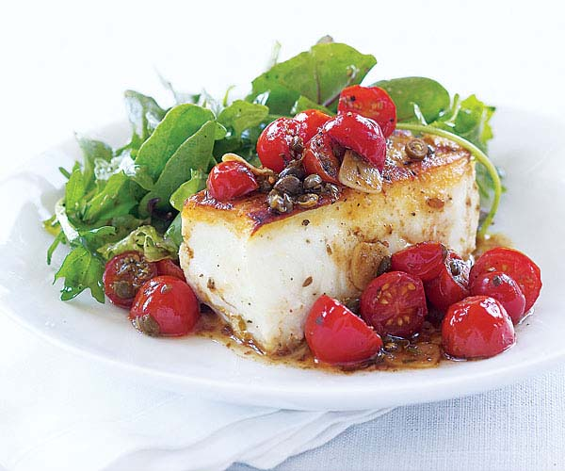
Fresh/freshly is by far the top seafood descriptor across menus; leading seafood descriptors saw a decline since 2018
Notes:
Base: Menu Items Across 277 Restaurant Operators in the UK
Source: Technomic Ignite Menu Data

Slide 20
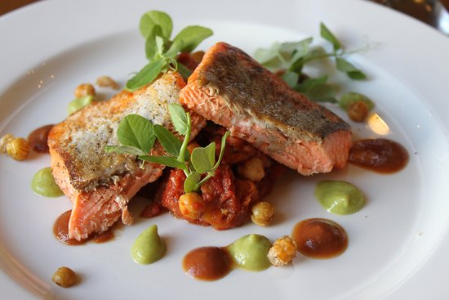
Origin-related and functional descriptors are more often featured on seafood dishes
Notes:
Base: Menu Items Across 277 Restaurant Operators in the UK
Menu incidence for fastest-growing is at least 9 menu items
Source: Technomic Ignite Menu Data

Slide 21
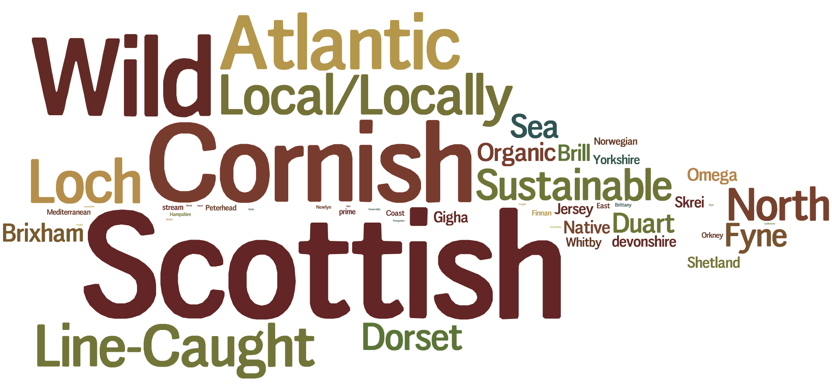
Seafood Descriptors (2019)
Fresh/Freshly

Slide 22
Seafood Descriptors On The Menu
Waterside Inn | Carpaccio Of Loch Duart Salmon | With seaweeds and sunflower seeds, salad of kolhrabi and radishes, pumpkin emulsion. | £42.50
Brakspear | Brixham Cod | Dauphinoise potatoes, black garlic paste, herb crumb, cavolo nero, mussel broth. Gluten free available. Also available on Sunday menu | £17.50
The Star Inn | Cured and Smoked North Sea Halibut | With coastal shoreline vegetables, village hen's egg mayonnaise, cultured buttered sourdough crumpets and tartare vinaigrette.. | £14.00
Thorley Taverns Ltd. | Atlantic Prawn And Crab Sandwich | With lemon mayonnaise, spring onion and rocket. Served daily until 6pm. | £6.95
The Spyglass | Locally Caught Lobster Salad | Freshly Prepared Salad. Gluten Free | £13.95
pod | Salmon And Egg Protein Nutri Pod | Rich in essential Omega-3's to keep skin youthful, enjoy premium smoked salmon and free-range egg over A healthy portion of bright green edamame beans. Gluten free. | £3.60

Slide 23
For More Information Please Contact:
April Brady
Senior Account Manager
abrady@technomic.com
Maria Minulescu
Research Analyst
mminulescu@technomic.com

