Slide 1
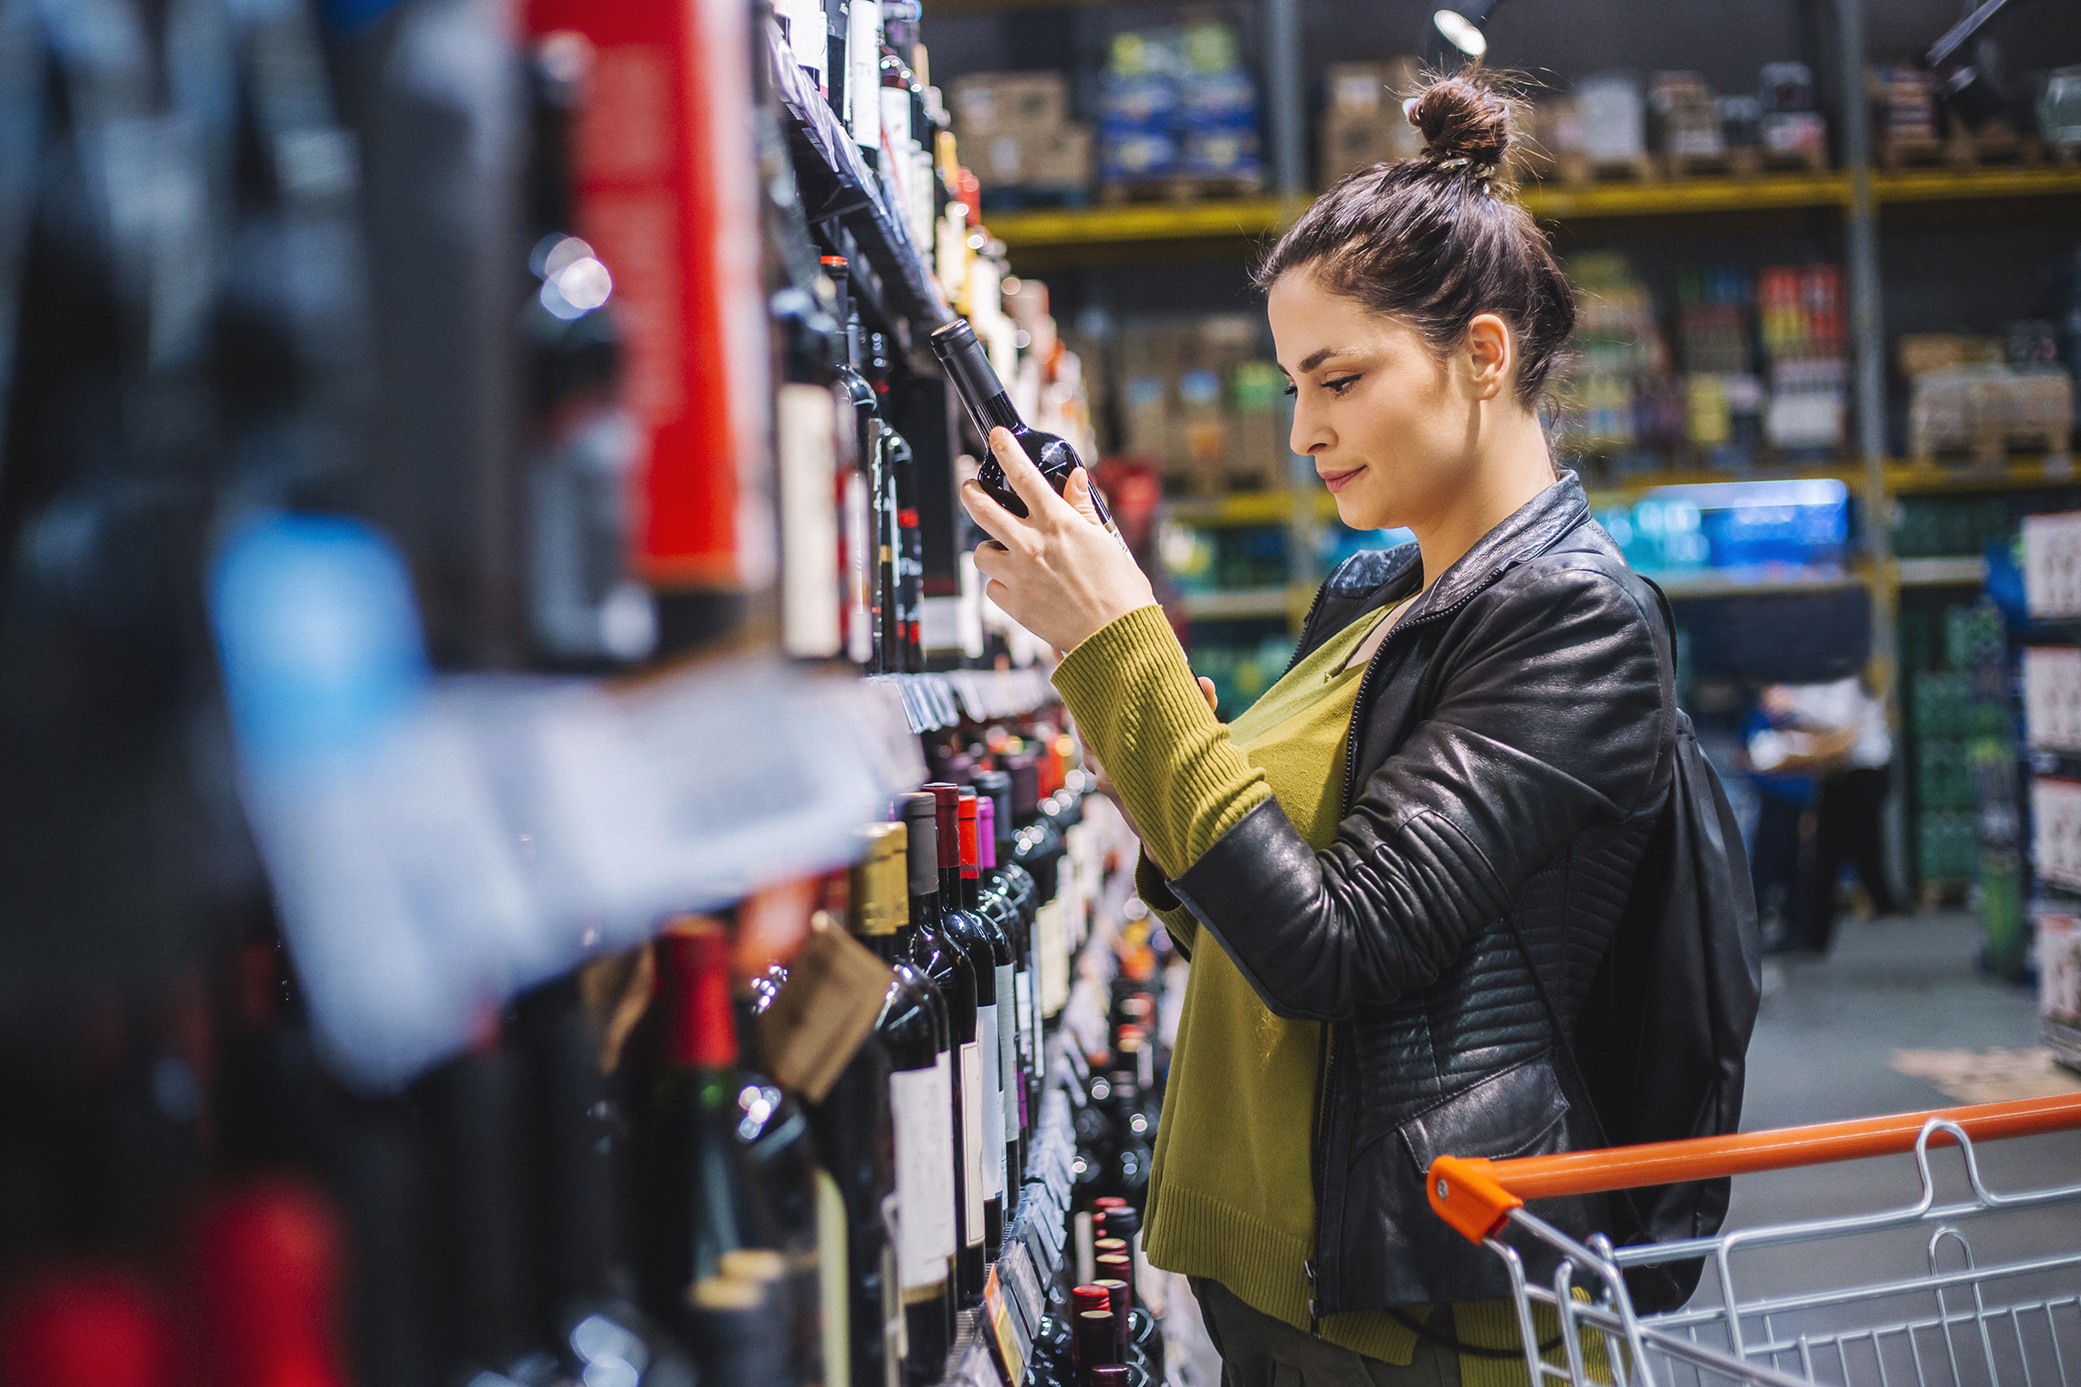
FMCG Essential Retail – What you need to know!
Share of Trade
52 we data to 31.12.22
Share of Total Grocers
Value Change %
Penetration
£ Spend per Visit
2021
2022
2021
2022
% Change
2021
2022
% Change
27.2% | 27.1% | 2.8% | 85.4 | 86.5 | 2.2% | 27.63 | 26.84 | -2.9%
13.8% | 13.7% | 2.0% | 66.6 | 68.4 | 3.5% | 26.00 | 25.02 | -3.8%
12.2% | 12.0% | 1.7% | 69.0 | 70.0 | 2.3% | 28.45 | 27.70 | -2.6%
10.7% | 11.3% | 9.6% | 65.5 | 68.7 | 5.8% | 24.73 | 24.71 | -0.1%
9.5% | 8.7% | -4.8% | 61.7 | 62.7 | 2.4% | 26.90 | 24.24 | -9.9%
7.6% | 8.2% | 11.5% | 58.2 | 63.3 | 9.7% | 22.03 | 21.18 | -3.9%
4.5% | 4.5% | 3.9% | 49.7 | 50.7 | 2.9% | 9.46 | 9.11 | -3.7%
4.3% | 4.0% | -3.7% | 25.2 | 25.9 | 3.9% | 25.40 | 22.06 | -13.1%
3.4% | 3.6% | 7.0% | 47.8 | 49.9 | 5.1% | 16.40 | 15.11 | -7.9%
2.6% | 2.6% | 2.4% | 49.9 | 52.2 | 5.4% | 20.73 | 19.77 | -4.6%
1.7% | 1.6% | -0.7% | 5.0 | 6.4 | 28.9% | 72.00 | 71.09 | -1.3%
Store Portfolio
Store Numbers as of 31.12.22
Store Numbers
Total
Convenience
Small
Large
Super
Mega
2722 | 1863 | 26 | 285 | 195 | 353
1397 | 811 | 43 | 170 | 143 | 230
587 | 1 | 133 | 86 | 113 | 254
498 | 2 | 10 | 186 | 245 | 55
3695 | 2696 | 823 | 176 | 0 | 0
332 | 23 | 50 | 207 | 44 | 7
1012 | 541 | 297 | 154 | 13 | 7
964 | 77 | 840 | 47 | 0 | 0
25 | 0 | 0 | 0 | 0 | 25
Value Index
(52 we 31.12.22)
Life stage
Pre Family
New Family
Maturing Family
Post Family
Older Couple
Older Singles
Established Family
112 | 97 | 101 | 103 | 96 | 103 | 92
77 | 96 | 75 | 100 | 100 | 110 | 107
92 | 136 | 142 | 128 | 102 | 86 | 70
85 | 105 | 84 | 82 | 93 | 116 | 103
90 | 145 | 146 | 128 | 84 | 89 | 75
101 | 81 | 78 | 90 | 98 | 84 | 162
99 | 67 | 39 | 73 | 92 | 130 | 123
126 | 112 | 122 | 109 | 84 | 103 | 75
93 | 72 | 50 | 57 | 90 | 122 | 141
66 | 57 | 122 | 128 | 97 | 96 | 101
115 | 78 | 114 | 72 | 146 | 93 | 74
Source: Nielsen Homescan SOT based on FMCG [New Base], Benchmark Total Grocers% Change Penetration = % Change in actual buyers
Penetration = Change in shoppers

Slide 2
FMCG Essential Retail
Tesco has announced a new price lock on more than 1,000 products until Easter, in a move it said would help shoppers tackle the impact of inflation on household budgets. The move, which covers leading brands as well as
own-label products, will run until 10 April. Tesco said it would help families to manage their shopping budgets, as they faced record inflation figures.
Sainsbury’s has said it will increase pay for its 127,000 hourly workers in the third hike over the past year. The retail giant, which runs almost 600 supermarkets and more than 800 convenience stores, said it will raise these workers’ pay to at least £11 an hour from February. The move, which represents a 10% increase year-on-year, comes as UK retailers seek to attract talent amid a tight labour market and pressure on household finances. It revealed that the pay increase will cost the firm around £185 million in investment.
ASDA launched the offer for kids under 16 to enjoy a hot meal in any of their 205 cafes in June 2022, has extended the deal until the end of March 2023, with no minimum adult spend. Over 60s will also be able to continue enjoying hot soup, a roll and unlimited tea and coffee in Asda cafes for just £1 until the end of March 2023. Asda hopes this will ensure thousands of older customers can benefit from a warm space and hot meal during the colder months. Since Asda launched the two initiatives last year, it has served over 1.2 million meals to kids and over 60s from its cafes nationwide.
Morrisons is helping drivers across the country save money when they fill up their car at the pumps - but only for a limited time. The supermarket giant is offering a new deal that will help shoppers stretch their budgets that bit further this month amid the cost-of-living crisis. All customers will be offered a coupon that entitles them to 5p off every litre of fuel at the pumps when they spend £35 in-store between Thursday, January 5 and Sunday, January 15.
Source: NielsenIQ Homescan, Grocer & Nam News

Slide 3
FMCG Essential Retail
Waitrose are making collection points clear for shoppers through 2023, Waitrose has updated its in-store Food Bank donation points. Alongside signs on shelves to show customers which items are most sought after at local food banks, pre-filled food bank bags will also be available in 31 stores. “It’s vital that we do everything we can to help those in our communities who may be in need during the festive season”, Waitrose sustainability and ethics lead, “Every year, we’re humbled and filled with gratitude at the generosity from our customers.” Lindsey Crompton said. This comes as Waitrose recently gave four million carrier bags to local food banks to ensure food supplies are secure in new, good quality packaging.
Aldi has extended its partnership with Company Shop Group in a bid to reduce more food waste in the UK. As a result of the partnership, the German discount grocer has revealed that all its Regional Distribution Centres will now help redistribute surplus food that cannot be sold in its stores. This will then be redistributed to the group’s Community Shops across the UK, where items will be sold at discounted prices as a way to help those in need. With this new national roll out, Aldi aims to prevent a further 2,860 tonnes of food from going to waste each year. “Reducing food waste is incredibly important to us, and we know that by rolling this scheme out nationally, it will make a huge difference to communities across the UK,” Aldi UK corporate responsibility director Liz Fox said.
Lidl’s said sales increased by 24.5% over the four weeks to December 25, compared with the same period in 2021.
It added that it welcomed 1.3 million more customers to stores over the week before Christmas compared with the previous year. “We know they switch to us to make savings, but then they stay with us when they realise that they’re not having to compromise on quality, and this Christmas was no exception.”
Source: NielsenIQ Homescan, Grocer & Nam News

Slide 4
FMCG Essential Retail
Iceland You will soon be able to get shredded chicken inspired by two popular Nik Nak flavours. Crisp fanatics have been sent absolutely wild by the announcement that a retro brand is set to be turned into a new treat in Iceland stores. If you grew up in the 90s, then you will know just how popular Nik Naks crisps were, with many of the flavours proving to be a regular tuck-shop must have. And now the geniuses at Iceland have gone and cooked up a brand new range of frozen shredded chicken that has been inspired by the nostalgic treat. News of the retro inspired freezer product quickly went viral when it was announced on the Newfoodsuk Facebook page where shoppers were quickly sent into a meltdown. Even though it is unclear when the new Nik Naks shredded chicken will be available, it has already managed to gain the attention of shoppers who were blown away by the news.
Coop has teamed-up with Just Eat to launch an on-demand online delivery partnership, increasing access to quick convenience shopping in communities nationwide. Initial 2023 roll-out of 50 stores, but service is expected to expand to over 1,000 Co-op stores by Spring 2023. Through the tie-up, shoppers will be able to order items from Co-op for speedy delivery in as little as under 30 minutes via the Just Eat app and website. Chris Conway, eCommerce Director, Co-op, said: “Co-op stores are well placed in the heart of local communities to provide quick, easy and convenient home deliveries – whether a full shop or last-minute top-ups. We are committed to exploring new and innovative ways to increase access to our products and services and, with our members and customers leading busy lives, ease, speed and convenience is a cornerstone of our approach.
Ocado is set to expand its plant-based range for Veganuary, rolling out Crave snacks across its online store. Having recently won the store cupboard episode of Channel 4’s Aldi’s Next Big Thing. This listing will widen our customer base and mean that more people will have access to Crave’s vegan and free from snacks “With a larger range of vegan products than any UK supermarket, we’re excited that our customers will be able to get their hands on this tasty product as part of their regular food shop.”
Source: NielsenIQ Homescan, Grocer & Nam News

