Slide 1
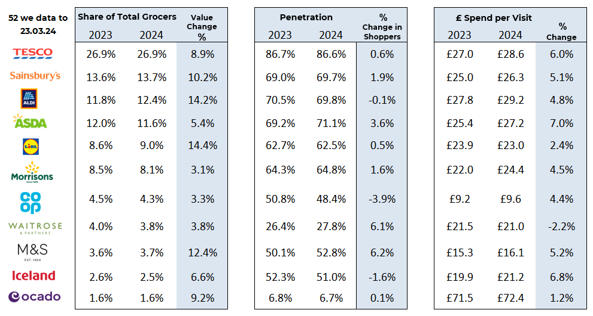
Essential
Retail
52 w/e, 23rd March 24
FMCG - Share of Trade and KPIs
Share of Trade
Source: NIQ Homescan SOT based on FMCG, Benchmark Total Grocers
% Change in Shoppers = % Change in Households buying

Slide 2
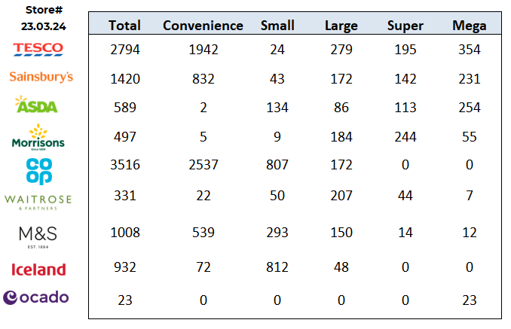
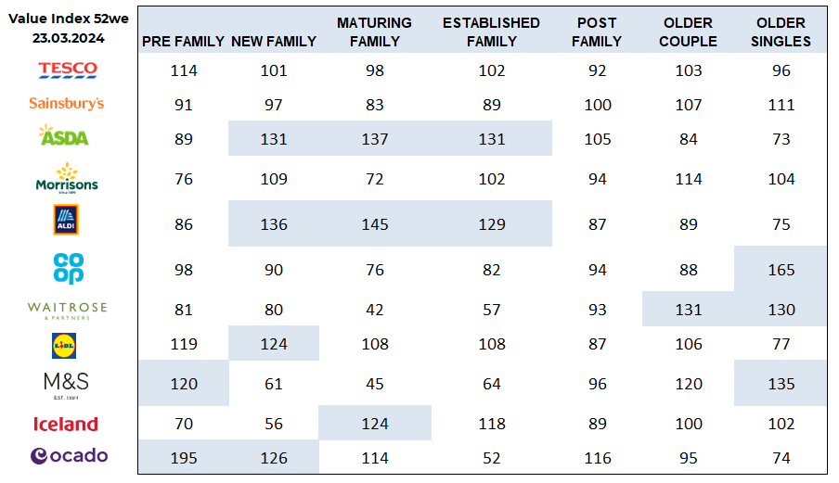
FMCG - Store Numbers and Demographics
Store Profile
Life Stage
Source: NIQ Store Numbers, Homescan Lifestage indices indexed on GB Households

Slide 3
Tesco has slashed the price of five traditional Easter vegetables to 15p for Clubcard members. From 27 March (today) until 2 April, all rounder potatoes, carrots, swedes, brown onions and white cabbage are 15p on Clubcard Prices – down from 19p last Easter. The supermarket has also introduced a range of Easter discounts on popular seasonal essentials, including 50% off a host of centrepieces and roasting joints and Tesco Whole Lamb Leg (£6.50 per kilo). Other traditional favourites for the bank holiday include Tesco Large Beef Roasting Joint with Basting Fat (£6.00 per kilo), Tesco Boneless Salmon Side (£12.00 per kg) and Tesco Finest Smoked or Unsmoked Wiltshire Gammon Joint (£6.00 per kilo).
Sainsbury’s has unveiled its latest value offering, ‘Low Everyday Prices’, giving shoppers “market low prices” on selected big brand products, many of which aren’t available in Aldi. The new offer, which replaces Price Lock, gives customers great value on over 1000 favourites, including PG Tips Tea Bags, Quaker Rolled Porridge and Surf Tropical Lily Washing Powder. The supermarket said it now has “three clear ways of giving customers consistent value across its incredible products” – Low Everyday Prices, Aldi Price Match and Nectar Prices.
ASDA is extending its ‘Kids Eat for £1’ meal deal to run all year long in more than 205 cafés, instead of just during the school holidays. The supermarket giant launched the offer for kids under 16 in June 2022 and it has since served over 3m hot meals in its cafés nationwide. Last year, Asda refreshed the menu with more nutritionally balanced offers, including vegan and healthy meal options. Current dishes include penne pasta with meatballs, a vegan ‘hidden’ veg pasta meal, fish fingers, chicken nuggets and an all-day breakfast. In addition, kids receive a free piece of fruit such as an apple, pear or banana when purchasing the deal. Asda also offers a £1 cold pick and mix selection alternative that includes a sandwich, drink and a piece of fruit.
Morrisons has delivered its strongest like-for-like growth in a three years. Much of this growth has been attributed to improving customer relations, which new CEO Rami Baitiéh described as the “canaries in the retail coalmine”. The chief executive, who joined the grocer last November, flagged that Morrisons had developed and implemented plans across the business, including wholesale, convenience, franchise, export markets and global sourcing as the supermarket attempted to “start a new chapter” and return to “peak form”. Earlier this year, Morrisons revealed it had sold its petrol forecourt business to Motor Fuel Group in a £2.5bn deal with the funds understood to be ploughed into paying down its debt.
Source: NielsenIQ Homescan, Grocer & Nam News
© 2024 Nielsen Consumer LLC. All Rights Reserved.

Slide 4
Waitrose has diverted the equivalent of 20m meals worth of surplus food to charities and community groups across the UK through its partnership with food waste charity FareShare. The upmarket retailer donated 168 tonnes of food between July and December 2023, which prevented over 269 tonnes of CO2 emissions and more than 252m litres of water from going to waste. This food was received by 2,681 charities and community groups, including 182 that are working with people experiencing homelessness, 50 supporting asylum seekers and refugees, 622 working with children and young people, and 120 older people’s community groups. Waitrose distributes food daily from more than 300 stores via FareShare Go, which links local charities and community groups with their nearest store.
Aldi is donating more than half a million meals to local charities, community groups and food banks throughout the upcoming Easter school holidays. The discount grocer expects almost two-thirds of these meals to be donated to causes solely focused on supporting families. The food donations form part of Aldi’s ongoing work with giving platform Neighbourly, which has seen the supermarket donate more than 44m meals across the UK since the partnership began in 2019. Aldi and Neighbourly also recently launched a new ‘spring’ fund to provide additional help for families in need across the UK. Eligible charities across the Neighbourly network, such as baby banks and children’s centres, will be able to access microgrants of £500 to help them provide immediate support to struggling families.
While earlier this month, Aldi hit a significant milestone having donated 2.5m meals from its regional distribution centres across the UK. The move, made in partnership with Company Shop Group, has saved an estimated 1,000 tonnes of food from going to waste.
Lidl’s is set to improve its chicken welfare standards by increasing space allocating to its own-label fresh chicken by 20% above current industry standards. The new commitment, which is due to start this summer and be completed by 2025, will see the maximum stocking density reduced to 30kg/sqm, in an attempt to positively impact living conditions of the birds.
Lidl claims the new increased space will allow chickens more space to roam and “roam enables them to engage in natural behaviours”, such as stretching their wings, and encourages “psychological well-being, leading to more fulfilling lives”.
Lidl’s latest pledge follows animal welfare campaign group Open Cages’ investigation that revealed millions of supermarket chickens showed excrement burns, known as hock marks. Despite not submitting data, Lidl was the subject of the campaign group’s store spot checks, where volunteers found that 74% of the chickens they checked had hock burn ulcers.
Source: NielsenIQ Homescan, Grocer & Nam News
© 2024 Nielsen Consumer LLC. All Rights Reserved.

Slide 5
Iceland is rolling out new and reinforced versions of its paper carrier bag, which has been bolstered by “new technology” and designed to be more durable. They are splash-proof, easier to carry and reuse, and perfect for carrying frozen food. Iceland’s latest innovation comes after it became the first UK supermarket to launch plastic-free reusable woven bags, expanding its alternatives to traditional plastic bags in 2022.
The supermarket was the first UK supermarket to trial plastic bag-free stores in 2019.
Coop has introduced member price benefits to its online shop as it aims to boost its membership growth ambitions. The move will now offer the same member price benefits online as members can receive in-store, meaning shoppers can access the same value through its rapid community delivery service.
The convenience retailer’s member prices span across 300 key lines and everyday The retailer says it has seen an influx of customers joining its membership price scheme, and earlier this year announced it plans to grow its number of members from its current 5 million to 8 million by 2030. In February, it extended its membership discount by launching in-app member pricing for shoppers using the Uber Eats app, in a first for UK supermarkets.
Ocado’s welcomed more than 1m customers over the quarter as sales and volumes have surged as the online supermarket “stepped up” to expand its product range and availability. Ocado reduced the prices of more than 1,700 cupboard, fridge, freezer and household products as part of its Big Price Drop campaign. Gibson added that the retailer’s strategy is “resonating with customers and volume growth is building well. There’s still so much more we can do and I’m looking forward to raising the bar even further in 2024.”
Source: NielsenIQ Homescan, Grocer & Nam News
© 2024 Nielsen Consumer LLC. All Rights Reserved.

