Slide 1
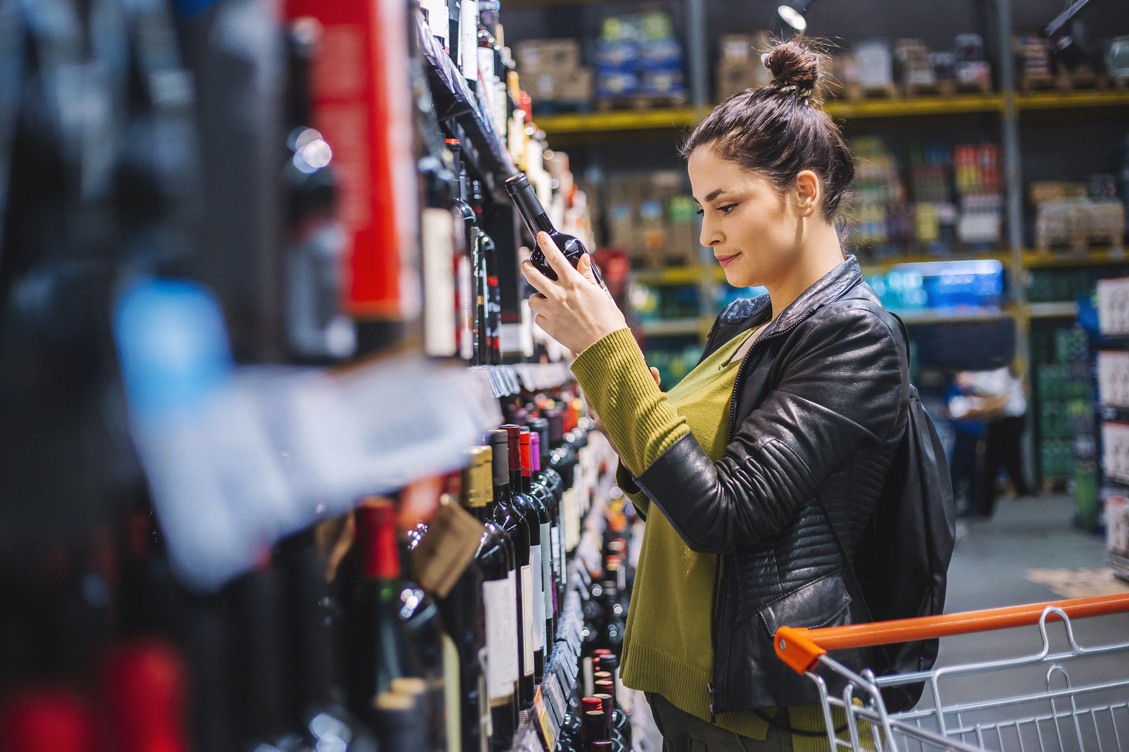
FMCG Essential Retail – What you need to know!
Share of Trade
Share of Trade
52 we data to 25.02.23
52 we data to 25.02.23
Share of Total Grocers
Value Change %
Share of Total Grocers
Value Change %
£ Spend per Visit
Penetration
£ Spend per Visit
Penetration
% Change
% Change
2022
2023
% Change
2022
% Change
2023
2022
2023
2022
2022
2023
2022
2023
2023
27.2% | 27.0% | 4.4% | 85.9 | 86.7 | 1.8% | 21.5 | 21.1 | -1.9%
13.8% | 13.6% | 3.7% | 66.8 | 68.8 | 3.8% | 27.2 | 26.9 | -1.1%
12.1% | 12.0% | 3.8% | 69.2 | 70.3 | 2.5% | 25.5 | 25.0 | -2.0%
10.8% | 11.6% | 12.8% | 66.2 | 69.0 | 5.1% | 28.1 | 27.7 | -1.2%
9.3% | 8.6% | -3.5% | 62.1 | 62.5 | 1.4% | 24.4 | 25.1 | 2.7%
7.7% | 8.4% | 14.5% | 58.9 | 63.9 | 9.3% | 26.3 | 23.9 | -9.0%
4.5% | 4.5% | 5.7% | 49.4 | 50.6 | 3.2% | 21.7 | 21.6 | -0.8%
4.3% | 4.0% | -2.6% | 25.5 | 26.3 | 3.7% | 9.3 | 9.1 | -1.4%
3.5% | 3.6% | 6.4% | 49.2 | 50.0 | 2.5% | 24.6 | 21.7 | -11.7%
2.6% | 2.6% | 5.3% | 49.9 | 52.3 | 5.7% | 15.9 | 15.2 | -4.3%
1.7% | 1.6% | 0.8% | 5.1 | 6.7 | 32.0% | 20.2 | 19.8 | -1.7%
Store Portfolio
Store Numbers as of 25.02.23
Store Numbers
Total
Convenience
Small
Large
Super
Mega
2722 | 1863 | 26 | 285 | 195 | 353
1397 | 811 | 43 | 170 | 143 | 230
587 | 1 | 133 | 86 | 113 | 254
498 | 2 | 10 | 186 | 245 | 55
3695 | 2696 | 823 | 176 | 0 | 0
332 | 23 | 50 | 207 | 44 | 7
1012 | 541 | 297 | 154 | 13 | 7
964 | 77 | 840 | 47 | 0 | 0
25 | 0 | 0 | 0 | 0 | 25
Value Index
(52 we 25.02.23)
Pre Family
New Family
Maturing Family
Life stage
Post Family
Older Couple
Older Singles
Established Family
114 | 96 | 102 | 102 | 94 | 104 | 92
79 | 96 | 79 | 98 | 100 | 109 | 107
90 | 140 | 139 | 129 | 102 | 85 | 71
83 | 104 | 83 | 84 | 95 | 115 | 103
89 | 147 | 147 | 129 | 85 | 89 | 75
101 | 84 | 78 | 91 | 93 | 85 | 162
105 | 71 | 36 | 75 | 89 | 131 | 121
126 | 110 | 121 | 106 | 87 | 103 | 75
95 | 70 | 48 | 59 | 88 | 122 | 145
68 | 57 | 118 | 125 | 96 | 98 | 102
117 | 76 | 106 | 76 | 143 | 98 | 71
Source: Nielsen Homescan SOT based on FMCG [New Base], Benchmark Total Grocers% Change Penetration = % Change in actual buyers
Penetration = Change in shoppers

Slide 2
FMCG Essential Retail
Tesco is expanding it’s existing meal deal offering by introducing a new ‘premium meal deal’ for £5. The new range from the UK’s largest retailer will sit alongside the standard meal deal in shops, and is set to include a wider variety of items, with brands such as itsu, YO! Sushi, Pollen and Grace, and items from the Tesco Finest range. The premium meal deal is currently available in 1,200 Tesco stores around the UK for £5 per head with a Clubcard, or £5.50 without. “We know that our Tesco Meal Deal is hugely popular with our customers, and is a lunchtime staple for millions of people day in, day out,” Chief Customer Officer, at Tesco, Alessandra Bellini said. Bellini added: “Featuring a wide range of mains including new Finest and Wicked Kitchen sandwiches and salads, as well as options from itsu, YO! Sushi and Pollen & Grace.
Sainsbury’s has ramped up plans to ban plastic packaging in stores by introducing a new vacuum-packed alternative across its beef mince range, saving 450 tonnes of plastic annually. In a UK supermarket first, the new packaging will result in a minimum 55% reduction in plastic per product. Customers will be able to purchase beef mince in the revamped packaging both in-store and online from today, and the change will be across all of the big 4 grocer’s beef mince products, currently retailing from £1.99 for 500g. “We know our customers expect us to be reducing the use of plastic across our products and we’re constantly looking for new ways to innovate to meet our Plan for Better plastic reduction targets,” director of product and innovation at Sainsbury’s Claire Hughes said.
ASDA has opened its 100th On The Move convenience store today in partnership with EG Group, marking a new milestone for both companies. Asda On the Move stores stock up to 2,500 products, including a selection of Asda’s premium ‘Extra Special’ range, and a more extensive range of fresh produce and chilled lines. They also feature EG-owned and operated foodservice brands and franchise partner offers such as Starbucks, KFC, Burger King, Greggs, Subway, and others.“The opening of the 100th Asda on the Move store is a milestone in our convenience journey to bring Asda’s great products to more customers through our partnership with EG Group,” senior director of wholesale and convenience at Asda, James Laws said.
Morrisons is set to re-launch and re-brand its Savers range as it looks to help shoppers amid the cost-of-living crisis and attract more customers. New products will be added to the value offering in coming weeks with brand new blue and white packaging in a bid to draw more shoppers to the lower-priced products. This follows on from the supermarket giant’s price reduction across 820 products in January, with a further investment of £25 million last month across an additional 64 items. IPLC Europe partner, Paul Stainton told The Grocer: “I’m not surprised Morrisons is making this move. Despite its investment in price cuts, its value range is very bland and doesn’t really stand out. “They will be looking to have the same impact as Asda Essentials which has made a point of having very bright packaging so it stands out in store.”
Source: NielsenIQ Homescan, Grocer & Nam News

Slide 3
FMCG Essential Retail
Waitrose is investing £100 million to lower the prices of over 300 everyday products in a bid to help households save during the cost-of-living crisis. Across hundreds of own-brand products, nearly a quarter of prices will be cut by 20% or more. Almost a third of the upmarket retailers lowest priced 900 product own-brand range, ‘Essential Waitrose’ will see price drops of 14% on average. “We understand that getting value for money has never been more important for everyone. So we’re cutting the prices of hundreds of everyday favourites from carrots to butter, and tea and coffee, with many cut by 20% or more,” Waitrose executive director, James Bailey said. “This means our customers can enjoy greater value in every shop, and by lowering prices in our Essential range we’re making our lowest prices even lower.
Aldi is set to invest over £400m as part of its hunt for new and refurbished sites across the UK. The discount grocer currently has more than 990 stores but looks to meet its current target of 1,200 sites across the UK in a bid to reach more shoppers. “Demand for Aldi has never been higher here are still some towns and areas that either don’t have access to an Aldi or have capacity for additional stores,” Aldi UK chief executive officer, Giles Hurley said. “To meet that demand, we need to open more stores and it’s our mission to keep driving our ambitious expansion plan to achieve that.”
Lidl’s has become the first discount supermarket to partner with WWF in a bid to halve the environmental impact of the average UK shopping basket by 2030.WWF is working with UK supermarkets to address their environmental impacts in seven key areas including climate, deforestation and conversion of habitat, agricultural production, marine, diets, food waste and packaging. As well as setting science-based net-zero targets aligned with 1.5 degrees across all scopes, Lidl has also confirmed alignment to WWF’s joint retailers’ climate action focus on reducing supply chain emissions.
“As the first UK discounter to work with WWF on this, we’re continuing to demonstrate that affordability and sustainability don’t have to be mutually exclusive, Lidl GB CEO, Ryan McDonnell said.
Source: NielsenIQ Homescan, Grocer & Nam News

Slide 4
FMCG Essential Retail
Iceland Foods has entered a 10-year partnership with Octopus Energy’s generation arm to be supplied with green power. The power, which will come from the Octopus-managed Breach solar farm in Cambridgeshire, will provide c.64 Gigawatt hours (GWh) of renewable energy every year to power 150 sites, which will cover 14% of Iceland’s electricity needs for its UK stores.As a result, the deal will reduce the frozen food retailers emissions by 23,000 tonnes of CO2, the equivalent of removing 12,000 petrol cars from the roads. “This partnership is an exciting step in our journey towards achieving net zero by 2040. It also gives us some clarity on our energy costs for the coming years – at a significant discount to the current wholesale price,” Iceland Foods CEO, Tarsem Dhaliwal said. “This helps to mitigate the impact of the volatility that has plagued the industry for the past 12 months.”
Coop has launched a ‘community fridge’ pilot in Greenacres, Manchester with the aim of fighting tackling food insecurity in local communities. A community fridge is a space that brings people together to eat, connect, learn new skills and reduce food waste. It is a site where local people can share food, including surplus from supermarkets, local food businesses, producers, households and gardens. Oldham council leader Amanda Chadderton and mayor of Greater Manchester Andy Burnham announced the project 1st March at the Greenacres Community Centre. The fridge will be run by community groups with the main purpose of saving fresh food from going to waste, more important than ever with current ongoing high costs of living and the climate crisis. “Our recent Greater Manchester Residents Survey found that 8 in 10 people say their cost of living has increased over the past month and around 70,000 more households are experiencing food insecurity compared to last spring,” mayor of Greater Manchester, Andy Burnham, said. He added: “People are clearly struggling and that’s why projects such as Community Fridges are so vital in providing a safety net for those who need it.
Ocado is set to launch its new Price Promise which looks to compare prices against over 10,000 like for like products at Tesco. This comes as the latest investment in value by the online-only supermarket to support its shoppers amid the cost-of-living crisis. The promise will compare prices and promotions on Tesco.com, including Clubcard deals. Alongside its range of over 700 own-label grocery lines and its collection of Everyday Savers, the Price Promise looks to offer customers lower prices on everyday staples. “At Ocado, everything we do starts with our customers and we know how important value is to them right now. We continue to support our customers by investing in price across branded and own-brand products,” Ocado Retail CEO, Hannah Gibson said.
Source: NielsenIQ Homescan, Grocer & Nam News

