Slide 1
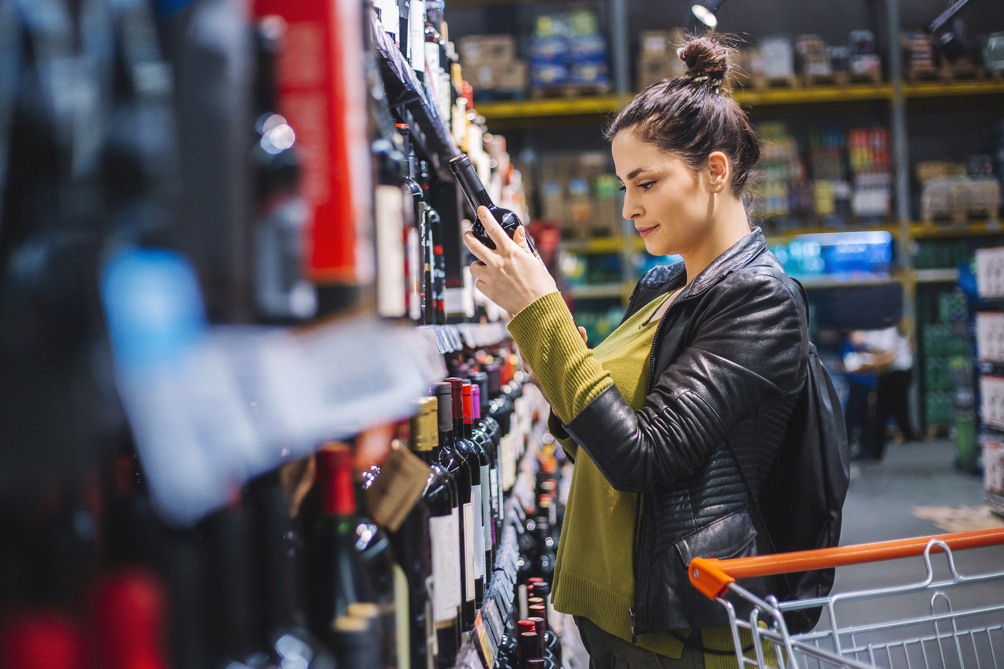
FMCG Essential Retail – What you need to know!
Share of Trade
52 we data to 25.03.23
Share of Total Grocers
Value Change %
Penetration
£ Spend per Visit
2022
2023
2022
2023
% Change
2022
2023
% Change
27.1% | 27.0% | 5.4% | 85.9 | 86.7 | 1.8% | 27.0 | 27.0 | -0.8%
13.7% | 13.6% | 5.0% | 66.8 | 69.0 | 4.0% | 25.3 | 25.0 | -0.1%
12.0% | 12.0% | 5.5% | 69.1 | 70.5 | 2.8% | 27.9 | 27.8 | -1.3%
10.8% | 11.7% | 14.6% | 66.4 | 69.2 | 5.0% | 24.3 | 25.2 | -0.3%
9.3% | 8.5% | -2.6% | 62.3 | 62.6 | 1.4% | 26.0 | 23.8 | 3.9%
7.8% | 8.5% | 15.4% | 59.4 | 64.1 | 8.8% | 21.6 | 21.7 | -8.5%
4.5% | 4.5% | 6.1% | 49.7 | 50.8 | 3.2% | 9.2 | 9.1 | 0.3%
4.3% | 4.0% | -1.5% | 25.8 | 26.4 | 3.3% | 24.2 | 21.5 | -1.1%
3.5% | 3.6% | 7.4% | 49.2 | 50.1 | 2.8% | 15.6 | 15.3 | -11.3%
2.6% | 2.6% | 6.3% | 50.0 | 52.3 | 5.4% | 20.0 | 19.9 | -2.2%
1.7% | 1.6% | 1.9% | 5.1 | 6.8 | 34.2% | 70.1 | 71.9 | -0.8%
Store Portfolio
Store Numbers as of 25.03.23
Store Numbers
Total
Convenience
Small
Large
Super
Mega
2750 | 1893 | 25 | 284 | 195 | 353
1399 | 813 | 43 | 171 | 142 | 230
588 | 1 | 134 | 86 | 113 | 254
498 | 4 | 10 | 184 | 245 | 55
3673 | 2677 | 821 | 175 | 0 | 0
331 | 22 | 50 | 207 | 44 | 7
1009 | 539 | 296 | 154 | 13 | 7
960 | 78 | 835 | 47 | 0 | 0
26 | 0 | 0 | 0 | 0 | 26
Value Index
(52 we 25.03.23)
Pre Family
New Family
Maturing Family
Life stage
Post Family
Older Couple
Older Singles
Established Family
113 | 95 | 103 | 101 | 93 | 104 | 92
77 | 97 | 80 | 98 | 100 | 109 | 108
89 | 140 | 140 | 129 | 103 | 85 | 71
84 | 102 | 80 | 86 | 97 | 115 | 104
88 | 149 | 148 | 128 | 85 | 89 | 74
104 | 84 | 78 | 91 | 92 | 85 | 162
110 | 70 | 36 | 73 | 90 | 130 | 121
122 | 113 | 119 | 108 | 89 | 103 | 76
100 | 69 | 47 | 63 | 89 | 120 | 143
71 | 58 | 116 | 120 | 97 | 98 | 103
122 | 74 | 105 | 79 | 142 | 99 | 70
Source: Nielsen Homescan SOT based on FMCG [New Base], Benchmark Total Grocers% Change Penetration = % Change in actual buyers
Penetration = Change in shoppers

Slide 2
FMCG Essential Retail
Tesco is donating £5m to help boost school funds for extra food and healthy activities as part of a new initiative launching this summer. “Tackling classroom hunger is vitally important in helping children get a stronger start in life,” said Tesco CEO Jason Tarry. “Children with enough food have more energy, better concentration and ultimately do better in school. As a business that is at the heart of communities, we know that urgent action is needed to improve the lives and prospects of young people. We hope our initiative will help families and schools that are struggling to keep children fed.” Recent data from Groundwork revealed that 78% of schools are currently having to provide food for children from their own budget
Sainsbury’s has opened a new Local store in Leeds city centre, as the UK’s second-largest grocer reveals that its convenience stores have achieved sales of £3 billion for the first time. The supermarket giant is focusing on expanding its convenience business, which currently comprises over 800 stores across the UK. “We know how much customers value being able to shop when and how they want, particularly in the post-pandemic world,” said Sainsbury’s retail and digital director, Clo Moriarty. “Convenience is a growing part of our business and seeing our convenience stores reach today’s £3 billion sales milestone is a huge achievement and testament to how we are delivering what customers want.
ASDA is catering to Muslim customers by launching new shelves dedicated to Ramadan in 150 stores nationwide, an increase of 47% from last year. The supermarket giant, bought by Muslim brothers Zuber and Mohsin Issa in a £6.8m deal in 2020, will add 150 new product lines across all categories for the holy month. The stores with the new Ramadan themed aisles will be in key areas with high Muslim populations, such as Wembley, Leicester and Sheffield. Asda will be stocking Halal products, tinned ingredients, frozen food, baked goods, fresh fruit, and vegetables for the event, with store cupboard essentials like 10kg Elephant Atta flour for £7 and 10kg Trophy Basmati rice at £13. Director at Beacon Confectionary Ltd, Paul Dudley, believes it was important to introduce chocolate countdown calendars for Ramadan, after spotting a huge gap in the market and lack of variety available. Dudley said: “This is the first year we have launched our products in Asda. By working with Asda, we can reach out to a wider audience, especially through its extensive Ramadan aisle.”
Morrisons has launched a new traditional roast deal for the Easter holidays that will offer a leg of lamb and all the trimmings for under £24. All items included in the meal are British and customers can pick up a tender leg of lamb, parsnips, carrots, savoy cabbage, potatoes, mint sauce, and a cheesecake for dessert for just £23.82. The Easter roast meal will be available in all Morrisons nationwide and online from Monday 3 April. In total, the new deal means the entire roast will feed six and cost less than £4 per person. The supermarket chain is assisting British farmers mitigate ongoing cost pressures to meet demand. As a result, Morrisons is now working with over 700 lamb farmers across the UK in which it stays committed to only selling fresh lamb that is 100% British. “Our Easter meal will help people come together to enjoy delicious, fresh food at an affordable price and because roast lamb would not be the same without it, mint sauce is included!”
Source: NielsenIQ Homescan, Grocer & Nam News

Slide 3
FMCG Essential Retail
Waitrose has unveiled that it plans to launch a major £250 million revamp of 332 UK stores to win back more shoppers. The plans come as Waitrose experiences a drop in its market share as shoppers flock to discount supermarkets for better deals amid the ongoing cost-of-living crisis. The John Lewis-owned supermarket has now executed a turnaround plan with US consultant Bain. Waitrose has reduced the range of products stocked on its shelves on the advice of the consultant to reduce “duplication” and boost sales. Bain’s work with Waitrose, which focused on improving efficiency within stores, began in the middle of last year and has since been completed.. The move to try to make Waitrose more efficient is understood to have been orchestrated by executive director James Bailey and commercial director Charlotte Di Cello, who are keen to free up capital to invest into modernizing stores.
Aldi is set to invest over £400m as part of its hunt for new and refurbished sites across the UK. The discount grocer currently has more than 990 stores but looks to meet its current target of 1,200 sites across the UK in a bid to reach more shoppers. Aldi is currently on the lookout for freehold town-centre or edge-of-town sites that are around 1.5 acres and can accommodate a 20,000sq foot store with around 100 parking spaces. “Demand for Aldi has never been higher here are still some towns and areas that either don’t have access to an Aldi or have capacity for additional stores,” Aldi UK chief executive officer, Giles Hurley said. “To meet that demand, we need to open more stores and it’s our mission to keep driving our ambitious expansion plan to achieve that.”
Lidl’s is expanding its plant-based range as it looks to meet the demands of vegan customers, putting a focus on the supermarkets long-term sustainability. The German discounter is aiming to increase its plant-based range ‘through 2025 and beyond’. Currently, Lidl’s own plant-based line-up, ‘Vemendo’, has increased to more than 50 private label products since its launch two years ago. The retailer also intends to publish a sustainability report later this year, with a focus on “key differences between animal and plant-based foods.” Lidl corporate engagement director, Stephanie Jaczniakowska-McGirr said: “Lidl has taken a bold and necessary step to help consumers transition to a more plant-based diet. “We urge other retailers to follow in the footsteps of Lidl and actively increase their plant-based offerings to support the growing number of people following flexitarian, vegetarian and vegan diets,” she added.
Source: NielsenIQ Homescan, Grocer & Nam News

Slide 4
FMCG Essential Retail
Iceland has redistributed over 3.5 million meals to local communities since January 2022, having surpassed its target of donating three million meals to tackle food waste in the UK. With the financial year ending on March, the frozen food retailer says it is on track to hit four million before the end of the month. In partnership with food sharing app Olio, Iceland has also reached the milestone of redistributing 1 million meals through the platform. In addition to their partnership with Olio, surplus food is offered free of charge to store colleagues, converted into animal feed, or used to produce electricity and compost through anaerobic digestion. Iceland has saved up to 1,518 tonnes worth of food so far – weighing the equivalent to seven blue whales or 125 double decker buses. “executive chairman of Iceland Foods, Richard Walker said. “We are thankful to be able to work with partners such as Olio to support local communities with food that otherwise would have gone to waste. “We have committed to reducing food and drink waste by 50% by 2030, and it is great to see we are on track to achieve our goals, as taking action against food waste remains one of our top priorities,”.
Coop has joined forces with Trafford Council and Starship Technologies to offer the online delivery service to 24,000 residents in the Sale area. The robots are lightweight and travel at human walking pace, no faster than 4mph (6km/h), and can detect cars. The scheme has previously been trialled in Leeds, Milton Keynes and Northampton. The service is available from Co-op stores in Washway Road and Coppice Avenue.
Mother-of-two Sally Jones recently used the robot and told BBC North West Tonight that "it was so much fun". She added: "It played Baby Shark after we took the shopping out and then went off down the road. "The boys were so excited."Another shopper Karen Smith said she now wanted to sign up to use the service as "all my neighbours are using it - they are loving it". Co-op's e-commerce director Chris Conway said: "We are committed to exploring new and innovative ways to increase access to our products and services, and delighted to be able to roll out autonomous robots to provide additional online flexibility and choice in Greater Manchester."
Ocado are celebrating. The UK High Court ruled in favour of Ocado in the patent infringement case brought by AutoStore. The case concerned robotic warehousing and, in particular, the technology underpinning the Ocado Smart Platform which is being rolled out in multiple countries across the world. The ruling establishes that Ocado’s activities do not infringe AutoStore’s patents in the UK and that Ocado is free to operate its own proprietary technology, in which it has invested over $1 billion to date. For AutoStore, the decision severely undermines the value of its intellectual property, since the judge found that AutoStore’s core patents were invalid, as well as not being infringed by Ocado.
Source: NielsenIQ Homescan, Grocer & Nam News

