Slide 1
Sea Fish – Frozen Fish by Retailer
Data to WE 31.12.2022
Presenter’s Name
Date

Slide 2
Contents
Category Overview
KPIs of Frozen Fish across Retailers
Retailer Shifting – Frozen Fish
Shifting - Fresh:Frozen:Ambient
Demographics – Frozen Fish

Slide 3
Executive Summary
Frozen fish continues to decline in basket size, penetration and shifting.
Increased basket size helped Co-op, Iceland and M&S gain . Shoppers are typically buying less often.
AWOP is the major driver for M&S’s growth. Shifting is mainly from Iceland followed Lidl and Aldi
Frozen fish sales overindex from affluent older couples, of class AB, aged 45+ with 2 members in family, located at London and Central.

Slide 4
Category Overview

Slide 5
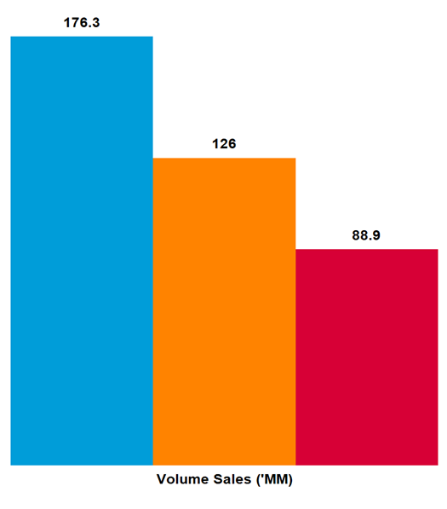
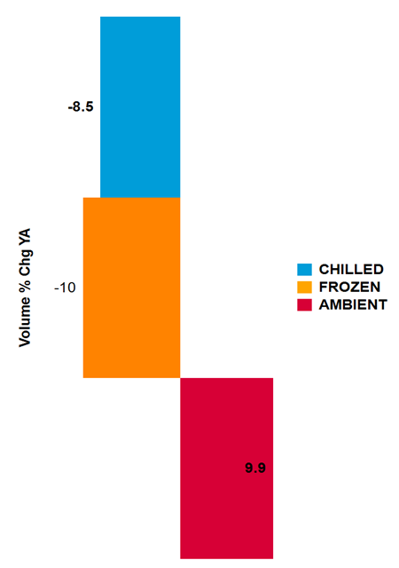
TOTAL CATEGORY VOLUME in decline (-23.1M KG’S) WITH chilled driving much of this
Fish| Segment Trends (Volume) | Total Coverage UK including Discounters | MAT TY vs YA - Data to WE 31.12.2022
Source – Nielsen Scantrack, Data to WE 31.12.2022

Slide 6
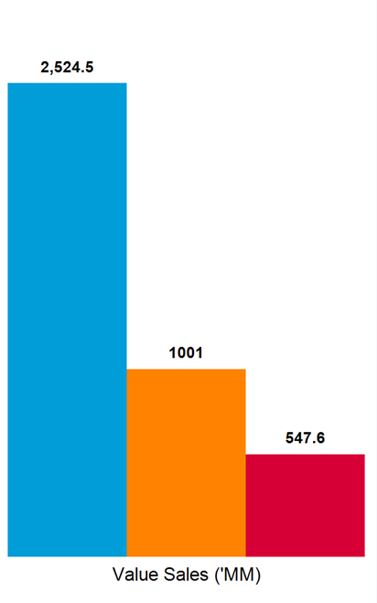
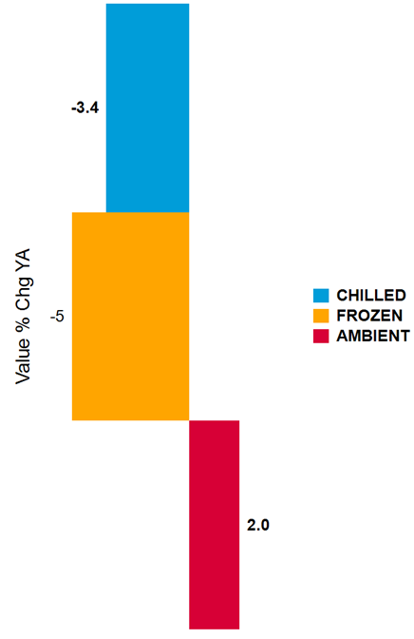
CHILLED AND FROZEN sales HINDER VALUE CATEGORY GROWTH​
Fish| Segment Trends (Value)| Total Coverage UK including Discounters| MAT TY vs YA - Data to WE 31.12.2022
Source – Nielsen Scantrack, Data to WE 31.12.2022

Slide 7
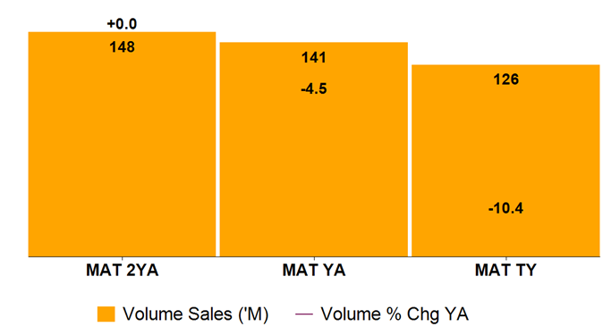
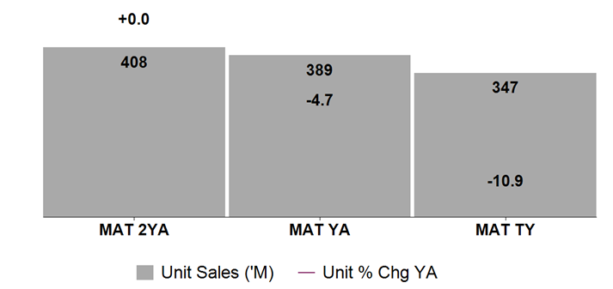
VALUE SALES DOWN 4.7% DESPITE INCREASE IN PRICE AS CONSUMERS BUY LESS
Fish| Frozen Fish Trends | Total Coverage UK including Discounters | 3 x MAT to 31.12.2022
Source – Nielsen Scantrack, Data to WE 31.12.2022

Slide 8
Market Summary’s

Slide 9
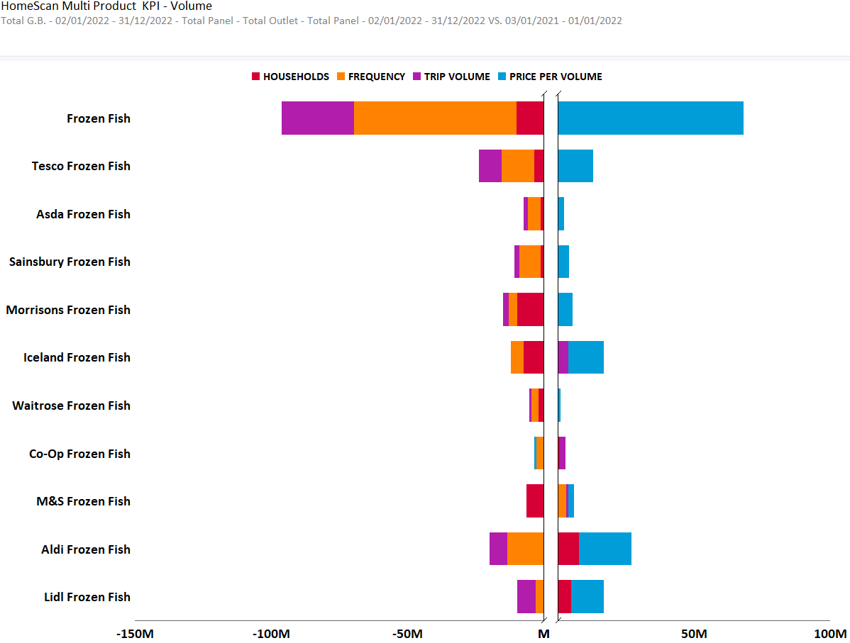
TOTAL FROZEN FISH – KPIS BY RETAILER SUMMARY
CATEGORY GROWTH IN DECLINE DUE TO DECREASED TRIP VOLUME, FREQUENCY AND A DECREASE IN PENETRATION. ONLY ICELAND AND COOP SEE INCREASED TRIP VOLUME.

Slide 10
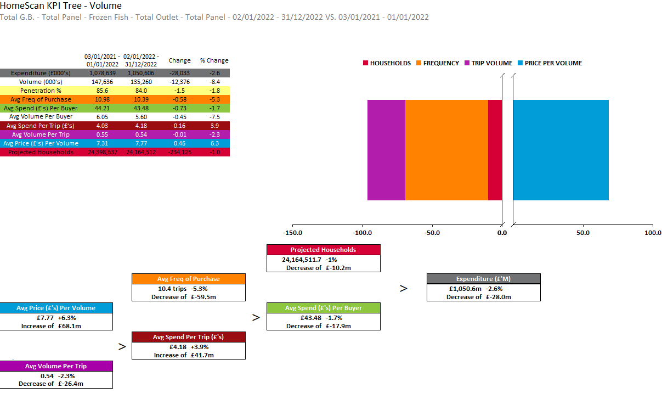
TOTAL FROZEN FISH
CATEGORY GROWTH IN DECLINE DUE TO DECREASED TRIP VOLUME, FREQUENCY AND A DECREASE IN PENETRATION.

Slide 11
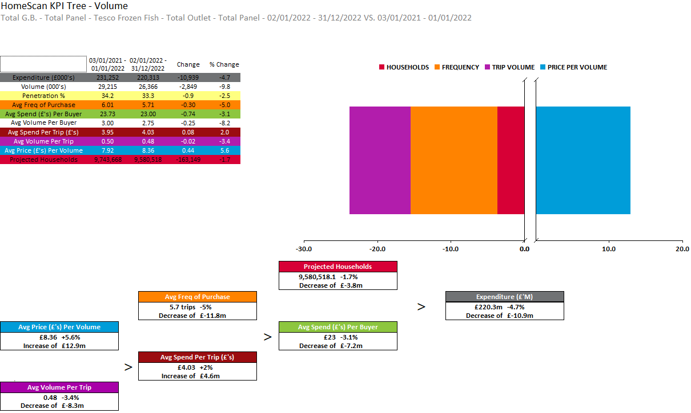
TESCO
CATEGORY GROWTH IN DECLINE AT TESCO DUE TO DECREASED TRIP VOLUME, FREQUENCY AND A DECREASE IN PENETRATION.

Slide 12
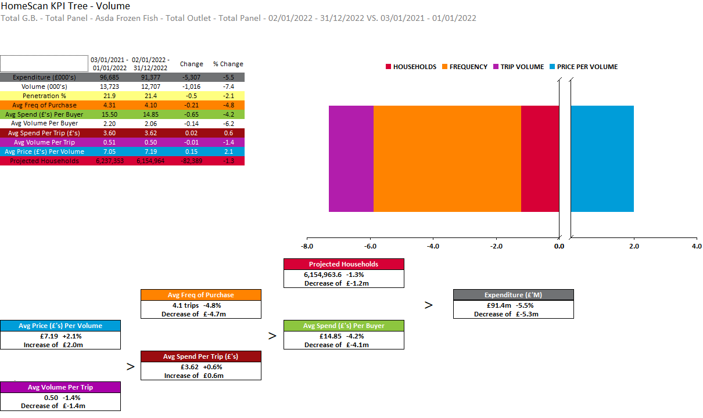
ASDA
CATEGORY GROWTH IN DECLINE AT ASDA DUE TO DECREASED TRIP VOLUME, FREQUENCY AND A DECREASE IN PENETRATION.

Slide 13
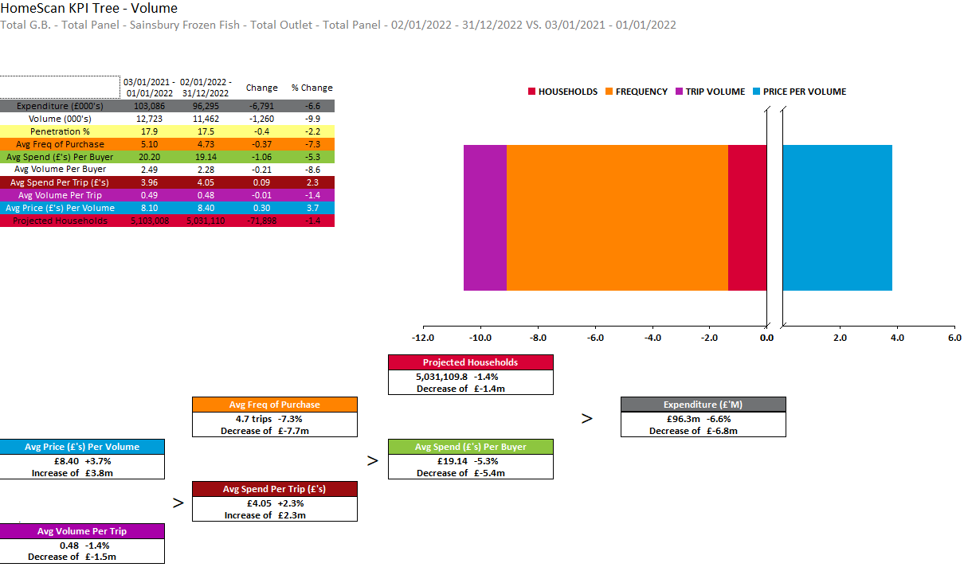
SAINSBURY
CATEGORY GROWTH IN DECLINE AT SAINSBURYS DUE TO DECREASED TRIP VOLUME, FREQUENCY AND A DECREASE IN PENETRATION.

Slide 14
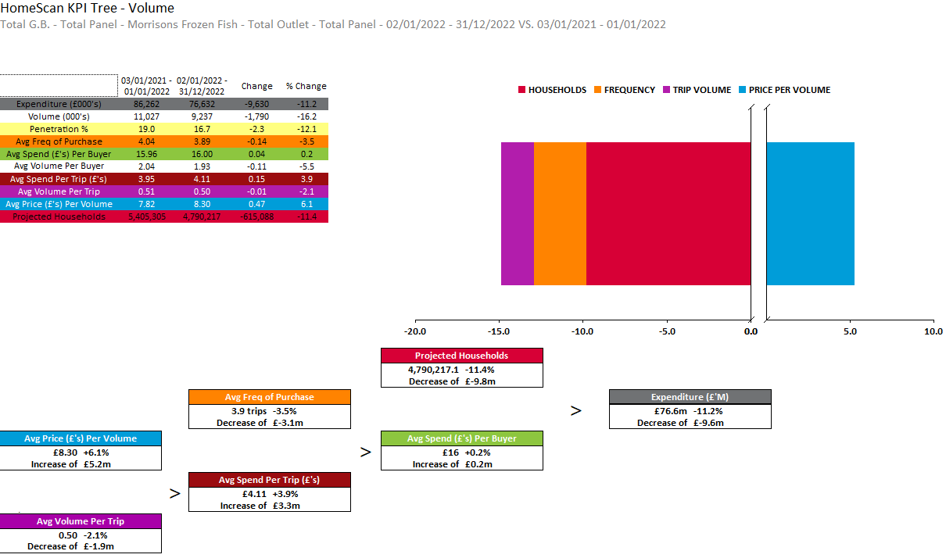
MORRISONS
CATEGORY GROWTH IN DECLINE AT MORRISON’S DUE TO DECREASED TRIP VOLUME, FREQUENCY AND A DECREASE IN PENETRATION.

Slide 15
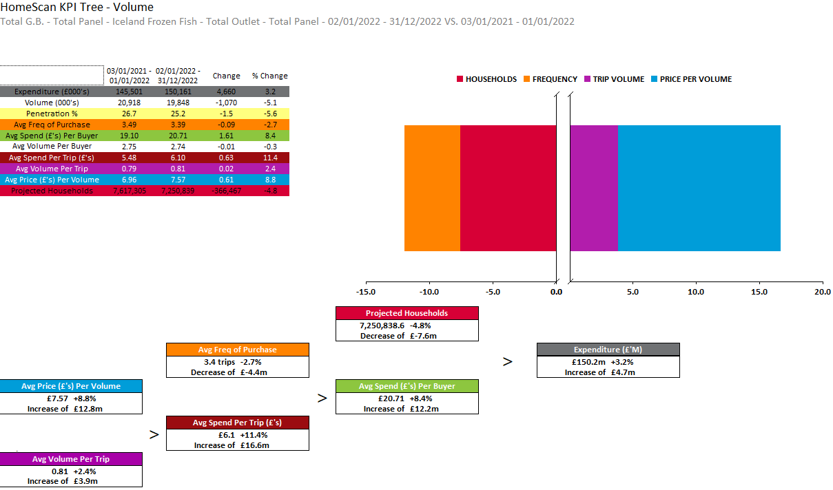
ICELAND
ICELAND SEE TRIP VOLUME INCREASE UNLIKE THE MAJORITY OF RETAILERS. PENETRATION AND FREQUENCY OF PURCHASE IN DECLINE.

Slide 16
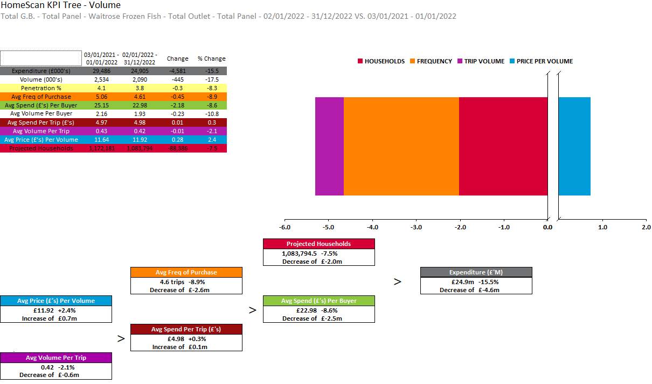
WAITROSE
CATEGORY GROWTH IN DECLINE AT WAITROSE DUE TO DECREASED TRIP VOLUME, FREQUENCY AND A DECREASE IN PENETRATION.

Slide 17
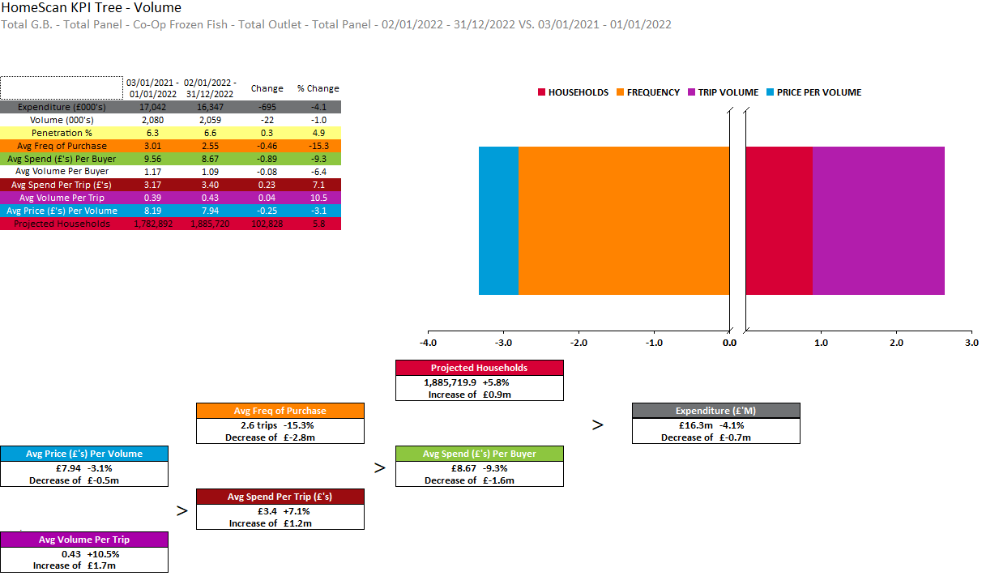
CO-OP
COOP SEE TRIP VOLUME INCREASE AND PENETRATION INCREASE UNLIKE THE MAJORITY OF RETAILERS. PRICE AND FREQUENCY OF PURCHASE IN DECLINE.

Slide 18
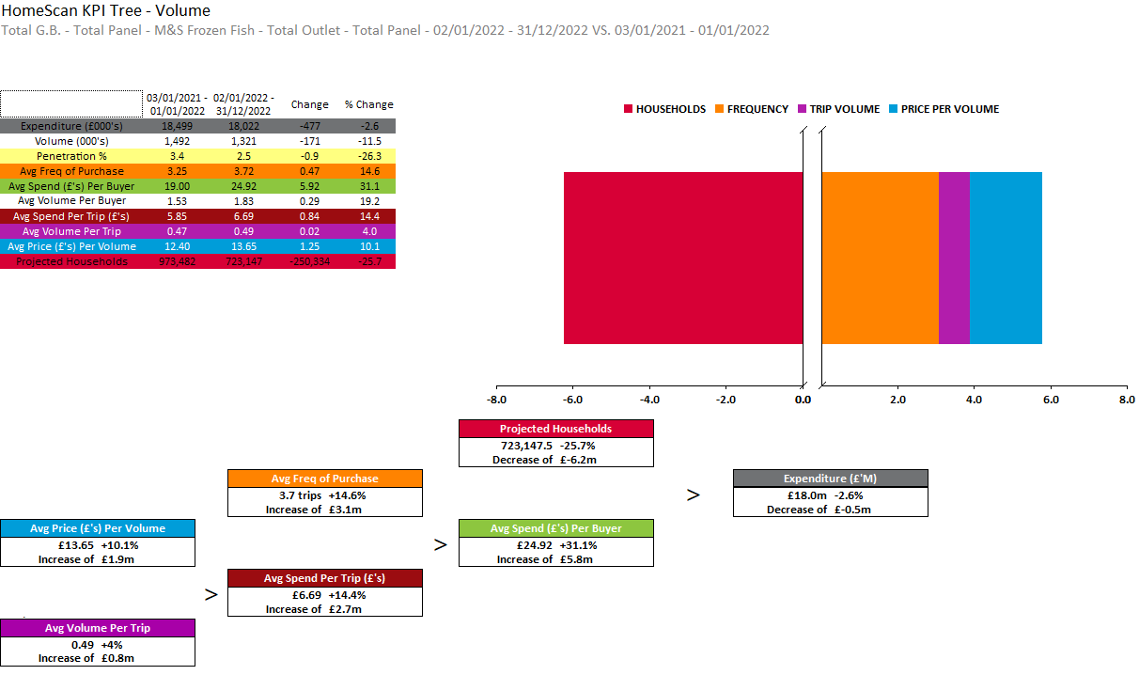
M&S
M&S SEES DECREASE IN PENETRATION HOWEVER FREQUENCY OF PURCHASE AND TRIP VOLUME SHOW INCREASES.

Slide 19
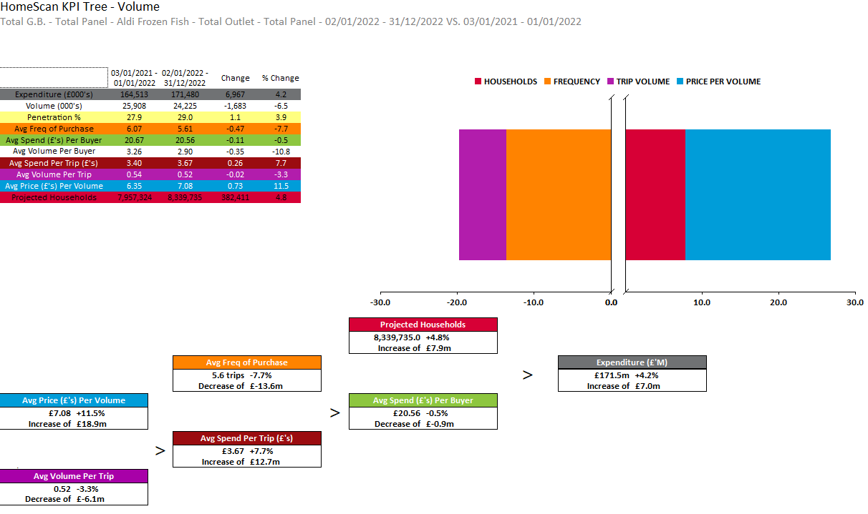
ALDI
ALDI IS IN GROWTH THROUGH INCREASED HOUSEHOLDS AND PRICE IN THE LATEST MAT.

Slide 20
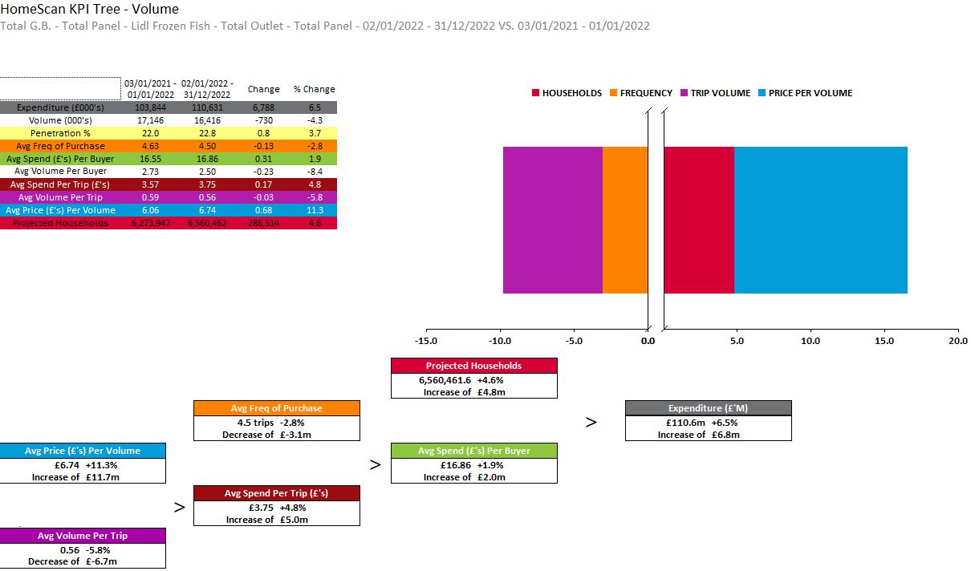
LIDL
LIDL IS GROWING WITH INCREASED HOUSEHOLDS AND PRICE IN THE LATEST MAT.

Slide 21
Source of Growth & Shifting by Retailers

Slide 22
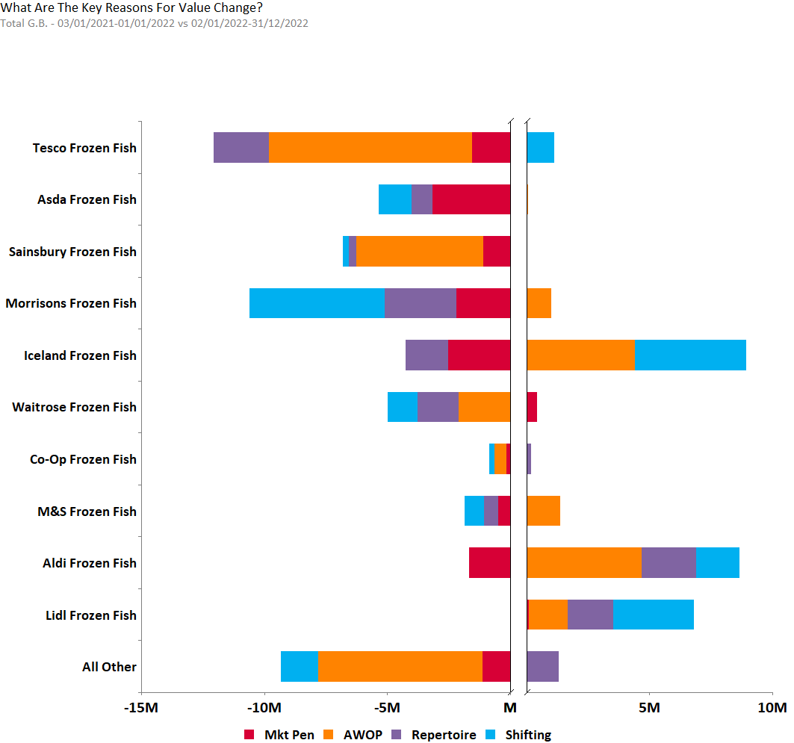
FROZEN FISH – SOURCE OF GROWTH BY RETAILER
Source – Nielsen Homescan Data to 52 WE 31.12.2022 vs YA

Slide 23
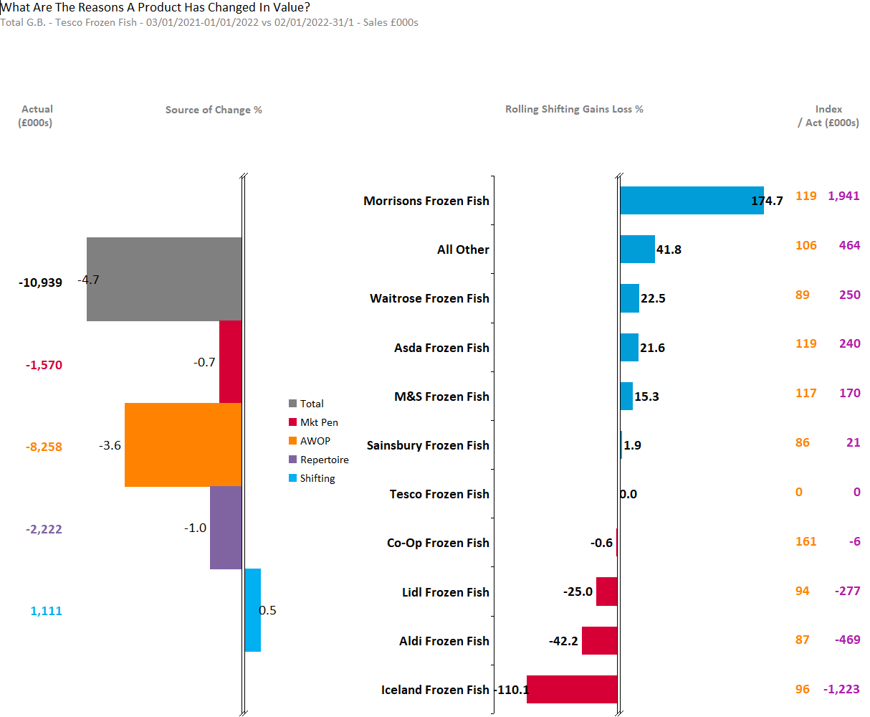
TESCO
ALL THE KEY MEASURES ARE DRIVING TESCO’S DECLINE EXCEPT SHIFTING. SHIFTING IS GROWING MAINLY FROM MORRISONS, ALL OTHER ,WAITROSE FOLLOWED BY ASDA AND M&S .
Source – Nielsen Homescan Data to 52 WE 31.12.2022 vs YA

Slide 24
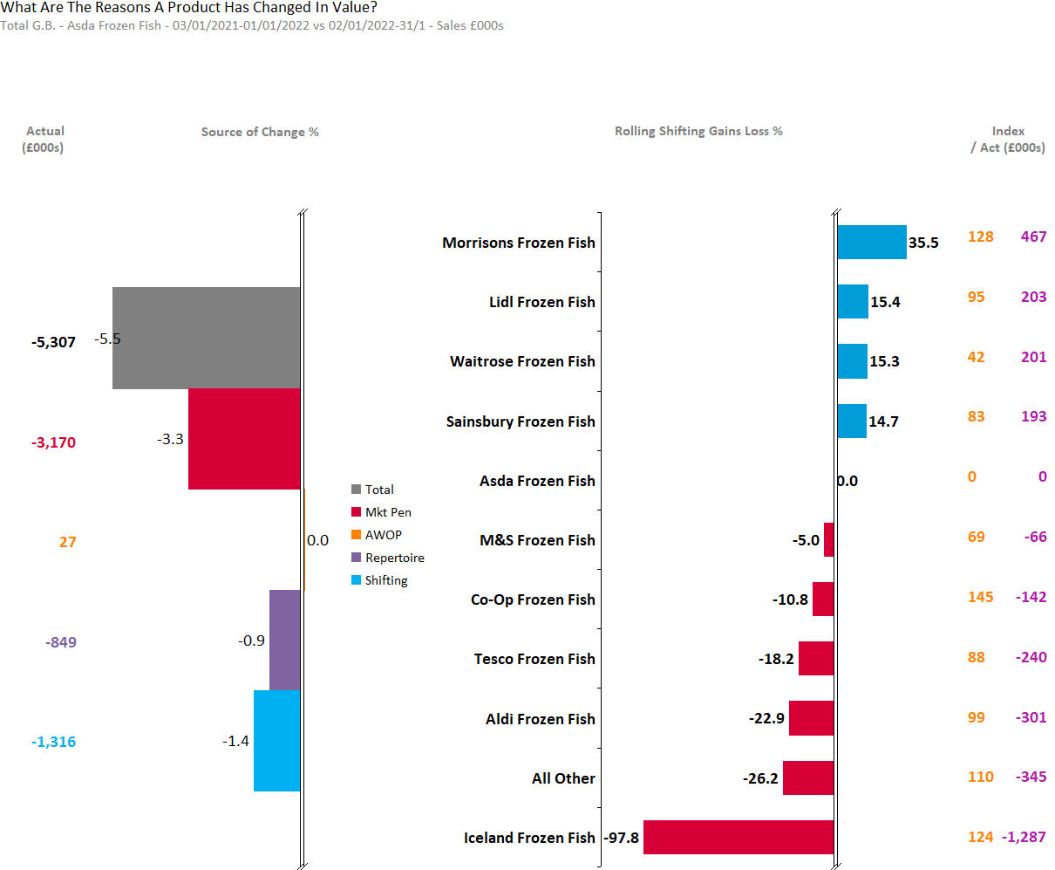
ASDA
ASDA’S DECLINE IS MAINLY DRIVEN BY MARKET PENETRATION. SHIFTING LOSSES IS SEEN TO ICELAND FOLLOWED BY M&S ,CO-OP ,TESCO AND ALDI
Source – Nielsen Homescan Data to 52 WE 31.12.2022 vs YA

Slide 25
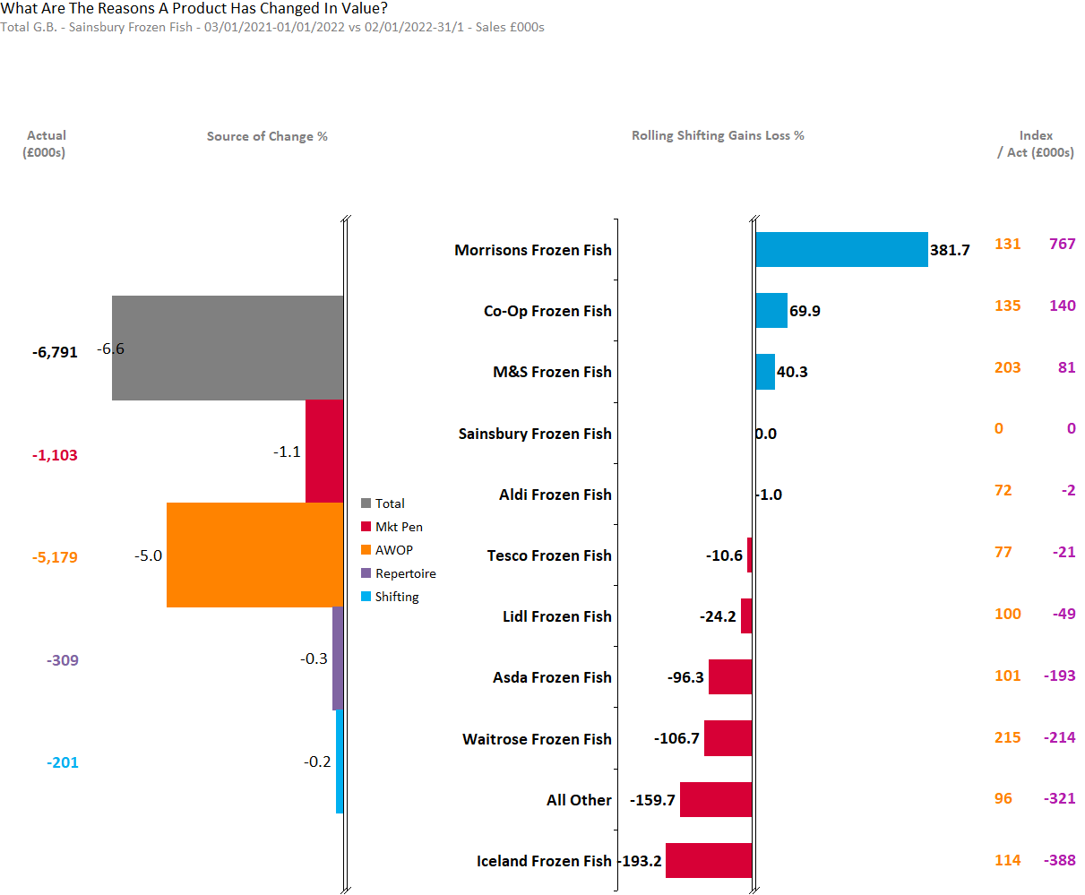
SAINSBURY
AWOP IS THE MAJOR DRIVER FOR SAINSBURY’S DECLINE. SHIFTING GAINS IS MAINLY FROM CO-OP, MORRISONS, M&S AND SAINSBURY
Source – Nielsen Homescan Data to 52 WE 31.12.2022 vs YA

Slide 26
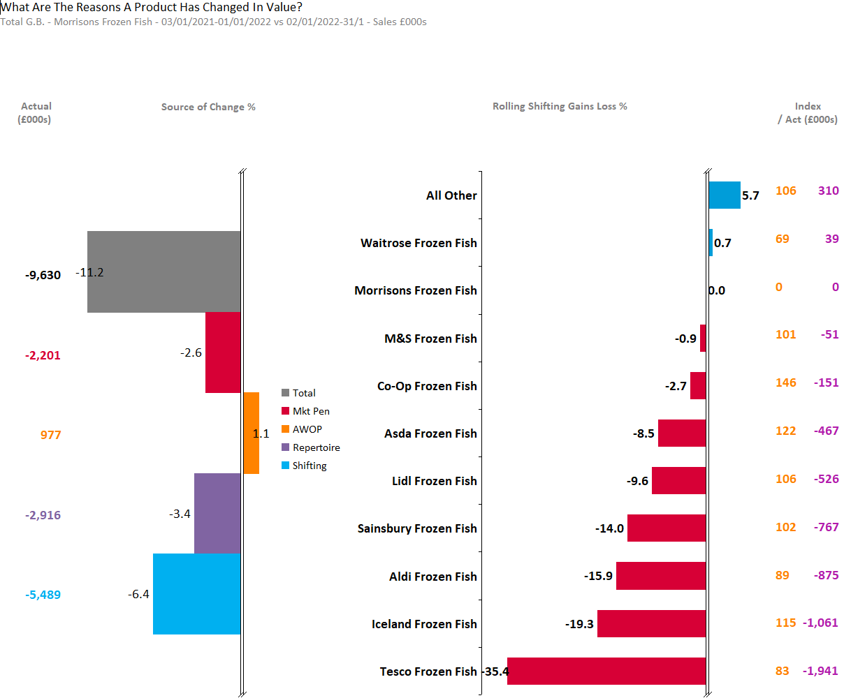
MORRISONS
MORRISON’S DECLINE IS MAINLY DRIVEN BY SHIFTING LOSSES. SHIFTING IS GROWING ONLY BY WAITROSE WITH SHIFTING LOSSES TO THE MAJORITY OF OTHER RETAILERS.
Source – Nielsen Homescan Data to 52 WE 31.12.2022 vs YA

Slide 27
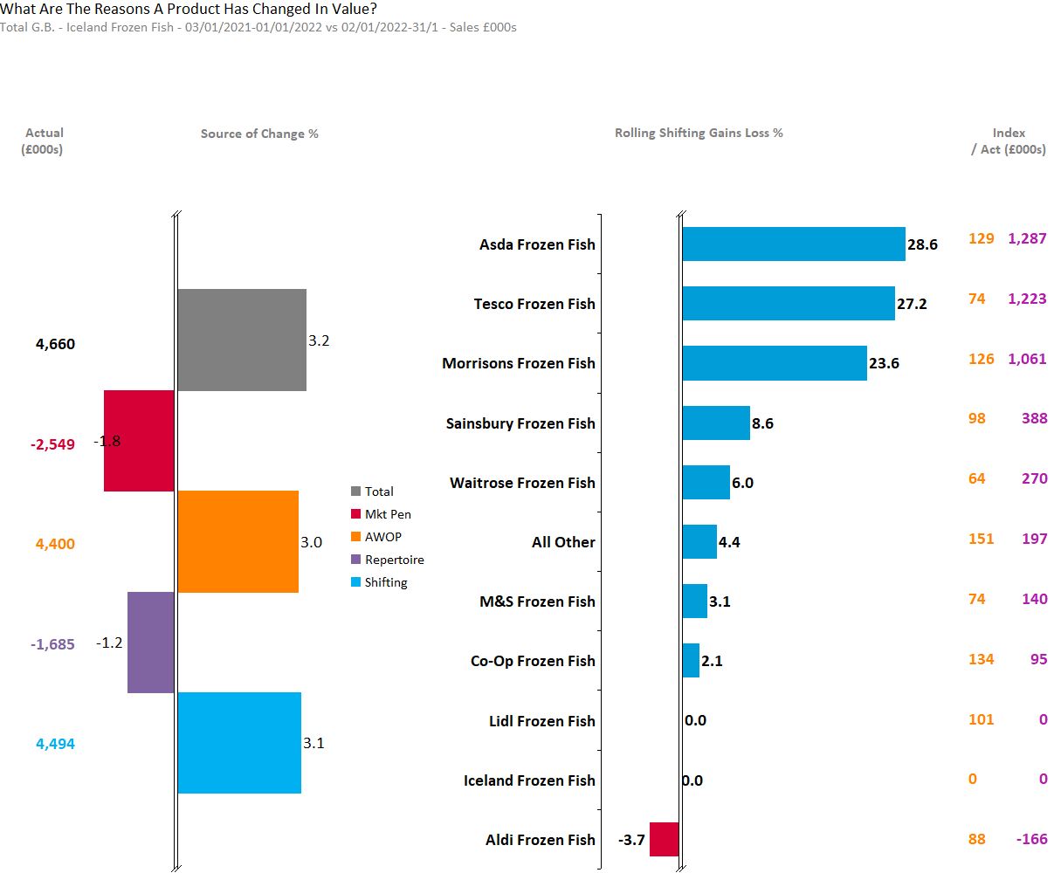
ICELAND
ICELAND GROWTH COMES FROM AWOP AND SHIFTING GAINS . SHIFTING GAINS COME FROM ALL RETAILERS EXCEPT ALDI
Source – Nielsen Homescan Data to 52 WE 31.12.2022 vs YA

Slide 28
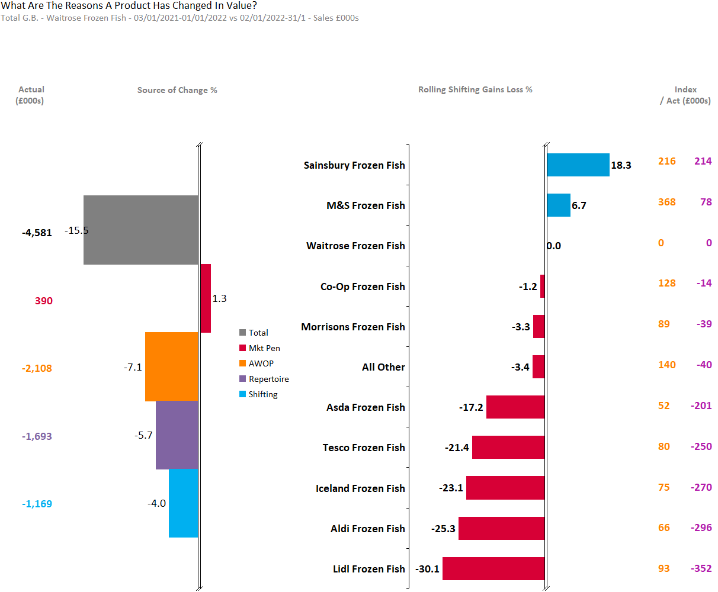
WAITROSE
WAITROSE DECLINE DRIVEN BY ALL MEASURES EXCEPT PENETRATION WITH SHIFTING LOSSES TO LIDL, ALDI, ICELAND, TESCO AND ASDA.
Source – Nielsen Homescan Data to 52 WE 31.12.2022 vs YA

Slide 29
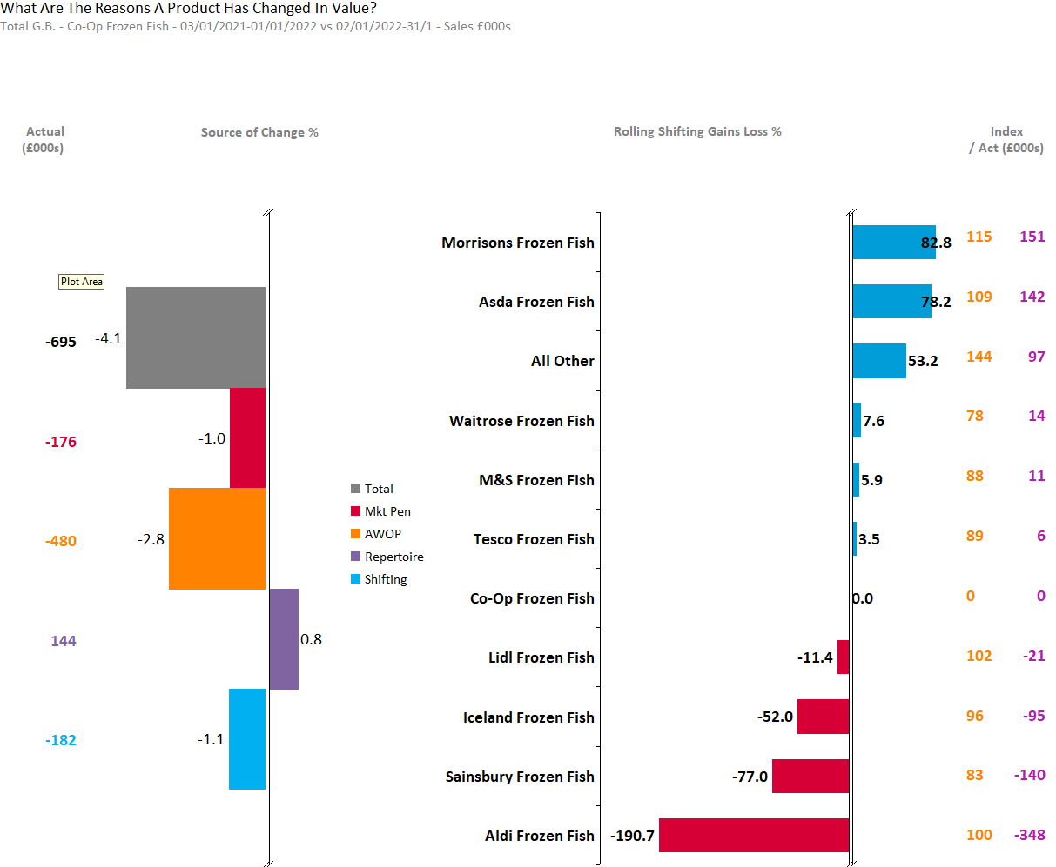
CO-OP
COOP DECLINE DRIVEN BY AWOP AS WELL AS PENETRATION AND SHIFTING DECLINES. SHIFING DECLINES COME FROMM ALDI, SAINSBURY’S, ICELAND AND LIDL.
Source – Nielsen Homescan Data to 52 WE 31.12.2022 vs YA

Slide 30
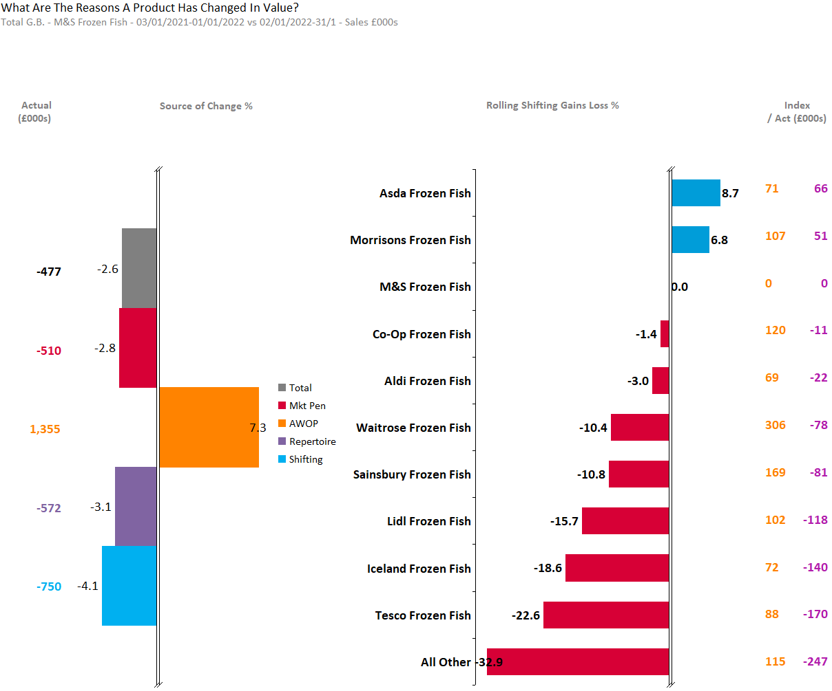
M&S
M&S IN DECLINE DESPITE AWOP GAINS. SHITING LOSSES TO ALL RETAILERS EXCEPT ASDA AND MORRISONS.
Source – Nielsen Homescan Data to 52 WE 31.12.2022 vs YA

Slide 31
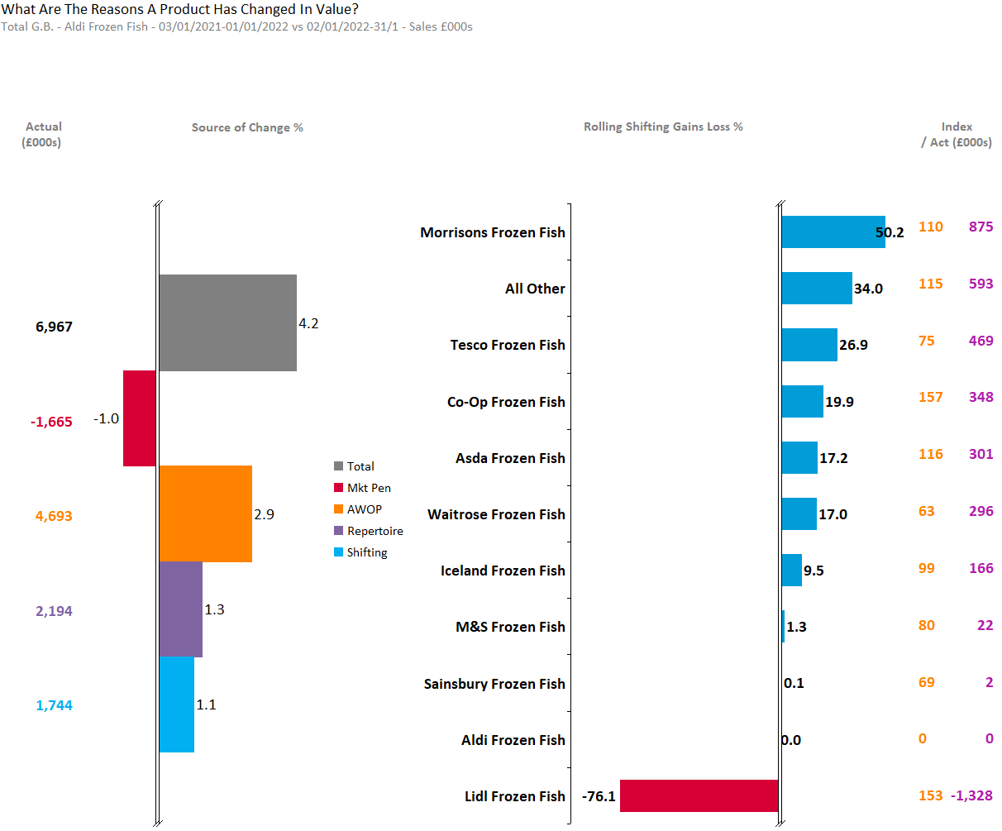
ALDI
ALDI PERFORMS STRONGLY WITHH SHIFTING GAINS FROM ALL RETAILERS EXEPT LIDL.
Source – Nielsen Homescan Data to 52 WE 31.12.2022 vs YA

Slide 32
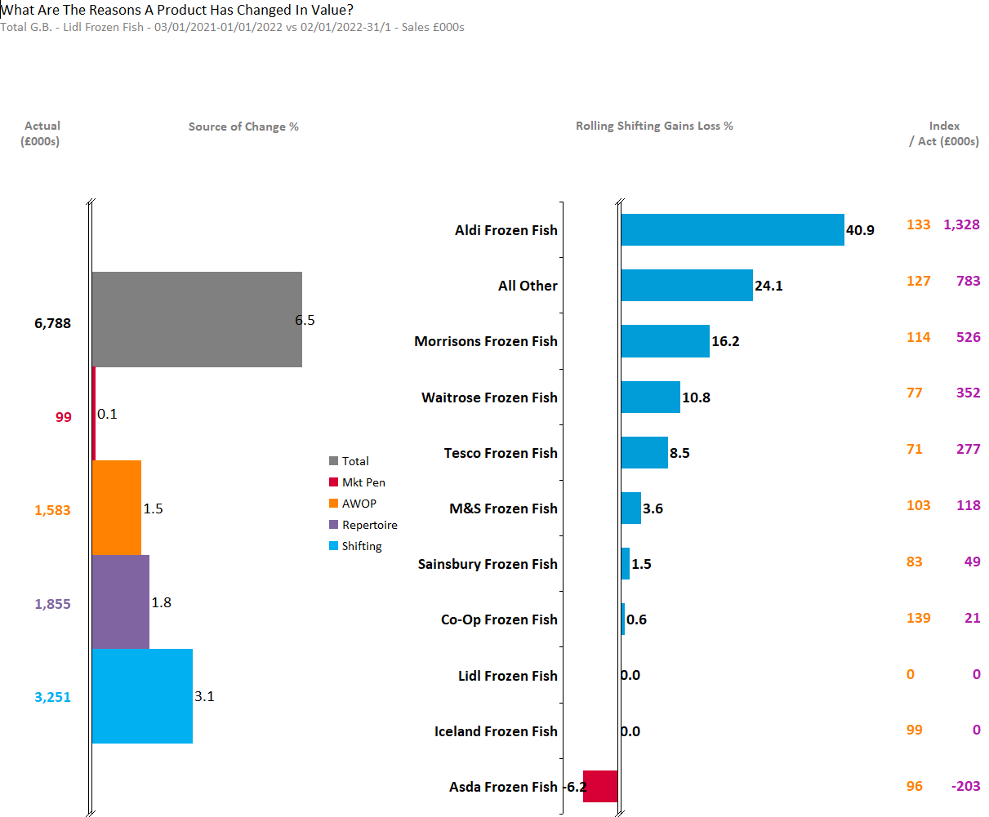
LIDL
LIDL PERFORMS STRONGLE WITH SHIFTING GAINS FROM ALL RETAILERS EXCEPT ASDA.
Source – Nielsen Homescan Data to 52 WE 31.12.2022 vs YA

Slide 33
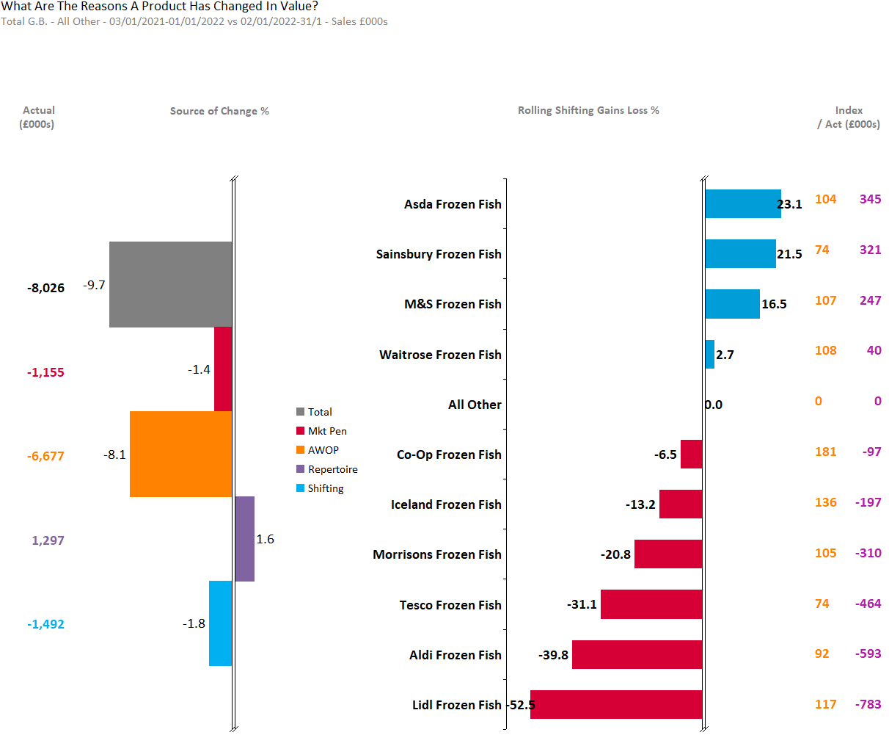
ALL OTHER
ALL OTHER RETAILERS SEE 9.7% DECLINE WITH LOSSES IN PENETRATION, AWOP AND SHIFTING.
Source – Nielsen Homescan Data to 52 WE 31.12.2022 vs YA

Slide 34
Shifting by Category – Frozen, Chilled, Ambient
Value

Slide 35
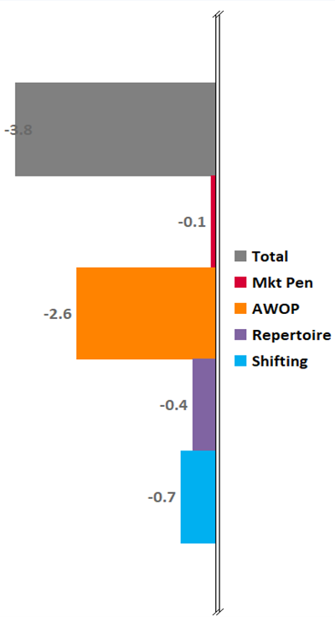
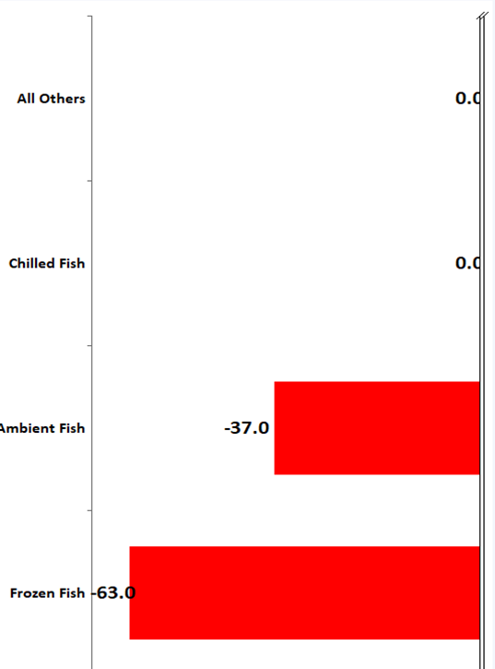
CHILLED FISH
Source – Nielsen Homescan Data to 52 WE 31.12.2022 vs YA

Slide 36
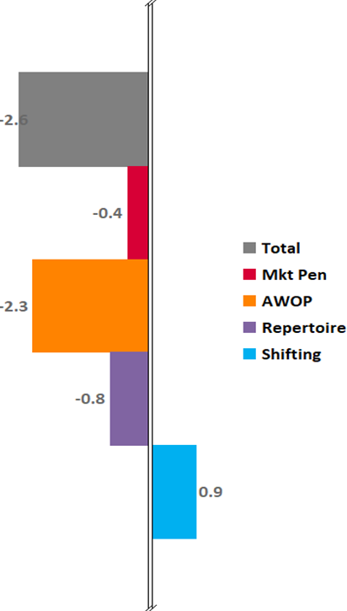
FROZEN FISH
Source – Nielsen Homescan Data to 52 WE 31.12.2022 vs YA

Slide 37
AMBIENT FISH
Source – Nielsen Homescan Data to 52 WE 31.12.2022 vs YA

Slide 38
Demographics by Total GB & Retailers

Slide 39
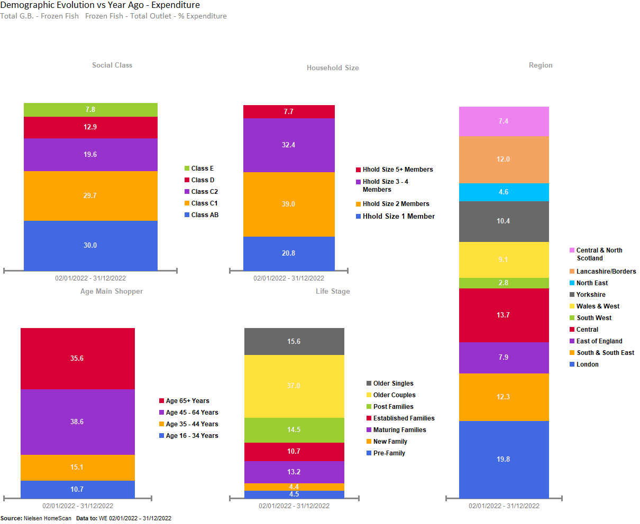
FROZEN FISH SALES PROMINANT FROM AFFLUENT, OLDER COUPLES, OF CLASS AB, AGED 45+, WITH 2 MEMBERS IN FAMILY, LOCATED AT LONDON AND CENTRAL.

Slide 40
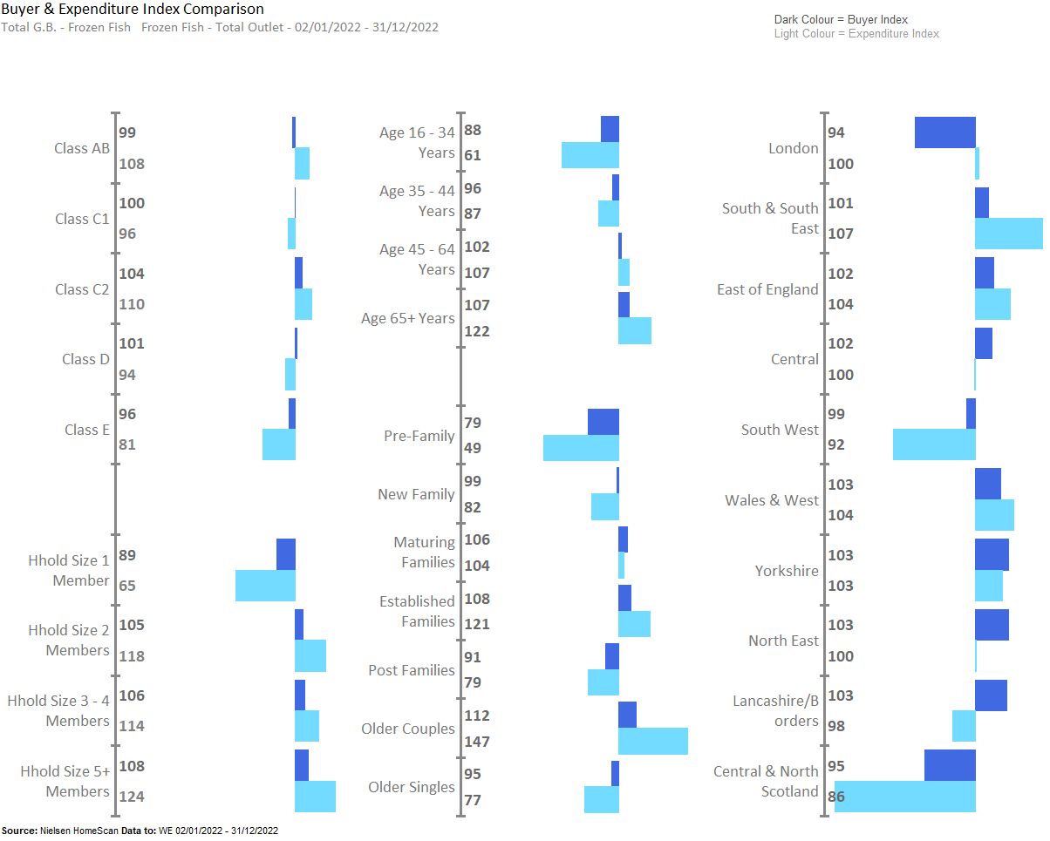
FROZEN FISH SALES UNDERINDEX AMONGST PRE- FAMILY, WHILST OVERINDEX AMONGST THOSE LIVING IN EAST OF ENGLAND, SOUTH & SOUTH EAST , WALES AND WEST , YORKSHIRE AND NORTH EAST

Slide 41
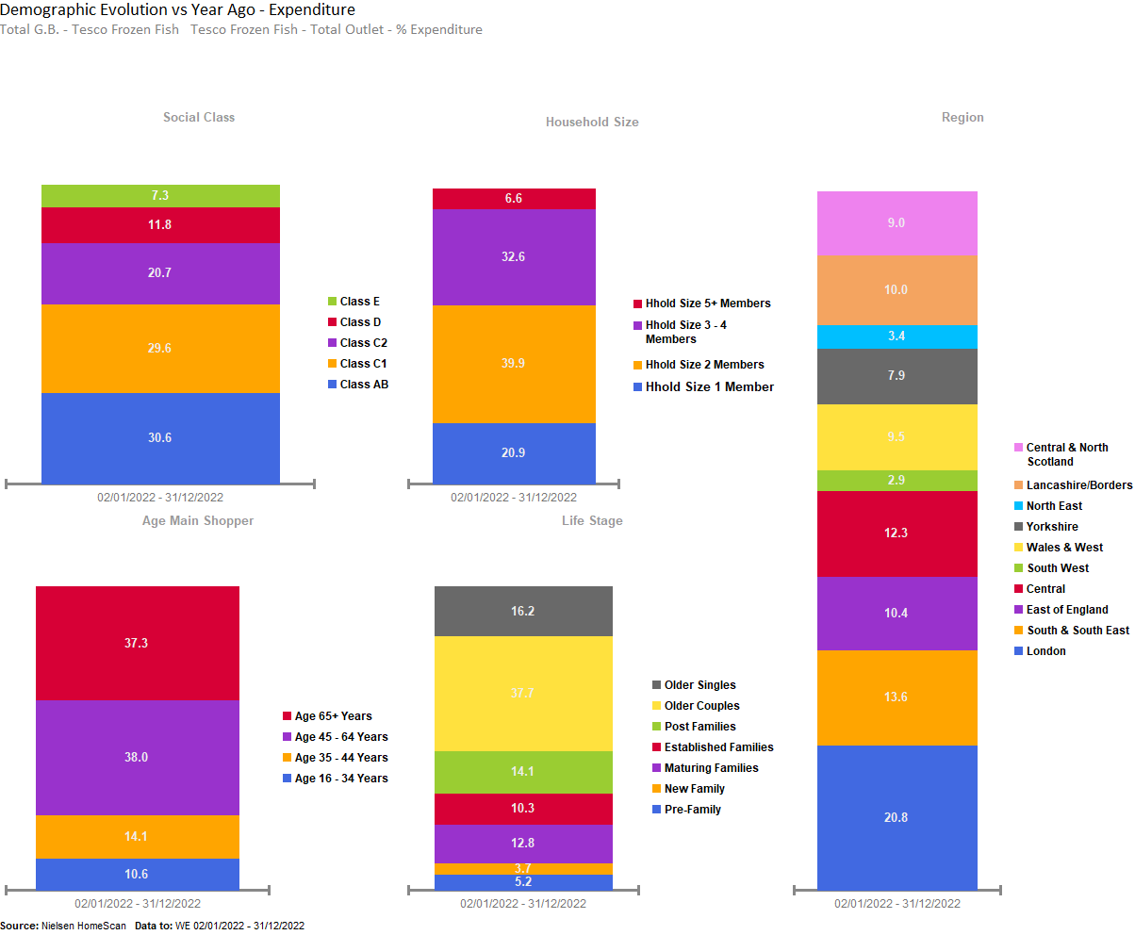
IN TESCO SALES ARE PROMINENT FROM AFFLUENT OLDER COUPLES AGED 45+, WITH 2 MEMBERS IN FAMILY, LOCATED AT LONDON AND SOUTH & SOUTH EAST.

Slide 42
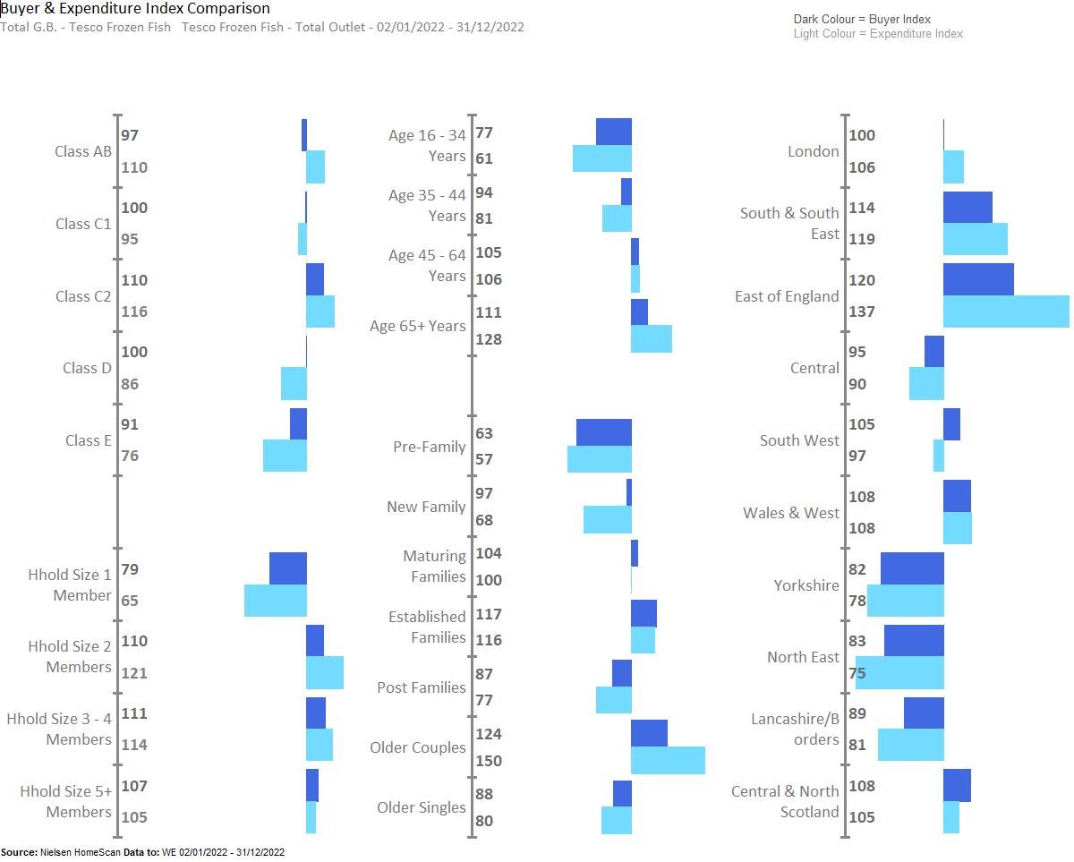
IN TESCO FROZEN FISH SALES UNDERINDEX AMONGST YOUNGER GROUP, WHILST OVERDINDEX FROM THOSE LIVING IN EAST OF ENGLAND, LONDON, WALES AND WEST AND SOUTH & SOUTH EAST.

Slide 43
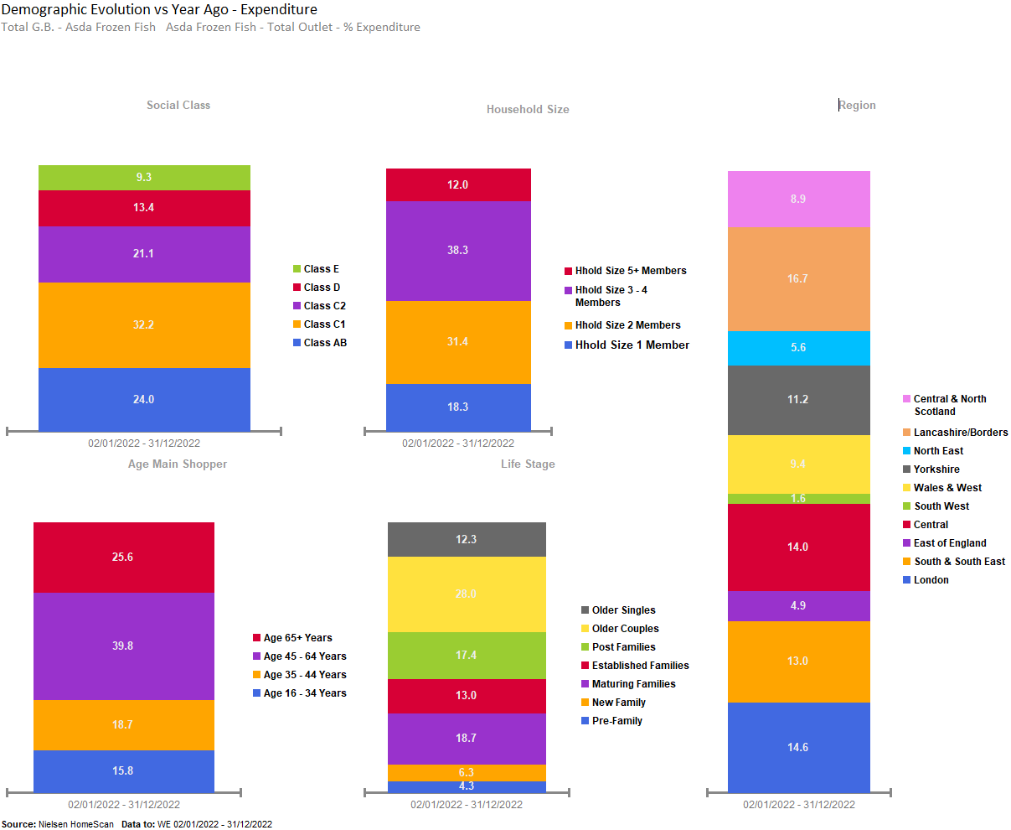
ASDA FROZEN FISH PROMINENT FROM OLDER COUPLES AGED 45+, WITH 3-4 MEMBERS IN FAMILY, LOCATED AT LANCASHIRE/BORDERS AND LONDON.

Slide 44
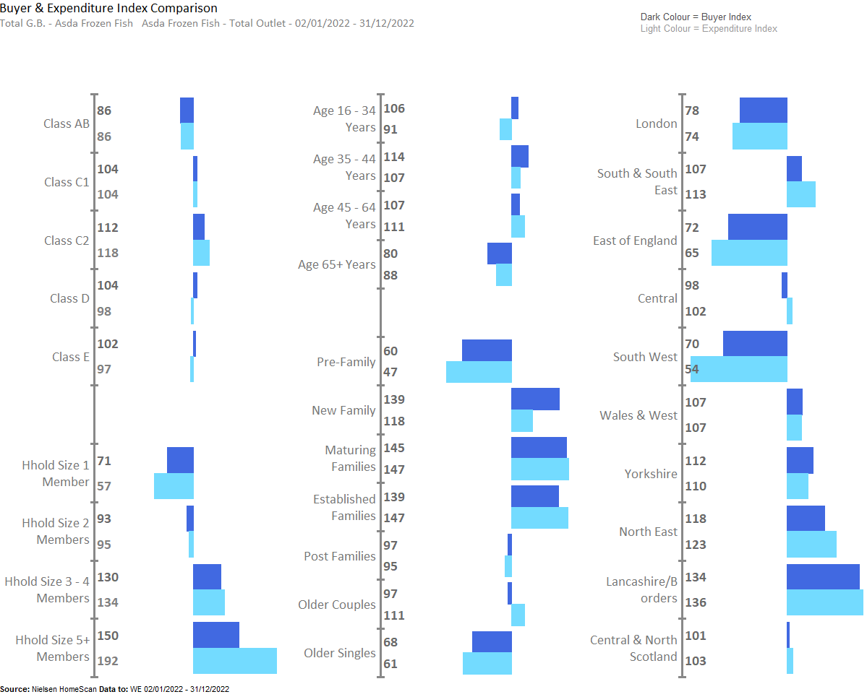
IN ASDA FROZEN FISH UNDERINDEX AMONGST OLDER SINGLES AND PRE-FAMILY, WHILST OVERINDEX FROM THOSE LIVING IN LANCASHIRE, NORTH EAST , YORKSHIRE , WALES AND WEST , YORKSHIRE, SOUTH & SOUTH EAST ,

Slide 45
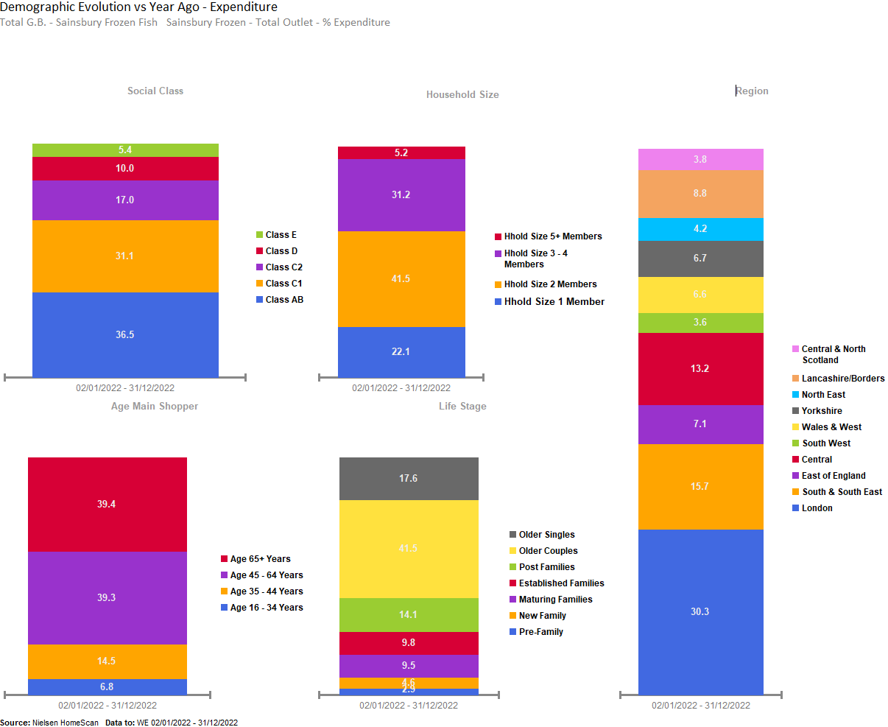
SAINSBURY’S FROZEN FISH PROMINENT FROM AFFLUENT OLDER COUPLES, AGED 65+, WITH 2 MEMBERS IN FAMILY, LOCATED AT LONDON.

Slide 46
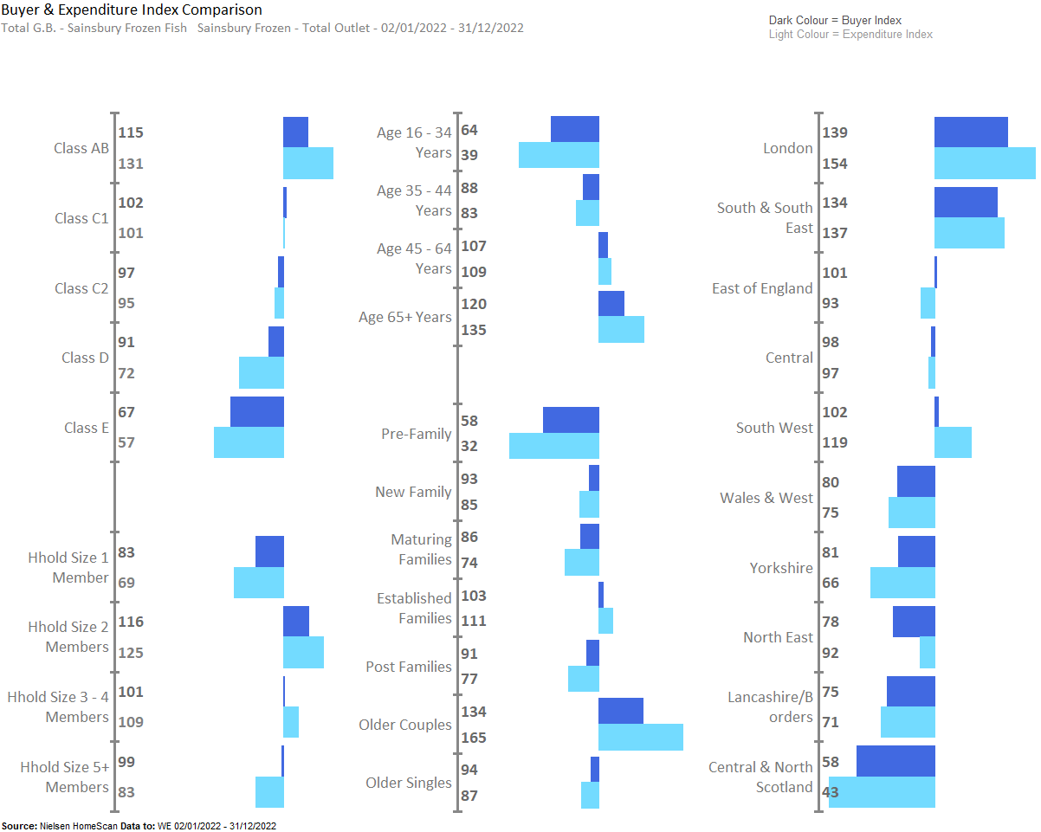
SAINSBURY’S FROZEN FISH OVERINDEX AMONGST OLDER COUPLES , LIVING IN LONDON, SOUTH & SOUTH EAST AND SOUTH WEST

Slide 47
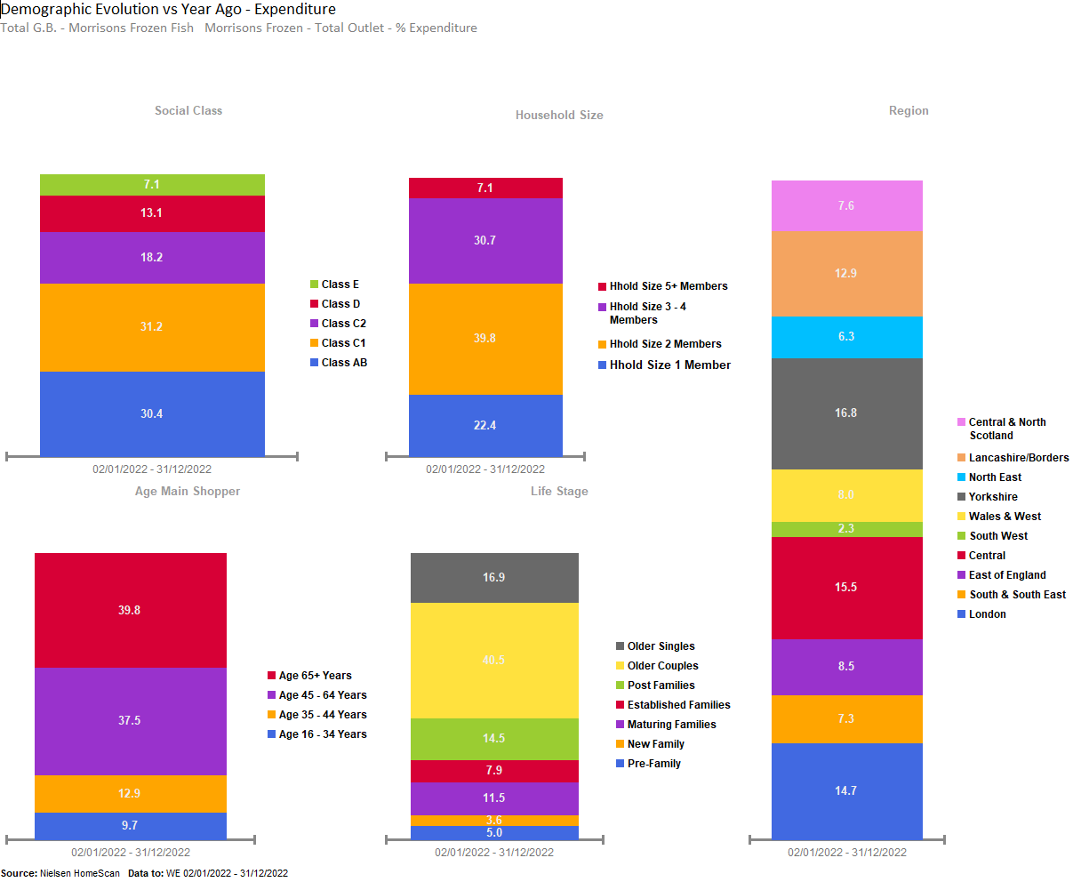
MORRISON’S FROZEN FISH SALES PROMINENT FROM AFFLUENT OLDER COUPLES, OF CLASS AB & C1, AGED 65+, WITH 2 MEMBERS IN FAMILY, LOCATED AT LONDON,YORKSHIRE AND CENTRAL.

Slide 48
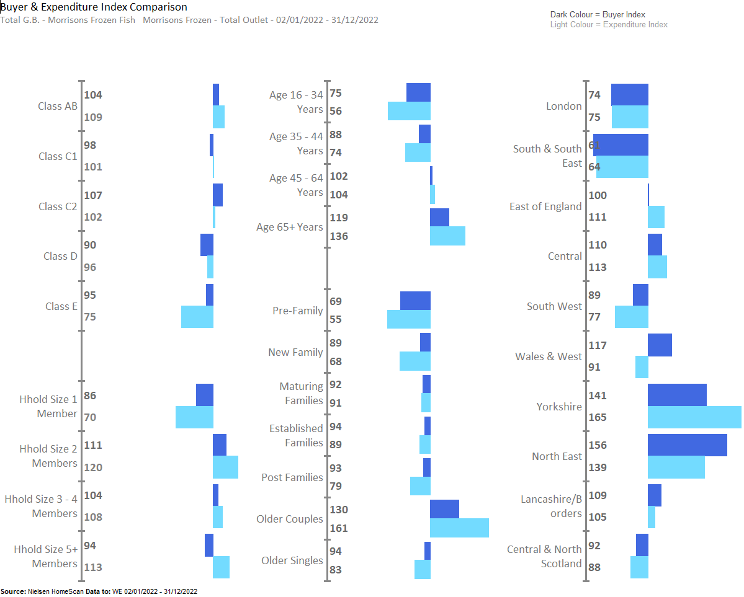
MORRISON’S FROZEN FISH OVERINDEX AMONGST OLDER GROUP, WHILST OVERINDEX AMONGST THOSE LIVING IN NORTH EAST & YORKSHIRE.

Slide 49
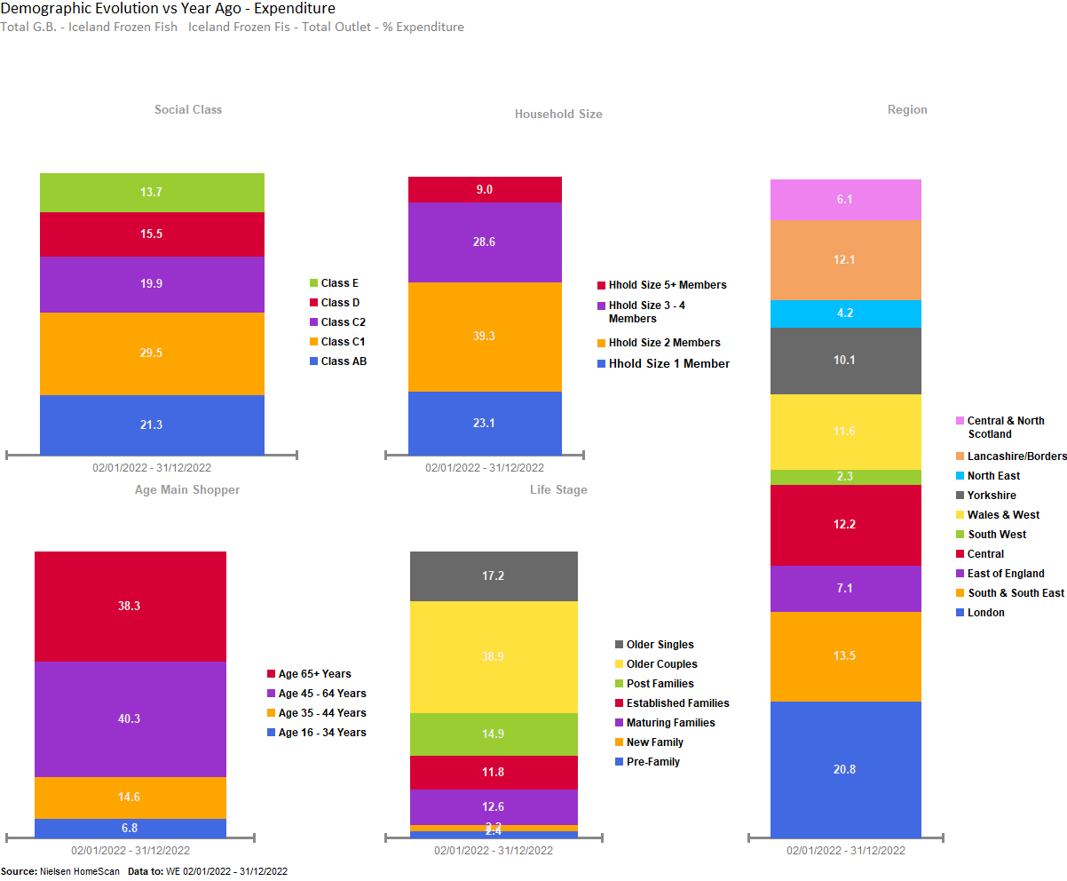
ICELAND FROZEN FISH SALES PROMINENT FROM OLDER COUPLES, AGED 45+, WITH HOUSEHOLD SIZE OF 2 MEMBERS, MAINLY FROM LONDON.

Slide 50
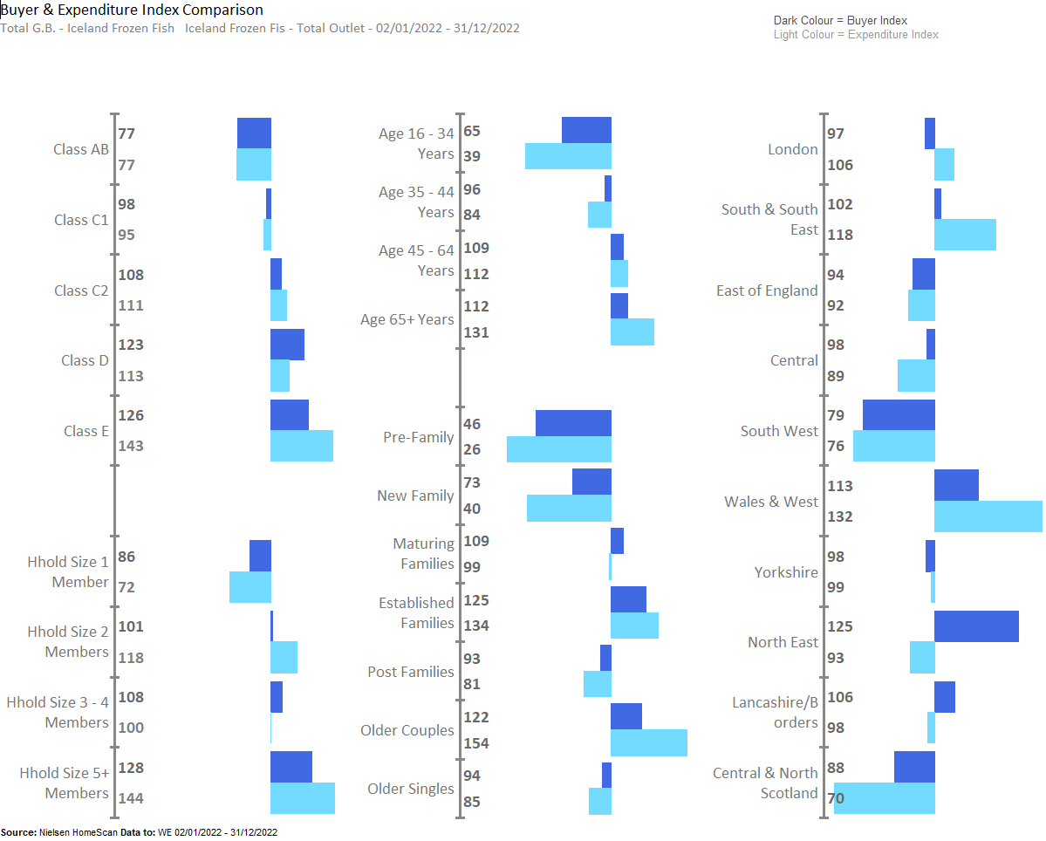
ICELAND FROZEN FISH SALES OVERINDEX AMONG OLDER COUPLES, AND ESTABLISHED FAMILIES, WITH 5+ MEMBERS IN THE FAMILY, THOSE THAT LIVE IN WALES & WEST AND SOUTH & SOUTH EAST.

Slide 51
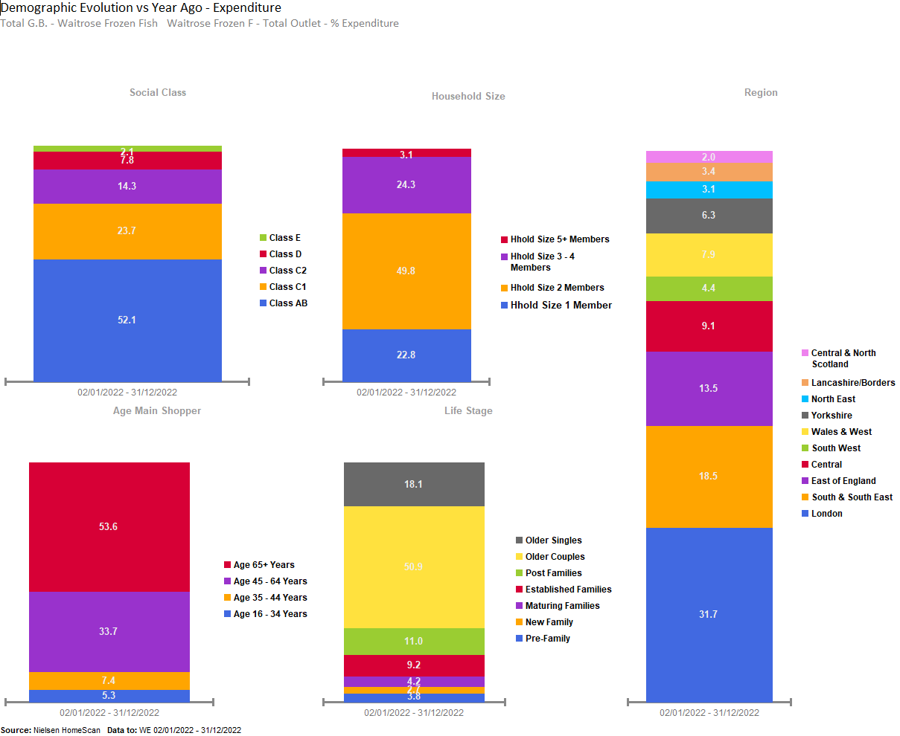
WAITROSE FROZEN FISH SALES PROMINENT FROM AFFLUENT OLDER COUPLES OF CLASS AB, AGED 65+, WITH 2 MEMBERS IN FAMILY, LOCATED AT LONDON.

Slide 52
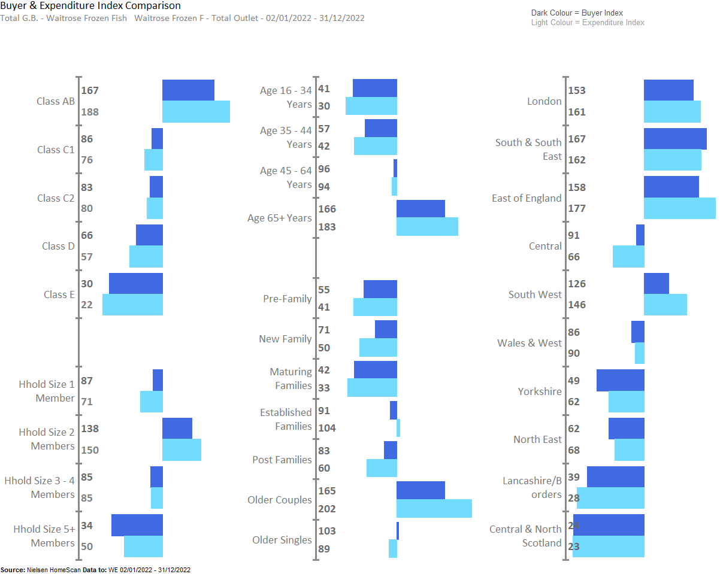
WAITROSE FROZEN FISH SALES OVERINDEX AMONGST CLASS AB, THOSE LIVING IN SOUTH & SOUTH EAST, LONDON AND EAST OF ENGLAND.

Slide 53
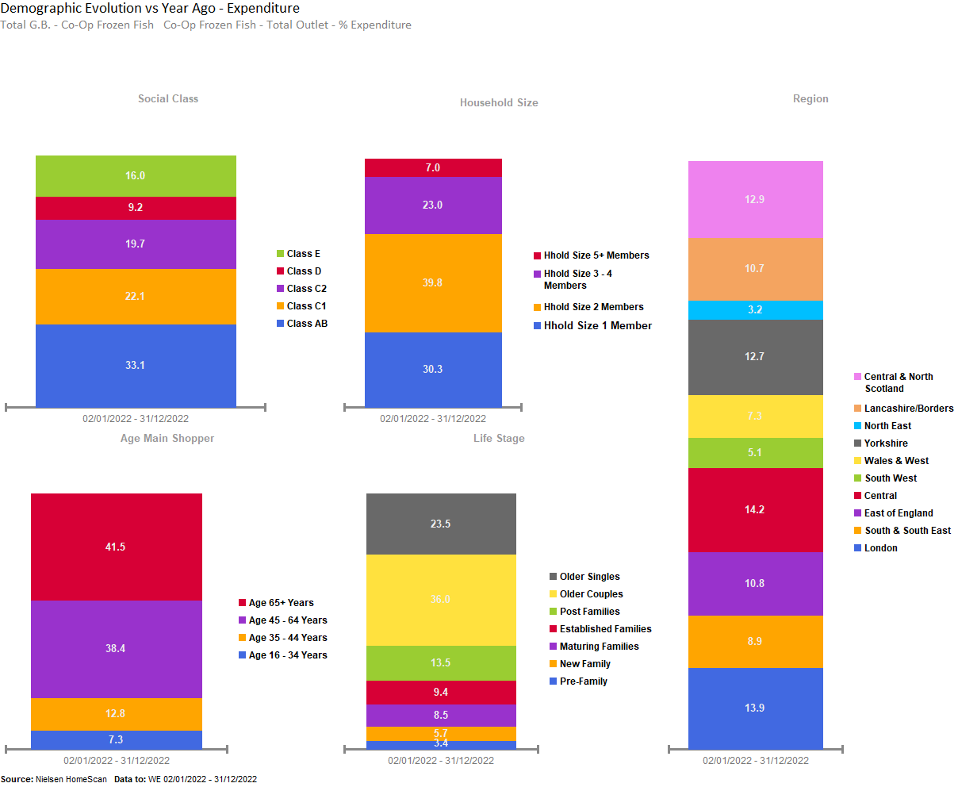
CO-OP FROZEN FISH PROMINENT FROM AFFLUENT OLDER COUPLES, AGED 65+, WITH 2 MEMBERS IN FAMILY, LOCATED AT CENTRAL & LONDON.

Slide 54
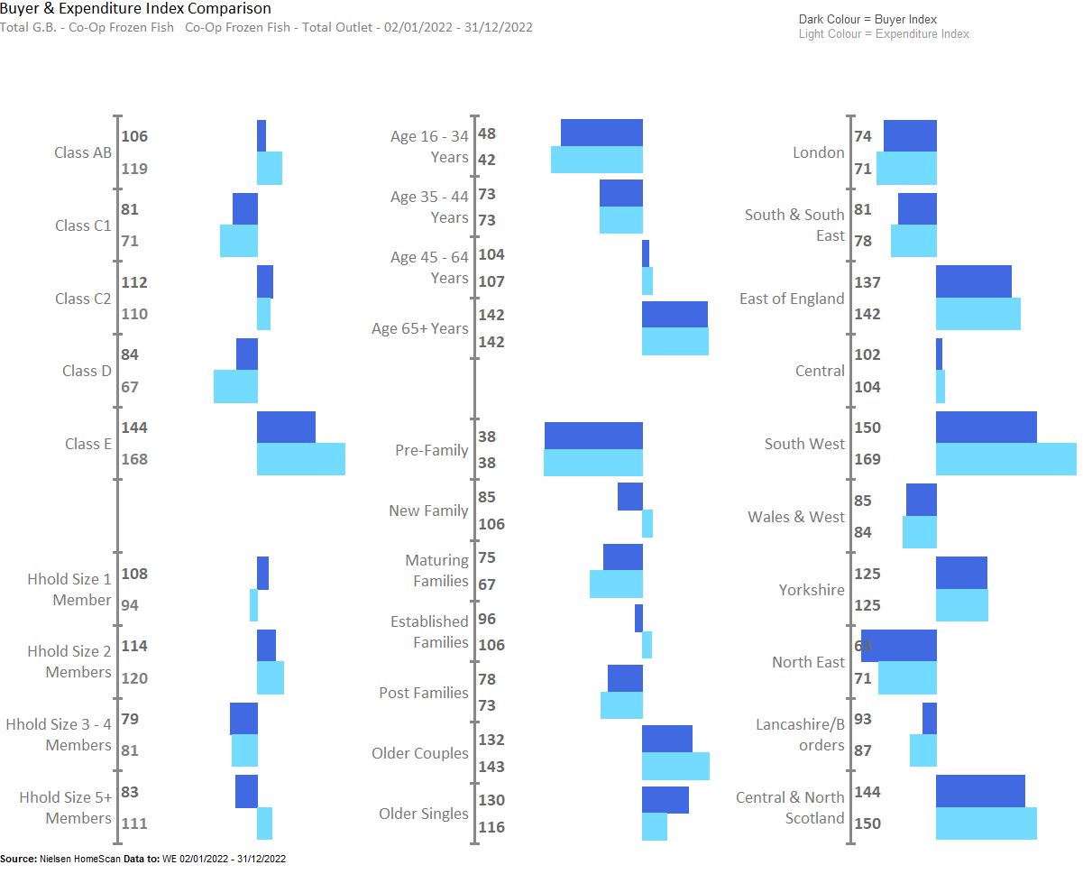
CO-OP FROZEN FISH UNDERINDEX AMONGST YOUNGER GROUPS, WHILST OVERINDEX AMONGST THOSE LIVING IN EAST OF ENGLAND, SOUTH WEST , SOUTH WEST AND CENTRAL & NORTH SCOTLAND

Slide 55
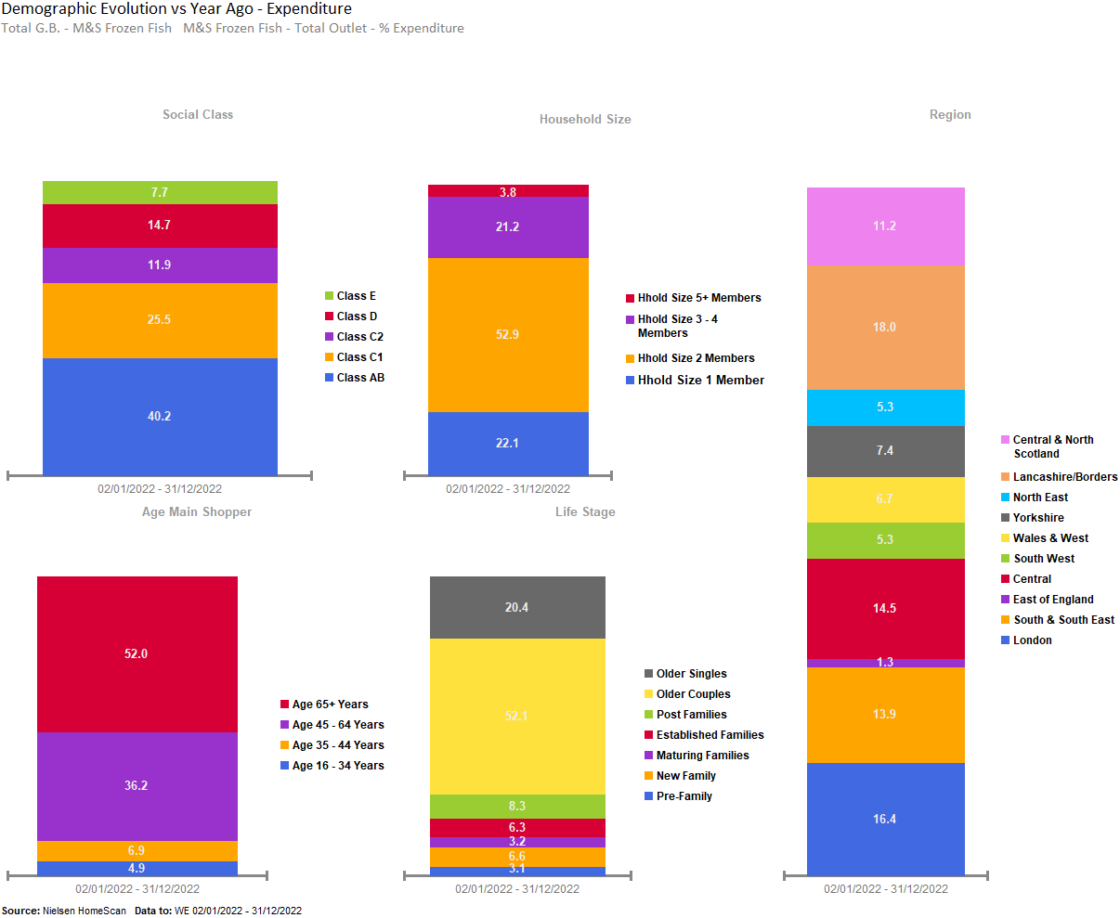
M&S FROZEN FISH SALES PROMINENT FROM AFFLUENT OLDER COUPLES AGED 65+, WITH 2 MEMBERS IN FAMILY, LOCATED AT LONDON AND LANCASHIRE /BORDERS.

Slide 56
M&S FROZEN FISH SALES OVERINDEX AMONGST OLDER GROUPS, LIVING IN THE NORTH EAST , LANCASHIRE AND CENTRAL & NORTH SCOTLAND

Slide 57
ALDI FROZEN FISH SALES PROMINENT FROM AFFLUENT OLDER COUPLES, AGED 45+, WITH 5+ MEMBERS IN FAMILY, LOCATED AT CENTRAL & LANCASHIRE BORDERS.

Slide 58
ALDI FROZEN FISH UNDERINDEX AMONGST CLASS E, WHILST OVERINDEX AMONG THOSE LIVING IN YORKSHIRE , NORTH EAST AND LANCASHIRE /BORDERS

Slide 59
LIDL SALES PROMINENT FROM OLDER COUPLES, AGED 45+, WITH 2 MEMBERS IN FAMILY, LOCATED AT LONDON, SOUTH & SOUTH EAST.

Slide 60
IN LIDL FROZEN FISH UNDERINDEX AMONGST CLASS E , WHILST OVERINDEX FROM THOSE LIVING IN SOUTH WEST, WALES AND WEST.

