Slide 1
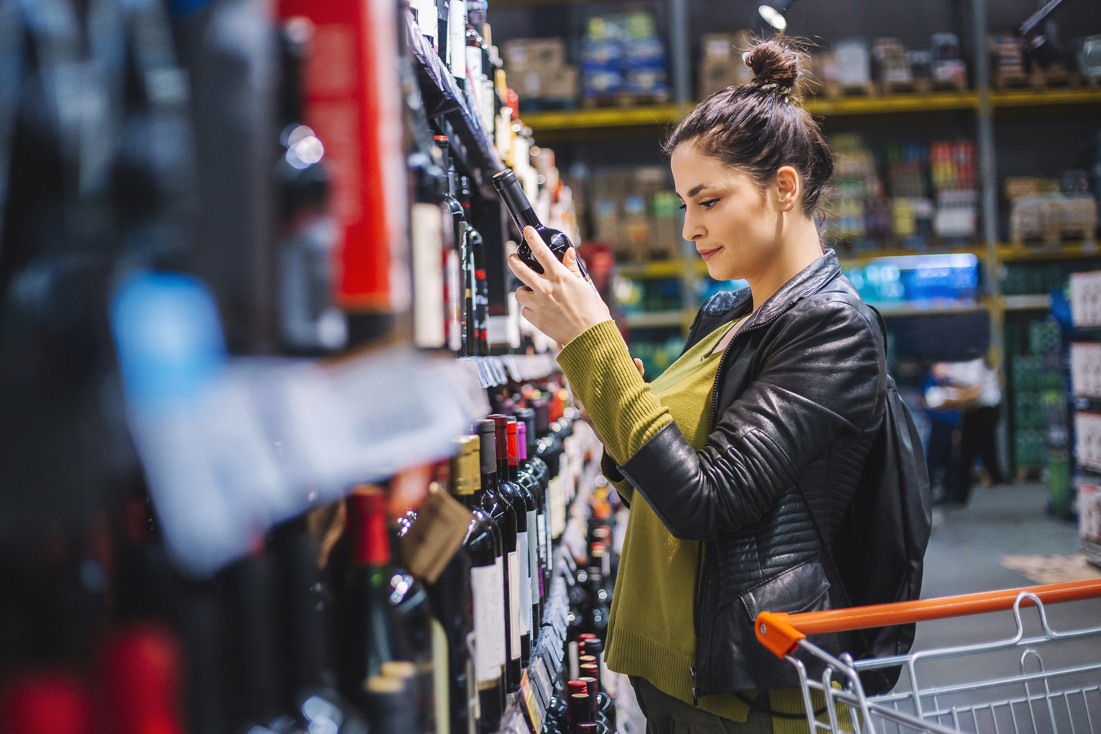
FMCG Essential Retail – What you need to know!
Share of Trade
52 we data to 10.09.22
Share of Total Grocers
Value Change %
Penetration
£ Spend per Visit
2021
2022
2021
2022
% Change
2021
2022
% Change
27.1% | 27.1% | 0.4% | 84.6 | 86.5 | 3.1% | 28.18 | 26.66 | -5.4%
13.9% | 13.7% | -1.5% | 65.8 | 68.0 | 4.3% | 26.77 | 24.89 | -7.0%
12.3% | 12.0% | -1.9% | 68.5 | 69.7 | 2.6% | 29.31 | 27.57 | -5.9%
10.5% | 11.0% | 5.4% | 64.7 | 67.5 | 5.2% | 25.34 | 24.26 | -4.3%
9.6% | 9.0% | -5.8% | 60.9 | 62.9 | 4.2% | 27.66 | 24.85 | -10.2%
7.4% | 8.0% | 8.7% | 57.4 | 61.9 | 8.7% | 22.33 | 21.08 | -5.6%
4.6% | 4.5% | -0.7% | 48.9 | 50.7 | 4.6% | 9.87 | 9.03 | -8.5%
4.3% | 4.1% | -4.3% | 24.1 | 26.4 | 10.4% | 26.12 | 22.83 | -12.6%
3.3% | 3.6% | 7.5% | 45.8 | 50.0 | 9.9% | 17.38 | 14.93 | -14.1%
2.7% | 2.6% | -1.3% | 49.7 | 51.4 | 4.3% | 21.14 | 19.62 | -7.2%
1.7% | 1.6% | -2.9% | 4.4 | 6.0 | 37.6% | 72.71 | 69.56 | -4.3%
Store Portfolio
Store Numbers as of 10.09.22
Store Numbers
Total
Convenience
Small
Large
Super
Mega
2724 | 1866 | 26 | 285 | 194 | 353
1396 | 809 | 43 | 171 | 143 | 230
587 | 0 | 133 | 86 | 113 | 255
497 | 2 | 10 | 185 | 245 | 55
3715 | 2709 | 829 | 177 | 0 | 0
334 | 23 | 50 | 209 | 44 | 7
1011 | 540 | 299 | 152 | 13 | 7
962 | 79 | 837 | 46 | 0 | 0
25 | 0 | 0 | 0 | 0 | 25
Value Index (52 we 10.09.22)
Life stage
Pre Family
New Family
Maturing Family
Post Family
Older Couple
Older Singles
Established Family
109 | 96 | 102 | 107 | 98 | 102 | 89
84 | 96 | 72 | 101 | 99 | 109 | 109
96 | 135 | 139 | 128 | 100 | 85 | 72
91 | 104 | 82 | 84 | 91 | 117 | 102
96 | 142 | 143 | 123 | 83 | 90 | 76
111 | 83 | 74 | 82 | 107 | 84 | 160
82 | 65 | 41 | 69 | 93 | 130 | 129
120 | 115 | 121 | 106 | 83 | 105 | 75
85 | 73 | 49 | 57 | 91 | 124 | 141
75 | 60 | 130 | 121 | 97 | 91 | 103
115 | 92 | 128 | 62 | 144 | 89 | 78
Source: Nielsen Homescan SOT based on FMCG [New Base], Benchmark Total Grocers% Change Penetration = % Change in actual buyers
Penetration = Change in shoppers

Slide 2
FMCG Essential Retail
Tesco have relaunched the “Helping you to live healthier” campaign. The scheme was first launched in 2018 and involves the self-service tills prompting customers to round their shop up to the nearest pound to raise money for charity. The list of charities for the September relaunch are Cancer Research UK, the British Heart Foundation, and Diabetes UK. The money that is raised will be equally split between the three charities. As well as funds being raised, the campaign aims to increase awareness around healthy lifestyle choices which will help people lower their chances of getting cancer, diabetes, and heart circulatory diseases. Oonagh Turnbull, Head of Health Campaigns at Tesco, said: “The funds raised will continue to support the health of UK communities at such a critical time. Our health charity partners rely on donations to continue their awareness, prevention, and research work.”
Sainsbury’s is launching a ‘September price blitz’ with the aim of helping customers fight the rising cost of living. £60 million will be invested into Sainsbury’s Quality, Aldi Price Match Campaign, Price Lock Promise and everyday Special Offers to make products “more affordable” for customers. Furthermore, 20% more own brand lines are being included into the Price Lock as customer are increasingly looking to own brand lines to reduce outgoings. Simon Roberts, Chief Executive of Sainsbury’s said: “We have made huge strides to lower prices since we launched our new plan, but we are committed to going further. These are difficult times and all of us at Sainsbury’s are standing with our customers to ease the financial pressure they face.” This latest value investment in food is part of Sainsbury’s commitment to spend £500 million by March 2023 to keep prices low.
ASDA marks the opening of its 50th roadside convenience store in Derby. The stores, which are operated in partnership with EG Group, are designed to broaden the number of new and existing customers who can access the supermarket’s fantastic products in convenient neighbourhood and roadside locations. With over 1,300 branded and Asda-own label products, Asda On the Move sites offer great value and quality in a modern and welcoming convenience store environment. Asda supplies the products on a wholesale agreement to EG Group, which own and operate each site. Steve Shirley, Vice President of Wholesale and Convenience at Asda, said: “We are delighted to have reached the landmark opening of our 50th Asda On The Move store. The popularity of these stores shows us that customers want to be able to pick up essentials quickly and conveniently or grab a spontaneous treat whilst they’re refuelling, and we look forward to continuing to provide that service to our customers in the future.’’
Morrisons £190 million takeover of McColl’s looks to be going ahead after the competition regulator has found that the move will “not harm the vast majority of shoppers or other businesses”. The move comes after Morrisons was acquired by US private equity firm Clayton, Dubilier & Rice (CD&R), the parent company of MFG, for £7 billion last year. Although the CMA found 35 areas where competition will be reduced because of the merger Morrisons are confident their proposals to the CMA are adequate. Concerns were initially raised due to the fear that some customers may be overcharged where competition is low despite the rising cost of living. A Morrisons spokesman said: “We welcome the announcement today by the CMA that the acquisition of McColl’s only raises concerns in a small number of local areas. “We will now work closely with the CMA on our proposed remedies in these 35 local areas and look forward to a swift conclusion of the process.”
Source: NielsenIQ Homescan, Grocer & Nam News

Slide 3
FMCG Essential Retail
Waitrose has launched a new seasonal value campaign to help its customers through the cost-of-living crisis. The supermarket is running its Great September Savings campaign this month both in store and online, with a variety of offers on over 4,000 branded and own-label products. Of these, more than 1,000 are part of the ’Save 1/3’ promotion, which helps customers save money on key shopping basket staples, according to Waitrose. “We’re committed to offering great value and have thousands of price reductions in our Great September Savings event,” said a Waitrose spokesman.
Aldi has become the first UK supermarket to back calls for a new Global Plastics Treaty to end plastic pollution. More than 80 global businesses across the plastics value chain, financial institutions, and non-governmental organisations (NGOs) have committed to supporting the development of a legal UN treaty to end plastic pollution. The coalition is calling for an ambitious and effective global agreement to accelerate progress towards a circular economy in which plastic never becomes waste or pollution, and the value of products and materials is retained in the economy. This collective vision will form the basis for future policy engagements with governments through the newly launched Business Coalition for a Global Plastics Treaty, which will be convened by the Ellen MacArthur Foundation and WWF. Richard Gorman, plastics, and packaging director at Aldi UK, said: “Like all those in this coalition, we never stop looking for ways to reduce plastic waste. It’s important to our customers and it’s important to us as well. Tackling the use of plastic is a global issue and requires a global response. Having a United Nations treaty, supported by businesses around the world, will be an essential step in solving this issue and we look forward to working together to achieve that.”
Lidl is looking to implement its deposit return scheme (DRS) across stores in England, starting with their Bristol based stores. The scheme allows customers to return undamaged recyclable goods to a Lidl machine in exchange for a 10p voucher as an incentive to recycle more. A Lidl spokeswoman said, “We are preparing for the future implementation of DRS across England but we are still awaiting further clarity and guidance from the government”.
Source: NielsenIQ Homescan, Grocer & Nam News

Slide 4
FMCG Essential Retail
Iceland have partnered with Del Monte to promote the ‘Healthy Start’ scheme on its frozen fruit. This comes after Iceland had already implemented the scheme on other products. It will come as good news for households struggling through the cost-of-living crisis, after food and fuel prices soared in recent months. The scheme could help upcoming or new parents by saving those eligible up to £442 per year.
Coop has agreed to sell its petrol forecourt business to Asda for £600 million. The transaction includes 129 petrol forecourt sites and represents 5% of Co-ops retail estate. Co-op aims to re-invest the money from the same into several aspects of the business. Most notably, it will be used to reinvest into Co-ops convenience business as well as growing its wholesale, franchise, and e-commerce operations, including new convenience stores. Shirine Khoury-Haq, Chief Executive at the Co-op comments: “This transaction is in line with our strategy to move away from operating petrol forecourts and supports our vision of Co-operating for a fairer world while building our core leading convenience business.
Ocado has promoted the chief product officer of its technology division Hannah Gibson to CEO. Gibson, who has spent 10 years at Ocado, replaces Mel Smith, who revealed she would step down in July. She will take over on 20 September. Gibson has had experience across customer, commercial and technology roles at Ocado and currently sets the strategy and drives forward the Ocado Smart Platform for the group’s partners including Ocado Retail, the joint venture between Ocado and M&S. She previously lead Ocado Zoom, launching the speedy delivery service in just two years. Ocado Retail chairman Tim Steiner said: “Ocado Retail has big ambitions and, with its foundations now firmly in place, is well-prepared for faster growth in the years to come. “I am confident that Hannah is the right leader to deliver on these ambitions, whilst also being able to navigate the nearer-term challenges associated with the macroeconomic environment”.
Source: NielsenIQ Homescan, Grocer & Nam News

