Slide 1
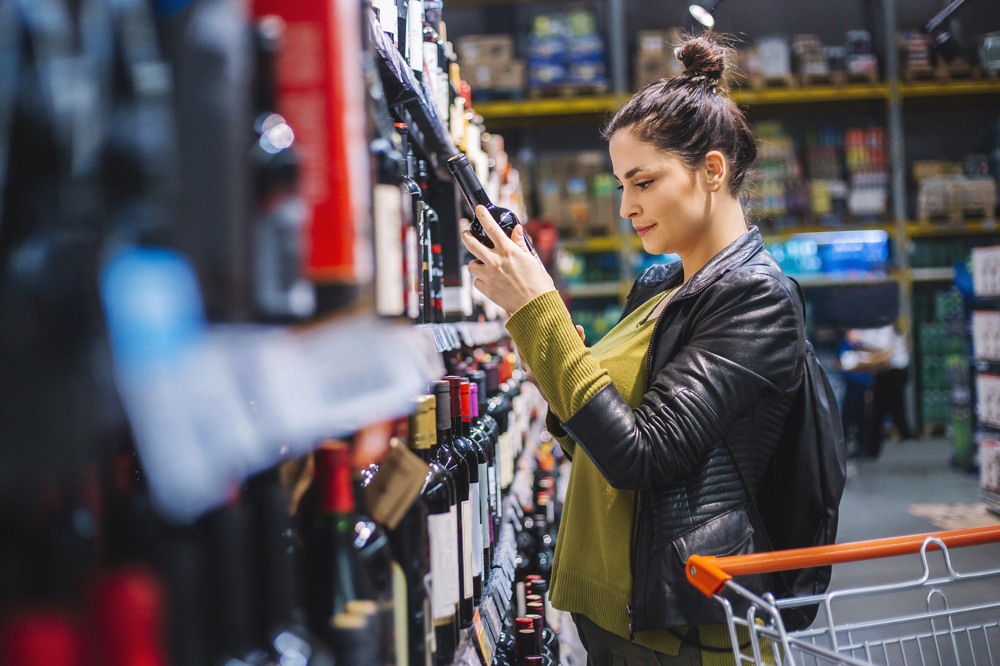
FMCG Essential Retail – What you need to know!
Share of Trade
52 we data to 05.11.22
Share of Total Grocers
Value Change %
Penetration
£ Spend per Visit
2021
2022
2021
2022
% Change
2021
2022
% Change
27.1% | 27.2% | 1.4% | 85.0 | 86.6 | 2.7% | 27.82 | 26.67 | -4.1%
13.9% | 13.7% | -0.3% | 66.2 | 68.3 | 4.0% | 26.41 | 24.88 | -5.8%
12.2% | 12.1% | -0.2% | 68.8 | 70.0 | 2.7% | 28.85 | 27.61 | -4.3%
10.6% | 11.1% | 5.7% | 64.9 | 68.5 | 6.4% | 24.97 | 24.37 | -2.4%
9.5% | 8.9% | -5.6% | 61.1 | 63.0 | 4.0% | 27.26 | 24.52 | -10.1%
7.5% | 8.1% | 9.0% | 57.8 | 62.5 | 9.1% | 22.13 | 21.10 | -4.7%
4.5% | 4.6% | 1.5% | 49.2 | 50.8 | 4.1% | 9.65 | 9.08 | -5.9%
4.3% | 4.1% | -3.8% | 24.9 | 25.9 | 4.9% | 25.69 | 22.35 | -13.0%
3.4% | 3.6% | 6.8% | 46.6 | 49.8 | 7.8% | 16.95 | 14.95 | -11.8%
2.6% | 2.6% | 0.5% | 50.1 | 51.7 | 4.2% | 20.95 | 19.71 | -5.9%
1.7% | 1.6% | -1.9% | 4.8 | 6.3 | 32.1% | 72.62 | 70.32 | -3.2%
Store Portfolio
Store Numbers as of 05.11.22
Store Numbers
Total
Convenience
Small
Large
Super
Mega
2727 | 1868 | 26 | 285 | 195 | 353
1395 | 810 | 43 | 169 | 143 | 230
586 | 0 | 133 | 86 | 112 | 255
498 | 2 | 10 | 186 | 245 | 55
3702 | 2701 | 824 | 177 | 0 | 0
334 | 23 | 50 | 209 | 44 | 7
1006 | 535 | 299 | 152 | 13 | 7
962 | 77 | 838 | 47 | 0 | 0
25 | 0 | 0 | 0 | 0 | 25
Value Index
(52 we 05.11.22)
Life stage
Pre Family
New Family
Maturing Family
Post Family
Older Couple
Older Singles
Established Family
112 | 97 | 99 | 106 | 97 | 103 | 91
82 | 95 | 74 | 101 | 99 | 110 | 108
94 | 135 | 141 | 128 | 102 | 85 | 70
86 | 106 | 84 | 81 | 91 | 117 | 103
92 | 139 | 146 | 127 | 84 | 90 | 75
111 | 84 | 74 | 84 | 103 | 84 | 161
82 | 65 | 41 | 69 | 93 | 131 | 124
121 | 113 | 123 | 110 | 84 | 103 | 75
88 | 72 | 47 | 56 | 92 | 124 | 141
68 | 60 | 125 | 125 | 98 | 93 | 103
113 | 97 | 127 | 64 | 145 | 89 | 76
Source: Nielsen Homescan SOT based on FMCG [New Base], Benchmark Total Grocers% Change Penetration = % Change in actual buyers
Penetration = Change in shoppers

Slide 2
FMCG Essential Retail
Tesco are trialling a number of new stores where shoppers can leave without paying for their shopping at the checkout. The new checkout-free stores are set to be trialled over the next few months. This concept means shoppers can pick up any items they want and leave the store without having to use the tills to pay, much like the similar Amazon Fresh supermarket. The aptly named "GetGo" stores will work by monitoring shoppers’ movements and product picks through ceiling cameras and on-shelf weight sensors. Customers will need to scan their receipt in order to exit the barriers. However, there will still be a number of staff members on hand to help.
Sainsbury’s appoint Checkout.com, the cloud-based payments service provider, to simplify and modernise payment infrastructure across its business. The new till-free technology aimed at creating more digital payment solutions for Sainsbury’s. The new Checkout.com enabled SmartShop functionality, will allow customers to pay for their shopping without having to visit a till. Instead, they will pay on-the-go via Sainsbury’s SmartShop app on their smartphones, saving them time and creating a more flexible shopping experience. Underpinning the new functionality will be Checkout.com’s payments platform, enabling transactions through digital wallets such as Apple Pay and Google Pay. This is live across Sainsbury’s ‘scan-and-go’ SmartShop stores and will be rolled out to Argos and Habitat stores in the coming months.
ASDA’s new ‘mini’ Asda, the first of its kind in the country, has opened on a Sutton Coldfield housing estate with a positive reaction from its first shoppers. The new Asda Express opened its doors a little after 10am on Tuesday (November 8). With around two dozen customers filing in to take a first look. The store has 3,500 lines, around a tenth of a typical Asda supermarket offering. The new Asda Express is the supermarket chain’s tiniest, at just 2,600 square feet, compared to other ‘small’ Asdas in Dudley High Street (9,000 sq feet). Asked about the preparations for the first ever Asda Express, manager Arnis said “It’s been hard work. Lots of long days. I did it as I want it to be successful. I’m very proud and excited because this is the first one and we are planning to open 200 of these in two years. Asda has bought 132 Co-ops and we are converting then to these and building some from scratch like this one.”
Morrisons is extending its Too Good To Go offering into all its cafés to prevent food waste while also helping customers to save money. Too Good To Go Magic Bags are now available in 397 Morrisons cafés across the UK and come packed with either warm or cold goods. The contents of each bag have a value of up to £11 but will be sold to customers for just £2.99 through the app which customers can download for free. All items from the popular Morrisons café English breakfast can be included in the hot Magic Bags such as bacon, beans, hash brown and sausages.
Source: NielsenIQ Homescan, Grocer & Nam News

Slide 3
FMCG Essential Retail
Waitrose Free coffee will be available once again in Waitrose in a bid to stop slumping sales amid the soaring cost of living crisis.
Any customer with a myWaitrose loyalty card will be able to pick up a free coffee or tea, two years after the supermarket scrapped the popular perk during the pandemic in June 2020. Shoppers can claim their hot drink from any of the supermarket’s 331 stores with no minimum spend required. The only catch is that customers will have to bring their own reusable cups to help the store prevent unnecessary waste. The return of the deal comes as bosses try to tackle declining sales at supermarkets, with Waitrose shoppers turning to cheaper rivals as inflation rates and food costs across the country rocket.
Aldi is making a change to the packaging in a bid to be more environmentally friendly. Asda has announced its own-brand toilet paper will now be double the length in order to be more sustainable. The move should save 74 tonnes of plastic and 760 tonnes of cardboard a year. It will also save 1,200 lorries per year from needing to deliver and rolls will last much longer. The change affects the own brand line Shades and takes place online and in stores today, November 14. Sarah Yorke, buying manager household paper at Asda said: “Shades toilet rolls are one of our most popular own brand products so to be able to make this change and help reduce both our customers and our own carbon footprint without affecting the great quality of our product in any way is an incredibly important step for us.”
Lidl’s brought back its sell out air fryer after an increase in popularity in the gadget rose by over 3,000 per cent. Shoppers can now bag themselves one of the chain’s Silvercrest Air Fryers for an incredibly affordable price. The product re-launched on Sunday, November 13 on Lidl's website, priced at a cool £49.99. Research by Utilita revealed the average cost of the gadgets was £55.71 a year, with an electric cooker running at as much as £335.57. Another study done by Hometree back in September revealed an oven with an average wattage of 3kW costs about 34p to run for 20 minutes, while a 1kW air fryer would cost 10p. Comparison website PriceRunner discovered top-selling air fryers have risen in popular by more than 3,000 per cent since this time in 2021 and up 2,000 over since the summer. Lidl shoppers shared their praise for the gadget, as one person called it “life changing”. They wrote on Twitter: “I can’t lie, the air fryer I got from Lidl has literally changed my life.”
Source: NielsenIQ Homescan, Grocer & Nam News

Slide 4
FMCG Essential Retail
Iceland is offering customers ready meals for 1p as supermarkets continue to look for ways to help their shoppers with the rapidly increasing cost of shopping bills. And with energy prices sky high the opportunity to microwave rather than use more costly appliances could keep gas and electric bills lower too, says the retailer. The vast discount is available only to online customers who must spend £25 with Iceland to be entitled to the promotion.
Coop is set to remove all coloured milk bottle tops from its shelves in a bid to cut plastic and increase recyclability. Shoppers will instead see clear caps on milk bottles, featured on Co-op’s skimmed, semi-skimmed and whole milks across its entire estate. It has so far trialled the initiative on semi-skimmed milk in more than 400 Co-op stores. The incentive is that clear bottle tops reduce colour contamination in the high-density polyethylene (HDPE) stream, allowing materials to be recycled more easily into food-grade packaging. Green caps are set to be eradicated across all stores first by the end of December, followed by red caps for skimmed milk, and blue caps for whole milk in early 2023. Switching all green caps first is expected to make the biggest difference, according to the convenience retailer.
Ocado ambitions to grow in Asia follow a deal this month to help Lotte Shopping, one of South Korea’s largest companies, grow its online business. In late 2019, Ocado announced it would build out the online business of Aeon, Japan’s largest supermarket operator, and it also has a technology partnership with Coles in Australia. “We’d love to do more business around Asia,” Tim Steiner, chief executive and one of the co-founders of the overall Ocado group, said in an interview during a visit to Chiba, where Aeon’s first robot-powered warehouse is scheduled to launch next year.
Source: NielsenIQ Homescan, Grocer & Nam News

