Slide 1
COVID 19 Impact
Inc multi-country insight
Data to WE 14.03.20

Slide 2
SHAPING SMARTER MARKETS
Nielsen has a responsibility to use our data and expertise to help our clients prepare and respond to the unfolding COVID-19 situation.
In our current time of mass uncertainty, our extensive global reach is enabling us to draw together the most significant consequences and learnings. These provide essential navigation beacons that highlight winning strategies that will help steer our industries towards stability and new prospects.
In the coming days, weeks and months, we are committed to continuing our collaboration with clients to ensure that our markets move forward in a safe, confident and smart manner—for the future health of our industry and people.
Notes:
Nielsen is clear about the role that we can play to help our clients.
Nielsen’s data and expertise will be the guiding light to help clients prepare and respond to current and future market circumstances
Nielsen’s global reach enables us to quickly draw together the consequences and essential learnings across markets to help clients make smarter, nimble decisions
Nielsen is committed to working with our clients to ensure that markets move forward in a safe, confident and smart manner

Slide 3
NIELSEN’S SIX CONSUMER BEHAVIOR THRESHOLDS OF COVID-19 CONCERN
#1
PROACTIVE HEALTH-MINDED BUYING
#2
REACTIVE HEALTH MANAGEMENT
#3 PANTRY PREPARATION
#4 QUARANTINED LIVING PREPARATION
#5 RESTRICTED LIVING
#6
LIVING A NEW NORMAL
CONSUMER BEHAVIOR SHIFTS
Interest rises in products that support overall maintenance of health and wellness.
Prioritize products essential to virus containment, health and public safety. E.g. face masks
Pantry stockpiling of shelf-stable foods and a broader assortment of health-safety products; spike in store visits; growing basket sizes.
Increased online shopping, a decline in store visits, rising out-of-stocks, strains on the supply chain.
Severely restricted shopping trips, online fulfillment is limited, price concerns rise as limited stock availability impacts pricing in some cases.
People return to daily routines (work, school, etc.) but operate with a renewed cautiousness about health. Permanent shifts in supply chain, the use of e-commerce and hygiene practices.
COVID-19 EVENT MARKERS
Minimal localized cases of COVID-19 generally linked to an arrival from another infected country.
First local transmission with no link to other location + first COVID-19 related death/s.
Multiple cases of local transmission and multiple deaths linked to COVID-19.
Localized COVID-19 emergency actions. Percentage of people diagnosed continues to increase.
Mass cases of COVID-19. Communities ordered into lockdown.
COVID-19 quarantines lift beyond region/country’s most-affected hotspots and life starts to return to normal.

Slide 4
UK MOVING INTO PHASE 4 AND SHOPPERS WILL BE PREPARING FOR QUARANTINED LIVING
#4 QUARANTINED LIVING PREPARATION
#5 RESTRICTED LIVING
#6
LIVING A NEW NORMAL
PREDICTIONS
Online shopping infrastructure will be put to the test.
Supply chain challenges will drive consumers to be less price sensitive on high demand packaged goods or those that guarantee hygiene standards.
Crisis-buying patterns during the outbreak will speed adoption of new, permanent behavior change.
EARLY INDICATORS
In Italy, consumers grew heavily reliant on online shopping and fulfillment (while significantly reducing in-store visits) to meet their health and household needs. This will challenge areas where fulfillment infrastructure cannot keep up with demand.
China experienced severely restricted shopping trips and online fulfillment challenges at this stage. And, price hikes on in-demand products will occur in some countries, but not all. We expect these factors will drive increased basket sizes in other markets and in some cases, influence consumer willingness to spend more on hygiene needs and healthful food products.
New health and safety labeling may be critical in winning over cautious consumers, based on changes made in China, particularly in home delivery products. Older generations are turning to online shopping to meet more of their household needs.

Slide 5
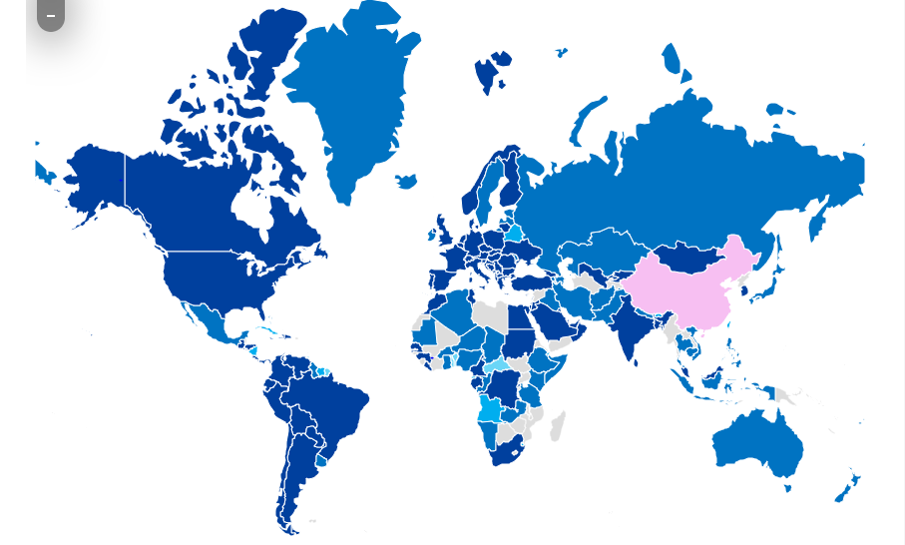
COUNTRY THRESHOLD MAP
#1 | Proactive Health-Minded Buying
#2 | Reactive Health Management
#3 | Pantry Preparation
#4 | Quarantine Living Prep
#5 | Restricted Living
#6 | Living a New Normal
Source: John's Hopkins Coronavirus database: https://www.arcgis.com/apps/opsdashboard/index.html#/bda7594740fd40299423467b48e9ecf6.
Formula: Number of reported cases, + Number of cases added per day + Government and Market News (including: quarantine measures, case transmission types, deaths)
Notes:
NOTE: Country thresholds can rapidly change. Use the most recent country threshold map from this link.
How to Update the Map:
Take a screenshot.
Paste into the slide
Crop the title and legend.
Ensure the map fills your entire slide

Slide 6
QUARANTINED LIVING PREP
#4
COVID-19 EVENT MARKERS
CONSUMER BEHAVIOUR SHIFTS
Localised COVID-19 emergency actions. Percentage of people diagnosed continues to increase.
Increased online shopping, declining store visits, rising out of stocks, strains on supply chain.

Slide 7
“
UNITED KINGDOM
COVID-19 RESPONSES IN ACTION
THRESHOLD 4 - QUARANTINED LIVING PREP
STABILIZING SUPPLY CHAIN
“While we expect that replenishment will eventually catch up in most categories, typically over a three to seven day period, especially where production is local, there are some instances where shortages could hang around—particularly for products manufactured in, or where packaging is sourced from China. Products that come off factory lines or go through distribution systems in virus-impacted countries could also face logistical issues, and these supply side shocks will further disrupt the industry.”
PAUL WALKER
Managing Director, Nielsen Connect UK
Morrisons supermarkets launched an initiative to pay small suppliers early. Not only does it generate goodwill, it will stabilize their supply chain during this testing time.
SECURING SUPPLY & CONTINUITY EARLY AS RESTRICTIONS INCREASE
Notes:
Consider the scenario…In many instances, pantry stockpiling will simply bring forward future purchases (e.g, toilet paper, dry pasta, medical supplies), and there will be a mid-term sales trough in future months as these products are gradually consumed. However, other categories, such as fresh foods, chilled and prepared food products and drinks may experience expansion as households potentially consume more in-home than they usually would do, as they reduce visits and spend at restaurants, pubs, bars and other fast food establishments.
Online pantry stocking driven by fear of a country wide pandemic is likely to spur a new wave of growth for online grocery. With an easy shopping experience, competitive prices and convenient delivery and/or pickup options, consumers are turning to e-commerce in turbulent times and may be open to exploring alternate retailing options if stock is available.
The impact could be that online FMCG sales accelerate to double digit growth over the forthcoming weeks, provided retailers are able to cope with this change in demand. If so, this would be a significant shift in U.K. shopping behaviour which may well continue for a while. Having an effective online strategy in place is now becoming critical for retailers and brands; and measuring the continued growth of this channel is key to understanding how it fits in within shoppers’ buying patterns and overall spending repertoire.
.

Slide 8
SHOPPERS CONTINUE TO STOCK UP TO MINIMISE VISITS TO SUPERMARKETS.
UNITED KINGDOM
JAN 7 |  |  | JAN 31 |  |  | FEB 22 | FEB 23 – 29 | MAR 1 - 7 | MAR 8 - 14
China reports novel coronavirus |  |  | UK Public health campaign launched |  |  | <10 CASES | 10 – 20 cases PM unveils COVID-19 Action Plan, declared “level 4 incident". | 35 – 206 cases. Govt launches public health/hygiene campaign | PM announces non-essential contact; working from home; avoiding pubs etc
#4
QUARANTINE LIVING
PREP
#3
PANTRY
PREP
#2
REACTIVE HEALTH MANAGEMENT
#1
PROACTIVE HEALTH-MINDED BUYING
Source: Nielsen Retail Measurement Services Weekly Sales Growth Trend vs. Year-ago.
Notes:
U.K. consumers are actively stockpiling grocery and health and personal care items as concerns grow around COVID-19 becoming a worldwide pandemic. Stocks of hand sanitisers and toilet paper have already dried up in some stores, as the supply chains come under pressure to mitigate any delays to replenishments.
In doing so, the U.K. is following in the footsteps of many other countries including China, the U.S. and Italy, where Nielsen research found significant spikes in the hoarding of emergency and essential supplies as consumers rush to build “pandemic pantries.” They’re also following an early trend we’re seeing out of China and Australia to head online for the supplies they’re seeking. Paul Walker, U.K. and Ireland Managing Director, said: “The uncertainty created by news of the spread of COVID-19 is having an effect here in the U.K. Shoppers are following the government’s health instructions, but they are also taking precautionary measures.”
WEEK OF 22 FEB – 29 FEB: CONSUMERS NOTICEABLY STOCKED UP
Looking at pandemic pantry items that consumers tend to stock up on during emergencies (e.g. cleaning products, pasta, rice and canned preserves in particular), we didn’t see significant stockpiling in the first eight weeks of the year. But corresponding to a moderate rise in cases in the U.K., shoppers began to prioritise items to prepare for a possible crisis situation.
“Shoppers began to stock up at the end of February on key items to prepare themselves for every eventuality. Alongside the cupboard staples, shoppers stocked up on medicines for the family, cleaning supplies, tissues and both fresh meat substitutes and canned meat. And it looks as though they purchased more than they intended, as sales of reusable shopping bags were up 177%,” says Walker.
We can see U.K. consumer behavior threshold levels change during the first week of March, directly linked to concerns around the development of the COVID-19 outbreak.
“These thresholds offer early signals of spending patterns, particularly for grocery items and health supplies where shoppers are concerned about not running out should they be unable to visit shops “, says Walker. “We can see these patterns unfold in the U.K. at the beginning of March with a sharp increase in sales of key pantry items, emergency health and personal care products and shelf-stable foods.”

Slide 9
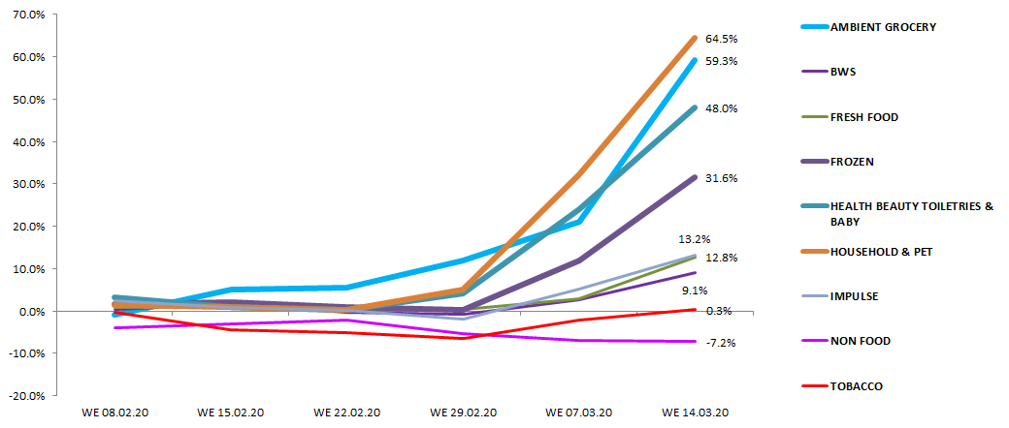
FRESH AND BWS ALSO SEEING INCREASES AS SHOPPERS TRY TO MINIMISE VISITS AND PREPARE FOR LOCKDOWN.
Total Coverage | Total Till by Super Category | Value % Chg YA | Last 6 Weeks
Source: Nielsen Scantrack Data to WE 14.03.20

Slide 10
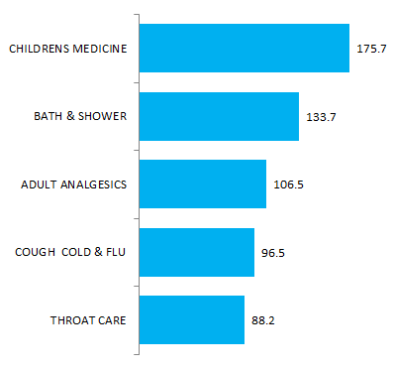
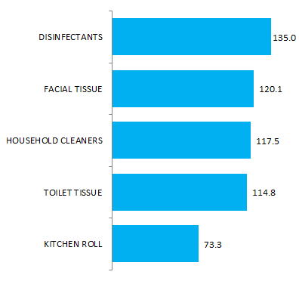
HYGIENE & MEDICINES REMAIN TOP 2 NON-FOOD PRIORITIES.
Total Coverage | Non Food by Sub Category (Top 5 Fastest Growing) | Value % Chg YA | Last 2 Weeks
HPC
Household & Pet
Source: Nielsen Scantrack Data to WE 14.03.20
Notes:
Unsurprisingly Disinfectants & household cleaning leading homecare growth.

Slide 11
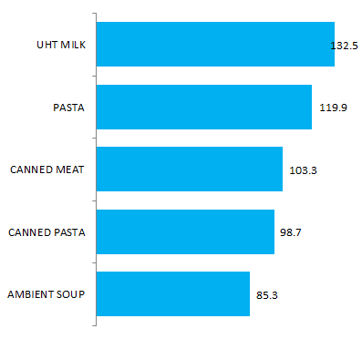
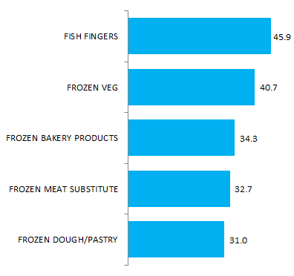
SHOPPERS CONTINUE TO STOCK UP ON STAPLE ITEMS.
Total Coverage | Ambient Grocery and Frozen by Sub Category (Top 5 Fastest Growing ) | Value % Chg YA | Last 2 Weeks
Ambient Grocery
Frozen
Source: Nielsen Scantrack Data to WE 14.03.20

Slide 12
UK - Preparing for Quarantine - Restricted Living
As UK moves into stricter lock down - we see behaviours and supermarkets actions changing fast
U.K. consumers have continued to increase their stockpiling of grocery and health, personal care and household items in the week ending 14th March as they prepare for quarantined living. This is probably the fastest record FMCG sales growth seen with this week in + 19.5% value growth vs year ago. For ref, since Nielsen started increased reporting on the impact of COVID 19, WE22.02 + 0%; WE29.02 +0.3%; WE07.03 +6.9%; WE 14.03 +19.5!
As concerns grow around COVID-19, for the first time this week we see increased purchasing of beers, wines, and spirits and Impulse snacking items have also started to emerge.
Retailers are now having to make changes to their business models to cope with this unprecedented demand and shoppers are also exploring new retail channels to find available products. The announcement on 20th March that retailers are now allowed to collaborate on supply chain planning and can share distribution and logistics, is a welcomed development, as manufacturers, wholesalers, and retailers work together to reduce the impact of stockpiling.
SOURCE: COVID 19 IMPACT - data to 14th March

Slide 13
RESTRICTED LIVING
#5
COVID-19 EVENT MARKERS
CONSUMER BEHAVIOUR SHIFTS
Mass cases of COVID-19. Communities ordered into lockdown.
Severely restricted shopping trips, online fulfilment is limited, price concerns rise as reduce stock availability impacts pricing.

Slide 14
Italy - Restricted Living
Highlights from Week ending 15th March
The weekend of the fourth week from the beginning of the health emergency has registered a decrease of sales in the large-scale distribution, while the other weekdays show positive trends in comparison to the same days of 2019. The peak has been registered on Tuesday 10th (+45,7%), while on Saturday and Sunday the decrease has been respectively of -19,9% and -36,2%. This decrease has been registered in all Areas of Italy.
During week 11 of 2020 purchases have grown particularly thanks to some products categories that are still related to the three effects identified by Nielsen.
The “shock effect”, according to turnover generated: UHT milk (+62,2%, 14,1 millions more every week), pasta (+65,3%), canned meat and fish (+56,0%), flour (+185,3%), chicken eggs (+59,6%), frozen products (+48,0%), ground coffee (+26,2%), butter (+71,9%), water bottles (+20,1%) that now are the driving products in the beverages segment, rice (+71,2%) and tomato products (+82,2%).
The “health & prevention effect”, according to turnover generated: gloves (+362,5%), 7,4 millions in total, Surfaces Detergents (+49,7%), toilet paper (+43,3%), home paper (+52,4%), hand soap, liquid and solid (+100,3%), bleach (+99,9%), wet wipes (+196%), denatured alcohol (+169,2%), thermometers (+115,9%) and paper tissues (+43,1%).
The “stay at home effect”, on one hand there is a growth in categories that can relate to an “homemade happy hour”, jam and similar products (+32,4), mozzarella cheese (+43,3%), chips (+31,3%), beer (+13,8%), but there is also a growth in “comfort food” segment, like sweet creams (+57,7%), frozen pizza (+54,3%), chocolate bars (+21,9%). Instead there has been a decrease in makeup and perfumes segments, respectively by -60% and -61,9%.
SOURCE: COVID 19 IMPACT - Weekly data to 15th March.

Slide 15
HYGIENE FIRST TO SPIKE, THEN PANTRY STOCKING.
ITALY
JAN 7 |  |  | JAN 31 |  |  | FEB 16 - 22 | FEB 23 – 29 | MAR 1 - 7 | MAR 8 - 14
China reports novel coronavirus |  |  | First two cases confirmed in Italy |  |  | 1st death. Italy announces a lockdown affecting 50,000 people in the northern Lombardy and Veneto regions | 132 -888 cases Schools started to close across affected regions | Italy announces containment decreed between red and yellow,. All schools shut Mar 4 – 100 deaths | March 8, North Italy lockdown followed by whole country on Mar 10
#4
QUARANTINE LIVING
PREP
#5
RESTRICTED LIVING
#3
PANTRY
PREP
#2
REACTIVE HEALTH MANAGEMENT
Hand Soap + 103%
#1
PROACTIVE HEALTH-MINDED BUYING
Canned Food+ 56%
Source: Nielsen Retail Measurement Services. Weekly % Sales Uplift vs. Year Ago. Delay in Sanitiser sales reported
Notes:
In Italy, consumers grew heavily reliant on online shopping and fulfilment (while significantly reducing in-store visits) to meet their health household needs, This will challenge areas where fulfilment infrastructure cannot keep up with demand
“EVEN LAST WEEK (MARCH 2- 8)THE RACE FOR ITALIAN PURCHASES CONTINUED. EVEN IN THE DAYS IMMEDIATELY PRECEDING THE DECREE OF 8 MARCH, LARGE-SCALE RETAIL SALES GREW AT A RAPID PACE AND THEN EXPLODED ON SUNDAY FOLLOWING THE NEW RESTRICTIVE MEASURES. THE GROWTH IN SALES TESTIFIES, FOR THE THIRD CONSECUTIVE WEEK, THE AVAILABILITY OF PRODUCTS ON THE SHELVES AND THE ORGANIZATIONAL CAPACITY OF THE CONSUMER GOODS SECTOR TO FACE THE EXCEPTIONAL SITUATION. “
Sales growth during week 10 of 2020 continues to be driven by some categories of products, the greatest demand for which can be attributed to three "effects". A decline in other categories is also beginning to emerge.
"stock" effect , with a double-digit increase in some categories of long-lasting foodstuffs, such as rice (+ 28.8%), pasta (+ 29.6%), animal preserves (+ 19.9%) and preserves red (+ 32.7%). In terms of absolute value, it is bakery products that generate the greatest growth, in particular pastry and biscuits. In addition, in the Basic Ingredients sector (+ 40.2%) the flour stands out (+ 57.5%) and in the Frozen Products sector (+ 18.4%) the natural fish stands out (+ 23.0%). The stock effect also positively impacts UHT milk sales (+ 20.2%). The growth in drinks (+ 6.8%) is below average, driven mainly by the beer (+10.4) and wine (+ 9.6%) sectors.
“prevention and health” effect , with an increase in sales in the Home Care categories ( + 19.6% ), driven in particular by the Surface Cleaners segment (+ 37.8%) and by the Commodities (+ 102.3%); Personal Care grew slightly below average (+ 10.4%), while the parapharmaceutical segments (+ 94.9%), toilet paper (+ 17.3%, predominantly in terms of turnover), wet wipes (+ 216.3%) and paper tissues (+ 30.6%). The growth of hand soap, liquid and solid, also continues, with a trend of + 64.3%, and the growth of intimate soaps with a + 25.2%.
“stay at home” effect , many categories related to aesthetics and consumption away from home saw a drop in week 10, to be noted: Cosmetics (-17.3%), Perfumery (-23.1%), Depilation (-6 , 7%), Sweet Snacks (-3.5%), Kit for sweet snacks (-11.7%), Savory after-meal kits (-51.5%)
In the early days of the COVID-19 crisis in Italy, Nardiello said consumers rushed to stores to stock up on emergency health items, such as hand sanitisers and face masks, along with fresh fruit and vegetables. The rush came as Italy saw the number of diagnosed COVID-19 cases rise dramatically in February and early March, prompting the government to lock down the north of the country, and then, by March 9, the entire country.
Unlike in some countries, where similar panic buying took place on the news of rising diagnoses, Nardiello said his teams had not witnessed attempts by major retailers to limit sales of in-demand items. However, he said concerned retailers attempted a proactive approach with messaging, including via media outlets to advise that there was no need to be concerned about supply levels. But the guidance was largely unheeded.
At the height of panic buying, he saw retail sales reach levels that he normally sees only during holiday periods like Christmas. But once the initial rush on stores was over, sales plateaued outside of spikes driven by news events such as the expanded quarantine efforts.
Some of Nardiello’s observations:
Some stores began limiting the number of people who could be inside the store at the same time. He believes this may drive people to buy products in larger quantities or pack sizes.
Particularly for in-demand items, he says the market may see fewer promotions because consumers will be less price sensitive than normal.
People have not increased their food ordering from restaurants in an effort to avoid food shopping. “This is not in our culture; we are happy to cook food from scratch.”
Locally grown food and local brands have always been the norm in terms of popularity in Italy, but this may be amplified during the outbreak.

Slide 16
“In the coming weeks additional growth will only be achieved if online retailers are able to meet the exponential growth in consumer demand. In the future, e-commerce in Italy is likely to be a consolidated reality, with e-tailers providing a more structured and established platform, and consumers keener to buy FMCG baskets online”. ROMOLO DE CAMILLIS Nielsen Retailer Leader, Italy
ITALY
COVID-19 RESPONSES IN ACTION
THRESHOLD 5 - RESTRICTED LIVING
SERVICE TO THE COMMUNITY
Donated € 2.5 million to hospitals
Worked with financial institutions to strengthen credit lines to suppliers in need
Provide free delivery to 65 year + customers
Encourage customers to use loyalty rewards for donations
Welfare intervention of €150 per person
FOCUS ON HELPING THOSE IN NEED AND THE COMMUNITY
Notes:
https://www.esselunga.it/cms/area-stampa/comunicati/2020/03/continuita-del-servizio.html?fbclid=IwAR07x8z-tyrgjXvssMLxoSchTfR5wrLldYLCkUPB3coZCxw_gZeIZKUVOYg

Slide 17
ALTERED ENVIRONMENTS WILL EMERGE AS NEW OPPORTUNITIES
“As China returns to a new normal, there are sweeping learnings from their experience. It has been a very challenging time. Consumer habits have changed and manufacturers and retailers are looking ahead to turn the crisis into an opportunity
67% will invest more in online channels and applications for their consumers
53% will adjust their product mix to more to health and safety products.
43% will work on their supply chains”
Based on a Nielsen survey of 10,000 retailers
JUSTIN SARGENT
President Nielsen China
Notes:
As markets move through the various stages of altered behavior and response, Nielsen can provide essentials insights to help clients navigate the changes
By amassing Nielsen’s data and learnings across multiple countries around the world, Nielsen is able to quickly capture the leading indicators and insights to guide clients in other markets.
We know, based on China’s progression, that markets will return to a ‘new, but altered, normal’, and clients will need to adapt to these changed realities.
We are already seeing that some behavioral changes ingrained amidst the COVID-10 outbreak in China will emerge as opportunities for the future
Early learnings from China already point to technology, supply/origin and quality as 3 of the most important retailer opportunities ahead
The next slides take you through the 6 thresholds consumer journey

Slide 18
LIVING A NEW NORMAL
#6
COVID-19 EVENT MARKERS
CONSUMER BEHAVIOUR SHIFTS
COVID-19 quarantines are lifted beyond region/country’s most affected hotspots and life starts to return to a new normal.
People return to daily routines (work, school etc.) but operate with new cautiousness about health. Shifts in supply, e-comm & hygiene practices.

Slide 19
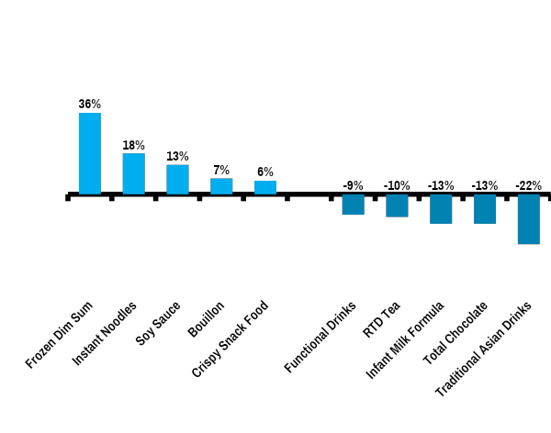
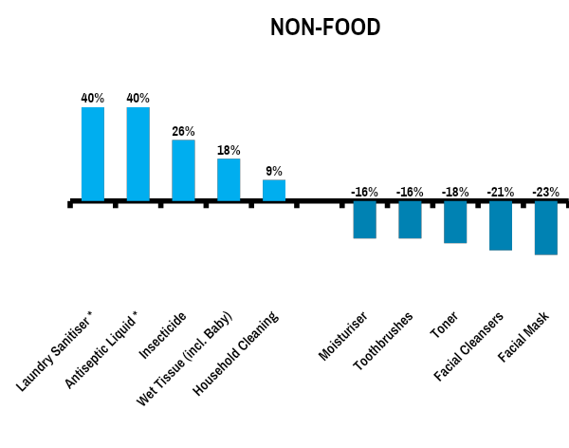
SPIKES IN VITAL HYGIENE & PANTRY CATEGORIES NON ESSENTIAL CATEGORIES ADVERSELY AFFECTED
CHINA
238%
163%
Source: Nielsen Retail Measurement Services Total China Modern & Traditional Trade (Jan/Feb 2020 sales growth versus year ago), excluding eCommerce and Mum/Baby Specialist stores. *Antiseptic Liquid and Laundry Sanitiser is Modern Trade only.
Notes:
China experienced severely restricted shopping trips and online fulfilment challenges at this stage.
Price hikes on in-demand products will occur in some countries, but not all.
We expect these factors will drive increased basket sizes in other markets and in some cases, influence consumer to spend more on hygiene needs and healthy food products.

Slide 20
“There is an emergence of a new retail environment. Consumers who might have been hesitant to embrace online shopping previously, older generation consumers or for fresh purchases, have now trialled it and experienced the benefits so will unlikely revert to their old patterns.”. RYAN ZHOU Nielsen Vice President CPG, Connect China
CHINA
COVID-19 RESPONSES IN ACTION
THRESHOLD 6 - LIVING THE NEW NORMAL
NEW HABITS: NEW NORMS
In China and South Korea older consumers began venturing online, welcoming the security and convenience that technology could provide amidst restrictions of movement and heightened caution
BEHAVIOUR CHANGES MAY STICK INTO THE FUTURE CREATING NEW RETAIL OPPORTUNITIES
Notes:
New health and safety labeling may be critical in winning over cautious consumers, based on changes made in China, particularly in home delivery products. Older generations are turning to online shopping to meet more of their household needs.
As it stands, China is the only country with large levels of its population impacted to reach level 6 and begin returning to normal ways of living. After extended periods of isolation, many workers have returned to offices and factories, with the exception of areas hardest hit, such as Hubei province.

Slide 21
WHAT LIES AHEAD FOR CONSUMERS?
CHINA
ONLINE SHOPPING DURING COVID-19 MAY BE THE EMBEDDED FUTURE REALITY
MULTI-DIMENSIONAL HEALTH ATTRIBUTES WILL BECOME
MORE INFLUENCIAL
SMART TECHNOLOGY TO SHAPE SMARTER EXPERIENCES
67% purchased daily necessities/ fresh products more than 2x per week
59% willing to buy daily necessities / fresh products more frequently online after the pandemic.
Expanded buzz from diet / nutrition to encompass fitness, mental health, immunity and disinfecting / hygiene.
90%+ will consider buying air and water purifiers
77%+ will consider buying blenders and smart bands.
93% would like a 5G phone
67% believe that A/VR can be used in future virtual shopping scenarios
~50% are interested in purchasing intelligent speakers / AI assistant
Source: Nielsen China Coronavirus Survey - Feb.24-Feb.29. Nielsen Social Intelligence Solution

Slide 22
STRATEGIES AND LEARNINGS FROM RETAILERS
CHINA
MARKET PERFORMANCE DURING THE OUTBREAK
CHALLENGES & RESPONSES DURING THE OUTBREAK
RETAIL OPPORTUNITIES AFTER THE PANDEMIC
Retailer performance was polarized during the COVID-19 impacted period
Hypers/Supers recorded growth, top retailers performed well with strong supply chains
Mini-channels, Convenience (CVS) & Grocery experienced setbacks and slowing sales
Specialty Stores suffered severe impacts , with some shifts to online
44% reported growing sales
42% reported declining sales
Main challenges:
Insufficient stock in some categories
Difficulty in logistics and distribution
Inadequate staff to deliver orders
Responses:
Flexible coordination of supply chain participants to ensure efficient supply
Showing care and concern for employees
Rationally deploying staff
Adjusting store opening hours
Rapidly expanding online sales
Strengthening corporate & brand marketing to enhance trust & empathy
46% are optimistic (next 6 months)
36% are worried (about the future)
Hypers/Supers:
Adjust supply chains, build self capacity
Expand omni-channel & O2O integration
Mini/Grocery/CVS:
Specialize in fresh from local providers
Match products to needs by neighborhoods
Resolve bottlenecks in supply via local and digital means
Specialty stores:
Accelerate integration of online & offline
Promote innovation & community operations
Source: Nielsen China COVID-19 Retail Industry Impact survey. 84 respondents across 75 key retailers, various regions and Modern Trade Channels.

Slide 23
China - Living New Normal
While things are still early and some regions continue to see COVID-19 cases, markets can look to China for indicators of purchase trends after the height of exposure. A month after the crisis peaked, life is slowly starting to return to a new normal. Travel restrictions are beginning to relax, people are returning to work, many factories have reopened, e-commerce and food delivery peaks are stabilizing, and many stores are reopening.
Retailers are upgrading their product assortment to meet consumers’ newly emerging needs, and leveraging e-commerce and social media, as well as promotional tactics, to encourage consumers to return to their normal shopping patterns. However, some long-time purchasing habits may be permanently changed. Some retailers were adversely impacted, but those who were able to pivot quickly came out ahead and are changing the retail landscape.

Slide 24
IMPLICATIONS AND
WINNING STRATEGIES

Slide 25
WE EXPECT A CORRECTION TO GROWTH RATES IN UK DEPENDENT ON MORE OR LESS IN HOME USAGE.
#4
QUARANTINE LIVING
PREP
#5
RESTRICTED LIVING
#5
LIVING NEW NORMAL
Sales % Chg
Increased in home consumption
Return to previous levels dependent on recessionary and longer terms behavioural impacts.
Historical growth rate
Stockpiling hangover & reduced in home consumption
Time
Food & Drink, Medicines + Hygiene products.
Beauty, Toiletries & Household excl. “Hygiene” products.
Nielsen Total Coverage growth rate expectations
Notes:
We expect the growth trends through the pandemic to broadly follow 1 of 2 routes. For all growth categories, we expect growth to peak 2 to 3 weeks after full restricted living arrangements. For UK, we would expect the peak over Easter week. Following that, a gradual correction will occur at different rates across categories.
For food in general, we expect continued above average growth rates as households consume more in the home. Obviously this is to the detriment of foodservice and restaurant outlets that we do not track in our service. For fresh food, the peak is lower than ambient and frozen but the slowdown will be longer due to less stockholding. We would expect “Treating & Indulgence” sectors to also hold up well as some households look to comfort both kids and themselves whilst at home. BWS would also come in this bracket for Adults only. For Hygiene & Health related products such as hand soaps, surface cleaners, vitamins & medicines we also expect continued growth at a slowing rate. Hand sanitisers are the possible exception to this. They are less important in the home so likely will see declines similar to toiletries and household.
For Beauty, Toiletries & Household products, we would expect sales to fall in to decline 2-4 weeks after the peak, as consumers use up stock at a slower rate in the home. This would be especially the case for beauty products that are more reliant on social occasions (Make-up, Hair Styling, Fragrances) and to a lesser extent for products that are more habitual such as deodorants, hair care and laundry. Toilet and face tissues, although will be used more in the home, are likely to experience more of a stockpiling hangover than other categories.

Slide 26
IMPLICATIONS AND WINNING STRATEGIES
#1 PROACTIVE HEALTH-MINDED BUYING | #2 REACTIVE HEALTH MANAGEMENT | #3 PANTRY PREPARATION | #4 QUARANTINED LIVING PREPARATION | #5 RESTRICTED LIVING | #6 LIVING A NEW NORMAL
IMPLICATIONS
Awareness drives low volume, preemptive purchases. Supply copes with demand. Greater sway towards product quality & safety | Rising demand surge strains supply of broader health related & essential supplies. Distinct demand surfaces for efficacy & assurance | Mass stock pressure from excessive food & homecare stockpiling demand Local supply and credentials become advantageous | Supply interruptions & breakdowns. Reliance turns to online buying, where possible. Consumers seek direct retail & brand online fulfilment. | Online demand & delivery standards explode, ill-equipped for multiplying needs. Consumers need product sanitation & delivery guarantees. | Ongoing health unease & financial anxiety. Restrictions lessen, but many new habits are ingrained. Rebased consumer standards for quality, origin & tech
WINNING STRATEGIES
Inform consumers early about restricted quantities to avoid hoarding or profiteering. Reinforce reserve stock supply. | Industry co-operation vital to protect & serve high-risk populations. Bring in alternate suppliers to maintain balanced demand - deflate panic. | Clear communication regarding ongoing availability to instill confidence. Limit product quantities & control store environments (access, queues, hours). | Add safety measures (packaging, staff, hygiene). Cooperation between retailers & suppliers to secure supply chain especially local origin. | Ramp up tech solutions quickly – online buying, apps, A/VR, auto subscriptions, Empathise & allay concerns with more engagement & communication. | Agile businesses recognize lingering concerns & new behaviors that may slow but not disappear, & continue to adapt to meet these altered needs
Notes:
The implications encompass broader industry insights for retailers and manufacturers, not only those related to individual categories and shopping
Each threshold emphasizes an important accelerator within each level. These are guidelines and could be expanded or different for each client depending on their portfolio and country context.
Winning strategies are indicative and not exhaustive, as there are many corporate, labour, operational, logistics, marketing, technology, sales and distribution areas to consider.

