Slide 1
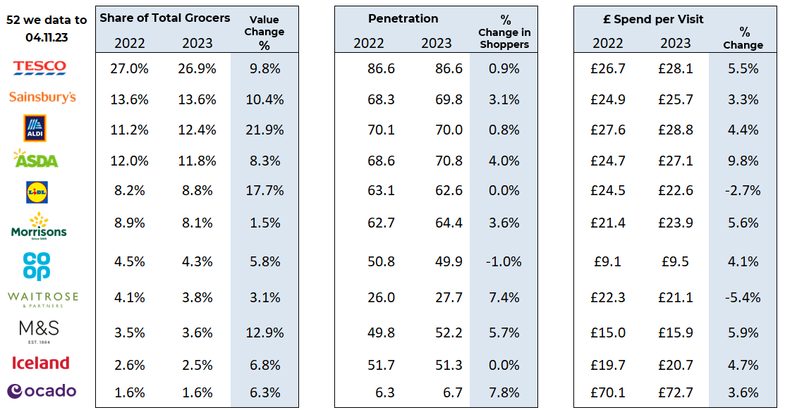
Essential
Retail
52 w/e, 04TH NOV 23
FMCG - Share of Trade and KPIs
Share of Trade
Source: NIQ Homescan SOT based on FMCG, Benchmark Total Grocers
% Change in Shoppers = % Change in Households buying

Slide 2
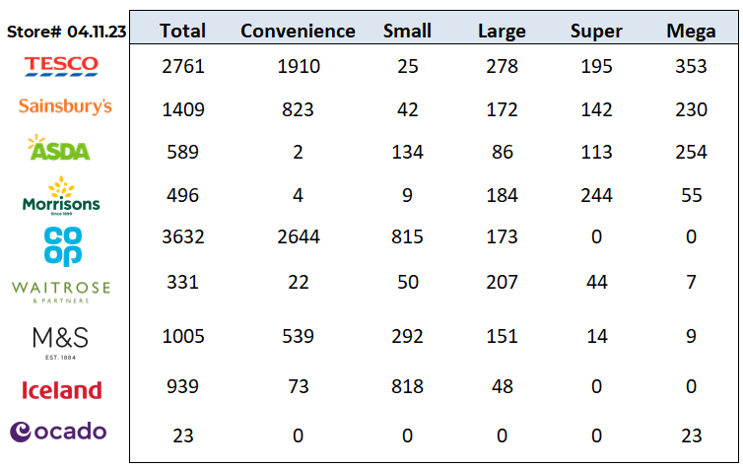
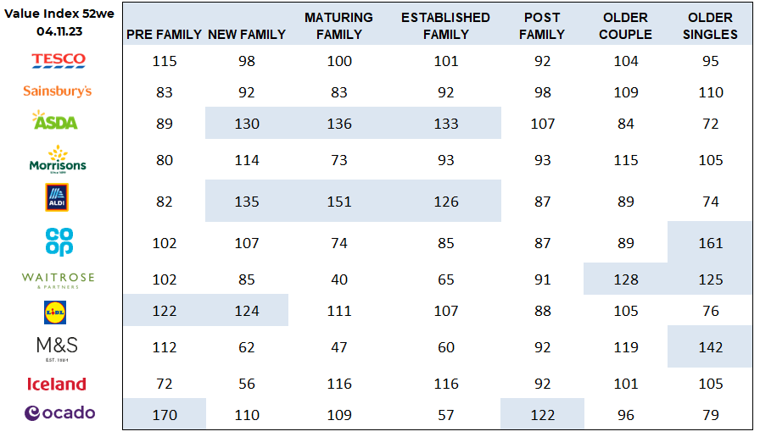
FMCG - Store Numbers and Demographics
Store Profile
Life Stage
Source: NIQ Store Numbers, Homescan Lifestage indices indexed on GB Households

Slide 3
Tesco has launched its first major marketing push for its Whoosh rapid grocery delivery service, in a humorous campaign aimed at consumers who don’t want to go to the shops. All three films depict the word ‘Whoosh’ and a simple voice over stating “Tesco Whoosh. Delivery from as little as 20 minutes. Because going to the shops isn’t everyone’s bag”. Some people would rather do anything else but go down the shops to get what they need for dinner,” said BBH deputy executive creative director, Felipe Serradourada Guimaraes.
Sainsbury’s is creating 22,000 additional seasonal roles nationwide, including 2,000 at Argos, ahead of the busy Christmas period. The supermarket giant will welcome temporary colleagues earlier than usual this year, to serve customers, restock shelves and fulfill online orders by picking, packing and delivering. Prerana Issar, said: “⁠With Christmas just around the corner, we’re gearing up to serve our customers brilliantly this festive season”.
ASDA is to convert all 356 acquired EG Group convenience sites to Asda Express stores by next summer. Asda completed the acquisition of EG Group’s UK business in October for an enterprise value of £2.07bn. As part of the conversion programme, the supermarket giant will be turning 117 Spar stores into Asda Express sites which were previously sat on EG forecourts. Alongside its acquisition of 119 convenience sites from Co-op, Asda has said that it will now be opening up to 20 stores per week. ASDA has committed to opening a further 300 standalone convenience stores by the end of 2026. The growth strategy forms a key part of its long-term ambition to become the UK’s second largest supermarket.
Morrisons is cutting the price of 58 popular festive items and will be keeping the prices low until the end of the year. Products will include stuffing, roast potatoes, cranberry sauce and tin foil, with prices being locked from today (6 November) to ensure shoppers can stock up ahead of Christmas day. Drinks and nibbles will also be added to the price lock, such as mulled wine, bucks fizz, tonic and peanuts. The supermarket giant is investing over £4m to cut the price of the items by an average of almost 20% from current prices. The products have all been chosen due to being particularly popular at Morrisons last Christmas – with an average uplift in sales of over 90% throughout the festive period. Morrisons chief customer and marketing officer, Rachel Eyre, said: “We know that Christmas is an expensive time of year and that our customers are having to make tough choices about what to put in their baskets. “
Source: NielsenIQ Homescan, Grocer & Nam News

Slide 4
Waitrose is pushing its suppliers to lower their costs as it looks to improve its margins in line with anticipated falls in food inflation. The supermarket met with representatives from its supply chain to discuss business proposals ahead of the 2024 financial year. During the meeting, suppliers were told the supermarket was anticipating deflation, following what has been a prolonged period of inflation. As a result, Waitrose is now requesting for businesses to identify any areas of their supply chain where costs have fallen, and could facilitate a price decrease. The news comes as the rate of food inflation decreased for the sixth consecutive month in October, according to the latest figures released by the British Retail Consortium and NIQ this week, falling to 8.8%, down from 9.9% in September.
Aldi is spreading festive cheer by donating Christmas lunches to low-income areas across the UK. The grocery giant has teamed up with food redistributor Company Shop Group to provide free Christmas dinners at their social enterprise Community Shops in the run-up to the holidays. Over the festive period, its members can sign up for a three-course Christmas meal, with around 2,000 free places available Aldi UK national sustainability director Liz Fox said: “Our regional distribution centres work with Company Shop Group all year round, redistributing our surplus stock and donating food to provide affordable groceries for Community Shop members.
Lidl’s has reduced food waste by almost half (43%) since 2016 as it remains on track to hit its 50% reduction target by 2030. To limit food waste, Lidl provided over six million meals to charities in 2022 and prevented nearly 9,000 tonnes from being binned through the sale of 1.7m ‘Too Good To Waste’ boxes – an initiative which allows shoppers to purchase 5kg of damaged, discoloured or deteriorated fruit and veg that can still be eaten for £1.50. The discounter has also looked to reduce waste in the form of plastic packaging with 95% of its own-brand packaging now recyclable, reusable, renewable or refillable. Overall, Lidl has cut the amount of plastic packaging across its own-brand ranges by 29% since 2017 as it looks to achieve 40% by 2025..”
Source: NielsenIQ Homescan, Grocer & Nam News

Slide 5
Iceland has chosen not to release a Christmas TV ad and will instead invest in supporting customers during the cost-of-living crisis. In a statement by executive chairman Richard Walker, “As a business we were faced with a decision. This was a no brainer for us. I am grateful that as a family-run company, we can make the decisions we believe are right for our business and our customers.” Walker said that it chosen to invest in “keeping prices low” for customers through initiatives such as its Christmas Bonus Cards Saving scheme, which gives shoppers £15 back when they top up £100, as well as deals such as a turkey roast dinner bundle for 8-10 people for just £30. The frozen food specialist has also slashed prices on over 1,000 household staples and expanded its £1 value range. Walker’s announcement comes as the supermarkets have signed up some superstars to star in their Christmas ads.
Coop Six new suppliers are set to hit Co-op shelves following the latest round of its accelerated support scheme. The search for small businesses to join the Apiary programme began at the start of 2023, with products launching in almost 300 stores from this week. Successful suppliers include Black Milk, which will offer its Hazelnut Cream, Pistachio Cream and White Chocolate sweet spreads, and Blue Turaco which supplies Robusta Ground coffee and Robusta Wholebean coffee sourced directly from small coffee-farming communities in Uganda. With each purchase of Blue Turaco’s coffee, a Ugandan village school will be provided with lunches to help fight hunger.
Ocado’s latest digital deposit return scheme (DDRS) has been deemed a success following a pilot which saw Ocado customers claim monetary rewards for two and four pint milk bottles over the summer. The pilot from the online delivery platform was launched in partnership with recycling technology firm Polytag and recycling app Bower. The scheme – which sends 20p to digital wallets for each code scanned – was trialled to increase demand for retail recycling initiatives. As a result, more than 20,000 Ocado Retail milk bottles were scanned by these consumers through their smartphones before being placed in their home kerbside recycling – totalling reward claims of up to £4,000. Since launch in July, more than 3,000 Ocado customers have claimed monetary rewards for recycling their two and four-pint milk bottles. Speaking to sustainability publication edie, Polytag’s chief executive officer Alice Rackley said: “Through cutting-edge technology and end-to-end packaging solutions, this project has delivered on what consumers have been asking for. Today’s outcome is the result of years of public consultation and stringent testing working to feed the appetite of consumers for retailers to offer real incentives for recycling.”
Source: NielsenIQ Homescan, Grocer & Nam News

