Slide 1
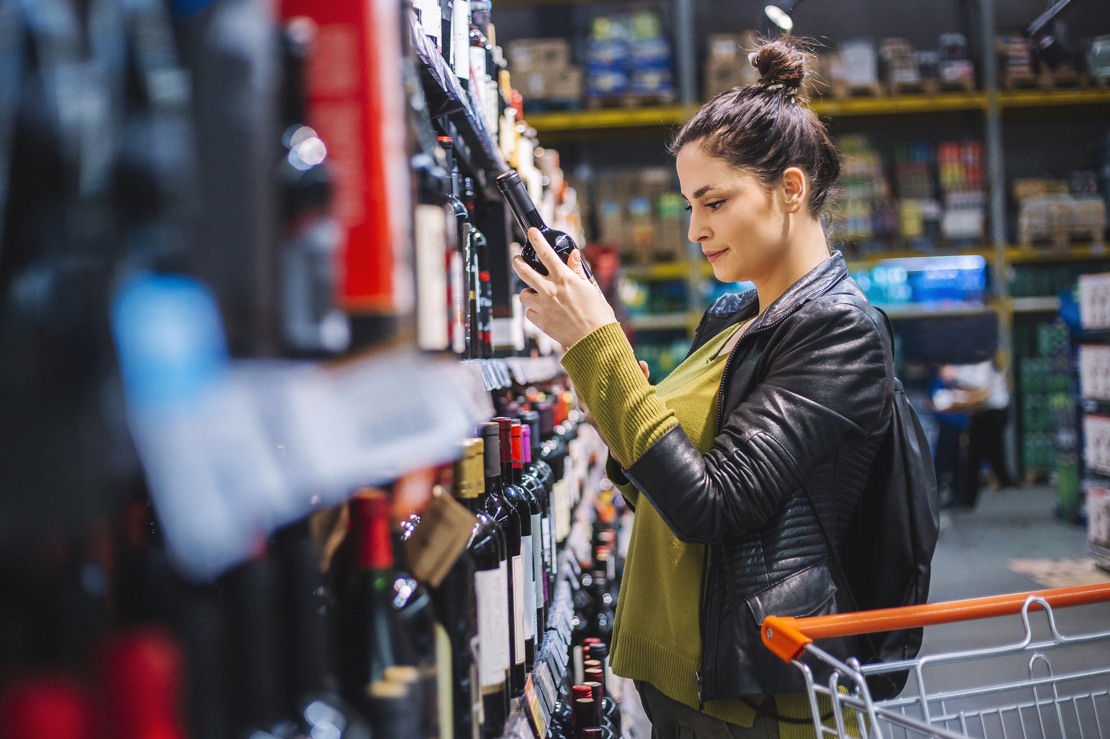
FMCG Essential Retail – What you need to know!
Share of Trade
52 we data to 12.08.23
Share of Total Grocers
Value Change %
Penetration
£ Spend per Visit
2022
2023
2022
2023
% Change
2022
2023
% Change
27.1% | 26.9% | 8.7% | 86.4 | 86.7 | 1.2% | 26.7 | 27.7 | 3.9%
13.6% | 13.6% | 9.1% | 67.9 | 69.7 | 3.5% | 24.9 | 25.4 | 3.7%
11.9% | 11.9% | 9.3% | 69.5 | 70.5 | 2.2% | 27.6 | 28.5 | 2.2%
11.1% | 12.2% | 20.3% | 67.3 | 70.3 | 5.4% | 24.5 | 26.5 | 3.5%
8.1% | 8.6% | 16.4% | 61.6 | 64.8 | 6.0% | 21.4 | 22.3 | -4.8%
9.0% | 8.2% | -0.2% | 62.8 | 62.4 | 0.2% | 25.0 | 23.8 | 8.1%
4.5% | 4.4% | 6.0% | 50.5 | 50.3 | 0.5% | 9.1 | 9.4 | 4.1%
4.1% | 3.9% | 1.6% | 26.2 | 27.4 | 5.5% | 23.0 | 21.2 | 3.2%
3.6% | 3.6% | 10.6% | 50.0 | 51.5 | 3.9% | 15.0 | 15.6 | -7.7%
2.6% | 2.6% | 7.3% | 51.2 | 51.9 | 2.1% | 19.7 | 20.3 | 4.3%
1.6% | 1.6% | 4.1% | 6.0 | 6.8 | 14.2% | 69.7 | 72.9 | 3.0%
Store Portfolio
Store Numbers as of 12.08.23
Store Numbers
Total
Convenience
Small
Large
Super
Mega
2752 | 1897 | 24 | 283 | 195 | 353
1403 | 816 | 43 | 172 | 142 | 230
589 | 2 | 134 | 86 | 113 | 254
499 | 4 | 10 | 185 | 245 | 55
3651 | 2658 | 819 | 174 | 0 | 0
331 | 22 | 50 | 207 | 44 | 7
1004 | 538 | 293 | 151 | 14 | 8
949 | 77 | 824 | 48 | 0 | 0
25 | 0 | 0 | 0 | 0 | 25
Value Index
52 we 12.08.23
Pre Family
New Family
Maturing Family
Life stage
Post Family
Older Couple
Older Singles
Established Family
113 | 99 | 102 | 100 | 93 | 103 | 95
77 | 92 | 83 | 93 | 100 | 108 | 112
88 | 140 | 138 | 132 | 105 | 84 | 71
80 | 107 | 72 | 95 | 95 | 115 | 104
85 | 139 | 152 | 126 | 86 | 90 | 73
98 | 100 | 75 | 87 | 85 | 89 | 163
123 | 77 | 34 | 66 | 89 | 131 | 121
129 | 116 | 114 | 107 | 88 | 103 | 75
115 | 63 | 48 | 60 | 90 | 118 | 144
73 | 52 | 113 | 115 | 97 | 102 | 102
152 | 91 | 107 | 64 | 127 | 100 | 76
Source: Nielsen Homescan SOT based on FMCG [New Base], Benchmark Total Grocers% Change Penetration = % Change in actual buyers
Penetration = Change in shoppers

Slide 2
FMCG Essential Retail
Tesco has become one of the first retailers to have its latest net-zero commitments validated by the Science Based Targets Initiative (SBTi), the official global body that verifies climate targets. To meet the targets, Tesco will work towards its commitment to become carbon neutral across its own operations by 2035, and value chain by 2050, in line with the Paris Agreement’s aim of limiting global temperature rise to 1.5C. Tesco group chief executive, Ken Murphy, said: “With the effects of climate change now upon us, we’re absolutely committed to achieving our target of net zero by 2050.
Sainsbury’s is set to save 103 tonnes of plastic with the introduction of new cardboard hangers across its Tu Clothing Baby range. The supermarket chain will replace five million plastic hangers following a successful trial, expanding the offer to over 400 stores nationwide.
ASDA could be in the stages of launching a new healthy food range as it looks to ramp up its nutritional offerings. Asda has registered ‘The Health Kitchen’ brand name with the government’s Intellectual Property Office, The Grocer reported. This covers a range of products including prepared and frozen food such as meat, fish and vegetables, fresh and raw fruit and vegetables, bread, pastries, pasta and noodles, and alcoholic and non-alcoholic drinks.
Morrisons has launched a new trial to support farmers by underwriting 100% of the costs associated with growing crops. This looks to help British farmers mitigate cost and weather pressures, including field rent and fertiliser cost, and gives them greater financial security. Morrisons senior buying manager for root vegetables, Gareth Cosford, said: “As British farming’s biggest direct customer we understand the impact that higher costs are continuing to have on farmers. Therefore, our trial scheme allows us to take all the risk associated with growing the crop away from our farmers and continue to grow the best quality British produce that our customers know and love.”
Source: NielsenIQ Homescan, Grocer & Nam News

Slide 3
FMCG Essential Retail
Waitrose has partnered with beverage giant Diageo to introduce dedicated areas that offer the retailer’s full range of over 70 low and alcohol free drinks. Rolling out in 253 stores across the UK, the area will feature a range of beer, cider, wines and spirits. Research by Diageo found that seven in ten UK adults want to be able to find low and no-alcohol drinks more easily, with two fifths wanting to moderate their drinking. Waitrose master of wine and head of beers, wines and spirits, Pierpaolo Petrassi, said: “Demand for low alcohol and alcohol-free drinks is growing at a phenomenal rate. It’s now the norm for customers to buy both.”
Aldi. has cut the price of more than 30 household products across its range of grocery staples. The move from the German discounter means that shoppers will now pay even less for fresh produce including apples, oranges and peaches. Essentials including butter, spread, canned food, personal hygiene products and pet treats are also included in the latest price drop. The move is the latest of more than 130 prices that Aldi has cut in the past two months across its entire range, which also includes expanding its Super 6 fruit and veg promotional range to Super 7.
Lidl’s is to make its own-brand tea bags fully compostable in a bid to help shoppers make more sustainable choices. Customers will be able to dispose of the tea bags in food or green waste bins, while the transition to fully compostable is expected to divert up to 800 million tea bags per year from traditional waste bins and landfill. The discount grocer said the plant-based plastic, plylactic acid (PLA) material ensures the compostability of the tea bags and maintains the quality and flavour.
Source: NielsenIQ Homescan, Grocer & Nam News

Slide 4
FMCG Essential Retail
Iceland has slashed the price of 200 products as part of a summer savings initiative. Customers can save up to £3.75 across products such as Richmond Sausages, Greggs cheese and onion bakes, Lurpak, Persil three in one washing capsules and Starbucks Multiserve caffe latte or caramel macchiato. Iceland Foods and The Food Warehouse group sales director, Paul Dhaliwal, said: “Families are more likely to be spending their summer at home due to rising costs. We want to alleviate some of the stress for parents so they, and the kids, can enjoy that time together. “Our summer Heroes initiatives not only help families put food on the table thanks to value prices on household essentials as well as our exclusive Bonus Card benefits, but it will also help to keep the kids entertained on a budget.”
Coop has launched two new member offers to help shoppers save up to £18.45 during the summer holidays.The convenience retailer’s ‘Freezer Filler’ and ‘Supersaver’ deals will run until August 29, offered for £5 each to Co-op members. The ‘Freezer Filler’ deal allows shoppers to purchase five frozen food items for £5, such as a Dr.Oetker Ristorante mozzarella cheese pizza, Goodfellas garlic bread, McCain potato wedges, Birds Eye nuggets and Magnum Classics, saving £9.45 in total. The ‘Supersaver’ deal offers members a Co-op stonebaked pizza and a tub of Ben & Jerry’s across a range of flavours for £5, with a saving of £9.
Ocado is set to expand its same-day delivery options, creating more slots for shoppers as it faces increasing pressure from part-owner M&S to begin showing signs of a turnaround. Currently, the online grocer offers same-day delivery options in most locations across the UK, but availability is limited to a few thousand each week. According to the Telegraph, Ocado will focus on getting shoppers to order larger deliveries for same-day slots, rather than just last-minute ingredients which are typically sold on delivery apps.
Source: NielsenIQ Homescan, Grocer & Nam News

