Slide 1
UK Cod Report Data to 18.05.24
ScanTrack data includes GB Total Coverage and the discounters, plus Northern Ireland Total Coverage and Musgraves.
HomeScan data is based upon a GB consumer panel and should only be used for trends, not absolute values.
All data released after w/e 26.03.16 is coded according to refined definitions available from Seafish.
Species specific data now includes Meals

Slide 2
Moving Annual Trends
Source – ScanTrack MAT

Slide 3
Long Term Trends – Total Cod
Source – ScanTrack MAT

Slide 4
Long Term Trends – Frozen Cod
Source – ScanTrack MAT

Slide 5
Long Term Trends – Chilled Cod
Source – ScanTrack MAT

Slide 6
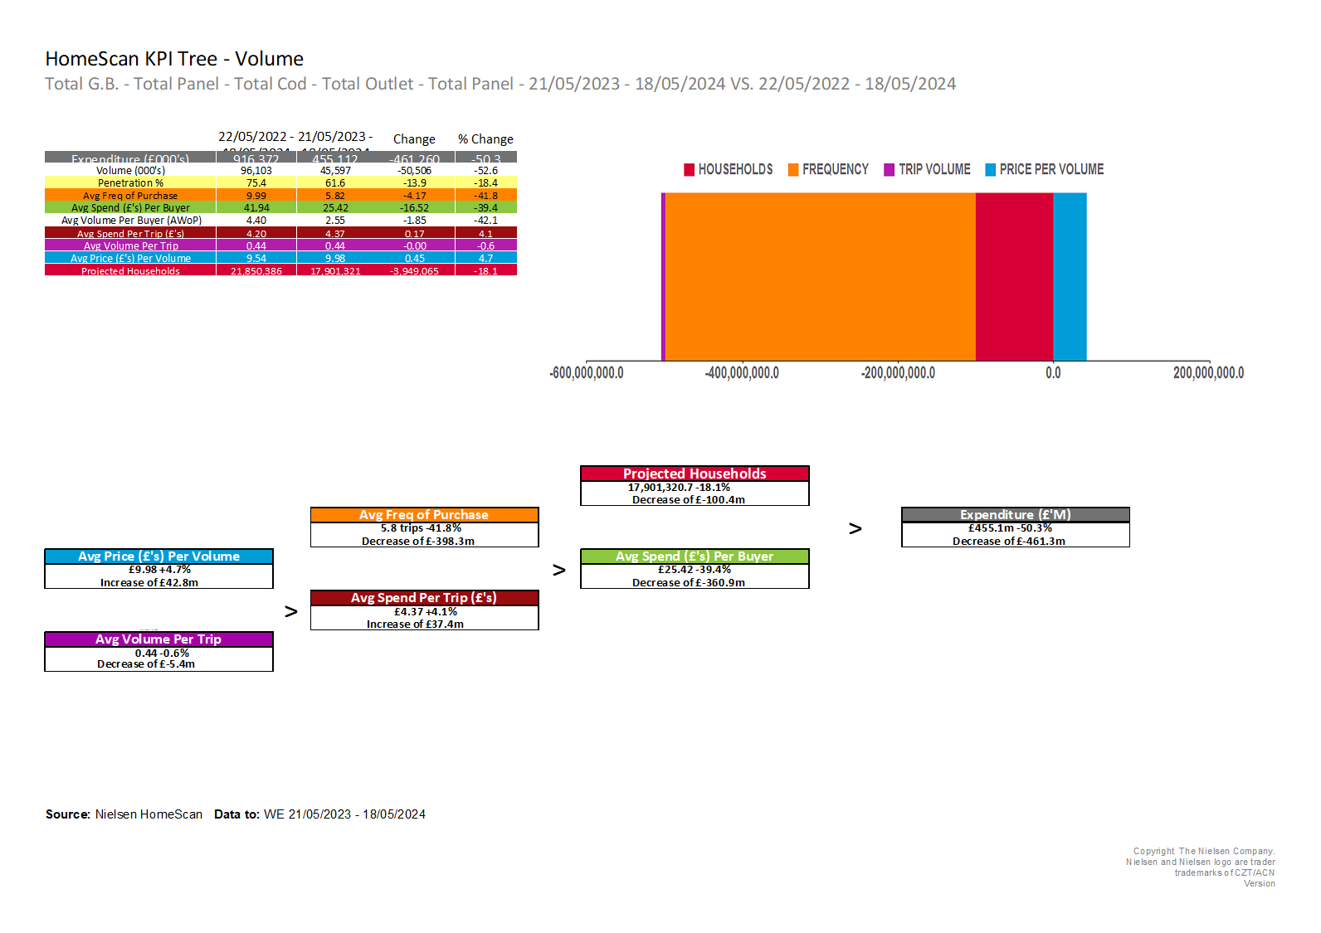
Purchase KPI’s - Total Cod
Source – HomeScan MAT

Slide 7
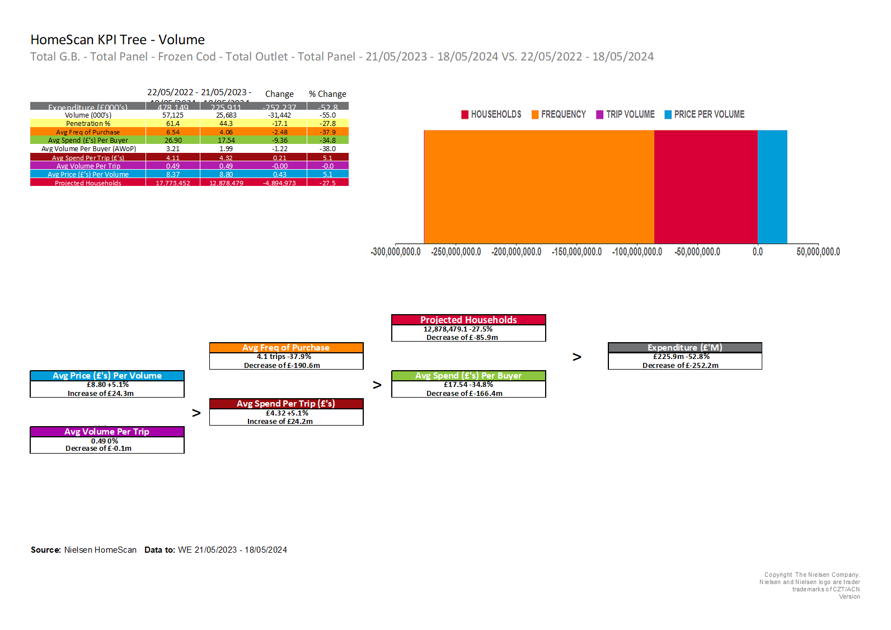
Purchase KPI’s - Frozen Cod
Source – HomeScan MAT

Slide 8
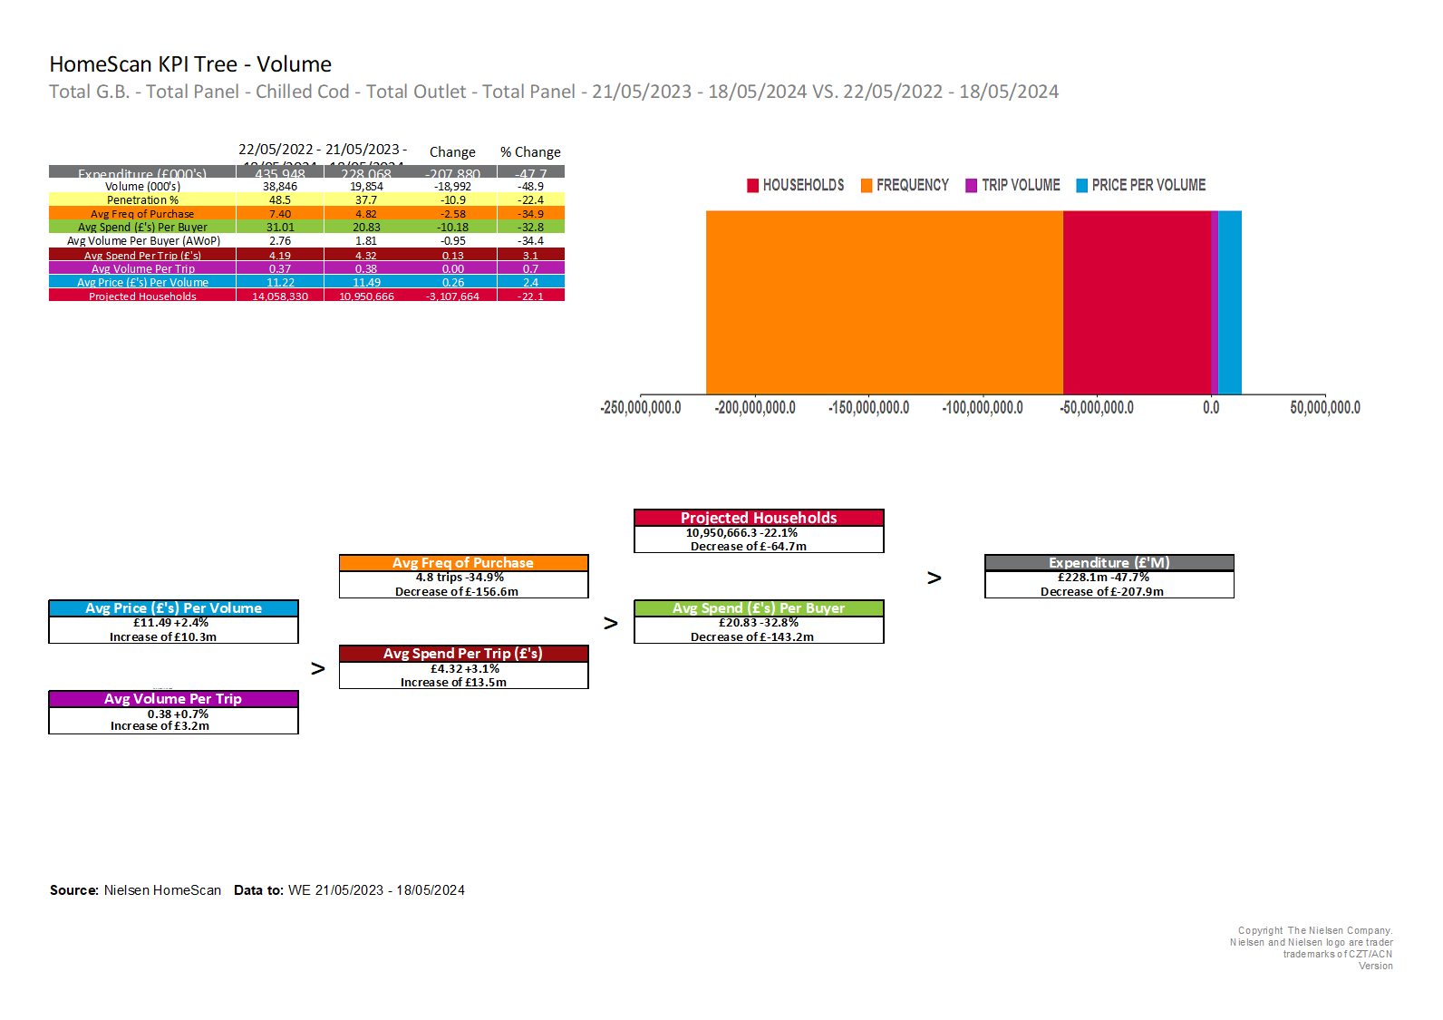
Purchase KPI’s - Chilled Cod
Source – HomeScan MAT

Slide 9
Rolling Purchase KPI’s – Total Cod
Source – HomeScan MAT

Slide 10
Rolling Purchase KPI’s – Frozen Cod
Source – HomeScan MAT

Slide 11
Rolling Purchase KPI’s – Chilled Cod
Source – HomeScan MAT

Slide 12
Share of Trade – Total Cod
Source – HomeScan MAT

Slide 13
Share of Trade – Frozen Cod
Source – HomeScan MAT

Slide 14
Share of Trade – Chilled Cod
Source – HomeScan MAT

Slide 15
Market Context – Total Fish
Source – ScanTrack MAT

Slide 16
Market Context – Total Fish continued
Source – ScanTrack MAT

Slide 17
Glossary
Data is sourced from Nielsen
Scantrack – EPOS from key retailers and some sample EPOS.
Homescan – Consumer panel of 15,000 households using hand held scanners to record grocery purchases
MAT – Moving Annual Total i.e. 52 weeks, TY= This year, YA= Year ago, 2YA =Two years ago
Fish – Seafood (i.e. fish and shellfish)
Fresh – Chilled
Segment definitions:
Batter - Fish / shellfish which is described as being coated in batter / battered / tempura n.b. cake / finger segment takes priority.
Breaded - Fish / shellfish which is described as being coated in breadcrumbs / breaded / crumb n.b. cake / finger segments takes priority.
Cakes - Fish / shellfish which are described as cakes.
Dusted - Fish / shellfish which are described as dusted or lightly coated (in seasoned flour)
Fingers - Fish / shellfish which are described as fingers.
Meals - Fish / shellfish which are described as meals and/or contain a carbohydrate, exclude all meals which contain a mixture of meat and seafood protein.
Natural - Fish / shellfish that has not had anything added or done to it, other than that required for basic processing. It can be raw or cooked or smoked, whole / fillets/ headed / gutted fish or shucked & peeled shellfish.
Prepared - Fish / shellfish that has other ingredients or has been processed in any way different to the other segments e.g. packaged in brine / water / oil / marinade, or smoked / treated / prepared / topped / crusted / stuffed / served with a relish but is not a meal.
Sauce - Fish / shellfish which is described as being in a sauce or with a separate sauce / dressing / dip (can be a sachet) but has no other additions e.g. lettuce n.b. Batter, Breaded, Cakes, Dusted & Finger segments take priority.
Sushi - Fish / shellfish which is described as sushi or sashimi.
Segments can be further broken down into:
By Sector i.e. Chilled, Frozen & Ambient
By Species e.g. Cod, Haddock
Smoked & Unsmoked
Organic & Standard

