Slide 1
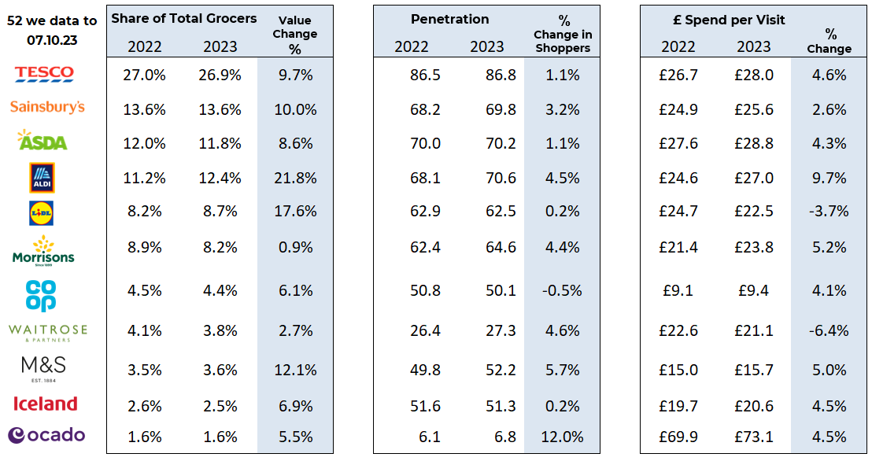
Essential
Retail
52 w/e, 07TH OCT 23
FMCG - Share of Trade and KPIs
Share of Trade
Source: Nielsen Homescan SOT based on FMCG [New Base], Benchmark Total Grocers%
Change Penetration = % Change in actual buyers, Penetration = Change in shoppers

Slide 2
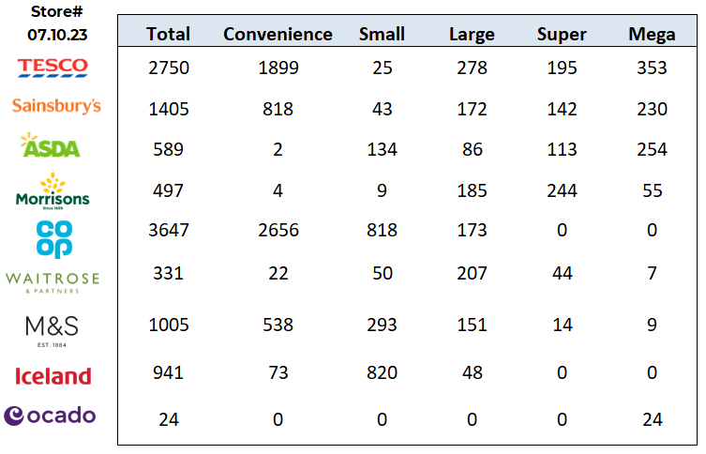
FMCG - Store Numbers and Demographics
Store Profile
Life Stage
Source: Nielsen Homescan SOT based on FMCG [New Base], Benchmark Total Grocers%
Change Penetration = % Change in actual buyers, Penetration = Change in shoppers

Slide 3
Tesco is launching a new range of festive decorations and gifting products in collaboration with the Dragons’ Den-backed brand March Muses, which will bring representation and diversity to the celebrations. The exclusive collection from the UK’s largest retailer, which launches in late October, includes decorations, cards and gift wraps that feature people with a variety of skin tones, including Father Christmas, the Nutcracker and painted ballerinas. “We are elated for the opportunity to bring our products to even more people through Tesco, and we hope that this partnership will inspire other retailers to embrace diversity in their offerings.”
Sainsbury’s Today marks the launch of Sainsbury’s updated premium Taste the Difference British beef range, showcasing a more sustainable product portfolio that is rolling out in 60 UK stores. 10 years of development and five years of production to create the beef, which has a 25% lower carbon footprint compared to industry standards. As a result, the supermarket giant will be offering the largest low-carbon beef range ever produced in the UK – making the occasion quite the milestone. It consists of 16 varieties including 12% and 5% fat beef mince, 30-day ribeye fillet, sirloin and rump steaks, and a 30-day beef roasting joint, which was developed in partnership with the supermarket’s long-standing supplier and beef processor ABP. While the products will initially be introduced to 60 stores in the north, a nationwide rollout will be taking place later.
ASDA is cutting the price of 232 branded and own-label products in its latest efforts to support shoppers amid the cost-of-living crisis. The supermarket giant is investing £9m in lowering prices by an average 14% on popular items including bread, fresh fruit and vegetables, and meat. Effective from today (11 October), other products featured in the price cuts include Asda fish pie mix, garlic pizza, McCain’s home chips and Jaffa Cake bars. This follows a £35m investment to reduce the price of over 600 items in July and August, bringing the total Asda has spent on lowering prices to £44m since the start of the summer period .
Morrisons is looking to recruit an additional 3,500 workers for the busy Christmas period. The positions include customer assistants, home delivery drivers, and production and warehouse operatives. Morrisons has also said that many colleagues previously working in temporary roles have continued to work for the supermarket in permanent positions, The Retail Bulletin reported. Morrisons people director, Clare Grainer, said: “Christmas is one of our busiest periods and we’re looking for an additional 3,500 people to join our talented teams. “There are lots of great opportunities on offer across the UK with both temporary and permanent roles in our stores”.
Source: NielsenIQ Homescan, Grocer & Nam News

Slide 4
Waitrose is in talks to sell groceries on Amazon UK website as it looks to reclaim the market share it lost during the cost-of-living crisis. The pair have been considering a third-party deal which could see the upmarket retailer selling a range of products via the ecommerce giant, The Telegraph reported. This comes as Iceland Foods and Amazon struck a new deal last month, which will see the frozen food retailer selling own-brand fresh and frozen items, as well as branded products from Greggs and Heinz on its UK site. According to Kantar, Waitrose grocery market share has fallen from 5.1% to 4.6% since the start of 2020.
Aldi is adding the signs and symptoms of bowel cancer to its own-brand toilet wipes to raise awareness of the fourth most common cancer in the UK. The updated packaging follows the addition to the information on all its packs of toilet roll as part of Bowel Cancer UK’s #GetOnARoll campaign last June. Bowel cancer affects thousands of people each year, with early detection critical for treating and even curing the disease. Ashfield added: “We understand that spotting the signs early is vital, so if we can raise awareness and direct people to Bowel Cancer UK for more information, we hope to make a real difference.” M&S had previously also launched its own-brand toilet roll packaging featuring bowel cancer symptoms. In turn, this August Morrisons added written advice to underwear labels, urging people to contact their GP practice if they spot potential symptoms of breast or testicular cancer.
Lidl’s GB has been named as the most trusted supermarket in the UK after placing ahead of its rivals in the latest Retail Trust Index. According to the results of consumer research conducted by the Ethical Commerce Alliance (ECA), the German discounter beat all other supermarkets, ranking second across the retail industry as a whole. Lidl placed far ahead of its competitors, with Tesco in 15th place and fellow discounter Aldi further back in 21st place. Meanwhile, premium supermarkets Waitrose and M&S are in 28th and 29th place, respectively. The news comes as Lidl was named the fastest growing retailer in September, with sales up 15.2% and a market share of 7.65%, up 0.5% year on year – according to research from Kantar Head of communications and CSR at Lidl GB, Georgina Hall, said: “We’re a business built on trust and transparency, and it’s humbling to see that this has been reflected in the results of the Retail Trust Index.”
Source: NielsenIQ Homescan, Grocer & Nam News

Slide 5
Iceland Foods has launched a new and exclusive brand after partnering with Irish fruit and veg supplier Keelings. The frozen food retailer has named the brand ‘Keelings, Love to Grow’, and began rolling the new lines into Iceland stores and online earlier this month. The new range includes more than 60 fruit and vegetable products such as lettuces, salad tomatoes, avocados, and cucumber, as well as prepared lines such as mashed potato and shredded kale. The products are included in Iceland’s three for £5 mix and match multibuy deal, launched in response to the cost-of-living crisis. Furthermore, Keelings supplies berries, melons, pineapples, apples and pears to Tesco stores in Ireland, and has previously supplied several berry lines for M&S stores in the country. It comes as the supermarket has been investing in innovation, including through exclusive partnerships with brands like Blue Dragon, MyProtein and TGI Fridays.
Coop - The Midcounties Co-operative has launched a new members-only offers programme, giving loyal customers lower prices and the opportunity to save more every day. The new offers will mean that every member could save at least £150 per year on food alone. Midcounties operates the ‘Your Co-op’ family of businesses, covering more than 230 Your Co-op Food stores across the West Midlands, Oxfordshire, Gloucestershire and Wiltshire. Last year Midcounties donated more than £140,000 to support over 300 local charities and community groups.
Ocado Retail has introduced further price cuts on over 500 items as part of its Big Price Drop.
With an average reduction of 8% across the range, the announcement comes as food prices begin to fall for the first time in two years. It marks the fourth wave of cuts from the online delivery platform since June, taking the total number of reductions to more than 1000. Products in the latest round of cuts include fresh, ambient and household products, with a particular focus on cupboard fillers for the autumn and winter. They include: Kellogg’s Special K (was £4.25, now £4), Dolmio Tomato & Basil Sauce (was £2.20, now £1.75), M&S Microwave Basmati Rice (was 80p now 75p), Ambrosia Devon Custard (was £1.95, now £1.60) and more
Source: NielsenIQ Homescan, Grocer & Nam News

