Slide 1
Innovation in Foodservice
18th January 2021 | Suzi Pegg-Darlison

Slide 2
Key questions
What do Brits think of Fish and Chips?
How much was spent in total foodservice and in Fish and Chips shops?
What types of innovation was seen in foodservice 2020?
What are the opportunities as we enter 2021?
and, your invited….

Slide 3
What do Brits think of Fish and Chips? They like it! Its appetising and satisfying.
2nd
4th
99%
Most popular
British dish
Most famous
British dish
Have heard of it
86%
90%
87%
Positive
opinion rating
Baby Boomers
positive opinion
Men
positive opinion
Sources: YouGov Ratings, 2020, Dish Fish and Chips

Slide 4
How much was spent in total foodservice in 2020? -36% less than 2019*
£19bn
Less spend vs. last year
4.5bn
Fewer visits vs. last year
Sources: The NPD Group Inc., *Jan - Nov 2020, Foodservice in 2020

Slide 5
How much was spent in Fish and Chip shops in 2020? -24% less than 2019*
£238m
Less spend vs. last year
78m
Fewer visits vs. last year
Sources: The NPD Group Inc., *Jan - Nov 2020, Foodservice in 2020

Slide 6
Fish and Chip Shops are outperforming the total market
Sources: The NPD Group Inc., Jan - Nov 2020, Foodservice in 2020, Visit Growth (year to date November 2020)

Slide 7
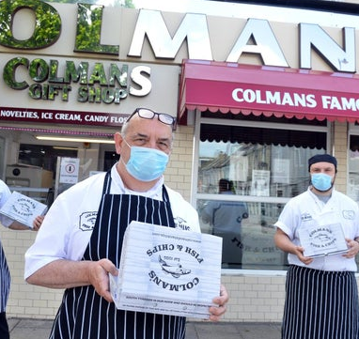
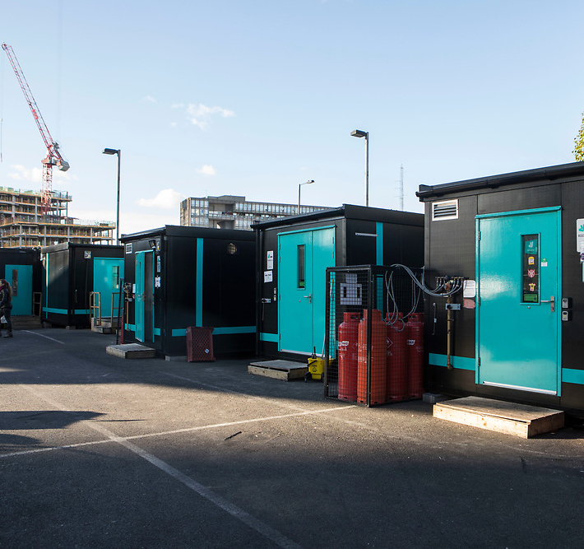
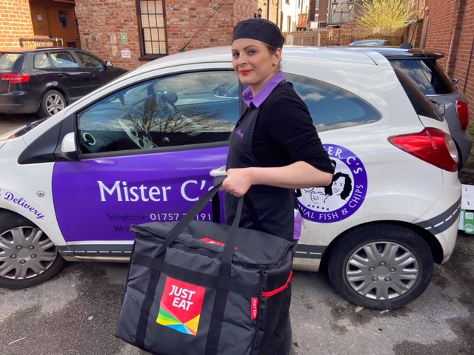
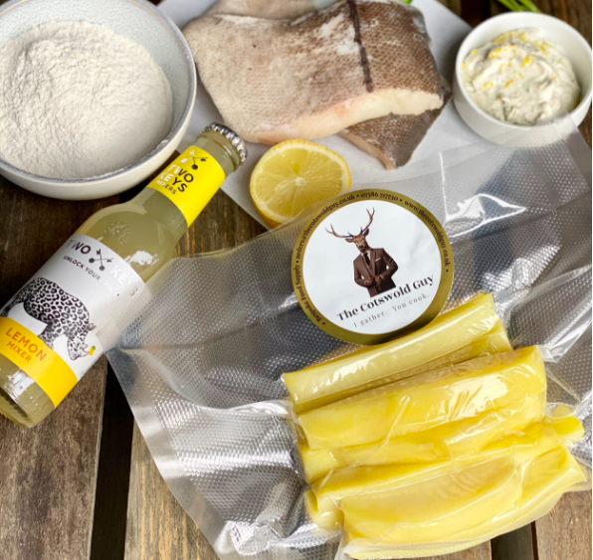
What types of innovation was seen in foodservice? Loads!
Takeaway & click and collect
Click and serve
Subscriptions & boxes
Dark/ghost kitchens
Delivery
Meal kits
Technology

Slide 8
Takeaway
& click
and collect

Slide 9
Click and serve

Slide 10
Subscriptions & boxes

Slide 11
Dark/ghost kitchens

Slide 12
Home delivery

Slide 13
Meal kits

Slide 14
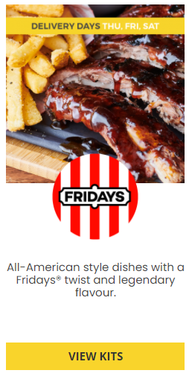
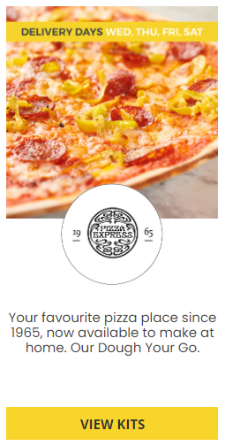
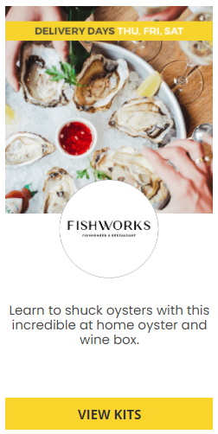
Meal kits: Great Food 2 U
Sources: Great Food 2 U, www.greatfood2u.co.uk

Slide 15
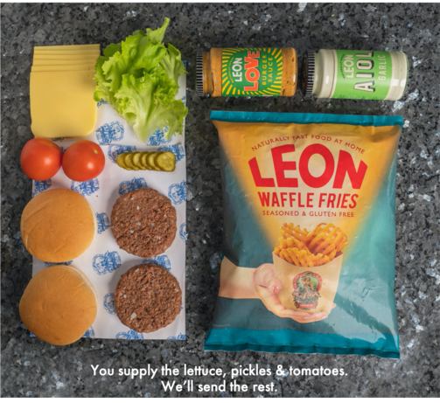
Meal kits: Leon
Sources: Leon, Love Burger, www.loveburger.co

Slide 16
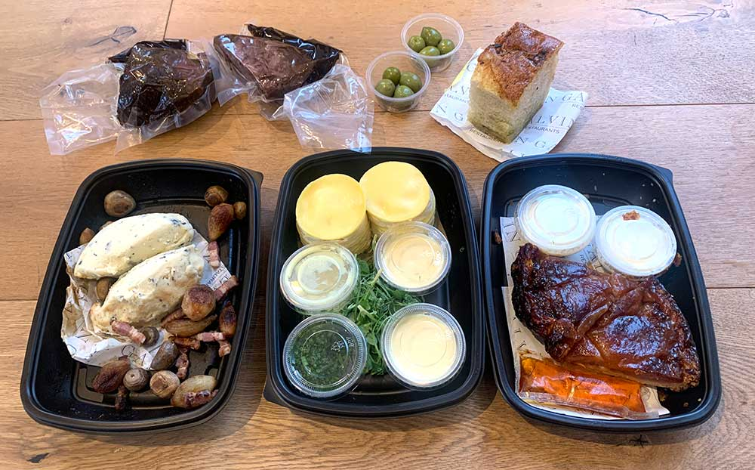
Meal kits: Galvin at Home
Sources: Galvin, www.galvinrestaurants.com/galvin-at-home and www.hotdinners.com

Slide 17
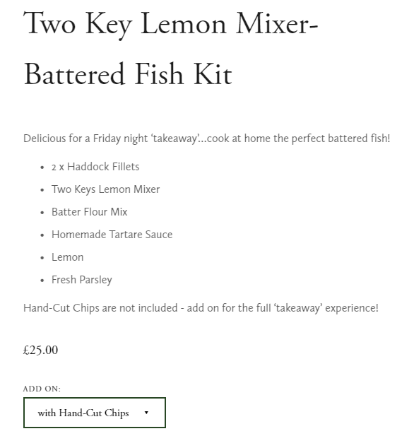
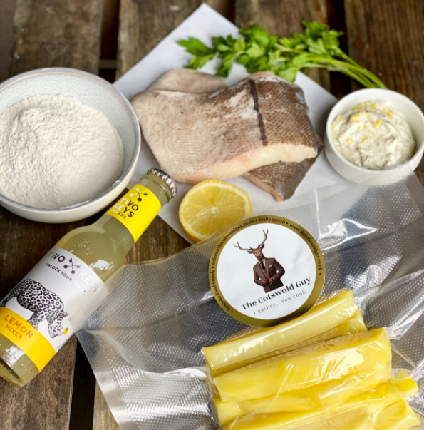
Meal kits: The Cotswold Guy
Sources: The Cotswold Guy, www.thecotswoldguy.co.uk/shop/two-key-lemon-mixer-battered-fish-amp-chips-kit

Slide 18
Technology

Slide 19
Off premise dining is growing in importance
-10.2%pts
+0.8%pts
+7.7%pts
+1.6%pts
-2.9%pts
+0.5%pts
+1.6%pts
+0.9%pts
Sources: The NPD Group Inc., Jan - Nov 2020, Foodservice in 2020

Slide 20
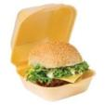
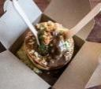
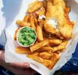
Off premise dining: top delivery food items
Pizza 26% +0.9%
Chips 18% +2.6%
Chinese 14% +2.0%
Beef 14% +2.3%
Sandwich 8.4% -2.3%
Bakery 7%
-0.3%
Indian 6.6% +0.2%
Fish 5%
-1.6%
Chicken 5% +1.1%
Wedges 3% +0.6%
Sources: The NPD Group Inc., Jan - Nov 2020, Foodservice in 2020

Slide 21
What are the opportunities as we enter 2021?
Delivery, technology and…
Delivery
Technology

Slide 22
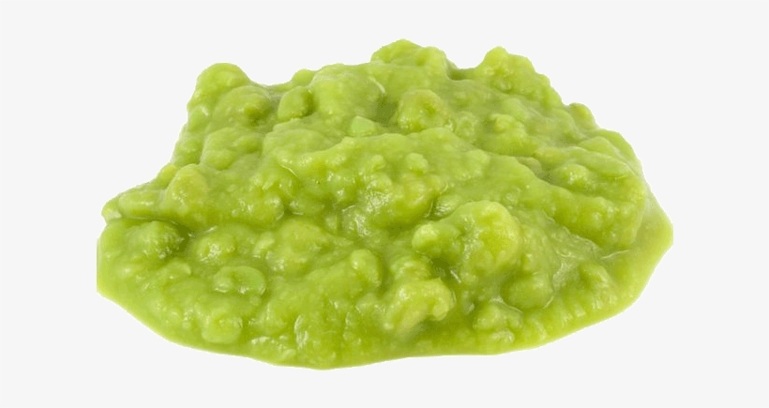
What are the opportunities as we enter 2021?
Meal deals!
Sources: Kantar, November 2020, Lockdown is eating away food takeaway and restaurant industry

Slide 23
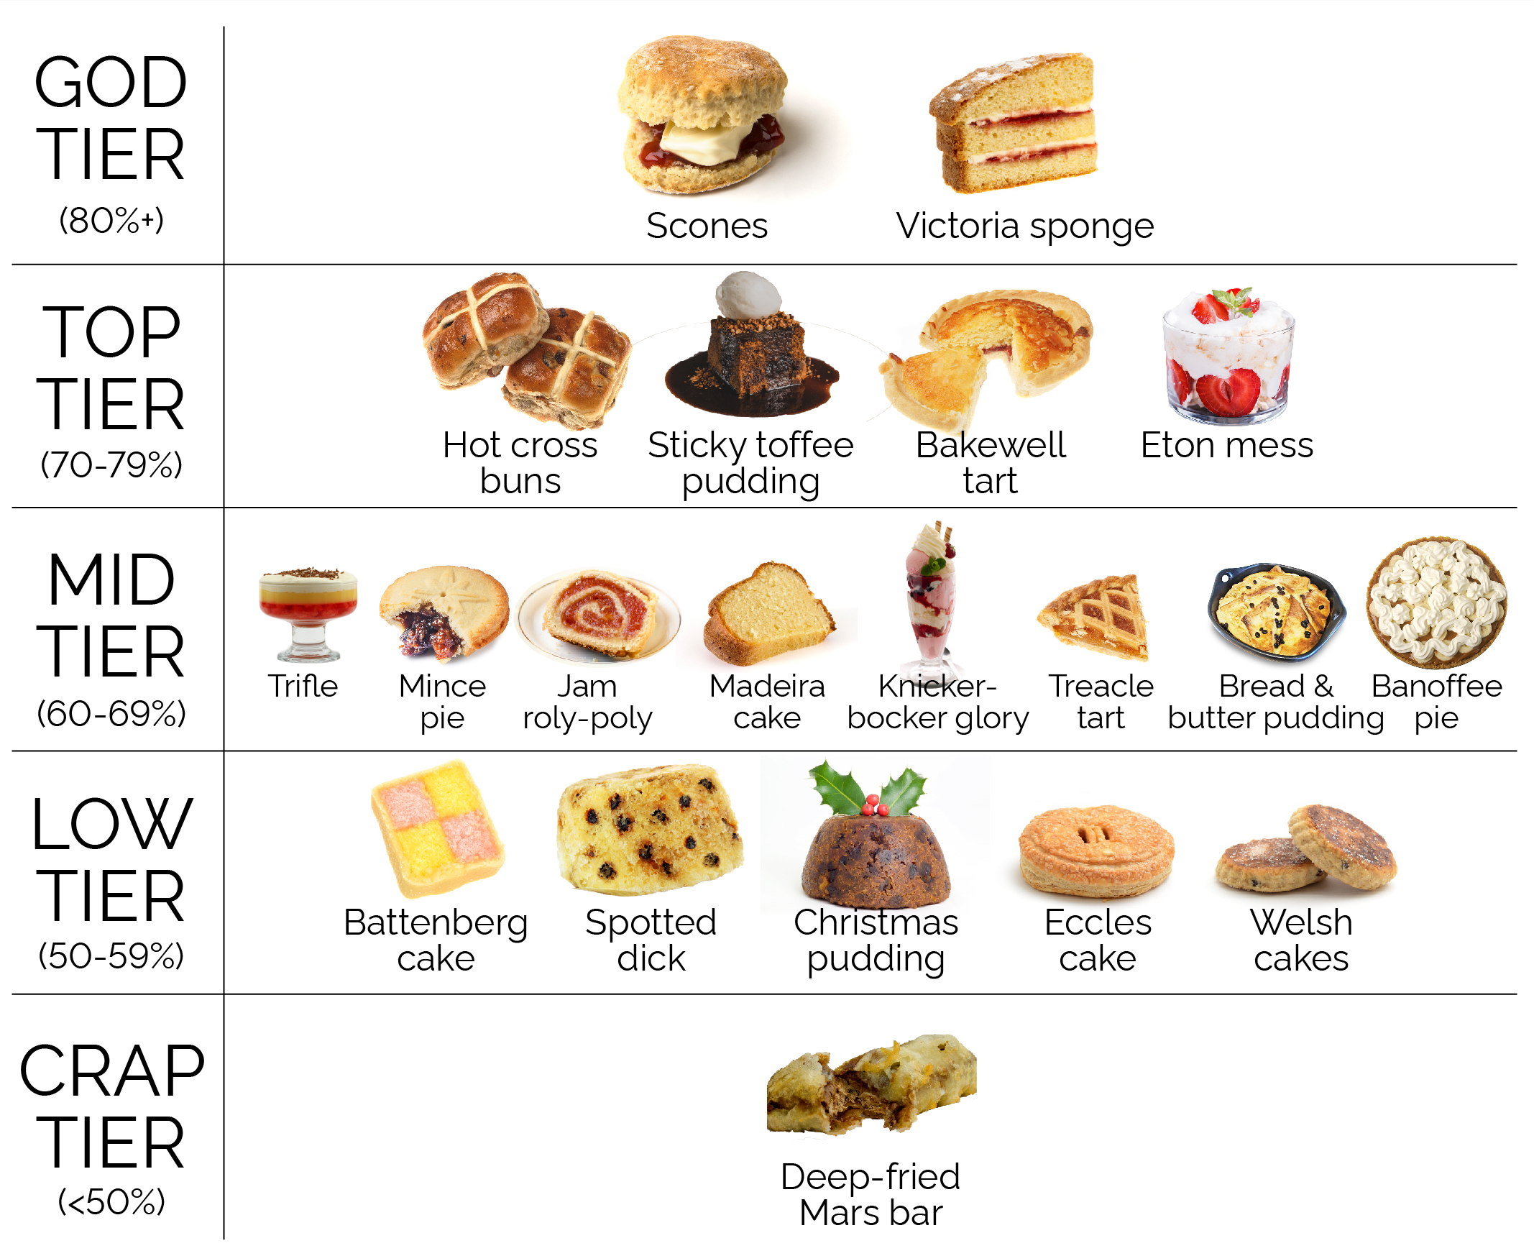
Sources: YouGov Reports, 2019, Classic British Cuisine Ranked

Slide 24
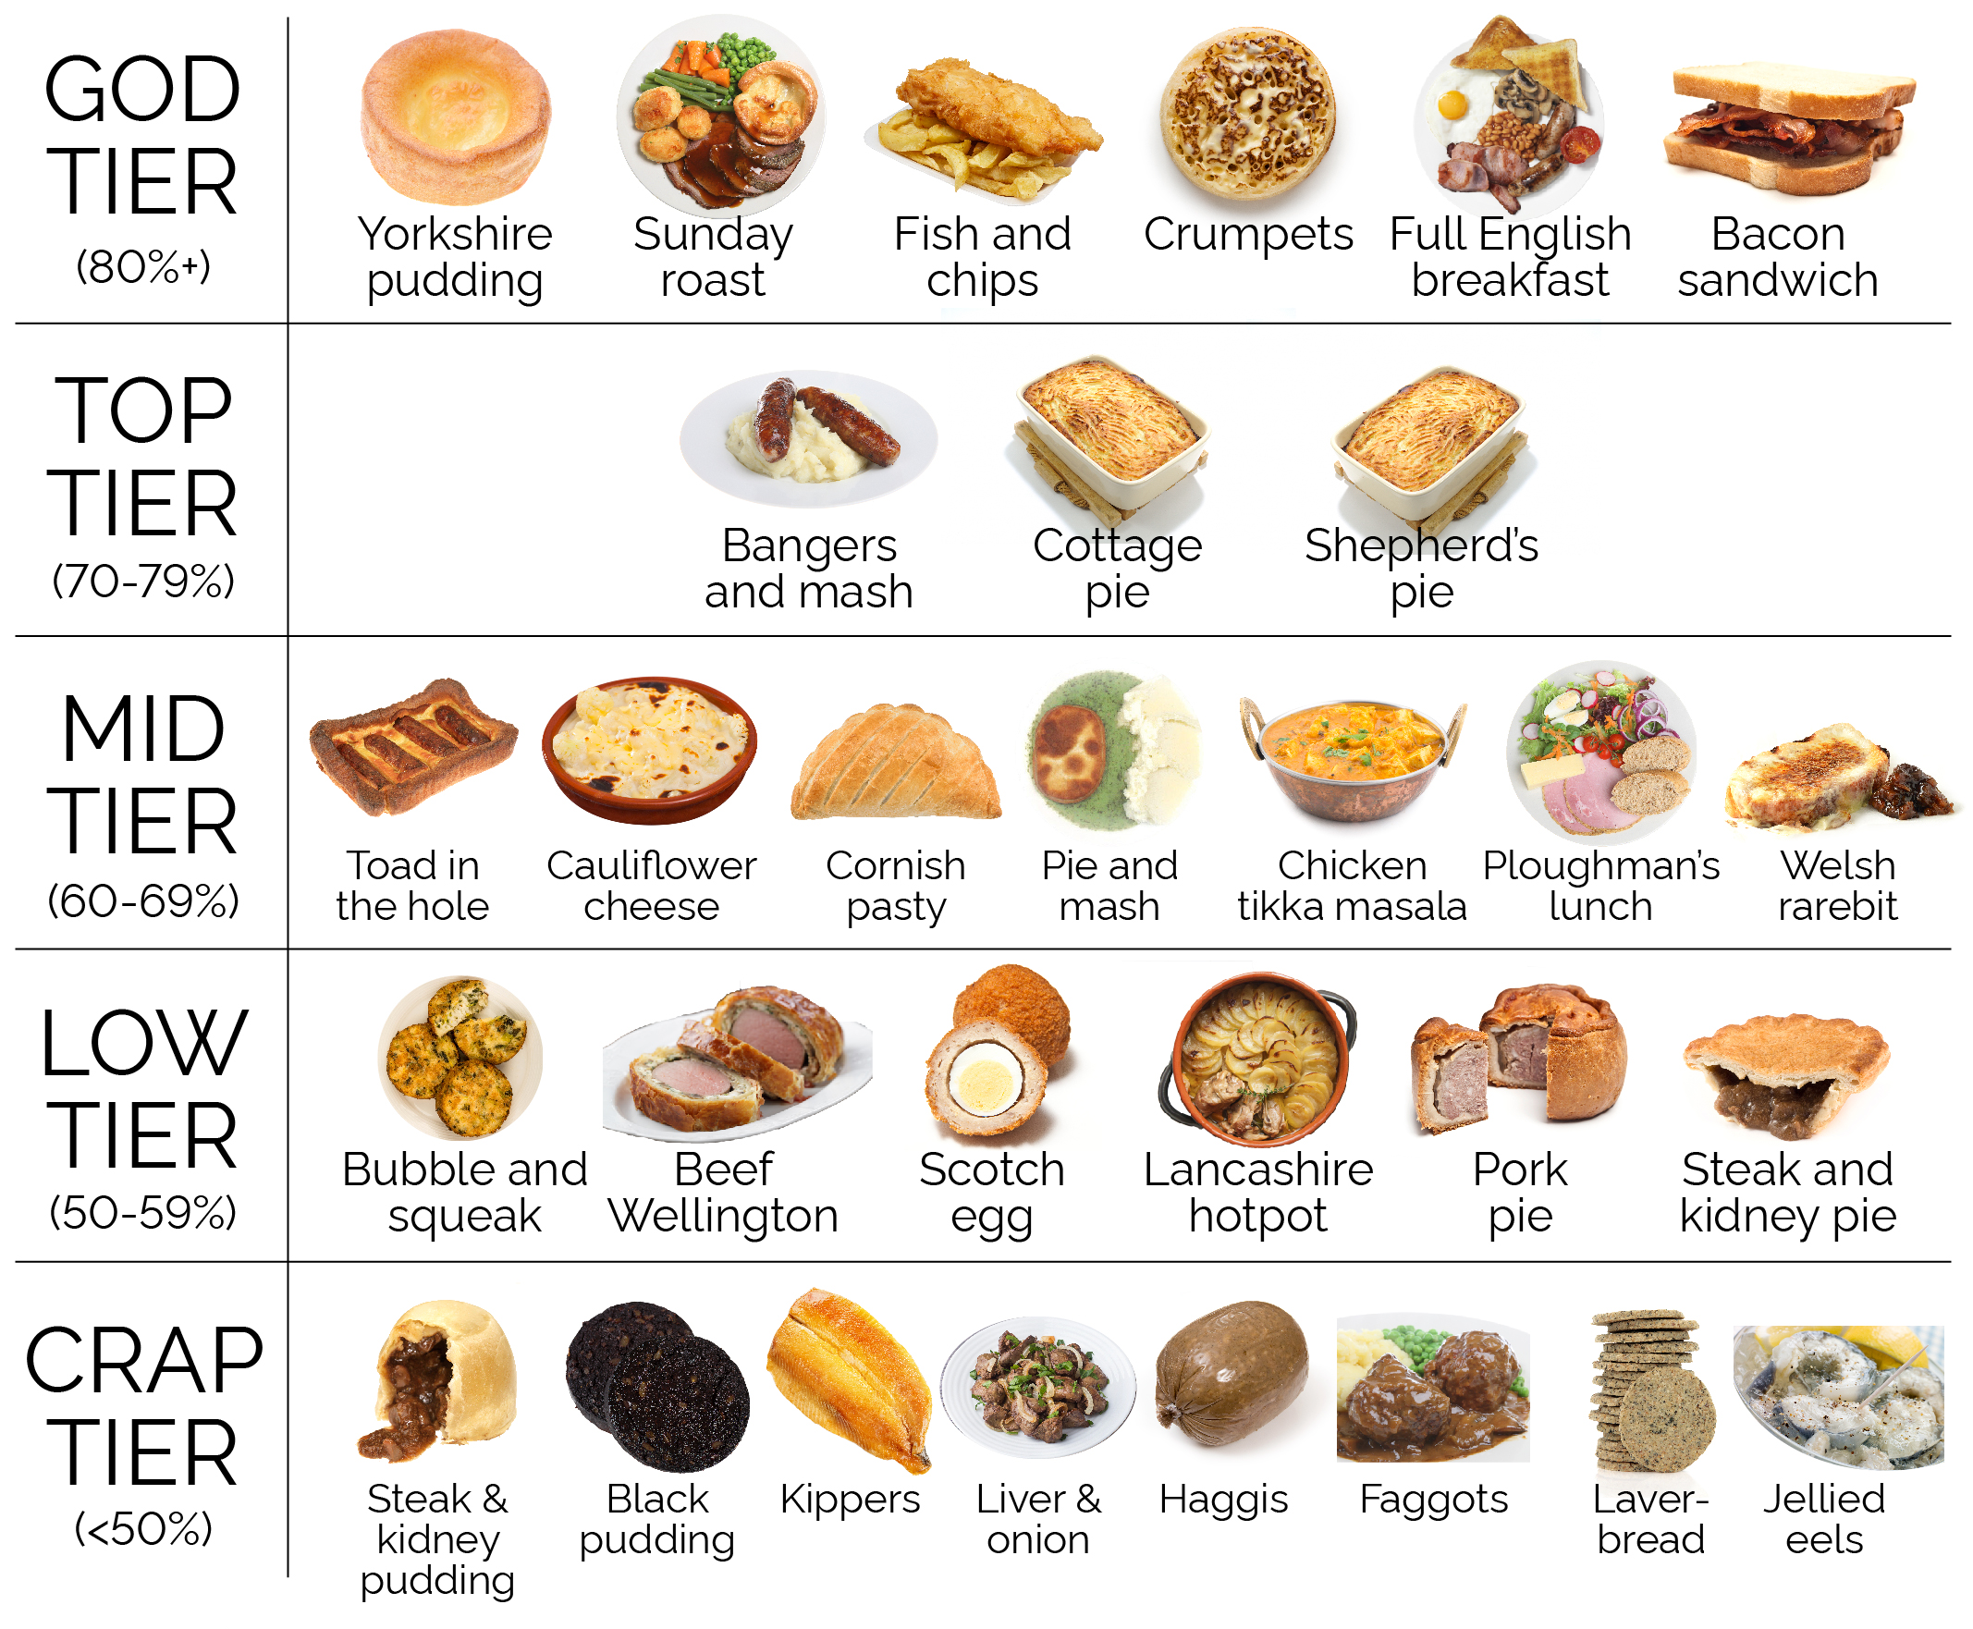
Sources: YouGov Reports, 2019, Classic British Cuisine Ranked

Slide 25
State of the Nation Webinar (TBC)
Newsletter subscription
Market Insight Portal
CLICK HERE

Slide 26
Thank you
For further details please contact:
Suzi Pegg-Darlison
Market Insight Analyst
suzanne.pegg@seafish.co.uk
+44 (0) 1472 252358 / 07944 682697

