Slide 1
Quarterly CREST Report
Data to March 2021

Slide 2
Executive Summary – GB – Q1 2021
UK GDP is estimated to have decreased by 1.5% in Q1 2021. All non-essential shops and hospitality outlets were closed in Q1 2021, apart from takeaway, drive thru and delivery services. In March, consumer confidence improved as the “roadmap to re-opening” was put in action and reached -15. Inflation was rather flat at 0.6% in the first quarter.
CREST data showed traffic was down -52% in the foodservice industry in Q1 2021, down from the -45% drop in Q4 2020. Pubs were the worst hit as lockdown practically wiped out all their visits, with Travel and Leisure as well as Workplace/Education settings suffering similar declines of near 90%. A strict national lockdown and instructions to continue to work from home have had a significant impact on these parts of the market. QSR continues to be the best performing segment, with a comparatively low -24% drop in visits, thanks to its ability to offer delivery, drive thru and takeaway services.
All dayparts saw declines in Q1 2021, with lunch hit the hardest, resulting in a -61% drop in visits. Remote working and studying have removed many of the occasions associated with workday lunch visits. Dinner was the most resilient daypart, seeing a drop of -31% in visits, driven by a strong increase in delivery orders, up +16% in Q1 2021.
Although QSR fared better than the market, individual QS segments performed differently. QS Burger visits declined by -26%, as on-premise visits were not allowed during the national lockdown. In contrast, segments with a stronger focus on delivery saw double-digit growth in visits. QS Pizza visits were up +14%, and QS Indian visits increased by +46%. Coffee bars saw the greatest drop in visits, at -41%, as consumers continued to work from home.
Visits declined for all age groups. Families (kids 0 to 15) did better than other groups, with a drop of -28% for family visits, compared with -60% for Adult Only trips. Ordering a delivery has become a regular treat for many families. Younger adults were also more active in the market than older consumers, with 16-34s seeing a -54% drop in visits, compared to -70% for 35-49s and -59% for the 50+.
2

Slide 3
Executive Summary - Seafood Q1 2021
QSR, and Fish & Chip Shops in particular, are the biggest opportunity for all seafood;
F&C Shops performed better during the pandemic than the market due to the better adaptability of the busines model and already developed takeaway and delivery;
Keeping the gains of the delivery and offering a compelling and competitive offer after the reopening will key to grow in the market. Pubs is the channel to watch.
SERVINGS AFFECTED BY LOCKDOWN
Seafood serving are only marginally less depressed than the rest of the market
All channels affected with Pubs, Travel & Leisure and Work/Education suffering the most due to lockdown restrictions
ALL CHANNELS IN DECLINE
ENGAGING WITH YOUGER CONSUMERS
Travel and Leisure, and Workplace/Education settings are convenient channels to engage with younger customers post lockdown
1/3 of Seafood visits were on deal. The price paid for seafood have increased over last 12 months: value will be important when economy re-opens.
DEAL RATES & PRICE
Source: The NPD Group/CREST®, YE Mar 21

Slide 4
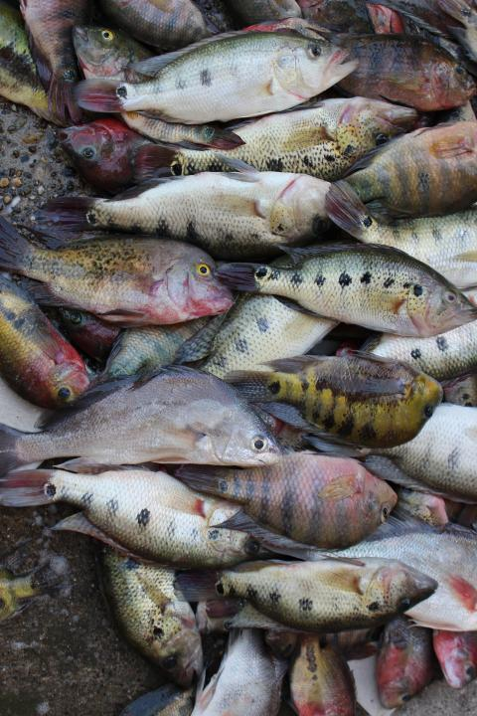
Topline Industry
& Protein Performance
Visits declined further in Q1 2021 amid national lockdown
All segments declined with Pubs, Travel & Leisure, and Workplace/Education affected the most
Fish & Chip Shops ended Q1of 2021 almost at the last year’s level of visits

Slide 5
Amid Lockdown #3, visits declined even further in Q1 2021
Total Out of Home
Components of Spending vs. Year Ago
Total Spend, Visits and Avg. Eater Check
Source: The NPD Group/CREST®, YE Mar 21
28
n.a.: Low sample / Numbers flagged grey and italic: Please read as tendencies / ++/--: pcya >+/-15%

Slide 6
Total Food and Drink Servings declined across all channels with T&L, Pubs, Work/Education, and FSR losing the most
Spend(£bn)
Visits(bn)
Av. Ind. Spend
Total Food & Drink Servings (m)
Total OOH | £30.9 | -45.4% | 5.2 | -53.6% | £6.0 | 17.5% | 12,891 | -54.7%
Pubs | £3.2 | -69.7% | 0.4 | -71.1% | £9.1 | 5.0% | 1,060 | -73.7%
FSR* | £5.7 | -53.7% | 0.5 | -59.4% | £12.0 | 13.9% | 1,377 | -63.6%
QSR** | £20.0 | -17.0% | 3.7 | -37.4% | £5.4 | 32.8% | 8,934 | -36.2%
Travel & Leisure | £1.7 | -78.0% | 0.3 | -77.0% | £6.3 | -4.2% | 691 | -77.8%
Work/Education | £0.3 | -83.6% | 0.3 | -79.3% | £0.9 | -20.4% | 761 | -76.9%
Fish & Chips | £0.9 | -18.6% | 0.2 | -24.7% | £3.8 | 8.3% | 555 | -26.0%
QSR excl. Fish & Chips | £19.1 | -17.0% | 3.5 | -38.1% | £5.5 | 34.5% | 8,379 | -36.8%
*FSR includes Café/Bistro
**QSR includes Fish & Chips
Source: The NPD Group/CREST®, YE Mar 21

Slide 7
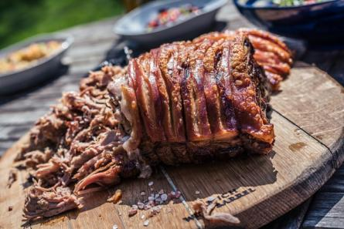
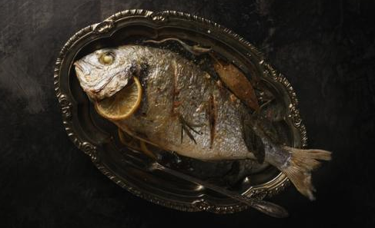
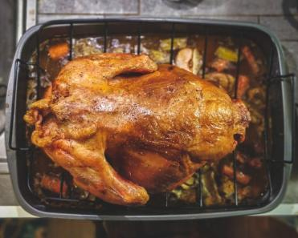
Topline Protein Performance
Both protein and non-protein servings declined
Poultry continues to be the best performing protein
Seafood declined but its incidence grew vs last year

Slide 8
Both protein and non protein visits declined in YE March 2021
Total Out of Home
Protein/Non-Protein Servings
% Servings Share
YOY Servings (%)
YOY Servings (000s)
-52.9%
-52.5%
Source: The NPD Group/CREST®, YE Mar '21

Slide 9
Each protein group saw servings decline in the last 12 months to March 2021; Pork lost share
Total Out of Home
Servings Share & YOY, and Incidence by Protein
% Incidence Change
Servings Change (000s)
0.57
-1.61
0.07
0.05
2.73
Source: The NPD Group/CREST®, YE Mar '21

Slide 10
All proteins but lamb have increased average spend
Total Out of Home
Average Individual Spend
YE Mar'21
Spend Change
YE Mar'21 vs. '20
Source: The NPD Group/CREST®, YE Mar '21

Slide 11
As before, one third of Seafood visits were on deal
Total Out of Home
Deal Rate %pts Change
YE Mar '21 vs. '20
Deal Rates %
YE Mar '21
Source: The NPD Group/CREST®, YE Mar '21

Slide 12
Topline Seafood Performance
All segments were negatively affected by lockdown
Pubs, Workplace/Education, and T&L are the segments hit the hardest due to work from home, lockdown closures, and travel restrictions

Slide 13
Q1 2021 Seafood visits were depressed even more than in Q4’20, but spend fared better due to growth in average cheque
Seafood Only
Components of Spending vs. Year Ago
Total Spend, Visits and Avg. Eater Check
 | Q1 19 | Q2 19 | Q3 19 | Q4 19 | Q1 20 | Q2 20 | Q3 20 | Q4 20 | Q1 21 |  | YE Mar 19 | YE Mar 20 | YE Mar 21
Visits, m | 243.2 | 271.3 | 276.8 | 263.4 | 215.1 | 51.5 | 180.5 | 156.9 | 117.3 |  | 1,032.6 | 1,026.5 | 506.1
Total Spend, £m | 833.3 | 1,227.8 | 1,057.9 | 1,150.3 | 823.1 | 271.7 | 815.5 | 658.5 | 713.2 |  | 4,380.3 | 4,183.2 | 2,512.4
Avg. Eater Check, £ | 3.43 | 4.53 | 3.82 | 4.37 | 3.83 | 5.28 | 4.52 | 4.20 | 6.08 |  | 4.24 | 4.08 | 4.96
Source: The NPD Group/CREST®, YE Mar 21
28
n.a.: Low sample / Numbers flagged grey and italic: Please read as tendencies / ++/--: pcya >+/-15%

Slide 14
In the past 12 months seafood visits declined the most in Workplace and Pub settings due to closures, restrictions and working from home
Seafood Visits (bn)
Seafood Servings (bn)
Total OOH | 0.51 | -50.7% | 0.57 | -51.2%
Total QSR | 0.34 | -32.9% | 0.37 | -33.2%
QSR excl. Fish & Chip Shops | 0.19 | -41.6% | 0.22 | -41.0%
QSR Fish & Chip Shops | 0.15 | -16.2% | 0.15 | -17.8%
Pubs | 0.04 | -73.0% | 0.05 | -73.4%
Full Service(incl. Cafe/Bistro) | 0.06 | -58.0% | 0.08 | -58.9%
Workplace/College/Uni | 0.02 | -72.8% | 0.03 | -70.1%
Travel & Leisure | 0.04 | -69.9% | 0.05 | -69.7%
Source: The NPD Group/CREST®, YE Mar '21

Slide 15
QSR share grew to 68% of all OOH visits and 38% of all seafood servings. 37% of seafood sold through F&C shops
Total Out of Home
Channel Shares Incidence
Source: The NPD Group/CREST®, YE Mar '21

Slide 16
Fish & Chips Shops hugely rely on dinner; Lunch is under-represented
Total Out of Home
Servings % by Daypart
Source: The NPD Group/CREST®, YE Mar '21

Slide 17
Fridays and Saturdays are over-represented at F&C Shops
Total Out of Home
Servings % by Day of the Week
Source: The NPD Group/CREST®, YE Mar '21

Slide 18
Quick Service
QSR visits decline improved further to “only” -23.6% in Q1 2021
Seafood lost servings but gained incidence; poultry is the protein that has gained the most incidence during the pandemic

Slide 19
In QSR visits recovered to 76.4% of pre-lockdown
QSR
Total Quick Service
Components of Spending vs. Year Ago
Total Spend, Visits and Avg. Eater Check
Source: The NPD Group/CREST®, YE Mar '21
140
slide 4
n.a.: Low sample / Numbers flagged grey and italic: Please read as tendencies / ++/--: pcya >+/-15%

Slide 20
Seafood incidence in QSR grew in the last 12 months
QSR
Servings Share & YOY, and Incidence by Protein
% Incidence Change
1.10
-3.90
0.60
-0.90
2.60
Source: The NPD Group/CREST®, YE Mar '21

Slide 21
Fried Fish share grew to nearly half of the QSR seafood market
QSR
Servings % Share
% Contribution to Growth
Source: The NPD Group/CREST®, YE Mar '21

Slide 22
Average individual spend continued to grow in the last 12 months; Seafood was growing the most
QSR
Average Individual Spend
YE Mar'21
Spend Change
YE Mar'21 vs. '20
Source: The NPD Group/CREST®, YE Mar '21

Slide 23
Seafood Sandwiches are the largest sub-type in QSR, but lost some share due to closures and less commute
QSR
Incidence by Seafood Type/Species
YE Mar '21
YE Mar 21 vs. 20 Positive
YE Mar 21 vs. 20 Negative
Source: The NPD Group/CREST®, YE Mar '21

Slide 24
Deal rates at QSR have decreased the most for Seafood over last 12 months
QSR
Deal Rates %
YE Mar '21
Deal Rate Ppt Change
YE Mar '21 vs. '20
Source: The NPD Group/CREST®, YE Mar '21

Slide 25
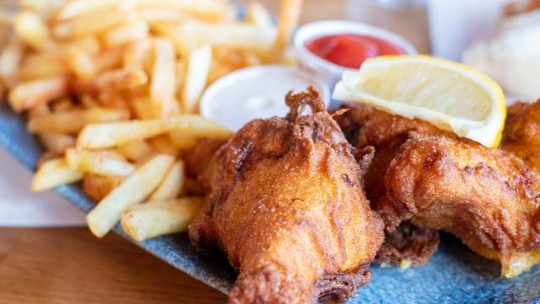
Fish & Chip Shops
Visits to Fish & Chip Shops nearly recovered to pre-pandemic levels in Q1 of 2021
Seafood represents 70% of protein sold in F&C Shops and its incidence grew substantially in Q1/21

Slide 26
Visit to Fish & Chip Shops declined only by -0.2% in Q1 – the best performance in the market
F&C
Components of Spending vs. Year Ago
Total Spend, Visits and Avg. Eater Check
Source: The NPD Group/CREST®, YE Mar '21

Slide 27
Seafood is the largest protein for Fish & Chip Shops, and it gained its share over the last 12 months
F&C
Servings Share & YOY, and Incidence by Protein
% Incidence Change
5.60
0.40
-0.40
0.40
-3.40
Source: The NPD Group/CREST®, YE Mar '21

Slide 28
Fried Fish is the largest product group for Fish & Chip Shops and thus declined the most
F&C
Servings % Share
% Contribution to Growth
Source: The NPD Group/CREST®, YE Mar '21

Slide 29
Cod is the most popular of at Fish and Chip Shops; haddock losing its share
F&C
Incidence by Seafood Type/Species
YE Mar '21
YE Mar 21 vs. 20 Positive
YE Mar 21 vs. 20 Negative
Source: The NPD Group/CREST®, YE Mar '21

Slide 30
Seafood’s average spend has grown the most in the past year to March 2021
F&C
Average Individual Spend
YE Mar'21
Spend Change
YE Mar'21 vs. '20
Source: The NPD Group/CREST®, YE Mar '21

Slide 31
Seafood deal rate within the Fish & Chip Shops has declined insignificantly in 12 months to March 2021
F&C
Deal Rates %
YE Mar '21
Deal Rate Ppt Change
YE Mar '21 vs. '20
Source: The NPD Group/CREST®, YE Mar '21

Slide 32
Quick Service excl. Fish & Chip Shops
QS excl. Fish and Chip Shops decline slowed down to -25%;
The recovery in Q1 was halted by the national lockdown

Slide 33
QSR excl. Fish and Chip Shops declined by 24.9% in Q1 2021
QSR
(excl. F&C)
Components of Spending vs. Year Ago
Total Spend, Visits and Avg. Eater Check
Source: The NPD Group/CREST®, YE Mar '21

Slide 34
Poultry and Beef had the biggest servings share in QSR excl. F&C Shops in the last 12 months; seafood is down to 8.7%.
QSR
(excl. F&C)
Servings Share & YOY, and Incidence by Protein
% Incidence Change
-0.50
-4.00
0.70
-0.60
3.90
Source: The NPD Group/CREST®, YE Mar '21

Slide 35
Non-fried Fish is the largest category in the QSR excl. Fish & Chip Shops; Shellfish share increased over last year
QSR
(excl. F&C)
Servings % Share
% Contribution to Growth
Source: The NPD Group/CREST®, YE Mar '21

Slide 36
Seafood Sandwiches is the most important sub-category, but its share declined
QSR
(excl. F&C)
Incidence by Seafood Type/Species
YE Mar '21
YE Mar 21 vs. 20 Positive
YE Mar 21 vs. 20 Negative
Source: The NPD Group/CREST®, YE Mar '21

Slide 37
Seafood products have seen significant increase in individual spend of £1.60 over year ago
QSR
(excl. F&C)
Average Individual Spend
YE Mar'21
Spend Change
YE Mar'21 vs. '20
Source: The NPD Group/CREST®, YE Mar '21

Slide 38
All proteins with the exception of beef are seeing slight deal rates decrease in the last year
QSR
(excl. F&C)
Deal Rates %
YE Mar '21
Deal Rate PPT Change
YE Mar '21 vs. '20
Source: The NPD Group/CREST®, YE Mar '21

Slide 39
Pubs
Pubs remained closed in Q1 of 2021
12-month seafood incidence is rather stable while pork gained share; largest losses in servings are among (the largest in share) pork and beef items

Slide 40
Pub visits got annihilated to almost zero in Q1/2021 amid lockdown
Pubs
Components of Spending vs. Year Ago
Total Spend, Visits and Avg. Eater Check
Source: The NPD Group/CREST®, YE Mar '21
228
n.a.: Low sample / Numbers flagged grey and italic: Please read as tendencies / ++/--: pcya >+/-15%

Slide 41
Seafood incidence is rather stable while pork gained share
Pubs
Servings Share & YOY, and Incidence by Protein
% Incidence Change
-0.30
5.80
-1.10
-3.70
0.00
Source: The NPD Group/CREST®, YE Mar '21

Slide 42
Non-fried fish share grew in the last 12 months
Pubs
Servings % Share
% Contribution to Growth
Source: The NPD Group/CREST®, YE Mar '21

Slide 43
Cod and Salmon are the most popular fish species in Pubs
Pubs
Incidence by Seafood Type/Species
YE Mar '21
YE Dec 21 vs. 20 Positive
YE Mar 21 vs. 20 Negative
Source: The NPD Group/CREST®, YE Mar '21

Slide 44
Average cheque in Pubs has increased only marginally, seafood spend is increasing ahead of the market
Pubs
Average Individual Spend
YE Mar'21
Spend Change
YE Mar'21 vs. '20
Source: The NPD Group/CREST®, YE Mar '21

Slide 45
Different to other segments, Pubs have seen an increase in the percentage of deal/promotions
Pubs
Deal Rates %
YE Mar '21
Deal Rate Ppt Change
YE Mar '21 vs. '20
Source: The NPD Group/CREST®, YE Mar '21

Slide 46
Full Service (Including Café/Bistro)
Visit losses intensified in Q1 of 2021 amid lockdown
Seafood incidence were stable over the last 12 months

Slide 47
Visits to Full Service restaurants slumped in Q1/21 due to lockdown
FSR
Components of Spending vs. Year Ago
Total Spend, Visits and Avg. Eater Check
Source: The NPD Group/CREST®, YE Mar '21
185

Slide 48
Seafood incidence stayed unchanged in Full Service over last 12 months
FSR
Servings Share & YOY, and Incidence by Protein
% Incidence Change
0.00
-0.30
-1.40
-0.60
3.90
Source: The NPD Group/CREST®, YE Mar '21

Slide 49
Fried fish and other products with fish-based fillings showed growth over last 12 months
FSR
Servings % Share
% Contribution to Growth
Source: The NPD Group/CREST®, YE Mar '21

Slide 50
Salmon is the most important species in full service restaurants, followed by shellfish
FSR
Incidence by Seafood Type/Species
YE Mar '21
YE Mar 21 vs. 20 Positive
YE Mar 21 vs. 20 Negative
Source: The NPD Group/CREST®, YE Mar '21

Slide 51
The data shows that Seafood individual spend grew the slowest over last 12 months
FSR
FSR
Average Individual Spend
YE Mar'21
Spend Change
YE Mar'21 vs. '20
Source: The NPD Group/CREST®, YE Mar '21

Slide 52
Seafood deal rates were ahead of all other proteins but beef but were growing the slowest
FSR
Deal Rates %
YE Mar '21
Full Service Restaurants
Deal Rate Ppt Change
YE Mar '21 vs. '20
Source: The NPD Group/CREST®, YE Mar '21

Slide 53
Travel & Leisure
Travel & Leisure visits were nearly wiped out in Q1 after some recovery in Q4 with travel at its lowest in years
Seafood increased incidence in 12 months to March’21

Slide 54
Travel & Leisure visits are the slowest to recover with tourism still at historically low level
T&L
Components of Spending vs. Year Ago
Total Spend, Visits and Avg. Eater Check
Source: The NPD Group/CREST®, YE Mar '21
77
slide 4

Slide 55
Seafood servings in Travel and Leisure grew in incidence
T&L
Servings Share & YOY, and Incidence by Protein
% Incidence Change
3.60
-5.50
-0.60
5.10
-2.90
Source: The NPD Group/CREST®, YE Mar '21

Slide 56
Fish, both fried and non-fried, lost share
T&L
Servings % Share
% Contribution to Growth
Source: The NPD Group/CREST®, YE Mar '21

Slide 57
Seafood individual spend has stayed stable in Travel and Leisure over last 12 months to March 2021
T&L
Average Individual Spend
YE Mar'21
Spend Change
YE Mar'21 vs. '20
Source: The NPD Group/CREST®, YE Mar '21

Slide 58
Deal rates for Seafood are on par with the market for proteins
T&L
Deal Rates %
YE Mar '21
Deal Rate Ppt Change
YE Mar '21 vs. '20
Source: The NPD Group/CREST®, YE Mar '21

Slide 59
Workplace & Education
It’s one of the biggest losers of Q1 with a lot of people still working from home
Seafood gained incidence, while pork and lamb lost

Slide 60
Traffic recovered somewhat after an almost 90% decline in Q2, but still only a third of last year’s
W&E
Workplace & Education
Components of Spending vs. Year Ago
Total Spend, Visits and Avg. Eater Check
Source: The NPD Group/CREST®, YE Mar '21

Slide 61
In a significantly smaller market seafood gained incidence
W&E
Servings Share & YOY, and Incidence by Protein
% Incidence Change
2.40
-2.30
-0.30
3.60
0.40
Source: The NPD Group/CREST®, YE Mar '21

Slide 62
Seafood Performance
& Demographics by Type
Socialising is still the most important motivation when choosing Seafood while eating out;
Convenance is lagging behind the market, especially at QSR
Fried Fish has increased its share in the last 12 months due to better performance of F&C Shops where it dominates
Seafood doesn’t attract its fare share of younger consumers. Pubs and Fish & Chip Shops have the largest proportion of older customers

Slide 63
Socialising is still the most important motivation when choosing Seafood while eating out
Index – Seafood vs. Total Food/Drink
Motivation for Eating/Drinking Visit OOH
 | Total OOH | Pubs | FSR | QSR | Fish & Chips | QSR excl. Fish & Chips
Convenience | 97 | 135 | 106 | 90 | 104 | 121
Functional | 104 | 76 | 88 | 108 | 97 | 105
Socialising | 125 | 116 | 116 | 119 | 101 | 103
Treating | 94 | 71 | 86 | 98 | 94 | 77
Source: The NPD Group/CREST®, YE Mar '21

Slide 64
QSR is still the major opportunity to improve the appeal of seafood
Total Seafood
Visits SWOT Analysis
O
S
Over/Under-Perform vs Total Channel Growth
W
T
Over/Under-Trade vs Channel Share of OOH
Bubble Size Represents Channel % Share of Seafood
Source: The NPD Group/CREST®, YE Mar '21

Slide 65
Fried Fish has increased its share due to better performance of F&C Shops than the rest of the market
Total Out of Home
Servings % Share
Source: The NPD Group/CREST®, YE Mar '21

Slide 66
More than half of all servings are consumed by 35+ year olds. Pubs and F&C Shops attract older crowd
Demographic Map – Servings by Channels & Types
% Servings Aged Over 35
% Servings Social Class ABC1
Source: The NPD Group/CREST®, YE Mar '21

Slide 67
Travel & Leisure, and Fish & Chip Shops are performing very well with kids
% Servings Involving Kids
Note: Low Sample sizes - use data cautiously: Work/Edu; Shellfish Fish & Chips.
Source: The NPD Group/CREST®, YE Mar '21

Slide 68
Fried Fish grew importance amid pandemic and better performance of QSR; Non-Fried Fish lost importance (due to FSR closures)
Total Seafood
Incidence and %pt Change by Type
Growingly Important but less Important overall
Growingly Important and more Important overall
% pt Incidence Change
Lessening Importance and less Important overall
Lessening Importance but more Important overall
% Incidence
Source: The NPD Group/CREST®, YE Mar '21

Slide 70
CREST Measures
Measure | Question answered
Sales | How much did the guests spend overall in the foodservice Market?
Visits | How many guests went to the restaurants?
Average Eater Check | What did the guests spend on average during a restaurant visit?
Average number of items | How many items did the guests order on average?
Average price per item | What was the average price of each product?
Servings | How many portions of a product were sold?
Incidence | What is the importance of a product in the Market?

Slide 71
CREST Calculations
Measure | Question answered
Average Price Per Item | Average Individual Spend divided by Items per Eater
Incidence | Simply stated, the %of orders (or visits) that include a specific food or beverage item, group of items, or category of items. A pure measure of item importance (e.g. on a scale from 1-100 how important is this item)
Index | Reflects the relative importance of a specific variable (e.g. demo, occasion segment, etc.)
Contribution to Growth/Marline | CTG and/or CTD = % of visit or servings growth/Marline sourced to a specific variable (e.g. demo, occasion segment, etc.)
% Change vs. Same Period Year Ago | YOY or PCYA the % change vs. same time period year ago (e.g. annual, quarter, month, etc.).

