Slide 1
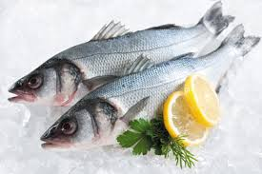
Sea Fish – Frozen fish by Species
Data to WE 18.06.2022
Presenter’s Name
Date

Slide 2
Contents
Category Overview
KPIs of Frozen Fish by Species
Shifting – Frozen Fish by Species
Demographics – Frozen Fish by Species

Slide 3
CATEGORY OVERVIEW

Slide 4
Category decline IN TERMS OF VOLUME is driven by chilled and frozen segments, BUT largely from Frozen (-14M).
Fish| Segment Trends (Volume) | Total Coverage UK including Discounters | MAT TY vs YA - Data to WE 18.06.2022
Source – Nielsen Scantrack, Data to WE 18.06.2022

Slide 5
Same trend is followed In terms of value
Fish| Segment Trends (Value)| Total Coverage UK including Discounters| MAT TY vs YA - Data to WE 18.06.2022
Source – Nielsen Scantrack, Data to WE 18.06.2022

Slide 6
Frozen Fish declines in Value, Volume and Units compared to YA as Price increases
Fish| Frozen Fish Trends | Total Coverage UK including Discounters | 3 x MAT to 18.06.2022
Source – Nielsen Scantrack, Data to WE 18.06.2022

Slide 7
MARKET SUMMARY

Slide 8
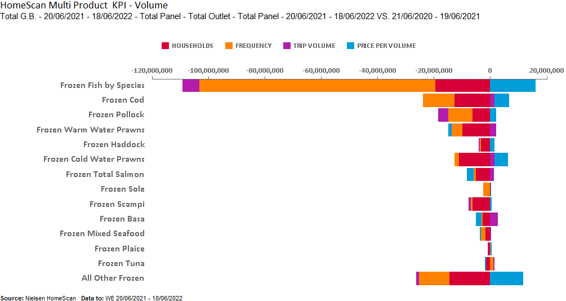
TOTAL FROZEN FISH – KPI’S BY SPECIES SUMMARY
Frozen Fish category declining through increased Price and decrease in frequency and households

Slide 9
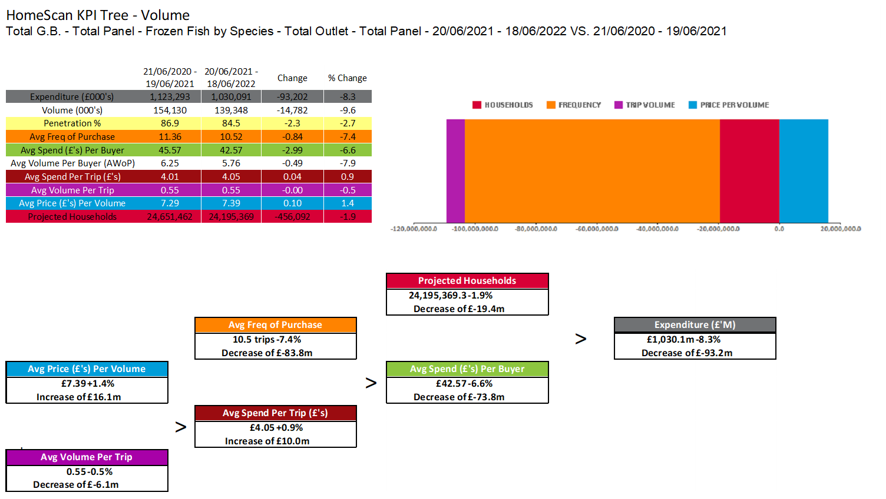
TOTAL FROZEN FISH
Frozen Fish value decreases by -93.2M by reduced Frequency(-7.4%)
Source – Nielsen Homescan, Data to WE 18.06.2022

Slide 10
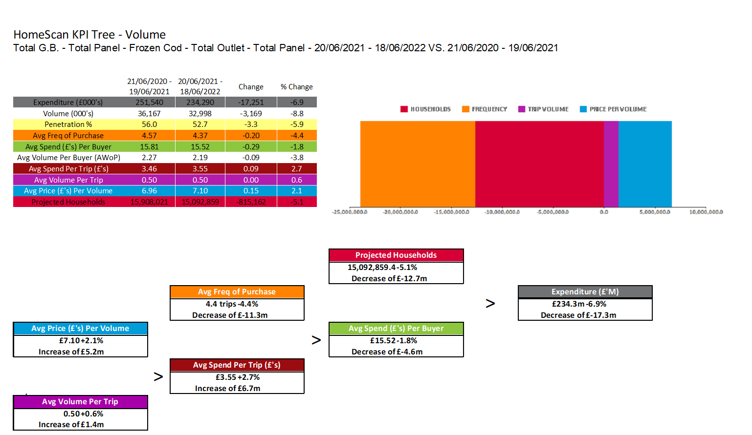
FROZEN COD
Decreased Penetration and buyers caused Frozen COD decline.
Source – Nielsen Homescan, Data to WE 18.06.2022

Slide 11
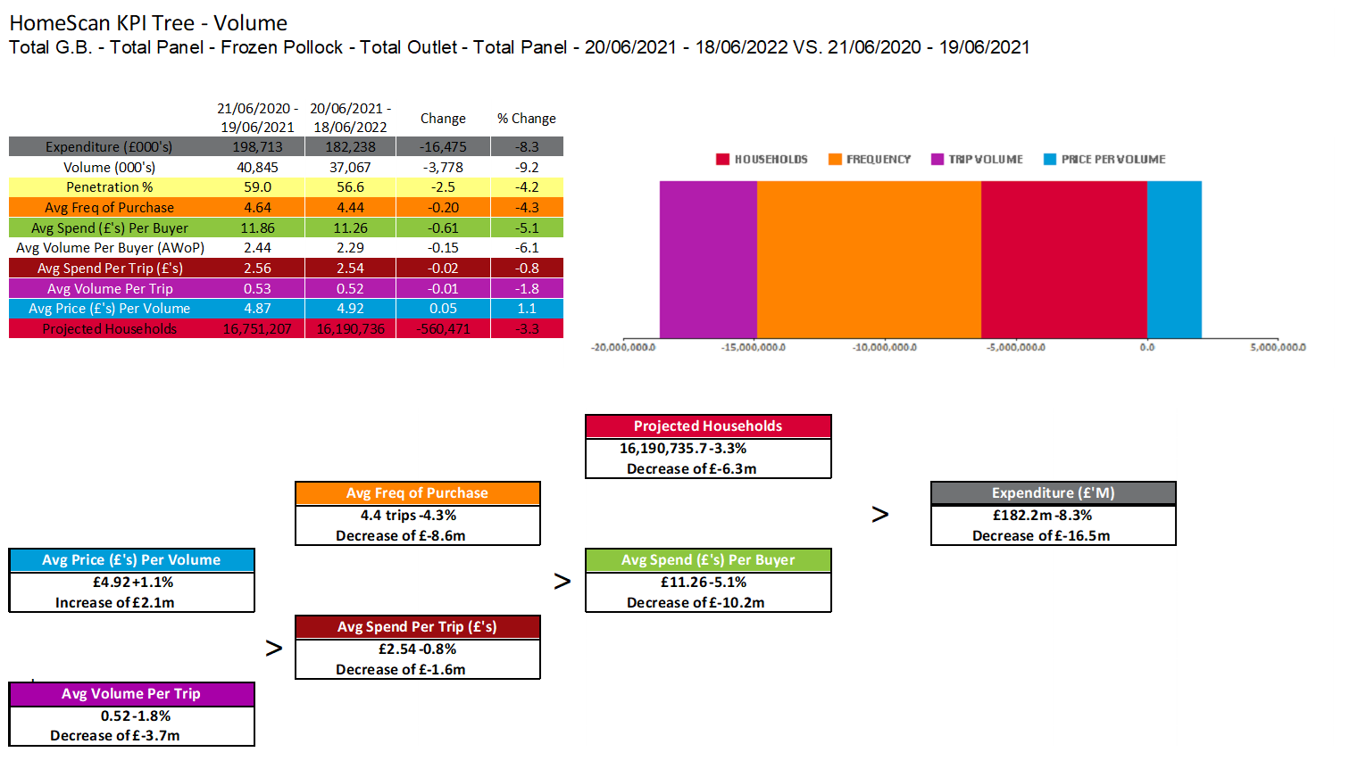
FROZEN POLLOCK
AWOP decrease caused decline in Frozen Pollock
Source – Nielsen Homescan, Data to WE 18.06.2022

Slide 12
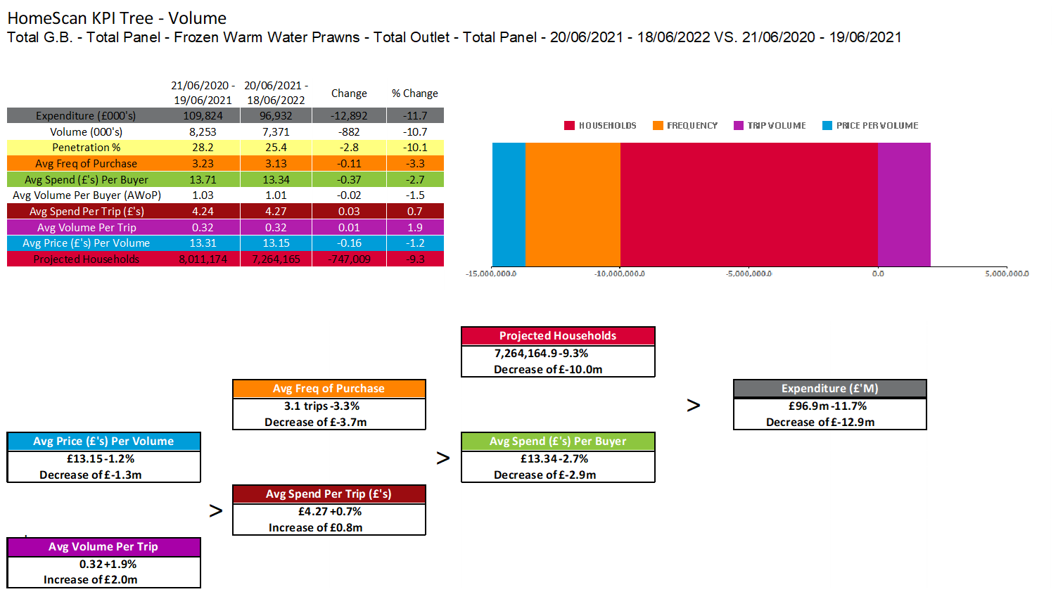
FROZEN WARM WATER PRAWNS
Reduced Penetration along with frequency results in decline of Frozen Warm Water Prawns
Source – Nielsen Homescan, Data to WE 18.06.2022

Slide 13
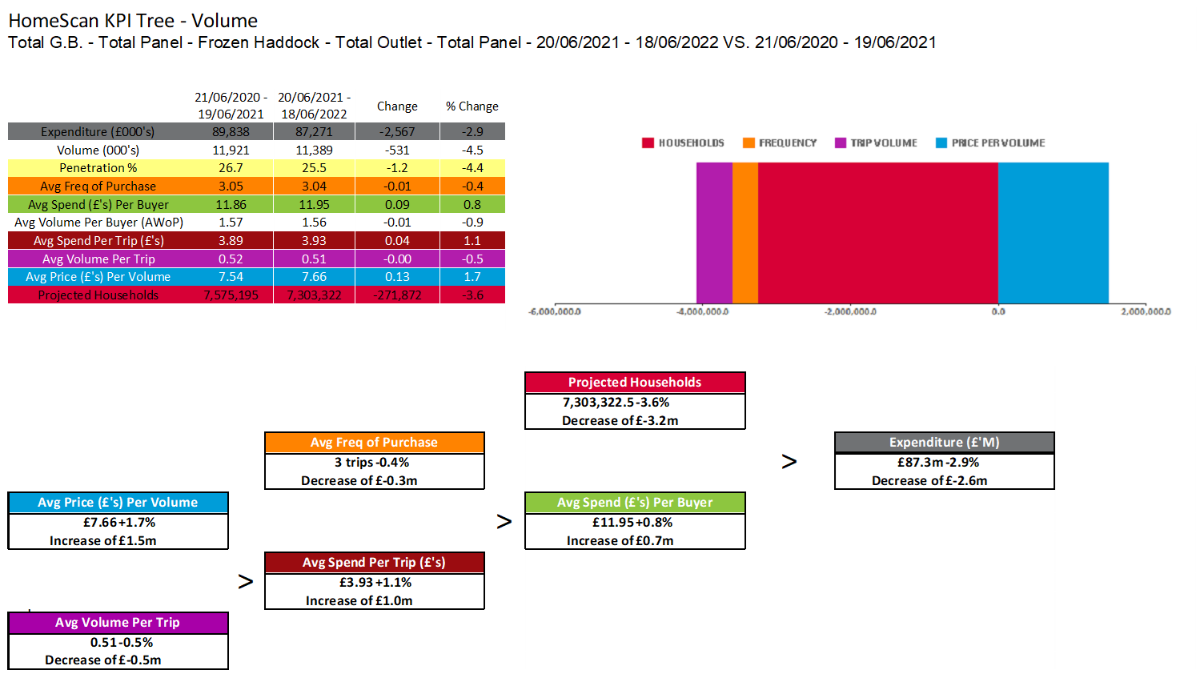
FROZEN HADDOCK
Decrease in buyers(-3.6%) results in Frozen Haddock decline of £2.6m
Source – Nielsen Homescan, Data to WE 18.06.2022

Slide 14
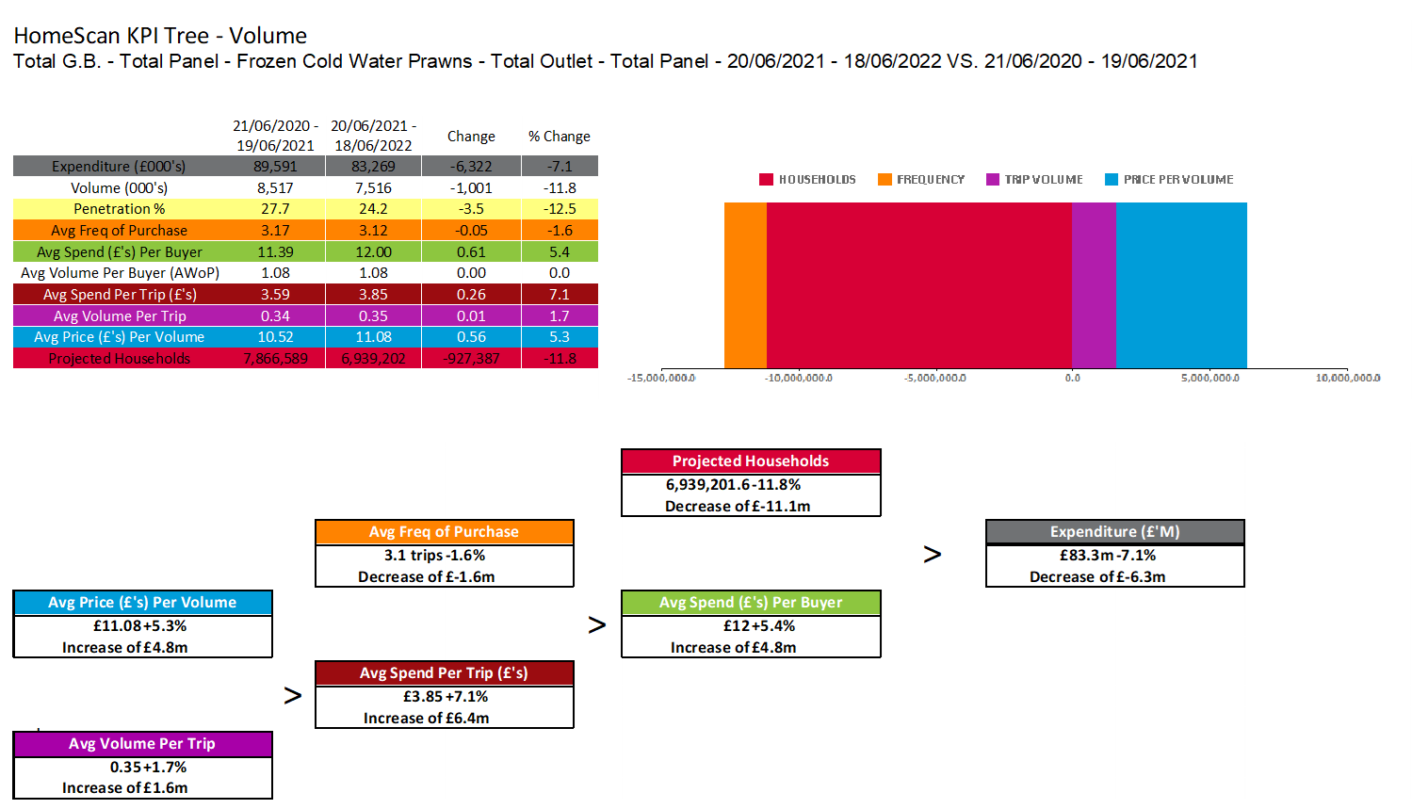
FROZEN COLD WATER PRAWNS
Increase in price(+5.3%) and decline in buyers caused cold water prawns decline
Source – Nielsen Homescan, Data to WE 18.06.2022

Slide 15
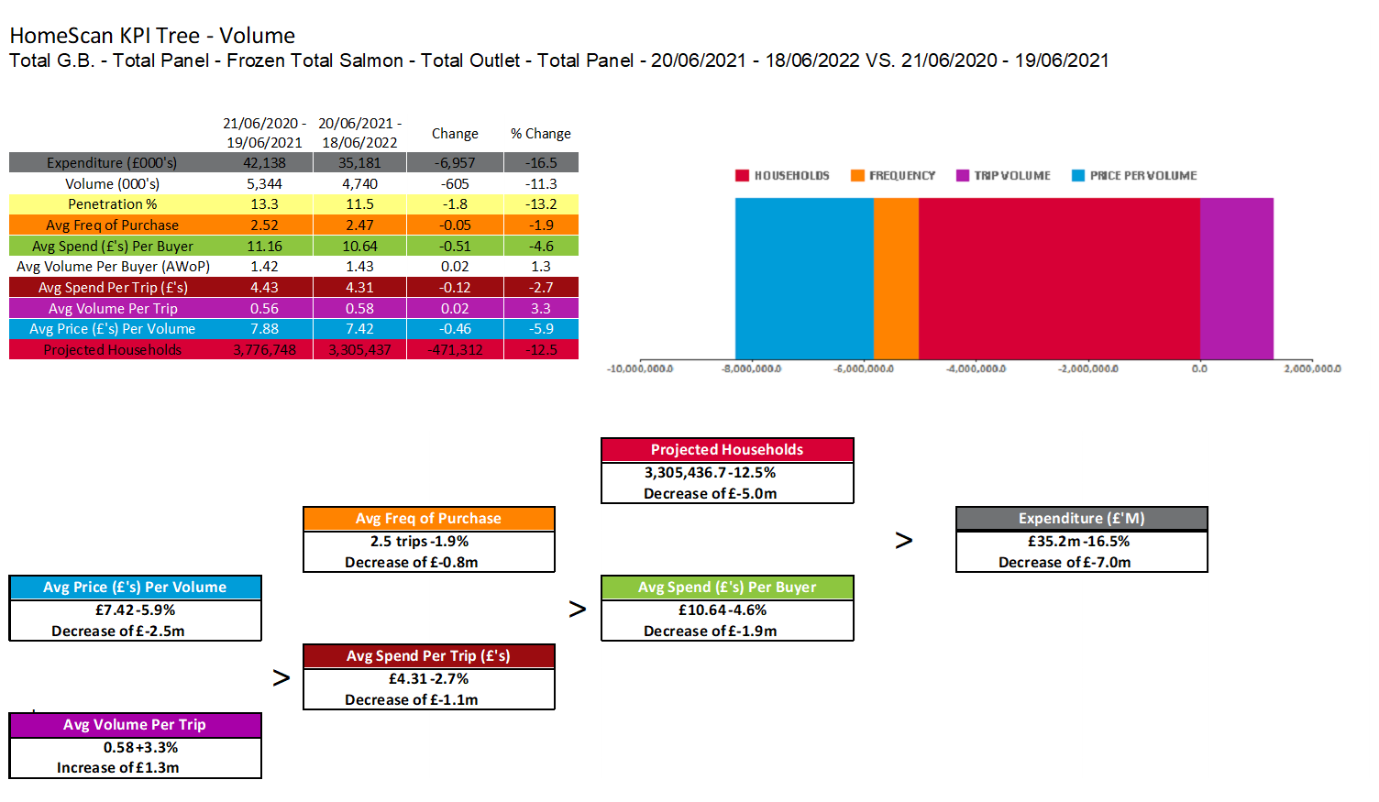
FROZEN TOTAL SALMON
Although Price has decreased, Salmon decline is mainly through decreased penetration
Source – Nielsen Homescan, Data to WE 18.06.2022

Slide 16
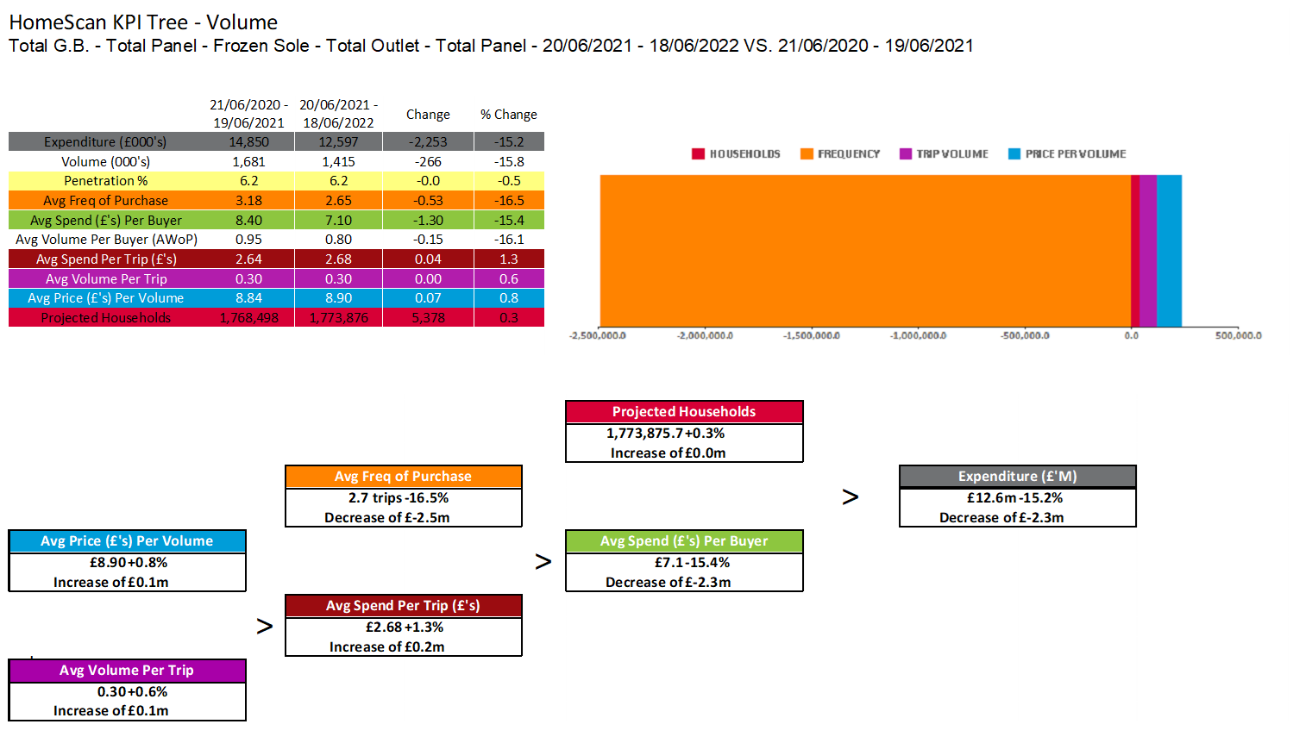
FROZEN SOLE
Frequency has reduced by -16.5% causing a decrease of -£2.5M
Source – Nielsen Homescan, Data to WE 18.06.2022

Slide 17
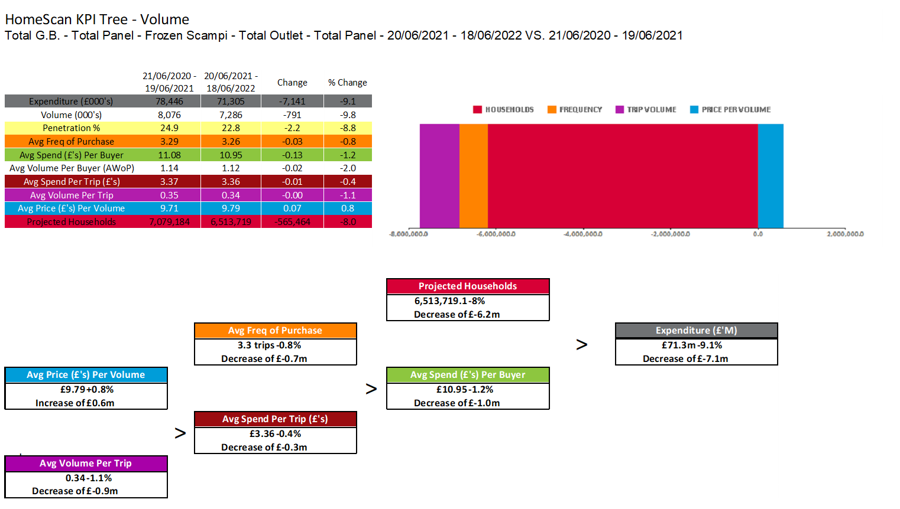
FROZEN SCAMPI
Penetration decrease mainly cause decline
Source – Nielsen Homescan, Data to WE 18.06.2022

Slide 18
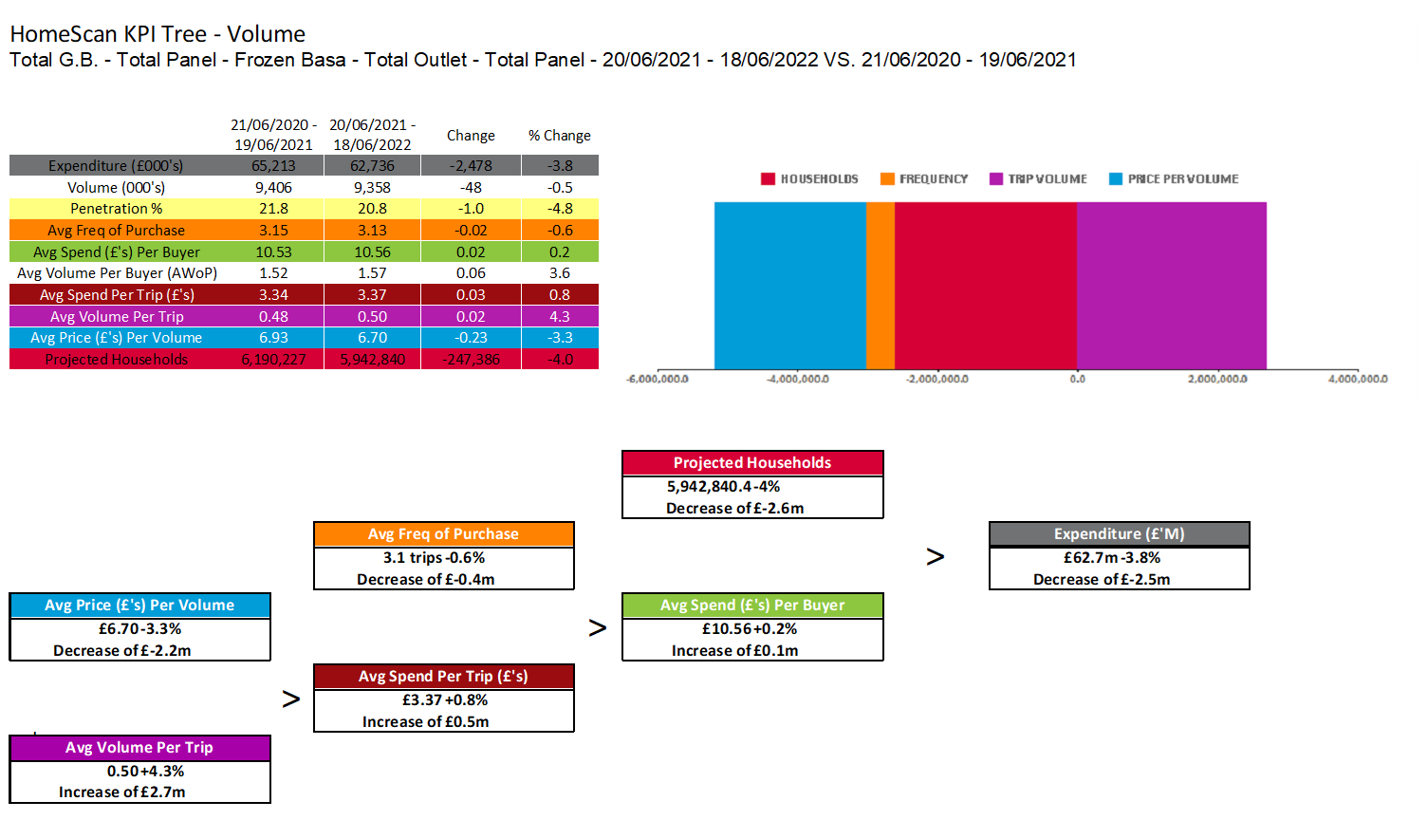
FROZEN BASA
Trip volume increase could not halt decline in Frozen Basa sales
Source – Nielsen Homescan, Data to WE 18.06.2022

Slide 19
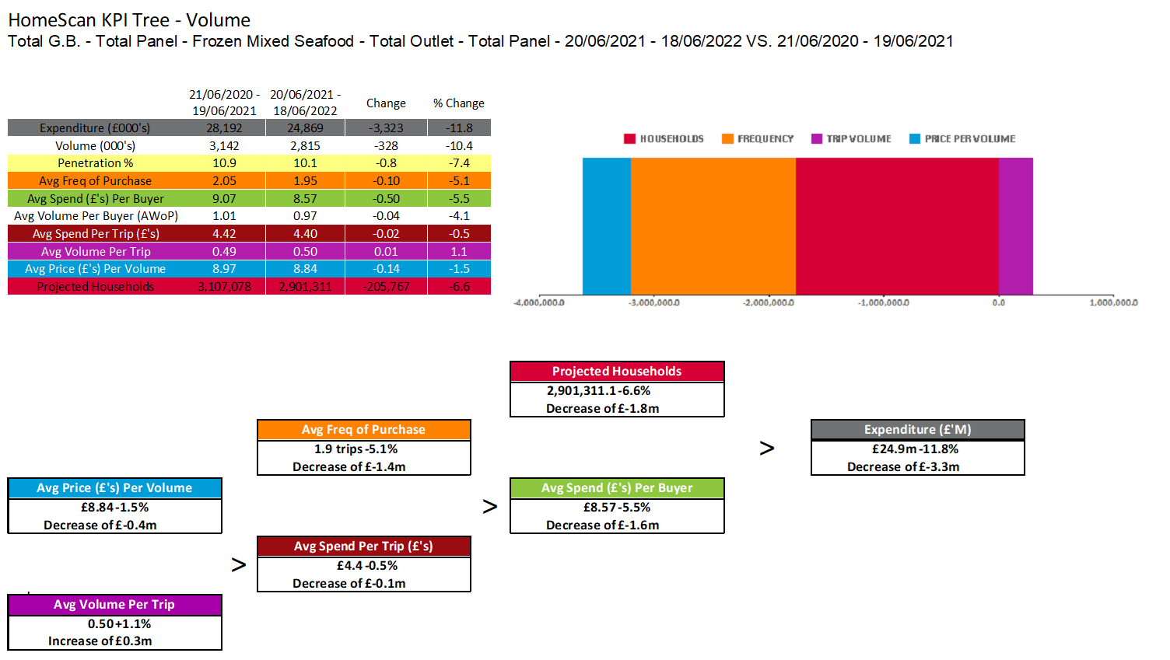
FROZEN MIXED SEAFOOD
Mixed Seafood is declining through reduced frequency and penetration
Source – Nielsen Homescan, Data to WE 18.06.2022

Slide 20
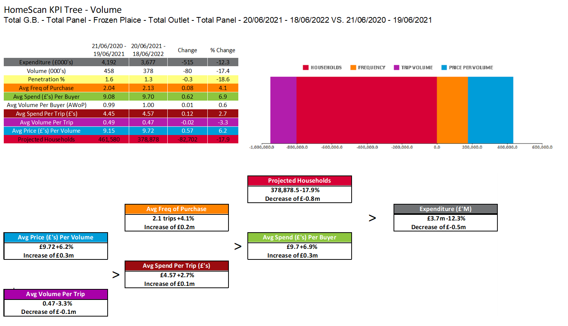
FROZEN PLAICE
Trip volume and buyers are declining whilst price sees increase
Source – Nielsen Homescan, Data to WE 18.06.2022

Slide 21
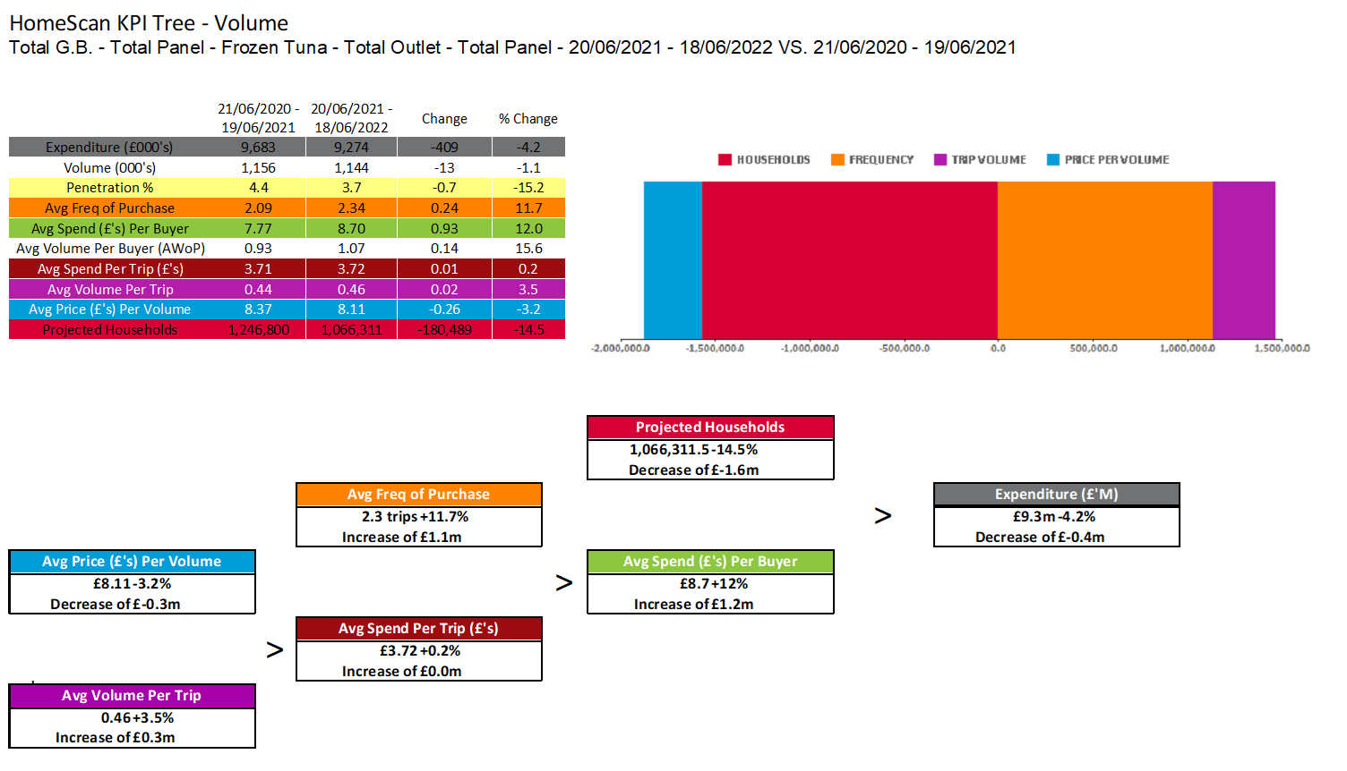
FROZEN TUNA
Frequency and Basket size increase as price decreases while numbers of buyers reduced significantly
Source – Nielsen Homescan, Data to WE 18.06.2022

Slide 22
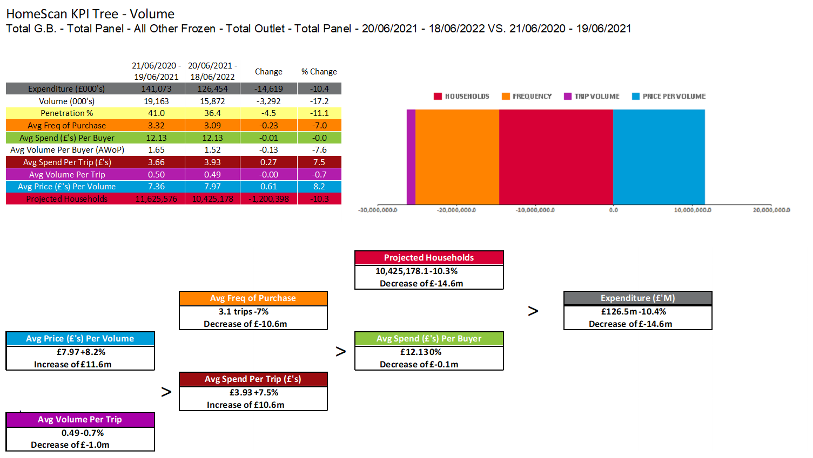
ALL OTHER FROZEN
All other decline is due to increase in price and decrease in buyers and frequency
Source – Nielsen Homescan, Data to WE 18.06.2022

Slide 23
SOURCE OF GROWTH AND SHIFTING BY SPECIES

Slide 24
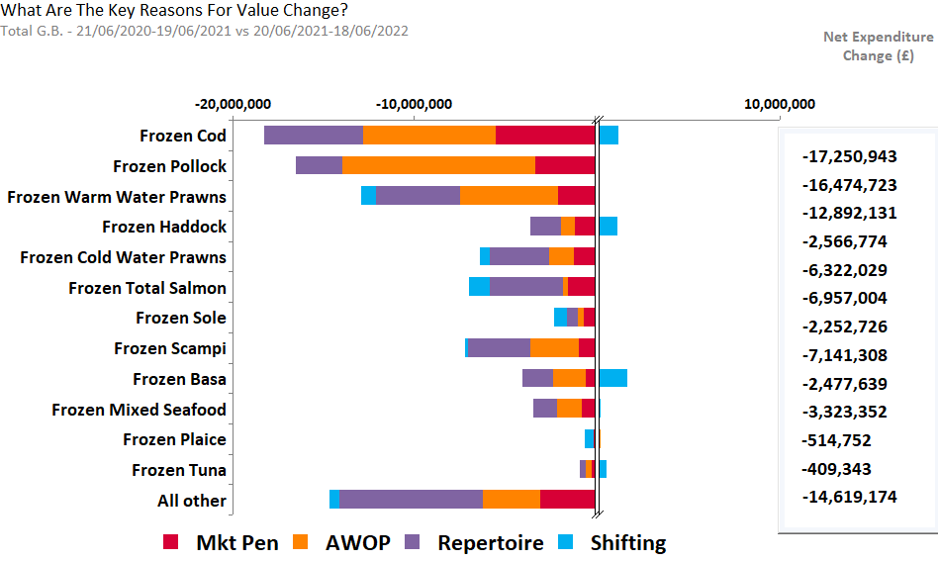
FROZEN FISH – SOURCE OF GROWTH BY SPECIES
Source – Nielsen Homescan Data to 52 WE 18.06.2022 vs YA

Slide 25
FROZEN COD
COD decline is mainly from AWOP, Market penetration and repertoire
Source – Nielsen Homescan Data to 52 WE 18.06.2022 vs YA

Slide 26
FROZEN POLLOCK
All the key measures are driving Pollock decline. Shifting losses mainly from Basa, Haddock, Tuna, Mixed Seafood and Salmon
Source – Nielsen Homescan Data to 52 WE 18.06.2022 vs YA

Slide 27
FROZEN WARM WATER PRAWNS
All the key measures are driving warm water prawns decline. Shifting losses to all species except Mixed seafood, Plaice, Cod, Tuna and Sole
Source – Nielsen Homescan Data to 52 WE 18.06.2022 vs YA

Slide 28
FROZEN HADDOCK
Declining mainly from Repertoire. Shifting losses to Scampi , Basa , Cold water prawns, Mixed Sea food and Tuna.
Source – Nielsen Homescan Data to 52 WE 18.06.2022 vs YA

Slide 29
FROZEN COLD WATER PRAWNS
Declining mainly from Repertoire. Shifting losses to Cod, Pollock, Basa, Scampi and Tuna
Source – Nielsen Homescan Data to 52 WE 18.06.2022 vs YA

Slide 30
FROZEN SOLE
All the key measures are driving Sole decline. Shifting losses to all species except Salmon and Scampi
Source – Nielsen Homescan Data to 52 WE 18.06.2022 vs YA

Slide 31
FROZEN SCAMPI
All the key measures are driving Scampi decline. Shifting losses to Basa, Pollock, Salmon, Sole, Mixed Sea food and Tuna
Source – Nielsen Homescan Data to 52 WE 18.06.2022 vs YA

Slide 32
FROZEN BASA
Basa decline is from all measures except Shifting. Shifting losses only to Cod, Salmon , Mixed Seafood and Plaice
Source – Nielsen Homescan Data to 52 WE 18.06.2022 vs YA

Slide 33
FROZEN MIXED SEAFOOD
Decline’s mainly from AWOP and Repertoire. Shifting losses to Warm water Prawns, Tuna, Cod and Cold water prawns
Source – Nielsen Homescan Data to 52 WE 18.06.2022 vs YA

Slide 34
FROZEN PLAICE
Decline is mainly through Shifting. Losses to all species except Sole, Salmon, Basa and Tuna
Source – Nielsen Homescan Data to 52 WE 18.06.2022 vs YA

Slide 35
FROZEN TUNA
Decline is mainly from AWOP, Repertoire and Mkt Penetration. Shifting gains from all species except Warm water prawns, Basa and Plaice.
Source – Nielsen Homescan Data to 52 WE 18.06.2022 vs YA

Slide 36
FROZEN TOTAL SALMON
All the key measures are driving Salmon decline. Shifting losses to all species except Scampi, Warmwater Prawns, Basa and Pollock
Source – Nielsen Homescan Data to 52 WE 18.06.2022 vs YA

Slide 37
FROZEN – ALL OTHER
All the key measures are driving ‘All Other’ decline
Source – Nielsen Homescan Data to 52 WE 18.06.2022 vs YA

Slide 38
DEMOGRAPHICS BY TOTAL GB AND SPECIES

Slide 39
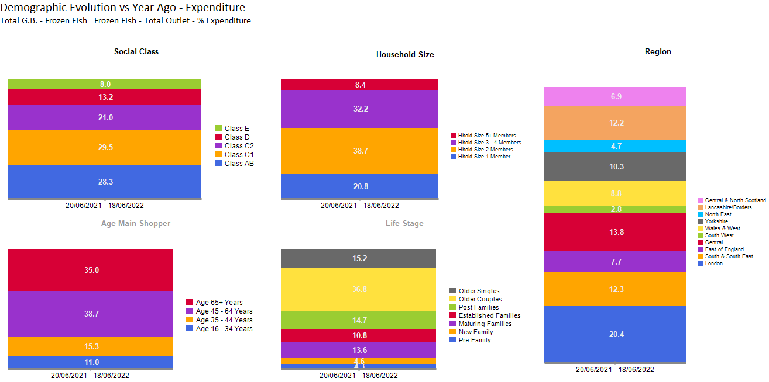
FROZEN FISH SALES OVERINDEX FROM OLDER COUPLES, OF THOSE CLASS C1, AGED 45+, WITH 2 MEMBERS IN FAMILY, AND LOCATED AT LONDON AND CENTRAL.
Source – Nielsen Homescan Data to 52 WE 18.06.2022 vs YA

Slide 40
FROZEN FISH UNDERINDEX AMONGST YOUNGER GROUPS

Slide 41
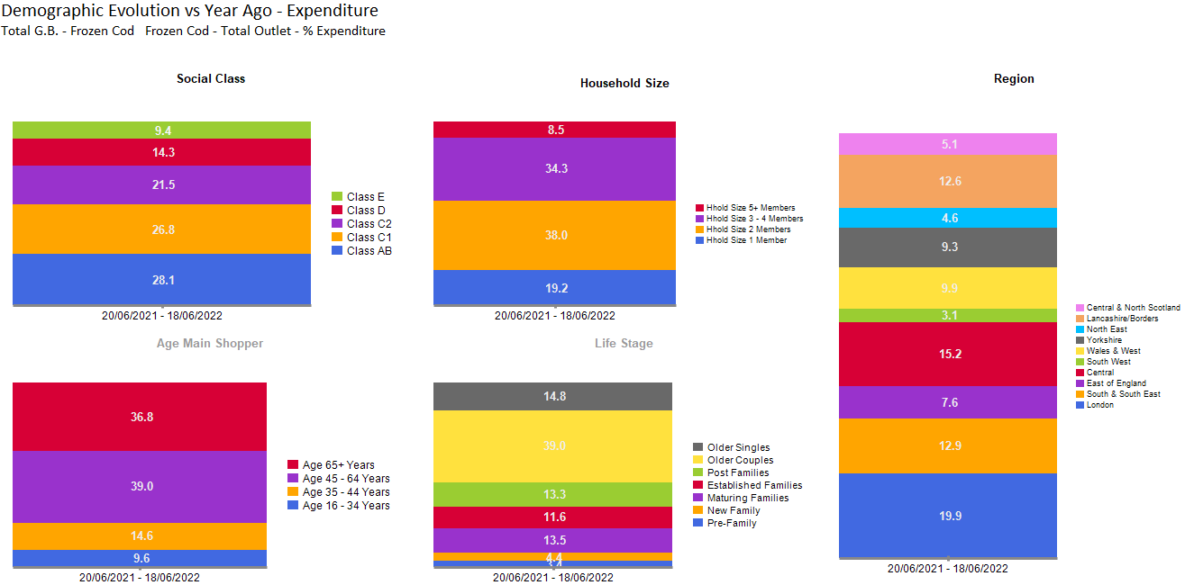
COD SALES COME MORE PREDOMINANTLY FROM OLDER COUPLES, OF CLASS AB, AGED 45+, WITH 2 MEMBERS IN FAMILY, LOCATED AT LONDON AND CENTRAL.
Source – Nielsen Homescan Data to 52 WE 18.06.2022 vs YA

Slide 42
COD UNDER INDEX AMONGST SINGLES LIVING IN CENTRAL AND NORTH SCOTLAND

Slide 43
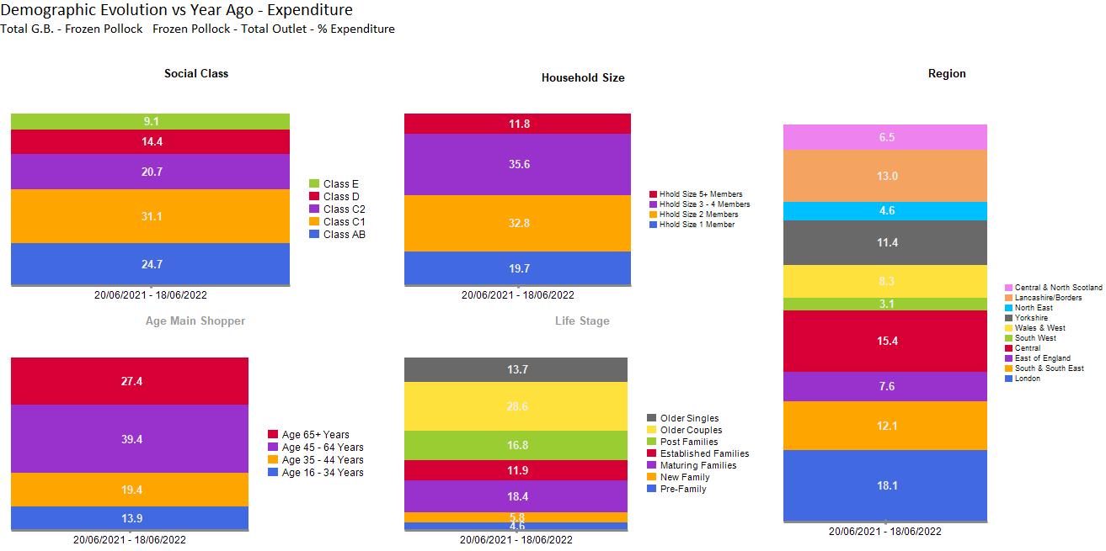
POLLOCK SALES COME MORE PREDOMINANTLY FROM OLDER COUPLES, OF CLASS C1, AGED 45+, WITH 3-4 MEMBERS IN FAMILY, LOCATED AT LONDON AND CENTRAL.
Source – Nielsen Homescan Data to 52 WE 18.06.2022 vs YA

Slide 44
POLLOCK UNDERINDEX AMONST SINGLES LIVING IN LONDON AND CENTRAL AND NORTH SCOTLAND

Slide 45
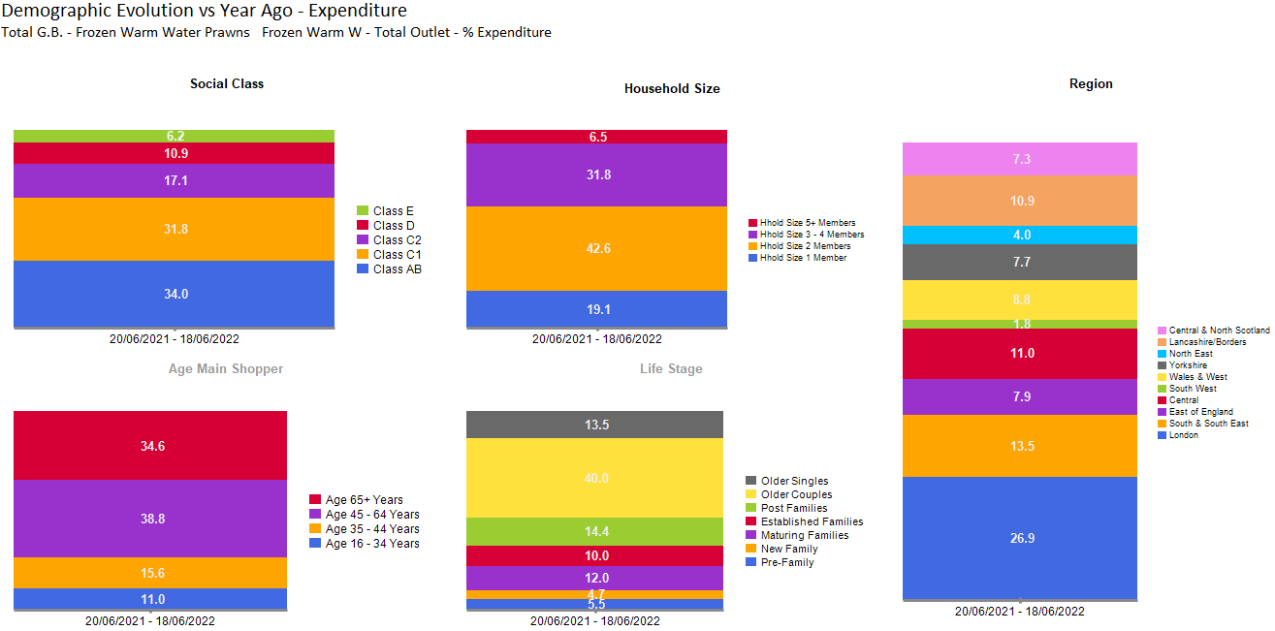
FROZEN WARM WATER PRAWNS COME MORE PREDOMINANTLY FROM THOSE AGED 45+, CLASS AB & C1, WITH 2 MEMBERS IN FAMILY, AND THOSE LOCATED AT LONDON
Source – Nielsen Homescan Data to 52 WE 18.06.2022 vs YA

Slide 46
WARM WATER PRAWNS OVERINDEX FOR THOSE LIVING IN LONDON , SOUTH & SOUTH EAST, EAST OF ENGLAND AND IN OLDER COUPLES & ESTABLISHED FAMILIES.

Slide 47
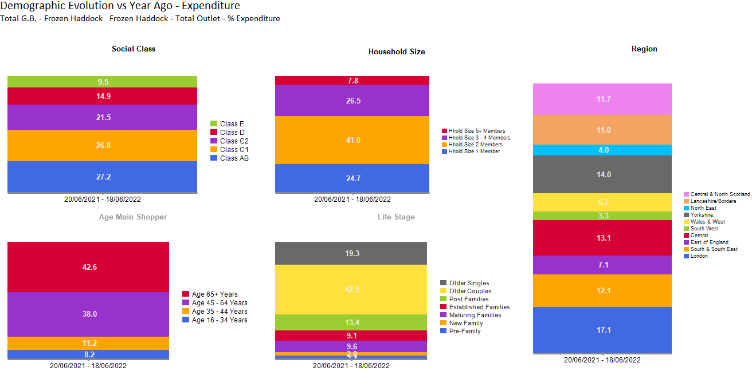
HADDOCK COME MORE PREDOMINANTLY FROM HOUSEHOLDS WITH 2 MEMBERS IN FAMILY, FROM OLDER COUPLES, CLASS AB & C1, AGED 65+, AND LOCATED AT LONDON AND YORKSHIRE.
Source – Nielsen Homescan Data to 52 WE 18.06.2022 vs YA

Slide 48
HADDOCK OVERINDEX AMONGST OLDER COUPLES, 2 MEMBERS & 5+ MEMBERS HOUSEHOLDS, AND THOSE AGED 65+

Slide 49
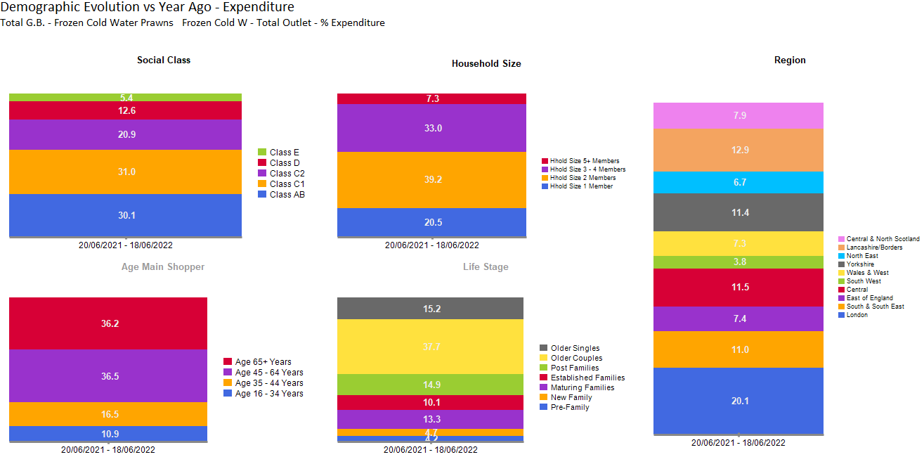
COLD WATER PRAWN SALES COME MORE PREDOMINANTLY FROM OLDER COUPLES, AGED 45+, OF CLASS C1, WITH 2 MEMBERS, AND HOUSEHOLDS FROM LONDON
Source – Nielsen Homescan Data to 52 WE 18.06.2022 vs YA

Slide 50
FROZEN COLD WATER PRAWNS OVERINDEX AMONGST OLDER COUPLES, AGED 65+ , AND THOSE LIVING IN NORTH EAST.

Slide 51
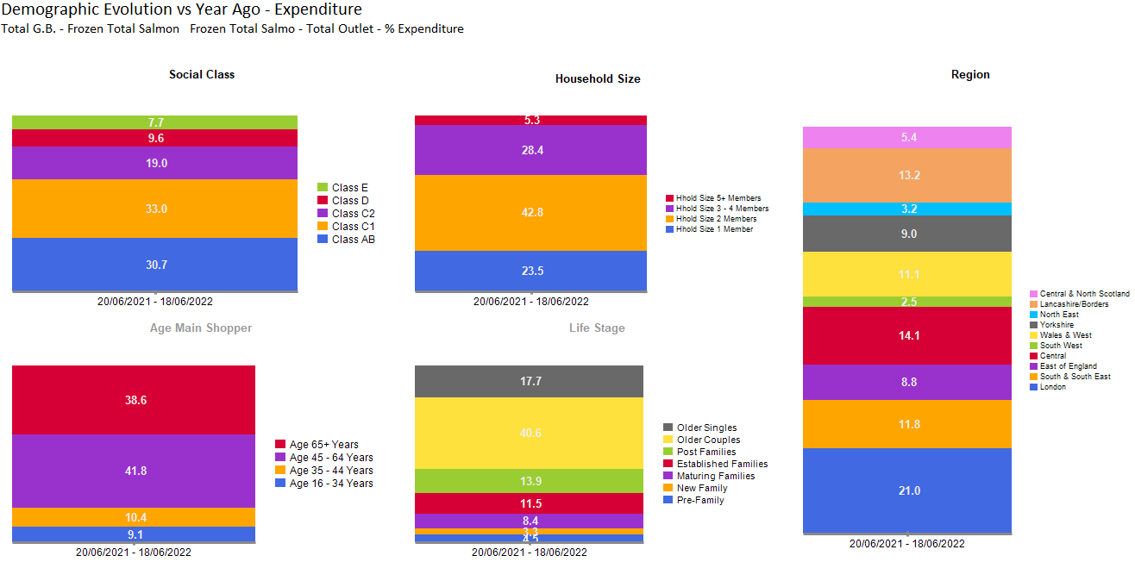
TOTAL SALMON SALES COME MORE PREDOMINANTLY FROM THOSE WITH 2 MEMBER HOUSEHOLDS, OF CLASS C1, AGED 45+ AND FROM OLDER COUPLES.
Source – Nielsen Homescan Data to 52 WE 18.06.2022 vs YA

Slide 52
SALMON OVERINDEX FROM OLDER COUPLES AND ESTABILISED FAMILIES WITH THE AGE GROUP OF 45+ AND HOUSEHOLD SIZE 2 MEMBERS

Slide 53
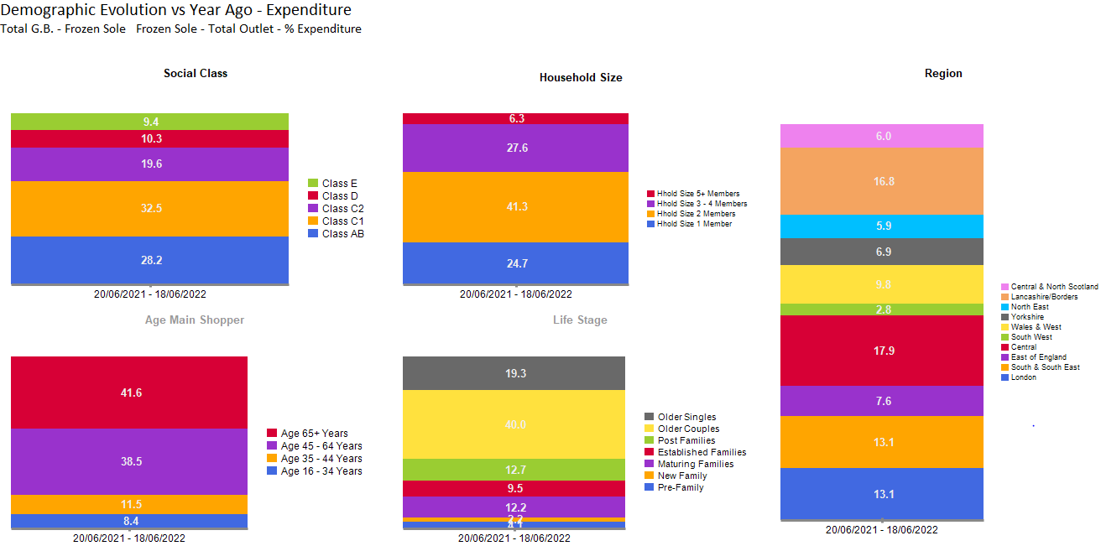
SOLE SALES COME MORE PREDOMINANTLY FROM AFFLUENT OLDER COUPLES, OF CLASS AB & C1, AGED 65+, WITH 2 MEMBERS IN FAMILY, AND THOSE LOCATED AT CENTRAL.
Source – Nielsen Homescan Data to 52 WE 18.06.2022 vs YA

Slide 54
SOLE OVERINDEX AMONGST OLDER COUPLES WHILST UNDERINDEX IN HOUSEHOLDS LOCATED IN LONDON, YORKSHIRE AND CENTRAL & NORTH SCOTLAND

Slide 55
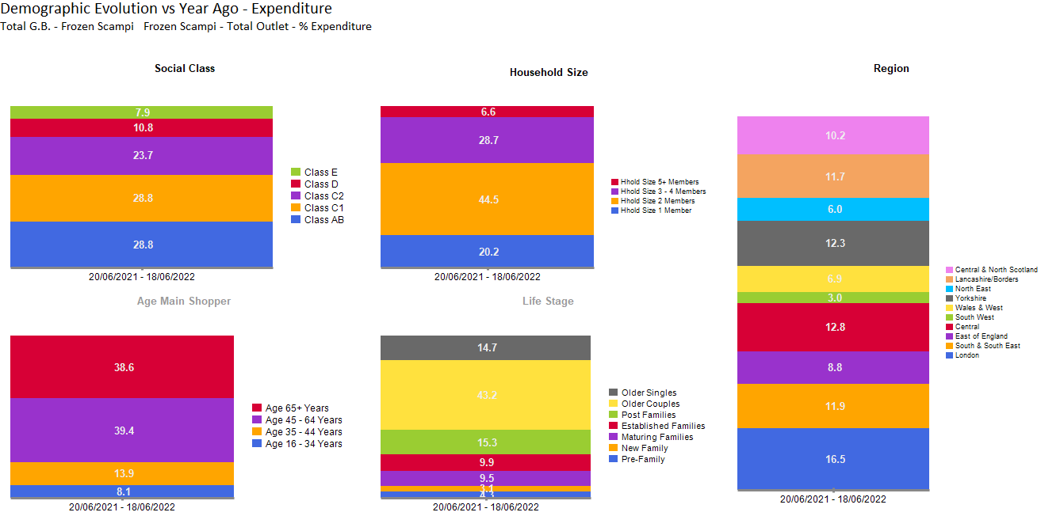
SCAMPI SALES COME MORE PREDOMINANTLY FROM OLDER COUPLES, OF CLASS AB, C1, AGED 45+, WITH 2 MEMBERS IN FAMILY, LOCATED IN LONDON AND CENTRAL.
Source – Nielsen Homescan Data to 52 WE 18.06.2022 vs YA

Slide 56
SCAMPI OVERINDEX AMONG OLDER COUPLES

Slide 57
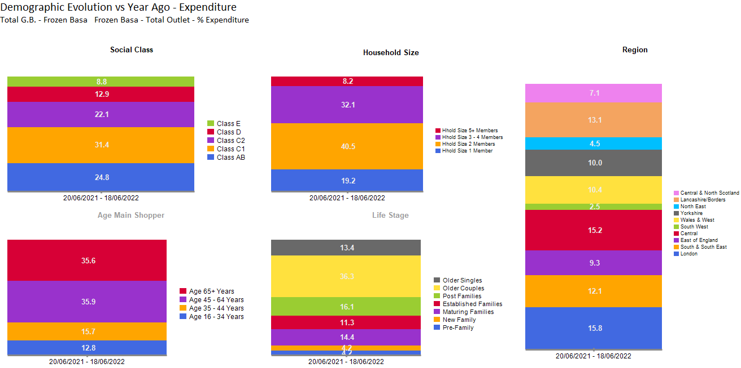
BASA SALES COME MORE PREDOMINANTLY FROM AFFLUENT OLDER COUPLES, OF CLASS C1, AGED 45+, WITH 2 MEMBERS IN FAMILY, LOCATED AT CENTRAL & LONDON.
Source – Nielsen Homescan Data to 52 WE 18.06.2022 vs YA

Slide 58
BASA OVERINDEX AMONGST OLDER GROUPS, WITH HOUSEHOLD SIZE 2+ MEMBERS.

Slide 59
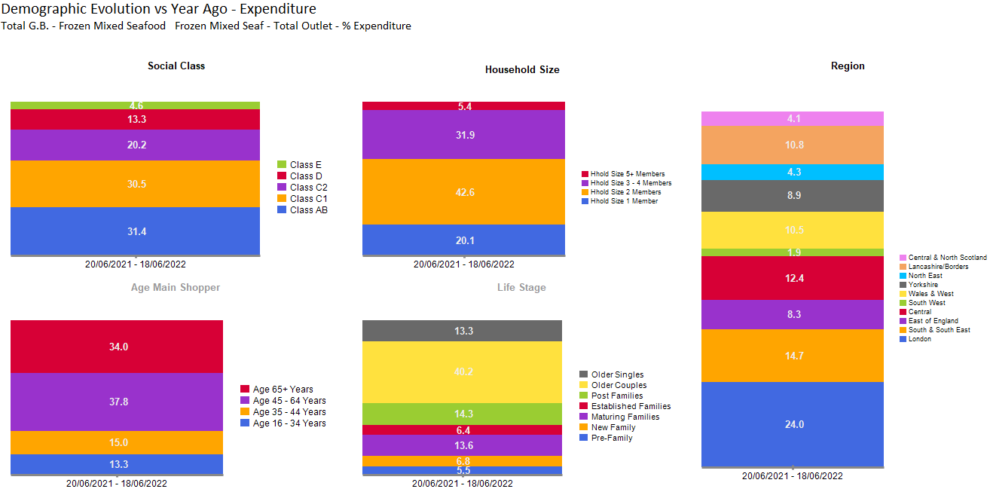
MIXED SEAFOOD SALES COME MORE PREDOMINANTLY FROM OLDER COUPLES, OF CLASS AB, AGED 45+, WITH 2 MEMBERS IN FAMILY, LOCATED AT LONDON
Source – Nielsen Homescan Data to 52 WE 18.06.2022 vs YA

Slide 60
MIXED SEAFOOD OVERINDEX WITH THOSE IN CLASS AB, C2 AND OLDER COUPLES BASED IN LONDON AND SOUTH & SOUTH EAST

Slide 61
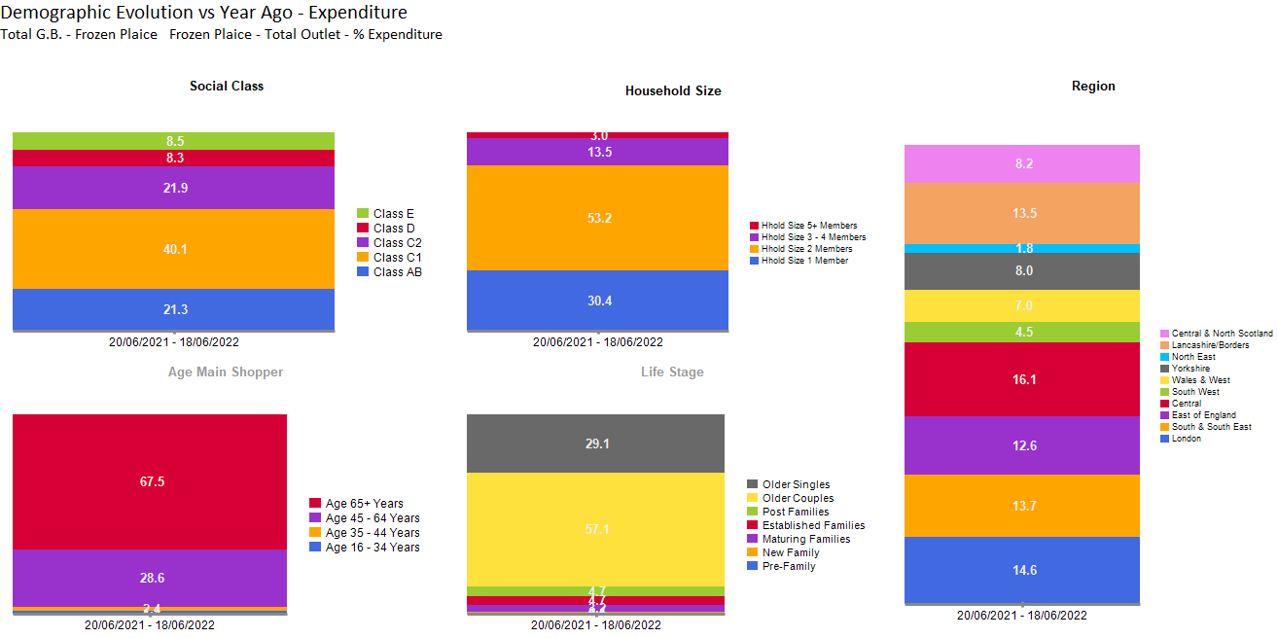
PLAICE SALES COME MORE PREDOMINANTLY FROM OLDER COUPLES, OF CLASS C1, WITH 2 MEMBERS IN FAMILY, LOCATED AT LONDON AND CENTRAL.
Source – Nielsen Homescan Data to 52 WE 18.06.2022 vs YA

Slide 62
PLAICE BUYERS UNDER INDEXING IN CLASS D AND AB, ALONG WITH ALL HOUSEHOLD SIZES EXCEPT 2 MEMBERS.

Slide 63
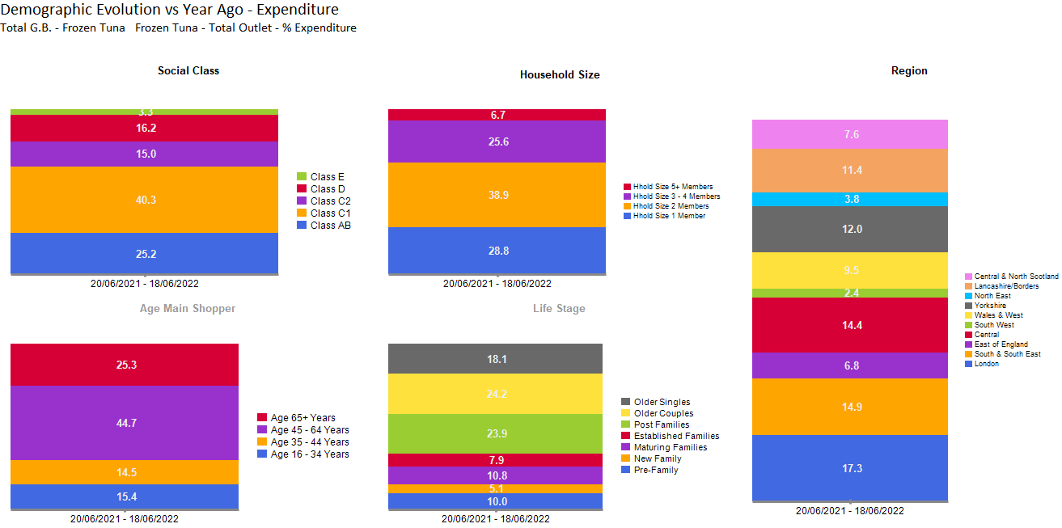
TUNA SALES COME MORE PREDOMINANTLY FROM OLDER COUPLES, OF CLASS C1, AGED 45+, WITH 2 MEMBERS IN FAMILY, LOCATED AT LONDON.
Source – Nielsen Homescan Data to 52 WE 18.06.2022 vs YA

Slide 64
TUNA OVERINDEX AMONGST CLASS C1 AND POST FAMILES

