Slide 1
Sea Fish – Chilled fish by Segment
Data to WE 10.09.2022
Presenter’s Name
Date

Slide 2
Contents
Category Overview
KPIs of Chilled Fish by Segment
Shifting – Chilled Fish by Segment
Demographics – Chilled Fish by Segment

Slide 3
Category Overview

Slide 4
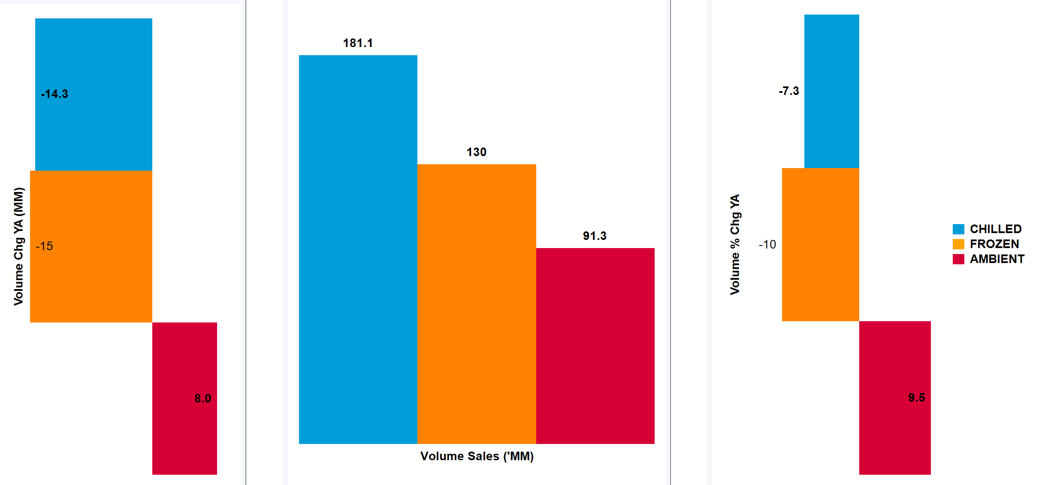
Category VOLUME GROWTH is Decreasing -21.3M kg’s with frozen DRIVING THE DECLINE
Fish| Segment Trends (Volume) | Total Coverage UK including Discounters | MAT TY vs YA - Data to WE 10.09.2022
Source – Nielsen Scantrack, Data to WE 10.09.2022

Slide 5
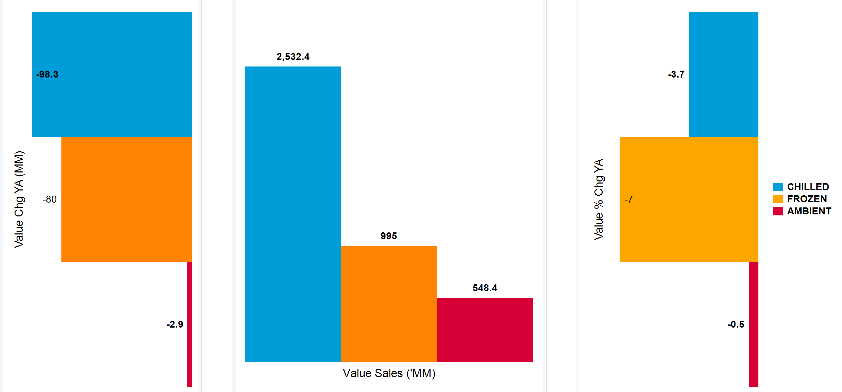
Value growth is down 4.3% driven by frozen
Fish| Segment Trends (Value)| Total Coverage UK including Discounters| MAT TY vs YA - Data to WE 10.09.2022
Source – Nielsen Scantrack, Data to WE 10.09.2022

Slide 6
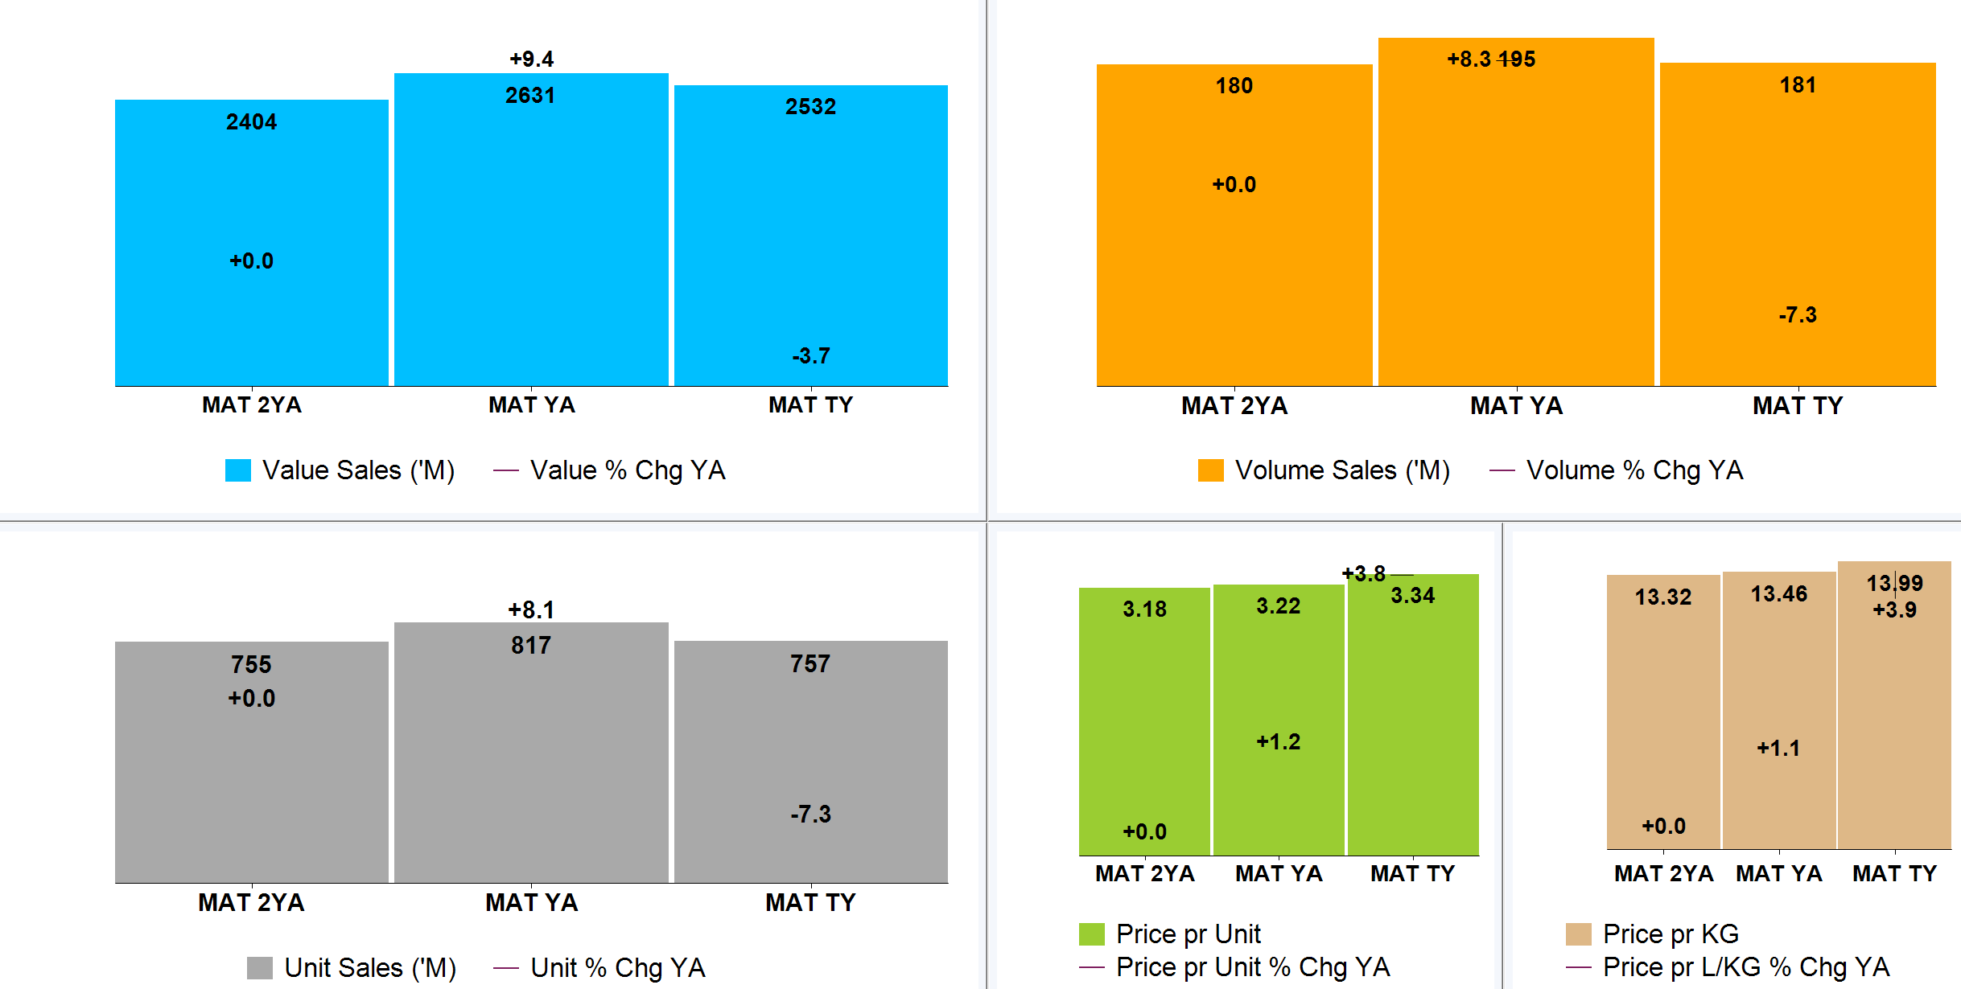
INCREASE IN PRICE/KG HINDERS BY CHILLED GROWTH COMPARED TO YA
Fish| Chilled Fish Trends | Total Coverage UK including Discounters | 3 x MAT to 10.09.2022
Source – Nielsen Scantrack, Data to WE 10.09.2022

Slide 7
Market Summary’s

Slide 8
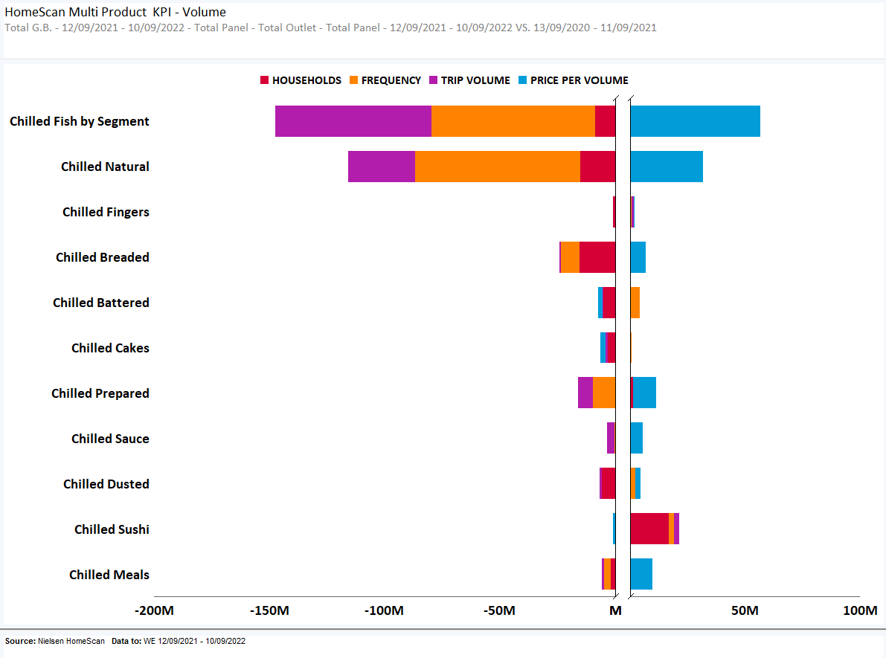
TOTAL CHILLED FISH – KPI’S BY SPECIES SUMMARY
Category has showed decline through decreased Frequency of Purchase and Trip Volume.
Source – Nielsen Homescan, Data to WE 10.09.2022

Slide 9
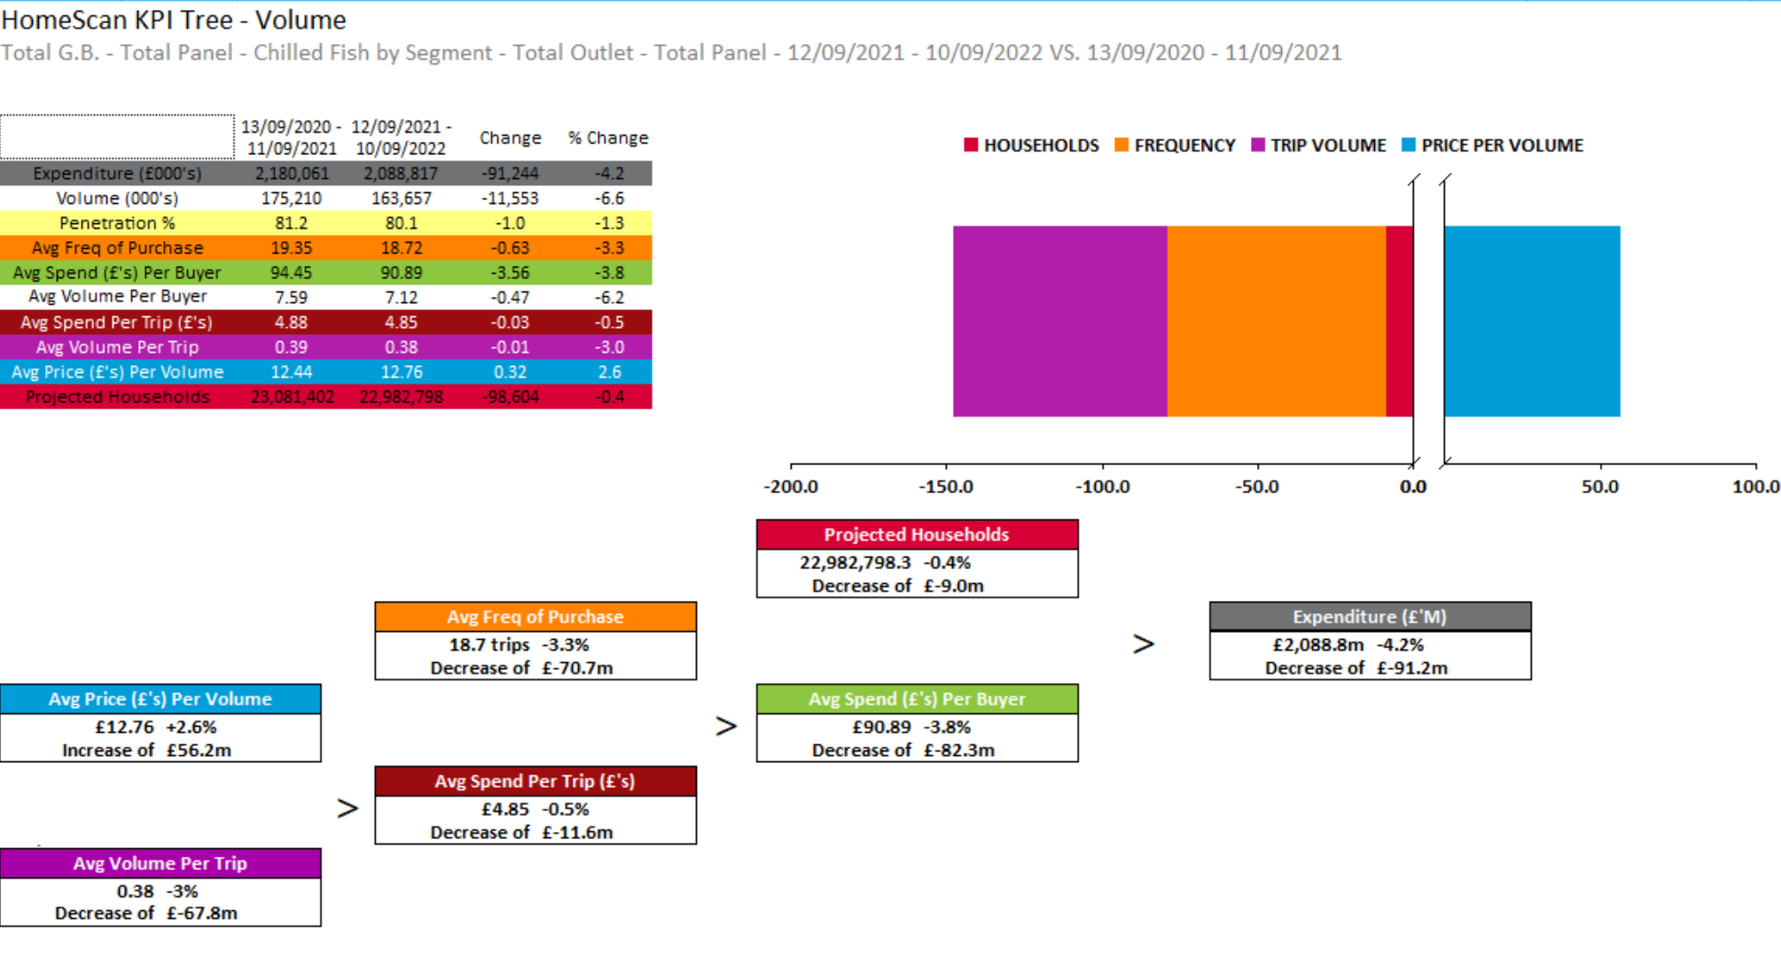
TOTAL CHILLED FISH
Due to increase in price per volume category has declined -£91m in category
Source – Nielsen Homescan, Data to WE 10.09.2022

Slide 10
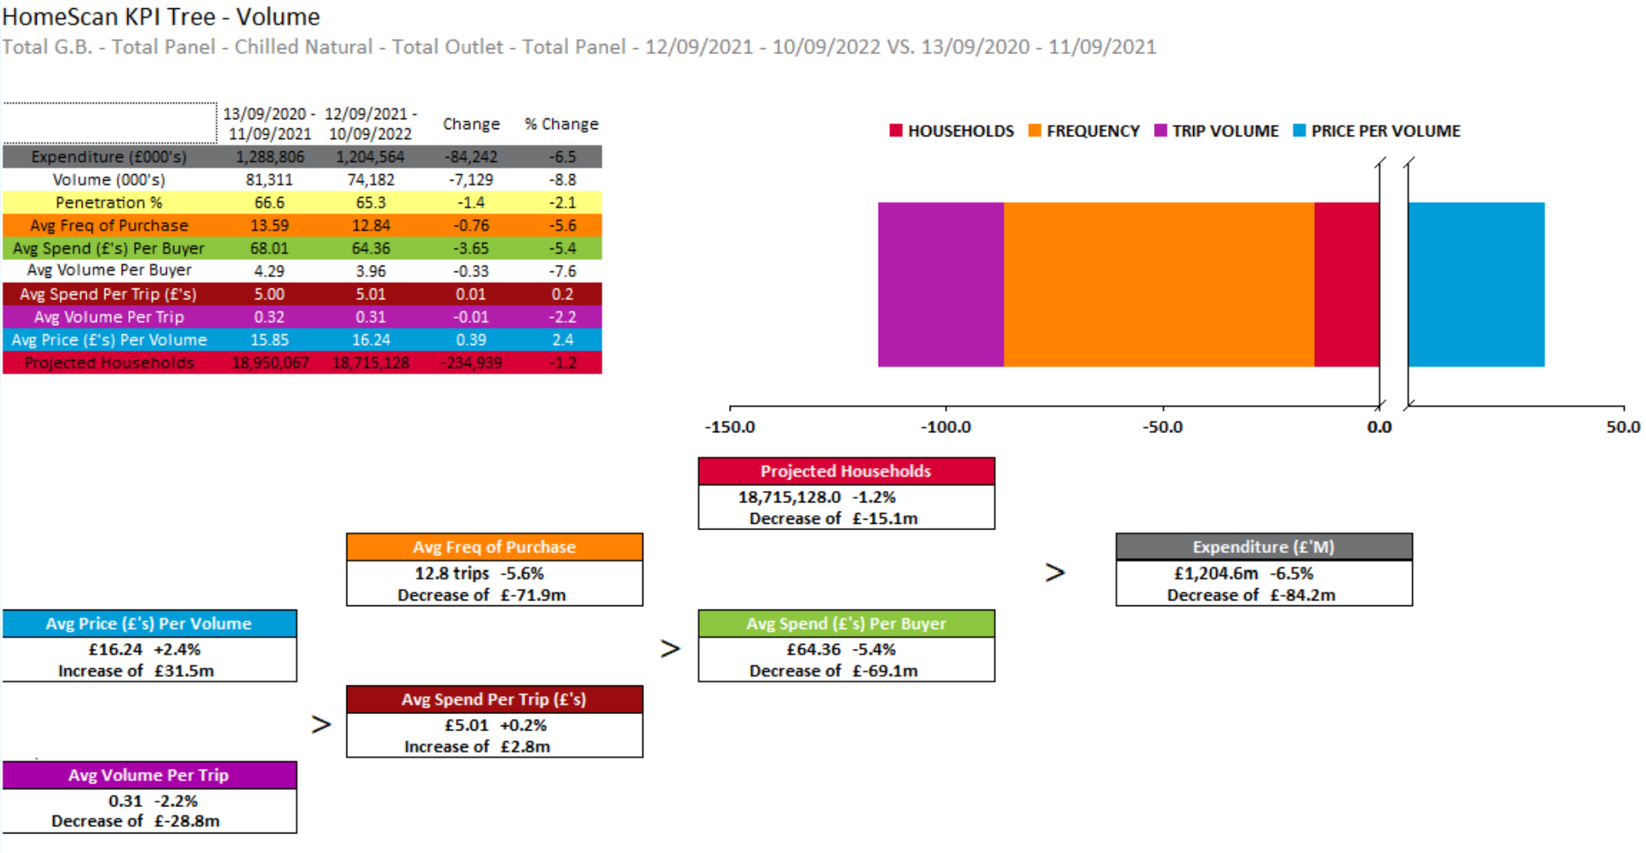
CHILLED NATURAL
Decreased Penetration, frequency of purchase and trip volume results in ‘Natural’ loss by -£84.2M.
Source – Nielsen Homescan, Data to WE 10.09.2022

Slide 11
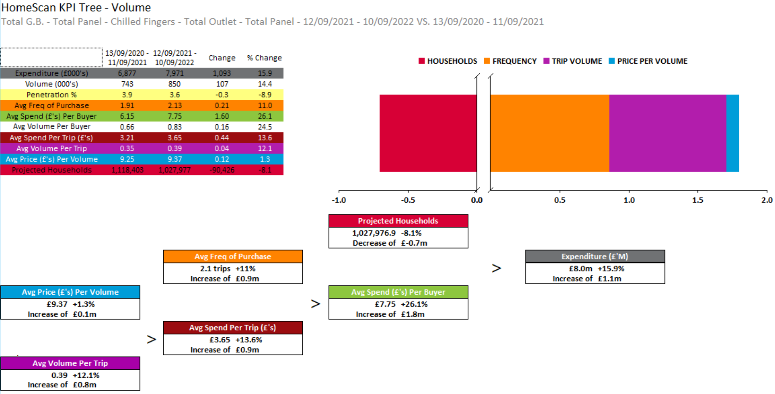
CHILLED FINGERS
Increased Avg spend per buyer and frequency of purchase drives Chilled Fingers growth
Source – Nielsen Homescan, Data to WE 10.09.2022

Slide 12
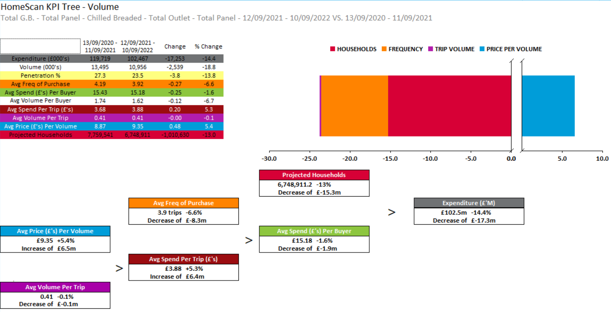
CHILLED BREADED
Increase in price per volume results in -£17.2m decline in segment
Source – Nielsen Homescan, Data to WE 10.09.2022

Slide 13
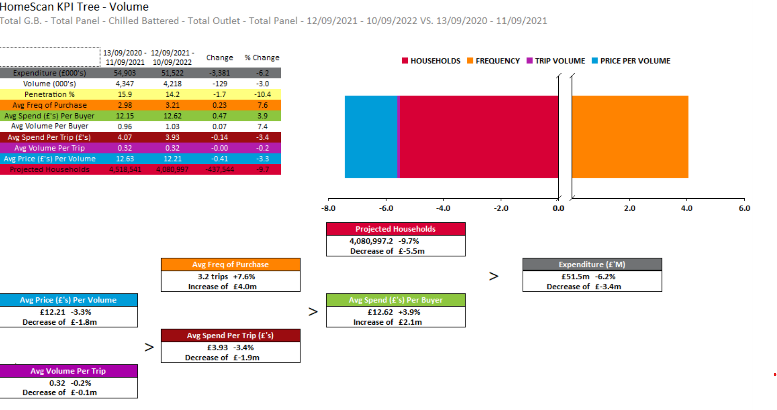
CHILLED BATTERED
Penetration and trip volume decline sees segment decline
Source – Nielsen Homescan, Data to WE 10.09.2022

Slide 14
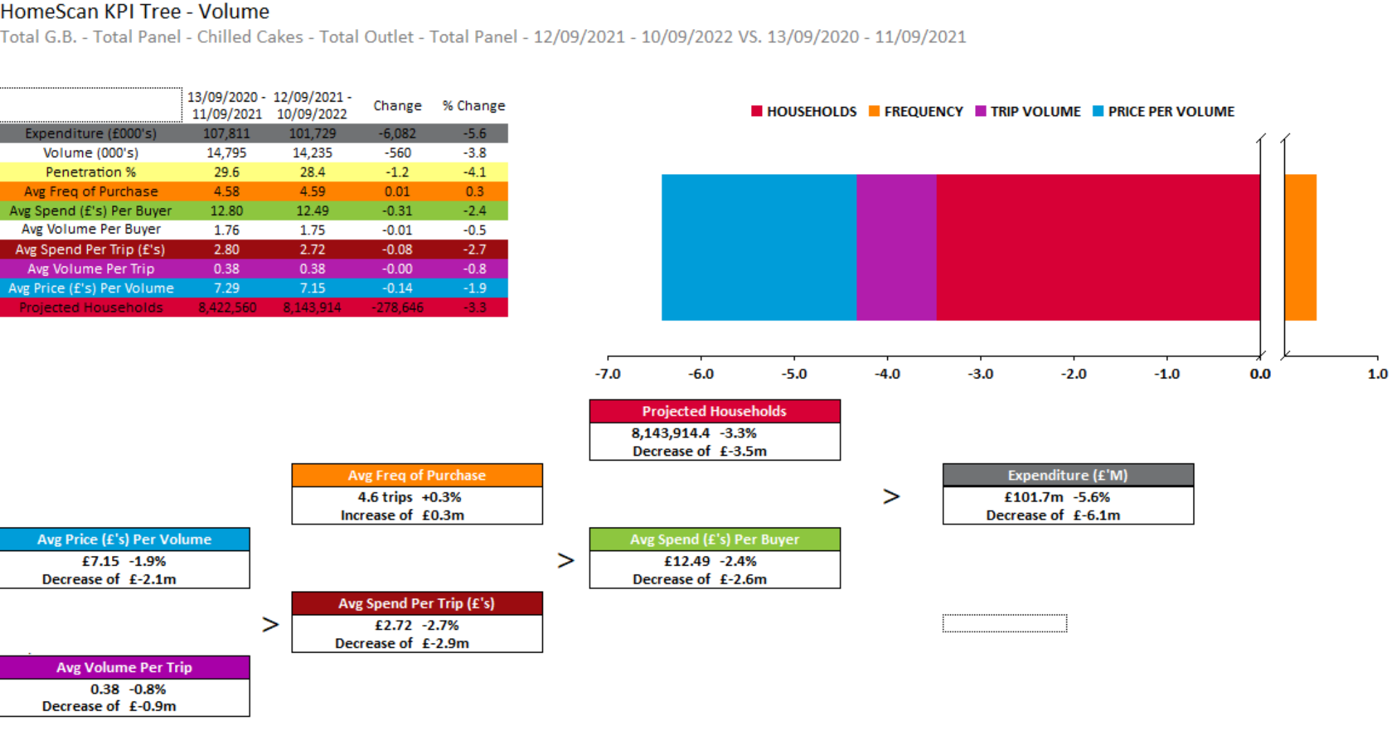
CHILLED CAKES
Decrease in price per volume, penetration aids segment decline
Source – Nielsen Homescan, Data to WE 10.09.2022

Slide 15
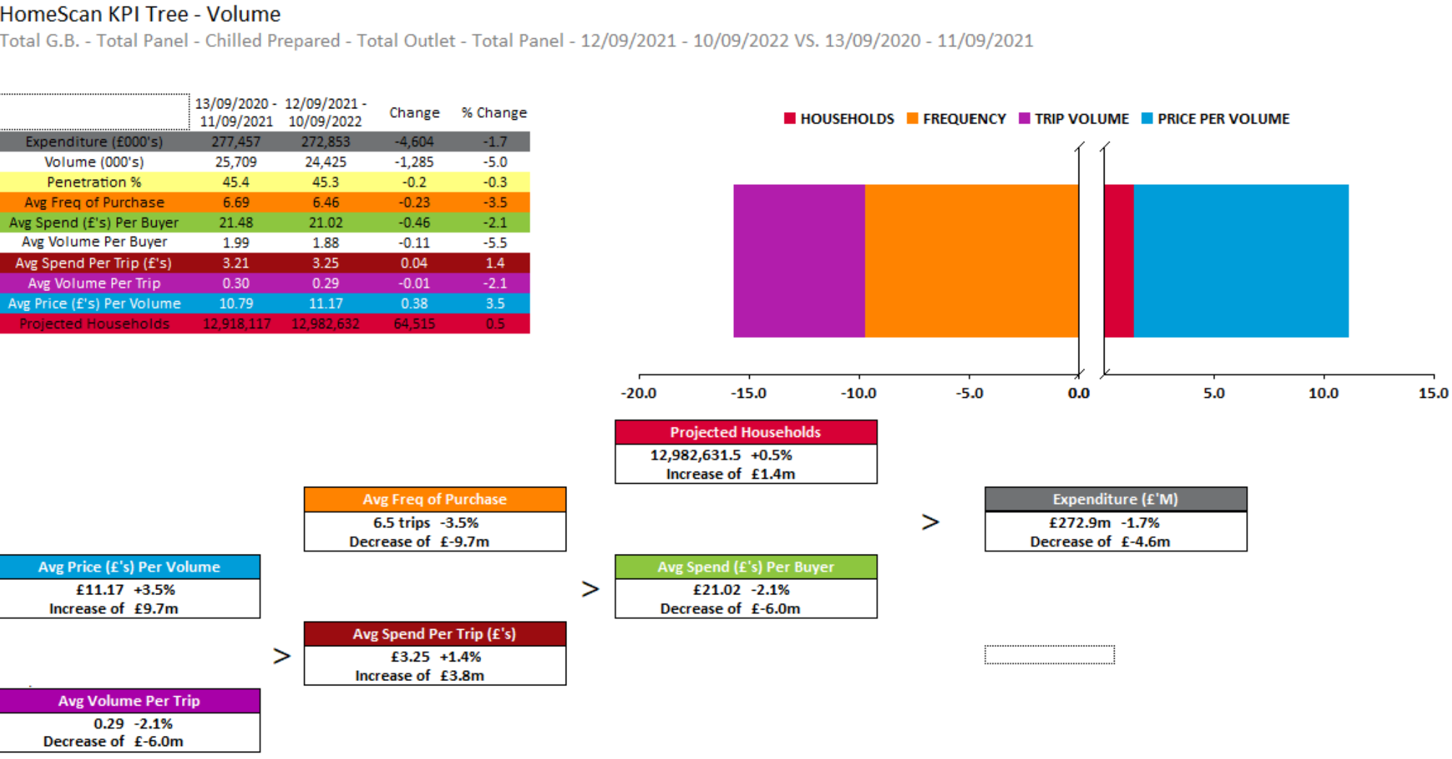
CHILLED PREPARED
Decrease in penetration see market decline by -1.7% .
Source – Nielsen Homescan, Data to WE 10.09.2022

Slide 16
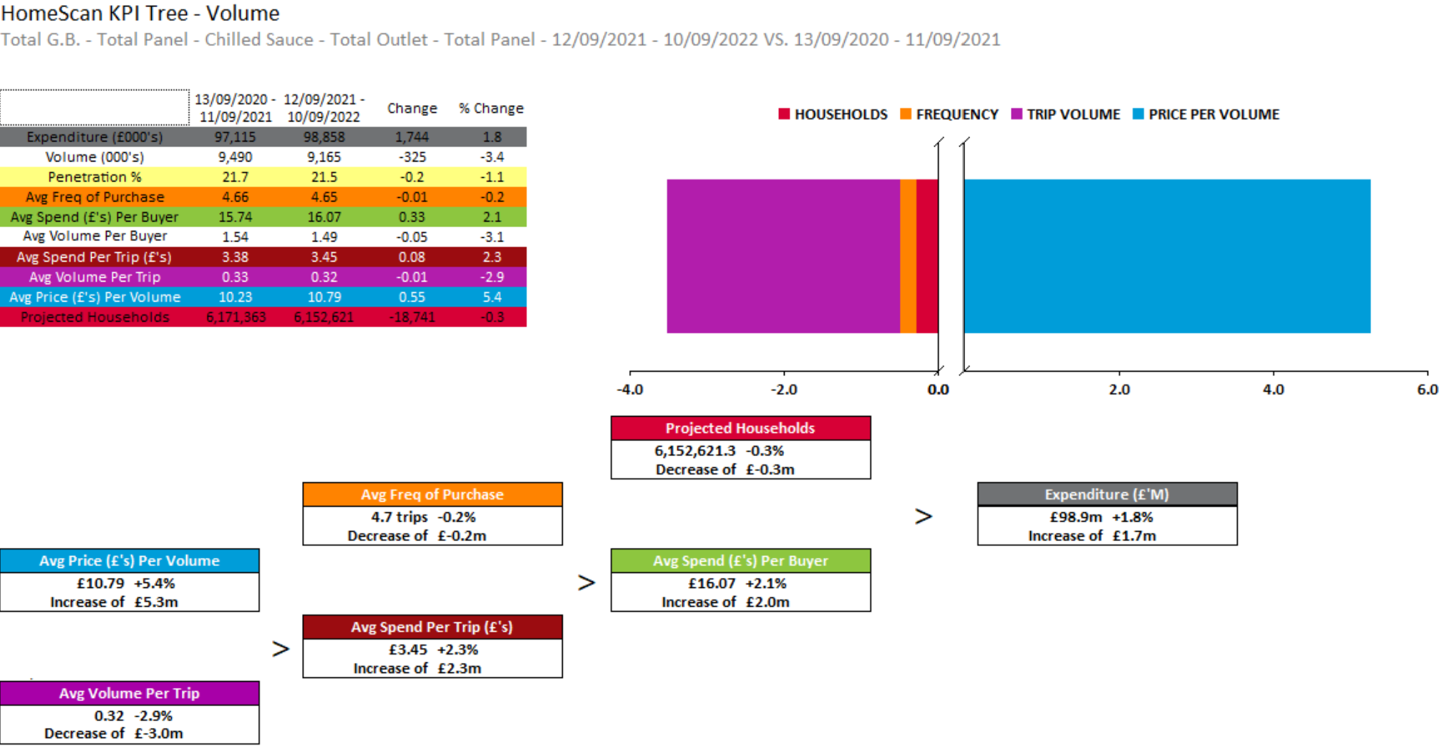
CHILLED SAUCE
Despite Frequency of purchase and penetration declines, increased price sees market growth by 1.8%
Source – Nielsen Homescan, Data to WE 10.09.2022

Slide 17
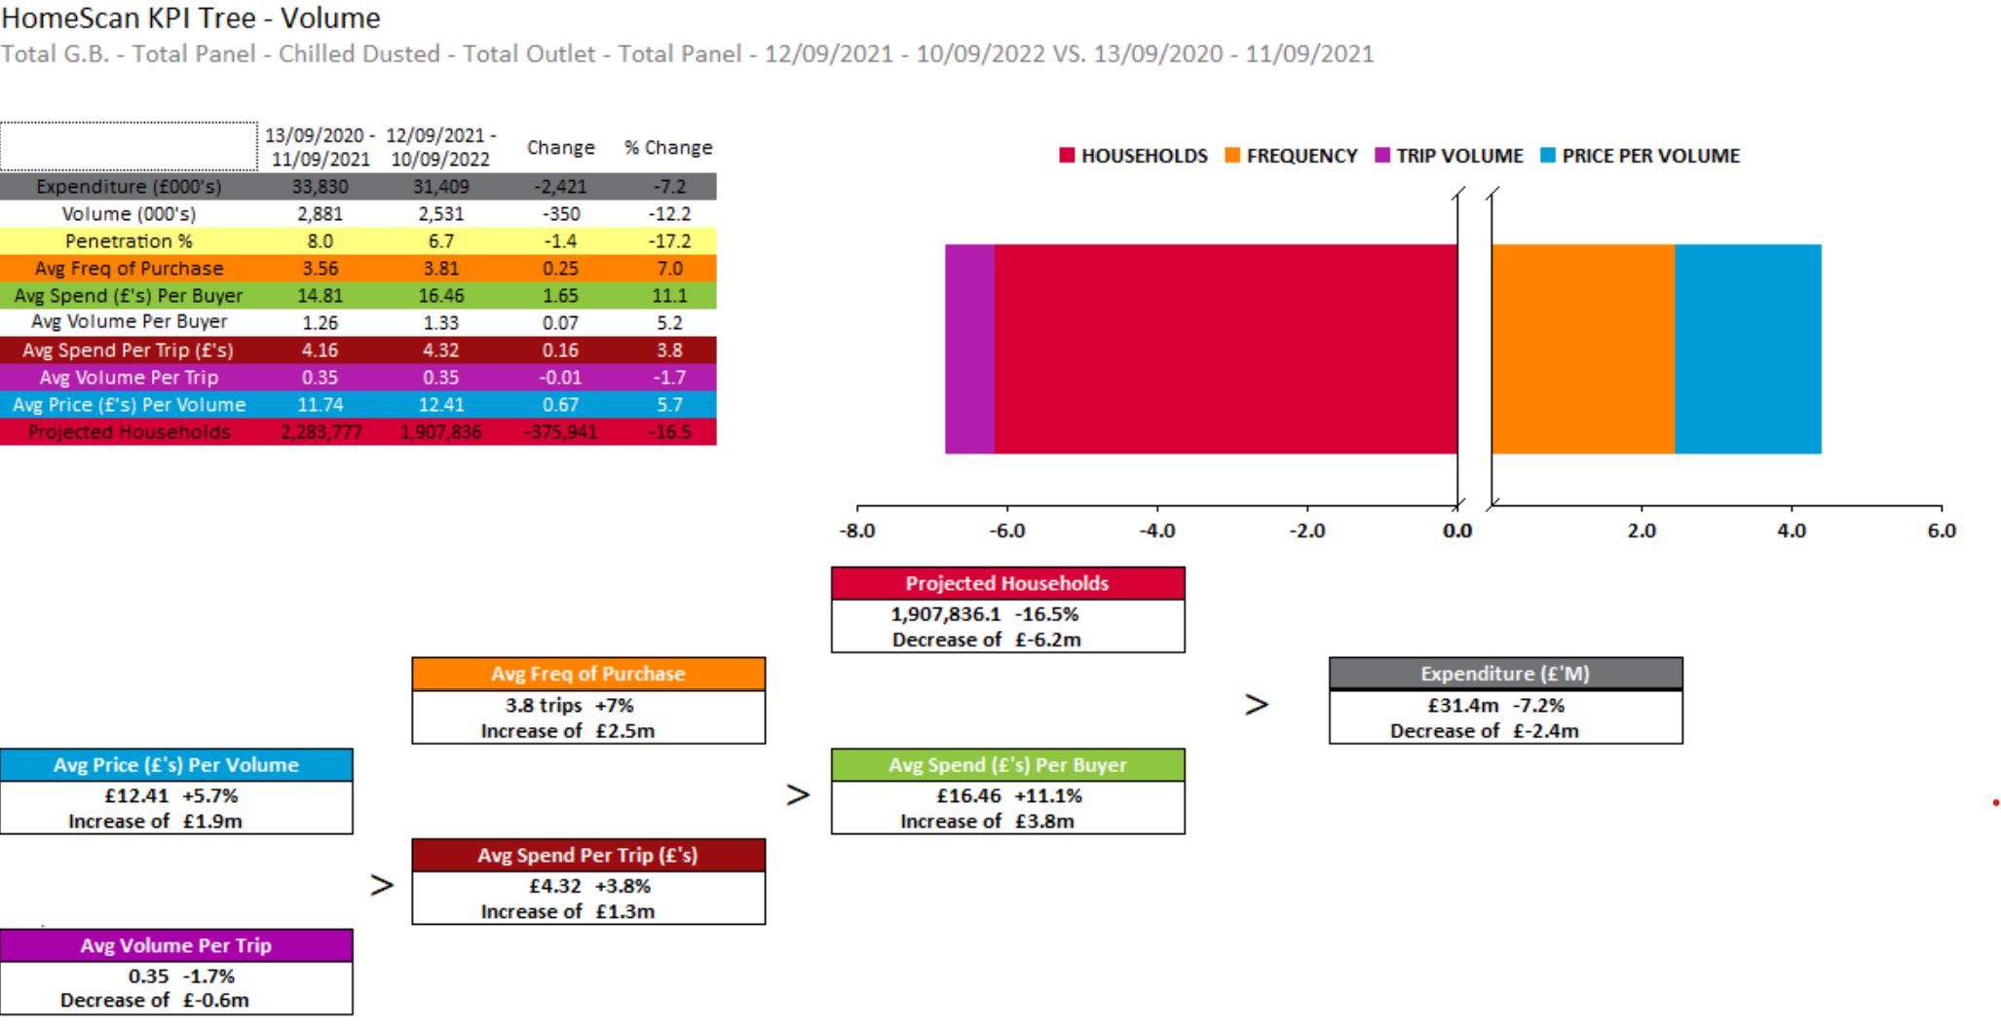
CHILLED DUSTED
Value decline of -7.2% is influenced by decreased penetration and trip volume
Source – Nielsen Homescan, Data to WE 10.09.2022

Slide 18
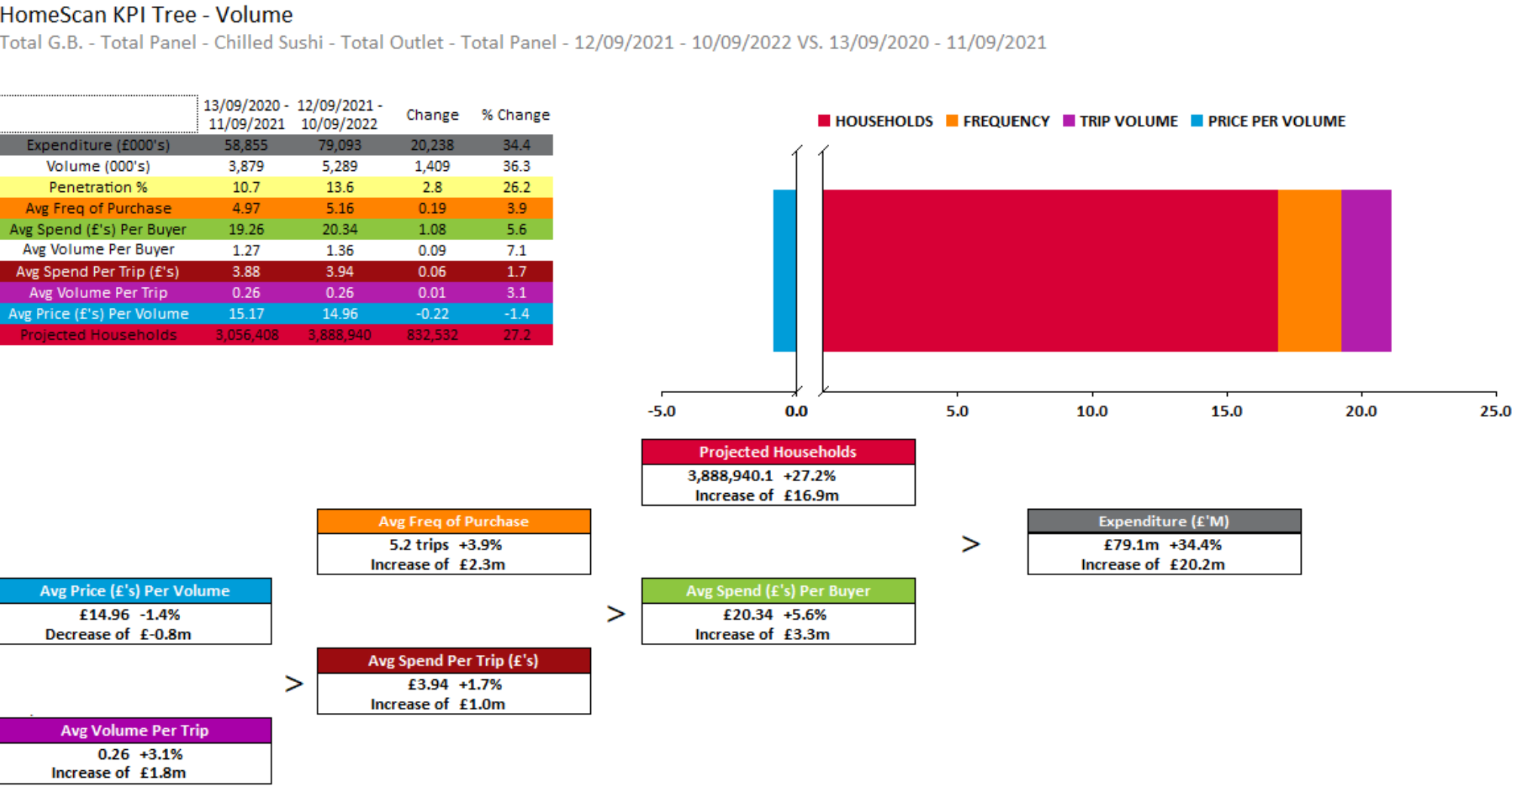
CHILLED SUSHI
Increase in penetration sees expenditure growth of 34.4% in Chilled Sushi.
Source – Nielsen Homescan, Data to WE 10.09.2022

Slide 19
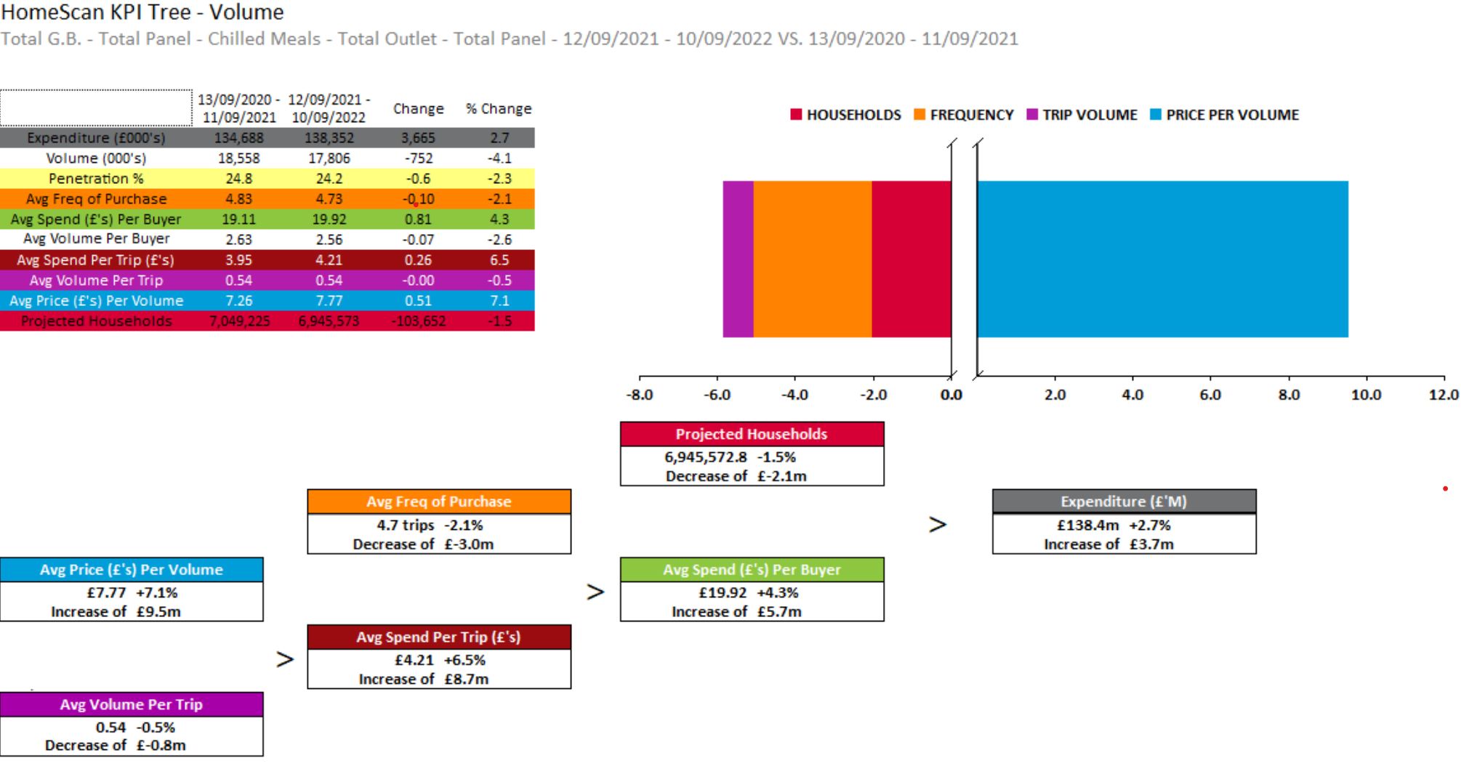
CHILLED MEALS
Penetration decline and increased in price per volume see value growth of 2.7% in chilled meals.
Source – Nielsen Homescan, Data to WE 10.09.2022

Slide 20
Source of Growth & Shifting by Retailers

Slide 21
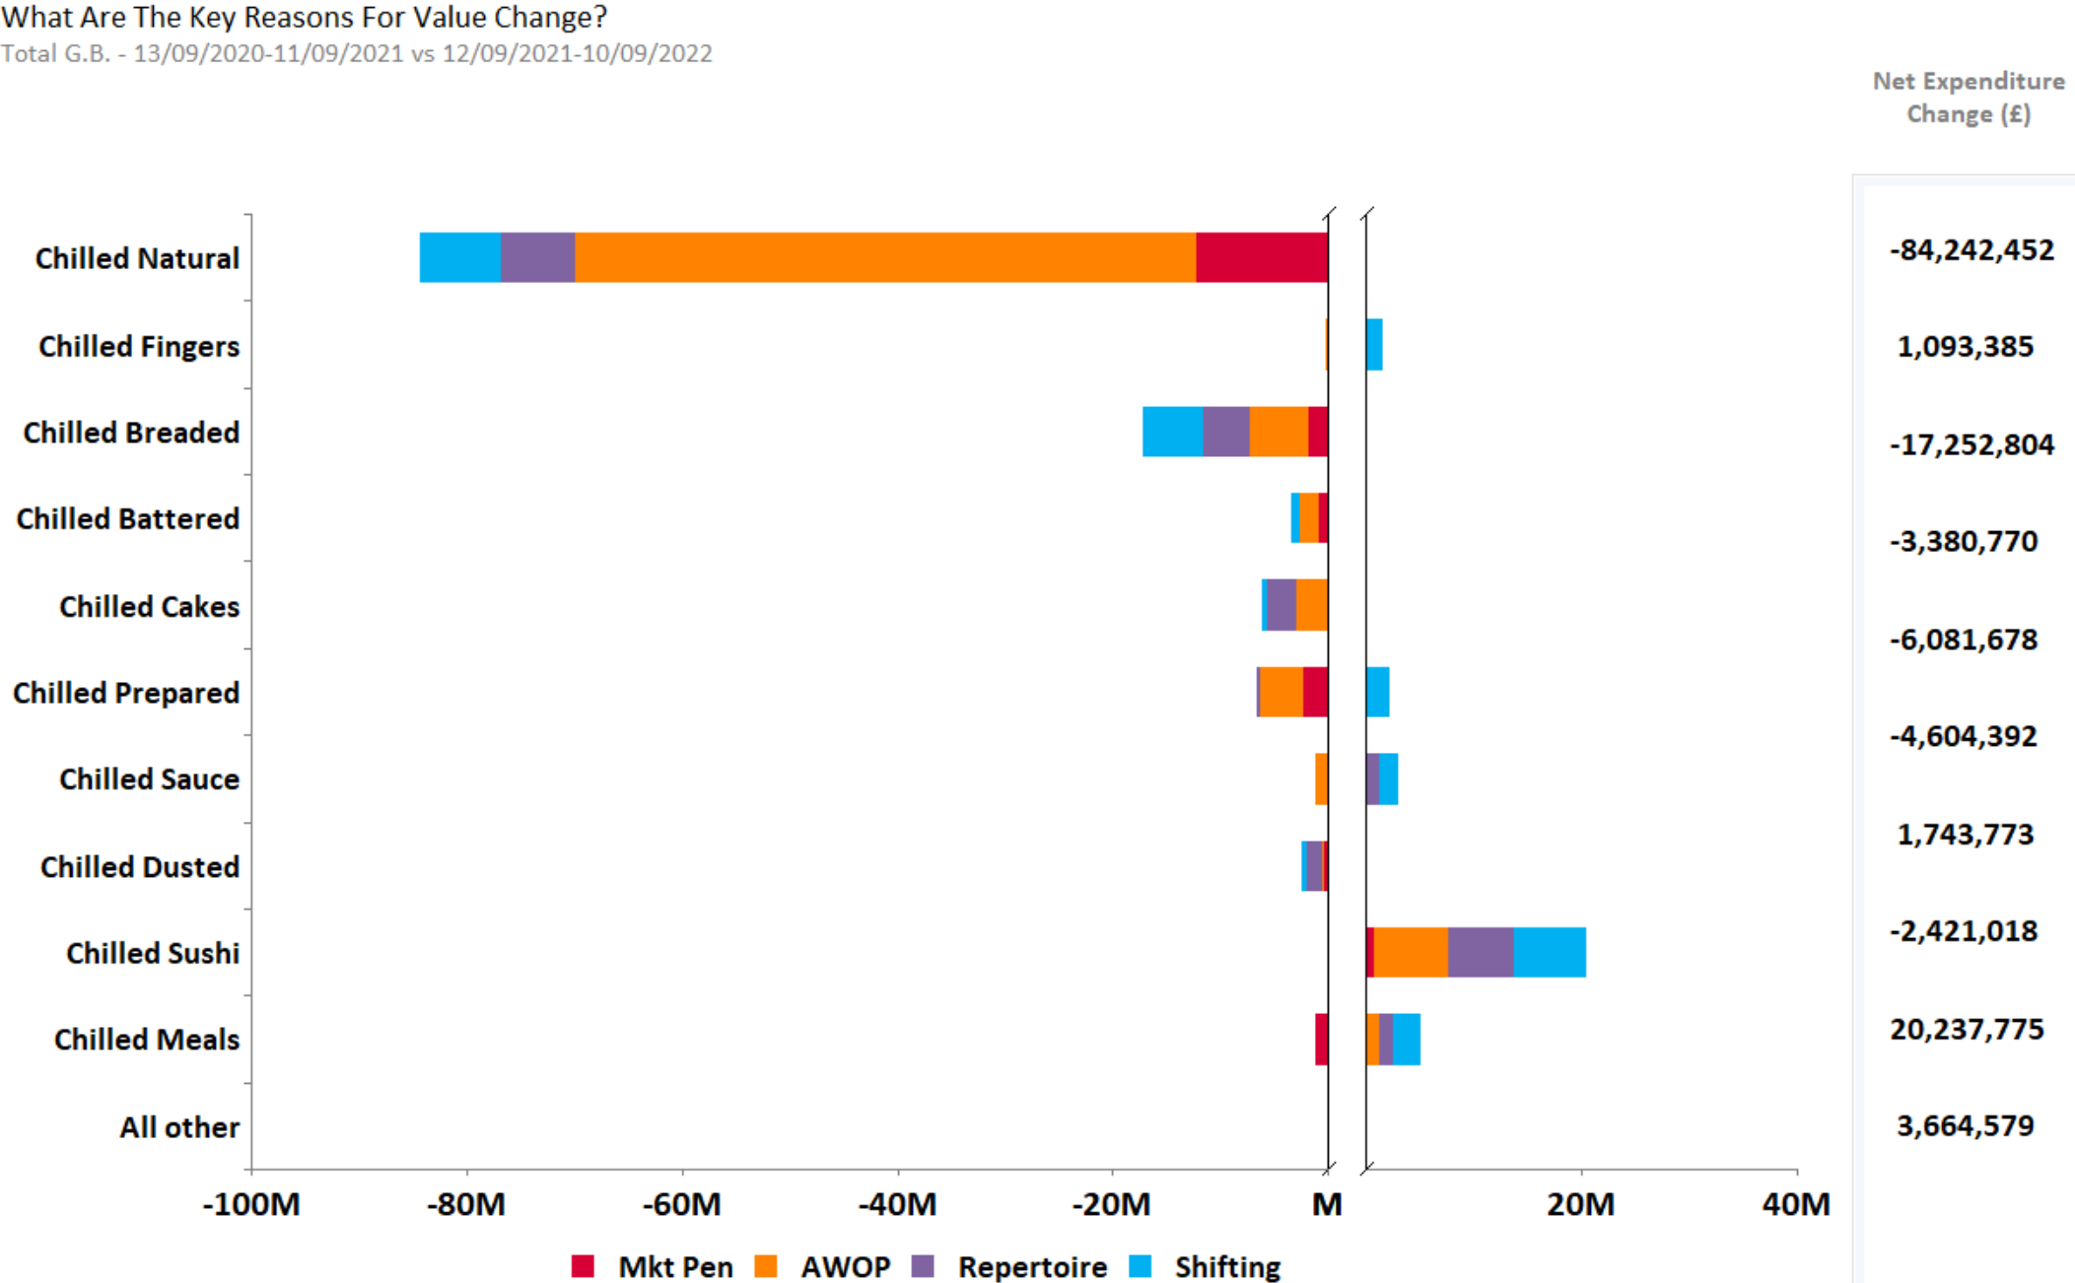
CHILLED FISH – SOURCE OF GROWTH BY SEGMENTS
Source – Nielsen Homescan Data to 52 WE 10.09.2022 vs YA

Slide 22
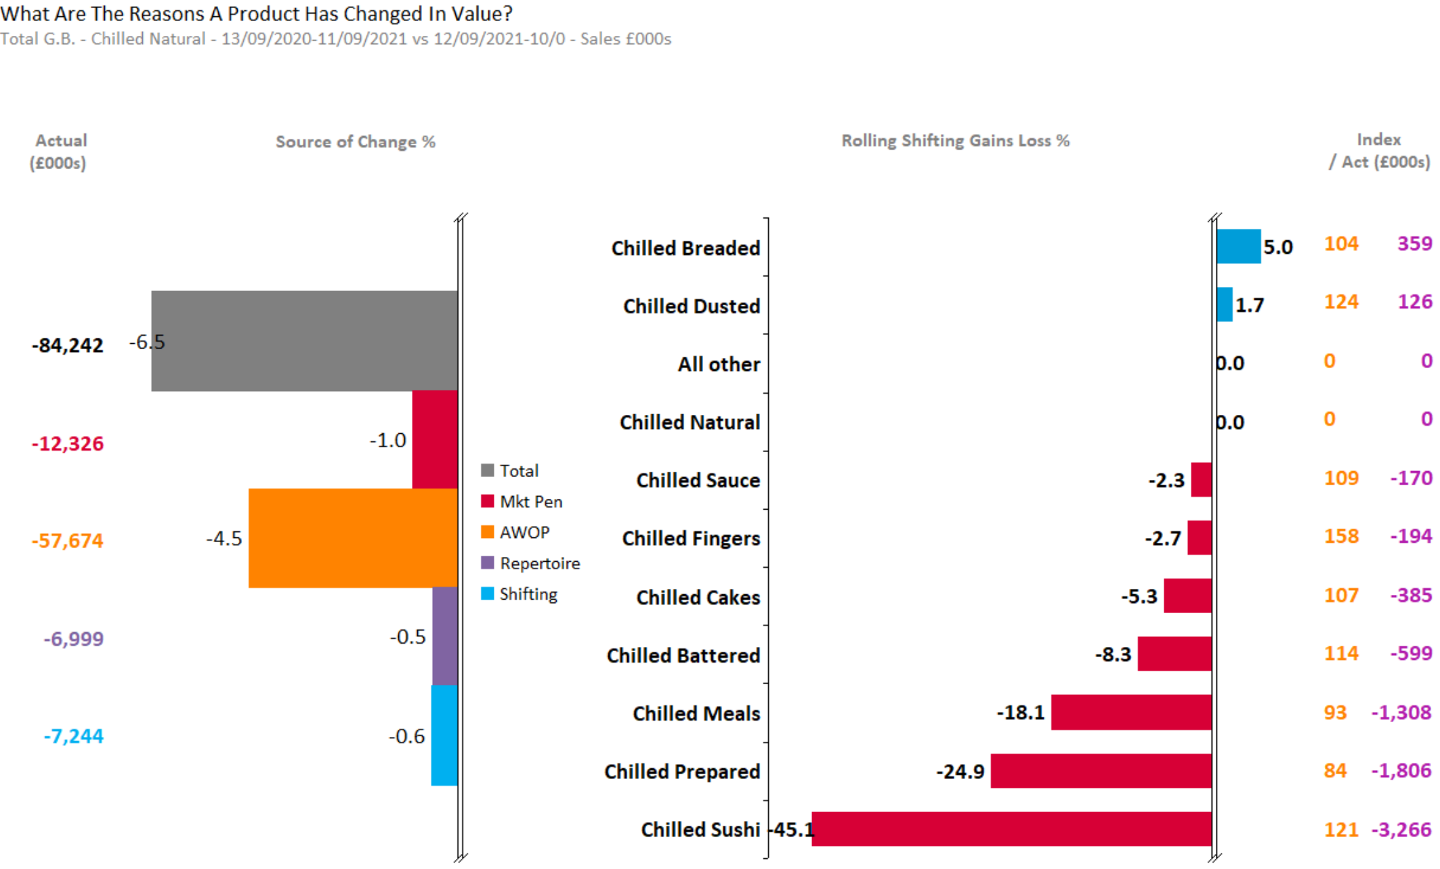
CHILLED NATURAL
Chilled Natural loss is mainly from AWOP decrease; with shifting loss from most of the segments except breaded and dusted
Source – Nielsen Homescan Data to 52 WE 10.09.2022 vs YA

Slide 23
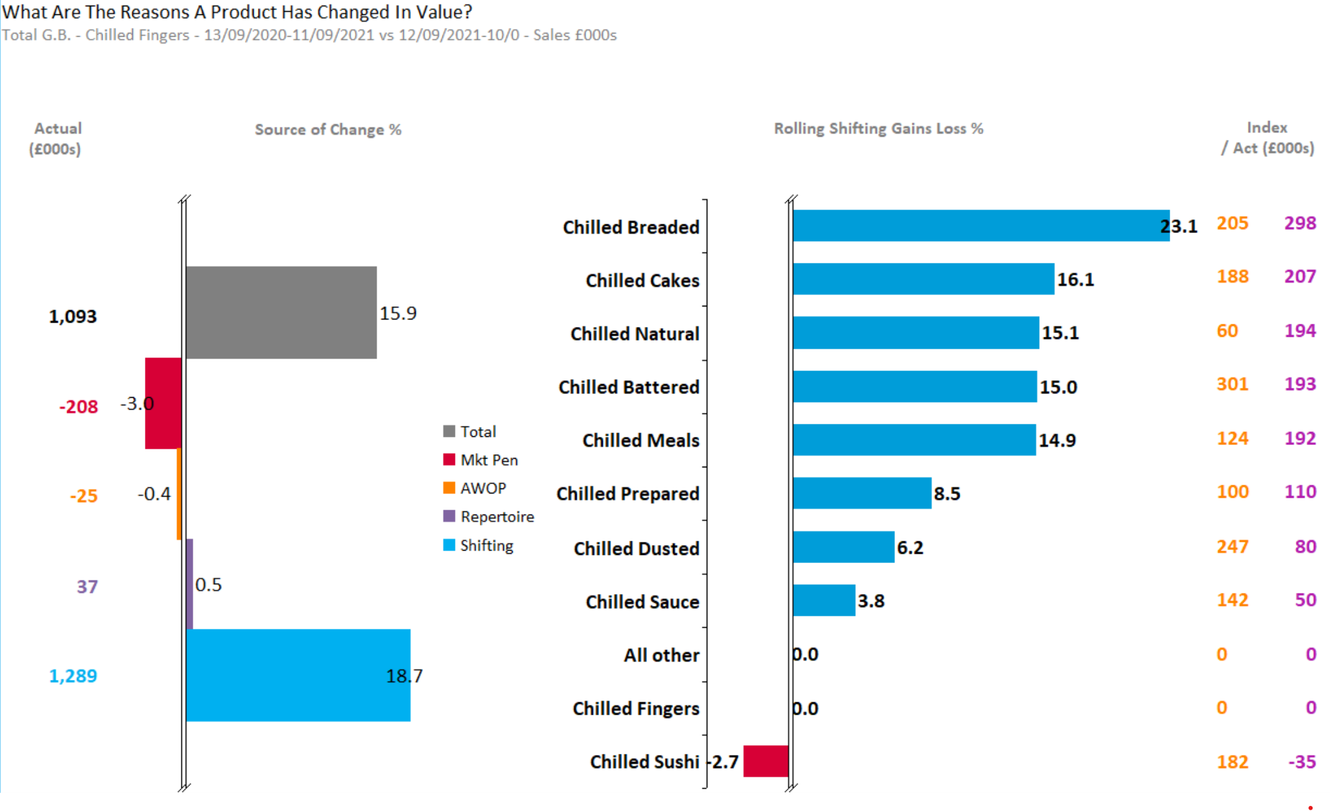
CHILLED FINGERS
Increase in Shifting see segment increase of 15.9% ; with shifting gains from most except sushi
Source – Nielsen Homescan Data to 52 WE 10.09.2022 vs YA

Slide 24
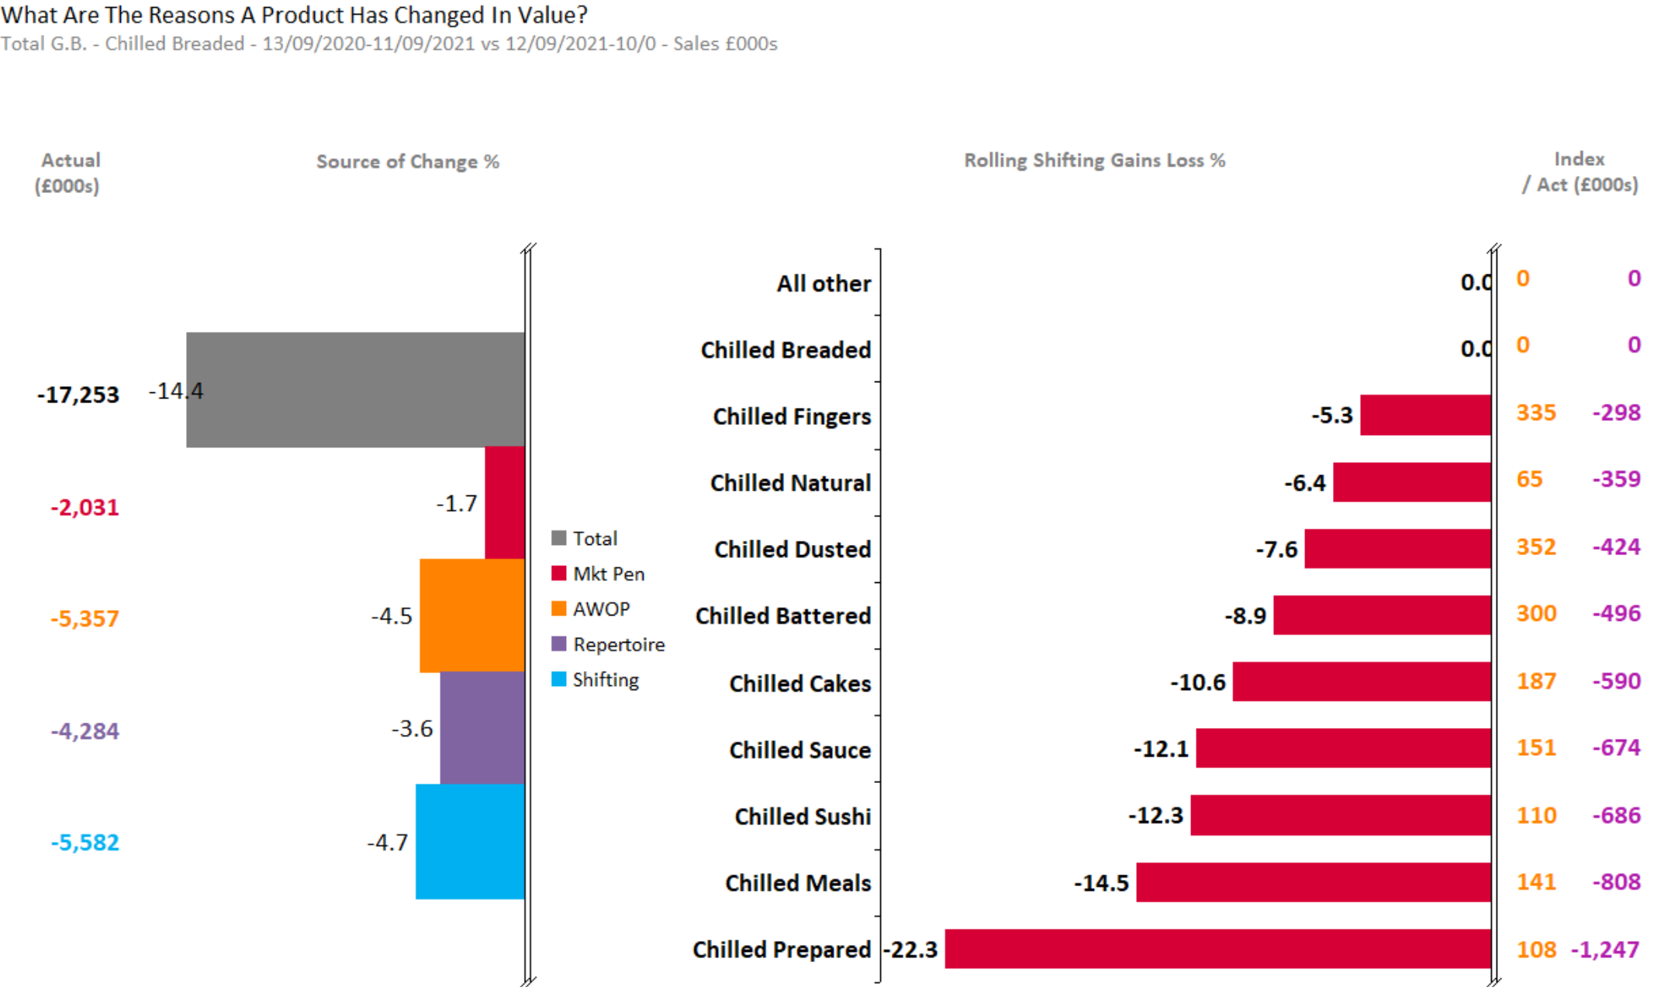
CHILLED BREADED
Chilled Breaded loss is mainly from AWOP and shifting decrease; with shifting loss from all the segments
Source – Nielsen Homescan Data to 52 WE 10.09.2022 vs YA

Slide 25
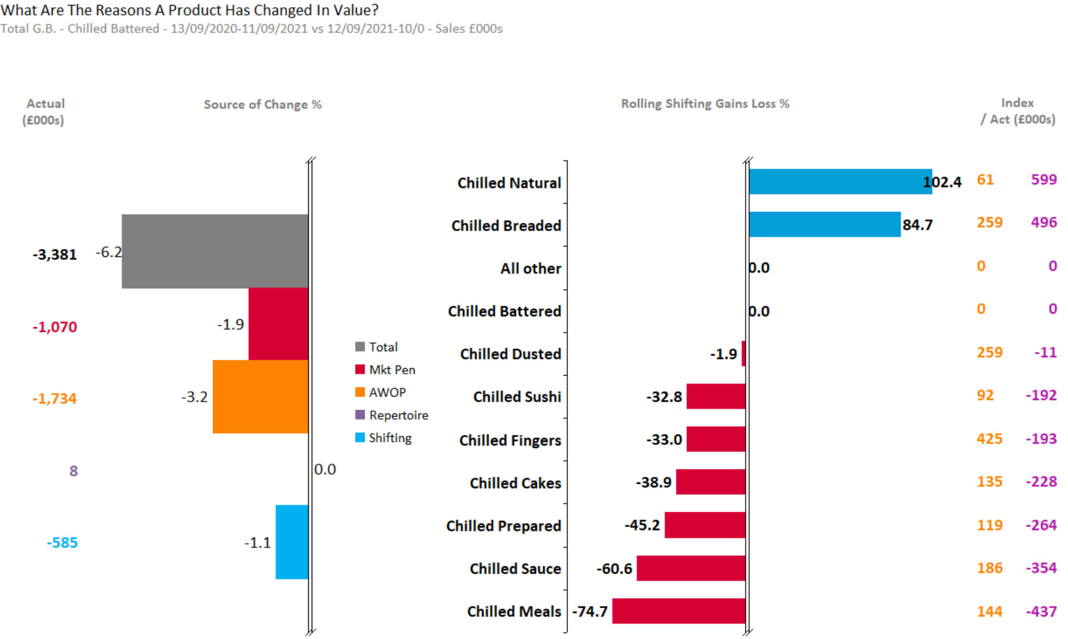
CHILLED BATTERED
AWOP loss for Battered sees -6% segment decrease
Source – Nielsen Homescan Data to 52 WE 10.09.2022 vs YA

Slide 26
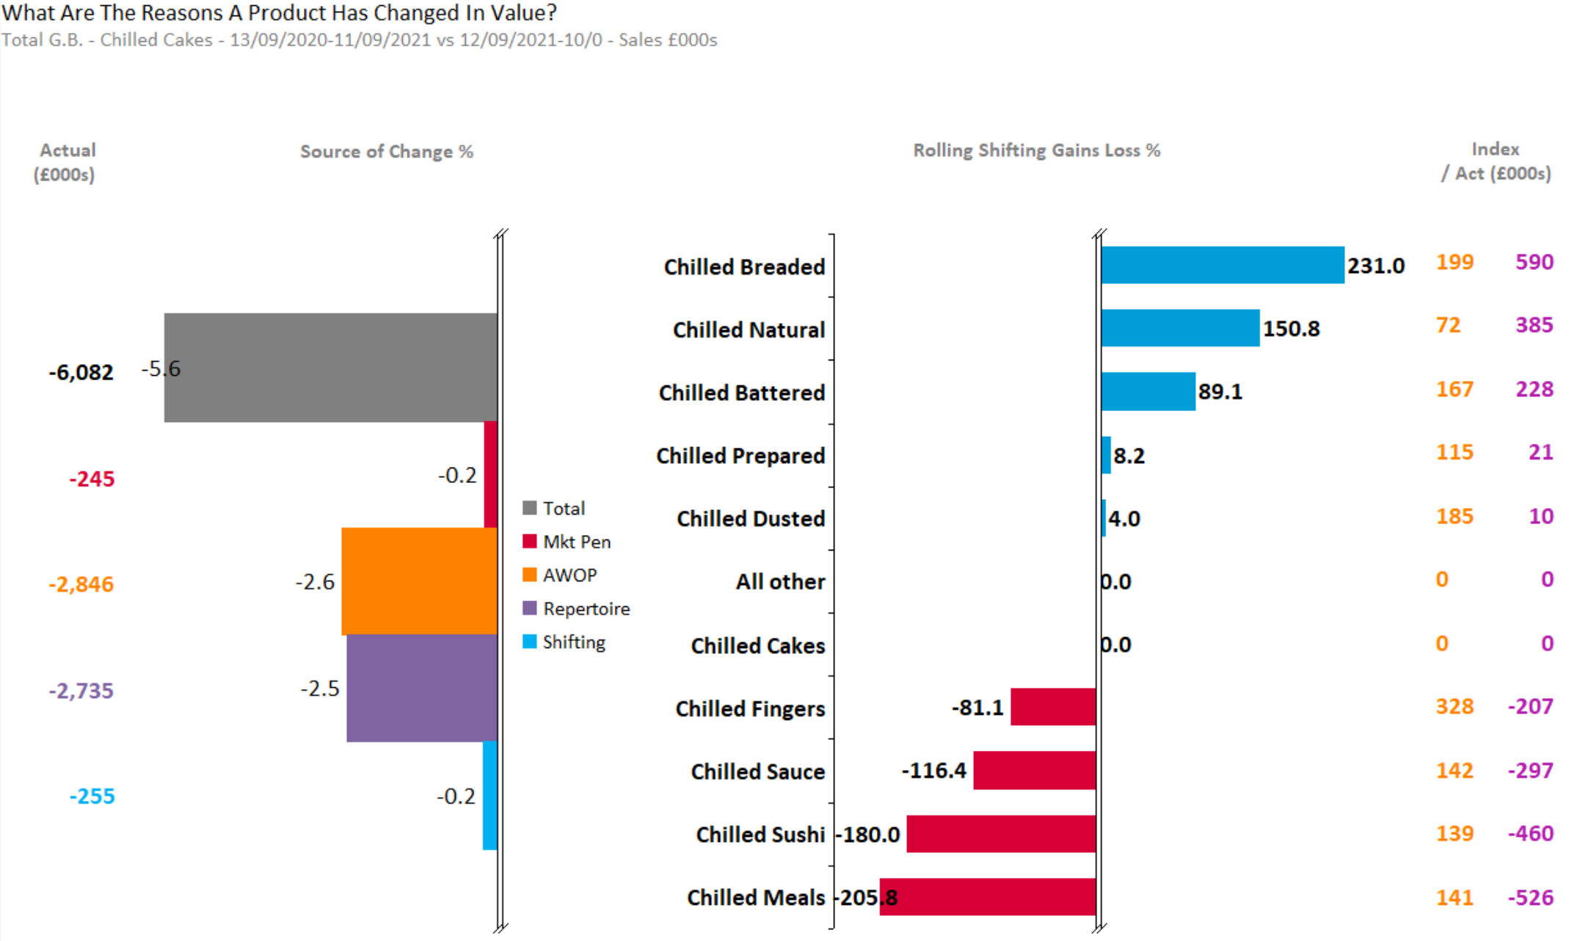
CHILLED CAKES
Cakes sees significant declines from AWOP and Repertoire with the segment down 5.6% as a result. Shifting gains only from Breaded , Natural ,Battered , Prepared and Dusted
Source – Nielsen Homescan Data to 52 WE 10.09.2022 vs YA

Slide 27
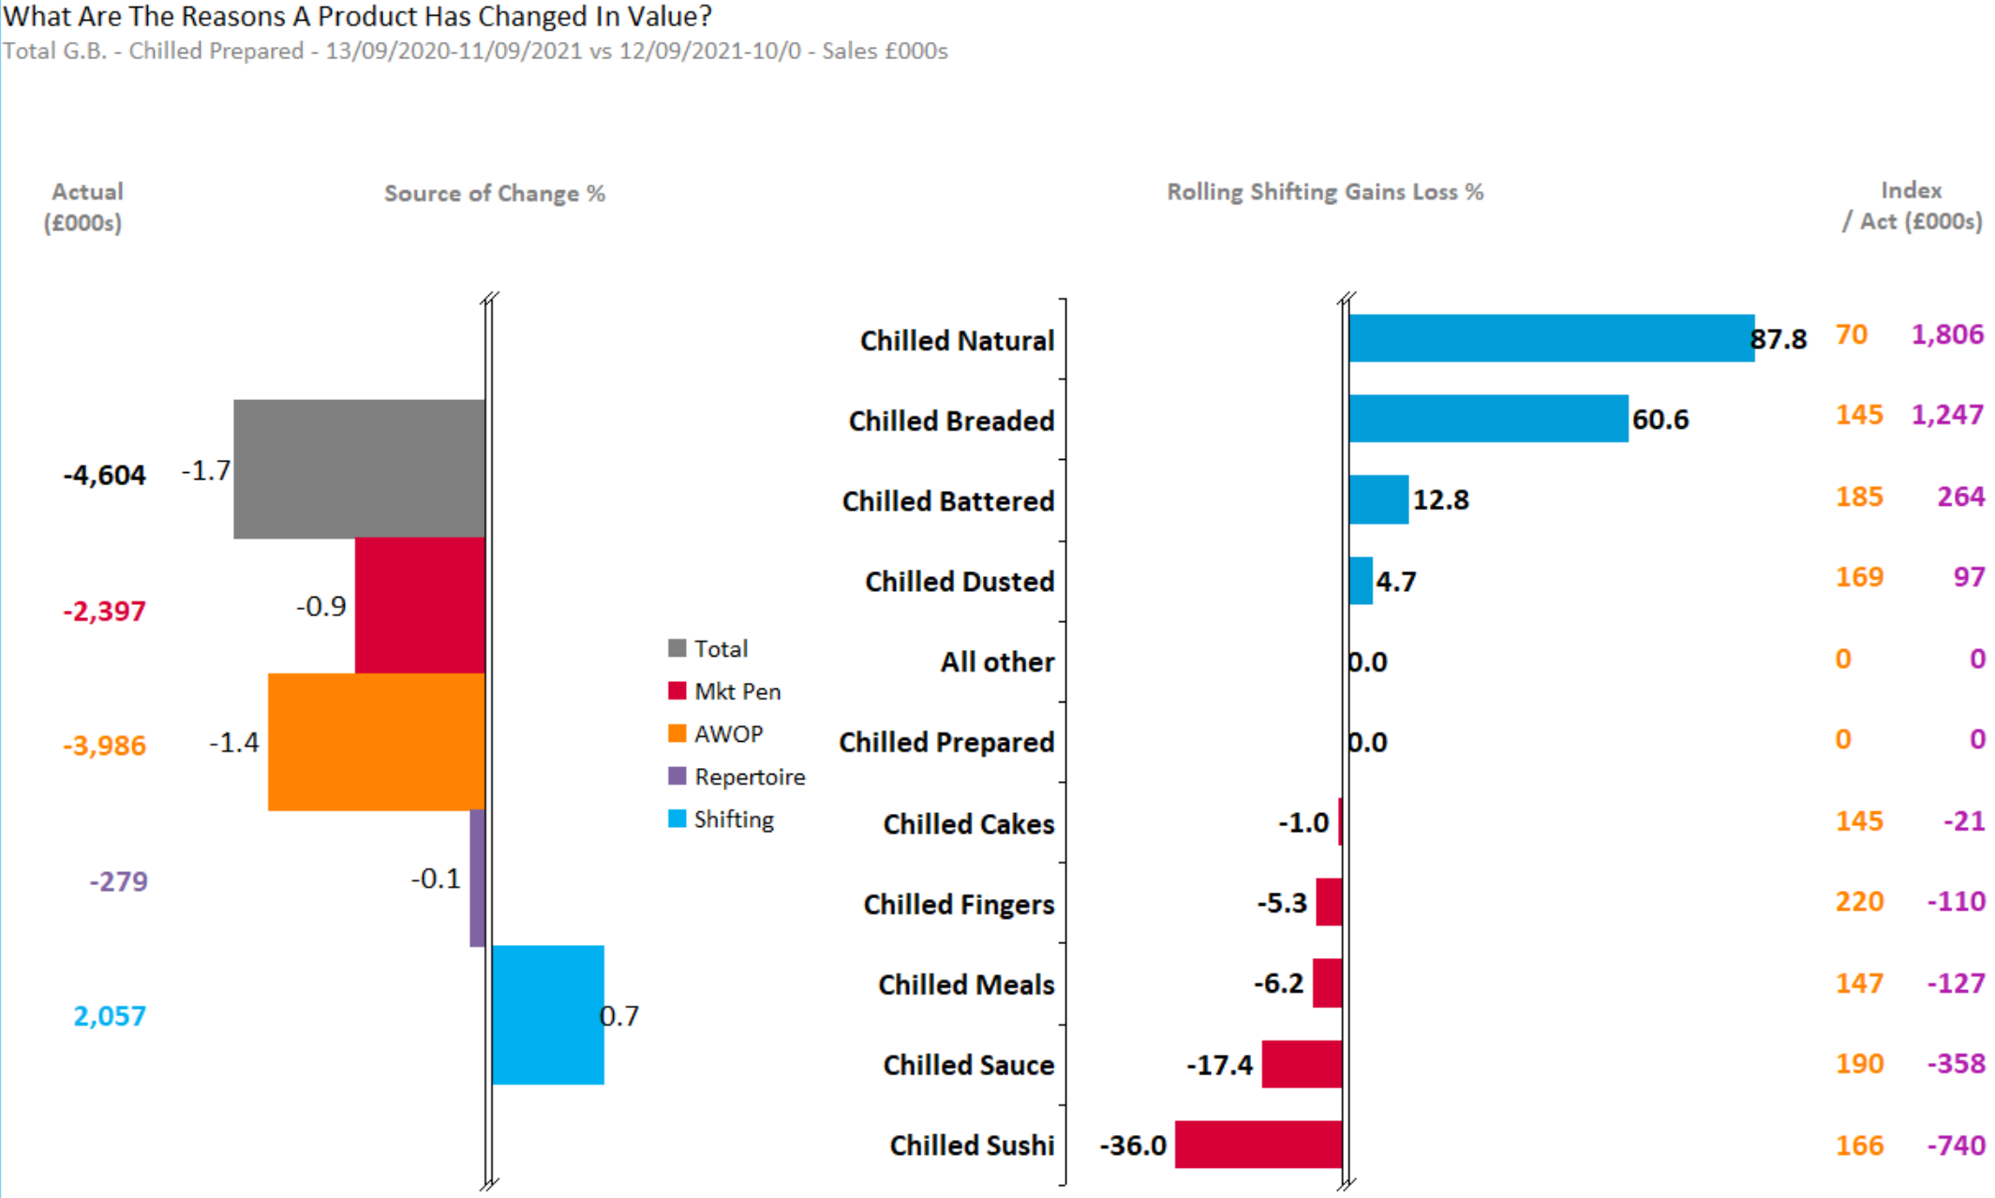
CHILLED PREPARED
Prepared sees significant declines from AWOP, with the segment down 1.7% as a result.
Source – Nielsen Homescan Data to 52 WE 10.09.2022 vs YA

Slide 28
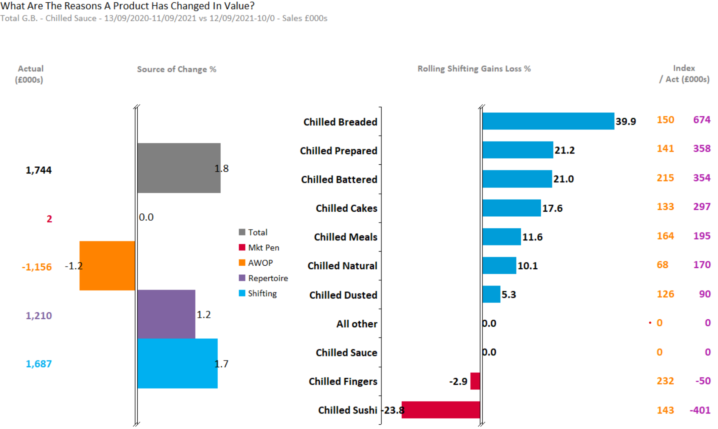
CHILLED SAUCE
Sauce sees significant gains from shifting . Shifting gains from all segments except fingers and Sushi
Source – Nielsen Homescan Data to 52 WE 10.09.2022 vs YA

Slide 29
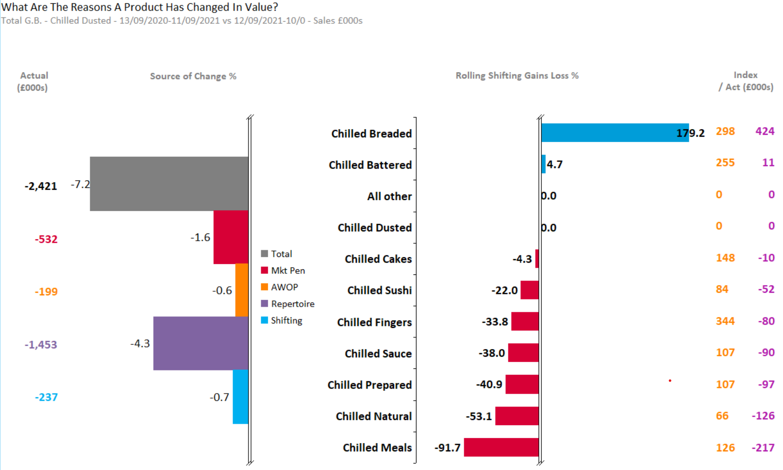
CHILLED DUSTED
Dusted sees significant declines from all source with the segment down 7.2% as a result
Source – Nielsen Homescan Data to 52 WE 10.09.2022 vs YA

Slide 30
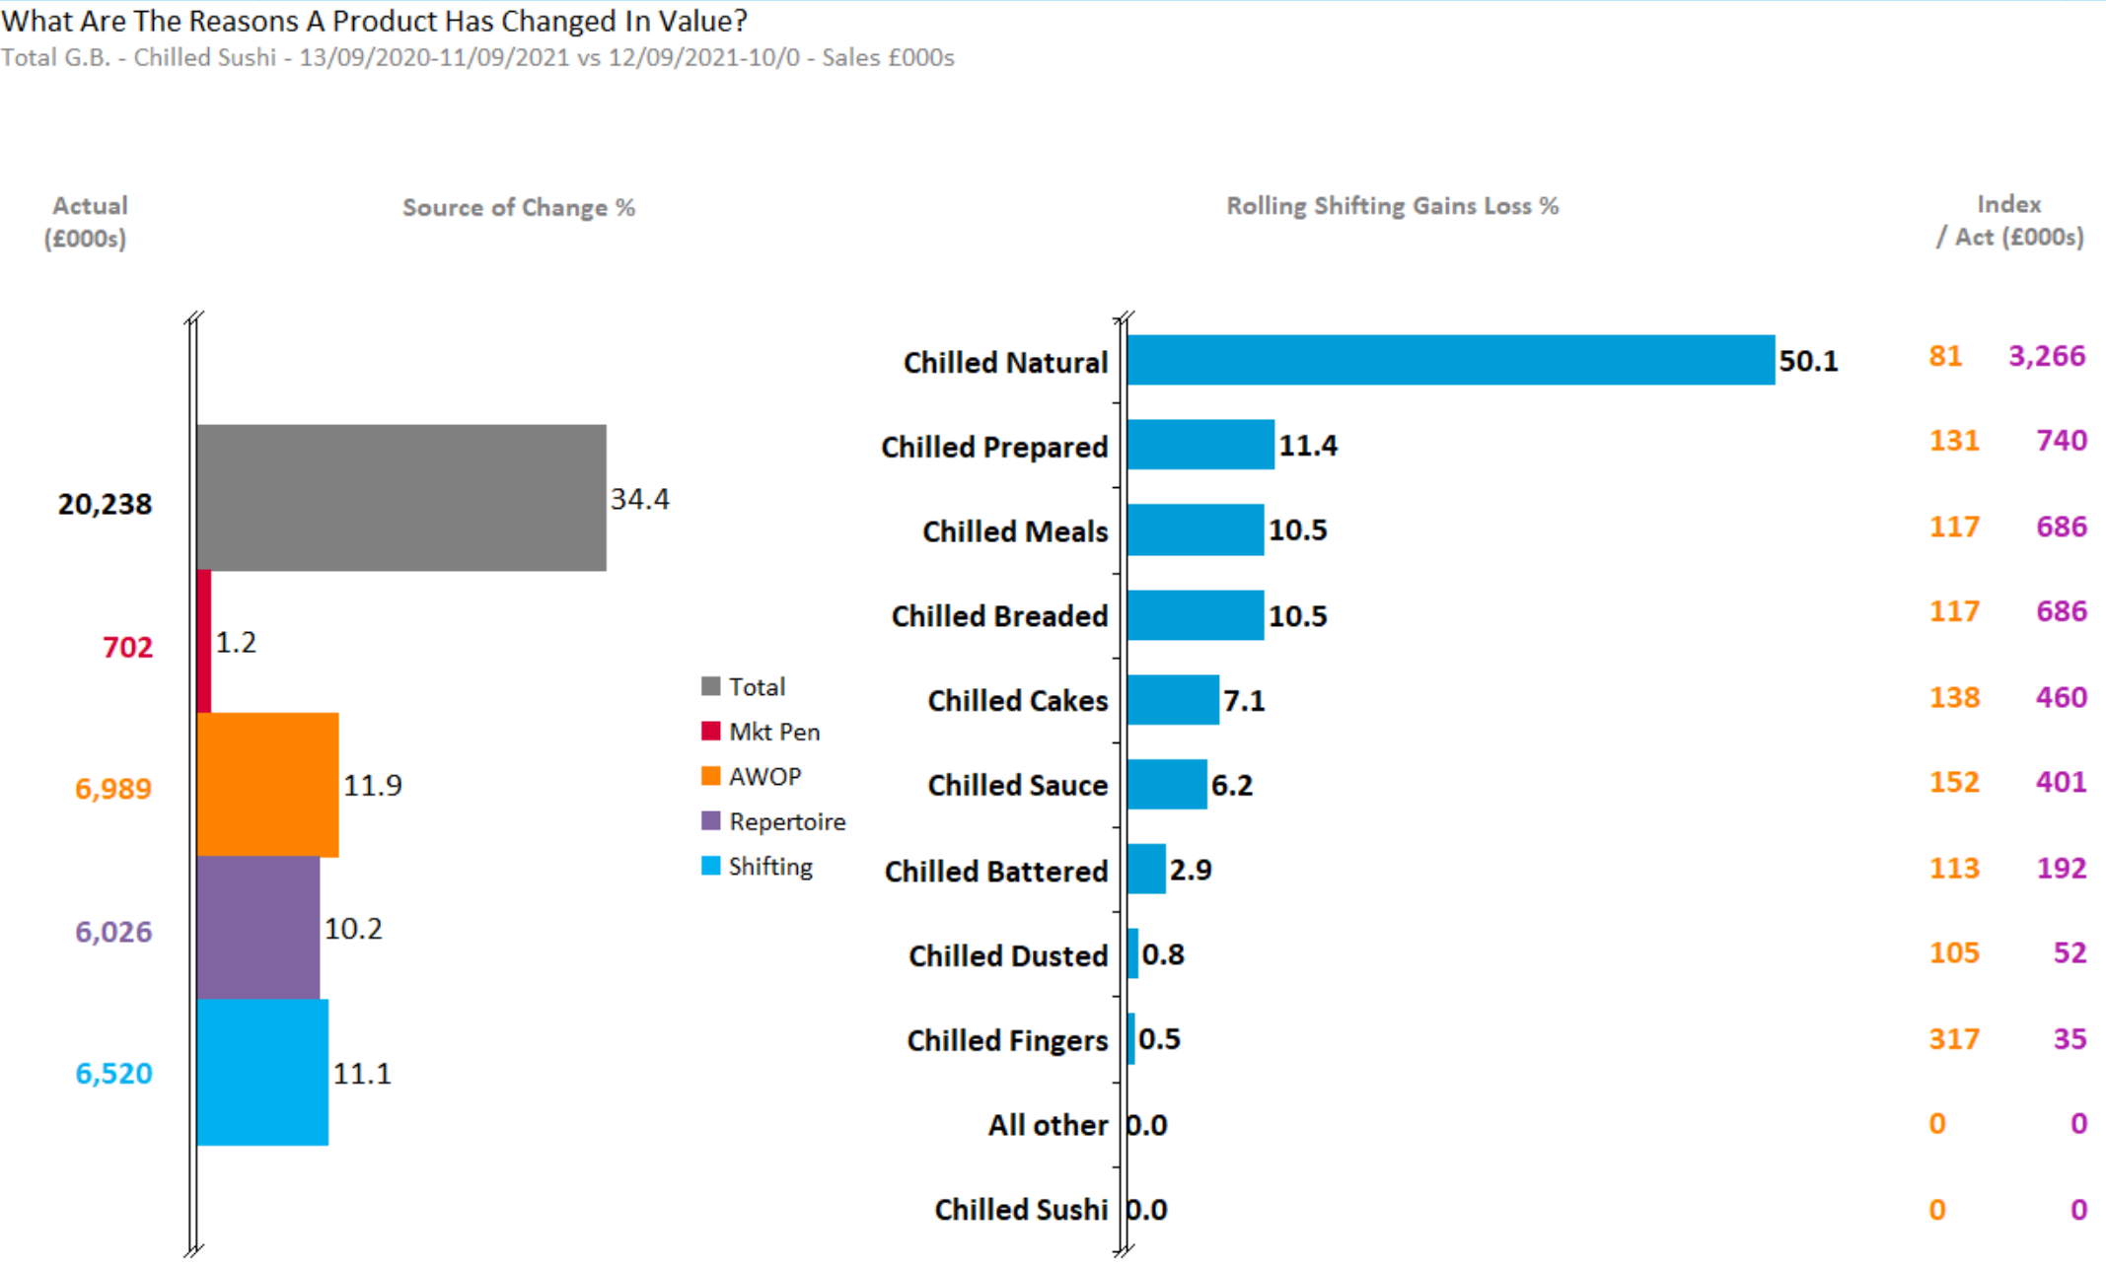
CHILLED SUSHI
Sushi sees gains from all segments resulting in growth of 34.4% as a result.
Source – Nielsen Homescan Data to 52 WE 10.09.2022 vs YA

Slide 31
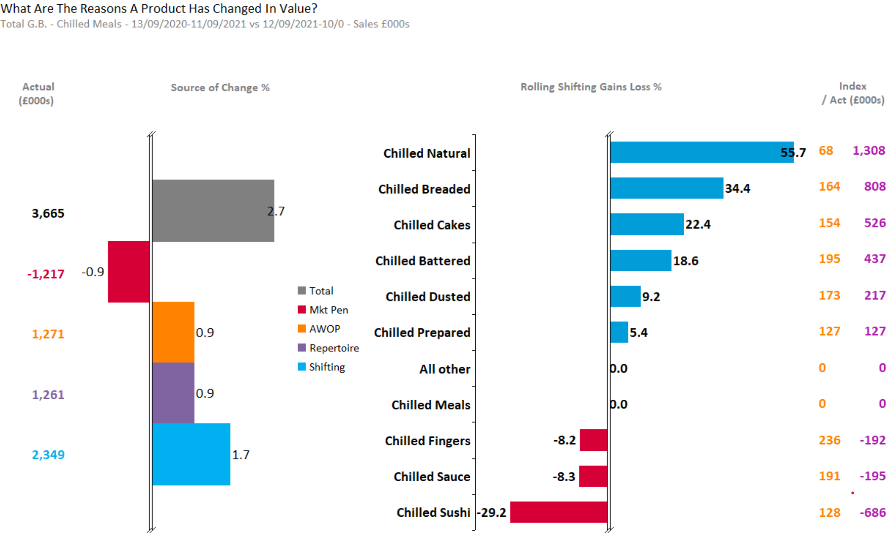
CHILLED MEALS
3% growth in meals is driven by shifting and penetration gains.
Source – Nielsen Homescan Data to 52 WE 10.09.2022 vs YA

Slide 32
Demographics by Total GB & Retailers

Slide 33
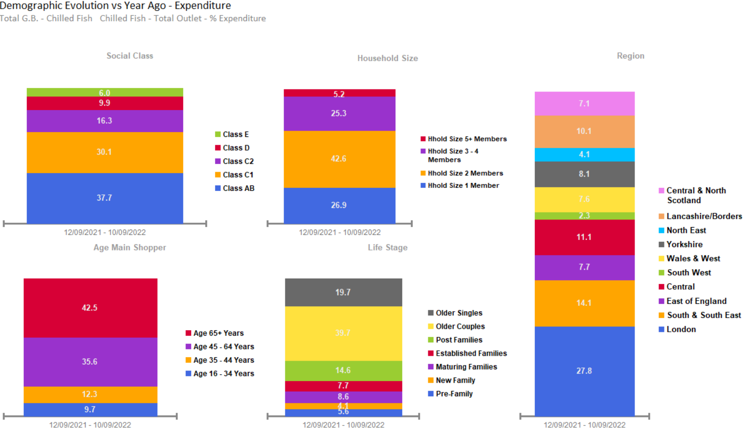
CHILLED FISH SALES OVERINDEX FROM OLDER COUPLES, OF CLASS AB, AGED 65+, WITH 2 MEMBERS IN FAMILY, LOCATED AT LONDON AND SOUTH & SOUTH EAST.
Source – Nielsen Homescan Data to 52 WE 10.09.2022 vs YA

Slide 34
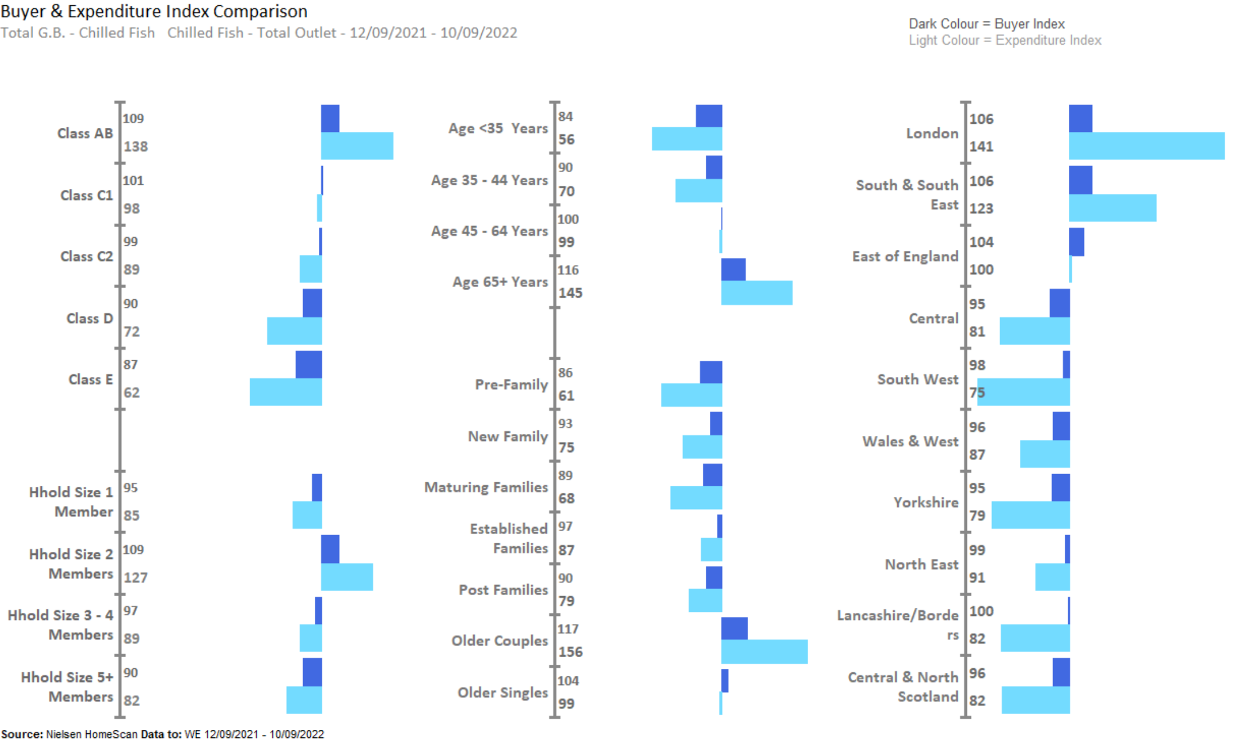
CHILLED FISH UNDERINDEX AMONGST YOUNGER GROUP, WHILST OVERINDEX WITH THOSE LIVING IN LONDON, SOUTH & SOUTH EAST AND CLASS AB .
Source – Nielsen Homescan Data to 52 WE 10.09.2022 vs YA

Slide 35
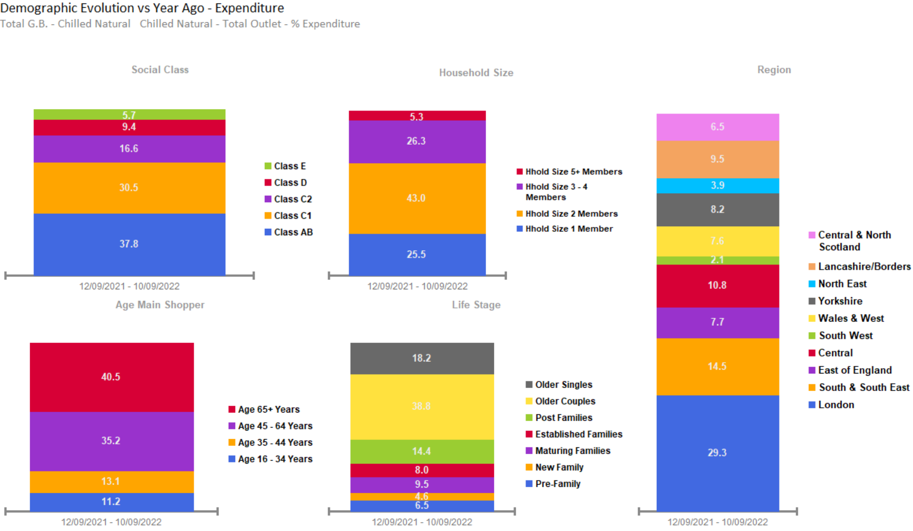
NATURAL SALES OVERINDEX FROM OLDER COUPLES, OF CLASS AB, AGED 65+, WITH 2 MEMBERS IN FAMILY, LOCATED AT LONDON AND SOUTH & SOUTH EAST.
Source – Nielsen Homescan Data to 52 WE 10.09.2022 vs YA

Slide 36
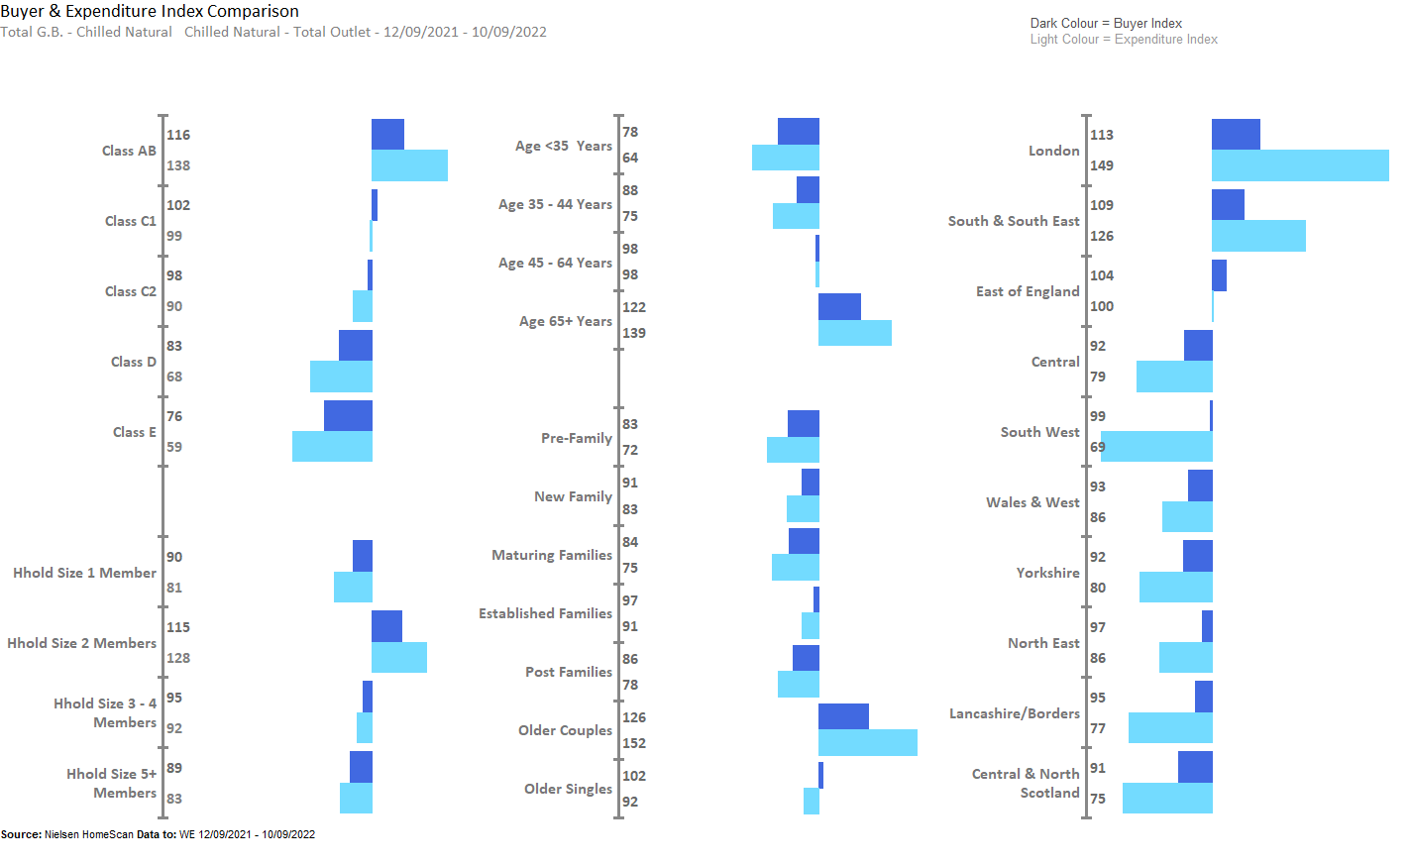
NATURAL OVERINDEX’S AMONGST OLDER COUPLES, LIVING IN LONDON AND SOUTH & SOUTH EAST.
Source – Nielsen Homescan Data to 52 WE 10.09.2022 vs YA

Slide 37
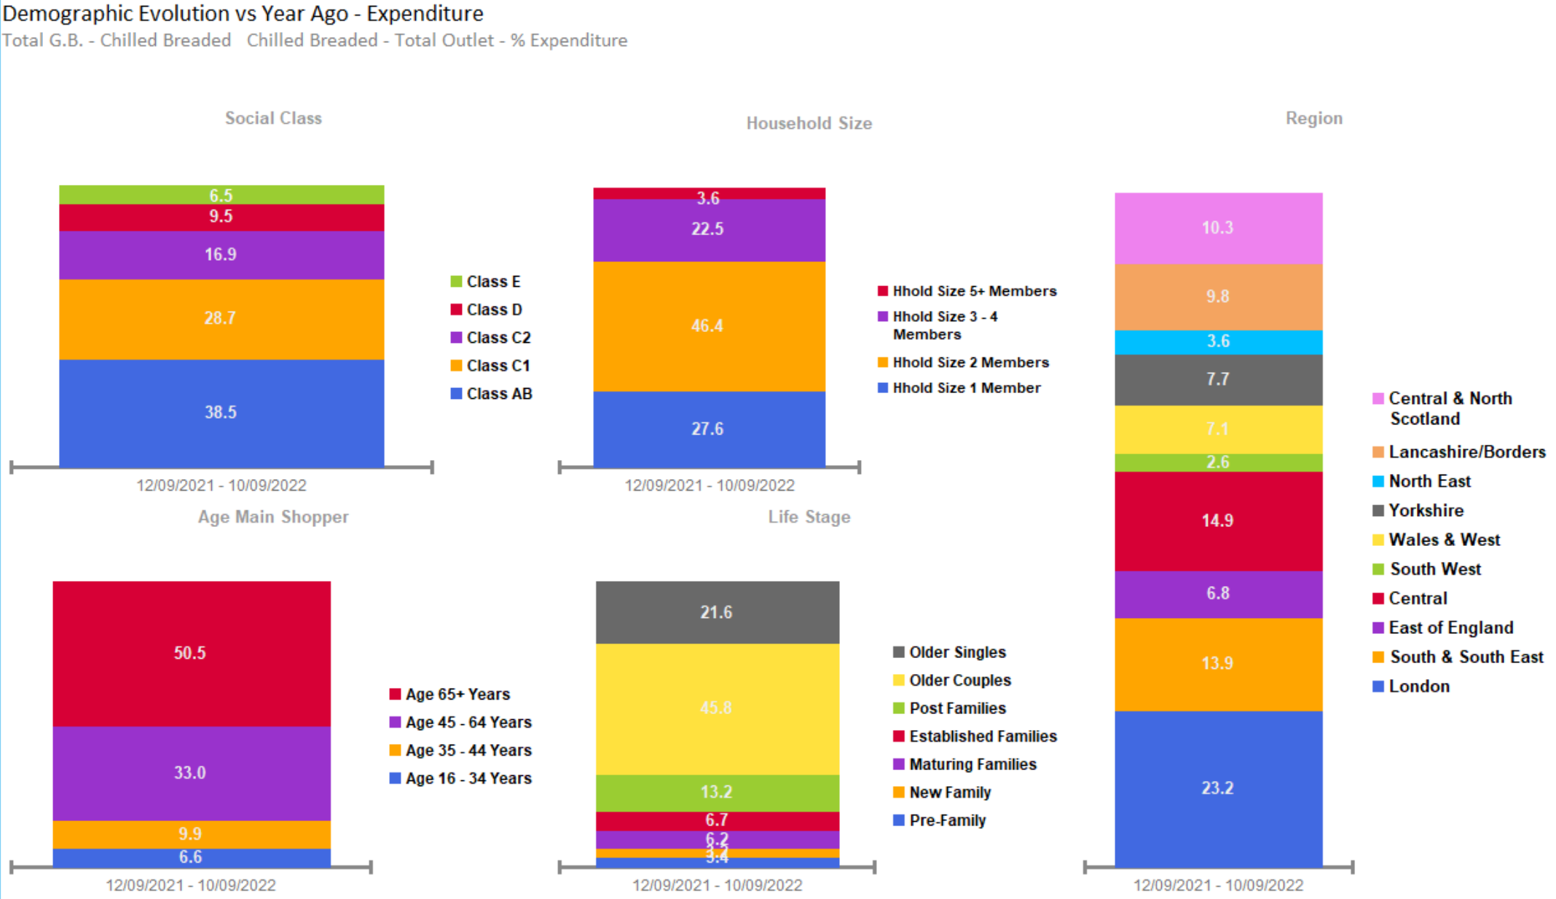
BREADED SALES OVERINDEX FROM OLDER COUPLES OF CLASS AB & C1, AGED 65+, WITH 2 MEMBERS IN FAMILY, LOCATED AT LONDON AND CENTRAL.
Source – Nielsen Homescan Data to 52 WE 10.09.2022 vs YA

Slide 38
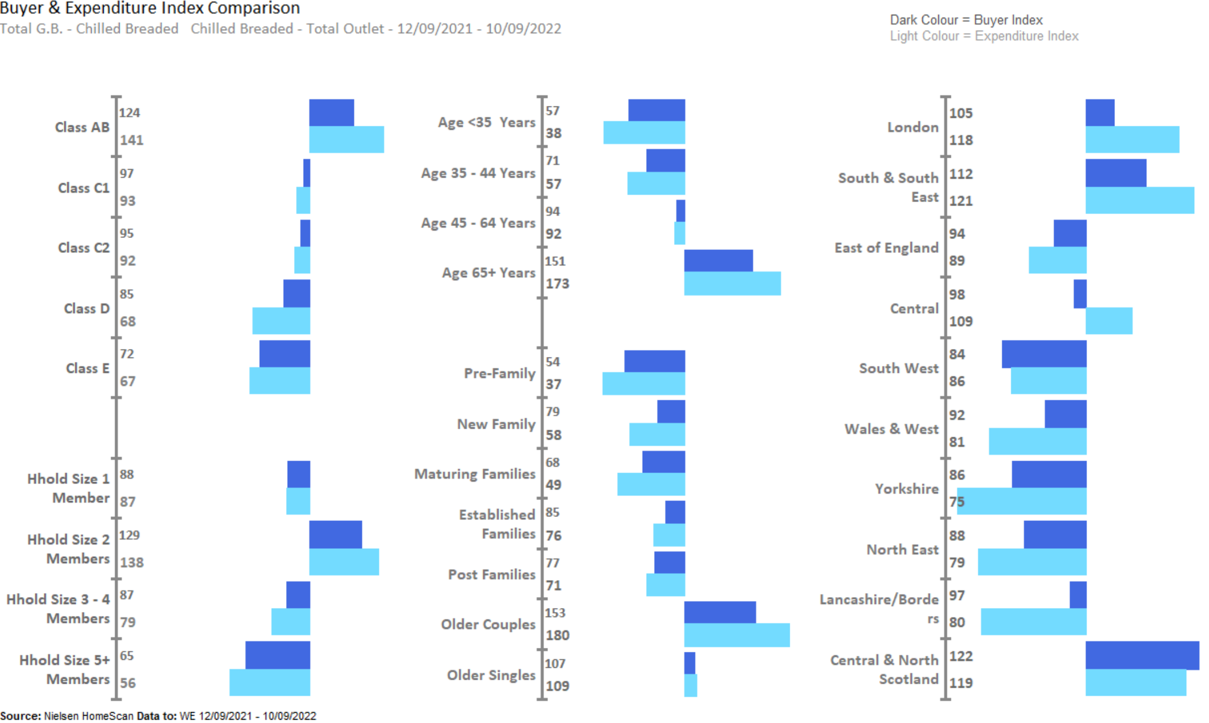
BREADED OVERINDEX AMONGST OLDER GROUP, MAINLY LIVING IN LONDON, SOUTH & SOUTH EAST, SOUTH WEST, CENTRAL AND NORTH SCOTLAND.
Source – Nielsen Homescan Data to 52 WE 10.09.2022 vs YA

Slide 39
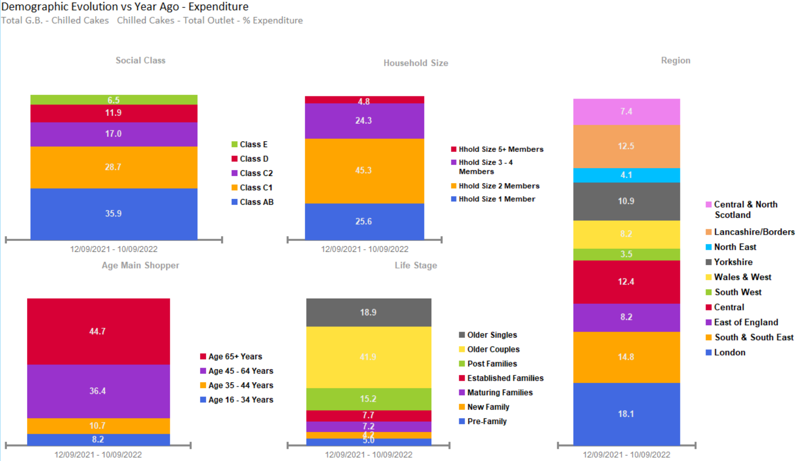
CAKE SALES OVERINDEX FROM OLDER COUPLES, OF THOSE AGED 65+, CLASS AB, WITH 2 MEMBERS IN FAMILY, AND LONDON AND SOUTH & SOUTH EAST
Source – Nielsen Homescan Data to 52 WE 10.09.2022 vs YA

Slide 40
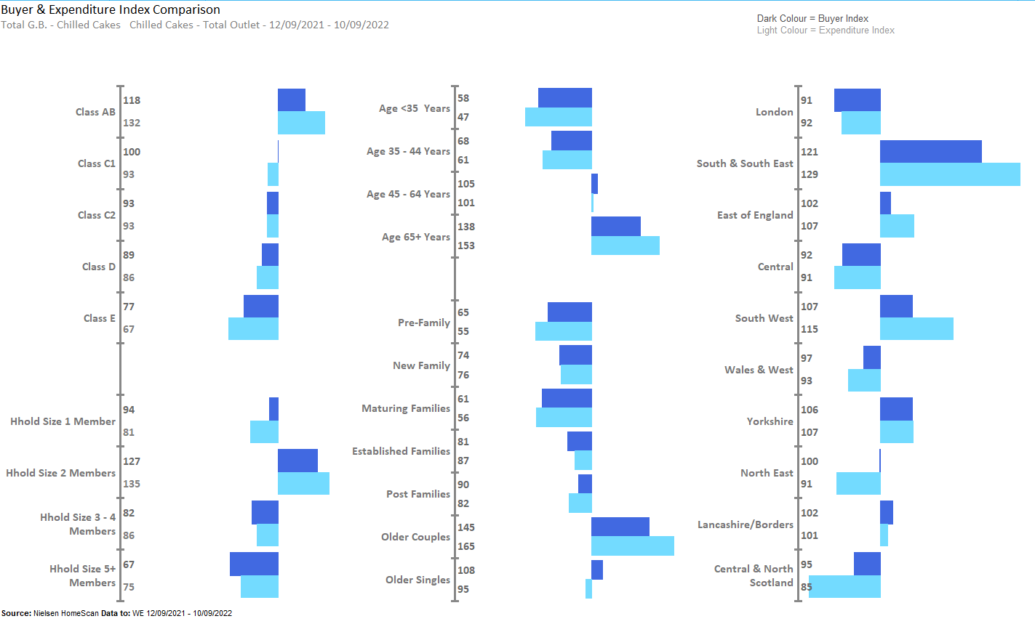
CAKES MAJORILY LIVING IN SOUTH & SOUTH EAST, SOUTH WEST, NORTH EAST ,YORKSHIRE,EAST OF ENGLAND WITH CLASS AB & OLDER COUPLES.
Source – Nielsen Homescan Data to 52 WE 10.09.2022 vs YA

Slide 41
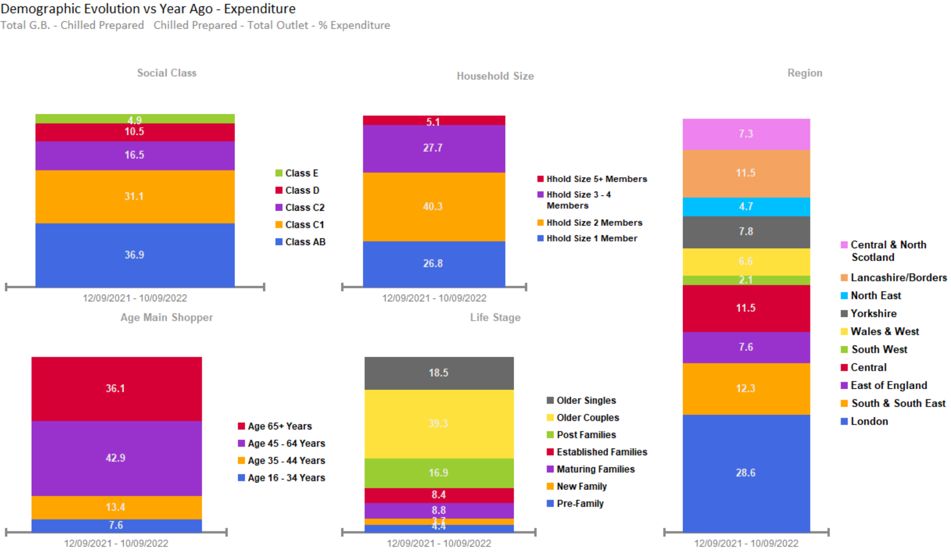
PREPARED SALES OVERINDEX FROM 2 MEMBER HOUSEHOLDS, OLDER COUPLES, OF CLASS AB & C1 AGED 45+, LOCATED AT LONDON AND SOUTH AND SOUTH EAST.
Source – Nielsen Homescan Data to 52 WE 10.09.2022 vs YA

Slide 42
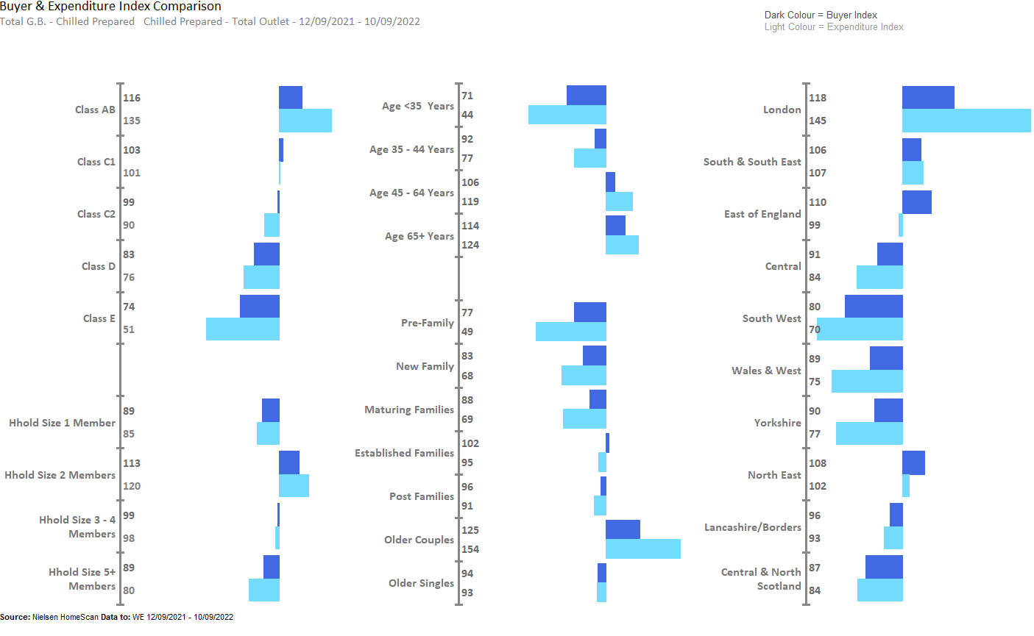
PREPARED OVERINDEX AMONGST OLDER COUPLES, 2 MEMBERS OF HOUSEHOLD, WITH THE AGE 45+ AND THOSE WHO LIVE IN LONDON, SOUTH & SOUTH EAST AND NORTH EAST
Source – Nielsen Homescan Data to 52 WE 10.09.2022 vs YA

Slide 43
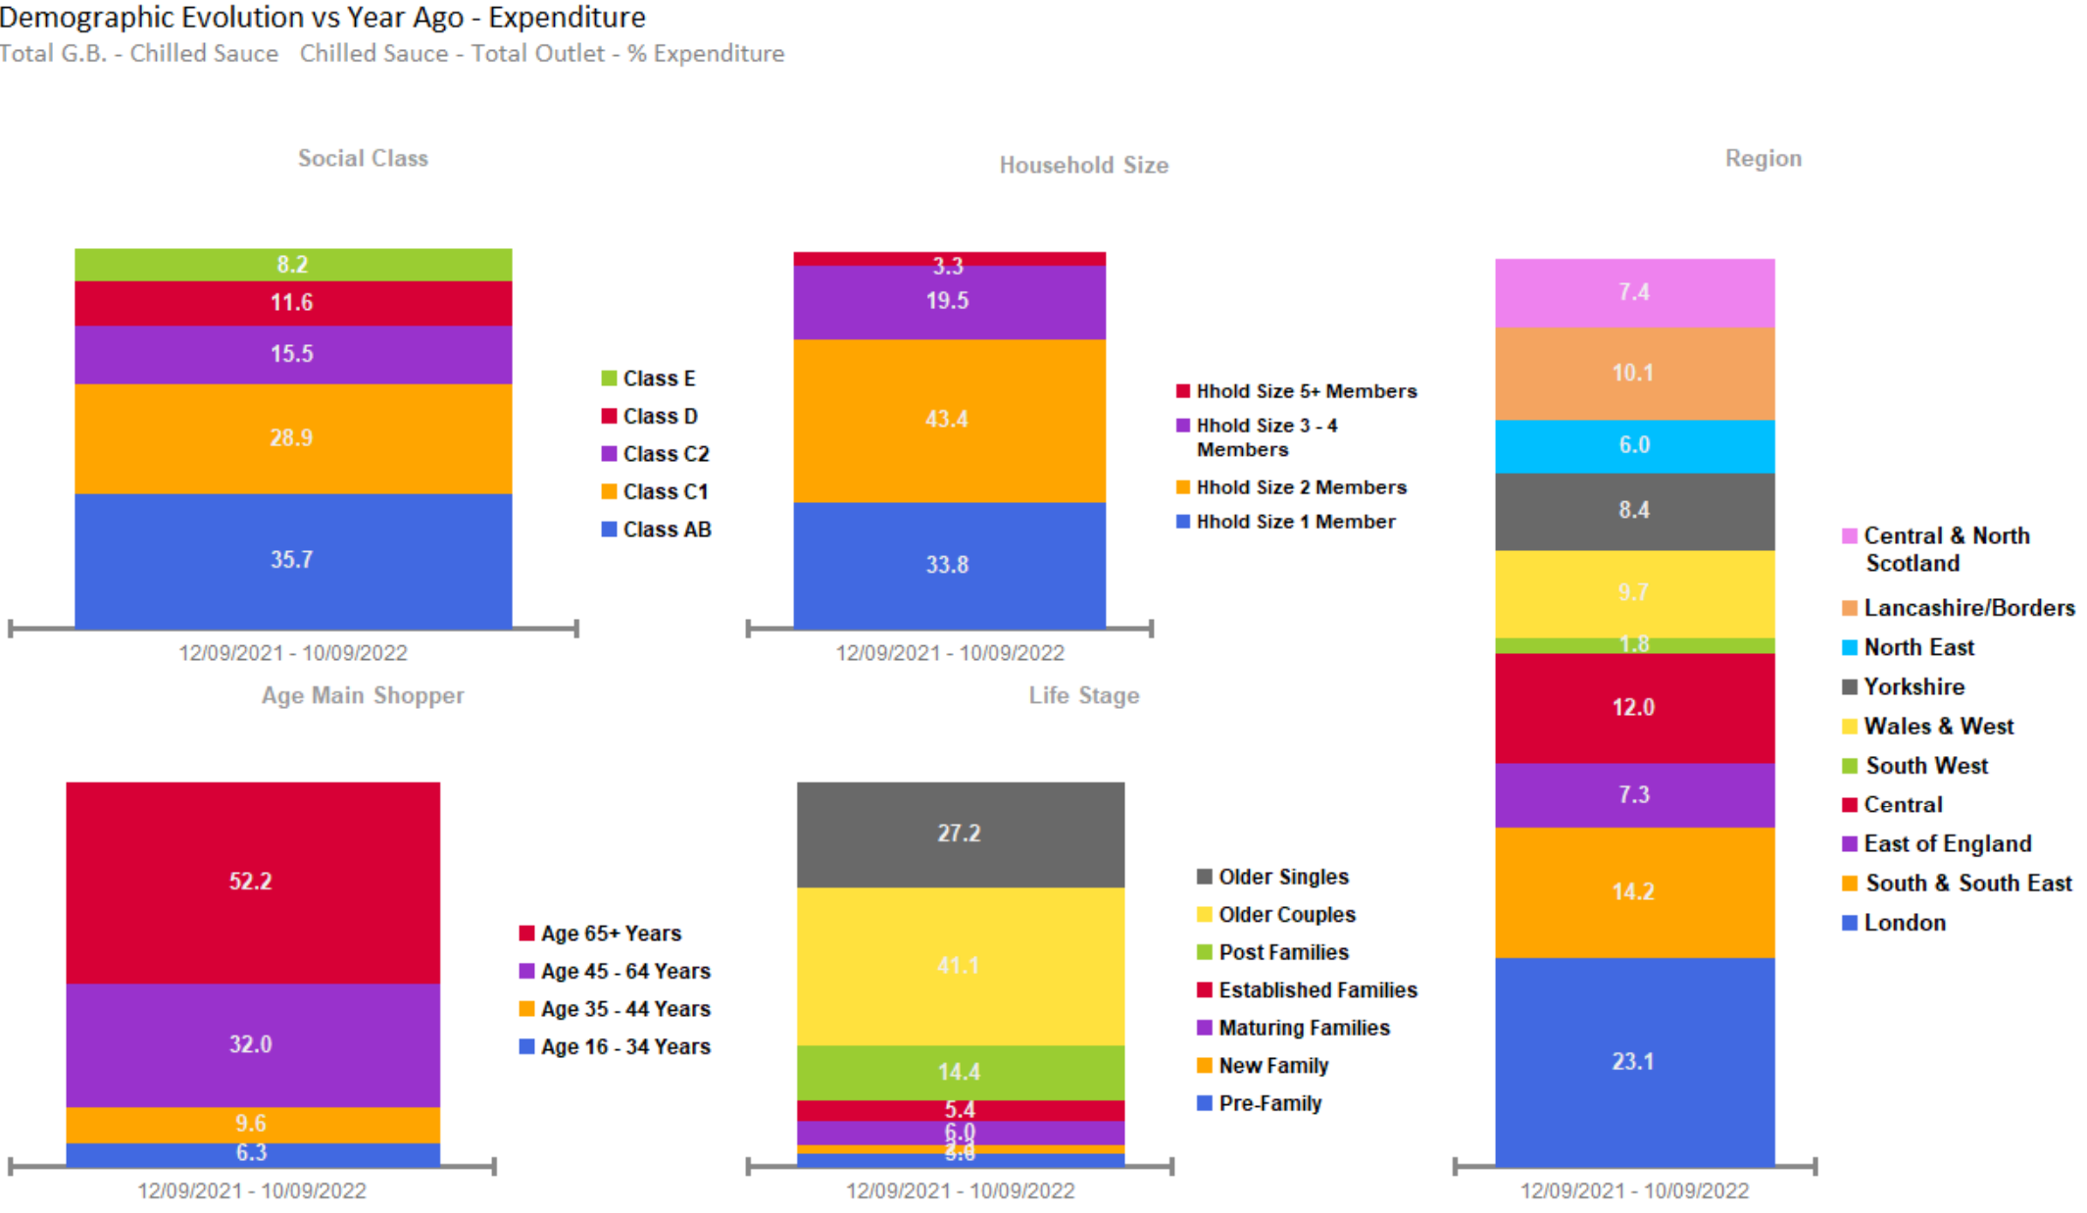
SAUCE SALES OVERINDEX FROM OLDER COUPLES, THOSE AGED 65+, OF CLASS AB, WITH 2 MEMBERS OF HOUSEHOLD, AND THOSE BASED IN LONDON
Source – Nielsen Homescan Data to 52 WE 10.09.2022 vs YA

Slide 44
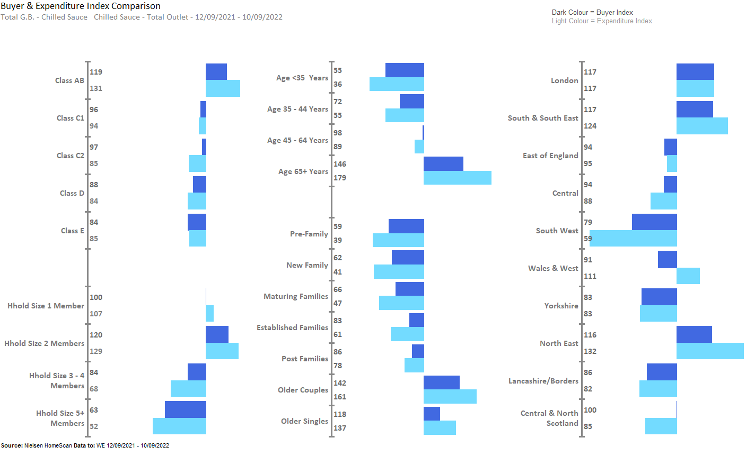
SAUCE OVERINDEX AMONGST OLDER COUPLES AND SINGLES, 65+ AGE GROUPS, AND THOSE LIVING IN LONDON, SOUTH & SOUTH EAST AND NORTH EAST
Source – Nielsen Homescan Data to 52 WE 10.09.2022 vs YA

Slide 45
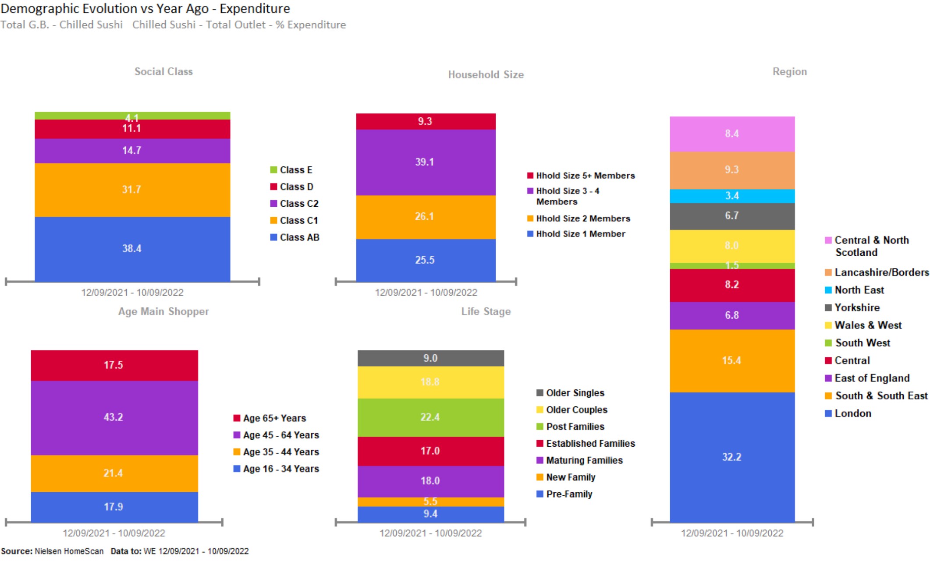
SUSHI SALES OVERINDEX PREDOMINANTLY FROM THOSE BASED IN LONDON.
Source – Nielsen Homescan Data to 52 WE 10.09.2022 vs YA

Slide 46
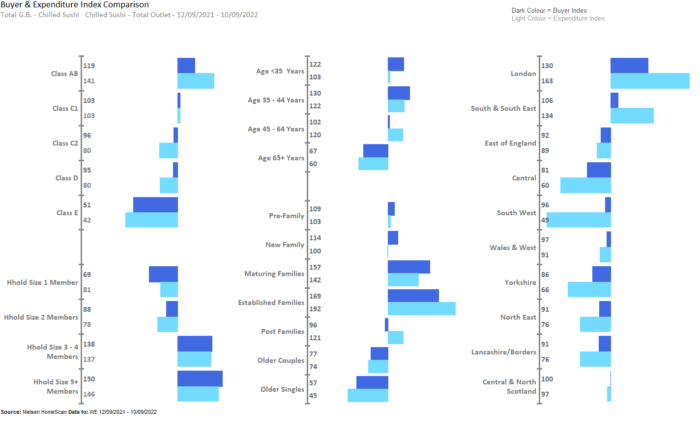
SUSHI SALES OVERINDEX WITH ESTABLISHED AND MATURING FAMILIES, AND THOSE WHO ARE LIVING IN LONDON AND SOUTH & SOUTH EAST , IN CLASS AB
Source – Nielsen Homescan Data to 52 WE 10.09.2022 vs YA

Slide 47
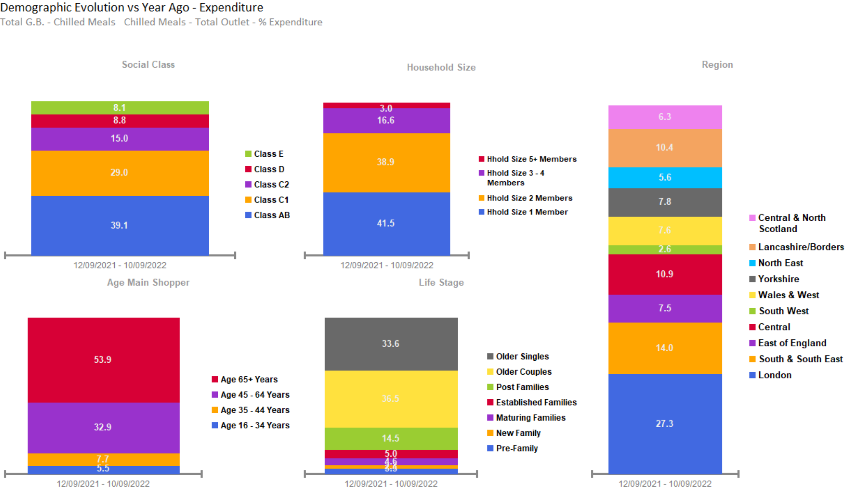
MEAL SALES OVERINDEX FROM AFFLUENT OLDER COUPLES, OF CLASS AB, AGED 65+, WITH 1 MEMBER IN FAMILY, LOCATED AT LONDON
Source – Nielsen Homescan Data to 52 WE 10.09.2022 vs YA

Slide 48
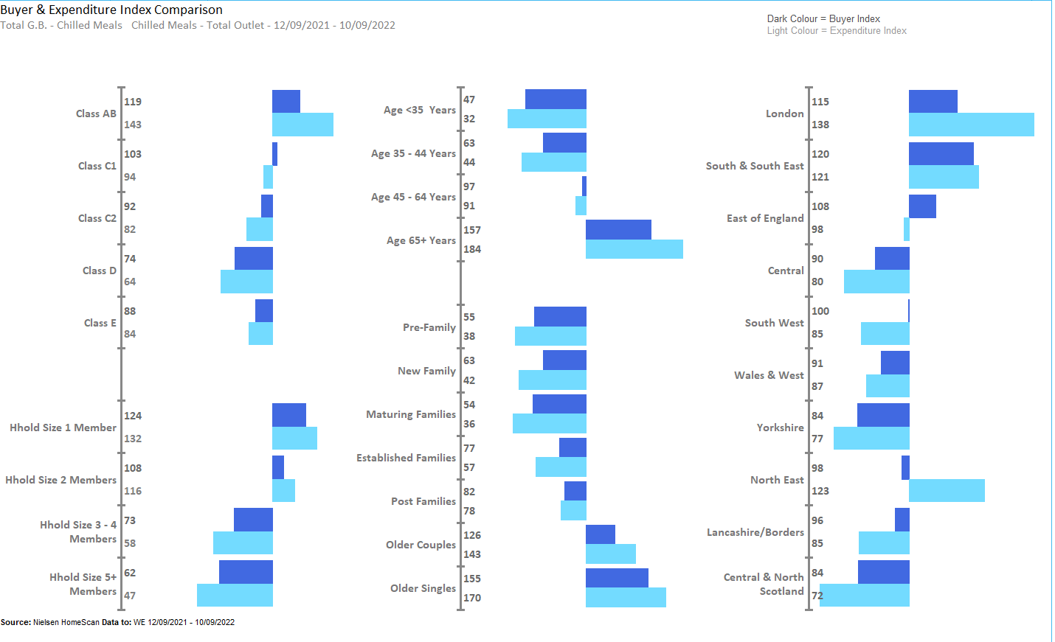
MEALS OVERINDEX AMONGST OLDER COUPLES AND SINGLES, AND HOUSEHOLDS LOCATED IN LONDON, SOUTH & SOUTH EAST AND EAST OF ENGLAND
Source – Nielsen Homescan Data to 52 WE 10.09.2022 vs YA

Slide 49
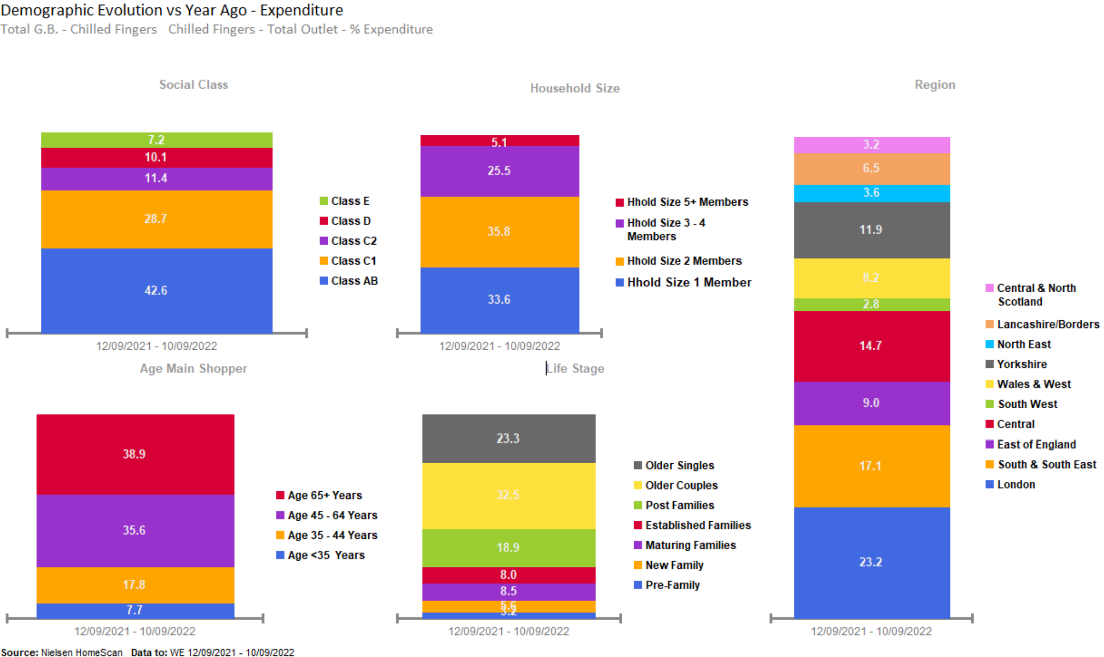
FINGERS OVERINDEX AMONGST OLDER COUPLES, OF CLASS C1, AGED 65+ WITH 2 MEMBERS IN FAMILY, LOCATED AT LONDON AND SOUTH & SOUTH EAST
Source – Nielsen Homescan Data to 52 WE 10.09.2022 vs YA

Slide 50
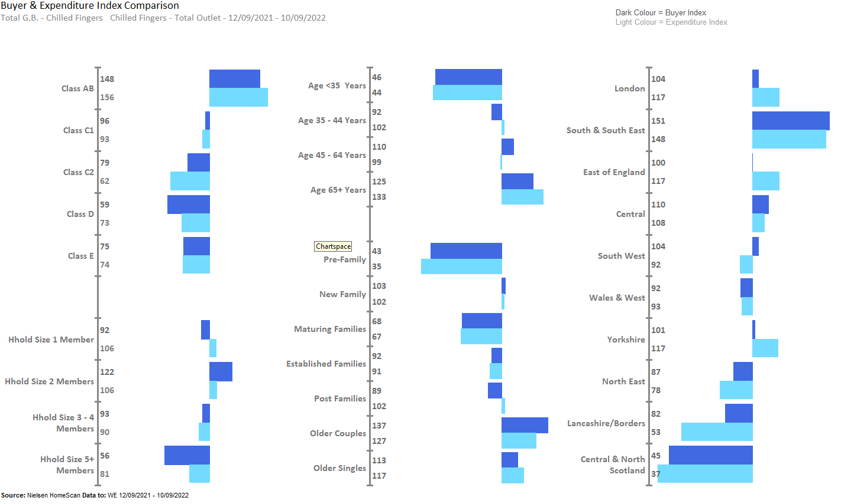
FINGERS OVERINDEX AMONGST OLDER COUPLES AND SINGLES, AND HOUSEHOLDS LOCATED IN SOUTH & SOUTH EAST, LONDON,YORKSHIRE, SOUTH WEST AND EAST OF ENGLAND
Source – Nielsen Homescan Data to 52 WE 10.09.2022 vs YA

Slide 51
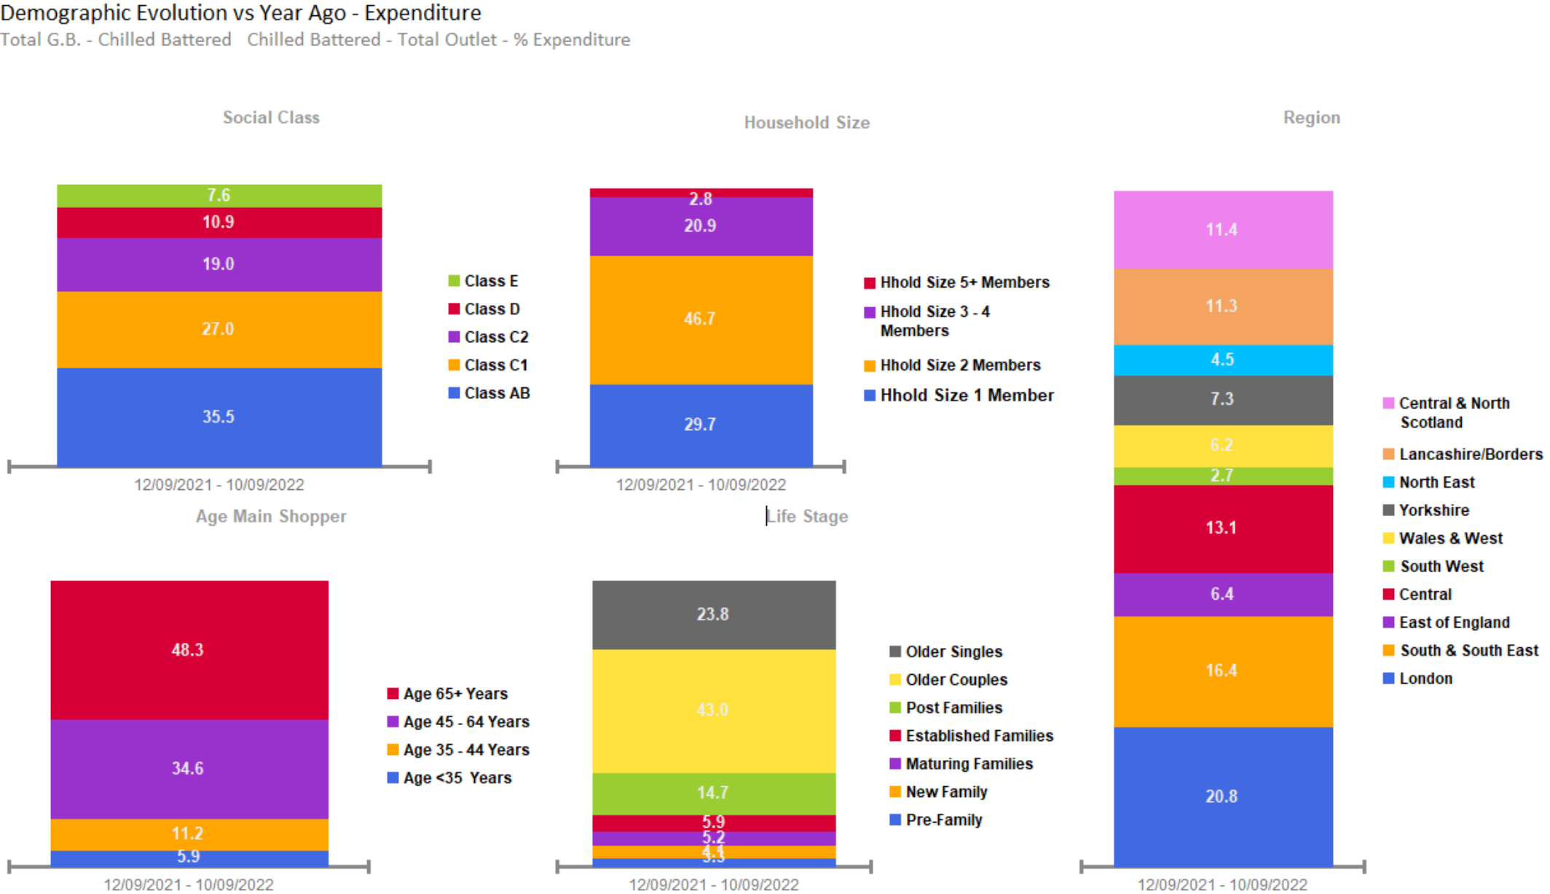
BATTERED SALES OVERINDEX FROM AFFLUENT OLDER COUPLES, OF CLASS AB, AGED 65+, WITH 2 MEMBERS IN FAMILY, LOCATED AT LONDON
Source – Nielsen Homescan Data to 52 WE 10.09.2022 vs YA

Slide 52
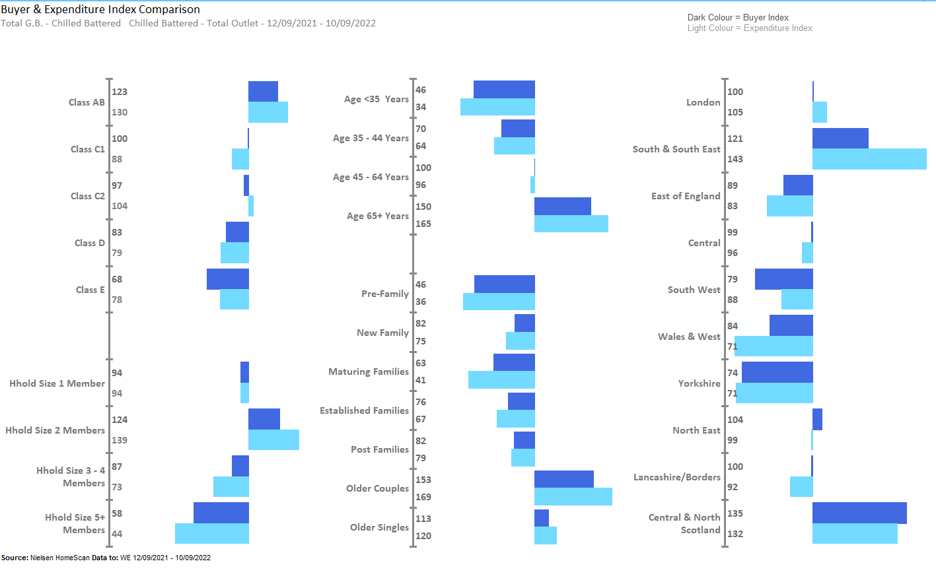
BATTERED OVERINDEXES AMONGST OLDER COUPLES, AND THOSE LOCATED FROM CENTRAL & NORTH SCOTLAND, LONDON, SOUTH & SOUTH EAST
Source – Nielsen Homescan Data to 52 WE 10.09.2022 vs YA

Slide 53
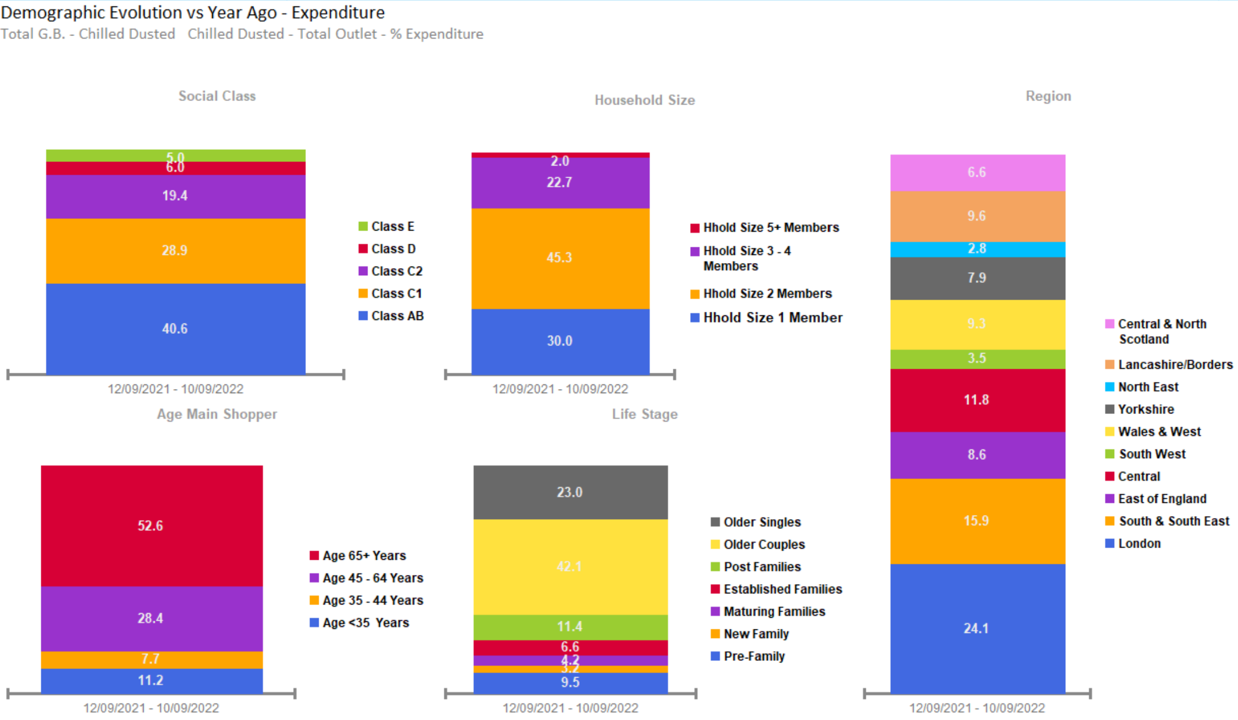
DUSTED SALES OVERINDEX FROM OLDER COUPLES, OF CLASS AB, AGED 65+, WITH 2 MEMBERS IN FAMILY, LOCATED AT LONDON
Source – Nielsen Homescan Data to 52 WE 10.09.2022 vs YA

Slide 54
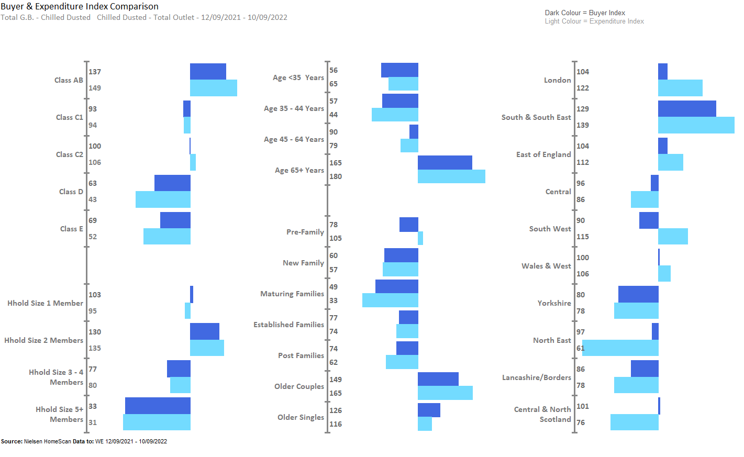
DUSTED OVERINDEX AMONGST OLDER COUPLES AND HOUSEHOLDS LOCATED FROM LONDON, SOUTH & SOUTH EAST.
Source – Nielsen Homescan Data to 52 WE 10.09.2022 vs YA

