Slide 1
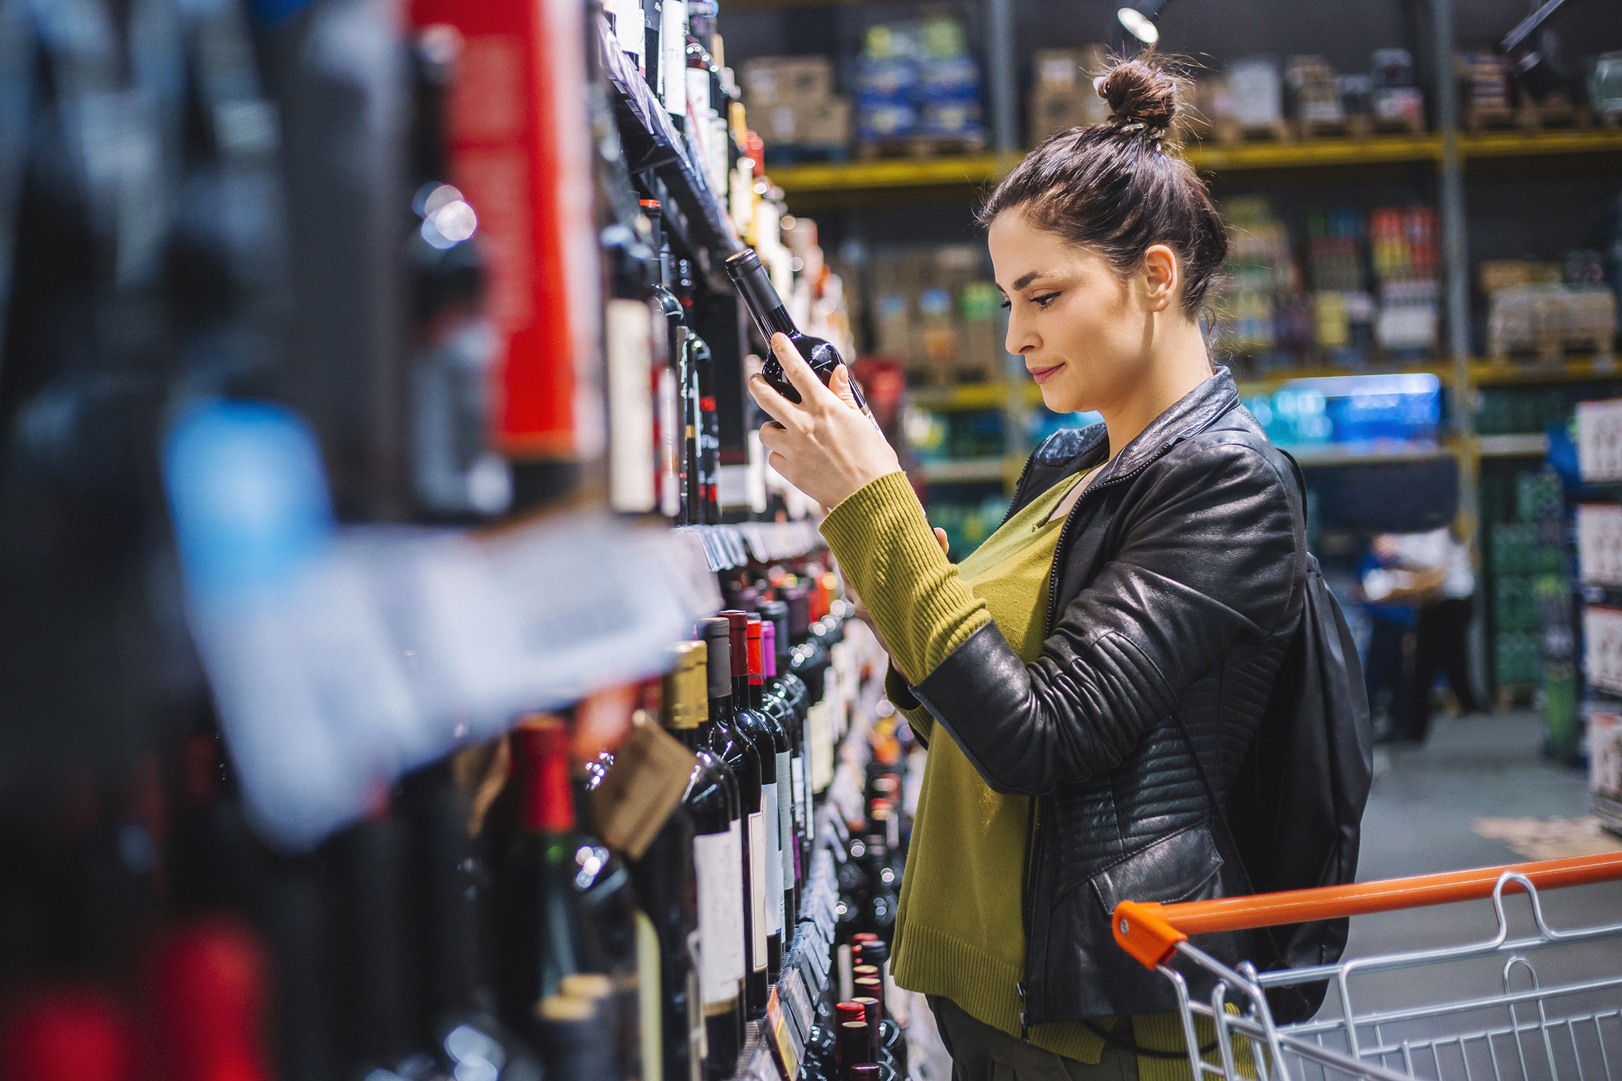
FMCG Essential Retail – What you need to know!
Share of Trade
52 we data to 28.01.23
Share of Total Grocers
Value Change %
Penetration
£ Spend per Visit
2022
2023
2022
2023
% Change
2022
2023
% Change
27.2% | 27.0% | 3.4% | 85.7 | 86.6 | 1.9% | 27.41 | 26.85 | -2.0%
13.8% | 13.6% | 2.7% | 66.9 | 68.6 | 3.4% | 25.75 | 25.01 | -2.9%
12.2% | 12.0% | 2.5% | 69.1 | 70.3 | 2.6% | 28.23 | 27.73 | -1.8%
10.7% | 11.4% | 10.9% | 65.9 | 68.8 | 5.2% | 24.54 | 24.92 | 1.5%
9.4% | 8.7% | -4.1% | 61.9 | 62.6 | 1.8% | 26.55 | 24.16 | -9.0%
7.7% | 8.3% | 12.9% | 58.6 | 63.5 | 9.3% | 21.90 | 21.46 | -2.0%
4.5% | 4.5% | 4.8% | 49.4 | 50.7 | 3.4% | 9.38 | 9.11 | -2.9%
4.3% | 4.0% | -3.4% | 25.3 | 26.1 | 4.0% | 24.91 | 21.90 | -12.1%
3.5% | 3.6% | 6.4% | 48.5 | 49.9 | 3.6% | 16.20 | 15.13 | -6.6%
2.6% | 2.6% | 4.0% | 49.8 | 52.1 | 5.6% | 20.41 | 19.81 | -2.9%
1.7% | 1.6% | -0.3% | 5.0 | 6.6 | 31.6% | 71.40 | 71.10 | -0.4%
Store Portfolio
Store Numbers as of 28.01.23
Store Numbers
Total
Convenience
Small
Large
Super
Mega
2729 | 1872 | 26 | 283 | 195 | 353
1395 | 809 | 43 | 170 | 143 | 230
588 | 1 | 134 | 86 | 113 | 254
498 | 2 | 10 | 186 | 245 | 55
3679 | 2682 | 821 | 176 | 0 | 0
328 | 22 | 49 | 206 | 44 | 7
1007 | 537 | 296 | 154 | 13 | 7
963 | 77 | 839 | 47 | 0 | 0
26 | 0 | 0 | 0 | 0 | 26
Value Index
(52 we 28.01.23)
Life stage
Pre Family
New Family
Maturing Family
Post Family
Older Couple
Older Singles
Established Family
113 | 96 | 101 | 102 | 95 | 103 | 93
78 | 97 | 77 | 99 | 100 | 110 | 107
90 | 140 | 139 | 129 | 102 | 86 | 70
84 | 104 | 83 | 85 | 94 | 116 | 103
90 | 145 | 147 | 127 | 85 | 89 | 75
100 | 83 | 77 | 90 | 96 | 84 | 163
103 | 71 | 36 | 75 | 90 | 131 | 121
126 | 110 | 123 | 108 | 85 | 103 | 75
93 | 72 | 49 | 58 | 89 | 122 | 144
67 | 58 | 120 | 128 | 96 | 96 | 101
120 | 74 | 111 | 73 | 145 | 96 | 71
Source: Nielsen Homescan SOT based on FMCG [New Base], Benchmark Total Grocers% Change Penetration = % Change in actual buyers
Penetration = Change in shoppers

Slide 2
FMCG Essential Retail
Tesco has bought the Paperchase brand and related IP in a pre-pack administration deal. The grocer plans to bring the brand to its stores. It is thought that Paperchase’s 106 UK stores will all close. Tesco managing director of home and clothing Jan Marchant said: “Paperchase is a well-loved brand by so many, and we’re proud to bring it to Tesco stores across the UK. “We have been building out plans to bring more brands and inspiration to the ranges we currently offer, and this will help us to take those plans further. We look forward to sharing more with our customers in due course.”
Sainsbury’s shoppers across the UK are set to win over 50 million Nectar points in a nine-day giveaway event, ‘The Big Points Bonanza’. Launching 27th January and running until 4th February, customers can gain points in three ways, including to ‘Win Big’ and enter a prize draw where 50 shoppers will win one million Nectar points each, worth at least £5,000. “As our customers look for more ways to save money, we want to be able to provide great value and exciting offers for them,” Sainsbury’s director of nectar and loyalty, Sam Burston said “We love giving shoppers the feeling of little wins and this points giveaway is the perfect way to surprise and delight our Nectar customers this January.”
ASDA: A British vehicle maker is part of a consortium that has been awarded £6.6m in government funding to make the world's first self-driving, hydrogen-powered heavy goods vehicle for Asda to trial. HVS hopes the vehicles can help with issues in the haulage industry such as driver shortages. Self-driving vehicles will also reduce energy and tyre emissions by better managing acceleration and braking, it added. Commenting on the announcement, Business Secretary Grant Shapps said: "In just a few years' time, the business of self-driving vehicles could add tens of billions to our economy and create tens of thousands of jobs across the UK.” Hydrogen is an invisible, clean energy gas which experts generally agree the UK will need a significant proportion of hydrogen to reach net zero - reducing carbon emissions and offsetting the rest - by 2050.
Morrisons has saved over one million bags of surplus food from going to waste in the UK through its partnership with Too Good To Go. The grocer said it was the first supermarket to partner with food saving platform Too Good To Go to redistribute its surplus food in October 2019. Morrisons corporate responsibility manager, Rebecca Cranshaw said: “We’re thrilled to have reached this significant milestone. Through our partnership with Too Good To Go, we have not only saved our customers money but have now rescued over 1,000 tonnes of surplus food from being thrown away, helping us to work towards our target to halve food waste by 2030.”
Source: NielsenIQ Homescan, Grocer & Nam News

Slide 3
FMCG Essential Retail
Waitrose will replace the majority of its small wine bottles with aluminium cans in an effort to save 320 tonnes of packaging. The grocer said the majority of small wine formats (apart from Champagne. Prosecco and Cava, and Rioja, due to appellation restrictions) will be moved from glass bottles to aluminium cans from 15 January. Last year, Waitrose said customers purchased nearly three million small bottles of wine across both still and sparkling categories. Waitrose MW, Beer, Wine and Spirit Bulk Sourcing Manager, Barry Dick said: “We’re delighted to pioneer this move and make reducing waste even easier for our customers. “Aluminium cans weigh significantly less than glass and create less than half the amount of CO2 than the equivalent single-use glass bottle, cans can also be recycled an infinite number of times.”
Aldi is rolling out its partnership with the world’s largest surplus food platform, Too Good To Go, across all of its 990 UK stores. The ‘Magic Bags’ will contain a range of grocery products that are approaching their sell-by or use-by dates at less than a third of the price, costing just £3.30 each to purchase for at least £10 worth of food. Liz Fox, Corporate Responsibility Director at Aldi UK, said: “Rolling out our partnership with Too Good To Go is another way of allowing us to cut down on food waste, while also offering customers the opportunity to pick up our food at even lower prices. “With the rising cost of living impacting so many, Too Good To Go offers a simple and accessible way for consumers to save money and reduce waste.”
Lidl’s has unveiled plans to invest £4 billion in British food businesses in 2023, as the value supermarket cements its support for suppliers across the country. This accelerates initial spending plans unveiled in 2019, which saw the German retailer commit to a five-year £15 billion investment in the British Food Industry from 2020 to 2025, with the figure now expected to hit £17 billion. Lidl GB chief executive Ryan McDonnell said: “The farmers and producers that supply us, some of which have been with us for decades, are paramount to the success of our business. We see them as partners in our mission to provide households with high-quality affordable produce, and for many, working with Lidl GB and being part of our growth has opened opportunities for their own expansion, both here in the UK and across the globe.”
Source: NielsenIQ Homescan, Grocer & Nam News

Slide 4
FMCG Essential Retail
Iceland is celebrating hitting eight million transactions benefitting from its over-60s discount, since it first introduced it on 24th May 2022. As part of the celebrations, the frozen goods retailer will be surprising one lucky shopper with a years’ worth of shopping. Iceland first introduced the over-60 discount to establish its value offering during the cost-of-living crisis, open exclusively to people aged over 60 and only on Tuesdays. “It’s clear that not only are our over-60 shoppers regularly making use of the discount, but that every Tuesday represents an opportunity to get out into the community and socialise in store,” managing director of Iceland, Richard Walker said.
Co-op has partnered with digital payment provider, PayPal, to offer additional choice for shoppers to make simple, safe and secure purchases of groceries through the retailer’s online shop. PayPal is now available for shoppers as a payment option for purchases of online home delivery orders and click and collect via Co-op’s online shop enabling shoppers to buy online and pay for their purchase with PayPal quickly and easily, without having to enter their credit card or financial details. Paul Fletcher, Co-op’s head of payments, said: “We are continually looking for new ways to innovate and meet the needs of our Members and customers, and developing quick, convenient and flexible options online is a core part of our approach.
Ocado has partnered with the RSPB to design miniature meals for birds using food scraps in a bid to tackle food waste at home. The online-only supermarket’s recipes, which include Blackbird Berry Cheesecake, Wagtail’s Winter Stew, Robin Raisin Ice Cream, Seedy Sushi and Fruity Finch Tart, have also been launched to help families keep the nation’s birds well fed this winter. This comes as research by the NGO found that the average family with children throws away more than £700 worth of food each year. “Ocado has low levels of food waste at just 0.6% and we’re committed to helping our customers reduce waste at home too,” Ocado Retail director of sustainability, Rachel Cox-Reynolds said. “So many food items such a bruised fruits, extra roast vegetables and grated cheese are perfect to pass on to our feathered friends, and by working with RSPB, we’re encouraging the nation to get creative with food waste this year, just in time for Big Garden Birdwatch.
Source: NielsenIQ Homescan, Grocer & Nam News

