Slide 1
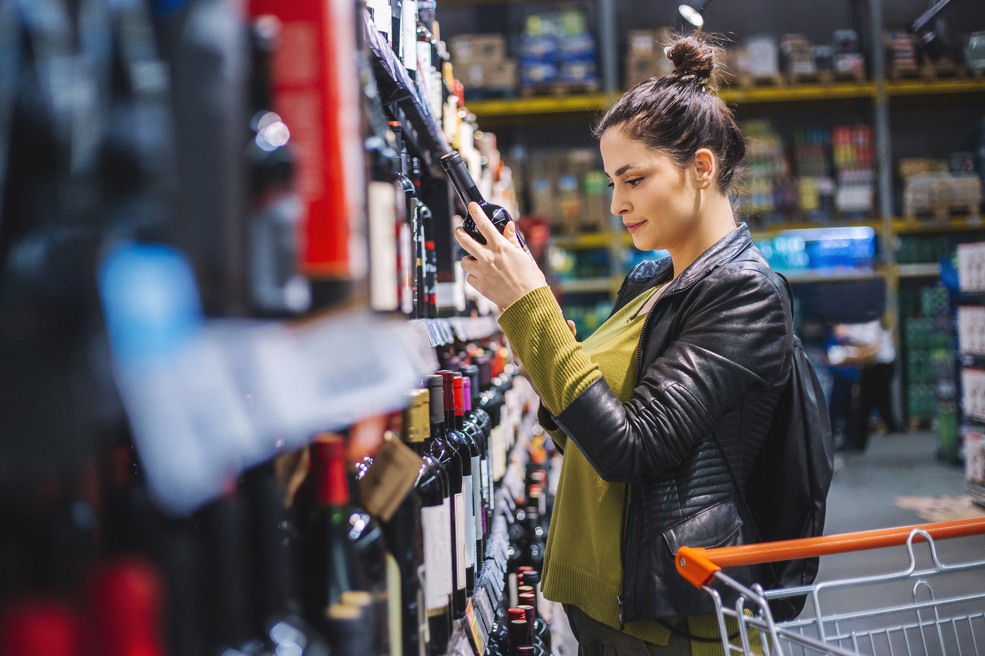
FMCG Essential Retail – What you need to know!
Share of Trade
52 we data to 06.11.21
Share of Total Grocers
Value Change %
Penetration
£ Spend per Visit
2020
2021
2020
2021
% Change
2020
2021
% Change
27.1% | 27.1% | 1.9% | 86.9 | 85.0 | -1.3% | 28.37 | 27.78 | -2.1%
14.0% | 13.9% | 1.4% | 69.2 | 66.2 | -3.4% | 26.60 | 26.40 | -0.8%
12.5% | 12.3% | -0.1% | 70.5 | 68.8 | -1.6% | 29.96 | 28.86 | -3.7%
10.1% | 10.6% | 7.1% | 66.8 | 64.9 | -2.0% | 25.94 | 24.96 | -3.8%
9.7% | 9.5% | -0.2% | 62.7 | 61.0 | -1.8% | 28.22 | 27.26 | -3.4%
6.6% | 7.4% | 13.4% | 59.2 | 57.8 | -1.5% | 21.43 | 21.79 | 1.7%
4.9% | 4.5% | -4.6% | 54.0 | 49.3 | -8.0% | 10.24 | 9.64 | -5.9%
4.3% | 4.3% | 2.6% | 25.7 | 24.9 | -2.1% | 25.37 | 25.71 | 1.3%
3.3% | 3.4% | 5.1% | 46.2 | 46.5 | 1.7% | 16.69 | 16.93 | 1.4%
2.7% | 2.6% | 0.5% | 52.6 | 50.1 | -3.9% | 19.38 | 20.95 | 8.1%
1.6% | 1.7% | 7.3% | 4.8 | 4.8 | 0.8% | 78.10 | 72.35 | -7.4%
Store Portfolio
Store Numbers as of 06.11.21
Store Numbers
Total
Convenience
Small
Large
Super
Mega
2675 | 1824 | 25 | 280 | 194 | 352
1397 | 811 | 46 | 173 | 144 | 223
593 | 0 | 134 | 86 | 113 | 255
497 | 2 | 10 | 189 | 243 | 53
3727 | 2719 | 828 | 180 | 0 | 0
333 | 22 | 50 | 209 | 44 | 7
998 | 522 | 300 | 156 | 13 | 7
956 | 77 | 836 | 43 | 0 | 0
25 | 0 | 0 | 0 | 0 | 25
Value Index (52 we 06.11.21)
Life stage
Pre Family
New Family
Maturing Family
Post Family
Older Couple
Older Singles
Established Family
110 | 102 | 103 | 108 | 100 | 100 | 89
88 | 96 | 72 | 92 | 103 | 111 | 108
104 | 135 | 134 | 122 | 100 | 85 | 73
93 | 102 | 80 | 89 | 93 | 116 | 99
108 | 141 | 150 | 115 | 81 | 88 | 76
111 | 71 | 87 | 82 | 103 | 91 | 146
82 | 60 | 36 | 67 | 101 | 128 | 138
121 | 106 | 123 | 112 | 82 | 103 | 76
79 | 52 | 49 | 64 | 90 | 128 | 145
128 | 62 | 123 | 123 | 93 | 89 | 98
95 | 190 | 121 | 59 | 142 | 85 | 68
Source: NielsenIQ Homescan SOT based on FMCG [New Base], Benchmark Total Grocers% Change Penetration = % Change in actual buyers
Penetration = Change in shoppers

Slide 2
FMCG Essential Retail
Tesco have launched ‘Whoosh’ in 96 of its stores. ‘Whoosh’ is a new online delivery service within the UK with a 60-minute turnaround. Shoppers can place an order with goods being delivered by bike, moped or car. There are no restrictions to how large an order can be and the service costs change dependent on shoppers spend.
Sainsbury’s boss Simon Roberts said his strategy is working, as the supermarket posted rising sales, profits, and market share. The results are a vindication of the company’s strategy to refocus on food, launching new products and investing in driving down the cost of everyday items.
ASDA announced plans to introduce a special shopping hour dedicated to its more vulnerable customers. Between the hour of 2pm and 3pm the supermarket will dedicate a ‘quieter’ shopping time to customers who have a hidden disability from Mondays to Thursdays so that they can shop with ease.
Morrisons Scottish stores from 8th November will be putting up an early Christmas tree with the aim of raising money for a variety of food banks and local communities throughout November and December. Customers will be able to donate by picking up one of the baubles in their nearest store, which can be added to their shopping at the checkout.
Aldi have continued their festive launch for this year with a whole host of exciting boozy advent calendars to help you ring in the festivities this year, and among them is this mouth-watering gin advent calendar. The Aldi Haysmith’s Gin Advent Calendar is available now for £ 69.99.
Coop have teamed up with Unilever to pilot refillable packaging models in stores for both brands to gain a better understanding of how reusable and refillable packaging works in a store setting. The models are being tested as part of efforts to provide shoppers with efficient alternatives to plastic. As part of the trial, some of Unilever’s brands, including Persil, Simple, Radox and Alberto Balsam, will be sold in returnable stainless steel bottles.
Source: NielsenIQ Homescan, Grocer & Nam News

Slide 3
FMCG Essential Retail
Waitrose are set to be the first UK supermarket to trial electric vehicles. Waitrose’s ambition is to end the use of fossil fuels across their entire transport fleet by 2030 - estimated to save 70,000 tonnes of CO2 every year. Waitrose aims to have electrified all its cars, vans and light trucks. The vehicles will be delivering groceries over the coming months from the St Katherine’s Dock Waitrose store in London and are expected to be expanded soon.
Lidl are having a British Craft Spirits Festival ahead of the festive season. Lidl has released a range of festive gins filled with Christmas flavours as part of its British Craft Spirits Festival. Other highlights of the in-store event include the Apple & Cinnamon spirit, as well as the Peaky Blinders Spiced Rum and five-year Malted Whisky.
Iceland has pledged to become “plastic neutral” from 2022 in what it claims is an industry first. The retailer said it will recover and recycle waste plastic to the equivalent of its own total plastic consumption from next year as it pledged to “continue to work towards” being plastic-free across its own-label packaging. It has announced a partnership with Seven Clean Seas, which works with companies to pull plastic out of the ocean on their behalf. Iceland has reported a 29% overall reduction in plastic packaging across its own-label range since 2017, removing 3,794 tonnes of plastic.
Ocado has unveiled a partnership and £10m investment into autonomous mobility start-up Wayve, which will focus on bringing automation to the last mile for the e-tailer and its international grocery partners.
Source: NielsenIQ Homescan, Grocer & Nam News

