Slide 1
Retail Observations: On-line New and Re-launched Products
9th August | Julia Brooks

Slide 2
New products summary
 | Ambient | Chilled | Frozen | Grand Total
Asda | 8 |  |  | 8
Iceland |  |  | 1 | 1
Morrisons | 3 | 1 | 1 | 5
Ocado | 2 | 3 | 5 | 10
Sainsburys |  | 2 |  | 2
Waitrose | 3 | 2 |  | 5
Grand Total | 16 | 8 | 7 | 31
Source: Retailer website (09/08/2021)

Slide 3
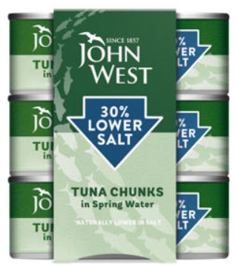
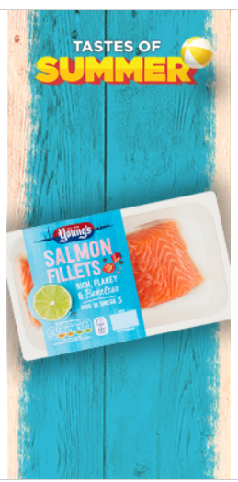
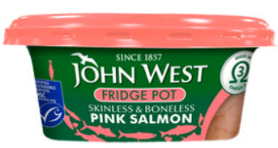
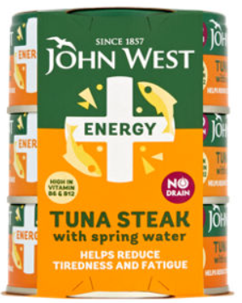
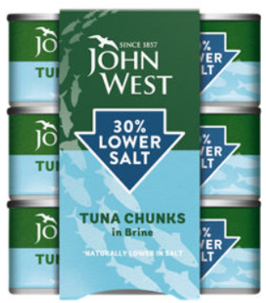
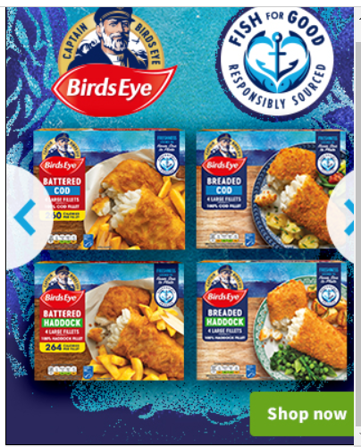
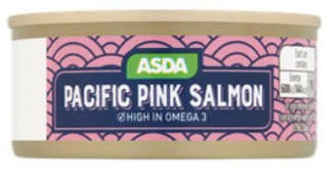
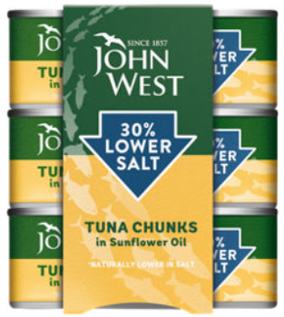
Asda
Ambient (8)
Chilled
Frozen
Source: Retailer website (09/08/2021)

Slide 4
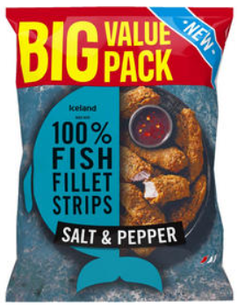
Iceland
Frozen (1)
Source: Retailer website (09/08/2021)

Slide 5
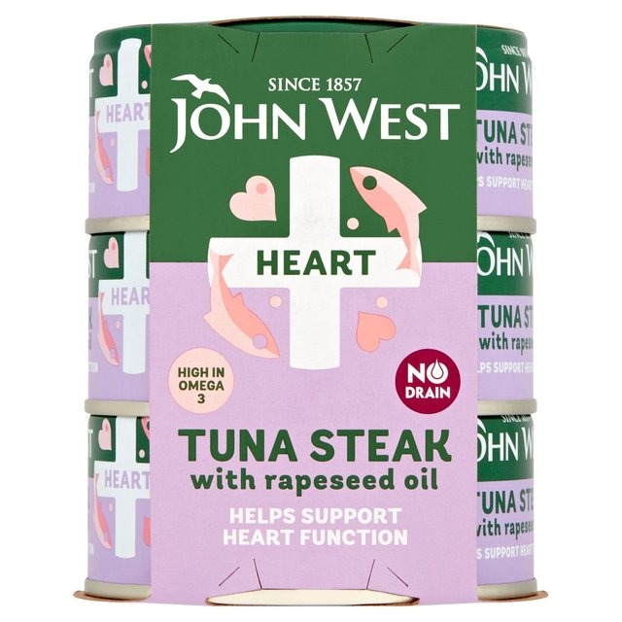
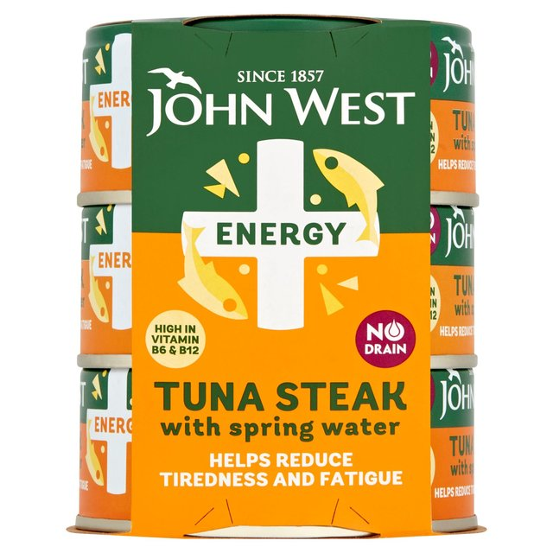
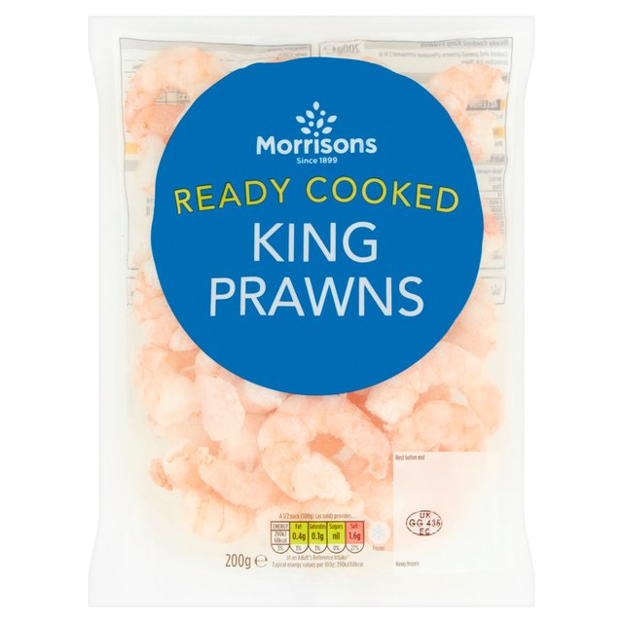
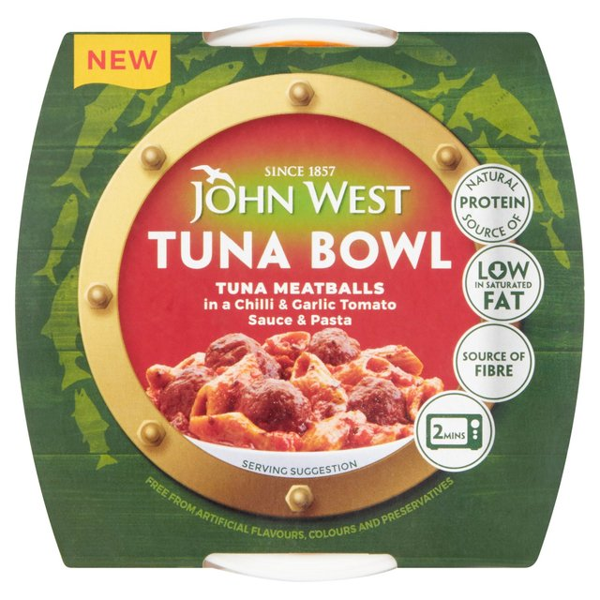
Morrisons
Ambient (3)
Chilled (1)
Frozen (1)
Source: Retailer website (09/08/2021)

Slide 6
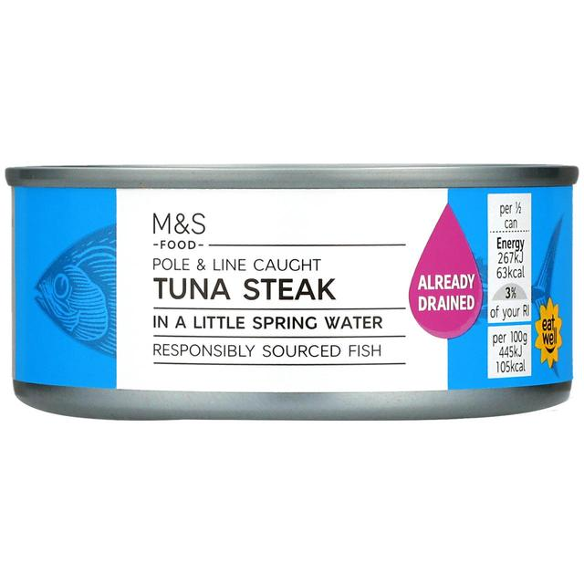
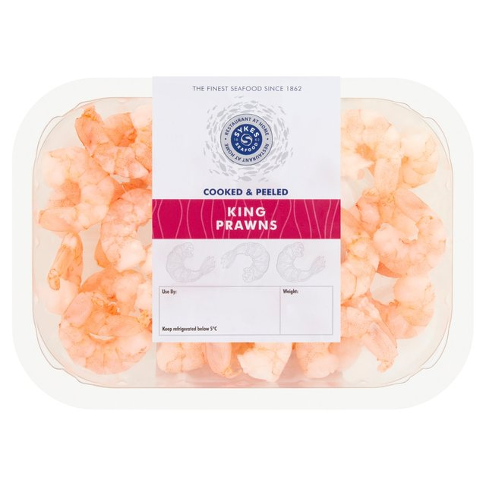
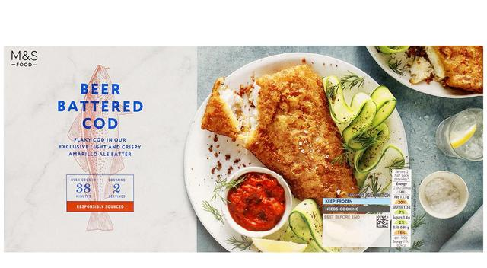
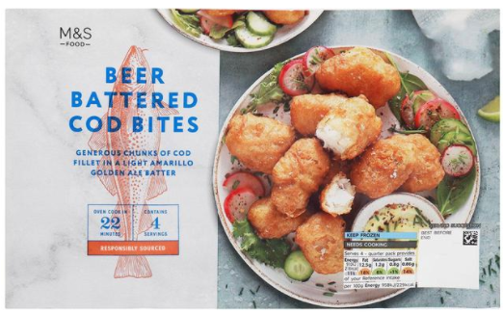
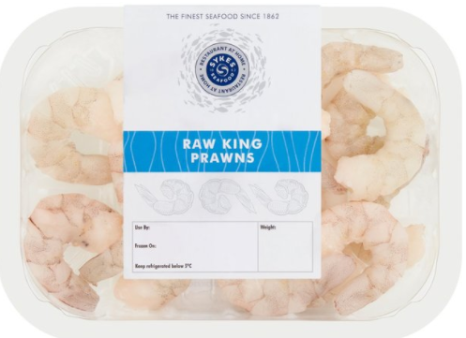
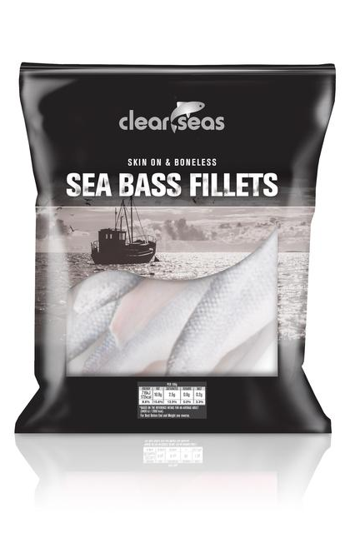
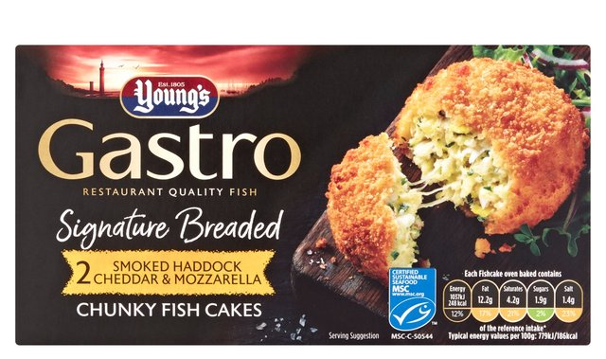
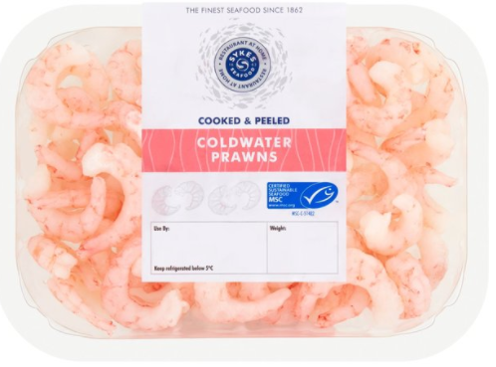
Ocado
Ambient (2)
Chilled (8)
Frozen (5)
Source: Retailer website (09/08/2021)

Slide 7
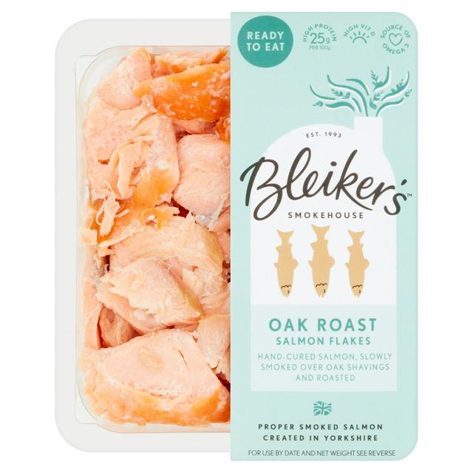
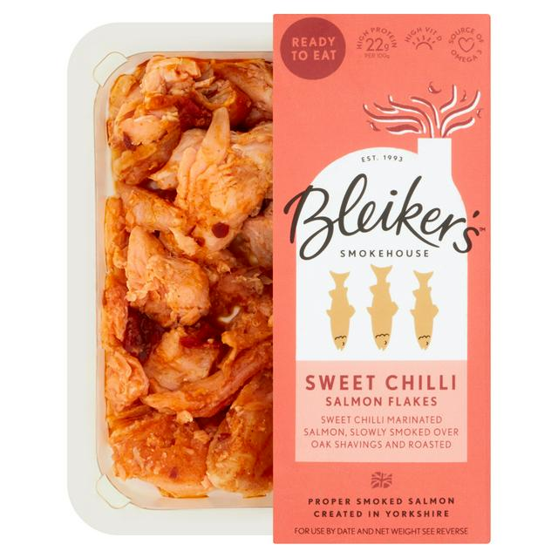
Sainsbury’s
Chilled (2)
Source: Retailer website (09/08/2021)

Slide 8
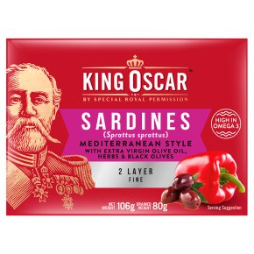
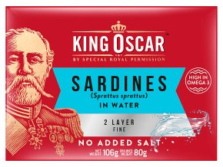
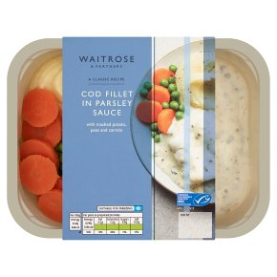
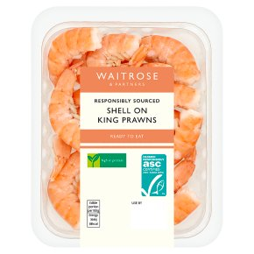
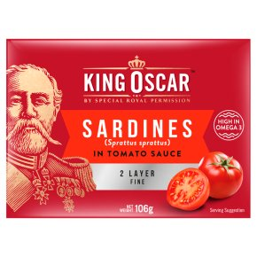
Waitrose
Ambient (3)
Chilled (2)
Source: Retailer website (09/08/2021)

Slide 9
Thank you
For further details please contact:
Julia Brooks
Market Insight Analyst
Julia.brooks@seafish.co.uk
+44 (0) 1472252358 / 07944 682751
Suzi Pegg-Darlison
Market Insight Analyst
Suzi.pegg-darlison@seafish.co.uk
+44 (0) 1472 252358 / 07944 682697

