Slide 1
Q3 2020 Seafish Retail Report
Sources: Nielsen UK ScanTrack ,GB HomeScan, and Essential Retail MAT 05.09.2020, Office for National Statistics (ONS), IGD, Grocers & NamNews, retailer websites

Slide 2
Contents
Executive summary
Economic context, UK shopper & retailer performance
Seafood performance
Retailer share of trade and purchase KPI’s
Proteins context report
On-line new product observations
Species, sales & pricing
Market data context and definitions

Slide 3
Executive summary
Economic context
The Consumer Prices Index including owner occupiers’ housing costs (CPIH) 12-month inflation rate was 0.9% in October 2020, up from 0.7% in September 2020
Fish CPI has continued to fall from a high of 6.9% in April, to a low of -0.1% in September compared to meat’s 1.6%
UK shopper & grocery
UK supermarket sales begin to stabilise but Brits now shop for groceries online more frequently
FMCG sales growth at supermarkets continue to level out at +5.3% over the last four weeks ending 5th September 2020
Online FMCG sales continue to soar at +102%, with 10% more online shopping ‘trips’ over the last 12 weeks
Seafood performance
Total seafood, and all sectors reported sales value, volume and unit growth
The chilled sector has lost market share to frozen and ambient seafood
Overall seafood more shoppers are shopping more often, buying larger baskets for a lower £/kg
Frozen purchase KPI’s have seen the largest average increase, followed by ambient, then chilled seafood

Slide 4
Economic context, UK shopper & retailer performance
Source: Office for National Statistics (ONS), IGD, Nielsen HomeScan, Grocers & NamNews

Slide 5
Economic context
The Consumer Prices Index including owner occupiers’ housing costs (CPIH) 12-month inflation rate was 0.9% in October 2020, up from 0.7% in September 2020.
The largest contribution to the CPIH 12-month inflation rate in October 2020 came from recreation and culture (0.26 percentage points).
Clothing; food; and furniture, furnishings and carpets made the largest upward contributions (with the contribution from these three groups totalling 0.16 percentage points) to the change in the CPIH 12-month inflation rate between September and October 2020.
These were partially offset by downward contributions of 0.06 and 0.04 percentage points, respectively, from the recreation and culture, and transport groups.
Eight CPIH items were unavailable to UK consumers in October, unchanged from September and accounting for 1.1% of the CPIH basket by weight; for October, we collected a weighted total of 90.0% of comparable coverage collected previously (excluding unavailable items).
The Consumer Prices Index (CPI) 12-month rate was 0.7% in October 2020, up from 0.5% in September.
Fish CPI has continued to fall from a high of 6.9% in April, to a low of -0.1% in September compared to meat’s 1.6%
Source: ONS Consumer price inflation, UK: October 2020

Slide 6
Post-COVID-19: five retailer priorities this holiday season: summary
Hygiene and safety is the top priority
Operating and maintaining clean and safe stores for associates and customers is the leading priority. Hygiene could be an important brand differentiator and driver of store choice.
A complex holiday season
The holiday season adds a further layer of complexity as retailers continue to adjust their product offer and space allocation in response to new customer behaviours. Many of these will be accentuated during this trading period. Digital and mobile will be centre-stage.
All eyes on ecommerce
Retailers are putting several measure in place to ensure their online platforms remain technically robust during the season. Although most retailers have added significant capacity over recent months, demand for online grocery shopping is expected to surge.
Source: IGD Post-COVID-19: five retailer priorities this holiday season October 2020

Slide 7
Post-COVID-19: five retailer priorities this holiday season: Five retailer priorities
Keeping associates and customers safe, using hygiene as a brand differentiator
Phasing the season and customer traffic
Adjusting the product mix to meet the “new normal”
Balancing value messaging and capturing premium trade-up opportunities
Ensuring the demand for online shopping can be met
Source: IGD Post-COVID-19: five retailer priorities this holiday season October 2020

Slide 8
Post-COVID-19: five retailer priorities this holiday season: New consumer behaviours
Source: IGD Post-COVID-19: five retailer priorities this holiday season October 2020

Slide 9
Post-COVID-19: five retailer priorities this holiday season: Key considerations for suppliers
Focus on the basics: product supply
Dealing with the pandemic remains the priority, especially as we see a second wave in many countries. It will be challenging to get new initiatives underway in the short term. Focus on ensuring solid product supply through the holiday season, to alleviate any shopper concerns which could drive a surge in demand.
Volatile and unpredictable
Shopping behaviour and buying patterns are expected to be unpredictable this year. Many countries and cities are putting new lockdown measures in place to slow a second-wave spread. Remain agile and ready to respond, adjusting resources where relevant, to balance supply and demand.
Celebrating at home
The at-home opportunity which has been a key feature of the pandemic for retailers and suppliers will be accentuated this holiday season. Consumption and usage are expected to remain elevated in the categories which have grown strongly since the start of the pandemic.
Budgetary pressures expected to intensify
Be prepared for a challenging 2021. Household budgets will be under pressure coming out of the holiday period. This will likely drive more at home dining, with strongest growth opportunities emerging within value-led operators.
Accelerated ecommerce
Retailers estimate that ecommerce growth has been accelerated by around three years. Have you adjusted your investment, resources and account plans to mirror this?
Source: IGD Post-COVID-19: five retailer priorities this holiday season October 2020

Slide 10
Source: Nielsen Essential Retail MAT 05.09.20

Slide 11
Source: Nielsen Essential Retail MAT 05.09.20

Slide 12
Seafood performance
Source: Nielsen UK ScanTrack and GB HomeScan 05.09.20

Slide 13
UK seafood market sector summary
 | Value Sales ('000) |  |  |  | Volume Sales ('000) |  |  |  | Unit Sales ('000) |  |  |  | Price per KG |  | Price per Unit
 | WE 08.09.18 | WE 07.09.19 | WE 05.09.20 | MAT % Chg YA | WE 08.09.18 | WE 07.09.19 | WE 05.09.20 | MAT % Chg YA | WE 08.09.18 | WE 07.09.19 | WE 05.09.20 | MAT % Chg YA | WE 05.09.20 | MAT % Chg YA | WE 05.09.20 | MAT % Chg YA
Total seafood | £3,834,497 | £3,837,940 | £4,099,146 | 6.8 | 395,108 | 393,125 | 420,604 | 7.0 | 1,471,931 | 1,471,913 | 1,576,859 | 7.1 | £9.75 | -0.2 | £2.60 | -0.3
Chilled | £2,375,364 | £2,368,002 | £2,436,943 | 2.9 | 176,488 | 178,440 | 185,845 | 4.2 | 734,327 | 744,154 | 774,509 | 4.1 | £13.11 | -1.2 | £3.15 | -1.1
Frozen | £914,380 | £917,583 | £1,055,856 | 15.1 | 134,815 | 131,202 | 143,484 | 9.4 | 365,650 | 362,419 | 397,337 | 9.6 | £7.36 | 5.2 | £2.66 | 5.0
Ambient | £544,753 | £552,354 | £606,346 | 9.8 | 83,805 | 83,483 | 91,274 | 9.3 | 371,954 | 365,339 | 405,014 | 10.9 | £6.64 | 0.4 | £1.50 | -1.0
Total seafood, and all sectors are reporting sales value, volume and unit growth
The average price per kg, and average price per unit fell for total seafood, and the chilled sector
The frozen sector is reporting higher average price per kg, and average price per unit
Ambient seafood average price per kg has increased, whilst the average price per unit has decreased
Click here for UK seafood by sector and segment
Click here for UK seafood by species
Source: Nielsen UK ScanTrack MAT 05.09.20

Slide 14
UK seafood market sector share of trade
Value £3,833m (+0.1%) | Volume 394m kg’s (-0.5%)
Chilled 59.5% (-3.6%) | Frozen 25.8% (+7.7%) | Ambient 14.8% (+2.8%)
Chilled 44.2% (-2.7%) | Frozen 34.1% (+2.2%) | Ambient 21.7% (+2.2%)
(Chg = % Share Chg)
The chilled sector has lost market share to frozen and ambient seafood.
Source: Nielsen UK ScanTrack MAT 05.09.20

Slide 15
Seafood sector purchase KPI’s
Sector | 52 Week Ending | Penetration 52w | Frequency of Purchase 52w | AWOP (Value) 52w | AWOP (Volume) 52w | Value per Occasion 52w | Volume per Occasion 52w | Price per kg 52w
Total Seafood | 07 Sep 2019 | 96.5 | 30.3 | £130.9 | 14.5 | £4.33 | 0.5 | £9.03
 | 05 Sep 2020 | 96.7 | 30.6 | £137.1 | 15.2 | £4.48 | 0.5 | £9.02
 | % Change | 0.2% | 1.1% | 4.8% | 4.9% | 3.6% | 3.8% | -0.2%
Chilled | 07 Sep 2019 | 81.5 | 20.0 | £93.3 | 7.6 | £4.66 | 0.4 | £12.23
 | 05 Sep 2020 | 81.7 | 19.8 | £93.7 | 7.7 | £4.73 | 0.4 | £12.18
 | % Change | 0.2% | -1.1% | 0.4% | 0.8% | 1.5% | 1.9% | -0.5%
Frozen | 07 Sep 2019 | 85.7 | 10.8 | £37.3 | 5.6 | £3.47 | 0.5 | £6.64
 | 05 Sep 2020 | 87.0 | 11.4 | £41.8 | 6.0 | £3.68 | 0.5 | £6.96
 | % Change | 1.5% | 5.7% | 11.9% | 6.9% | 5.9% | 1.2% | 4.7%
Ambient | 07 Sep 2019 | 78.7 | 9.1 | £23.3 | 3.8 | £2.56 | 0.4 | £6.20
 | 05 Sep 2020 | 79.6 | 9.4 | £24.8 | 4.0 | £2.63 | 0.4 | £6.17
 | % Change | 1.2% | 3.4% | 6.2% | 6.6% | 2.7% | 3.1% | -0.4%
Total seafood: more shoppers are shopping more often, buying larger baskets for a lower £/kg
Chilled seafood: more shoppers are shopping less often, buying larger baskets for a lower £/kg
Frozen seafood: more shoppers are shopping more often, buying larger baskets for a higher £/kg
Ambient seafood: more shoppers are shopping more often, buying larger baskets for a lower £/kg
Source: Nielsen GB HomeScan MAT 05.09.20

Slide 16
Frozen purchase KPI’s have seen the largest average increase, followed by ambient, then chilled seafood
Source: Nielsen GB HomeScan MAT 05.09.20

Slide 17
UK seafood by sector and segment
 | Value Sales ('000) |  |  |  | Volume Sales ('000) |  |  |  | Unit Sales ('000) |  |  |  | Price per KG |  | Price per Unit
 | WE 08.09.18 | WE 07.09.19 | WE 05.09.20 | MAT % Chg YA | WE 08.09.18 | WE 07.09.19 | WE 05.09.20 | MAT % Chg YA | WE 08.09.18 | WE 07.09.19 | WE 05.09.20 | MAT % Chg YA | WE 05.09.20 | MAT % Chg YA | WE 05.09.20 | MAT % Chg YA
Total seafood | £3,834,497 | £3,837,940 | £4,099,146 | 6.8 | 395,108 | 393,125 | 420,604 | 7.0 | 1,471,931 | 1,471,913 | 1,576,859 | 7.1 | £9.75 | -0.2 | £2.60 | -0.3
Chilled | £2,375,364 | £2,368,002 | £2,436,943 | 2.9 | 176,488 | 178,440 | 185,845 | 4.2 | 734,327 | 744,154 | 774,509 | 4.1 | £13.11 | -1.2 | £3.15 | -1.1
Chilled natural | £1,392,452 | £1,406,393 | £1,467,618 | 4.4 | 78,588 | 81,861 | 88,436 | 8.0 | 362,764 | 376,421 | 406,347 | 8.0 | £16.60 | -3.4 | £3.61 | -3.3
Chilled prepared | £330,482 | £312,635 | £323,956 | 3.6 | 27,197 | 26,011 | 26,583 | 2.2 | 128,432 | 126,468 | 130,293 | 3.0 | £12.19 | 1.4 | £2.49 | 0.6
Chilled meals | £167,436 | £162,254 | £155,052 | -4.4 | 22,737 | 22,471 | 21,098 | -6.1 | 54,397 | 53,193 | 49,628 | -6.7 | £7.35 | 1.8 | £3.12 | 2.4
Chilled breaded | £100,445 | £105,341 | £114,879 | 9.1 | 11,126 | 12,170 | 12,934 | 6.3 | 35,641 | 37,631 | 40,208 | 6.8 | £8.88 | 2.6 | £2.86 | 2.1
Chilled cakes | £108,613 | £102,947 | £108,277 | 5.2 | 15,286 | 14,412 | 15,222 | 5.6 | 55,099 | 52,323 | 54,967 | 5.1 | £7.11 | -0.4 | £1.97 | 0.1
Chilled sauce | £111,499 | £102,102 | £96,538 | -5.4 | 9,994 | 9,259 | 9,161 | -1.1 | 40,425 | 37,926 | 35,918 | -5.3 | £10.54 | -4.4 | £2.69 | -0.2
Chilled sushi | £97,637 | £105,900 | £89,775 | -15.2 | 5,807 | 6,381 | 5,580 | -12.5 | 35,168 | 36,986 | 30,896 | -16.5 | £16.09 | -3.1 | £2.91 | 1.5
Chilled batter | £26,559 | £31,170 | £37,355 | 19.8 | 2,172 | 2,494 | 3,072 | 23.2 | 9,094 | 10,545 | 12,686 | 20.3 | £12.16 | -2.7 | £2.94 | -0.4
Chilled dusted | £35,024 | £33,767 | £34,673 | 2.7 | 2,981 | 2,849 | 2,866 | 0.6 | 11,269 | 10,817 | 10,714 | -1.0 | £12.10 | 2.1 | £3.24 | 3.7
Chilled fingers | £5,217 | £5,493 | £8,820 | 60.6 | 600 | 531 | 892 | 67.9 | 2,040 | 1,844 | 2,853 | 54.7 | £9.89 | -4.4 | £3.09 | 3.8
Frozen | £914,380 | £917,583 | £1,055,856 | 15.1 | 134,815 | 131,202 | 143,484 | 9.4 | 365,650 | 362,419 | 397,337 | 9.6 | £7.36 | 5.2 | £2.66 | 5.0
Frozen natural | £289,185 | £289,023 | £331,141 | 14.6 | 29,806 | 29,138 | 33,370 | 14.5 | 83,011 | 81,356 | 93,849 | 15.4 | £9.92 | 0.0 | £3.53 | -0.7
Frozen fingers | £162,091 | £169,871 | £198,172 | 16.7 | 34,102 | 34,228 | 37,241 | 8.8 | 83,365 | 86,946 | 93,459 | 7.5 | £5.32 | 7.2 | £2.12 | 8.5
Frozen batter | £144,780 | £151,189 | £177,163 | 17.2 | 21,759 | 22,081 | 24,038 | 8.9 | 53,970 | 57,653 | 63,502 | 10.1 | £7.37 | 7.6 | £2.79 | 6.4
Frozen breaded | £136,488 | £141,130 | £173,926 | 23.2 | 19,174 | 18,877 | 21,847 | 15.7 | 56,911 | 57,159 | 66,374 | 16.1 | £7.96 | 6.5 | £2.62 | 6.1
Frozen prepared | £37,810 | £34,023 | £40,514 | 19.1 | 4,794 | 4,253 | 4,898 | 15.2 | 17,011 | 14,955 | 16,126 | 7.8 | £8.27 | 3.4 | £2.51 | 10.4
Frozen meals | £42,456 | £40,660 | £39,895 | -1.9 | 10,859 | 10,144 | 9,486 | -6.5 | 27,672 | 25,558 | 24,172 | -5.4 | £4.21 | 4.9 | £1.65 | 3.7
Frozen dusted | £38,531 | £34,558 | £37,879 | 9.6 | 4,309 | 3,671 | 4,057 | 10.5 | 14,367 | 12,516 | 13,888 | 11.0 | £9.34 | -0.8 | £2.73 | -1.2
Frozen sauce | £40,012 | £34,219 | £32,103 | -6.2 | 5,117 | 4,246 | 3,819 | -10.0 | 12,969 | 10,933 | 10,071 | -7.9 | £8.41 | 4.3 | £3.19 | 1.8
Frozen cakes | £22,256 | £21,970 | £24,830 | 13.0 | 4,843 | 4,498 | 4,712 | 4.8 | 16,119 | 15,027 | 15,815 | 5.2 | £5.27 | 7.9 | £1.57 | 7.4
Frozen sushi | £770 | £940 | £232 | -75.3 | 52 | 66 | 16 | -76.0 | 258 | 317 | 79 | -74.9 | £14.60 | 3.2 | £2.92 | -1.3
Ambient | £544,753 | £552,354 | £606,346 | 9.8 | 83,805 | 83,483 | 91,274 | 9.3 | 371,954 | 365,339 | 405,014 | 10.9 | £6.64 | 0.4 | £1.50 | -1.0
Ambient prepared | £498,754 | £505,929 | £553,632 | 9.4 | 74,954 | 74,569 | 81,895 | 9.8 | 309,244 | 302,636 | 339,128 | 12.1 | £6.76 | -0.4 | £1.63 | -2.3
Ambient sauce | £45,907 | £46,377 | £52,712 | 13.7 | 8,827 | 8,903 | 9,378 | 5.3 | 62,613 | 62,656 | 65,883 | 5.2 | £5.62 | 7.9 | £0.80 | 8.1
Ambient meals | £92 | £48 | £2 | -96.8 | 23 | 11 | 0 | -96.4 | 97 | 47 | 2 | -96.4 | £3.70 | -13.4 | £0.89 | -13.4
Source: Nielsen UK ScanTrack MAT 05.09.20

Slide 18
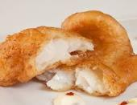
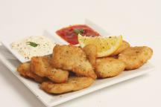
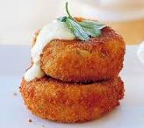
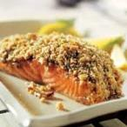
Segment winners by % volume growth
Chilled | Frozen | Ambient
Fingers (+67.9%) Batter (+23.2%) Natural (+8%) Breaded (+6.3%) Cakes (+5.6%) Prepared (+2.2%) Dusted (+0.6%) | Breaded (+15.7%) Prepared (+15.2%) Natural (+14.5%) Dusted (+10.5%) Batter (+8.9%) Fingers (+8.8%) Cakes (+4.8%) | Prepared (+9.8%) Sauce (+5.3%)
Source: Nielsen UK ScanTrack MAT 05.09.20

Slide 19
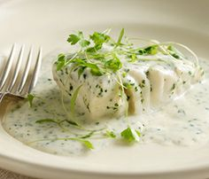
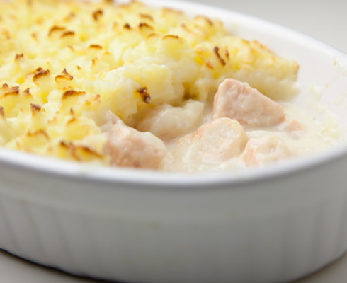
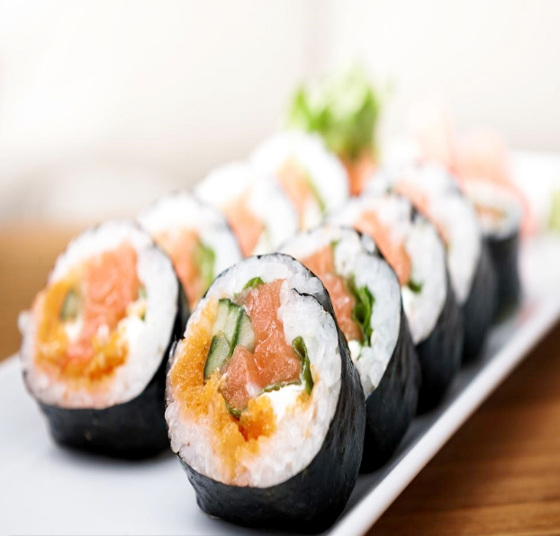
Declining segments by % volume
Chilled | Frozen
Sushi (-12.5%) Meals (-6.1%) Sauce (-1.1%) | Sushi (-76%) Sauce (-10%) Meals (-6.5%)
Source: Nielsen UK ScanTrack MAT 05.09.20

Slide 20
Top 5 species winners by volume
Overall volume sales
Tuna
68,114t (+10.3%)
Salmon
67,832t (+8.5%)
Cod
62,976t (+5.6%)
Pollock
34,392t (+7.5%)
Haddock
26,979t (+9.3%)
Volume sales % increase
Basa
9,889t (+31.6%)
Scampi
6,424t (+22.5%)
Sea Bass
4,989t (+17.8%)
Anchovy
887t (+17.1%)
Herring
2,253t (+10.8%)
For more details see ranked species tables
Source: Nielsen UK ScanTrack MAT 05.09.20

Slide 21
Retailer share of trade and purchase KPI’s
Source: Nielsen GB HomeScan we 05.09.20

Slide 22
52wks retailer share of total grocery and seafood: 6 retailers overtrade in seafood when compared to their share of total grocers
Source: Nielsen GB HomeScan MAT 05.09.20

Slide 23
52wks retailer share of total seafood: 4 retailers have increased their share of total seafood sales £
Source: Nielsen GB HomeScan MAT 05.09.20

Slide 24
52wks retailer share of chilled seafood: 4 retailers have increased their share of chilled seafood sales £
Source: Nielsen GB HomeScan MAT 05.09.20

Slide 25
52wks retailer share of frozen seafood: 5 retailers have increased their share of frozen seafood sales £
Source: Nielsen GB HomeScan MAT 05.09.20

Slide 26
52wks retailer share of ambient seafood: 5 retailers have increased their share of ambient seafood sales £
Source: Nielsen GB HomeScan MAT 05.09.20

Slide 27
Total seafood purchase KPI’s by retailer
 | Purchase Value ('000) 52w | Purchase Value % Chg YA 52w | Purchase Volume ('000) 52w | Purchase Volume % Chg YA 52w | Penetration 52w | Penetration % Chg YA 52w | Frequency of Purchase 52w | Frequency of Purchase % Chg YA 52w | AWOP (Value) 52w | AWOP (Value) % Chg YA 52w | Value per Occasion 52w | Value per Occasion % Chg YA 52w | Volume per Occasion 52w | Volume per Occasion % Chg YA 52w
Total GB | £3,735,549 | 5.8 | 414,257 | 6.0 | 96.7 | 0.2 | 30.6 | 1.1 | £137.10 | 4.8 | £4.48 | 3.6 | 0.5 | 3.8
Tesco | £782,528 | 1.2 | 84,933 | -0.4 | 56.1 | 1.2 | 11.1 | -2.5 | £49.55 | -0.8 | £4.47 | 1.8 | 0.5 | 0.2
Sainsbury | £527,740 | 3.7 | 50,448 | 5.8 | 37.4 | 2.8 | 10.8 | -0.8 | £50.05 | 0.1 | £4.66 | 0.9 | 0.4 | 2.8
Aldi | £437,853 | 13.2 | 64,945 | 14.5 | 44.8 | 5.6 | 9.5 | -1.1 | £34.70 | 6.3 | £3.65 | 7.5 | 0.5 | 8.8
Morrisons | £341,160 | 3.3 | 37,058 | 2.1 | 36.0 | 4.4 | 7.2 | -7.5 | £33.62 | -1.9 | £4.70 | 6.1 | 0.5 | 4.9
Asda | £308,222 | 5.3 | 38,684 | 4.0 | 40.2 | 4.1 | 7.0 | -3.7 | £27.18 | 0.3 | £3.87 | 4.2 | 0.5 | 2.9
Waitrose | £284,294 | 3.0 | 18,992 | 2.8 | 11.0 | -9.8 | 14.1 | 7.0 | £91.59 | 13.3 | £6.48 | 5.9 | 0.4 | 5.7
Lidl | £283,615 | 9.1 | 38,002 | 8.8 | 34.8 | 3.0 | 7.8 | 1.8 | £28.95 | 5.0 | £3.71 | 3.1 | 0.5 | 3.0
M&S | £248,284 | 2.7 | 17,466 | 4.5 | 18.3 | 1.3 | 8.0 | -2.8 | £48.24 | 0.6 | £6.07 | 3.5 | 0.4 | 5.1
Iceland | £153,368 | 11.1 | 23,598 | 5.8 | 30.4 | 5.4 | 3.7 | -4.4 | £17.88 | 4.5 | £4.83 | 9.3 | 0.7 | 4.2
Coop | £105,201 | 5.4 | 9,782 | 3.8 | 16.2 | 5.9 | 6.1 | -4.7 | £22.99 | -1.2 | £3.79 | 3.7 | 0.4 | 2.1
Farmfoods | £38,873 | 20.2 | 7,058 | 22.3 | 9.9 | 25.3 | 2.7 | -1.1 | £13.98 | -4.8 | £5.16 | -3.7 | 0.9 | -2.0
Budgens | £1,081 | 15.0 | 176 | 55.9 | 0.4 | 41.9 | 3.9 | -7.9 | £8.77 | -18.1 | £2.27 | -11.1 | 0.4 | 20.3
Source: Nielsen GB HomeScan MAT 05.09.20

Slide 28
Chilled seafood purchase KPI’s by retailer
 | Purchase Value ('000) 52w | Purchase Value % Chg YA 52w | Purchase Volume ('000) 52w | Purchase Volume % Chg YA 52w | Penetration 52w | Penetration % Chg YA 52w | Frequency of Purchase 52w | Frequency of Purchase % Chg YA 52w | AWOP (Value) 52w | AWOP (Value) % Chg YA 52w | Value per Occasion 52w | Value per Occasion % Chg YA 52w | Volume per Occasion 52w | Volume per Occasion % Chg YA 52w
Total GB | £2,155,754 | 1.5 | 177,054 | 2.0 | 81.7 | 0.2 | 19.8 | -1.1 | £93.68 | 0.4 | £4.73 | 1.5 | 0.4 | 1.9
Tesco | £435,599 | -3.7 | 35,689 | -7.2 | 37.5 | -2.0 | 8.9 | -2.3 | £41.26 | -2.6 | £4.66 | -0.3 | 0.4 | -3.9
Sainsbury | £344,049 | -1.3 | 26,726 | 0.8 | 27.2 | 0.3 | 9.6 | -1.6 | £44.84 | -2.5 | £4.66 | -0.8 | 0.4 | 1.1
Waitrose | £230,799 | -0.3 | 13,317 | -1.8 | 9.2 | -8.7 | 13.3 | 3.3 | £89.24 | 8.2 | £6.71 | 4.7 | 0.4 | 3.2
M&S | £223,608 | 0.6 | 14,797 | 0.7 | 17.0 | -1.8 | 7.6 | -1.8 | £46.60 | 1.6 | £6.12 | 3.4 | 0.4 | 3.5
Aldi | £218,061 | 9.4 | 24,786 | 12.7 | 31.0 | 4.9 | 7.0 | -1.1 | £24.99 | 3.4 | £3.56 | 4.6 | 0.4 | 7.6
Morrisons | £212,536 | -0.1 | 18,994 | 0.8 | 25.9 | 6.0 | 5.9 | -9.5 | £29.11 | -6.5 | £4.94 | 3.3 | 0.4 | 4.1
Lidl | £163,029 | 5.1 | 16,378 | 4.7 | 25.2 | -1.5 | 6.3 | 2.1 | £22.98 | 5.8 | £3.66 | 3.6 | 0.4 | 3.3
Asda | £141,201 | 3.2 | 13,570 | 3.6 | 24.6 | 6.6 | 5.4 | -3.9 | £20.37 | -4.0 | £3.79 | -0.1 | 0.4 | 0.5
Coop | £72,477 | 10.4 | 5,432 | 15.3 | 9.8 | 8.3 | 5.8 | 0.7 | £26.15 | 1.1 | £4.55 | 0.4 | 0.3 | 4.6
Iceland | £954 | -10.0 | 131 | 44.5 | 0.9 | 17.7 | 1.6 | 18.2 | £3.64 | -23.7 | £2.34 | -35.4 | 0.3 | 3.2
Budgens | £342 | -25.8 | 28 | -29.3 | 0.2 | 14.3 | 2.5 | -23.7 | £7.81 | -31.5 | £3.19 | -10.2 | 0.3 | -14.0
Farmfoods | £101 | 397.8 | 8 | 211.6 | 0.1 | 400.0 | 1.0 | -36.3 | £7.07 | 1.7 | £7.07 | 59.6 | 0.6 | 0.4
Source: Nielsen GB HomeScan MAT 05.09.20

Slide 29
Frozen seafood purchase KPI’s by retailer
 | Purchase Value ('000) 52w | Purchase Value % Chg YA 52w | Purchase Volume ('000) 52w | Purchase Volume % Chg YA 52w | Penetration 52w | Penetration % Chg YA 52w | Frequency of Purchase 52w | Frequency of Purchase % Chg YA 52w | AWOP (Value) 52w | AWOP (Value) % Chg YA 52w | Value per Occasion 52w | Value per Occasion % Chg YA 52w | Volume per Occasion 52w | Volume per Occasion % Chg YA 52w
Total GB | £1,024,197 | 14.6 | 147,226 | 9.4 | 87.0 | 1.5 | 11.4 | 5.7 | £41.79 | 11.9 | £3.68 | 5.9 | 0.5 | 1.2
Tesco | £225,863 | 9.7 | 30,327 | 5.6 | 37.9 | 5.9 | 5.9 | 1.2 | £21.14 | 2.8 | £3.58 | 1.6 | 0.5 | -2.2
Aldi | £148,984 | 22.4 | 25,349 | 20.0 | 29.4 | 8.5 | 5.7 | 2.5 | £17.97 | 11.8 | £3.15 | 9.1 | 0.5 | 7.0
Iceland | £139,894 | 11.3 | 21,415 | 4.7 | 29.3 | 5.2 | 3.6 | -3.2 | £16.95 | 4.9 | £4.71 | 8.4 | 0.7 | 2.2
Sainsbury | £104,162 | 14.6 | 13,099 | 10.8 | 21.2 | 8.8 | 4.7 | 1.1 | £17.44 | 4.5 | £3.68 | 3.4 | 0.5 | -0.1
Asda | £101,567 | 12.4 | 14,640 | 6.6 | 25.8 | 9.7 | 4.0 | -4.3 | £14.00 | 1.6 | £3.48 | 6.2 | 0.5 | 1.0
Morrisons | £78,983 | 13.5 | 10,692 | 1.7 | 20.9 | 9.9 | 3.7 | -10.7 | £13.44 | 2.4 | £3.59 | 14.7 | 0.5 | 3.0
Lidl | £78,982 | 18.4 | 12,458 | 12.9 | 20.5 | 8.3 | 4.1 | 3.8 | £13.66 | 8.4 | £3.37 | 4.4 | 0.5 | -0.5
Farmfoods | £32,062 | 18.9 | 5,782 | 20.5 | 8.9 | 27.5 | 2.5 | -4.5 | £12.73 | -7.5 | £5.01 | -3.2 | 0.9 | -1.7
Waitrose | £29,847 | 22.4 | 2,981 | 11.8 | 4.8 | -4.9 | 5.2 | 22.6 | £21.94 | 27.7 | £4.25 | 4.2 | 0.4 | -5.0
M&S | £18,590 | 25.4 | 1,852 | 15.0 | 4.2 | 36.6 | 3.2 | -16.8 | £15.80 | -9.0 | £4.97 | 9.3 | 0.5 | 0.3
Coop | £16,885 | -12.3 | 2,305 | -17.6 | 7.7 | -4.8 | 2.9 | -11.1 | £7.82 | -8.6 | £2.71 | 2.8 | 0.4 | -2.9
Budgens | £564 | 45.4 | 122 | 101.2 | 0.3 | 39.1 | 3.5 | 16.1 | £6.21 | 4.7 | £1.79 | -9.8 | 0.4 | 24.1
Source: Nielsen GB HomeScan MAT 05.09.20

Slide 30
Ambient seafood purchase KPI’s by retailer
 | Purchase Value ('000) 52w | Purchase Value % Chg YA 52w | Purchase Volume ('000) 52w | Purchase Volume % Chg YA 52w | Penetration 52w | Penetration % Chg YA 52w | Frequency of Purchase 52w | Frequency of Purchase % Chg YA 52w | AWOP (Value) 52w | AWOP (Value) % Chg YA 52w | Value per Occasion 52w | Value per Occasion % Chg YA 52w | Volume per Occasion 52w | Volume per Occasion % Chg YA 52w
Total GB | £555,599 | 8.4 | 89,977 | 8.9 | 79.6 | 1.2 | 9.4 | 3.4 | £24.77 | 6.2 | £2.63 | 2.7 | 0.4 | 3.1
Tesco | £121,066 | 5.5 | 18,917 | 4.4 | 32.6 | 4.0 | 4.9 | -0.2 | £13.17 | 0.6 | £2.70 | 0.8 | 0.4 | -0.3
Sainsbury | £79,529 | 14.9 | 10,622 | 14.0 | 20.1 | 7.3 | 5.0 | 2.9 | £14.08 | 6.3 | £2.82 | 3.3 | 0.4 | 2.7
Aldi | £70,808 | 7.5 | 14,810 | 8.8 | 26.7 | 6.6 | 4.7 | -5.5 | £9.42 | 0.0 | £2.02 | 5.8 | 0.4 | 6.9
Asda | £65,454 | -0.2 | 10,475 | 1.1 | 21.7 | 4.0 | 4.0 | -4.6 | £10.70 | -4.8 | £2.71 | -0.2 | 0.4 | 0.7
Morrisons | £49,641 | 3.5 | 7,372 | 6.3 | 17.7 | 7.3 | 3.6 | -7.9 | £9.97 | -4.4 | £2.76 | 3.8 | 0.4 | 6.4
Lidl | £41,605 | 8.9 | 9,166 | 11.2 | 17.5 | 6.0 | 4.1 | 2.5 | £8.42 | 1.9 | £2.06 | -0.6 | 0.5 | 1.9
Waitrose | £23,647 | 17.5 | 2,694 | 20.2 | 4.9 | -0.8 | 5.4 | 5.2 | £17.15 | 17.5 | £3.15 | 11.6 | 0.4 | 13.7
Coop | £15,839 | 6.1 | 2,045 | 7.0 | 5.8 | 30.7 | 4.2 | -20.3 | £9.70 | -19.5 | £2.34 | 1.1 | 0.3 | 1.9
Iceland | £12,520 | 11.0 | 2,052 | 16.6 | 5.2 | 15.6 | 1.8 | -21.5 | £8.55 | -4.8 | £4.78 | 21.3 | 0.8 | 27.4
Farmfoods | £6,710 | 25.5 | 1,269 | 30.7 | 3.0 | 26.3 | 2.0 | 10.1 | £7.85 | -1.7 | £3.98 | -10.7 | 0.8 | -7.3
M&S | £6,086 | 32.4 | 817 | 95.4 | 2.4 | 67.1 | 3.5 | -6.2 | £8.86 | -21.4 | £2.53 | -16.3 | 0.3 | 23.1
Budgens | £175 | 91.9 | 26 | 110.9 | 0.2 | 500.0 | 1.4 | -69.9 | £3.38 | -64.3 | £2.45 | 18.6 | 0.4 | 30.9
Source: Nielsen GB HomeScan MAT 05.09.20

Slide 31
Proteins context report
Source: Nielsen GB ScanTrack we 05.09.20

Slide 32
Meat & fish categories, value sales
Source: Nielsen UK ScanTrack MAT 05.09.20

Slide 33
Meat & fish categories, unit sales
Source: Nielsen UK ScanTrack MAT 05.09.20

Slide 34
Meat & fish categories, price per unit
Source: Nielsen UK ScanTrack MAT 05.09.20

Slide 35
On-line new product observations
Source: retailer websites July, August, September 2020

Slide 36
New products summary July, August, and September
Retailer | Chilled | Frozen | Ambient | Grand Total
Morrisons | 21 | 7 | 15 | 43
Iceland |  | 24 |  | 24
Sainsbury’s | 8 | 2 | 5 | 15
Waitrose | 7 | 1 |  | 8
Tesco |  | 3 | 4 | 7
Asda | 2 | 1 |  | 3
M&S | 1 |  |  | 1
Grand Total | 39 | 38 | 24 | 101
Source: Retailer websites July, August, and September 2020

Slide 37
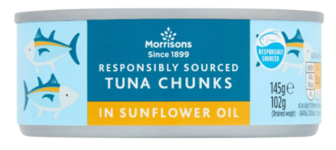
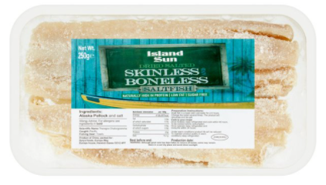
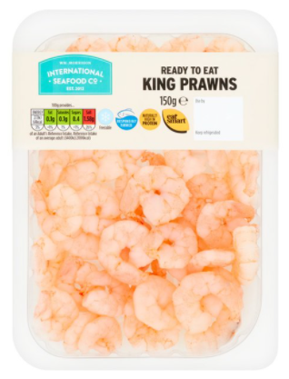
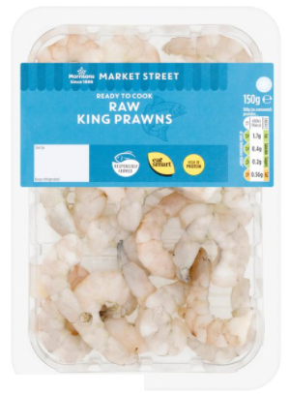
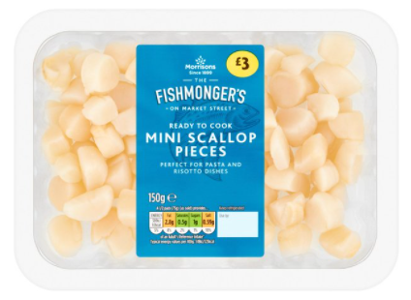
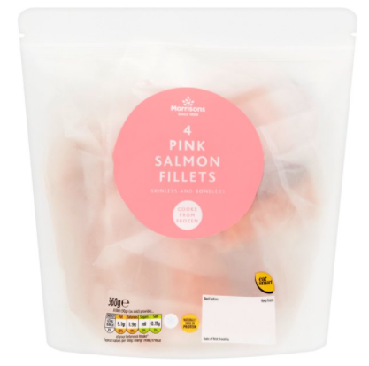
Morrisons
Segment | Chilled | Ambient | Frozen | Grand Total
Battered |  |  | 2 | 2
Breaded | 3 |  | 1 | 4
Cakes |  |  | 1 | 1
Dusted | 1 |  |  | 1
Fingers |  |  | 2 | 2
Natural | 8 |  | 1 | 9
Prepared | 9 | 13 |  | 22
Sauce |  | 2 |  | 2
Grand Total | 21 | 15 | 7 | 43
Source: Retailer website July, August, and September 2020

Slide 38
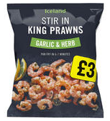
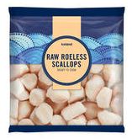
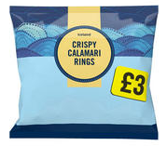
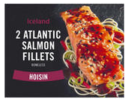
Iceland
Segment | Frozen | Grand Total
Battered | 6 | 6
Breaded | 4 | 4
Cakes | 1 | 1
Fingers | 3 | 3
Natural | 4 | 4
Prepared | 5 | 5
Sauce | 1 | 1
Grand Total | 24 | 24
Source: Retailer website July, August, and September 2020

Slide 39
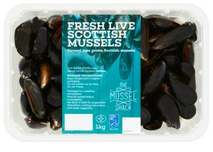
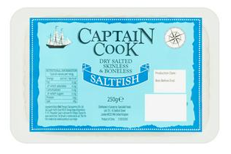
Sainsbury’s
Segment | Chilled | Ambient | Frozen | Grand Total
Meals | 1 |  | 2 | 3
Natural | 7 |  |  | 7
Prepared |  | 5 |  | 5
Grand Total | 8 | 5 | 2 | 15
Source: Retailer website July, August, and September 2020

Slide 40
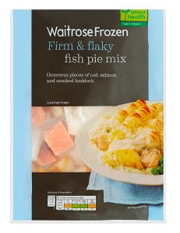
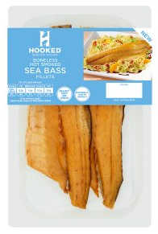
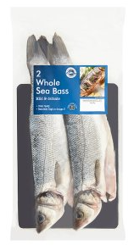
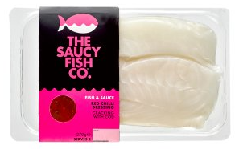
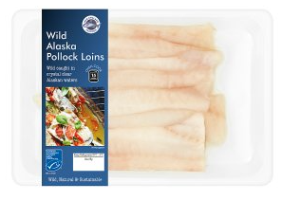
Waitrose
Segment | Chilled | Frozen | Grand Total
Natural | 5 | 1 | 6
Prepared | 1 |  | 1
Sauce | 1 |  | 1
Grand Total | 7 | 1 | 8
Source: Retailer website July, August, and September 2020

Slide 41
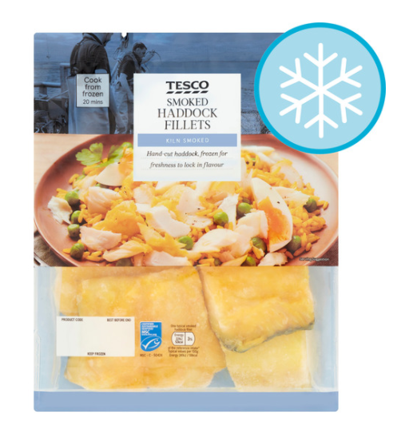
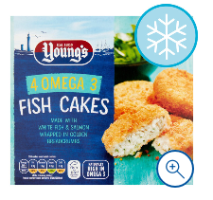
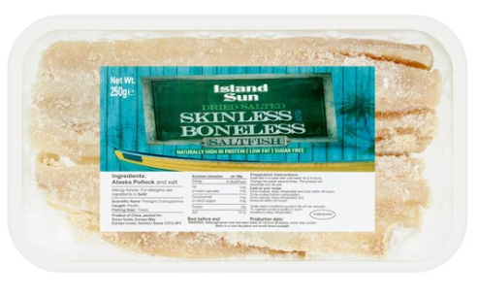
Tesco
Segment | Ambient | Frozen | Grand Total
Cakes |  | 1 | 1
Dusted |  | 1 | 1
Natural |  | 1 | 1
Prepared | 3 |  | 3
Sauce | 1 |  | 1
Grand Total | 4 | 3 | 7
Source: Retailer website July, August, and September 2020

Slide 42
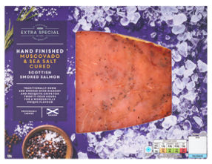
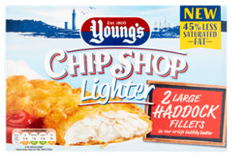
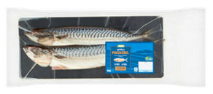
Asda
Segment | Chilled | Frozen | Grand Total
Battered |  | 1 | 1
Natural | 1 |  | 1
Prepared | 1 |  | 1
Grand Total | 2 | 1 | 3
Source: Retailer website July, August, and September 2020

Slide 43
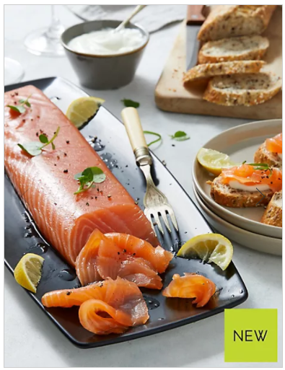
M&S
Segment | Chilled | Grand Total
Natural | 1 | 1
Grand Total | 1 | 1
Source: Retailer website July, August, and September 2020

Slide 44
Species, sales & pricing
Source: Nielsen UK Scantrack 05.09.20

Slide 45
Total seafood by species: top 25
 | Value Sales ('000) |  |  |  | Volume Sales ('000) |  |  |  | Unit Sales ('000) |  |  |  | Price per KG |  | Price per Unit
 | WE 08.09.18 | WE 07.09.19 | WE 05.09.20 | MAT % Chg YA | WE 08.09.18 | WE 07.09.19 | WE 05.09.20 | MAT % Chg YA | WE 08.09.18 | WE 07.09.19 | WE 05.09.20 | MAT % Chg YA | WE 05.09.20 | MAT % Chg YA | WE 05.09.20 | MAT % Chg YA
Total seafood | £3,834,497 | £3,837,940 | £4,099,146 | 6.8 | 395,108 | 393,125 | 420,604 | 7.0 | 1,471,931 | 1,471,913 | 1,576,859 | 7.1 | £9.75 | -0.2 | £2.60 | -0.3
Salmon | £1,073,864 | £1,076,310 | £1,140,009 | 5.9 | 61,997 | 62,538 | 67,832 | 8.5 | 277,268 | 279,081 | 299,866 | 7.4 | £16.81 | -2.3 | £3.80 | -1.4
Cod | £490,659 | £487,113 | £526,451 | 8.1 | 62,307 | 59,636 | 62,976 | 5.6 | 176,166 | 170,982 | 179,435 | 4.9 | £8.36 | 2.3 | £2.93 | 3.0
Tuna | £408,586 | £412,995 | £449,168 | 8.8 | 61,633 | 61,735 | 68,114 | 10.3 | 193,200 | 188,004 | 213,425 | 13.5 | £6.59 | -1.4 | £2.10 | -4.2
WW prawns | £341,039 | £346,362 | £370,507 | 7.0 | 23,459 | 24,433 | 25,957 | 6.2 | 110,881 | 116,516 | 126,328 | 8.4 | £14.27 | 0.7 | £2.93 | -1.3
Haddock | £249,415 | £239,514 | £258,347 | 7.9 | 26,529 | 24,676 | 26,979 | 9.3 | 83,694 | 78,181 | 84,191 | 7.7 | £9.58 | -1.3 | £3.07 | 0.2
Mixed seafood | £180,412 | £186,886 | £180,506 | -3.4 | 19,750 | 20,084 | 19,443 | -3.2 | 57,878 | 58,845 | 55,534 | -5.6 | £9.28 | -0.2 | £3.25 | 2.3
Pollock | £133,536 | £153,761 | £176,598 | 14.9 | 29,381 | 31,992 | 34,392 | 7.5 | 74,115 | 84,137 | 88,433 | 5.1 | £5.13 | 6.8 | £2.00 | 9.3
CW prawns | £172,022 | £166,422 | £170,796 | 2.6 | 14,464 | 13,917 | 13,717 | -1.4 | 62,456 | 61,908 | 62,595 | 1.1 | £12.45 | 4.1 | £2.73 | 1.5
Mackerel | £131,526 | £130,507 | £139,681 | 7.0 | 18,069 | 17,325 | 18,366 | 6.0 | 100,954 | 101,694 | 111,924 | 10.1 | £7.61 | 1.0 | £1.25 | -2.8
Sea Bass | £68,908 | £68,156 | £81,928 | 20.2 | 4,226 | 4,235 | 4,989 | 17.8 | 17,050 | 17,677 | 22,187 | 25.5 | £16.42 | 2.0 | £3.69 | -4.2
Basa | £63,010 | £59,193 | £75,900 | 28.2 | 8,029 | 7,516 | 9,889 | 31.6 | 26,111 | 23,932 | 29,904 | 25.0 | £7.68 | -2.5 | £2.54 | 2.6
Scampi | £57,653 | £57,834 | £69,869 | 20.8 | 5,446 | 5,246 | 6,424 | 22.5 | 24,104 | 23,000 | 26,730 | 16.2 | £10.88 | -1.3 | £2.61 | 4.0
Sardines | £39,986 | £41,127 | £43,718 | 6.3 | 8,511 | 8,489 | 9,267 | 9.2 | 69,957 | 70,647 | 77,010 | 9.0 | £4.72 | -2.6 | £0.57 | -2.5
Crabstick | £35,998 | £39,011 | £40,308 | 3.3 | 8,619 | 9,972 | 10,212 | 2.4 | 36,518 | 41,188 | 42,626 | 3.5 | £3.95 | 0.9 | £0.95 | -0.2
Trout | £37,796 | £36,013 | £32,140 | -10.8 | 2,812 | 2,479 | 2,082 | -16.0 | 10,209 | 9,607 | 8,253 | -14.1 | £15.44 | 6.2 | £3.89 | 3.9
Sole | £29,431 | £29,903 | £30,933 | 3.4 | 2,279 | 2,379 | 2,539 | 6.7 | 8,688 | 8,968 | 9,441 | 5.3 | £12.18 | -3.1 | £3.28 | -1.7
Mussels | £25,305 | £24,900 | £24,543 | -1.4 | 4,531 | 4,312 | 4,291 | -0.5 | 12,890 | 12,786 | 12,303 | -3.8 | £5.72 | -0.9 | £1.99 | 2.4
Crab | £27,862 | £26,045 | £23,661 | -9.2 | 1,453 | 1,322 | 1,005 | -24.0 | 8,535 | 7,570 | 6,345 | -16.2 | £23.53 | 19.5 | £3.73 | 8.4
Plaice | £25,223 | £18,641 | £18,400 | -1.3 | 2,508 | 1,674 | 1,563 | -6.6 | 8,369 | 5,778 | 5,501 | -4.8 | £11.77 | 5.7 | £3.35 | 3.7
Squid (calamari) | £17,115 | £16,857 | £18,275 | 8.4 | 1,252 | 1,420 | 1,509 | 6.3 | 6,043 | 6,075 | 6,556 | 7.9 | £12.11 | 2.0 | £2.79 | 0.5
Scallops | £16,508 | £17,366 | £17,697 | 1.9 | 743 | 719 | 728 | 1.3 | 3,425 | 3,486 | 3,467 | -0.5 | £24.30 | 0.6 | £5.10 | 2.5
Anchovy | £13,145 | £12,867 | £15,670 | 21.8 | 779 | 758 | 887 | 17.1 | 10,467 | 10,605 | 12,417 | 17.1 | £17.67 | 4.0 | £1.26 | 4.0
Herring | £12,809 | £13,560 | £14,377 | 6.0 | 1,964 | 2,033 | 2,253 | 10.8 | 7,434 | 7,920 | 8,595 | 8.5 | £6.38 | -4.3 | £1.67 | -2.3
Sea-Brm | £16,857 | £15,133 | £13,989 | -7.6 | 1,148 | 1,072 | 1,021 | -4.7 | 4,076 | 3,805 | 3,337 | -12.3 | £13.70 | -3.0 | £4.19 | 5.4
Kipper | £14,923 | £14,758 | £13,905 | -5.8 | 1,864 | 1,753 | 1,665 | -5.0 | 10,340 | 9,811 | 9,192 | -6.3 | £8.35 | -0.8 | £1.51 | 0.6
Source: Nielsen UK ScanTrack MAT 05.09.20

Slide 46
Total seafood by species: top 26-50
 | Value Sales ('000) |  |  |  | Volume Sales ('000) |  |  |  | Unit Sales ('000) |  |  |  | Price per KG |  | Price per Unit
 | WE 08.09.18 | WE 07.09.19 | WE 05.09.20 | MAT % Chg YA | WE 08.09.18 | WE 07.09.19 | WE 05.09.20 | MAT % Chg YA | WE 08.09.18 | WE 07.09.19 | WE 05.09.20 | MAT % Chg YA | WE 05.09.20 | MAT % Chg YA | WE 05.09.20 | MAT % Chg YA
Total seafood | £3,834,497 | £3,837,940 | £4,099,146 | 6.8 | 395,108 | 393,125 | 420,604 | 7.0 | 1,471,931 | 1,471,913 | 1,576,859 | 7.1 | £9.75 | -0.2 | £2.60 | -0.3
Shrimps | £7,461 | £10,522 | £12,134 | 15.3 | 384 | 631 | 711 | 12.7 | 1,590 | 2,634 | 2,939 | 11.6 | £17.06 | 2.3 | £4.13 | 3.4
Lobster | £9,324 | £6,960 | £7,857 | 12.9 | 339 | 238 | 296 | 24.4 | 1,199 | 841 | 929 | 10.5 | £26.54 | -9.3 | £8.46 | 2.2
Pilchards | £6,030 | £6,025 | £6,211 | 3.1 | 1,951 | 1,953 | 1,980 | 1.4 | 8,591 | 8,288 | 8,362 | 0.9 | £3.14 | 1.6 | £0.74 | 2.2
Hake | £8,046 | £7,025 | £5,689 | -19.0 | 559 | 500 | 381 | -23.9 | 2,175 | 1,941 | 1,611 | -17.0 | £14.95 | 6.4 | £3.53 | -2.4
Cockles | £5,887 | £5,636 | £4,981 | -11.6 | 553 | 494 | 455 | -7.9 | 3,099 | 2,863 | 2,685 | -6.2 | £10.95 | -4.0 | £1.86 | -5.8
Monkfish | £3,634 | £4,068 | £4,392 | 8.0 | 80 | 88 | 107 | 20.9 | 496 | 564 | 645 | 14.4 | £41.13 | -10.7 | £6.81 | -5.6
Crayfish | £6,552 | £5,113 | £3,132 | -38.7 | 254 | 183 | 105 | -42.8 | 2,116 | 1,605 | 1,006 | -37.3 | £29.89 | 7.1 | £3.11 | -2.2
Halibut | £1,114 | £1,435 | £2,063 | 43.8 | 46 | 48 | 58 | 22.7 | 131 | 153 | 214 | 39.6 | £35.40 | 17.2 | £9.66 | 3.0
Skat/Ry | £2,513 | £2,176 | £1,593 | -26.8 | 84 | 73 | 53 | -27.1 | 600 | 522 | 381 | -27.1 | £29.89 | 0.4 | £4.18 | 0.4
Langoustine | £824 | £1,179 | £1,519 | 28.8 | 42 | 66 | 80 | 20.8 | 140 | 198 | 246 | 24.2 | £19.01 | 6.6 | £6.16 | 3.7
Cod Roe | £1,367 | £1,612 | £1,517 | -5.9 | 148 | 139 | 134 | -3.6 | 792 | 841 | 852 | 1.4 | £11.31 | -2.4 | £1.78 | -7.1
Oysters | £1,252 | £1,296 | £1,333 | 2.9 | 56 | 50 | 53 | 5.0 | 464 | 445 | 448 | 0.6 | £25.18 | -2.0 | £2.98 | 2.2
Swordfish | £1,843 | £1,134 | £1,200 | 5.8 | 56 | 36 | 34 | -5.0 | 389 | 243 | 241 | -0.5 | £35.37 | 11.4 | £4.97 | 6.4
Tilapia | £641 | £967 | £1,110 | 14.8 | 84 | 87 | 95 | 10.2 | 153 | 211 | 229 | 8.9 | £11.63 | 4.1 | £4.84 | 5.4
Lumpfish Roe | £886 | £983 | £992 | 0.9 | 26 | 28 | 27 | -3.8 | 354 | 364 | 366 | 0.4 | £37.26 | 4.9 | £2.71 | 0.5
Octopus | £669 | £860 | £983 | 14.3 | 47 | 52 | 58 | 12.1 | 280 | 325 | 356 | 9.6 | £16.88 | 2.0 | £2.76 | 4.3
Sild | £717 | £808 | £956 | 18.2 | 61 | 79 | 79 | 0.3 | 554 | 642 | 720 | 12.0 | £12.06 | 17.8 | £1.33 | 5.5
Clams | £879 | £892 | £923 | 3.5 | 120 | 120 | 123 | 3.1 | 224 | 210 | 227 | 8.5 | £7.49 | 0.4 | £4.06 | -4.6
Caviar | £614 | £780 | £889 | 14.1 | 14 | 14 | 15 | 2.9 | 172 | 174 | 174 | -0.2 | £60.53 | 10.8 | £5.12 | 14.3
Surimi | £91 | £354 | £828 | 133.8 | 7 | 51 | 100 | 97.7 | 24 | 180 | 314 | 73.9 | £8.28 | 18.3 | £2.64 | 34.5
Coley | £1,593 | £1,158 | £802 | -30.8 | 193 | 132 | 89 | -32.7 | 526 | 371 | 234 | -36.8 | £9.04 | 2.9 | £3.42 | 9.6
Eel | £1,287 | £1,103 | £799 | -27.6 | 83 | 74 | 55 | -25.0 | 485 | 431 | 304 | -29.5 | £14.48 | -3.5 | £2.63 | 2.8
Whitebait | £2,356 | £1,504 | £761 | -49.4 | 383 | 293 | 155 | -47.2 | 1,001 | 717 | 363 | -49.3 | £4.92 | -4.2 | £2.09 | -0.1
Sprats | £892 | £764 | £750 | -1.9 | 108 | 86 | 76 | -12.1 | 773 | 624 | 585 | -6.3 | £9.90 | 11.6 | £1.28 | 4.7
Salmon Roe | £589 | £441 | £532 | 20.7 | 7 | 4 | 5 | 19.2 | 149 | 82 | 97 | 18.8 | £108.14 | 1.2 | £5.47 | 1.6
Source: Nielsen UK ScanTrack MAT 05.09.20

Slide 47
Chilled seafood by species: top 25
 | Value Sales ('000) |  |  |  | Volume Sales ('000) |  |  |  | Unit Sales ('000) |  |  |  | Price per KG |  | Price per Unit
 | WE 08.09.18 | WE 07.09.19 | WE 05.09.20 | MAT % Chg YA | WE 08.09.18 | WE 07.09.19 | WE 05.09.20 | MAT % Chg YA | WE 08.09.18 | WE 07.09.19 | WE 05.09.20 | MAT % Chg YA | WE 05.09.20 | MAT % Chg YA | WE 05.09.20 | MAT % Chg YA
Chilled | £2,375,364 | £2,368,002 | £2,436,943 | 2.9 | 176,488 | 178,440 | 185,845 | 4.2 | 734,327 | 744,154 | 774,509 | 4.1 | £13.11 | -1.2 | £3.15 | -1.1
Salmon | £943,810 | £956,533 | £1,007,749 | 5.4 | 48,407 | 50,898 | 55,660 | 9.4 | 225,500 | 236,257 | 257,012 | 8.8 | £18.11 | -3.7 | £3.92 | -3.2
WW prawns | £236,366 | £242,047 | £254,624 | 5.2 | 15,084 | 15,989 | 16,912 | 5.8 | 78,238 | 83,063 | 89,020 | 7.2 | £15.06 | -0.5 | £2.86 | -1.8
Cod | £225,531 | £230,519 | £236,800 | 2.7 | 19,708 | 20,488 | 21,677 | 5.8 | 72,820 | 73,918 | 75,394 | 2.0 | £10.92 | -2.9 | £3.14 | 0.7
Haddock | £173,850 | £168,648 | £176,203 | 4.5 | 15,820 | 15,145 | 16,486 | 8.9 | 57,851 | 55,347 | 58,925 | 6.5 | £10.69 | -4.0 | £2.99 | -1.9
Mixed seafood | £153,101 | £157,585 | £146,463 | -7.1 | 16,052 | 16,213 | 15,075 | -7.0 | 48,161 | 48,800 | 44,806 | -8.2 | £9.72 | 0.0 | £3.27 | 1.2
CW prawns | £109,561 | £103,877 | £102,518 | -1.3 | 8,439 | 8,389 | 7,765 | -7.4 | 42,651 | 42,385 | 41,244 | -2.7 | £13.20 | 6.6 | £2.49 | 1.4
Mackerel | £81,151 | £77,896 | £78,353 | 0.6 | 9,802 | 8,825 | 8,963 | 1.6 | 36,803 | 35,166 | 38,268 | 8.8 | £8.74 | -1.0 | £2.05 | -7.6
Sea bass | £64,153 | £63,421 | £77,019 | 21.4 | 3,883 | 3,870 | 4,571 | 18.1 | 16,102 | 16,518 | 20,861 | 26.3 | £16.85 | 2.8 | £3.69 | -3.8
Tuna | £46,765 | £44,216 | £44,221 | 0.0 | 3,388 | 3,399 | 3,670 | 8.0 | 12,160 | 12,040 | 12,137 | 0.8 | £12.05 | -7.4 | £3.64 | -0.8
Crabstick | £33,554 | £36,826 | £38,755 | 5.2 | 8,004 | 9,446 | 9,858 | 4.4 | 34,157 | 39,139 | 41,244 | 5.4 | £3.93 | 0.8 | £0.94 | -0.1
Trout | £34,938 | £34,363 | £30,637 | -10.8 | 2,525 | 2,284 | 1,912 | -16.3 | 9,455 | 9,132 | 7,825 | -14.3 | £16.03 | 6.5 | £3.92 | 4.1
Sole | £20,500 | £19,120 | £19,591 | 2.5 | 1,388 | 1,274 | 1,348 | 5.8 | 5,230 | 4,591 | 4,673 | 1.8 | £14.53 | -3.1 | £4.19 | 0.7
Crab | £21,552 | £20,163 | £19,380 | -3.9 | 1,026 | 868 | 750 | -13.6 | 5,835 | 5,034 | 4,750 | -5.6 | £25.86 | 11.3 | £4.08 | 1.9
Mussels | £20,664 | £20,171 | £19,009 | -5.8 | 3,851 | 3,631 | 3,569 | -1.7 | 10,480 | 10,428 | 9,677 | -7.2 | £5.33 | -4.1 | £1.96 | 1.6
Basa | £17,154 | £16,130 | £17,849 | 10.7 | 1,686 | 1,518 | 1,703 | 12.2 | 7,307 | 6,604 | 6,992 | 5.9 | £10.48 | -1.4 | £2.55 | 4.5
Plaice | £20,197 | £14,676 | £14,070 | -4.1 | 1,852 | 1,188 | 1,086 | -8.6 | 6,862 | 4,660 | 4,366 | -6.3 | £12.96 | 4.9 | £3.22 | 2.3
Sea-brm | £16,810 | £15,130 | £13,989 | -7.5 | 1,144 | 1,072 | 1,021 | -4.7 | 4,064 | 3,804 | 3,337 | -12.3 | £13.70 | -3.0 | £4.19 | 5.4
Pollock | £11,417 | £12,641 | £12,836 | 1.5 | 2,371 | 2,589 | 2,632 | 1.6 | 5,314 | 5,831 | 5,760 | -1.2 | £4.88 | -0.1 | £2.23 | 2.8
Scallops | £11,596 | £11,653 | £11,178 | -4.1 | 533 | 481 | 444 | -7.8 | 2,541 | 2,447 | 2,252 | -8.0 | £25.19 | 4.1 | £4.96 | 4.3
Kipper | £11,795 | £11,578 | £10,766 | -7.0 | 1,464 | 1,361 | 1,300 | -4.5 | 7,953 | 7,471 | 7,008 | -6.2 | £8.28 | -2.6 | £1.54 | -0.9
Scampi | £9,875 | £9,157 | £8,921 | -2.6 | 622 | 558 | 533 | -4.5 | 3,079 | 2,804 | 2,701 | -3.7 | £16.75 | 2.0 | £3.30 | 1.1
Herring | £8,274 | £8,438 | £8,895 | 5.4 | 1,262 | 1,272 | 1,415 | 11.2 | 4,620 | 4,669 | 4,900 | 4.9 | £6.29 | -5.2 | £1.82 | 0.4
Squid (calamari) | £9,823 | £8,099 | £8,247 | 1.8 | 505 | 386 | 408 | 5.7 | 3,373 | 2,793 | 2,797 | 0.2 | £20.23 | -3.7 | £2.95 | 1.7
Hake | £7,557 | £5,624 | £4,464 | -20.6 | 481 | 289 | 227 | -21.3 | 2,018 | 1,533 | 1,260 | -17.9 | £19.64 | 0.8 | £3.54 | -3.4
Monkfish | £3,597 | £3,856 | £3,897 | 1.1 | 76 | 78 | 88 | 13.5 | 488 | 532 | 587 | 10.3 | £44.21 | -11.0 | £6.64 | -8.4
Source: Nielsen UK ScanTrack MAT 05.09.20

Slide 48
Frozen seafood by species: top 25
 | Value Sales ('000) |  |  |  | Volume Sales ('000) |  |  |  | Unit Sales ('000) |  |  |  | Price per KG |  | Price per Unit
 | WE 08.09.18 | WE 07.09.19 | WE 05.09.20 | MAT % Chg YA | WE 08.09.18 | WE 07.09.19 | WE 05.09.20 | MAT % Chg YA | WE 08.09.18 | WE 07.09.19 | WE 05.09.20 | MAT % Chg YA | WE 05.09.20 | MAT % Chg YA | WE 05.09.20 | MAT % Chg YA
Frozen | £914,380 | £917,583 | £1,055,856 | 15.1 | 134,815 | 131,202 | 143,484 | 9.4 | 365,650 | 362,419 | 397,337 | 9.6 | £7.36 | 5.2 | £2.66 | 5.0
Cod | £264,525 | £255,902 | £288,715 | 12.8 | 42,549 | 39,091 | 41,237 | 5.5 | 103,161 | 96,856 | 103,789 | 7.2 | £7.00 | 7.0 | £2.78 | 5.3
Pollock | £122,118 | £141,059 | £163,438 | 15.9 | 27,010 | 29,392 | 31,716 | 7.9 | 68,800 | 78,277 | 82,527 | 5.4 | £5.15 | 7.4 | £1.98 | 9.9
WW prawns | £104,673 | £104,315 | £115,883 | 11.1 | 8,375 | 8,443 | 9,045 | 7.1 | 32,643 | 33,453 | 37,308 | 11.5 | £12.81 | 3.7 | £3.11 | -0.4
Haddock | £75,565 | £70,866 | £82,144 | 15.9 | 10,709 | 9,531 | 10,493 | 10.1 | 25,844 | 22,834 | 25,265 | 10.6 | £7.83 | 5.3 | £3.25 | 4.8
CW prawns | £62,460 | £62,545 | £68,277 | 9.2 | 6,025 | 5,528 | 5,952 | 7.7 | 19,805 | 19,522 | 21,351 | 9.4 | £11.47 | 1.4 | £3.20 | -0.2
Salmon | £62,937 | £57,472 | £66,563 | 15.8 | 7,801 | 6,856 | 7,596 | 10.8 | 20,449 | 17,027 | 18,402 | 8.1 | £8.76 | 4.5 | £3.62 | 7.2
Scampi | £47,778 | £48,677 | £60,948 | 25.2 | 4,825 | 4,688 | 5,891 | 25.7 | 21,025 | 20,196 | 24,029 | 19.0 | £10.35 | -0.4 | £2.54 | 5.2
Basa | £45,856 | £43,063 | £58,051 | 34.8 | 6,343 | 5,998 | 8,186 | 36.5 | 18,804 | 17,328 | 22,912 | 32.2 | £7.09 | -1.2 | £2.53 | 2.0
Mixed seafood | £27,257 | £29,246 | £33,977 | 16.2 | 3,693 | 3,868 | 4,365 | 12.9 | 9,698 | 10,029 | 10,708 | 6.8 | £7.78 | 2.9 | £3.17 | 8.8
Sole | £8,931 | £10,783 | £11,343 | 5.2 | 891 | 1,105 | 1,191 | 7.9 | 3,457 | 4,376 | 4,768 | 8.9 | £9.52 | -2.5 | £2.38 | -3.4
Squid (calamari) | £6,873 | £8,496 | £9,793 | 15.3 | 713 | 1,019 | 1,085 | 6.5 | 2,395 | 3,139 | 3,620 | 15.3 | £9.03 | 8.2 | £2.71 | 0.0
Tuna | £9,103 | £7,578 | £8,514 | 12.4 | 1,284 | 984 | 1,042 | 5.9 | 3,359 | 2,496 | 2,653 | 6.3 | £8.17 | 6.1 | £3.21 | 5.7
Shrimps | £3,707 | £6,012 | £8,420 | 40.1 | 272 | 484 | 601 | 24.1 | 773 | 1,596 | 2,079 | 30.2 | £14.02 | 12.9 | £4.05 | 7.5
Scallops | £4,844 | £5,650 | £6,476 | 14.6 | 207 | 235 | 282 | 20.3 | 859 | 1,013 | 1,197 | 18.1 | £22.94 | -4.7 | £5.41 | -2.9
Sea bass | £4,756 | £4,735 | £4,909 | 3.7 | 343 | 365 | 418 | 14.7 | 948 | 1,159 | 1,326 | 14.4 | £11.73 | -9.6 | £3.70 | -9.4
Plaice | £5,025 | £3,964 | £4,330 | 9.2 | 656 | 486 | 477 | -1.8 | 1,508 | 1,118 | 1,135 | 1.5 | £9.07 | 11.2 | £3.82 | 7.6
Lobster | £4,659 | £3,217 | £4,074 | 26.7 | 189 | 126 | 186 | 48.1 | 601 | 388 | 557 | 43.5 | £21.92 | -14.5 | £7.32 | -11.7
Mussels | £2,924 | £3,184 | £3,903 | 22.6 | 499 | 524 | 558 | 6.5 | 1,232 | 1,344 | 1,564 | 16.4 | £7.00 | 15.1 | £2.50 | 5.4
Mackerel | £2,306 | £1,877 | £1,973 | 5.1 | 246 | 209 | 221 | 5.9 | 670 | 544 | 553 | 1.6 | £8.91 | -0.8 | £3.57 | 3.4
Crabstick | £2,443 | £2,185 | £1,553 | -28.9 | 615 | 526 | 354 | -32.6 | 2,361 | 2,049 | 1,382 | -32.6 | £4.38 | 5.5 | £1.12 | 5.4
Trout | £2,856 | £1,649 | £1,500 | -9.0 | 287 | 195 | 171 | -12.6 | 754 | 475 | 428 | -9.9 | £8.79 | 4.1 | £3.51 | 1.0
Kipper | £1,467 | £1,491 | £1,398 | -6.3 | 227 | 222 | 194 | -13.0 | 1,320 | 1,296 | 1,126 | -13.1 | £7.22 | 7.7 | £1.24 | 7.9
Hake | £489 | £1,401 | £1,225 | -12.5 | 78 | 212 | 153 | -27.5 | 157 | 407 | 351 | -13.7 | £7.99 | 20.7 | £3.49 | 1.4
Langoustine | £596 | £927 | £1,108 | 19.6 | 36 | 60 | 72 | 20.4 | 71 | 119 | 144 | 20.4 | £15.43 | -0.7 | £7.71 | -0.7
Whitebait | £1,925 | £1,500 | £759 | -49.4 | 350 | 292 | 154 | -47.2 | 867 | 716 | 363 | -49.3 | £4.92 | -4.2 | £2.09 | -0.1
Source: Nielsen UK ScanTrack MAT 05.09.20

Slide 49
Ambient seafood by species: top 25
 | Value Sales ('000) |  |  |  | Volume Sales ('000) |  |  |  | Unit Sales ('000) |  |  |  | Price per KG |  | Price per Unit
 | WE 08.09.18 | WE 07.09.19 | WE 05.09.20 | MAT % Chg YA | WE 08.09.18 | WE 07.09.19 | WE 05.09.20 | MAT % Chg YA | WE 08.09.18 | WE 07.09.19 | WE 05.09.20 | MAT % Chg YA | WE 05.09.20 | MAT % Chg YA | WE 05.09.20 | MAT % Chg YA
Ambient | £544,753 | £552,354 | £606,346 | 9.8 | 83,805 | 83,483 | 91,274 | 9.3 | 371,954 | 365,339 | 405,014 | 10.9 | £6.64 | 0.4 | £1.50 | -1.0
Tuna | £352,718 | £361,201 | £396,432 | 9.8 | 56,961 | 57,353 | 63,402 | 10.5 | 177,681 | 173,468 | 198,635 | 14.5 | £6.25 | -0.7 | £2.00 | -4.2
Salmon | £67,116 | £62,305 | £65,697 | 5.4 | 5,790 | 4,784 | 4,577 | -4.3 | 31,320 | 25,796 | 24,451 | -5.2 | £14.35 | 10.2 | £2.69 | 11.2
Mackerel | £48,070 | £50,734 | £59,356 | 17.0 | 8,021 | 8,291 | 9,181 | 10.7 | 63,480 | 65,984 | 73,103 | 10.8 | £6.47 | 5.7 | £0.81 | 5.6
Sardines | £37,617 | £39,129 | £41,891 | 7.1 | 8,167 | 8,267 | 9,077 | 9.8 | 68,555 | 69,561 | 76,082 | 9.4 | £4.62 | -2.5 | £0.55 | -2.1
Anchovy | £8,842 | £9,101 | £11,781 | 29.5 | 534 | 544 | 678 | 24.5 | 8,744 | 9,031 | 10,879 | 20.5 | £17.38 | 3.9 | £1.08 | 7.5
Pilchards | £6,030 | £6,025 | £6,211 | 3.1 | 1,951 | 1,953 | 1,980 | 1.4 | 8,591 | 8,288 | 8,362 | 0.9 | £3.14 | 1.6 | £0.74 | 2.2
Herring | £4,534 | £5,121 | £5,481 | 7.0 | 702 | 761 | 838 | 10.1 | 2,814 | 3,251 | 3,695 | 13.7 | £6.54 | -2.8 | £1.48 | -5.8
Crab | £4,932 | £4,416 | £4,058 | -8.1 | 306 | 254 | 223 | -12.2 | 2,291 | 2,023 | 1,510 | -25.4 | £18.21 | 4.7 | £2.69 | 23.1
Cockles | £3,960 | £3,816 | £3,947 | 3.4 | 403 | 386 | 397 | 2.8 | 2,396 | 2,290 | 2,349 | 2.6 | £9.95 | 0.6 | £1.68 | 0.8
Kipper | £1,661 | £1,689 | £1,741 | 3.1 | 173 | 169 | 171 | 1.4 | 1,068 | 1,044 | 1,058 | 1.3 | £10.16 | 1.7 | £1.65 | 1.8
Mussels | £1,717 | £1,546 | £1,631 | 5.5 | 182 | 158 | 164 | 4.2 | 1,178 | 1,014 | 1,062 | 4.7 | £9.92 | 1.3 | £1.54 | 0.8
Cod roe | £1,246 | £1,259 | £1,286 | 2.1 | 146 | 133 | 130 | -2.8 | 770 | 767 | 795 | 3.8 | £9.93 | 5.1 | £1.62 | -1.5
Sild | £717 | £808 | £956 | 18.2 | 61 | 79 | 79 | 0.3 | 554 | 642 | 720 | 12.0 | £12.06 | 17.8 | £1.33 | 5.5
Cod | £602 | £692 | £936 | 35.2 | 49 | 57 | 62 | 10.1 | 185 | 209 | 252 | 20.5 | £15.00 | 22.8 | £3.71 | 12.2
Lumpfish roe | £670 | £752 | £855 | 13.7 | 20 | 21 | 23 | 8.0 | 273 | 284 | 320 | 12.6 | £37.27 | 5.3 | £2.67 | 1.0
Caviar | £585 | £557 | £545 | -2.1 | 14 | 12 | 12 | -2.8 | 171 | 149 | 140 | -6.4 | £45.97 | 0.6 | £3.90 | 4.5
Oysters | £534 | £520 | £545 | 4.7 | 21 | 21 | 22 | 3.7 | 248 | 245 | 254 | 3.7 | £25.22 | 1.0 | £2.14 | 1.0
Salmon roe | £443 | £441 | £532 | 20.7 | 5 | 4 | 5 | 19.2 | 103 | 82 | 97 | 18.8 | £108.14 | 1.2 | £5.47 | 1.6
Pollock | £1 | £60 | £324 | 442.3 | 0 | 10 | 44 | 328.8 | 1 | 29 | 146 | 396.5 | £7.36 | 26.5 | £2.22 | 9.2
Sprats | £273 | £299 | £293 | -2.2 | 40 | 43 | 38 | -11.6 | 230 | 237 | 208 | -12.4 | £7.70 | 10.7 | £1.41 | 11.7
Octopus | £251 | £287 | £285 | -0.9 | 27 | 24 | 28 | 17.1 | 158 | 154 | 173 | 12.3 | £10.02 | -15.4 | £1.64 | -11.7
Squid (calamari) | £419 | £261 | £236 | -9.9 | 34 | 16 | 16 | 3.7 | 275 | 143 | 139 | -2.8 | £14.58 | -13.1 | £1.70 | -7.3
Mixed seafood | £54 | £55 | £67 | 21.5 | 4 | 3 | 4 | 21.5 | 19 | 16 | 19 | 23.2 | £17.44 | 0.1 | £3.49 | -1.3
Scallops | £67 | £63 | £42 | -33.1 | 3 | 3 | 2 | -23.9 | 26 | 25 | 19 | -25.2 | £19.89 | -12.1 | £2.27 | -10.6
Lobster | £119 | £116 | £39 | -66.1 | 5 | 4 | 1 | -67.8 | 109 | 103 | 33 | -67.8 | £27.54 | 5.2 | £1.18 | 5.2
Source: Nielsen UK ScanTrack MAT 05.09.20

Slide 50
Market data context and definitions

Slide 51
Market data context
Scantrack data is now reported as UK (including discounters), as apposed to previously GB (excluding discounters). However Homescan remains unchanged as GB (including discounters).
Share of Trade and switching tables/ charts & KPI Trees use Homescan data which is panel derived. As such, these charts should only be considered indicative of trends. The stated values/ and % share may not reflect the true share due to limitations in pick up, panel size and penetration and scaling The data is considered robust (within its limitations) when penetration (% of panel purchasing) is greater than 1.0%. NB In July 2013 Nielsen introduced new algorithms to closely align homescan and scantrack trends. As a result, homescan data can only be compared up to and post this event

Slide 52
Market data definitions
Data sourced from Nielsen
Scantrack – UK EPOS from key retailers (including composite data from discounters Aldi & Lidl and N. Ireland)
Homescan – GB Consumer panel of 15,000 households using hand held scanners to record grocery purchases
MAT – Moving Annual Total i.e. 52 weeks, TY= This year, YA= Year ago, 2YA =Two years ago
Fish – Seafood (i.e. fish and shellfish)
Segment definitions:
Batter – include all fish & seafood which is described as being coated in batter or battered
Breaded – include all fish & seafood which is described as being coated in breadcrumbs or breaded
Cakes – include all fish & seafood which are described as cakes
Fingers – include all fish & seafood which are described as fingers
Meals – include all fish & seafood which packaged with a carbohydrate and sold as a meal
Dusted – include all fish & seafood which are described as ‘dusted’
Natural – include all fish & seafood which has not been treated in any way
Prepared – include all fish & seafood which has been treated/prepared in some way and is not included within the above values e.g. all fish & seafood sticks including sticks with a dipping sauce
Sauce – include all fish & seafood which is described as being in a sauce
Sushi – include all sushi, where fish & seafood are contained within
Segments can be further broken down by:
Sector i.e. Chilled, Frozen & Ambient
Species e.g. Cod, Haddock
Smoked & Unsmoked
Organic & Standard

Slide 53
Thank you
Julia Brooks
Market Insight Analyst
M: 07944 682 751
E: julia.brooks@seafish.co.uk

