Slide 1
Quarterly CREST Report
Data to December 2020

Slide 2
Executive Summary – GB – Q4 2020
UK GDP declined by -2.6% in November 2020, with the second national Covid lockdown in November ending six months of growth. All non-essential shops and the hospitality sector in England were ordered to close to combat the rapid growth in Covid infections, and tougher controls in Scotland, Wales and Northern Ireland also weighed on growth. In December, consumer confidence improved somewhat following the news of the vaccine roll-out but remained at -26. Inflation was virtually flat at 0.8% at the end of 2020. The UK economy continues to be under huge strain and is edging closer to a double-dip recession, but the vaccine is giving hope that the economy and foodservice market will begin to recover from Q2 2021 onwards. 2020 will be seen as a “great reset” of the foodservice industry in the UK, with new players, new business models and new consumer habits emerging from it in 2021.
CREST data showed traffic was down -45% in the foodservice industry in Q4 2020, down slightly from Q3 2020 (-42%) but an improvement on the -77% drop seen in Q2 2020. Workplaces and Education continue to be the worst hit, with visits in the Non-Commercial segment down -71%, followed by Travel & Leisure at -69%. Lockdowns, limitations on travel between different restriction tiers, and an advice to work from home where possible, have resulted in a major drop in visits in these segments. QSR continues to be best-placed to weather the storm, with a comparatively low -28% drop in visits, thanks to its ability to offer delivery, drive thru and takeaway services.
All dayparts saw declines in Q4 2020, with lunch and snacking hit the hardest, resulting in a -50% drop in visits for both dayparts. Remote working and studying have removed many of the missions associated with workday lunch and snack visits. Dinner was the most resilient daypart, seeing a drop of -29% in visits, driven by a strong increase in delivery orders, up +15% in Q4 2020.
Visits to Full Service Restaurants declined by -55%, down from -38% in Q3 2020 but an improvement on the -78% drop seen in Q2 2020. Restaurants struggled with the restrictions imposed on the ever-important Christmas trading period, starting with a lockdown in November, a tier system in December where restaurants were only allowed to operate in some parts of the country, and a last minute change that ordered all restaurants to close from the 20th December. Delivery and takeaway were allowed to continue and provided a lifeline to restaurants that were able to offer these services. Pubs faced similar challenges, with visits down -61% in Q4 2020.
Visits declined for all age groups. Families fared better than other groups, with a drop of -27% for family visits, compared with -53% for the 50+. During the lockdown in November, and the subsequent tiered restrictions in December, many families took to ordering deliveries instead of visiting restaurants. Younger adults were also more active in the market than older consumers, with 16-34s seeing a -43% drop in visits, driven by their higher use of delivery and digital order services.
2

Slide 3
Executive Summary - Seafood 2020
Seafood servings represent only 4% of total market having grown share marginally in 2020;
QSR is the largest segment of the market and the biggest opportunity for all seafood;
Seafood attracts more adult and affluent clientele. Highlighting its healthy credentials and quality of the product and educating younger consumer about the different species could increase its appeal;
Delivery and on the go options have helped QSR and Fish & Chips shops to grow share in the falling market.
SERVINGS AFFECTED BY LOCKDOWN
Seafood servings declined in line with the market in 2020 amid COVID-19 induced closures and restrictions
All channels affected with Travel & Leisure and Work/Education suffering the most due to work from home and travel restrictions
ALL CHANNELS IN DECLINE
ENGAGING WITH YOUGER CONSUMERS
Coming out of lockdown (whenever it finally happens) could be an opportunity to promote seafood to younger audience
More than 1/3rd of all Seafood visits were on deal in 2020 – this proportion grew in 2020 across all channels excluding Fish & Chip shops.
DEAL RATES
Source: The NPD Group/CREST®, YE Dec 20

Slide 4
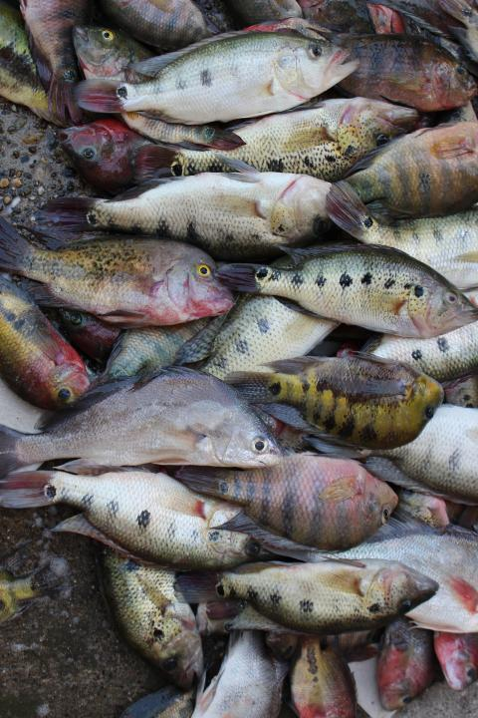
Topline Industry
& Protein Performance
Recovery of Q3 was halted by November lockdown and Christmas restrictions pushing Q4 visits down
All segments declined with Travel & Leisure, Workplace/Education, and Pubs affected the most
Fish & Chips is the segment with lowest relative decline

Slide 5
Recovery that started in Q3 was halted by November lockdown and Christmas restrictions pushing Q4 visits down by almost 45%
Total Out of Home
Components of Spending vs. Year Ago
Total Spend, Visits and Avg. Eater Check
Source: The NPD Group/CREST®, YE Dec 20
28
n.a.: Low sample / Numbers flagged grey and italic: Please read as tendencies / ++/--: pcya >+/-15%

Slide 6
In 2020, Servings declined across all channels with T&L, Work/Education, Pubs, and FSR losing the most
Spend(£bn)
Visits(bn)
Av. Ind. Spend
Total Food & Drink Servings (m)
Total OOH | £36.4 | -36.9% | 6.4 | -43.4% | £5.7 | 11.7% | 16,234 | -44.7%
Pubs | £5.3 | -50.4% | 0.6 | -51.3% | £8.8 | 2.0% | 1,902 | -55.2%
FSR* | £7.2 | -43.5% | 0.6 | -46.5% | £11.1 | 5.5% | 1,961 | -50.7%
QSR** | £20.0 | -17.6% | 4.1 | -33.0% | £4.9 | 22.9% | 9,625 | -32.7%
Travel & Leisure | £3.2 | -60.5% | 0.5 | -61.4% | £6.8 | 2.4% | 1,224 | -61.6%
Work/Education | £0.6 | -63.0% | 0.6 | -60.2% | £1.0 | -7.1% | 1,403 | -58.8%
Fish & Chips | £0.9 | -21.3% | 0.2 | -25.1% | £3.7 | 5.2% | 554 | -26.3%
QSR excl. Fish & Chips | £19.1 | -17.4% | 3.8 | -33.4% | £5.0 | 24.0% | 9,071 | -33.1%
*FSR includes Café/Bistro
**QSR includes Fish & Chips
Source: The NPD Group/CREST®, YE Dec 20

Slide 7
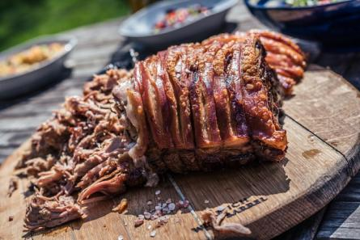
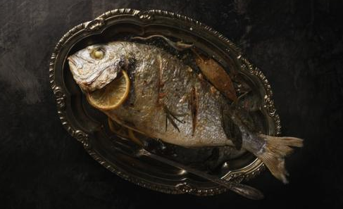
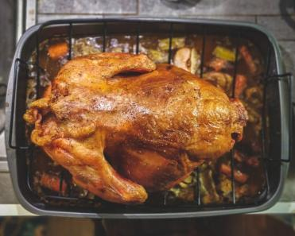
Topline Protein Performance
Both protein and non-protein servings declined
With 34% of the market, Poultry continues to be the best performing protein
Seafood’s visits declined but share remained

Slide 8
Both protein and non protein visits declined in 2020
Total Out of Home
Protein/Non-Protein Servings
% Servings Share
YOY Servings (%)
YOY Servings (000s)
-42.7%
-44.0%
Source: The NPD Group/CREST®, YE Dec '20

Slide 9
Each protein group saw servings decline in 2020; Poultry and Seafood grew share
Total Out of Home
Servings Share & YOY, and Incidence by Protein
% Incidence Change
Servings Change (000s)
0.11
-0.91
-0.07
-0.25
2.29
Source: The NPD Group/CREST®, YE Dec '20

Slide 10
All proteins but lamb have increased average spend in 2020
Total Out of Home
Average Individual Spend
YE Dec’20
Spend Change
YE Dec’20 vs. '19
Source: The NPD Group/CREST®, YE Dec '20

Slide 11
More than one third of Seafood visits were on deal. Share of ‘on deal’ visits has grown in 2020.
Total Out of Home
Deal Rate %pts Change
YE Dec '20 vs. '19
Deal Rates %
YE Dec '20
Source: The NPD Group/CREST®, YE Dec '20

Slide 12
Topline Seafood Performance
All segments were negatively affected by lockdown
Workplace, Pubs and T&L are the segments hit the hardest due to work from home, lockdown closures, and travel restrictions

Slide 13
Amid lockdown, seafood visits declined the most in Workplace and Travel setting due to closures, restrictions and working from home
Seafood Visits (bn)
Seafood Servings (bn)
Total OOH | 0.60 | -42.7% | 0.69 | -43.2%
Total QSR | 0.34 | -33.8% | 0.37 | -34.2%
QSR excl. Fish & Chip Shops | 0.20 | -39.2% | 0.23 | -37.9%
QSR Fish & Chip Shops | 0.14 | -23.6% | 0.14 | -27.1%
Pubs | 0.08 | -47.1% | 0.09 | -51.0%
Full Service(incl. Cafe/Bistro) | 0.08 | -44.3% | 0.11 | -43.9%
Workplace/College/Uni | 0.03 | -64.4% | 0.04 | -64.7%
Travel & Leisure | 0.06 | -53.8% | 0.08 | -50.9%
Source: The NPD Group/CREST®, YE Dec '20

Slide 14
QSR accounts for about 60% of all OOH visits and one third of all seafood servings.
Total Out of Home
Channel Shares & Incidence
Source: The NPD Group/CREST®, YE Dec '20

Slide 15
Fish & Chips Shops are more reliant on dinner than any other day part; lunch is under-represented
Total Out of Home
Servings % by Daypart
Source: The NPD Group/CREST®, YE Dec '20

Slide 16
Fish and Chip Shops are heavily reliant on Friday and Saturday visitors
Total Out of Home
Servings % by Day of the Week
Source: The NPD Group/CREST®, YE Dec '20

Slide 17
Quick Service
QSR visits decline improved further to -27.7% in Q4 2020 despite the 2nd lockdown in November and various tiered restrictions throughout December
Seafood lost servings but didn’t lose incidence, while poultry is the only protein to gain incidence

Slide 18
QSR ended 2020 ahead of the market, down ‘only’ 33%
QSR
Total Quick Service
Components of Spending vs. Year Ago
Total Spend, Visits and Avg. Eater Check
Source: The NPD Group/CREST®, YE Dec '20
140
slide 4
n.a.: Low sample / Numbers flagged grey and italic: Please read as tendencies / ++/--: pcya >+/-15%

Slide 19
While overall servings fell, seafood incidence in Quick Service haven’t changed much while others lost shares in favour of poultry
QSR
Servings Share & YOY, and Incidence by Protein
% Incidence Change
0.10
-2.90
0.40
-0.60
3.30
Source: The NPD Group/CREST®, YE Dec '20

Slide 20
Fried Fish - the largest category within Quick Service – contributed the most to the decline due to closures of main purveyors of the product in Q2
QSR
Servings % Share
% Contribution to Decline
Source: The NPD Group/CREST®, YE Dec '20

Slide 21
Average individual spend has grown in 2020 with Poultry and Beef growing the most
QSR
Average Individual Spend
YE Dec20
Spend Change
YE Dec20 vs. '19
Source: The NPD Group/CREST®, YE Dec '20

Slide 22
Seafood lost some share of QSR visits in 2020 due to the decline in burger/sandwich visits
QSR
Incidence by Seafood Type/Species
YE Dec '20
YE Dec 20 vs. 19 Positive
YE Dec 20 vs. 19 Negative
Source: The NPD Group/CREST®, YE Dec '20

Slide 23
Level of on deal visits in QSR decreased in 2020 with seafood deal level now below average
QSR
Deal Rates %
YE Dec '20
Deal Rate Ppt Change
YE Dec '20 vs. '19
Source: The NPD Group/CREST®, YE Dec '20

Slide 24
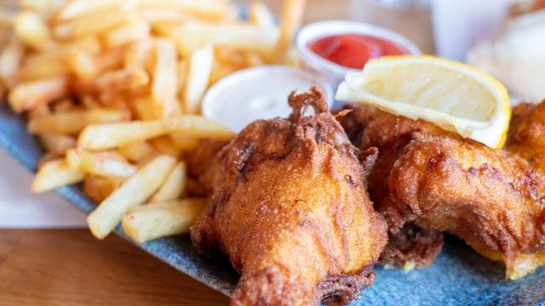
Fish & Chip Shops
Fish & Chip shops lost a quarter of visits in 2020
Q4 saw visits recovering to 92.0% of last year’s despite lockdown
Interestingly, customers were buying more poultry (chicken) from F&C shops than last year

Slide 25
Fish & Chip shops lost 25% of visits in 2020; Q4 saw marked improvement despite lockdown
F&C
Components of Spending vs. Year Ago
Total Spend, Visits and Avg. Eater Check
Source: The NPD Group/CREST®, YE Dec '20

Slide 26
Seafood is the largest protein for Fish & Chips shops; customers reported buying more poultry in 2020 than before
F&C
Servings Share & YOY, and Incidence by Protein
% Incidence Change
-0.20
0.30
-1.00
0.80
3.80
Source: The NPD Group/CREST®, YE Dec '20

Slide 27
Fried Fish is the largest product group for Fish & Chip Shops and thus declined the most during 2020
F&C
Servings % Share
% Contribution to Decline
Source: The NPD Group/CREST®, YE Dec '20

Slide 28
Cod is the most popular at Fish and Chip Shops; haddock lost share in 2020
F&C
Incidence by Seafood Type/Species
YE Dec '20
YE Dec 20 vs. 19 Positive
YE Dec 20 vs. 19 Negative
Source: The NPD Group/CREST®, YE Dec '20

Slide 29
Seafood’s average spend has grown in 2020
F&C
Average Individual Spend
YE Dec20
Spend Change
YE Dec20 vs. '19
Source: The NPD Group/CREST®, YE Dec '20

Slide 30
Seafood deal rate within the Fish & Chips Shops has declined by -2.4% in 2020
F&C
Deal Rates %
YE Dec '20
Deal Rate Ppt Change
YE Dec '20 vs. '19
Source: The NPD Group/CREST®, YE Dec '20

Slide 31
Quick Service excl. Fish & Chip Shops
QS excl. Fish and Chip Shops lost a third of visits in 2020;
The recovery in Q4 was delayed by the chaotic restrictions and lockdowns that swapped the UK from November

Slide 32
QSR excl. Fish and Chip Shops declined by 28.7% in Q4 2020
QSR
(excl. F&C)
Components of Spending vs. Year Ago
Total Spend, Visits and Avg. Eater Check
Source: The NPD Group/CREST®, YE Dec '20

Slide 33
2020 ended with beef overtaking pork as the second largest protein in QSR. Seafood’s share shrank to 8.5%.
QSR
(excl. F&C)
Servings Share & YOY, and Incidence by Protein
% Incidence Change
-0.70
-3.10
0.50
-0.40
3.70
Source: The NPD Group/CREST®, YE Dec '20

Slide 34
Non-fried Fish is the largest category in the QSR excl. Fish & Chips Shops; Shellfish share increased considerably over last year
QSR
(excl. F&C)
Servings % Share
% Contribution to Decline
Source: The NPD Group/CREST®, YE Dec '20

Slide 35
Seafood Sandwiches is the most important sub-category in QSR, but its share declined
QSR
(excl. F&C)
Incidence by Seafood Type/Species
YE Dec '20
YE Dec 19 vs. 17 Positive
YE Dec 19 vs. 17 Negative
Source: The NPD Group/CREST®, YE Dec '20

Slide 36
Seafood products have seen significant increase in individual spend in the course of 2020
QSR
(excl. F&C)
Average Individual Spend
YE Dec20
Spend Change
YE Dec20 vs. '19
Source: The NPD Group/CREST®, YE Dec '20

Slide 37
Share of deals for most proteins decreased with Seafood showing some insignificant increase in 2020
QSR
(excl. F&C)
Deal Rates %
YE Dec '20
Deal Rate PPT Change
YE Dec '20 vs. '19
Source: The NPD Group/CREST®, YE Dec '20

Slide 38
Pubs
After a partial recovery in Q3 Pubs ware faced with new closures and restrictions in Q4 losing 61% of visits compared with year ago
Seafood and Pork gained share in (reduced) Pub servings in 2020

Slide 39
Pub’s visit recovery stopped in Q4 amid lockdowns
Pubs
Components of Spending vs. Year Ago
Total Spend, Visits and Avg. Eater Check
Source: The NPD Group/CREST®, YE Dec '20
228
slide 4
n.a.: Low sample / Numbers flagged grey and italic: Please read as tendencies / ++/--: pcya >+/-15%

Slide 40
Pub’s seafood incidence increased in 2020 despite falling servings
Pubs
Servings Share & YOY, and Incidence by Protein
% Incidence Change
2.20
5.10
-1.90
-5.10
0.40
Source: The NPD Group/CREST®, YE Dec '20

Slide 41
Fried fish grew share amid declines
Pubs
Servings % Share
% Contribution to Decline
Source: The NPD Group/CREST®, YE Dec '20

Slide 42
Salmon and Cod are the most popular fish species in Pubs; Cod gained share in 2020
Pubs
Incidence by Seafood Type/Species
YE Dec '20
YE Dec 19 vs. 17 Positive
YE Dec 19 vs. 17 Negative
Source: The NPD Group/CREST®, YE Dec '20

Slide 43
Total AC in Pubs has increased only marginally, while seafood spend has increased by £1.69
Pubs
Average Individual Spend
YE Dec20
Spend Change
YE Dec20 vs. '19
Source: The NPD Group/CREST®, YE Dec '20

Slide 44
Seafood has seen an increase in the percentage of deals/promotions in 2020
Pubs
Deal Rates %
YE Dec '20
Deal Rate Ppt Change
YE Dec '20 vs. '19
Source: The NPD Group/CREST®, YE Dec '20

Slide 45
Full Service (Including Café/Bistro)
Amid lockdown and dine-in closures, visit losses widened in Q4 after some recovery in Q3
Seafood incidence were stable in 2020
Seafood is claimed to be ordered on deal in 2 out of 5 cases

Slide 46
Visits to Full Service restaurants started to recover in Q4 2020
FSR
Components of Spending vs. Year Ago
Total Spend, Visits and Avg. Eater Check
Source: The NPD Group/CREST®, YE Dec '20
185

Slide 47
Seafood incidence have grown in Full Service over last 12 months
FSR
Servings Share & YOY, and Incidence by Protein
% Incidence Change
0.20
0.70
-1.00
0.70
3.50
Source: The NPD Group/CREST®, YE Dec '20

Slide 48
Non-fried fish, fish burgers, and shellfish showed growth over last 12 months
FSR
Servings % Share
% Contribution to Decline
Source: The NPD Group/CREST®, YE Dec '20

Slide 49
Salmon is the most important species in full service restaurants, followed by shellfish
FSR
Incidence by Seafood Type/Species
YE Dec '20
YE Dec 20 vs. 19 Positive
YE Dec 20 vs. 19 Negative
Source: The NPD Group/CREST®, YE Dec '20

Slide 50
The data shows that Seafood individual spend decreased over last 12 months
FSR
FSR
Average Individual Spend
YE Dec20
Spend Change
YE Dec20 vs. '19
Source: The NPD Group/CREST®, YE Dec '20

Slide 51
Seafood deal rates are ahead of all other proteins and growing
FSR
Deal Rates %
YE Dec '20
Full Service Restaurants
Deal Rate Ppt Change
YE Dec '20 vs. '19
Source: The NPD Group/CREST®, YE Dec '20

Slide 52
Travel & Leisure
Travel & Leisure visits continue to suffer amid restrictions imposed on international and domestic travel and closed entertainment venues
Seafood and beef increased serving incidence in 2020

Slide 53
Travel & Leisure visits are the slowest to recover with tourism still at historically low level
T&L
Components of Spending vs. Year Ago
Total Spend, Visits and Avg. Eater Check
Source: The NPD Group/CREST®, YE Dec '20
77
slide 4

Slide 54
Seafood servings in Travel and Leisure grew in incidence
T&L
Servings Share & YOY, and Incidence by Protein
% Incidence Change
2.30
-1.20
-0.60
3.20
-1.00
Source: The NPD Group/CREST®, YE Dec '20

Slide 55
Fish, both fried and non-fried, grew share
T&L
Servings % Share
% Contribution to Decline
Source: The NPD Group/CREST®, YE Dec '20

Slide 56
Seafood individual spend has increased slightly in Travel and Leisure over last 12 months
T&L
Average Individual Spend
YE Dec20
Spend Change
YE Dec20 vs. '19
Source: The NPD Group/CREST®, YE Dec '20

Slide 57
Deal rates for Seafood are above average and growing TTM
T&L
Deal Rates %
YE Dec '20
Deal Rate Ppt Change
YE Dec '20 vs. '19
Source: The NPD Group/CREST®, YE Dec '20

Slide 58
Workplace & Education
It’s been the second biggest loser of 2020 with more than half of office workers working from home for most of the year and schools either closed or on remote learning
Seafood lost incidence in favour of poultry

Slide 59
Traffic recovered somewhat after an almost 90% decline in Q2, but still only a third of last year’s
W&E
Workplace & Education
Components of Spending vs. Year Ago
Total Spend, Visits and Avg. Eater Check
Source: The NPD Group/CREST®, YE Dec '20

Slide 60
Seafood lost incidence while poultry gained
W&E
Servings Share & YOY, and Incidence by Protein
% Incidence Change
-2.70
-3.90
0.40
-0.70
5.20
Source: The NPD Group/CREST®, YE Dec '20

Slide 61
Seafood Performance
& Demographics by Type
Socialising is still the most important motivation when choosing Seafood while eating out;
QSR (outside of Fish & Chip shops) is the major opportunity to improve the appeal of seafood;
Amid closures of Full Service Restaurants, Fried Fish has increased its share this year;
Shellfish, scampi in particular, grew in importance;
Seafood doesn’t attract its fare share of younger consumers and lower social classes outside of QSR

Slide 62
Socialising remains the most important motivation when choosing Seafood when eating out
Index – Seafood vs. Total Food/Drink
Motivation for Eating/Drinking Visit OOH
 | Total OOH | Pubs | FSR | QSR | Fish & Chips | QSR excl. Fish & Chips
Convenience | 94 | 125 | 92 | 95 | 107 | 133
Functional | 104 | 76 | 82 | 112 | 102 | 107
Socialising | 136 | 111 | 116 | 126 | 108 | 108
Treating | 96 | 84 | 99 | 97 | 95 | 73
Source: The NPD Group/CREST®, YE Dec '20

Slide 63
QSR (w/o F&C shops) is the largest seafood channel but it saw seafood visits declining faster than the sector overall in 2020
Total Seafood
Visits SWOT Analysis
O
S
Over/Under-Perform vs. Total Channel Growth
W
T
Over/Under-Trade vs. Channel Share of OOH
Bubble Size Represents Channel % Share of Seafood
Source: The NPD Group/CREST®, YE Dec '20

Slide 64
Fried Fish share has increased in 2020; Tuna dominates the Non-Fried varieties, while Cod solidified its prominence in Fried
Total Out of Home
Servings % Share
Source: The NPD Group/CREST®, YE Dec '20

Slide 65
Seafood consumers are richer and older than average. T&L attracts younger crowd; QSR caters to less affluent clientele
Demographic Map – Seafood Servings by Channel
Pubs
Fish & Chips
FSR
% Servings Aged Over 35
QSR excl. Fish & Chips
Work/Education
Travel & Leisure
% Servings Social Class ABC1
Source: The NPD Group/CREST®, YE Dec '20

Slide 66
Travel & Leisure, and Fish & Chip Shops are performing very well with kids
% Servings Involving Kids
Note: Low Sample sizes - use data cautiously: Work/Edu; Shellfish Fish & Chips.
Source: The NPD Group/CREST®, YE Dec '20

Slide 67
Fried Fish (Cod) and Shellfish (Scampi) grew importance; Non-Fried Fish lost importance (due to FSR closures)
Total Seafood
Incidence and % points Change by Type
Growingly Important but less Important overall
Growingly Important and more Important overall
% point Incidence Change
Lessening Importance and less Important overall
Lessening Importance but more Important overall
% Incidence
Source: The NPD Group/CREST®, YE Dec '20

Slide 69
CREST Measures
Measure | Question answered
Sales | How much did the guests spend overall in the foodservice Market?
Visits | How many guests went to the restaurants?
Average Eater Check | What did the guests spend on average during a restaurant visit?
Average number of items | How many items did the guests order on average?
Average price per item | What was the average price of each product?
Servings | How many portions of a product were sold?
Incidence | What is the importance of a product in the Market?

Slide 70
CREST Calculations
Measure | Question answered
Average Price Per Item | Average Individual Spend divided by Items per Eater
Incidence | Simply stated, the %of orders (or visits) that include a specific food or beverage item, group of items, or category of items. A pure measure of item importance (e.g. on a scale from 1-100 how important is this item)
Index | Reflects the relative importance of a specific variable (e.g. demo, occasion segment, etc.)
Contribution to Growth/Marline | CTG and/or CTD = % of visit or servings growth/Marline sourced to a specific variable (e.g. demo, occasion segment, etc.)
% Change vs. Same Period Year Ago | YOY or PCYA the % change vs. same time period year ago (e.g. annual, quarter, month, etc.).

