Slide 1
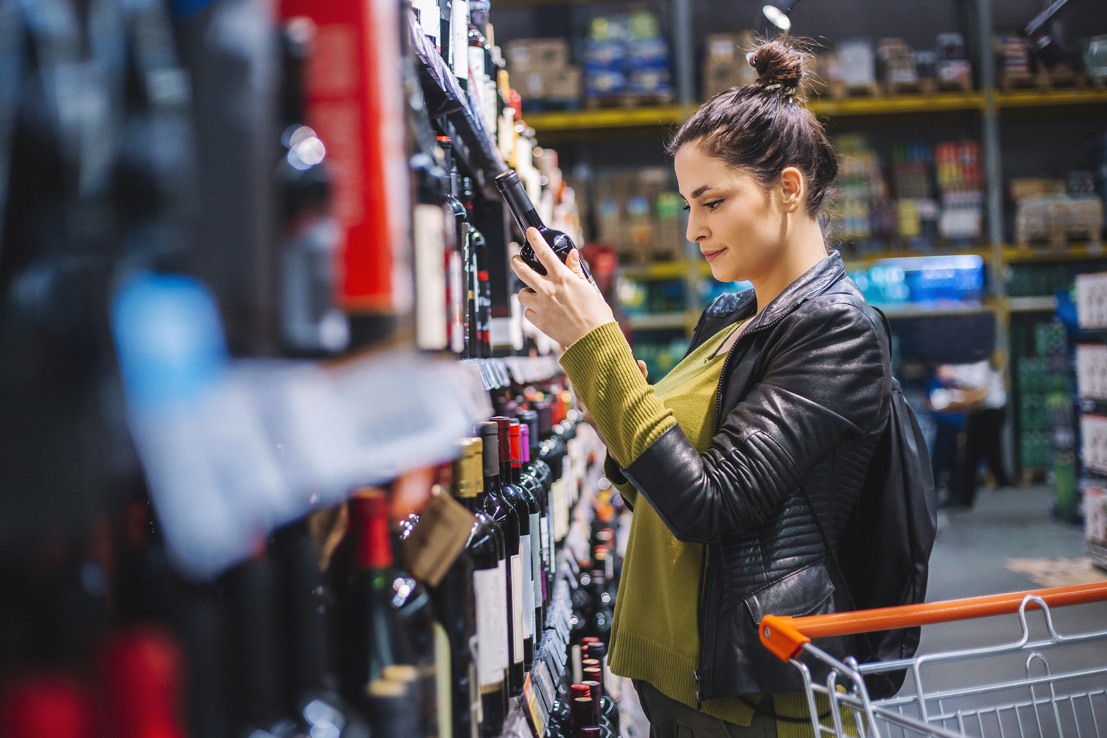
FMCG Essential Retail – What you need to know!
Share of Trade
52 we data to 23.04.22
Share of Total Grocers
Value Change %
Penetration
£ Spend per Visit
2021
2022
2021
2022
% Change
2021
2022
% Change
27.0% | 27.2% | -0.8% | 84.2 | 86.0 | 3.0% | 30.04 | 26.93 | -10.4%
14.0% | 13.7% | -3.1% | 65.3 | 67.1 | 3.6% | 28.70 | 25.13 | -12.4%
12.4% | 12.0% | -4.3% | 67.8 | 69.1 | 2.9% | 31.63 | 27.80 | -12.1%
10.2% | 10.9% | 5.5% | 63.2 | 66.6 | 6.4% | 26.95 | 24.23 | -10.1%
9.8% | 9.3% | -6.5% | 60.2 | 62.4 | 4.6% | 29.63 | 25.85 | -12.8%
7.0% | 7.7% | 8.9% | 56.1 | 59.7 | 7.4% | 22.88 | 21.06 | -8.0%
4.7% | 4.5% | -5.4% | 50.0 | 49.7 | 0.4% | 10.59 | 9.18 | -13.3%
4.3% | 4.3% | -2.2% | 23.4 | 25.9 | 12.0% | 28.01 | 23.97 | -14.4%
3.2% | 3.5% | 8.0% | 43.9 | 49.3 | 13.4% | 18.66 | 15.37 | -17.6%
2.7% | 2.6% | -4.9% | 49.5 | 50.2 | 2.4% | 21.89 | 19.93 | -9.0%
1.8% | 1.7% | -6.9% | 4.0 | 5.2 | 29.0% | 76.37 | 70.00 | -8.3%
Store Portfolio
Store Numbers as of 23.04.22
Store Numbers
Total
Convenience
Small
Large
Super
Mega
2682 | 1830 | 25 | 281 | 194 | 352
1402 | 814 | 46 | 174 | 143 | 225
588 | 0 | 134 | 86 | 113 | 255
497 | 2 | 10 | 189 | 243 | 53
3719 | 2716 | 823 | 180 | 0 | 0
334 | 23 | 50 | 209 | 44 | 7
1000 | 524 | 300 | 156 | 13 | 7
957 | 77 | 836 | 44 | 0 | 0
23 | 0 | 0 | 0 | 0 | 23
Value Index (52 we 23.04.22)
Life stage
Pre Family
New Family
Maturing Family
Post Family
Older Couple
Older Singles
Established Family
109 | 101 | 100 | 105 | 100 | 102 | 89
85 | 91 | 75 | 97 | 103 | 108 | 110
101 | 131 | 142 | 125 | 99 | 84 | 73
93 | 103 | 81 | 89 | 90 | 117 | 100
101 | 141 | 147 | 118 | 83 | 89 | 78
120 | 81 | 74 | 89 | 102 | 85 | 157
81 | 53 | 41 | 69 | 101 | 127 | 133
116 | 113 | 122 | 106 | 84 | 105 | 74
95 | 60 | 48 | 64 | 87 | 124 | 146
106 | 66 | 125 | 124 | 97 | 88 | 101
99 | 161 | 123 | 56 | 138 | 91 | 71
Source: Nielsen Homescan SOT based on FMCG [New Base], Benchmark Total Grocers% Change Penetration = % Change in actual buyers
Penetration = Change in shoppers

Slide 2
FMCG Essential Retail
Tesco shoppers will soon be buying more loose fruit and vegetables as the supermarket speeds up plans to scrap plastic packaging. Tesco wants to remove all plastic wrappers from 5 billion items sold by 2025. Tesco are now telling suppliers to speed up in scrapping plastics or supply products in recyclable or compostable packaging. The supermarket giant is also pressing ahead with stocking more products that can be refilled by consumers who bring their own containers into stores. Tesco's decision is part of a wider campaign by supermarkets to sell most fresh fruit and vegetables loose rather than packed in plastic, to help the environment. It estimates this will save more than 21,500 tonnes of plastic being thrown in the bin every year. Tesco group quality director Sarah Bradbury said: "We’ve already made progress to minimise the environmental impact of our packaging, but we know there is more we can do with suppliers on the issue of plastic waste." “We’re bringing suppliers together to work solutions because we are determined to go further and accelerate our progress, with a focus on the areas of greatest impact.”
Sainsbury’s has become one of the first major supermarkets to sign up to the Real Living Wage, meaning it will commit to paying its staff £11.05 an hour in London and £9.90 outside the capital. Sainsbury’s will join other major UK brands in opting to join the Real Living Wage, the voluntary rate paid by thousands of employers. "Our strategy is about investing in what matters most for both customers and colleagues", said Simon Roberts, CEO of Sainsbury’s. "We know times are tough for everyone. That's why we were one of the first in the industry to pay over the Real Living Wage at £10 per hour and brought forward the announcement of our annual pay review to early January, as we wanted to help colleagues plan and manage the cost of living in the year ahead."
ASDA is testing doorstep parcel return service from selected locations in the UK from this month. Customers in 48 trial locations can now return parcels, including George.com, to an Asda home shopping driver when taking delivery of their grocery orders. The initiative aims to offer flexibility when returning George products and other fashion items purchased online. In addition, customers can track their package until it reaches the original retailer. Asda e-commerce senior vice-president Simon Gregg said: “We know that customers increasingly want to be able to access more services more conveniently to better fit in with their lifestyle. By partnering with to you to efficiently use space available within our home shopping vans”.
Morrisons is helping customers spend less as it launches one of its biggest ever price cutting campaigns. The supermarket will be reducing prices on over 500 products as well as introducing new and improved multi saves. Items cover cupboard essentials, fridge staples and frozen favourites and include cereal, cooking sauces, chicken, and sausages. David Potts, Chief Executive, Morrisons said: “We know that our customers are under real financial pressure now, and we want to play our part in helping them when it comes to the cost of grocery shopping. These price cuts will have a noticeable and long-term impact on our customers' budgets and demonstrate our commitment to offering them the best possible value.”
Source: NielsenIQ Homescan, Grocer & Nam News

Slide 3
FMCG Essential Retail
Waitrose Essential range has been a staple of the grocery brand’s offering since 2009. Now, for the first time in the value-focused range’s history, it is getting its name in lights at the iconic Piccadilly Lights in London. The campaign, created by Adam&EveDDB, will see the Essential brand celebrated along one of London’s most famous streets. Waitrose customer director Martin George explained: “We’re very excited about this ground breaking first for us. As customers look for ways to make their money go further, it’s the right time to promote the unmatched quality and value of our Essential range, which offers over 1,000 great products. “Piccadilly Lights are so iconic and reach an audience of over a million people a week, so we know it’s an effective way to amplify this campaign.”
Aldi has launched a new wine collection with over a whopping 50 new wines for customers to enjoy. As part of its Spring Summer wine range, shoppers will be able to pick up a wide set of wines from all grape varieties. The range includes a fruity Austrian Zweigelt and a refreshing Greek Assyrtiko. Sam Caporn an internationally renowned master of wine says: “We’ve spent the last couple of years helping shoppers become wine buffs through covering the principles of tasting within the Aldiploma – our free wine education course – as well as continuing to showcase unusual grape varieties.
Lidl has announced plans to open 17 new stores in Devon following ambition plans to have 1,100 branches across the country by the end of 2025. The supermarket chain is on the lookout to acquire sites across various locations around the country that meet the standard store format requirements. This includes prominent locations with easy access including in town centres, edge of town and retail parks. An area of 1.5 acres plus is required for standalone stores or up to four acres for 'mixed-use schemes'. Richard Taylor, Chief Development Officer at Lidl GB, said: “We know that the majority of British shoppers still love doing their shopping in person and we are as committed as ever to opening new stores and enhancing our existing ones. We’re opening an average of one new store a week, which is incredible, and our teams have done a phenomenal job of keeping that pace going over the last couple of years.
Source: NielsenIQ Homescan, Grocer & Nam News

Slide 4
FMCG Essential Retail
Iceland is reducing the thresholds for its free delivery services in stores and online to combat the rising cost of living. The frozen food retailer will lower the minimum order value for its online free next day delivery service from £40 to £35. As well as this, Iceland will reduce the minimum order value for shoppers using its in-store home delivery service from £25 to £20. These measures will be trialled nationwide for a period of four weeks and customer feedback will be monitored to ensure the changes have helped shoppers. Richard Walker, Managing Director at Iceland, said: “The entire nation is feeling the pinch at the moment and the cost-of-living crisis is forcing some families to make difficult decisions in order to make ends meet. Our aim is to mitigate this as much as possible for shoppers on significantly reduced grocery shopping budgets by reducing the thresholds of our free delivery services in stores and online, meaning they won’t need to pay for fuel to get the groceries they need, or worry about paying delivery charges.”
Coop has been named the Free From Food Awards’ first ever ‘Convenience Retailer of the Year’ winner for its commitment to offer everyday staples across all its 2,600 stores for the millions who follow a free from diet. Now in the 15th year, the Free From Food Awards are the UK’s only awards dedicated to celebrating excellence and innovation in the free from food and drink industry. Co-op picked up the new award for its continued efforts to ensure shoppers can easily access everyday free from products such as bread, pasta and cereals locally, with the retailer offering a range across all its stores. Co-op picked up multiple awards for Free From products, including five silver and three bronze gongs. Amongst the winning products, Co-op’s Free From Strawberry and Vanilla Cones, Free From Spaghetti and Irresistible Hand Cooked Sea Salt & Chardonnay Wine Vinegar Crisps all picked up silver. Jayne Brown, Co-op’s assistant own brand strategy manager for free from, said: “We’re passionate that our customers, colleagues and communities have access to safe products – no matter their circumstance. That’s why we have a variety of great tasting products and clear allergy labelling, which we know is so vital to so many people.”
Ocado announce Stroud-based craft wine specialist, When in Rome, as a new listing. The product, which comes in a paper bottle, will sit alongside their existing sustainable range of alt-format bag-in-box and canned wines. The range is in partnership with alt-format experts Frugalpac, with the bottles being made from 94% recycled paper and having a carbon footprint 84% lower than a single-use glass bottle. “I’m very excited to be able to bring the When in Rome Paper bottle into our range at Ocado. It’s great to see the team consistently pushing the boundaries of wine packaging and leading the way in making the category more sustainable,” Ocado buying manager Rob Grimes said.
Source: NielsenIQ Homescan, Grocer & Nam News

