Slide 1
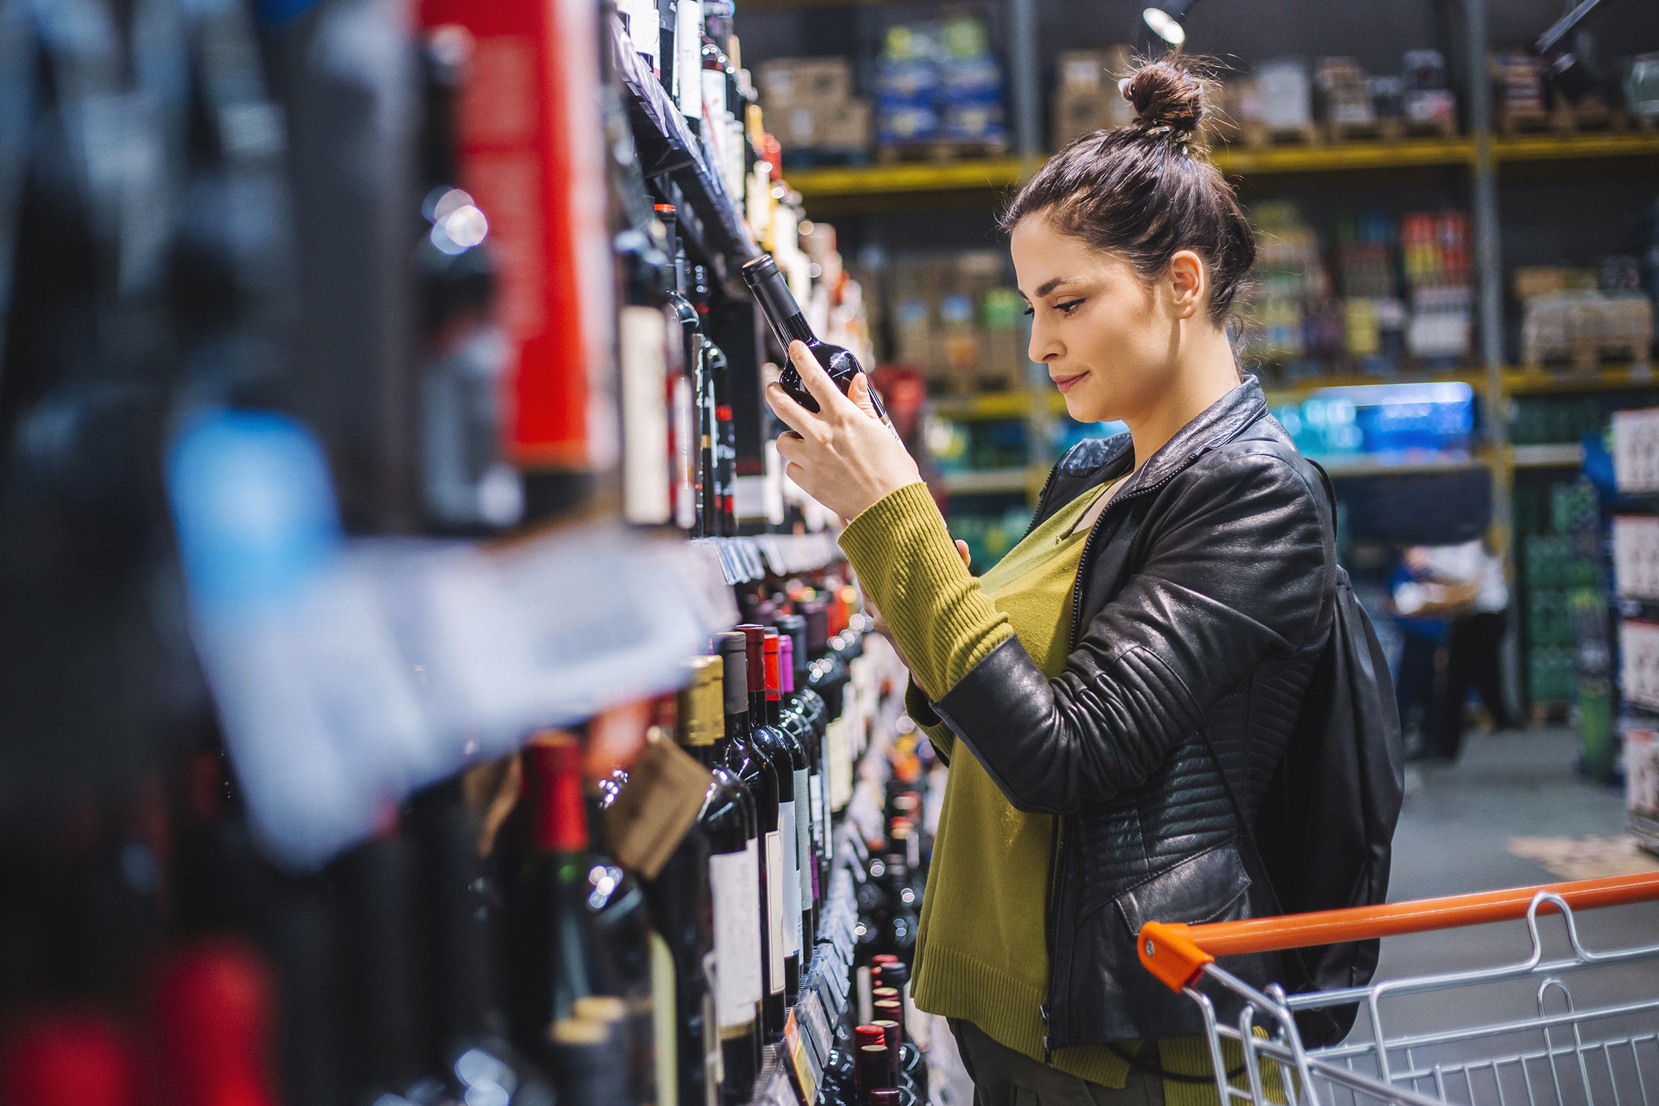
FMCG Essential Retail – What you need to know!
Share of Trade
52 we data to 21.05.22
Share of Total Grocers
Value Change %
Penetration
£ Spend per Visit
2021
2022
2021
2022
% Change
2021
2022
% Change
27.0% | 27.2% | -0.4% | 84.1 | 86.1 | 3.3% | 29.48 | 26.85 | -8.9%
14.0% | 13.7% | -3.1% | 65.2 | 67.3 | 4.1% | 28.14 | 24.97 | -11.3%
12.4% | 12.0% | -4.0% | 67.8 | 69.3 | 3.0% | 30.90 | 27.68 | -10.4%
10.3% | 11.0% | 5.2% | 63.5 | 66.7 | 5.9% | 26.50 | 24.20 | -8.7%
9.7% | 9.2% | -6.4% | 60.2 | 62.4 | 4.5% | 29.03 | 25.67 | -11.6%
7.1% | 7.7% | 8.2% | 56.2 | 60.1 | 7.8% | 22.70 | 20.99 | -7.5%
4.7% | 4.5% | -4.4% | 49.3 | 50.0 | 2.3% | 10.38 | 9.12 | -12.1%
4.3% | 4.2% | -2.8% | 23.6 | 26.1 | 11.9% | 27.35 | 23.72 | -13.3%
3.2% | 3.5% | 7.5% | 44.3 | 49.9 | 13.5% | 18.34 | 15.13 | -17.5%
2.7% | 2.6% | -4.2% | 49.3 | 50.4 | 3.1% | 21.66 | 19.84 | -8.4%
1.8% | 1.6% | -7.3% | 4.1 | 5.3 | 30.1% | 75.41 | 69.59 | -7.7%
Store Portfolio
Store Numbers as of 21.05.22
Store Numbers
Total
Convenience
Small
Large
Super
Mega
2712 | 1855 | 26 | 285 | 194 | 352
1396 | 809 | 43 | 173 | 143 | 228
587 | 0 | 133 | 86 | 113 | 255
497 | 2 | 10 | 185 | 245 | 55
3733 | 2726 | 828 | 179 | 0 | 0
334 | 23 | 50 | 209 | 44 | 7
1013 | 540 | 298 | 155 | 13 | 7
957 | 79 | 834 | 44 | 0 | 0
23 | 0 | 0 | 0 | 0 | 23
Value Index (52 we 21.05.22)
Life stage
Pre Family
New Family
Maturing Family
Post Family
Older Couple
Older Singles
Established Family
107 | 103 | 100 | 106 | 100 | 102 | 89
85 | 92 | 73 | 98 | 103 | 108 | 110
99 | 131 | 142 | 126 | 100 | 84 | 72
94 | 101 | 81 | 89 | 89 | 117 | 100
100 | 140 | 148 | 118 | 85 | 89 | 77
120 | 82 | 73 | 89 | 104 | 84 | 156
78 | 55 | 41 | 68 | 96 | 129 | 133
119 | 114 | 123 | 107 | 83 | 104 | 74
99 | 61 | 48 | 57 | 87 | 126 | 143
102 | 65 | 125 | 123 | 98 | 88 | 101
104 | 166 | 117 | 55 | 138 | 90 | 75
Source: Nielsen Homescan SOT based on FMCG [New Base], Benchmark Total Grocers% Change Penetration = % Change in actual buyers
Penetration = Change in shoppers

Slide 2
FMCG Essential Retail
Tesco has pledged to continue with the proposed ban on multibuy promotions despite the Government’s recent U-turn which delayed restrictions until October 2023. The UK’s largest supermarket will no longer display buy one get one free, amongst other offers on “unhealthy” food and drinks. Jason Tarry, Tesco’s UK and Republic of Ireland chief, said: “Our mission is to make Tesco the easiest place to shop for a healthy, more sustainable basket – while keeping the cost of the weekly shop in check. It’s vital we keep making the right calls on behalf of customers and communities”. Alessandra Bellini Tesco’s chief customer officer said: “Obesity levels are rising among adults and children and the health of our nation must also be at the top of our agenda.”
Sainsbury’s has announced a major fuel ban coming to every UK supermarket. In support of the people of Ukraine, the supermarket giant has confirmed that there will be no Russian diesel available in its 315 British forecourts by the end of the year. The move comes as the retail chain faced pressure from its customers over stocking Russian products. Rhian Bartlett, food commercial director at Sainsbury's, said “We stand united with the people of Ukraine and have taken a range of steps to show our support – from helping to fund the humanitarian effort on the ground, to removing products from our stores which are 100% sourced from Russia. “We have been working hard to reduce the amount of diesel we sell which comes from Russia since the early days of the conflict. “This is a complex process, but we are committed to working together with the rest of the UK fuel industry and Government to support the ban on Russian oil imports, which is due to take effect by the end of this year.”
ASDA has recently launched a massive price match campaign with one of the UK's biggest retailers - Home Bargains. It means shoppers will now be able to pick up more than 100 items that are priced at the same price - or even lower - as the budget retailer. Launched in stores last week, it is the latest pricing campaign to help shoppers with the ongoing cost of living crisis. Shoppers will be able to spot the price matched items in Asda stores across the country with a red Home Bargains price matched sticker. The price match campaign also lets shoppers pick up a range of big brand names, including Huggies, Heinz, Surf, Sure, Garnier, Colgate and much more. An Asda spokesperson said: "“We plan to expand the ‘Dropped and Locked’ and Home Bargains price match offering and will share further details as soon as we can, The economic climate is incredibly tough for families right now and we know from our research at Asda that nine out of ten customers are worried about inflation. We want to do all we can to support customers during these tough times.”
Morrisons shoppers will be pleased to hear the supermarket chain has officially slashed the minimum spend requirement on click and collect orders. Up until recently, shoppers have had to spend a minimum of £40 to be able to purchase their groceries through the grocer's click and collect service. But now the supermarket chain has reduced the minimum by almost 50 per cent, as online baskets now only need to be worth £25 to be eligible for a slot. The change will come as welcome news to smaller households or anyone looking to purchase a smaller shop through the online service. It is the latest change Morrisons have made to their click and collect service after it was expanded due to a surge in popularity during the UK's third national lockdown. By 2020 only 47 branches offered the service to shoppers, but this has since expanded to 447 stores across the entire country.
Source: NielsenIQ Homescan, Grocer & Nam News

Slide 3
FMCG Essential Retail
Waitrose has announced a further support package for its British pork farmers worth up to £16m to ensure prices paid for pigs to cover producers’ soaring costs of production. The retailer said the move means it will cover the full cost of rearing and producing. It stressed that the commitment ‘will not detract from our promise to provide great value for customers or our pledge to always maintain our leading welfare standards’. Waitrose’s executive director, James Bailey, said: “Farmers are the backbone of Britain, keeping food on our tables during our country’s hour of need through a pandemic. But now, they need our help. This investment is a direct response to some of the most challenging conditions the pig sector has ever faced. This is not only the right thing to do, but it will also ensure we continue to pay our farmers a fair price while maintaining our quality and high welfare standards”.
Aldi is removing plastic shrink wrap from the multipacks of its Corale baked beans in a bid to further reduce plastic waste. The retailer says the move will save seventy-eight tonnes of single-use plastic from going to landfills each year. Aldi believes the trial is successful, it will remove a further 24 tonnes of plastic from circulation per year, meaning Aldi customers will be able to buy more of their everyday item’s plastic-free. Plastics and Packaging Director at Aldi, Richard Gorman, said: “Removing unnecessary plastic from our multipack of beans is another step forward in our commitment to reduce plastic across our ranges. “We know it’s becoming increasingly important to our customers that their everyday products are environmentally-friendly, and we’re pleased that this move will help them shop more sustainably.” The supermarket has also pledged to halve the volume of plastic packaging it uses by 2025, which Aldi says will see it remove 74,000 tonnes of plastic from circulation.
Lidl has officially been named as the cheapest supermarket in the UK for the fifth month in a row. A new study from ‘Which?’ found that the popular discounted supermarket was offering the lowest prices in this month’s price comparison. The consumer champion website found that Lidl beat out tough competition to the top spot with a total price of just £25.92 for a basket of 18 items. Lidl manage to pip rival Aldi to the post by 74p, as the discounted supermarket came in at second place with a total of £26.66 for the same basket of items. “With household bills and food prices going up, it’s no surprise that budget supermarkets have seen an increase in footfall recently and we’ve found you can buy many of the same groceries for a much better price than at one of the Big 4 supermarkets,” Which? Money expert Reena Sewraz said.
Source: NielsenIQ Homescan, Grocer & Nam News

Slide 4
FMCG Essential Retail
Iceland has officially launched their new discount where any shoppers over the age of 60 can get 10% off their overall shopping bill. It is the latest savvy discount to be offered from the frozen foods retailer to help shoppers with their food bills during the cost-of-living crisis. Iceland launched the new discount after Age UK recently revealed that three-quarters of older people in the UK are worried about the rising cost of living. Richard Walker, Managing Director at Iceland, said: “We have a long history of supporting our over 60s customers, such as when we launched ‘Elderly Hour’ at the height of the pandemic. "The cost-of-living crisis has made support for these customers even more important, which is why I’m proud that we’re finding new ways to support them, including the launch of this discount. We hope it will help all those in this age category to cut costs where they can.”
Coop will become the first supermarket to trial the new walking delivery project. The project will operate from around 200 stores, including in smaller towns and villages. The chain vowed to include rural areas known as ‘quick delivery deserts’ where people feel they are ‘offline’ from many home delivery options enjoyed in cities and large towns. Trials were previously carried out in Cornwall and proved a success. The same-day deliveries will be available to households and businesses within a 15-minute walk of their nearest store. Orders will be placed into a specially designed trolley, before being walked towards each customer’s home. It comes as the Co-op also announces to expand its small army of delivery robots, which have become a familiar sight in Milton Keyes and in Northampton. According to the Co-op, the most popular items ordered by robot include milk, eggs, bread, bananas, and cucumbers. Chris Conway, Co-op’s ecommerce director, said: ‘Making shopping quick, easy and convenient for our members and customers is at the very heart of our approach. Our aim is to be the most convenient home delivery service and we continue to innovate to meet the needs of consumers”.
Ocado has launched a second distribution depot for its one-hour delivery service Zoom by Ocado. The 13,957 sq ft warehouse space is in Canning Town, Newham, east London, and offers customers a range of more than 10,000 products, which Ocado Retail said was “a range five times the size of most other immediacy services”. The depot will “open” with a fleet of 100% last-mile green delivery vehicles, comprising a mix of electric cars, e-cargo bikes, and electric mopeds. Orders will be delivered in recyclable bags. Ocado said the site will be “amongst the greenest and quietest grocery facilities in the UK”. Customers using the Zoom by Ocado service can opt for delivery within 60 minutes or select a one-hour slot. Delivery charges start from 99p with a delivery promise that if an order is late, there is no delivery charge for a customer’s next order. The Newham site has been built using the Ocado Smart Platform (OSP) with around 70 robots at work on a grid, picking items and adding them to orders.
Source: NielsenIQ Homescan, Grocer & Nam News

